Slide 1
STUDENT AGENCY, ACCESS, AND SUCCESS: USING LOCAL DATA AND CAMPUS ORGANIZING FOR AB1705 REFORM
Leslie Banta, Mendocino College, FACCC Vice President
Michael Peterson, Las Positas College, FACCC Think Tank
Sarah Thompson, Las Positas College, FACCC President

Slide 2
Collecting Data and Putting the Analysis to Use for AB1705 Reform
Implementation Data – A look at Mendocino College’s data and how you can collect your college’s data
Statewide Data – There’s more to consider than “throughput”
Faculty Organizing and Driving Change – Supporting student agency and access and protecting academic freedom

Slide 3
EXAMINING LOCAL DATA
Mendocino College

Slide 4
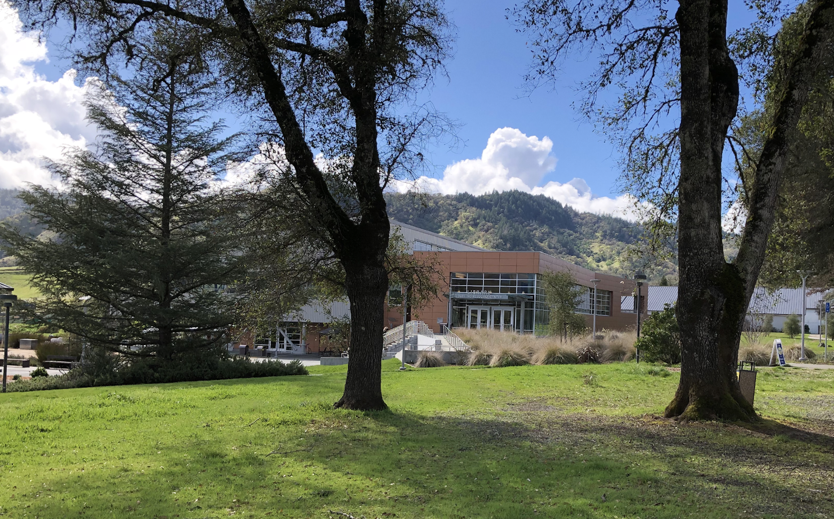
A Brief History
AB705/1705 Implementation at Mendocino College

Slide 5
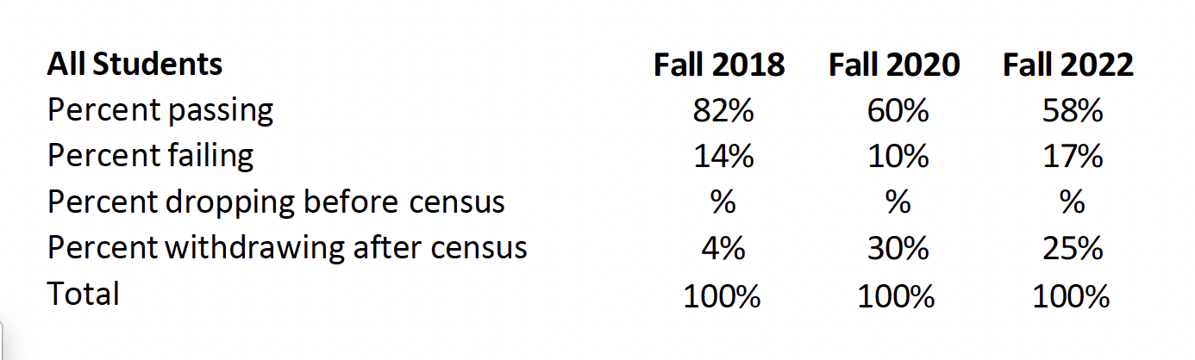
First Attempts at Transfer-Level Math (New Students)

Slide 6
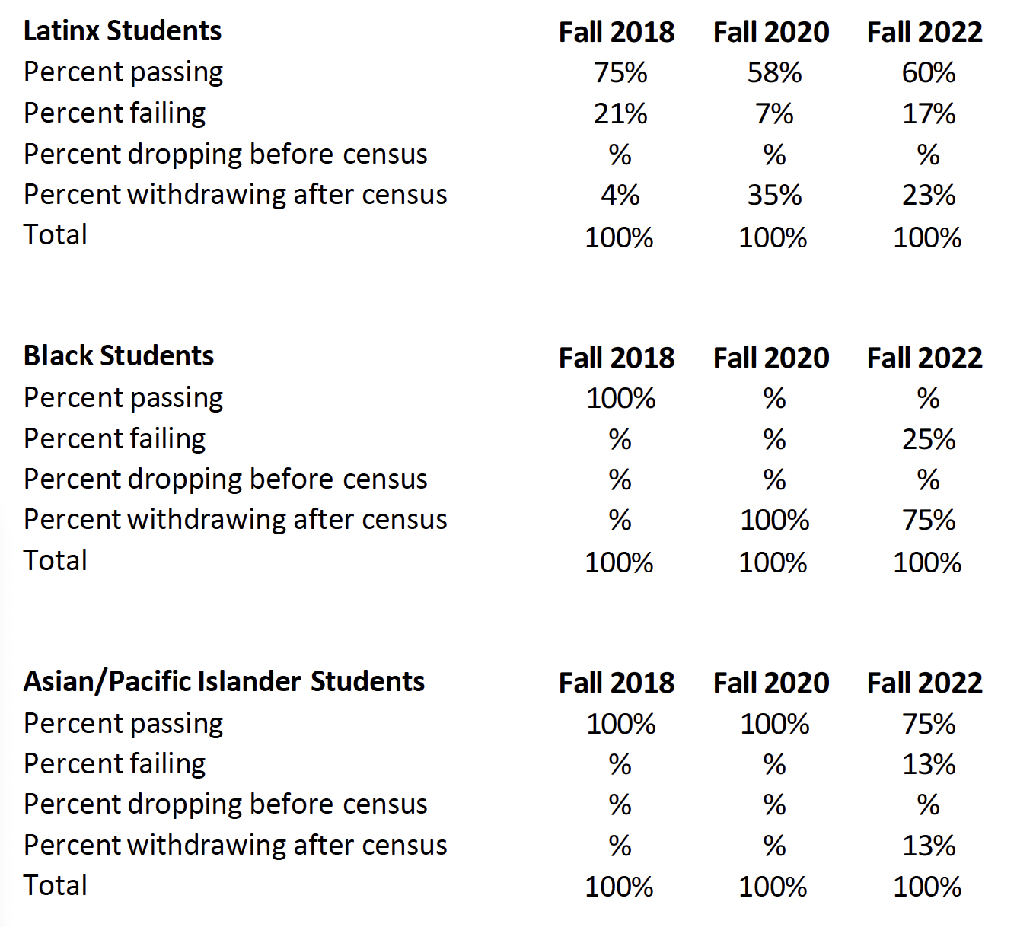
Considering Ethnicity
Percentage-wise,
things got worse.

Slide 7
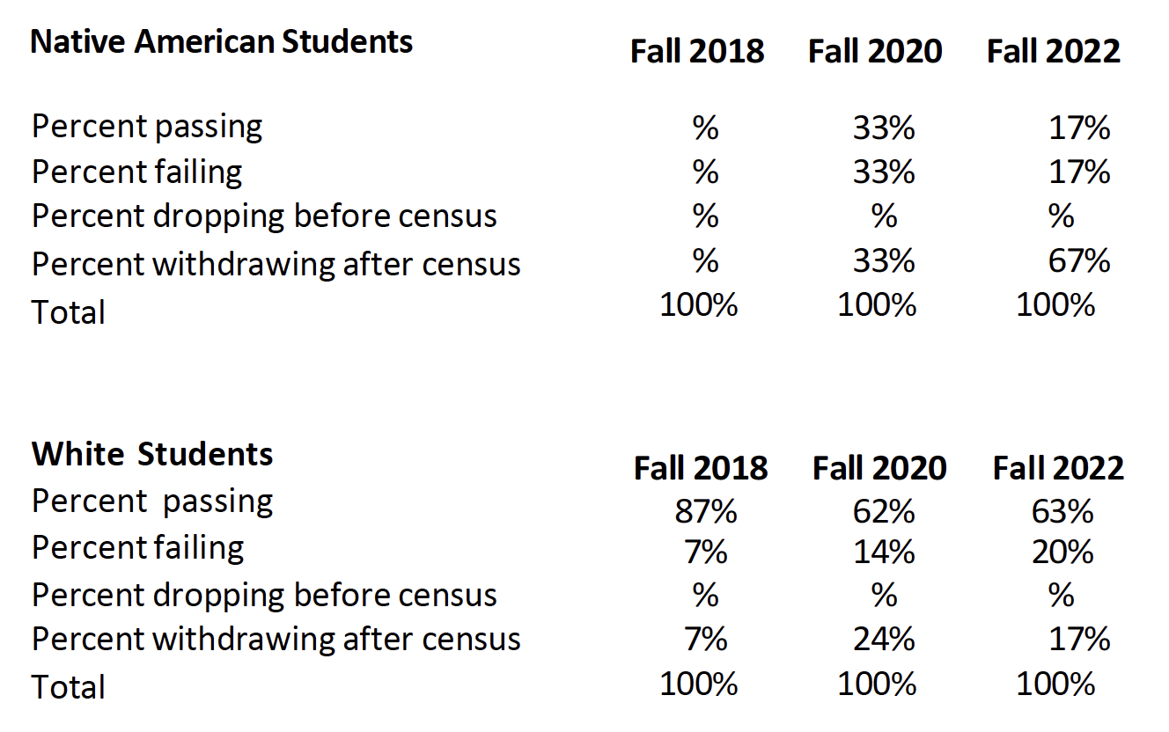
For Everyone
All groups showed a decrease in pass rates and a marked increase in withdrawals.

Slide 8
Okay, but what about Calculus I?
Calculus I with pre-requisites waived
  5-unit class + 2-unit support class
    Offered in same time block as “regular” class
    Only offered in fall
  Other supports we can’t require and aren’t supposed to recommend
    Math Lab
    Math Success

Slide 9
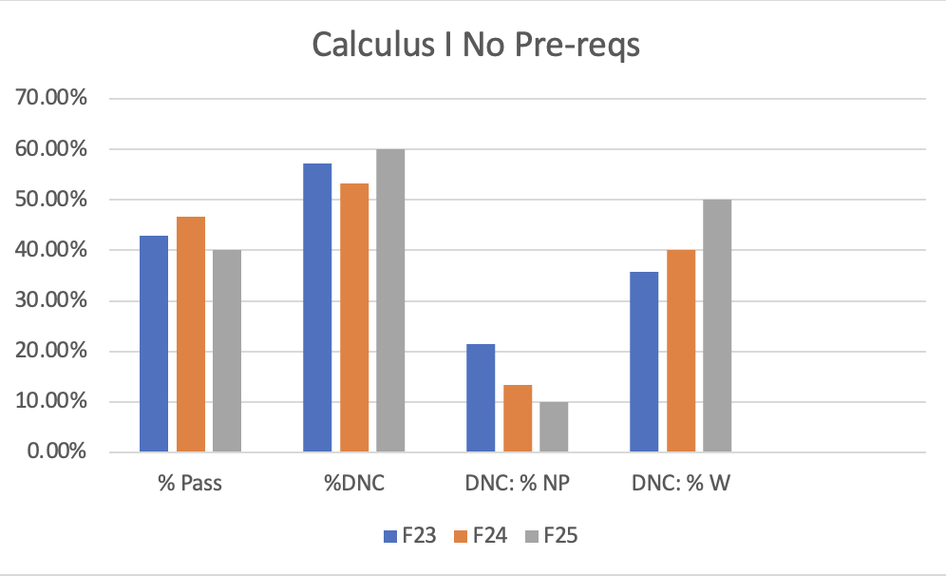
Open-entry Calculus

Slide 10
By the Numbers
39 Enrollments
  17 Passed (44.6%)
  22 Did not complete successfully (56.4%)
    16 withdrew (41%)
    6 did not pass (15.4%)

Slide 11
A Look at Success
Who was successful?
Who was not?
Students who had already taken (but not passed) a calculus course
  100%
Students who had taken Precalculus
  50%
Students who had taken Trig
  46%
Students whose last class was Algebra I, Algebra II, or Geometry
  1 student passed
    Only class taken
    Not employed
    Hours and hours in the Math Lab and MESA

Slide 12
Further Exploration Needed
Did the students who passed do well in their next course(s)?
What about after transfer?
Did the students who weren’t successful enroll again?
Are there equity gaps?

Slide 13
AB 1705 STATEWIDE DATA THROUGH A DIFFERENT LENS
Examining metrics differently and examining different metrics
to evaluate effects of AB 1705

Slide 14
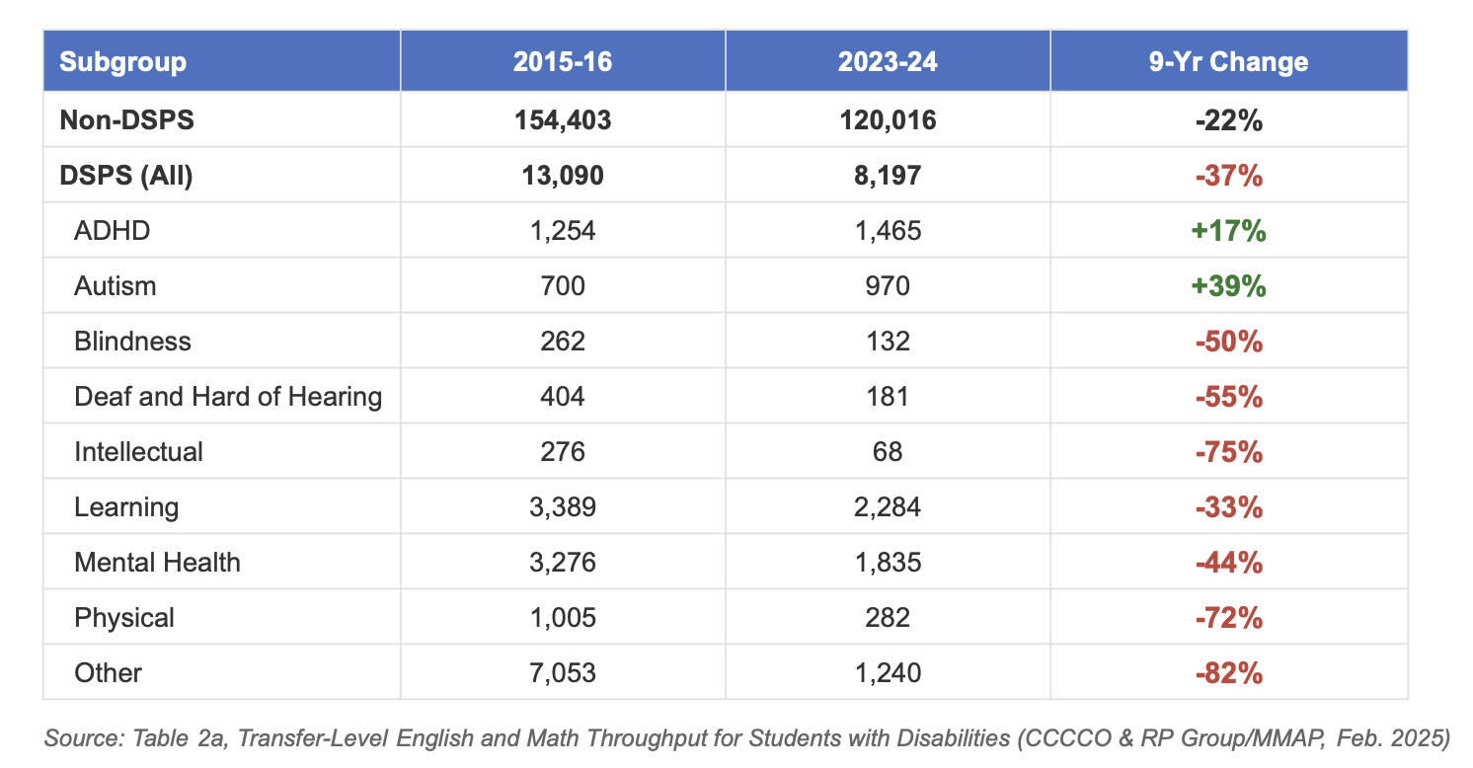
Disproportionate decline in DSPS students taking transfer-level math

Slide 15
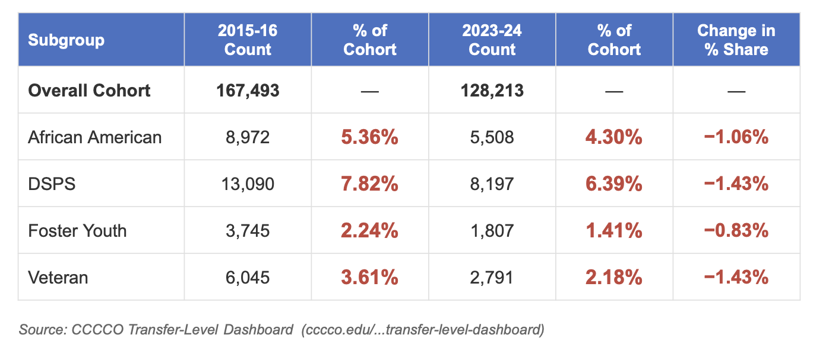
Composition of students has changed in transfer-level math

Slide 16
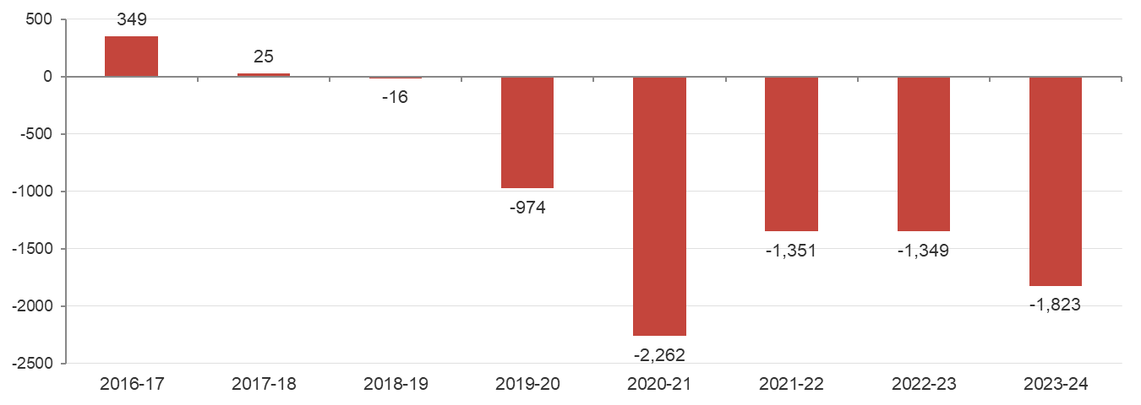
Lost DSPS Enrollments in Math
If DSPS students had maintained their 2015-16 share of the overall cohort (7.8%),
how many more would be enrolled?
Source: CCCCO Transfer-Level Dashboard (cccco.edu/...transfer-level-dashboard)

Slide 17
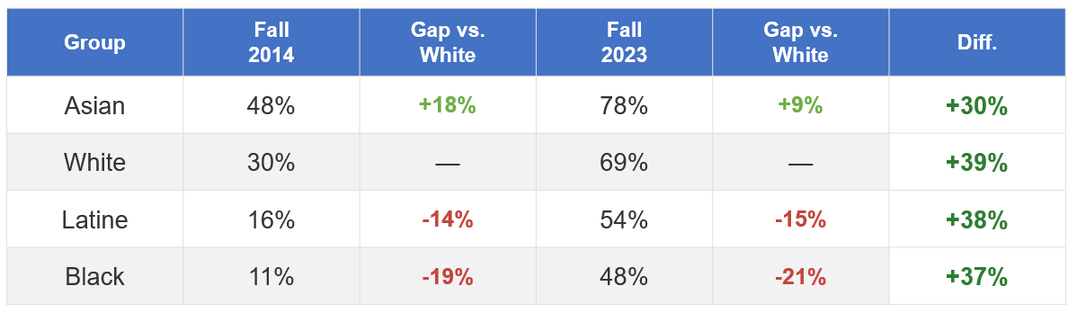
One-Year Throughput increased overall but equity gaps remain

Slide 18
Report on Outcomes from Research Request to CCCCO
Research Question
  Does taking intermediate algebra correlate with better grades in transfer-level math classes?
Student Cohort
  Community college students who first took a transfer-level math class between Fall 2019 and Spring 2024, split by whether they took intermediate algebra previously or not (in high school or community college).
    Note: Excludes students whose previous math class was unknown or unreported (25% of total). These students generally had higher grades in their transfer-level classes.

Slide 19
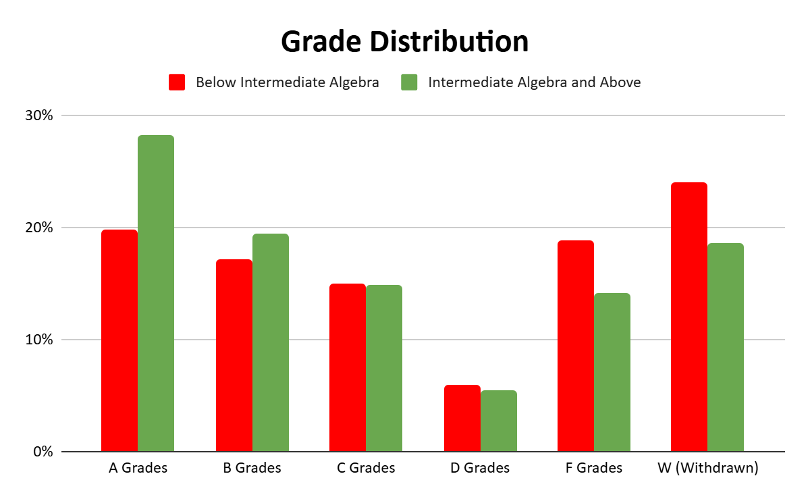
Grade Distribution in Transfer-Level Math
Comparing Students with and without prior Intermediate Algebra
Students with intermediate algebra earned more A grades (+8.8%), and fewer F (−4.6%) and W (−5.7%) grades.

Slide 20
What happens to students who don’t pass?
Below Intermediate Algebra
6.62%
retook the course and passed.
Intermediate Algebra & Above
8.40%
retook the course and passed.

Slide 21
Goodhart’s Law
“Every measure which becomes a target
becomes a bad measure.”
- Charles Goodhart, 1975
What metrics haven’t we studied yet?
The measures tracked most frequently have been direct enrollment and one-year throughput.
What outcomes matter to your students that we aren’t yet measuring?

Slide 22
It’s More Than Math Classes
Academic Freedom, The Role of the ASCCC, and
The Canary in the Coal Mine

Slide 23

A Clear Violation of Academic Freedom

Slide 24

The Canary in the Coal Mine

Slide 25
Closing Comments
What are the next steps and how can you help?

Slide 26
Next Steps
The importance of our messaging
Amplifying our voices
  FACCC Advocacy & Policy Conference, Feb. 21-22
Pass the AB 1705 Resolution
Email your college’s data template and the result of any passed resolutions to info@faccc.org
  For a PDF copy of the template and the resolution, email Lbanta@mendocino.edu

