Slide 1
My Journey to OER/ZTC
Ray Lapuz
CMC3
November 2, 2024

Slide 2
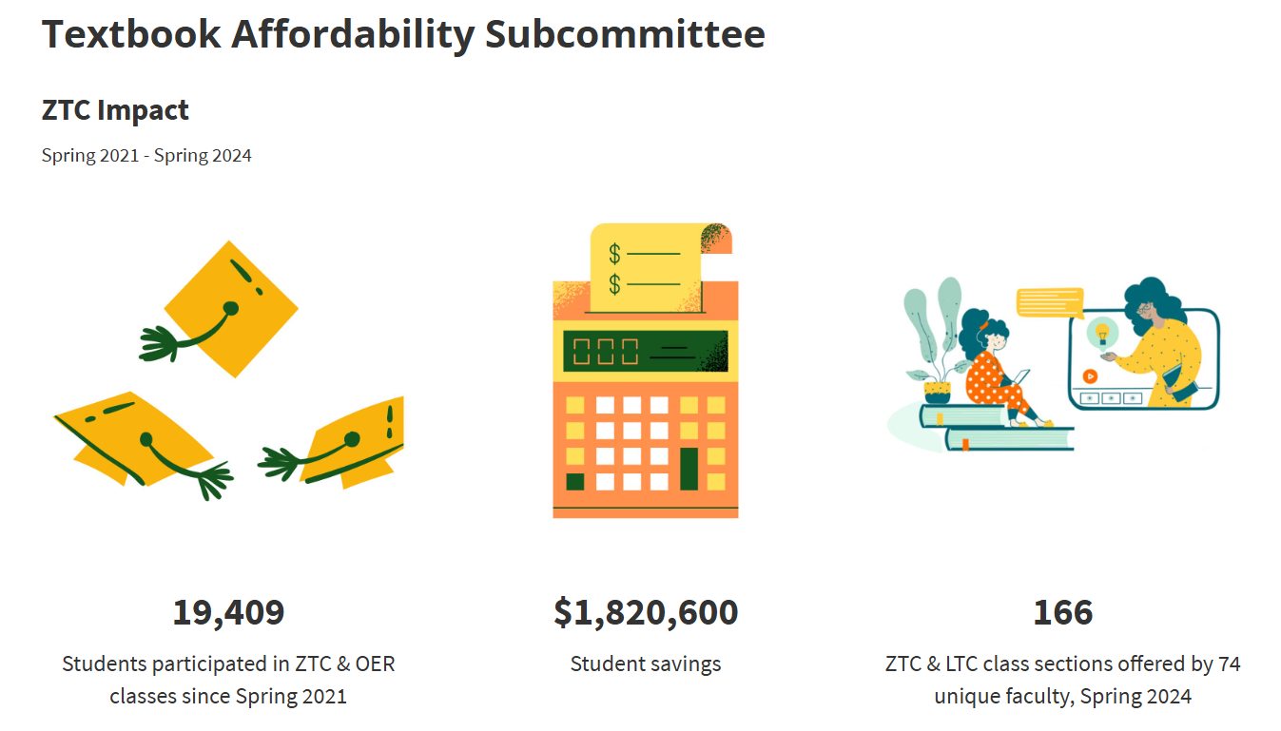
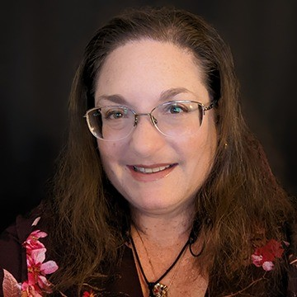
Coordinator and Committee
Sarah Harmon
OER/ZTC Coordinator
Online Instruction Coordinator
Librarian
Library Support Specialist
Bookstore Manager
Dean of Academic Services and Learning Technologies
Vice President of Instruction
https://canadacollege.edu/academicsenate/textbook_affordability_subcommittee.php

Slide 3

What are OER and ZTC?
Open Educational Resources (OER) are high-quality teaching, learning, and research resources that reside in the public domain or have been released under an intellectual property license, such as a Creative Commons license, that permits their free use and repurposing by others, and may include other resources that are legally available and free of cost to students. (Hewlett)
OER Materials may include:
Textbooks
Course readings, articles, and journals
Course packs
Quizzes
Streaming videos
Virtually any other material used for educational purposes

Slide 4
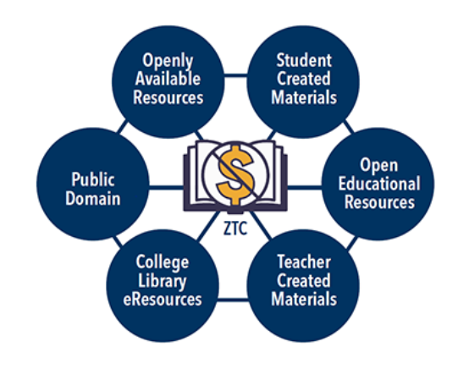
What are OER and ZTC?
S.B. 1359 states Zero Textbook Cost (ZTC) course materials “may include open educational resources, institutionally licensed campus library materials that all students enrolled in the course have access to use, and other properly licensed and adopted materials.”
Zero textbook cost (ZTC) also means that students do not incur any costs for purchasing course materials. Zero-cost to the students does not guarantee zero-cost to the institution, i.e. subscription databases, library equipment loans. To create a ZTC course, instructors might use Open Educational Resources (OER); Open Access, Creative Commons, and public domain materials, along with teacher-created materials and electronic resources owned or licensed by the Cañada College Library.

Slide 5
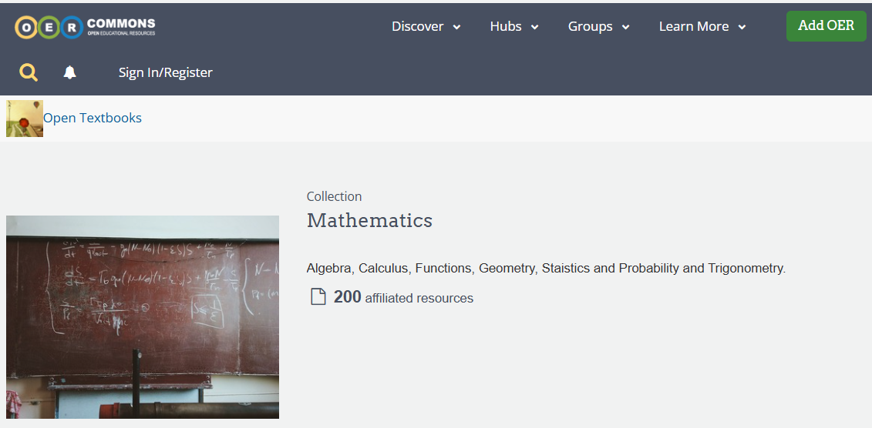
Searching for Resources
https://oercommons.org/curated-collections/810?__hub_id=19

Slide 6

OER Webinars (ASCCC)
https://asccc-oeri.org/webinars-and-events/

Slide 7
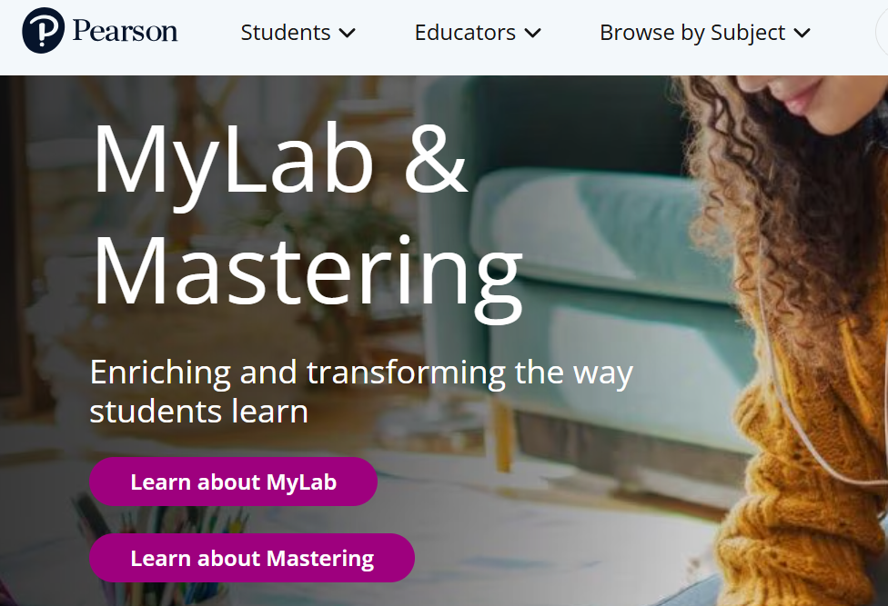
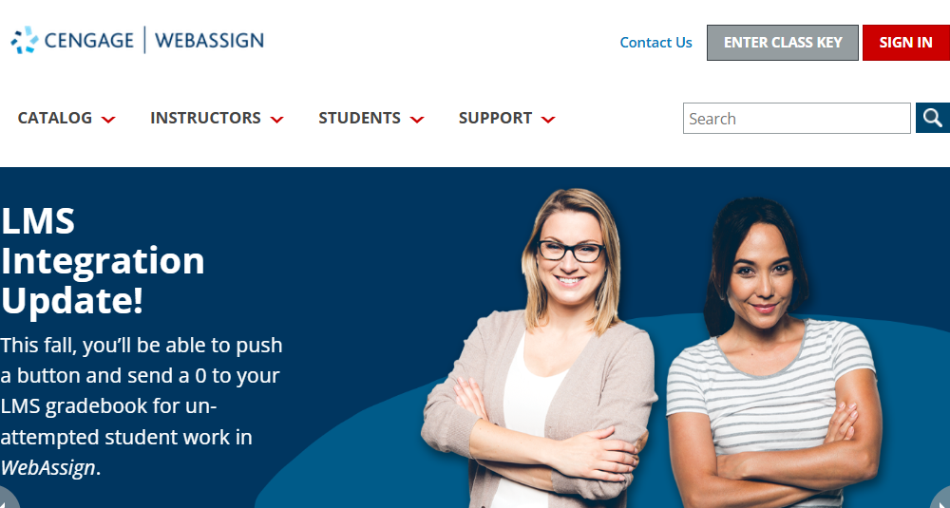
Old Learning Management Systems

Slide 8
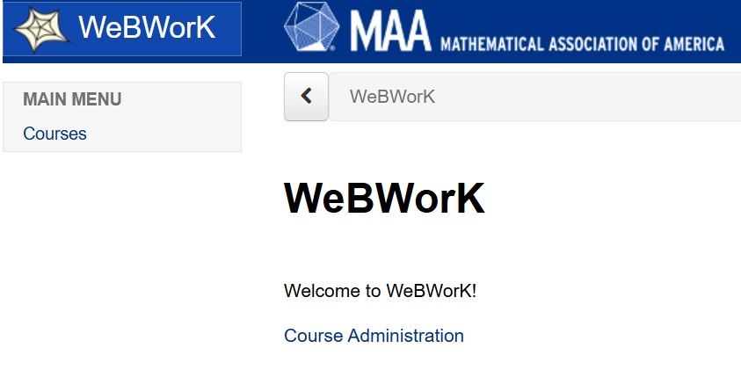

New Learning Management Systems

Slide 9
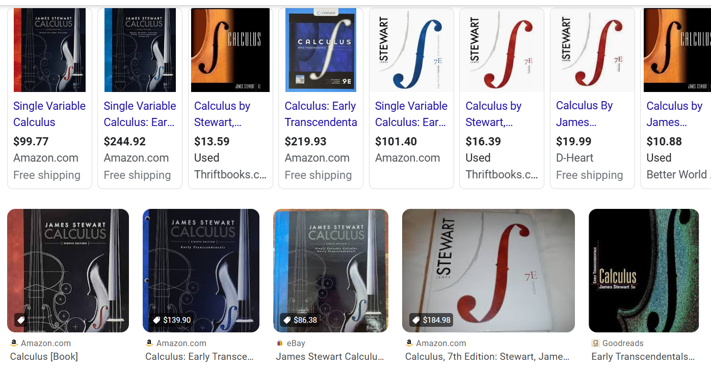
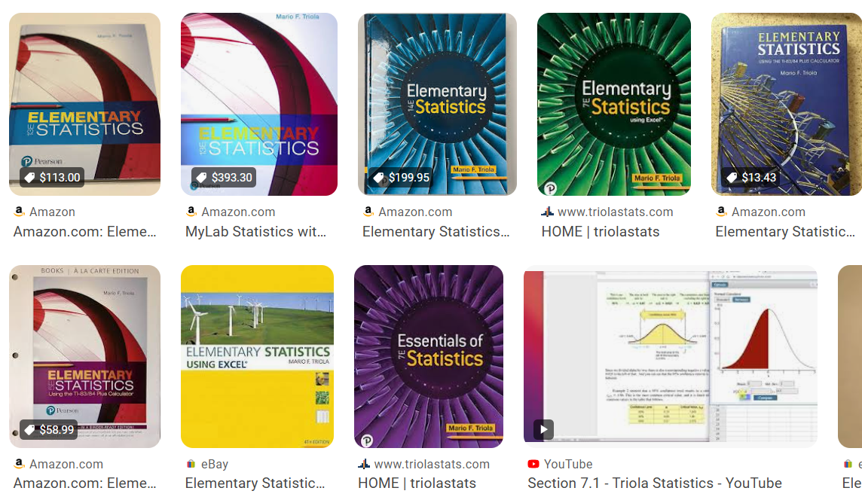
Old Textbooks

Slide 10
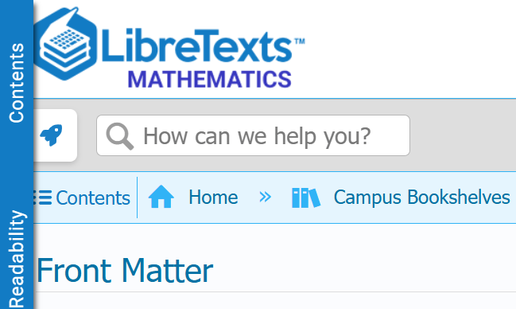
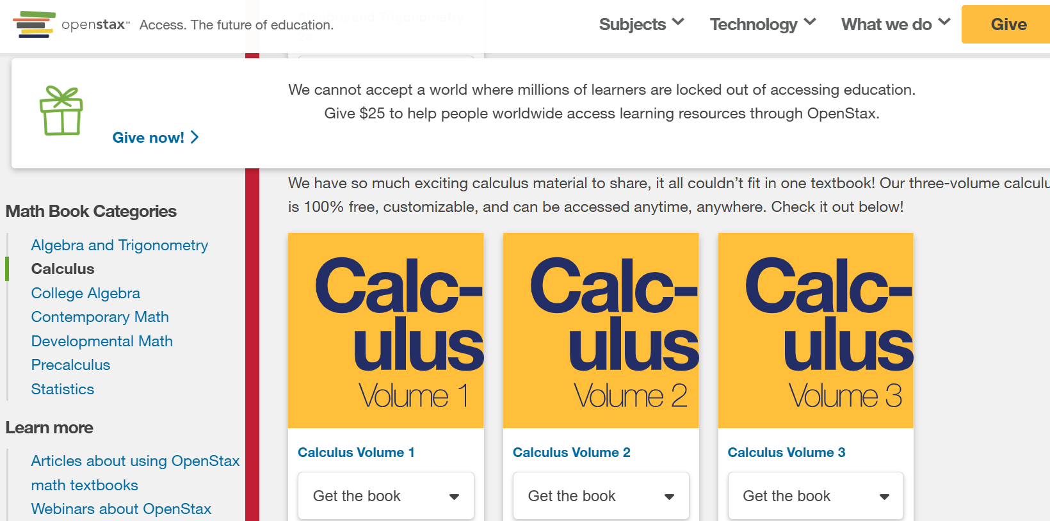
New Textbooks

Slide 11
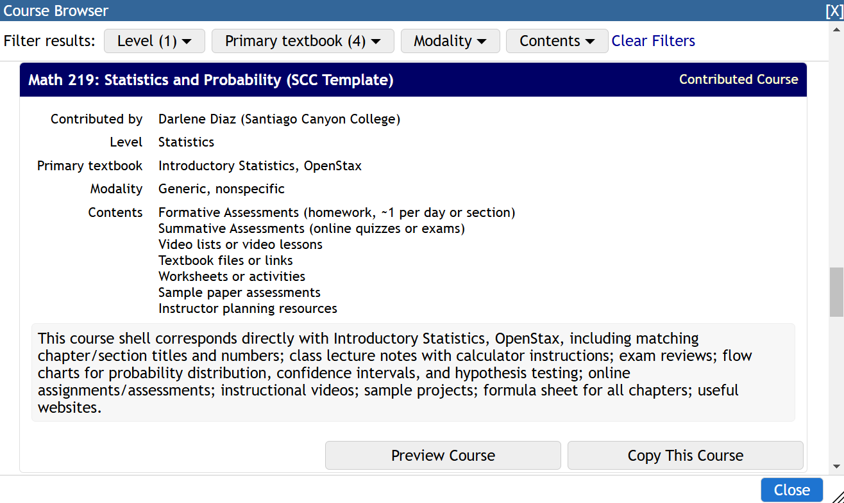
My Journey: myOpenMath …
MyOpenMath
Set up an instructor account
Add New Course
Copy a Template or Promoted Course
Find a Course [Preview]
Copy the Course
Set up the Course
https://www.myopenmath.com/

Slide 12
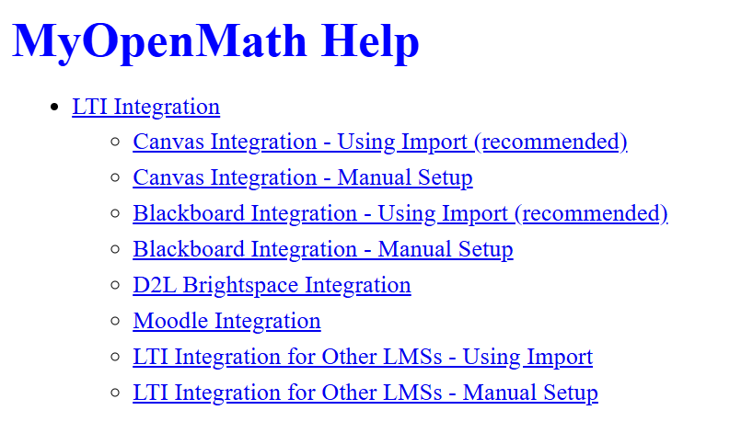
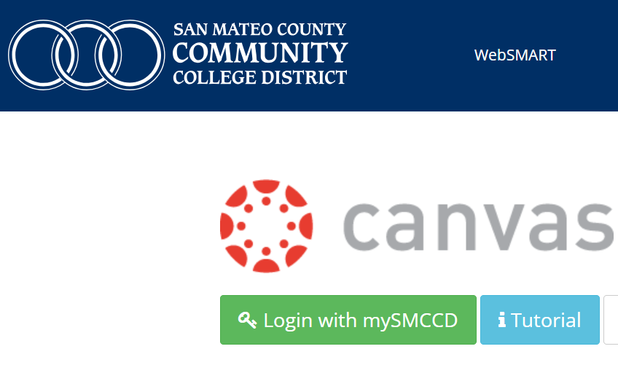
My Journey: … to Canvas

