Slide 1

The Power of Chance in Evidence-Based Medicine
Patrick Phillips, PhD
Associate Professor
Department of Medicine
Department of Epidemiology and Biostatistics
Patrick.Phillips@ucsf.edu

Slide 2
Outline
Decision-making in Medicine
The Randomized Trial
A case study: The Pfizer-BioNTech COVID-19 vaccine trial
Bias in randomized controlled trials
Blinding
Drop-out and intention to treat
Conclusions

Slide 3
Decision-making in medicine

Slide 4
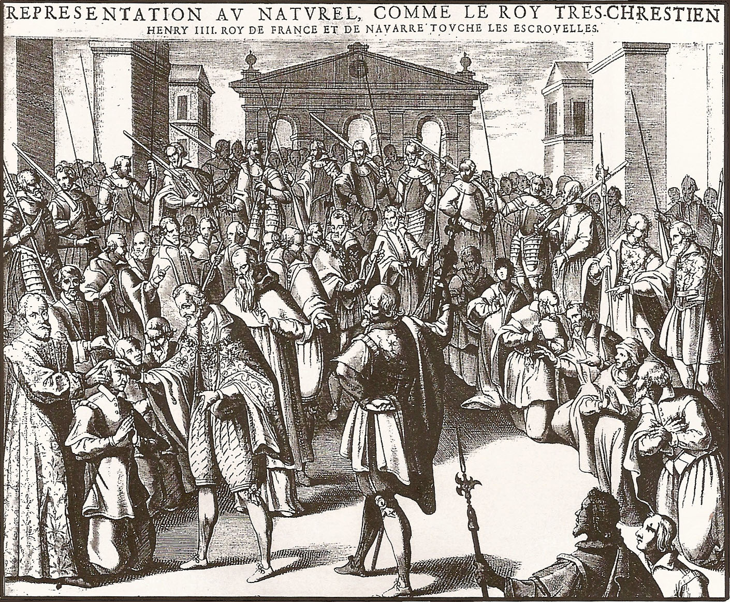
Medicine in the 1600s
Henry IV touching 575 people in Reims during the Holy Week of 1606 as a cure for lymph node tuberculosis. Engraving by Pierre Firrens

Slide 5
What one innovation has had the biggest impact on medicine over the last 500 years?

Slide 6
How should medical decisions be made?
Babylonia and Assyria (~1000 BC):
  “Exorcism of hostile powers was the declared aim of treatment… often combined with practical measures such as the use of poultices, purgatives, and enemas.”
Greece (~500 BC, Influenced by Hippocrates):
  “Medical therapeutics were dominated by a priori theories… over-simple derivations from a general philosophy of nature.”
  “The Dogmatists developed the theory of humors and qualities into a rigid formalism.”
  “The Empirics, on the other hand, discounted theory and relied upon practical tests only.”
Bull, J. P. (1959). "The historical development of clinical therapeutic trials." J Chronic Dis 10: 218-248.

Slide 7
How should medical decisions be made?
Evidence-based Medicine
James Lind, 1747 – Empirical research and use of controls
  “I took twelve patients in the scurvy, on board the Salisbury at sea. The cases were as similar as I could have them… they lay together in one place… and had one diet common to them all.”
  “To two of them was given a quart of cider a day, to two an elixir of vitriol, to two vinegar, to two oranges and lemons, and to the remaining two an electuary recommended by an hospital surgeon.”
  “The most sudden and visible good effects were perceived from the use of the oranges and lemons, one of those who had taken them being at the end of six days fit for duty.”
  “The other was appointed nurse to the rest of the sick.”
Lind, J. (1753). A Treatise of the Scurvy, Edinburgh, Sands, Murray, & Cochran.

Slide 8
How should medical decisions be made?
Evidence-based Medicine
There was a growing recognition of the importance of a ‘control group’ in the 19th and 20th Century
  Basis of many medical interventions that actually worked
    Vaccinations (Jenner), End of blood letting (Louis), Anti-septic methods (Lister), Anthrax vaccine (Pasteur), Vitamins for rickets,..
But the challenge was selecting the controls:
  Finding a group matched on key factors (e.g. sex, age, comorbidities)
  Alternating enrollment to intervention or control

Slide 9
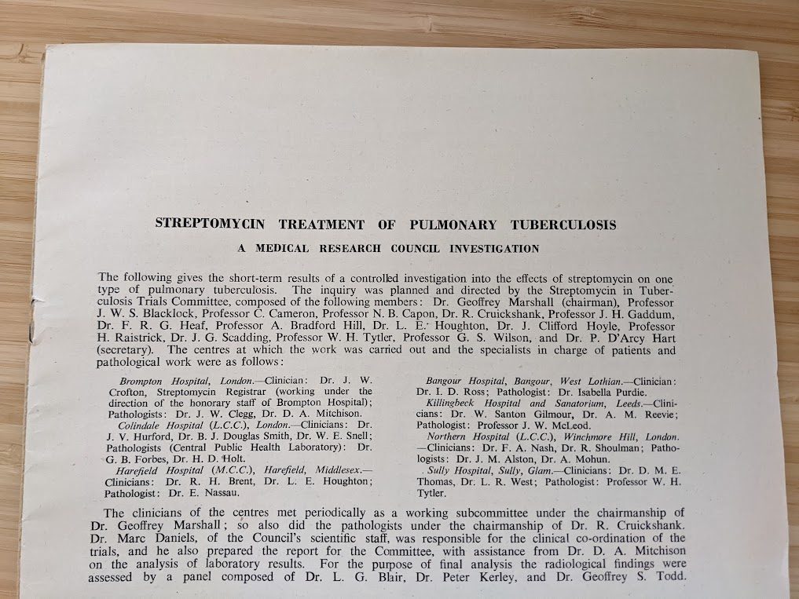
Randomization
The process by which participants
in a clinical research study are
allocated by chance to different
interventions.
As simple as the tossing of a coin, but usually implemented using a web-based system
Medical Research Council (1948). "Streptomycin treatment of pulmonary tuberculosis: A Medical Research Council investigation." Br Med J 2(4582): 769-782.

Slide 10
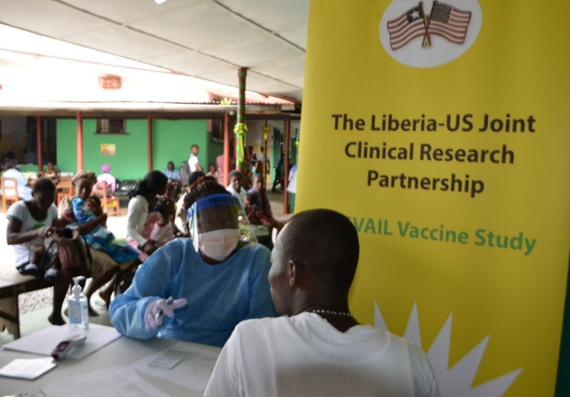
Implementation of randomization in epidemics
Alternative in pandemic setting:
  Ebola PREVAIL vaccine trial
    Kennedy et al. (2016). "Implementation of an Ebola virus disease
    vaccine clinical trial during the Ebola epidemic in Liberia: Design,
    procedures, and challenges." Clin Trials.
  “The randomization was implemented as follows: Each day at approximately 6 a.m., trained Liberian pharmacists removed vials of the vaccines from the freezers for thawing.
  “A total of 12 labelled syringes… were placed in bags.”
  “At the time of vaccination, one person randomly removed a syringe from the bag and handed the syringe to the person performing the vaccination.”

Slide 11
Randomization
The aim of randomisation is
  To increase the likelihood of known and unknown predictors being evenly distributed between treatment groups.
  To provide a basis for statistical inference
Statistical analysis of a randomized controlled trial is straightforward!

Slide 12
Key elements of randomization
Allocation concealment
  Neither the investigator nor the patient is aware of which arm the next patient will be allocated to.
  Different to blinding, where the investigator and/or patient is not aware of which arm the patient has already been allocated to.
Low predictability of random assignment
  Avoids selection bias.
  If, for example, an investigator is concerned about toxicities, they may be less likely to enrol a sicker patient if they know they will get experimental treatment.

Slide 13
Observational studies
An observational study is a study where choice of treatment is observed (without intervention) and the outcomes measured.
Often explicitly called non-randomized studies.

Slide 14
Limitations of observational studies
Severity of disease and other conditions may well affect choice of treatment.
  In ways that may not be able to be quantified.
Choice of treatment will likely differ by country, state, hospital
  Outcomes will also likely be different between hospitals for many known and unknown reasons (e.g. other diseases in the community, socio-demographic factors, hospital budget, etc.)
Collins, R., et al. (2020). "The Magic of Randomization versus the Myth of Real-World Evidence." N Engl J Med 382(7): 674-678.

Slide 15
Hormone Replacement Therapy (HRT)
Women’s Health Initiative (WHI)
Observational studies suggested 30-50% reduction in risk of cardiovascular disease among women.
  Hormone replacement therapy was a common treatment for symptoms associated with female menopause
Randomized trials were later conducted that conversely showed an increased risk of cardiovascular disease
800 participant variables were captured in the WHI observational and randomized studies
  Subsequent analyses using complex analytic methods have led to inconsistent results
  It was not possible to reliably understand what factors led to the wrong answer from the observational studies.

Slide 16
Simplicity of randomization in practice

Slide 17
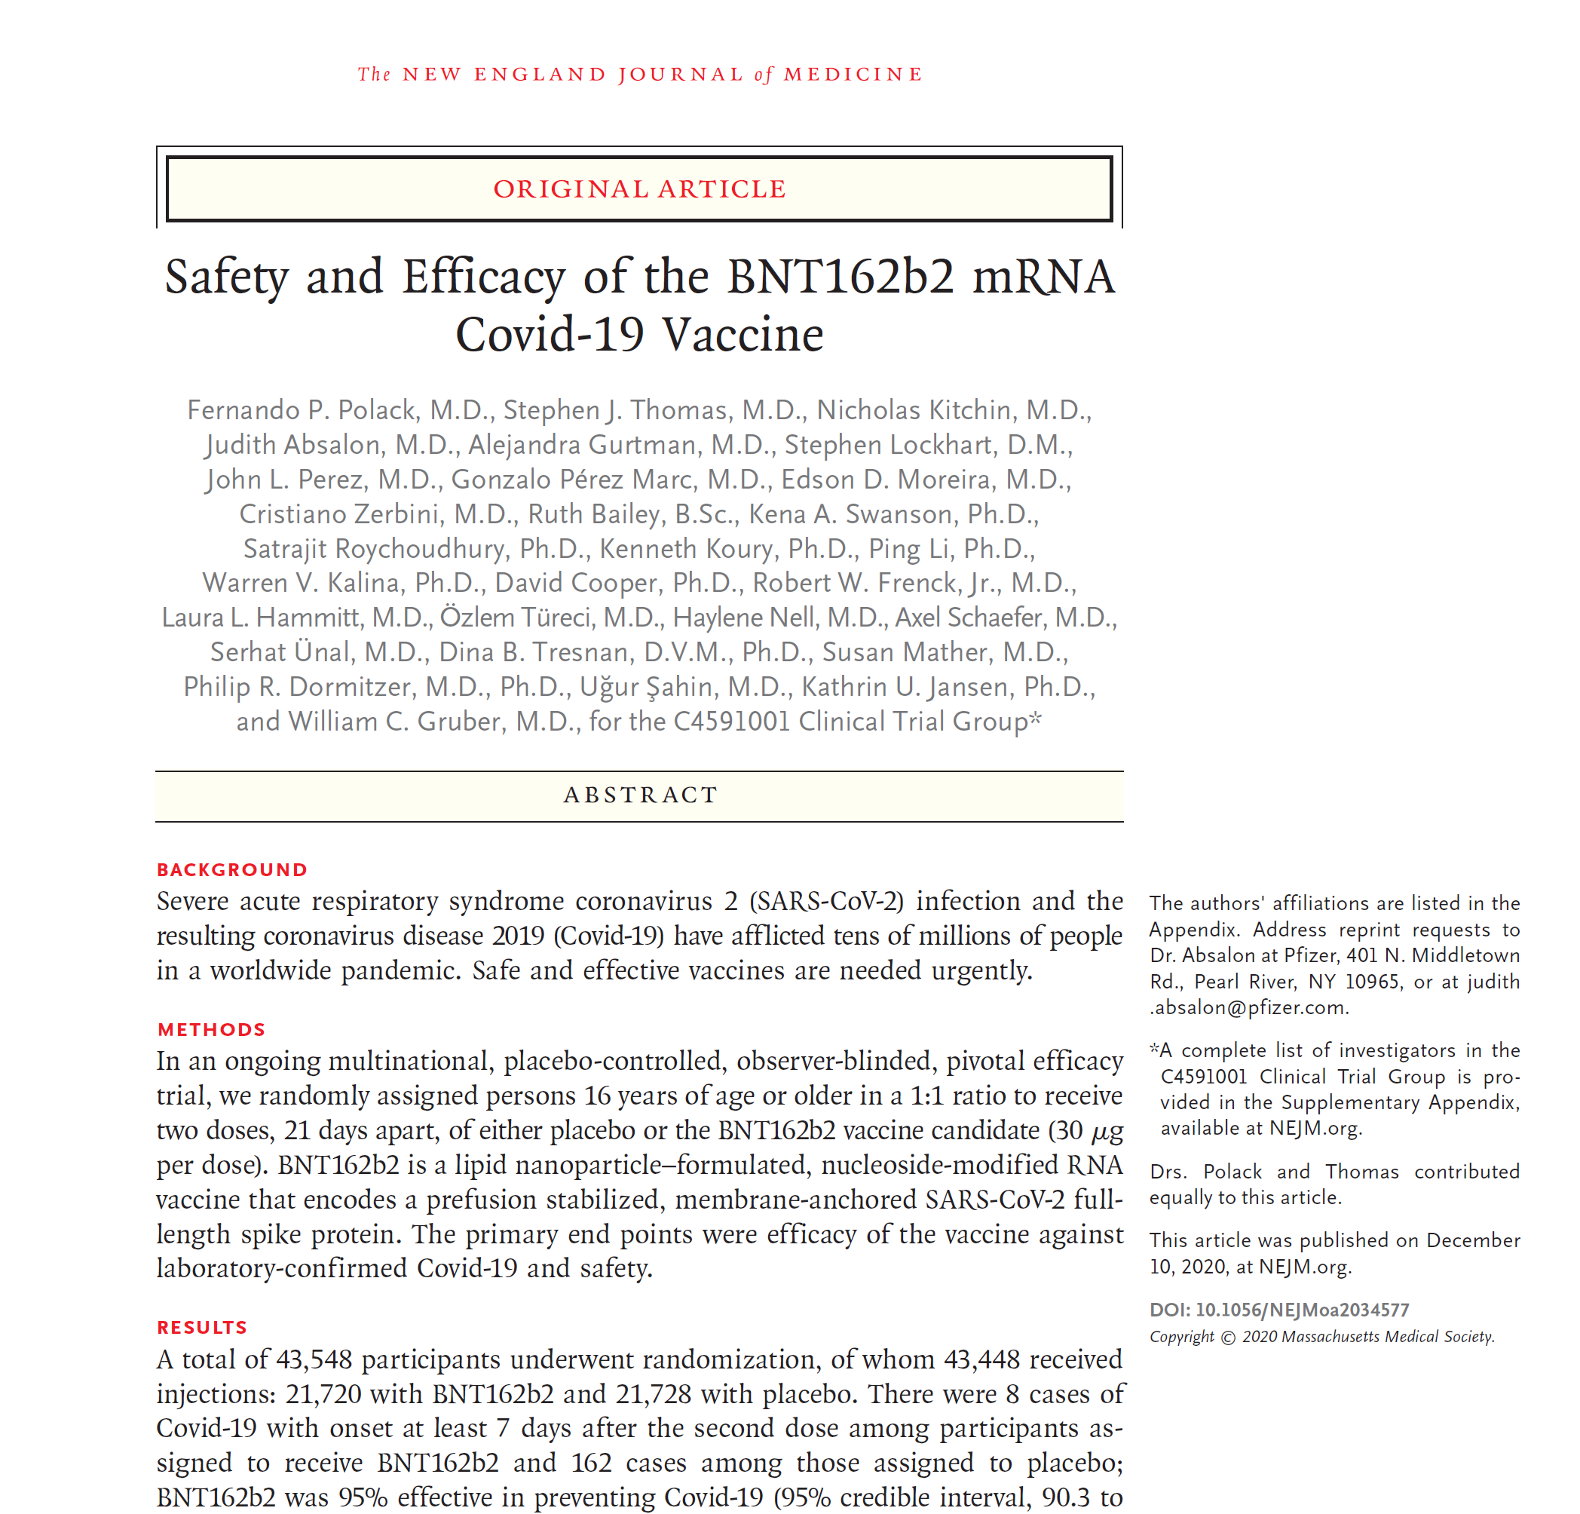
The Pfizer-BioNTech Covid-19 vaccine trials as a case study
Huge randomized controlled trial.
Main evidence to support FDA approval and roll-out of Pfizer-BioNTech vaccine.
Main intervention that brought an end to the pandemic
Polack, F. P., et al. (2020). "Safety and Efficacy of the BNT162b2 mRNA Covid-19 Vaccine." N Engl J Med.

Slide 18
How effective was the Covid-19 vaccine?
 | Vaccine | Placebo
Total participants received two doses | 17,411 | 17,511
Total follow-up time | 2,214 years | 2,222 years
Covid-19 cases | 9 | 169

Slide 19
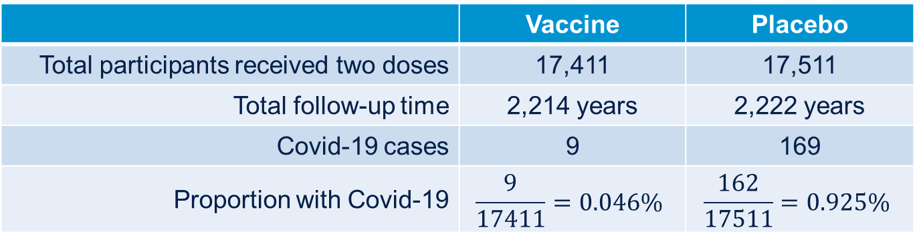
How effective was the Covid-19 vaccine?
 | Vaccine | Placebo
Total participants received two doses | 17,411 | 17,511
Total follow-up time | 2,214 years | 2,222 years
Covid-19 cases | 9 | 169
Proportion with Covid-19 | $$\frac{9}{17411}=0.046\%$$ | $$\frac{162}{17511}=0.925\%$$

Slide 20
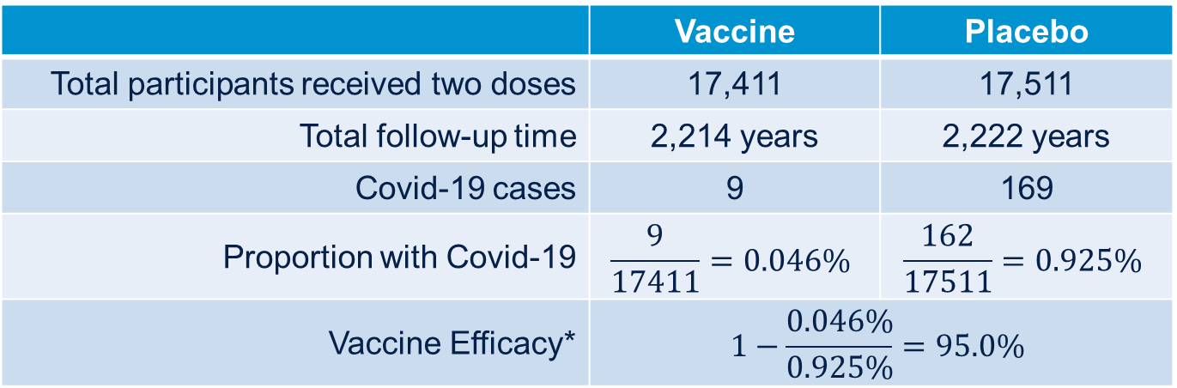
How effective was the Covid-19 vaccine?
 | Vaccine | Placebo
Total participants received two doses | 17,411 | 17,511
Total follow-up time | 2,214 years | 2,222 years
Covid-19 cases | 9 | 169
Proportion with Covid-19 | $$\frac{9}{17411}=0.046\%$$ | $$\frac{162}{17511}=0.925\%$$
Vaccine Efficacy* | $$1−\frac{0.046\%}{0.925\%}=95.0\%$$
* Primary analysis was a Bayesian Analysis with the use of a beta-binomial model with prior beta (0.700102, 1) adjusted for the
surveillance time.

Slide 21
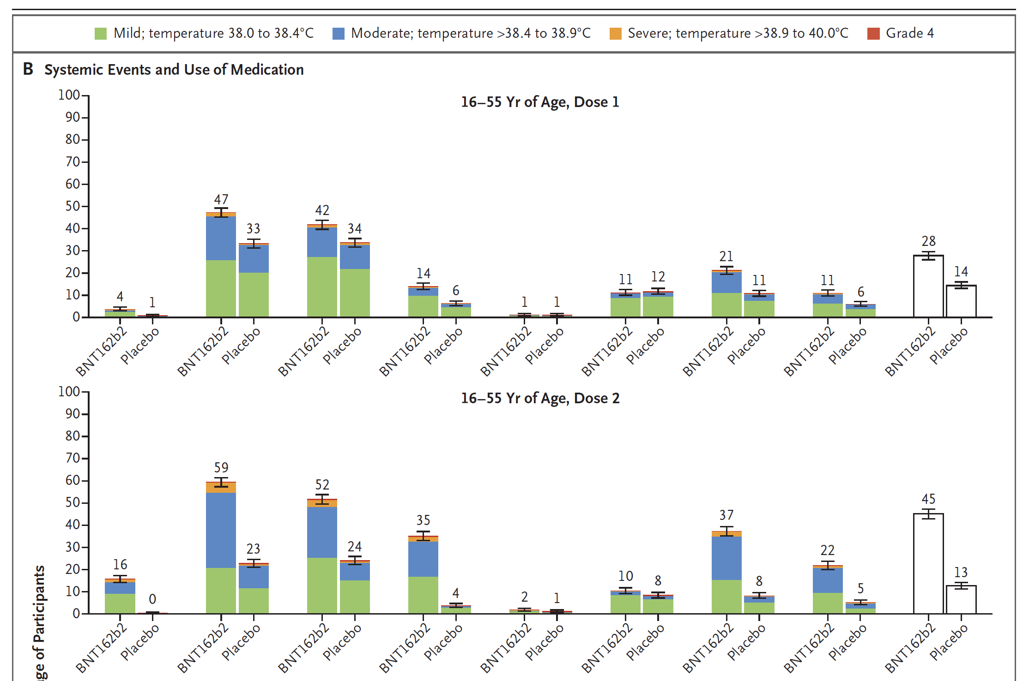
Safety of Covid-19 vaccine (median follow-up of 2 months)

Slide 22
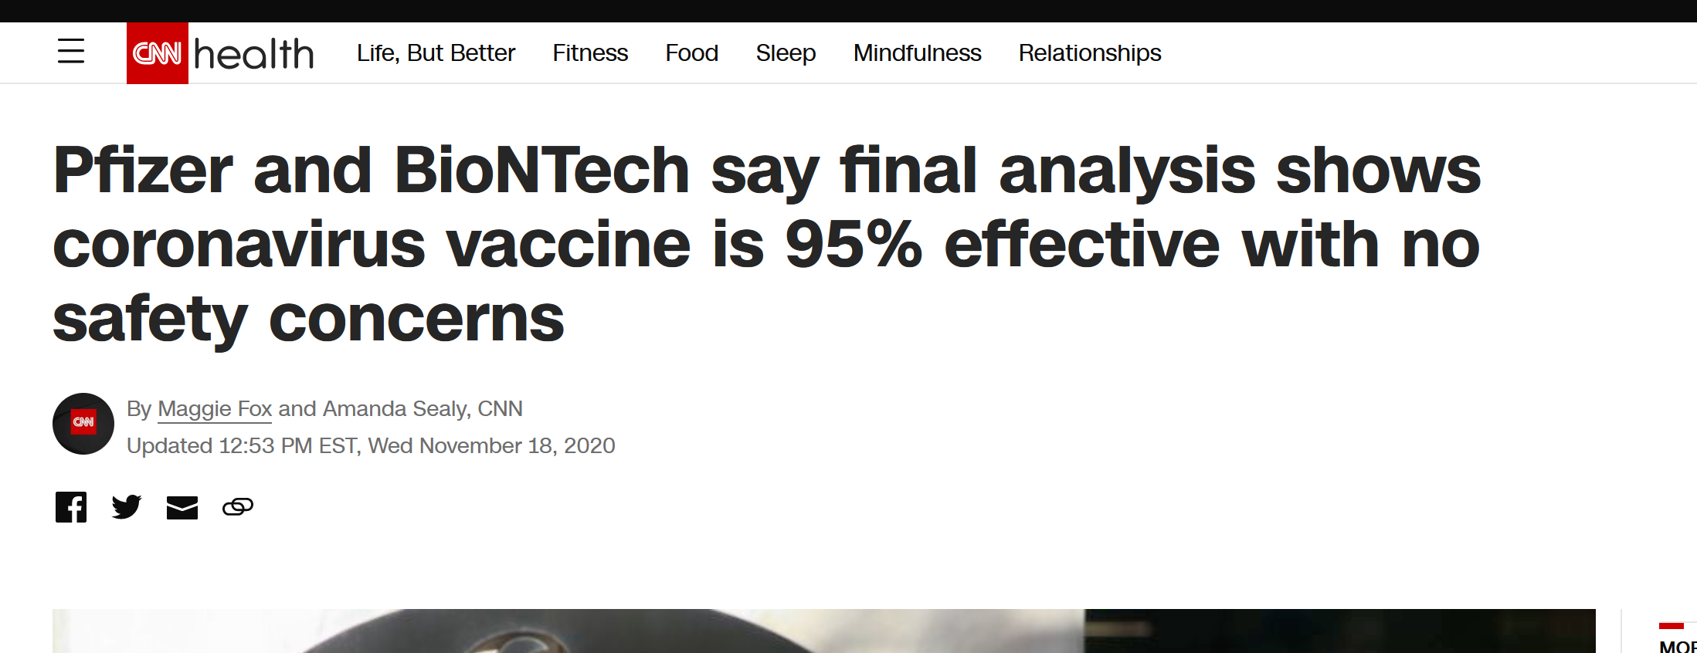
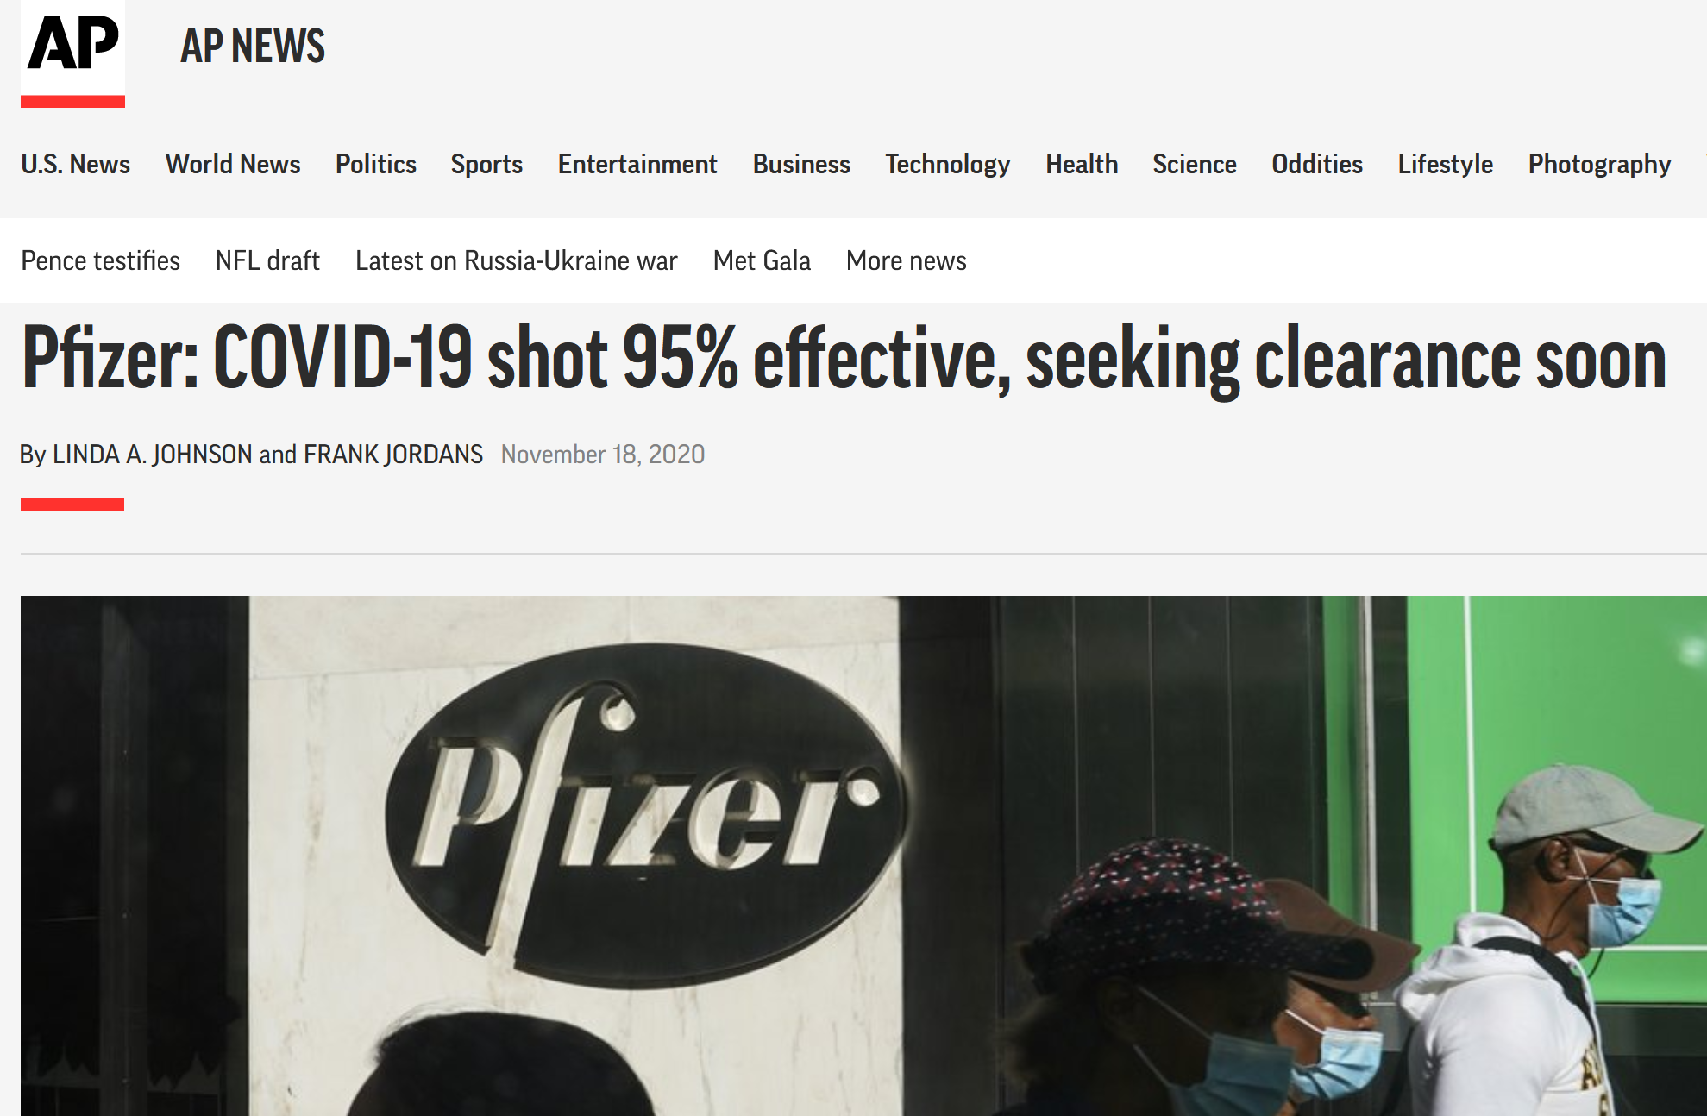
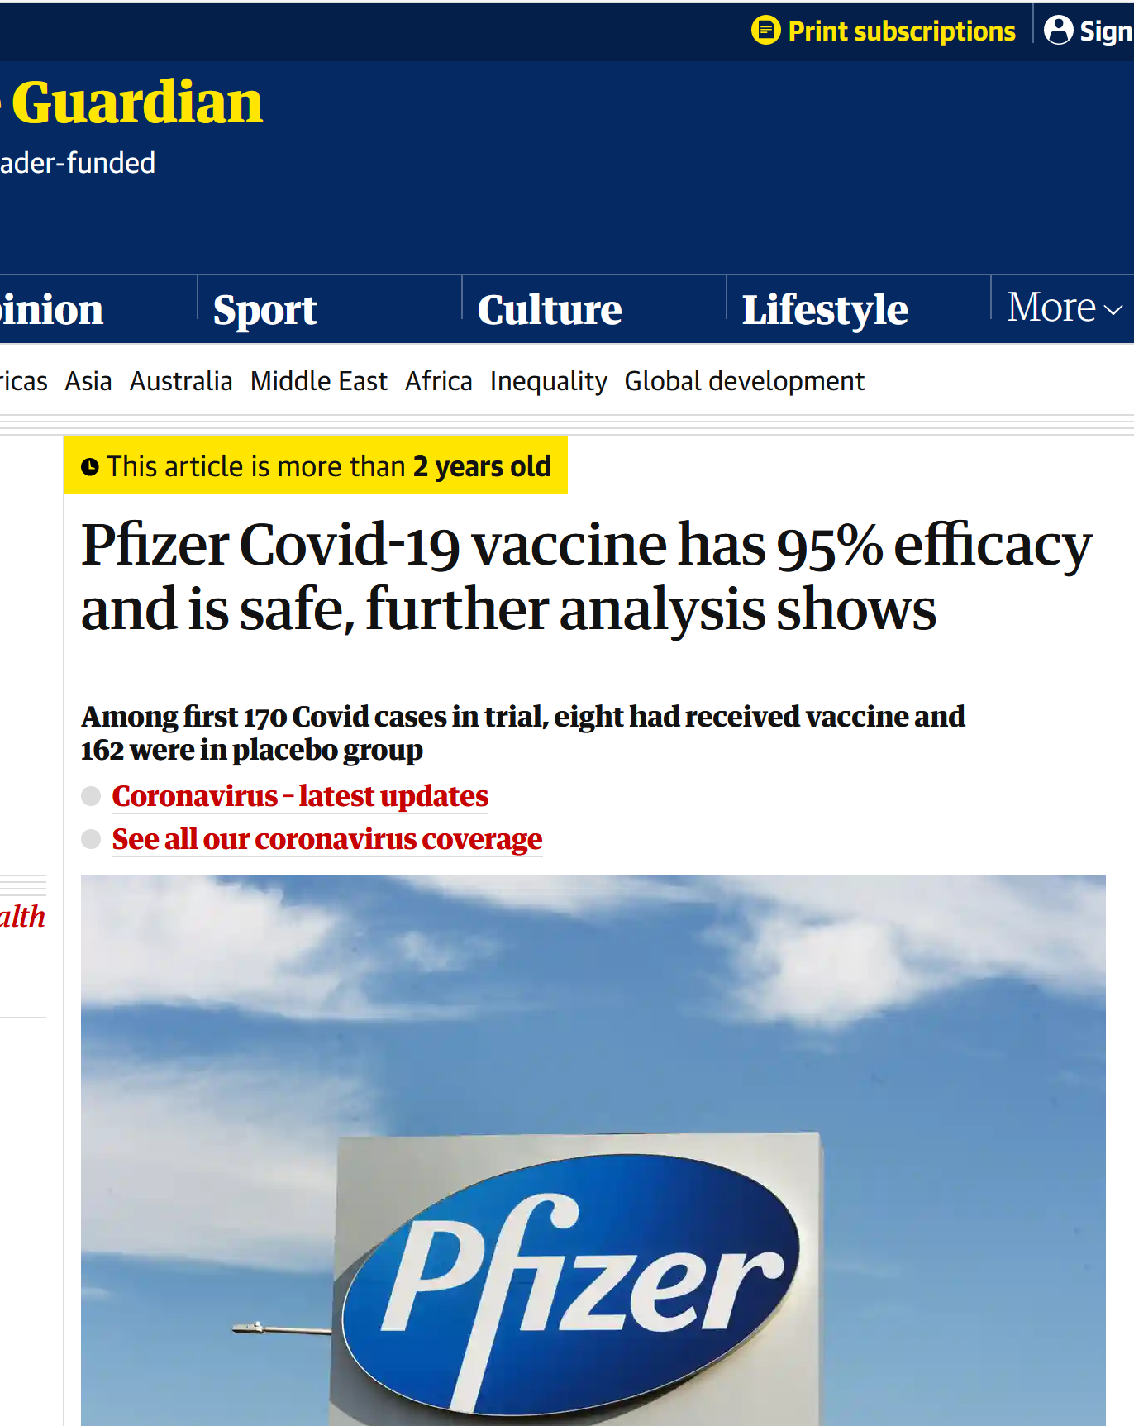
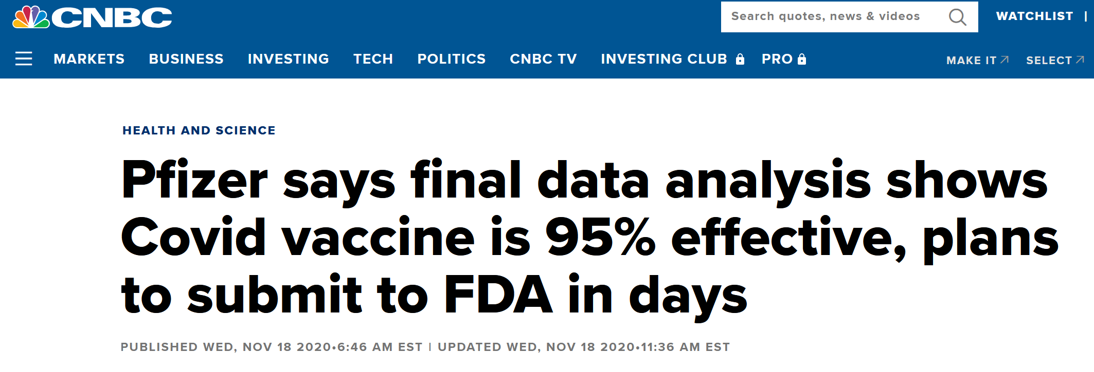
News Reports.

Slide 23
Bias in randomized clinical trials

Slide 24
Randomized controlled trials
Highest quality of evidence, but quality can be reduced by several sources of bias.
  Lack of blinding
  Patient drop-out

Slide 25

Bias
Statistical bias is the difference between an estimate and the true value of a parameter
Bias vs Precision
Many sources of bias
Precise, but biased
Unbiased and imprecise
Unbiased and precise
x
x
x
x
x
x
x
x
x
x
x
x
x
x
x
x
x
x

Slide 26
Drop-out and Intention-to-treat (ITT)
How should the data be analyzed when a participant drops out of a clinical trial?

Slide 27
Drop-out and Intention-to-treat (ITT)
How should the data be analyzed when a participant drops out of a clinical trial?
  Include only those that completed treatment and follow-up?
    No.
    Violation of randomization
      Other diseases may increase risk of drop-out leading to bias
      Participants may become aware of which treatment they are on and choose to withdraw

Slide 28
Drop-out and Intention-to-treat (ITT)
The alternative is to include all randomized participants in the analysis, irrespective of what happened
This is called the ‘Intention-to-treat’ principle.
  Preserves the randomized comparison (balance of known and unknown factors)
  Encourages quality in trials to maintain high rates of adherence and completion of follow-up
  More pragmatic, more relevant to health systems
  Hard to understand for the patient
    Addresses question of
      ‘What happens when there is an intention of giving this treatment’ rather than
      ‘What happens when this treatment is actually taken’

Slide 29
Blinding
Blinding (sometimes called Masking) is the process of keeping secret which treatment a patient is on until the end of the trial.
The strongest form of blinding is known as ‘double-blind’ where all of the following individuals are blinded to treatment allocation:
  Patients
  Clinicians
  Investigators
  Individuals carrying out assessments (including laboratory technicians)

Slide 30
Blinding
Blinding is achieved using identical inactive tablets (matched placebo).
Developing a matched placebo can be very difficult
  E.g. For rifampicin which turns a patient’s urine and body fluids an orange colour.

Slide 31
Blinding
The purpose is to ensure that every aspect of patient management and data collection is unaffected by the knowledge of which arm a patient has been allocated to.
Particularly important when the primary endpoint has a subjective element such as a patient reported quality of life measure
Less important when the primary endpoint is objective such as all-cause mortality.

Slide 32
Blinding
Even in trials that aren’t placebo-controlled, it is always important to limit knowledge of patient allocation for outcome assessors (including laboratory technicians)

Slide 33
Conclusions
Randomization is a deceptively powerful tool to which we owe so much in medicine.
Without randomization, results are hard to interpret, it is rarely possible to determine causation, even with complex statistical methods
Blinded randomized controlled trials employing the intention to treat principle yield the strong evidence to support medical decision-making.

Slide 34
tb.ucsf.edu

