Slide 1



Data Science at Community College
UC Berkeley Data 8 curriculum
Shawn Wiggins
City College of San Francisco
Eric Van Dusen, Kseniya Usovich
Data Science Undergraduate Studies, UC Berkeley
ericvd@berkeley.edu
Notes:
Eric

Slide 2
Overview
Data 8 overview
Shawn - Math 108 at CCSF
Math 108 at CCSF
- How the class is delivered
- Who is in the class (types of learners)
- How I have adapted the workflow to our setting
- What I wish I knew
Summer workshop - June 2024
California Alliance for Data Science Education-

Slide 3
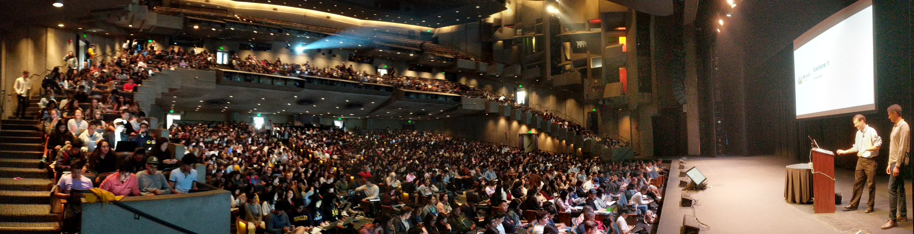
Data 8: Foundations of Data Science
1500 students per semester
Built to be scalable
Built as open source project

Slide 4
What are key Data 8 starting points
Coding is made accessible and not just for coders
Students learn within literate reproducible code documents
Consistent environments across learners has equity angle
(all machines are equal with cloud access)
No / Low prerequisites - data science as first class instead of upper division class
At Berkeley: 30-40 different majors in the class learning together - impacts how students see themselves, how they interact
Notes:
Balaji

Slide 5
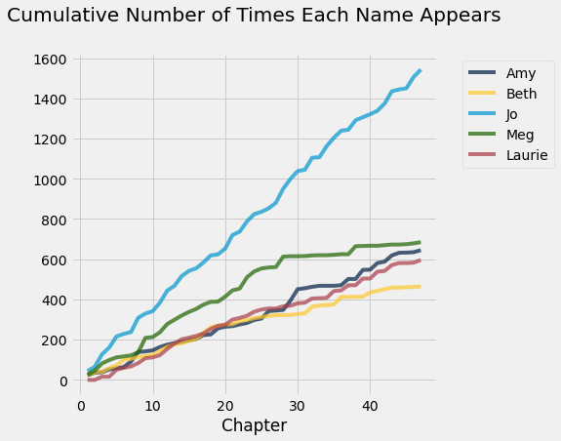
Teaching with Vignettes - Little Women Example

Slide 6
Data 8 - as a platform for teaching
Open source curriculum project
Set of Computational Notebooks
Labs, Projects, Lecture Notebooks
Autograding system
Online Free Textbook
Lots of resources to share with instructors
Handouts, Slides
UC Berkeley Pilot Juptyerhub server for community college partners
Notes:
Balaji

Slide 7
Data 8 Structure
Hybrid of an Intro Stats with Intro CS course
4 credit class
3 hours lecture / 1 hour lab / 1 hour discussion
Optional small group tutoring
Collaborative discussion board
Student powered office hours
Set of Jupyter notebooks with pedagogy and coding
Midterm and Final
Notes:
Balaji

Slide 8
Data 8 Jupyter Notebooks
Pedagogy and assignment combined curriculum
Mirrors textbook as well
10 labs - usually complete in lab class (supports hw)
11 homeworks - weekly most weeks
3 projects - longer, 2-week-long homework assignment
Applied to real world problems
Set of lecture (aka demo) notebooks as well
Autograding within notebooks
Real time feedback for sanity checks, progress
Can be used for assessment as well
Notes:
Balaji

Slide 9



Data 8 as a common platform
The following are officially articulated courses equivalent to Data C8 at California community colleges:
CIS 107 at San Jose City College
CompSci 8 at El Camino College
Math 211 at Skyline College
Math 108 at City College of San Francisco
CS 118 at Santa Barbara City College
CSIT 128 at Palomar College
~200 students per semester in Community College Pilot
Articulated at several institutions
Common curriculum platform
Computational Infrastructure

Slide 10
Data 8 at community colleges
San Jose CC - Sanjay Dorairaj - Run as flipped classroom
CC San Francisco - Shawn Wiggins & Amy McLanahan(Math)
El Camino CC - Solomon Russell & Alice Martinez (CS)
Santa Barbara CC - Nathalie Guebbels (CS co with Math)
Skyline CC - Bryan Swartout (Math)
Palomar CC - Peter Chen (CS)
Laney CC - Kyla Oh (Math)
Forming a Community of Practice from Existing Adopters
Notes:
Balaji

Slide 11
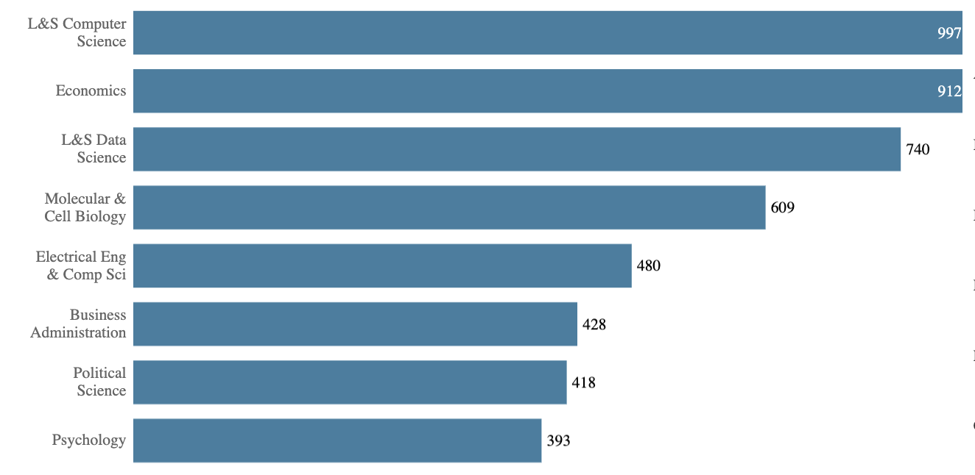
3rd Biggest Major at UC Berkeley

Slide 12
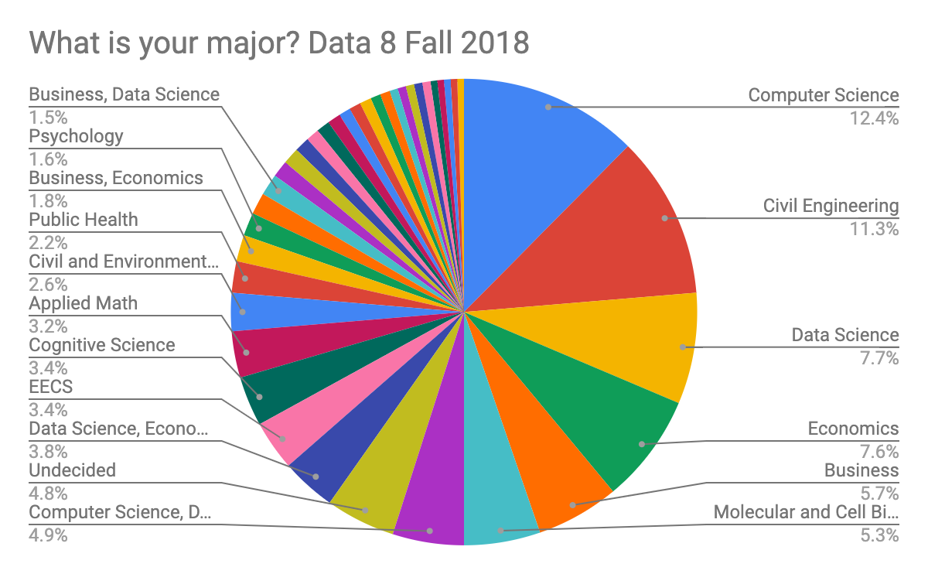
A New Path into Computing
Data 8, a first-year course with no programming or statistics prerequisites, fulfills the statistics requirement for 24 different majors on campus. (eg. like C-ID Math 110)

Slide 13
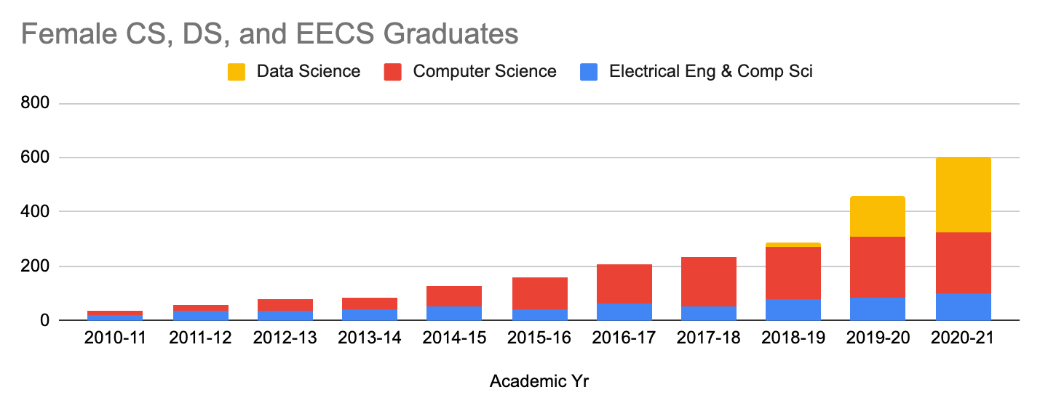
UC Berkeley Female Graduates in Computing

Slide 14


Metacognition ~ Hypothesis ~ Praxis
Tools built for data science are powerful for pedagogy
Meet student wherever they are in the University
Data Science teaching tools
built on Open Source tools and reproducible practices
Beginner students learn advanced toolkit ~ scaffold to more
Teachers learning open source stack work collaboratively
Simultaneously teach Computational Thinking & Inferential Thinking
Social Science students need Data Science skills / methods
CS/ML students need inference / ethics
“Notebook based instruction” - is it an evolution in how we teach?
Notes:
Balaji

Slide 15
Inclusion Efforts around Data 8
Data Scholars - Foundation Seminar with extra support
Peer mentors, small group cohort, extra homework support
Data 6 - A class before Data 8 - work in progress
Not a major requirement, builds familiarity with computing
Offered as a summer bridge for SEED scholars program for 3 years
Community College
Support for community college instructors
Transfer student seminar for new transfers once at Berkeley

Slide 16
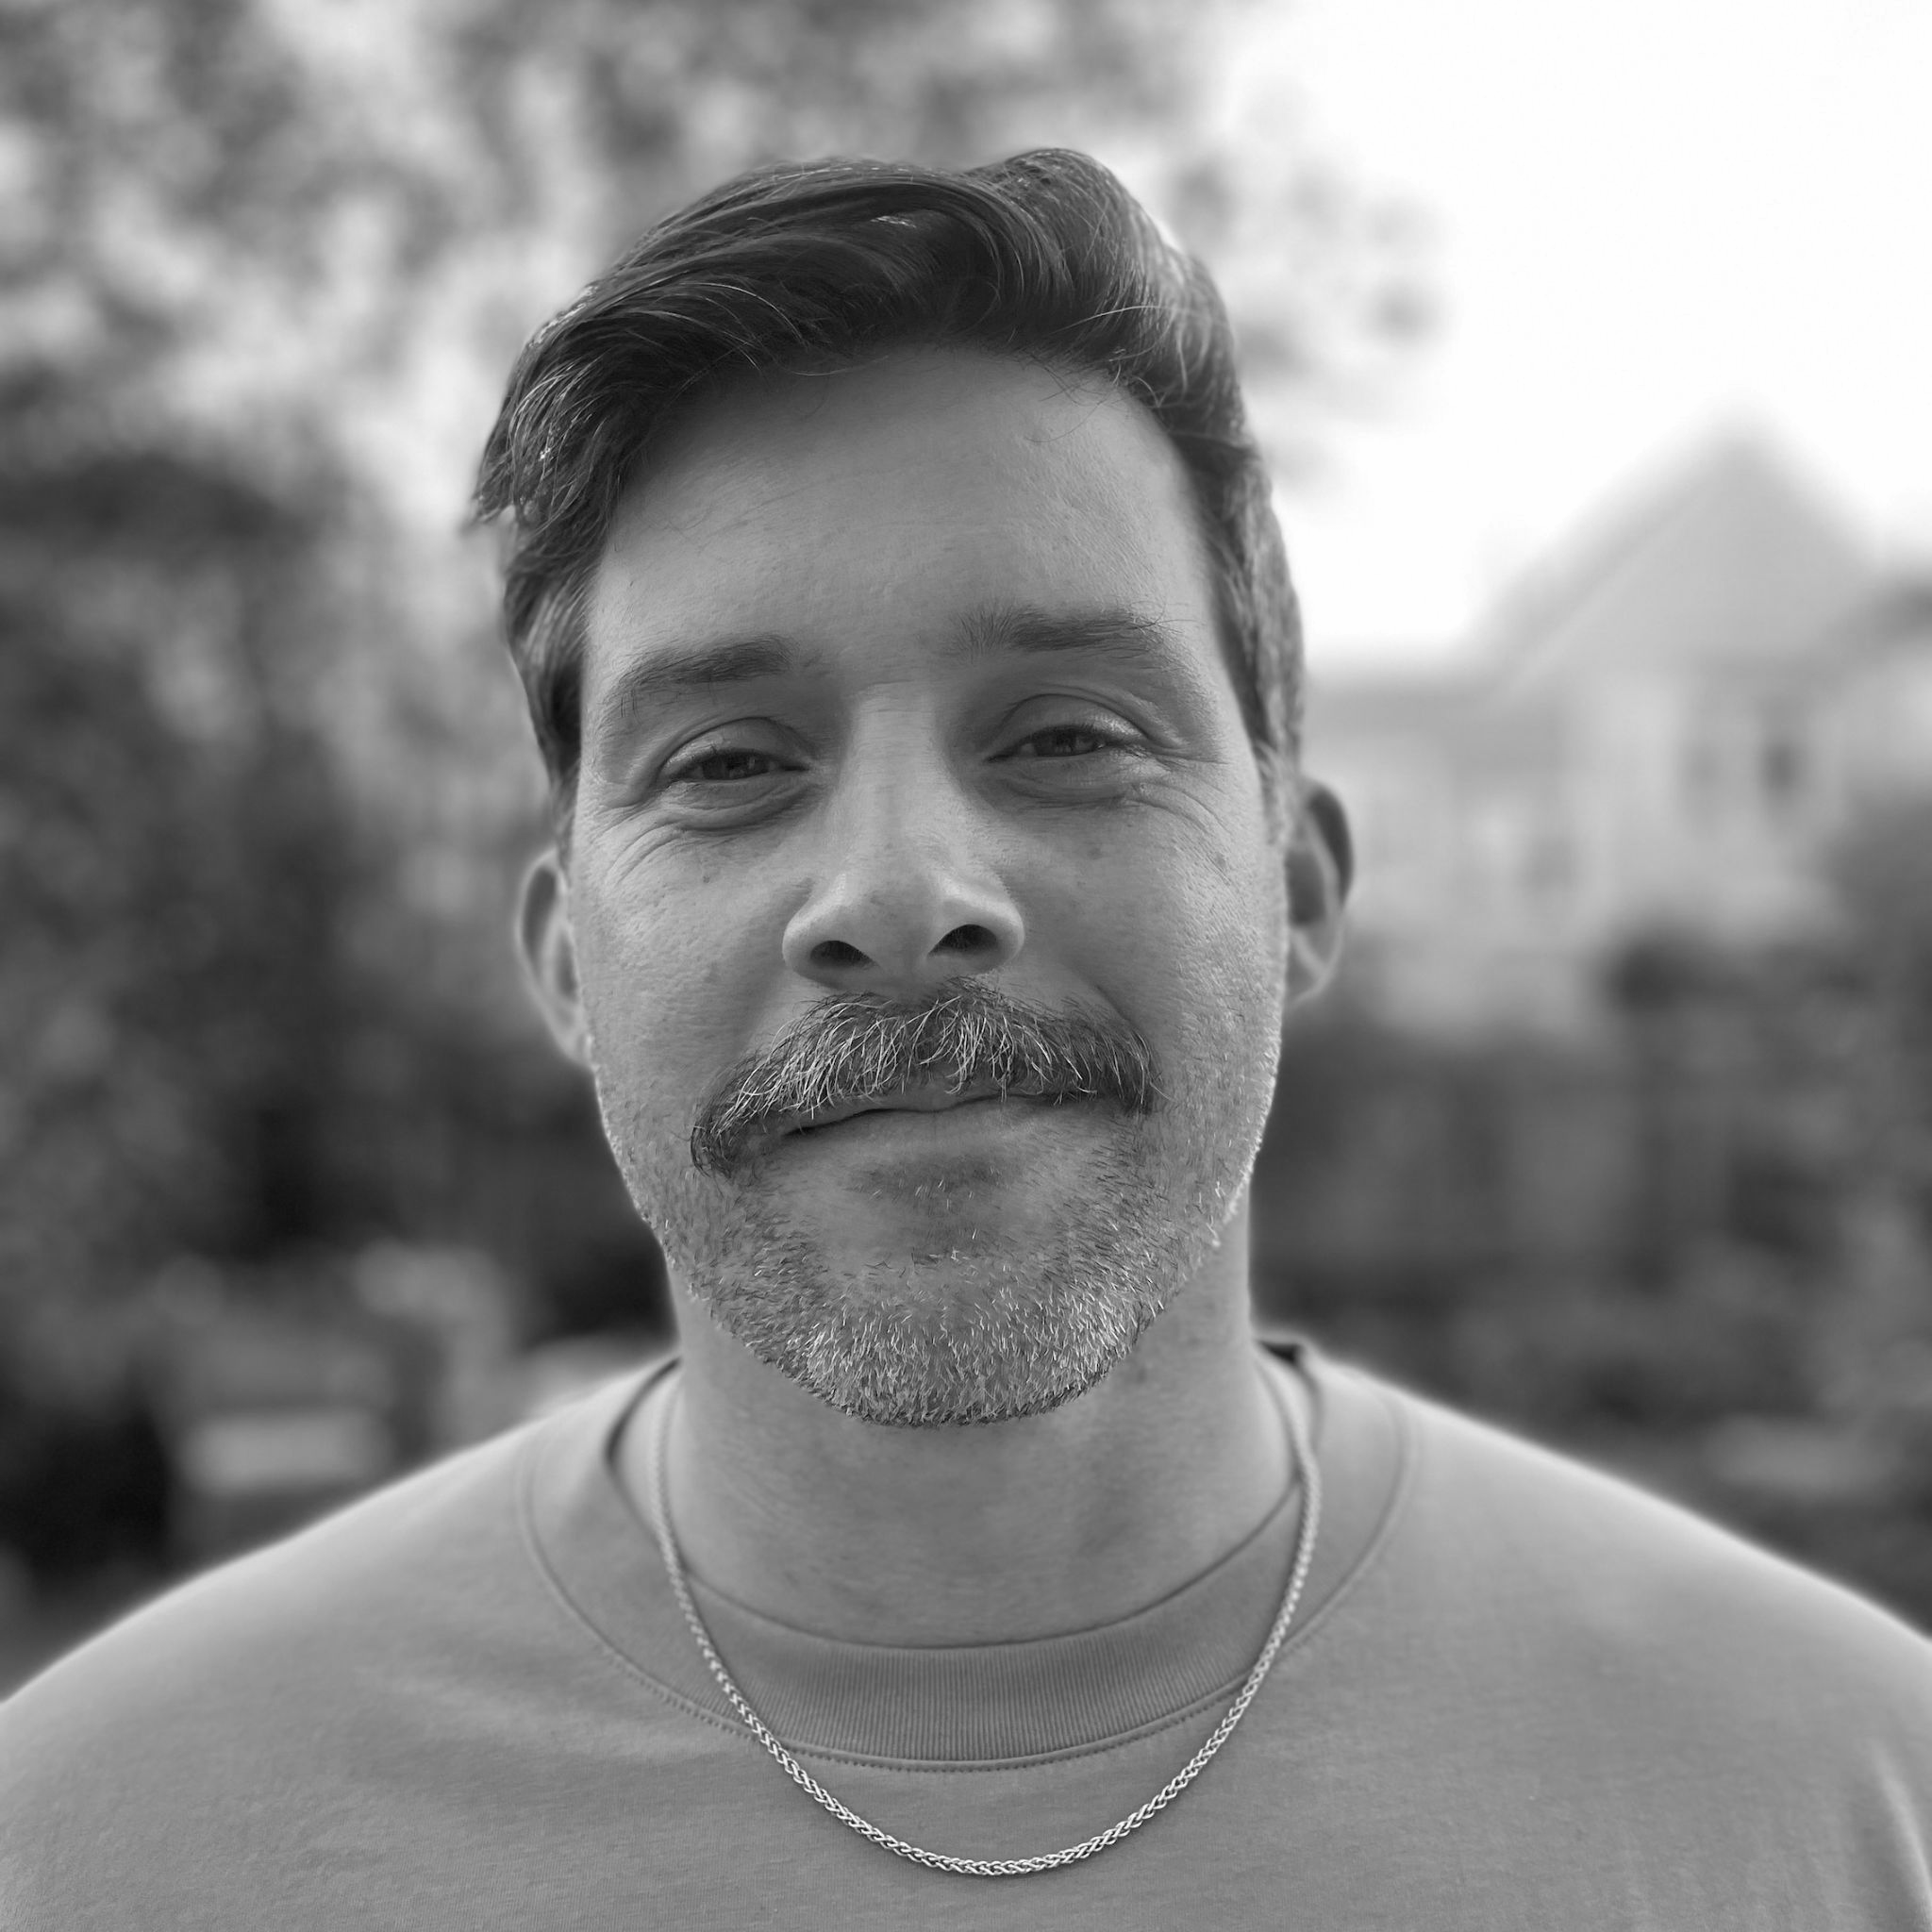
Shawn Wiggins
swiggins@ccsf.edu
Instructor
Data Science Coordinator

Slide 17
MATH 108 AT CCSF

Slide 18
Materials, Offerings, and Format
Materials
DATA 8 Spring 2020 and Spring 2022 Shared Materials
Customized Over Time
Current Offerings
Hybrid Format
Fall 2023
2 Instructors
2 Hybrid Sections
1 In-Person Section
Spring 2024
2 Instructors
3 Hybrid Sections
Pre-Recorded Lecture Videos
Textbook Readings and Quizzes
Homework and Project Assignments
Weekly In-Person Meeting
Discussion
Lab Assignment
Embedded Tutor

Slide 19
MATH 108 Enrollment Journey
68
78
70
60
52
50
57
DATA 8 Articulation
40
Number of Students
30
21
Approval for CSU GE Area B4
and IGETC Area 2
CCSF Data Science AS Degree Launched
& End Mask Mandate
20
10
17
0
Fall 21
Spring 22
Fall 22
Spring 23
Fall 23
Spring 24
Semester

Slide 20
Retention Rates 🫣
100
90
80
Retention %
Average
70
60
All Sections
50
Hybrid Sections
40
Fall 21
Spring 22
Fall 22
Spring 23
Fall 23
Semester

Slide 21
MATH 108 STUDENTS

Slide 22
Education Experience
% Surveyed with at least a Bachelor’s Degree
70
60
67%
50
60%
50%
40
30
20
10
0
Fall 22
Spring 23
Fall 23
Semester

Slide 23
Prior Programming Experience
% Surveyed
(Fall 22 - Fall 23)
30
25
20
15
10
5
0
9
1
10
2
3
4
5
6
7
8
Rating
No Experience
Professional Experience

Slide 24
Prior Statistics Experience
% Surveyed
(Fall 22 - Fall 23)
30
25
20
15
10
5
0
9
1
10
2
3
4
5
6
7
8
Rating
No Experience
Professional Experience

Slide 25
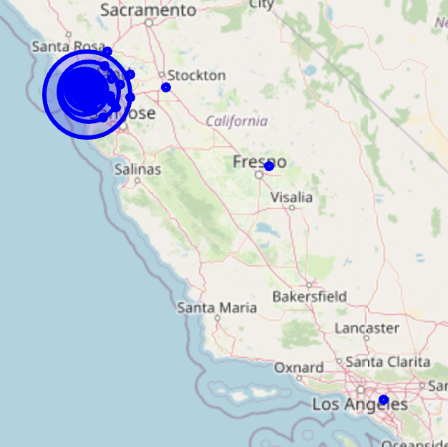
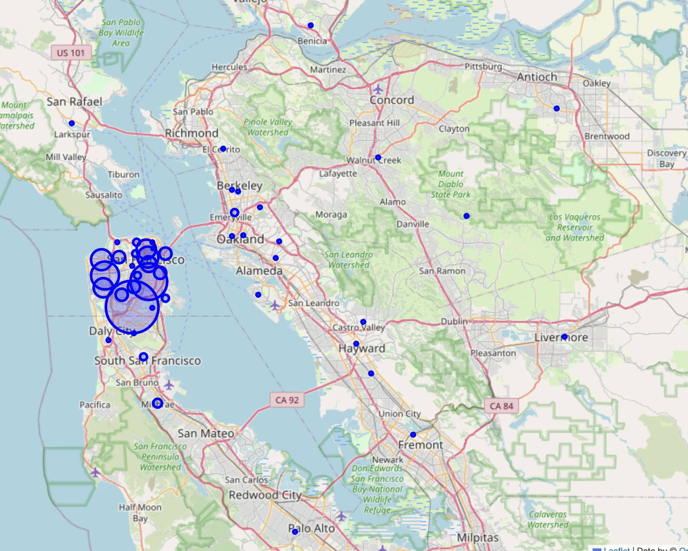
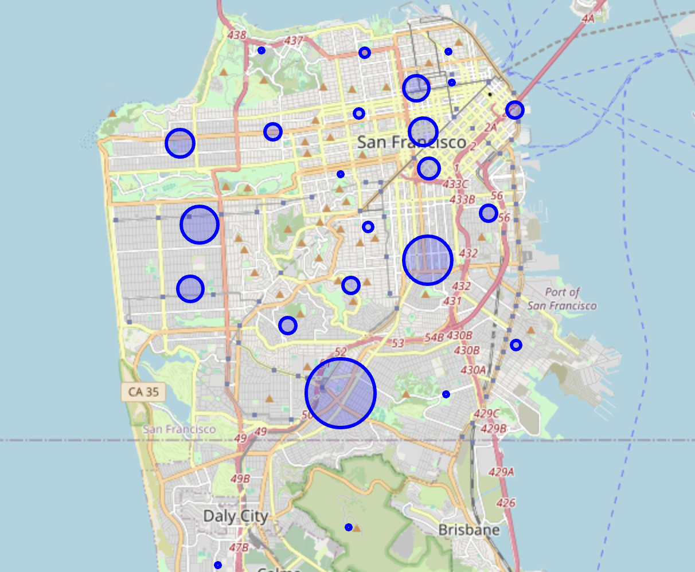
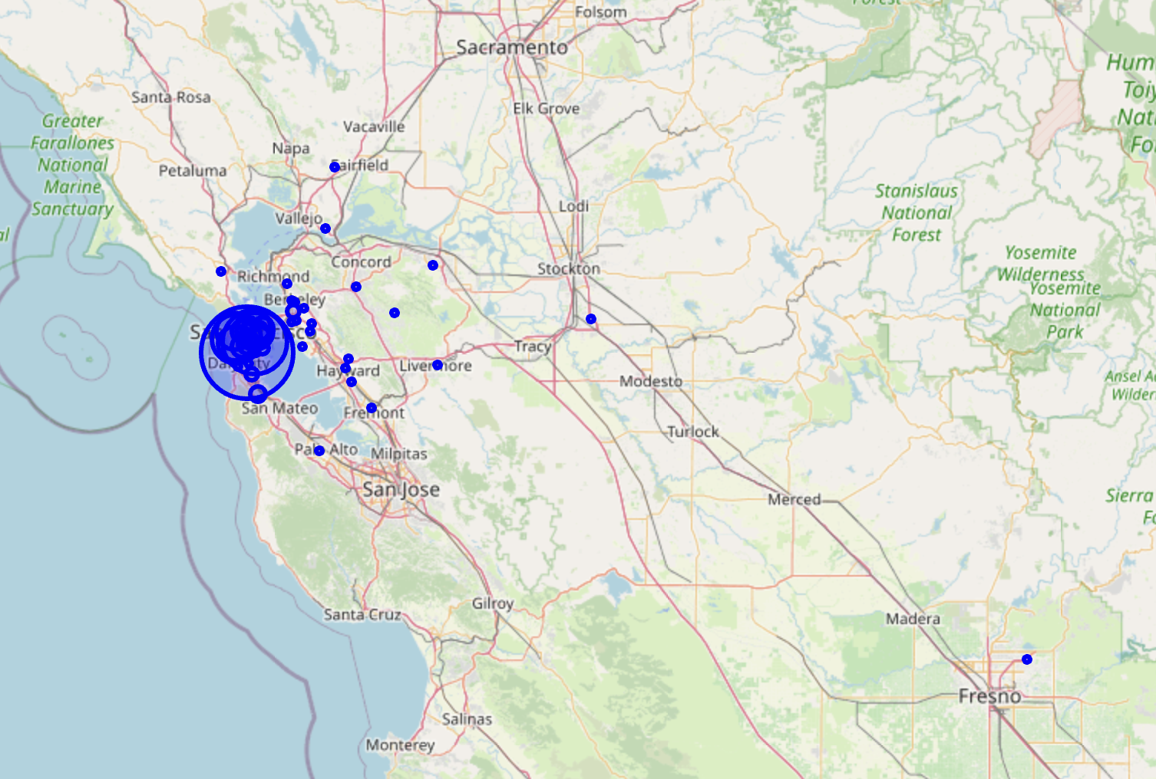
“Home” Zip Codes FA22 - FA23

Slide 26
CUSTOMIZING DATA 8 FOR CCSF

Slide 27
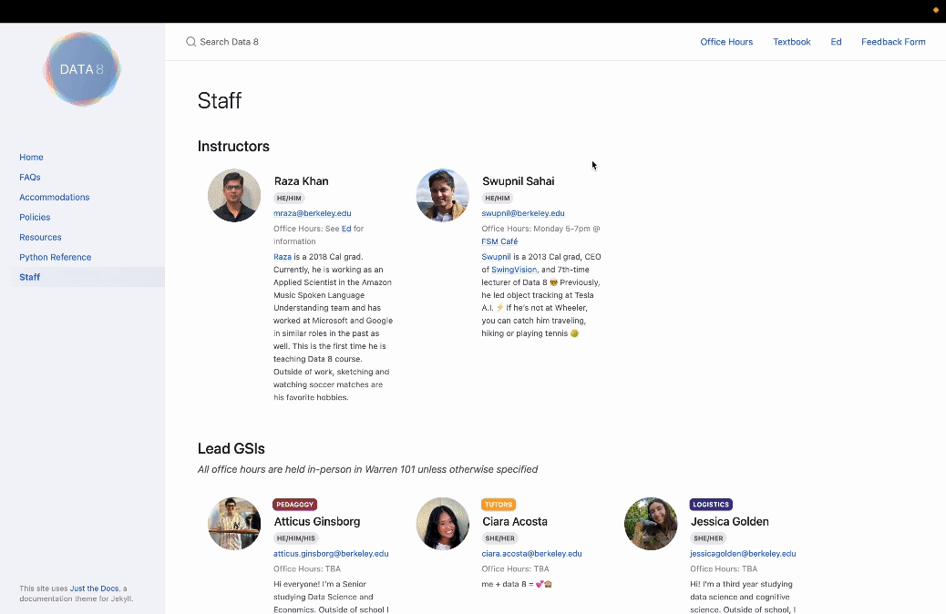
Student Support for DATA 8 😅

Slide 28
CCSF Student Support
Embedded Tutors
One professional tutor embedded in each in-person meeting
Exam Review Sessions
Virtual and in-person group review sessions lead by embedded tutors
🧑‍🎓
Math Lab
(Currently) 4 amazing professional tutors have experience with MATH 108 to offer daily in-person and occasional virtual tutoring sessions
Discord Channel
A student communication channel that contains former MATH 108 students and community volunteers
Instructor Meetings
Regular in-person (and virtual) meetings
Data Ambassadors
Virtual assignment support and mentoring sessions talented Berkeley DS students

Slide 29
More Support: ChatGPT Guidence
💻🤖
Prompts are suggested to focus the LLM’s response to:
Not suggest next steps
Utilize the datascience library and other course-specific technologies
Offer guidance as a tutor and not provide solutions
Generative AI Support
Exams and Discussions
Students Still Learn 🎉

Slide 30
MATH 108 Technology Universe
JupyterHub
GitHub
Canvas
A Hub that provides students with access to Jupyter Notebooks and a file system to complete most activities
Version-controlled storage and issue tracking for Notebooks and other materials
An LMS that organizes course content into weekly modules where nbgitpuller links are used to sync materials on GitHub with Student JupyterHub
nbgitpuller
Docker Image
An application that syncs materials between GitHub and JupyterHub while preserving student work
Instructions to customize the JuypterHub
Otter Grader
Runs tests on student code and provides feedback
Cloudbank + 2i2c + Berkeley really helped simplify all this part at the start 🙏

Slide 31
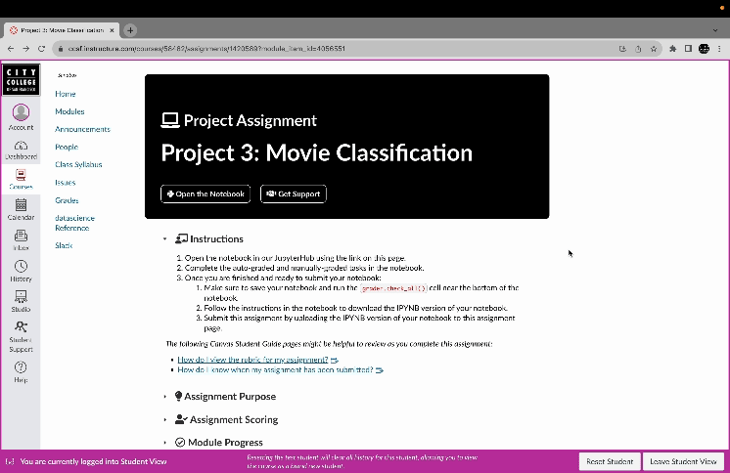
Hide (Most of) the Technology

Slide 32
MATH 108 GitHub Repositories
development
staff
student
Developer(s) build/edit main notebooks that include content, tasks, and auto-graders
Instructors, CCSF Tutors, and UCB Data Ambassadors review materials for tutoring and issues
Publicly available materials and issue tracking that is connect with Canvas and JupyterHub
jupyterhub
Private Repositories
Contains information to customize our JupyterHub

Slide 33


Personalize the Material
Be curious and explore data!
Start Small
Learn about Otter and reference the DATA 8 grader tests.

Slide 34
Writing Auto-Grader Tests
Simple
Focused
Deterministic
Write readable and simple tests that utilize standard methods and notation.
Write tests that check for one specific thing that can be articulated to the students and staff.
Use a seed for a work that utilizes randomly generated data.
Clear Expectations
In your task/question prompts or rubrics, make sure the things you are testing for are explicitly expressed. You don’t have to say how you will be testing their work.

Slide 35
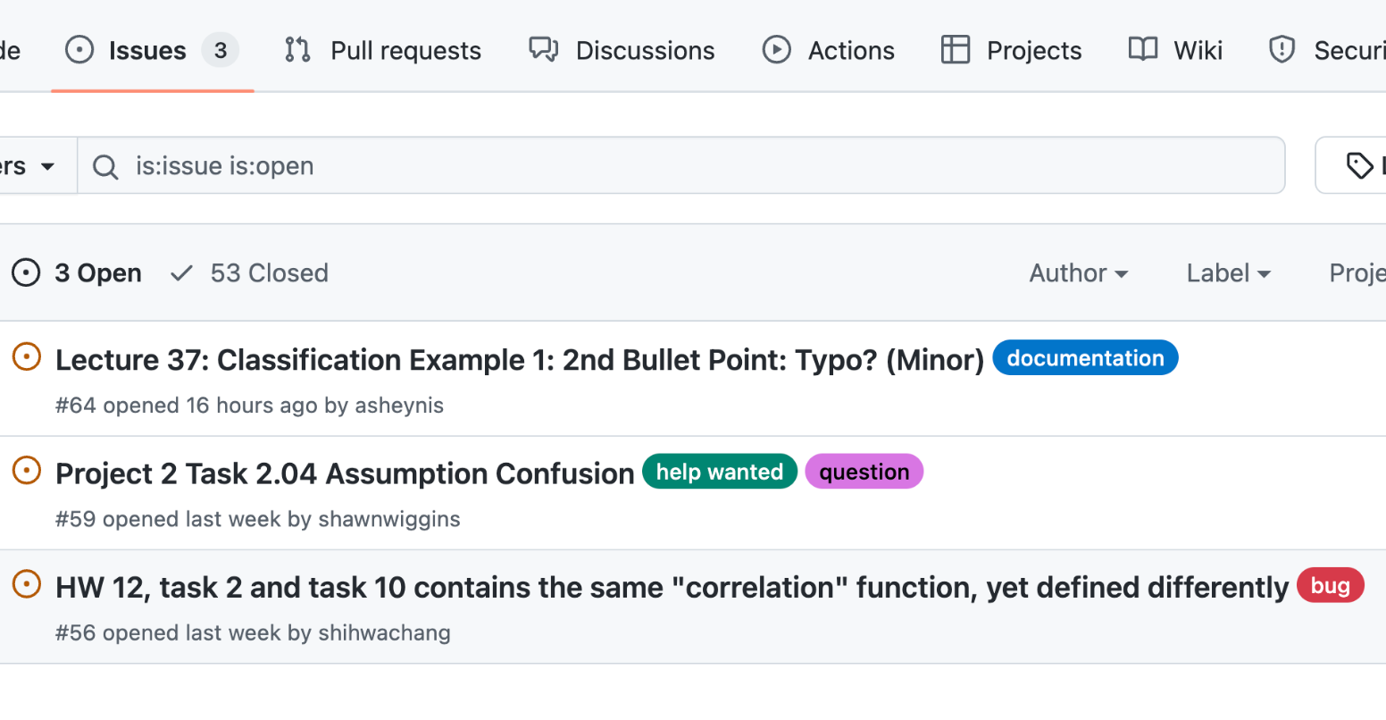
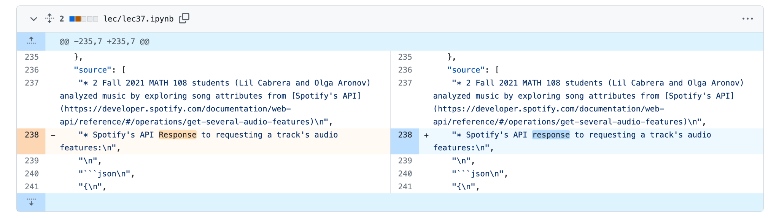
Incorporate Student Feedback
GitHub Issues
"I am really enjoying this class particularly as it's so open to feedback that is taken both seriously and creates an environment of discussion."
Alexander Sheynis

Slide 36
Issues Workflow
Issue is discussed in the issue page considering the repository
Student reports issue in student repository or by message
Developer implements changes in dev repository
Staff notebooks are re-distributed for review to staff repository
Staff reports issue in a repository or by message
Students or staff are messaged if needed
If approved, student notebooks are re-distributed to student repository

Slide 37
LESSONS LEARNED

Slide 38
Reflecting After Five Semesters
Learn About & From Your Students
Learn the Technology and Hide It
Customize the Materials
Incorporate Student Feedback
Utilize Technology & Empathy
Data Science ≠ Statistics + Programming
Development Can Create Hope
Create a Team and Collaborate 🤝
Katia, Amy, Craig, Charles, Jesús, Mischa, Sophia, Ed,…

Slide 39
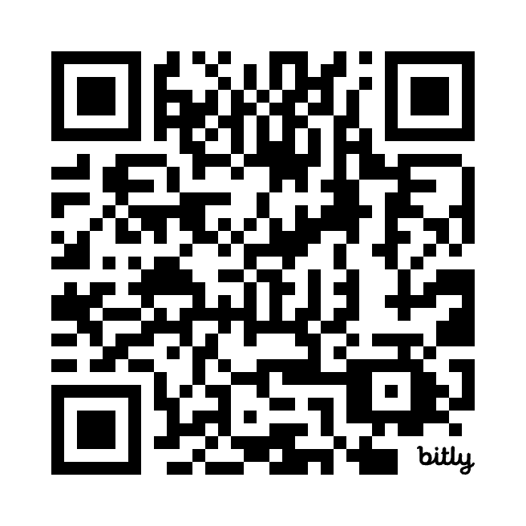
Details on National Workshop for Data Science Education
National Workshop on Data Science Education aims to bring together Data Science educators from all over the world.
Training for Data 8
Overview of Berkeley Data Science
Human Context & Ethics
Panels
Data Science across California
Equity and Inclusion
High School Data Science
Math for Data Science
dates: June 25-27, 2024 UC Berkeley & Online
June 23-24 - Learning Lab workshop
Register Here:
https://bit.ly/2024NWDSE

Slide 40
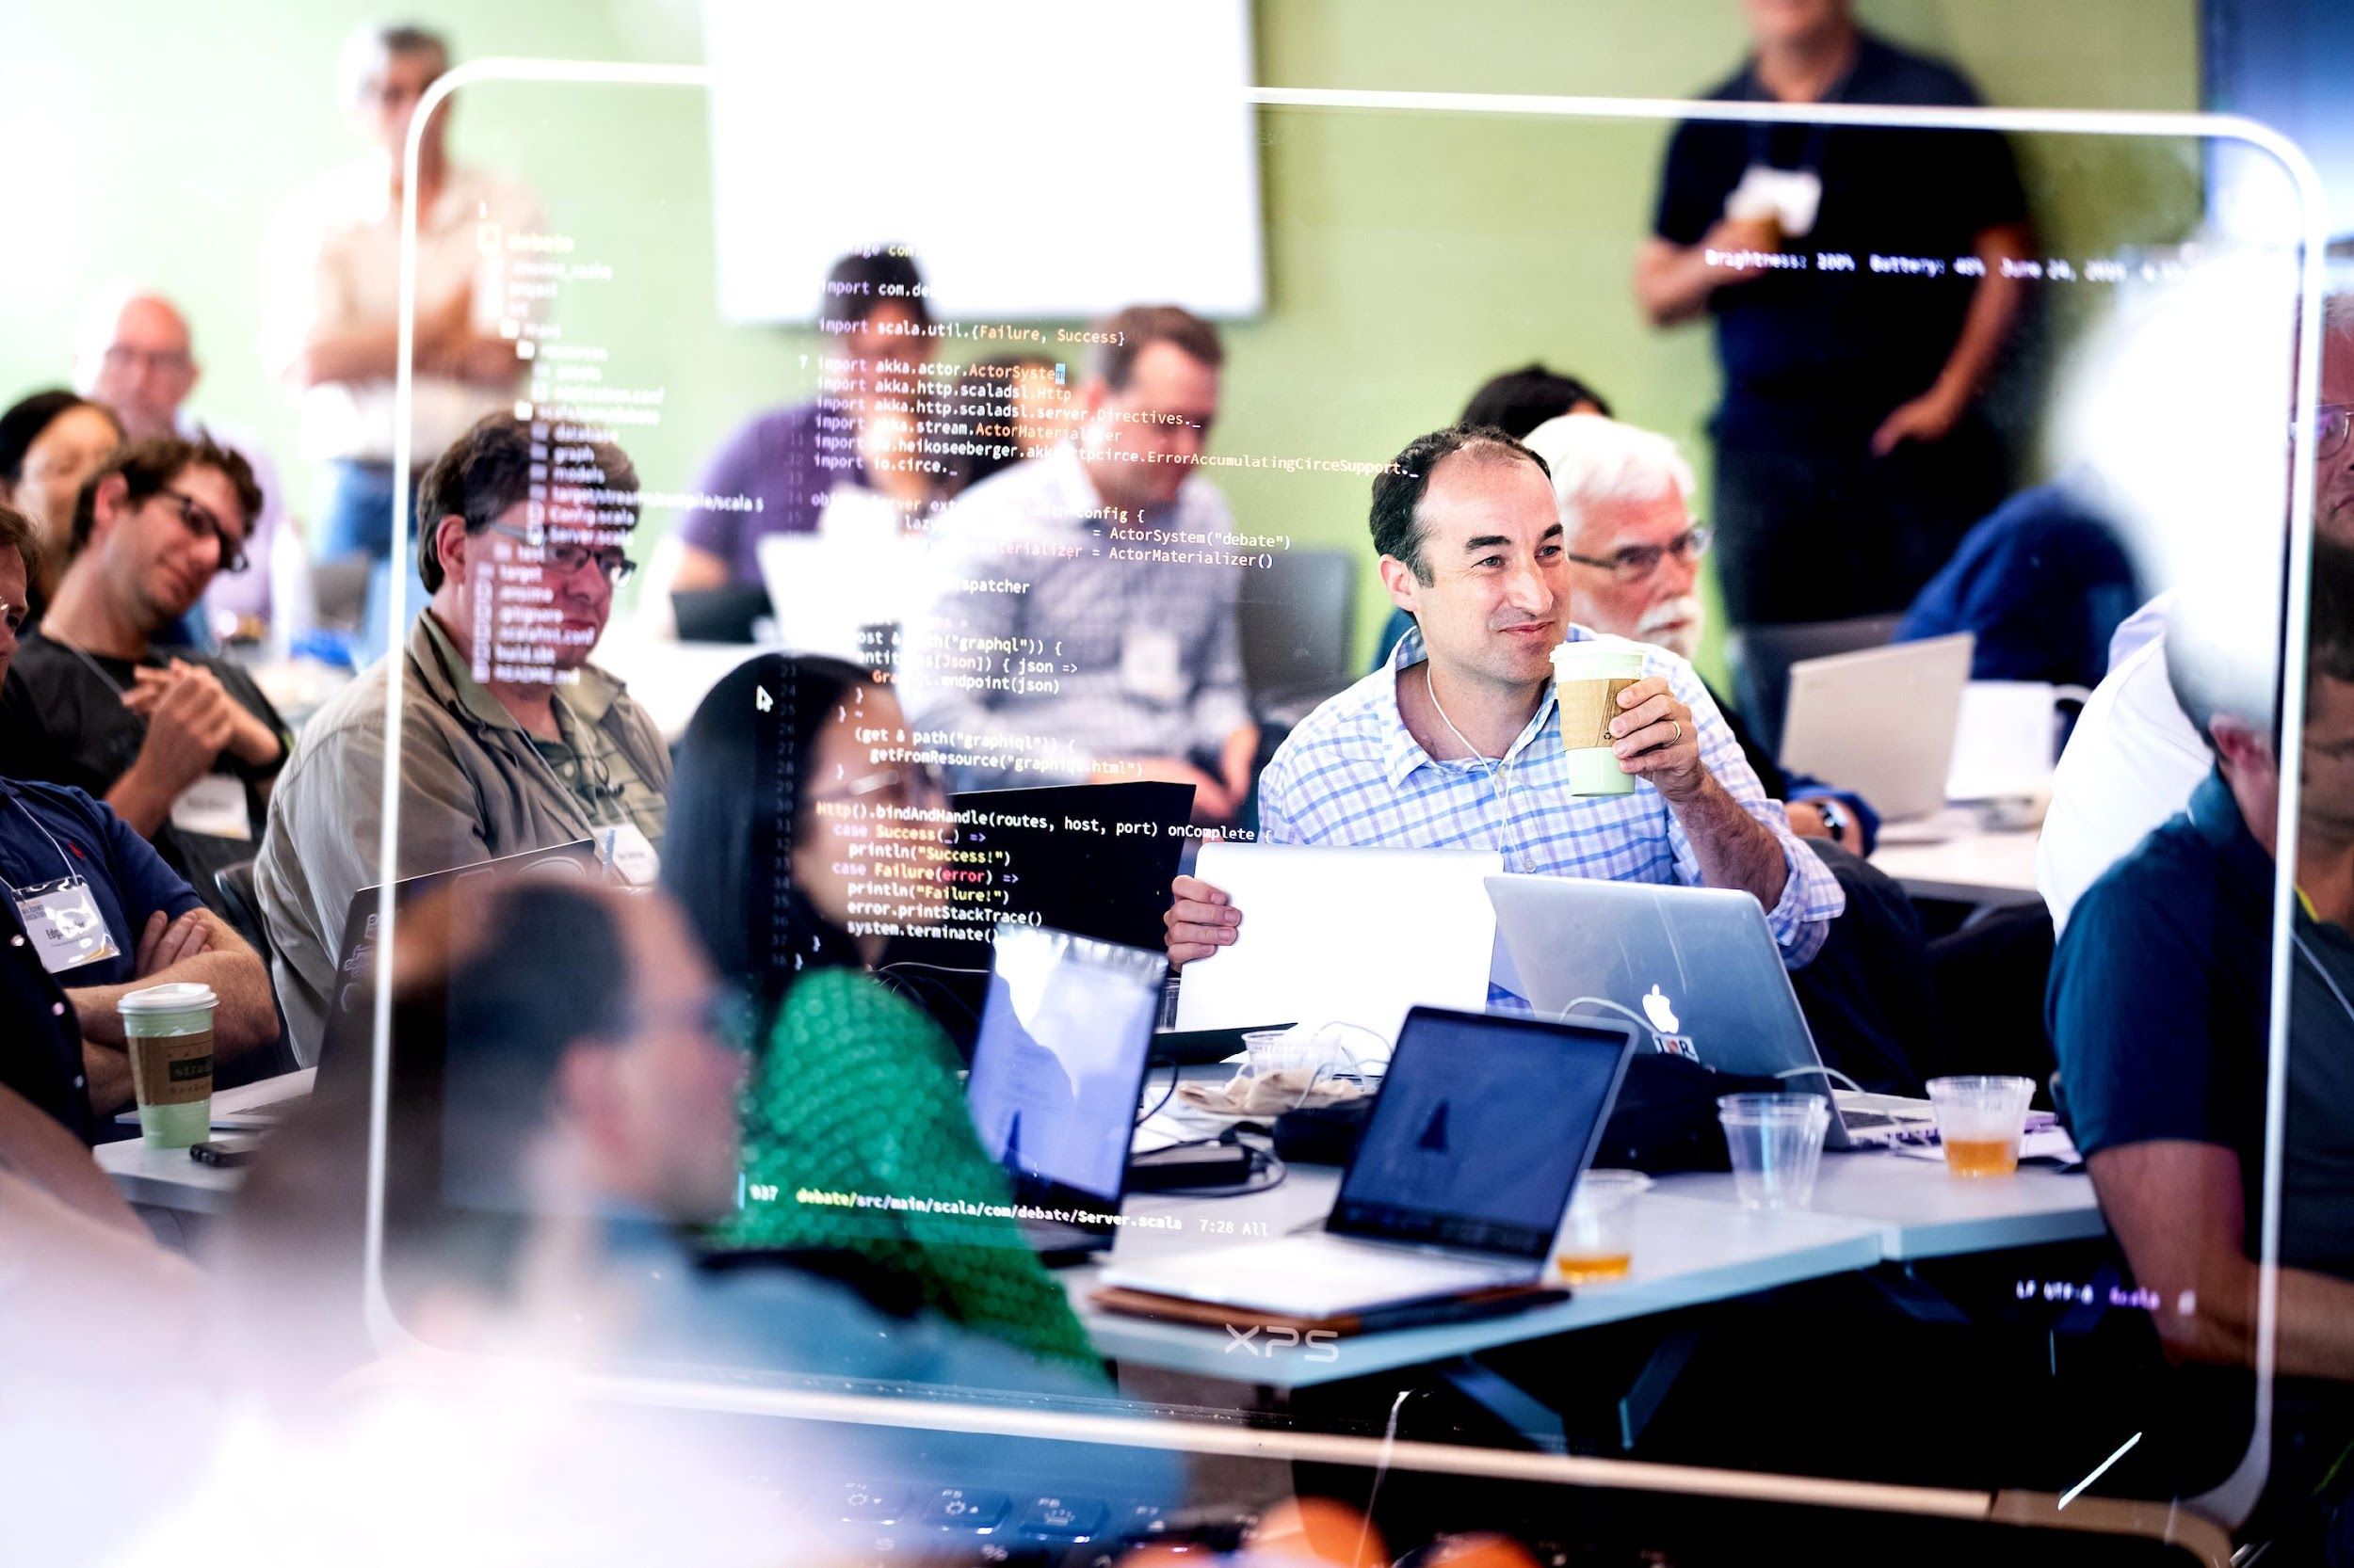
Teaching Other Teachers
Innovation in Pedagogy
Coding for Professors
Instructional Technology
Pedagogy workshop for UC Berkeley Professors → National Workshop for Data Science Education
Notes:
Balaji

Slide 41
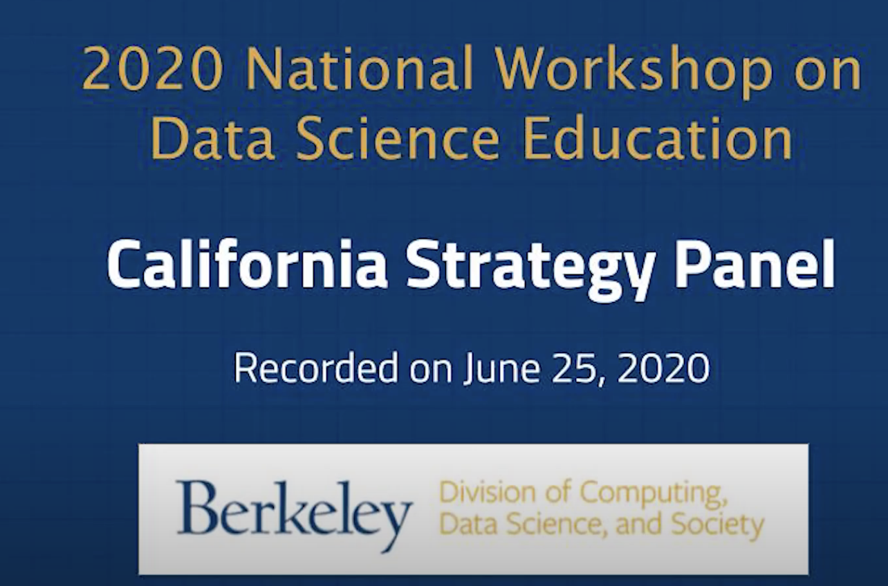
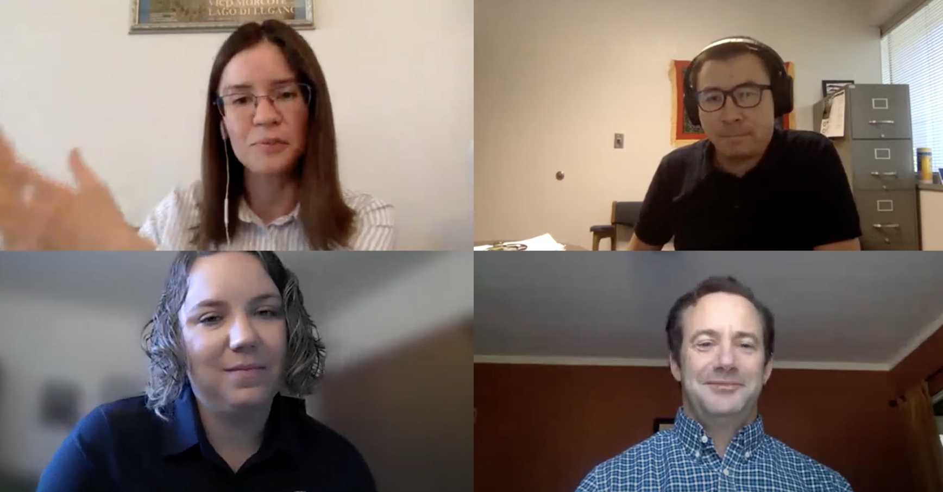





California Panel at National Workshop 2020-22
2020 - First Panel
2021 - Summary of efforts at UC CSU CCC
2022 - Learning Lab and CID Chair
Notes:
Balaji

Slide 42

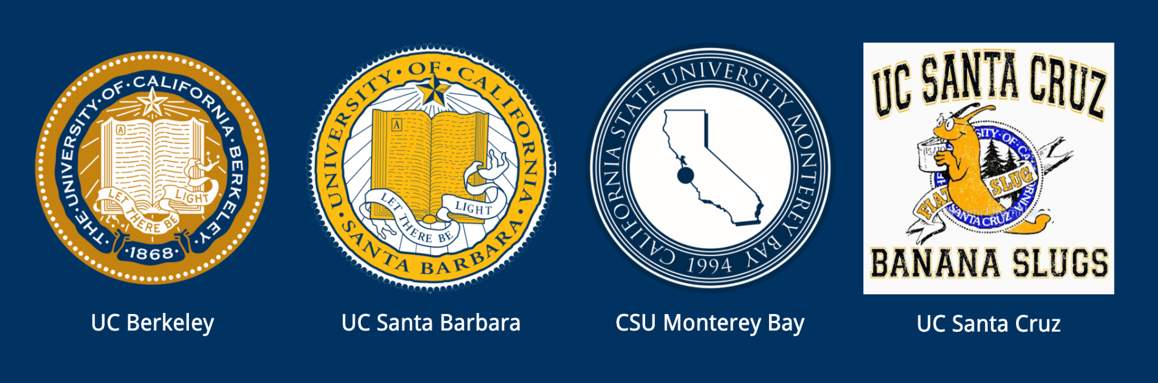



An advisory group from a diverse coalition of academic institutions.
16 California Institutions
6 UCs, 5 CSUs, 4 CCCs, 1 Private Institution
Quarterly Board Meetings
Key Topics Discussed
Articulation efforts
( eg Katia at CCSF )
Key Classes for Transfers
DS Major Requirements and Pathways
Notes:
Meets Quarterly

Slide 43
Collaborative Vision
Streamlining Data Science Education across California
Coordination - DS Efforts across institutions
Creating the first California-wide public survey of UC, CSUs and CCCs DS Programs
Gaining support from UCOP CSUCO and CCCO
Linkages for NSF (HDR) proposals
Process - Aiding the Transfer and Articulation process for CCCs
Organized a Community of Practice Workshop
Facilitating articulation for pilot institutions
Fundamentals of Data Science requirements
Mathematics background requirements
UC Office of the President - articulation coordination
Support - Infrastructure and Curriculum
Creating resources/training for Intro to Data Science adoption
Cloud pilot partnership with 2i2c.org and Cloudbank

Slide 44

2021-2022 Progress Summary:
CADSE Website
UC, CSU, CCC Summary of Data Science Programs
Mathematics background requirements for Intro. to Data Science
Fundamentals of Data Science requirements
Intro To Stats Project: Beginning Database of CSU Intro To Stats Courses
A few of our 2021 milestones:
February 2021 meeting 149 attendees from 65 institutions across California
Participated in the CMC^3 and ADSA Conferences (December)
Microsoft and CADSE’s Faculty Residency Program Completed
Held a CCC Instructors Community of Practice Workshop (October)
February 2022 meeting (February)
CSU-Wide Workshop (April)

Slide 45
Let’s work together
data.berkeley.edu/californiaalliance
data.berkeley.edu/2024workshop
ds-help@berkeley.edu
ericvd@berkeley.edu

Slide 46
Working towards a UC Transfer Pathway
UC Campus | Degree | Department | 1st Year Calculus | Multivar Calculus | CS1 - Intro to Computing | CS2 - Data Struct | Lin Algebra and/or Disc Math | Fndns of Data Science | Intro Stats class
UC San Diego | Data Science, B.S. | Halicioglu Data Science Institute | Math 20A 20B | Math 20C | DSC 20 | DSC 30 | Math 18 | DSC 10
UC Berkeley | Data Science, B.A. | Division of Computing, Data Science, and Society | Math 1A 1B |  | CS 61A | CS 61B | Math 54 | Data 8
UC Irvine | Data Science, B.S. | Bren School of Information & Computer Sciences | Math 2A 2B | Math 2D | ICS 31 32 33 | ICS 46 | Math 3A |  | Stat 7
UC Riverside | Data Science, B.S. | Bourns College of Engineering, College of Natural and Ag Sciences | Math 9A 9B 9C | Math 10A | CS 10A CS 10B | CS 10C | Math 31 - LA CS 11 - DS
UC Santa Barbara | Data Science and Statistics BS Data Science and Statistics BA | Department of Statistics and Applied Probability | Math 2A 2B |  | CS 8 CS 9 |  |  | DS1 | PSTAT 8 / PSTAT 10
Not all are required - many are recommended - or chose 3 of 5 etc

Slide 47
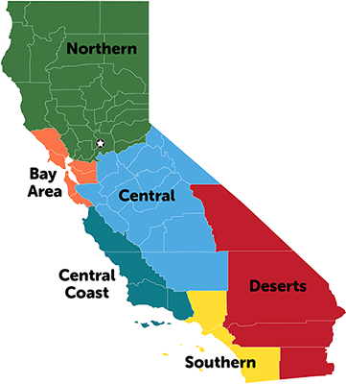
UC Berkeley Transfer Students
in DS Major (2021-22)
~200 Declared majors
~50-100 intending
75 incoming transfers
1
1
53 responses in a survey of 135 transfer students in the DS major
32
Which Community College did you transfer from?
LA
6
13

Slide 48
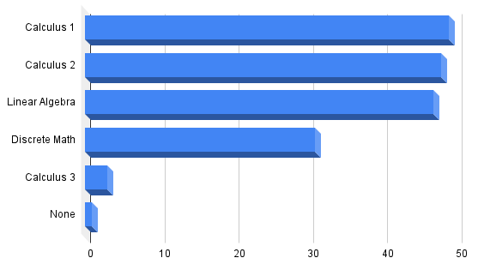
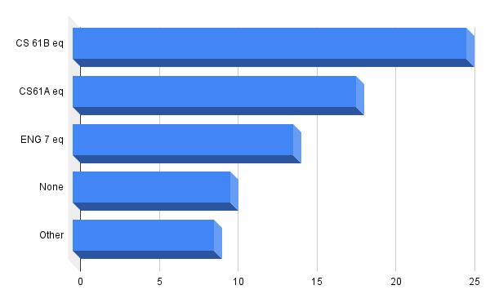
Math and CS/Engineering Classes Taken
Notes:
Some had 2 or more

Slide 49
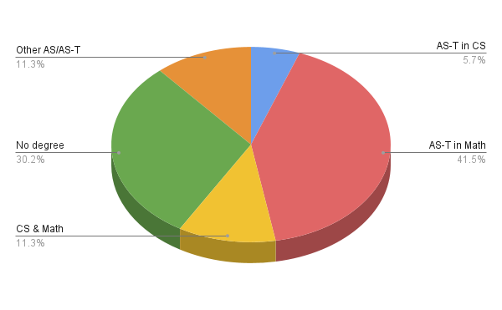
Did you transfer with a Transfer Degree?
More than 40% of respondents have transferred with a AS-T degree in Math
Some had 2+ degrees at the time of transfer

Slide 50
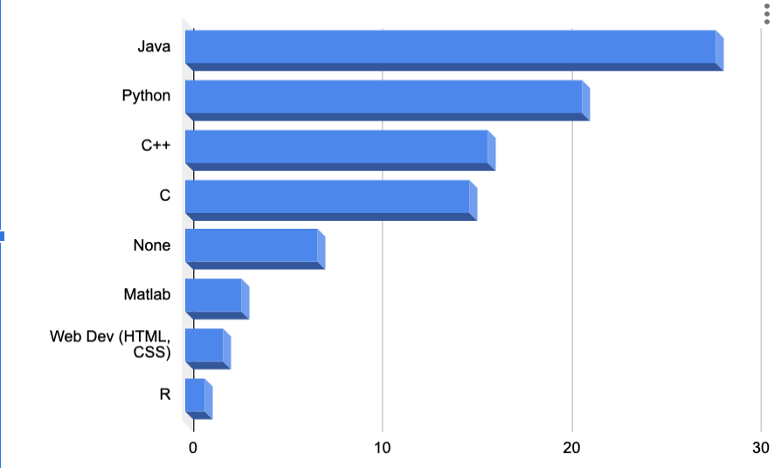
Familiarity with a programming language (if any)
Both Python & Java (studied in DS at UC Berkeley) were the most popular
Some had familiarity with 2 or more before transferring to UC Berkeley

Slide 51
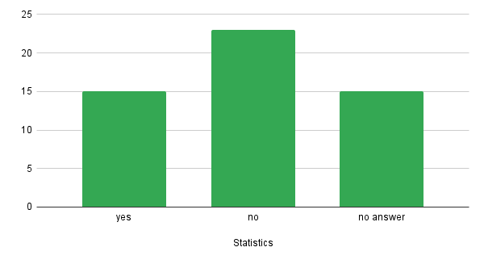
Have taken Statistics prior to the Transfer

Slide 52
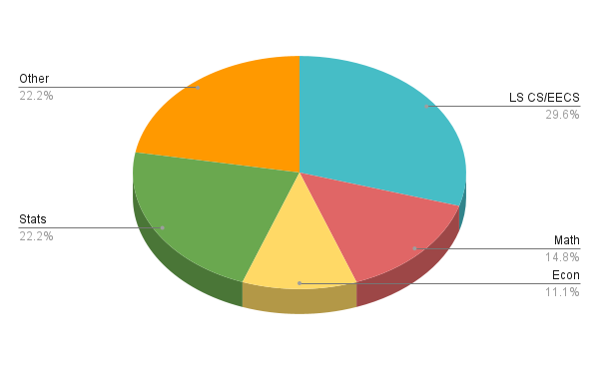
Intended major at the time of transfer (if not DS)

Slide 53
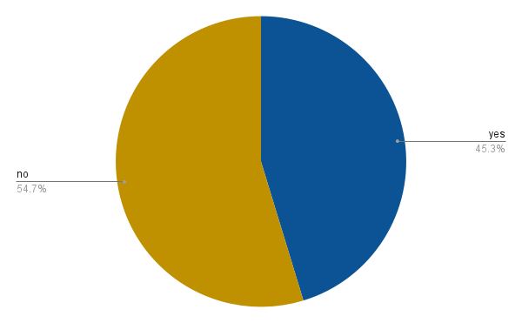
Did you know about Data Science before transferring to UC Berkeley?

Slide 54
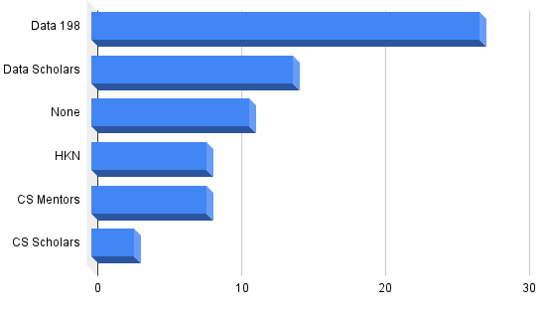
Support Programs at UC Berkeley
- transfer students have taken advantage of:
*Data 198 is a transfer success class
~30% get support from 2 or more of the organizations/classes listed here
Notes:
Thanks to Anara Myrzabekova, Vivrd Prasanna, and Kseniya Usovich as well as the DS advisors for helping us with the survey

Slide 55
Data 8 Course
Detailed Overview

Slide 56
Course Design

Slide 57
Computational Thinking
Use computation to automate repeated tasks & learn how repetition is useful for reasoning and inference.
Applying a function to many values
Iteration for repeated sampling
The effective use of modules (libraries) and objects
np.mean(nba.where(“height”, are.above(80)).column(“salary”))
nba.where(“height”, are.above(80)).select(“salary”).hist()

Slide 58
Computational Thinking
Use computation to automate repeated tasks & learn how repetition is useful for reasoning and inference.
Applying a function to many values
Iteration for repeated sampling
The effective use of modules (libraries) and objects
Keep the programming simple, let the data motivate, and provide lots of opportunity for practice toward mastery.
Supported by Jupyter notebooks, the datascience module, and automated feedback in all assignments.

Slide 59
Inferential Thinking
Visualize, then quantify:
Description & Visualization: Many questions can be answered with a carefully crafted picture.
Chance, models, hypotheses, inference: The primary tool for inference is to draw new samples and see the difference. Sampling variability is expected and visible.
Correlation, prediction, classification: Simple techniques with a strong emphasis on interpretation.
Throughout, precise conclusions stated in plain English.

Slide 60
Teaching with Real Data
Arrays, tables, visualizations, inference, regression, and classification can all be introduced with real-world data sets.
The human context and ethics of data become a natural focus when examples use real-world datasets.
How were data collected and why?
What information is lost due to data collection decisions?
Associations between geography and race in the U.S.

Slide 61
Content Highlights

Slide 62
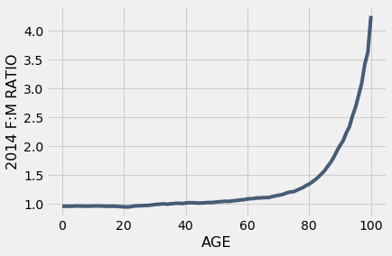
Table Manipulation
Relational operations: select columns, filter rows, sort, group, join, and perform arithmetic on columns of data

Slide 63
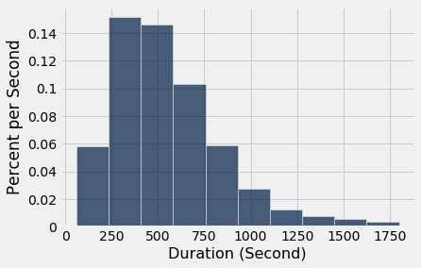
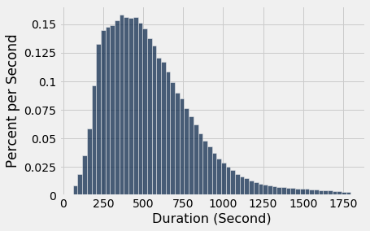
Histograms
Transition from measuring counts to density: allows for bins of different sizes and prepares for future probability courses.

Slide 64
Distributions
Probability content is intentionally limited:
Focus on uniform random sampling from finite populations.
Partitioning and addition, intersections and conditioning, & Bayes’ theorem including a discussion about base rates.
The normal curve, variability of sample means, & the Central Limit Theorem.
No formal treatment of random variables or distribution families other than the normal.

Slide 65
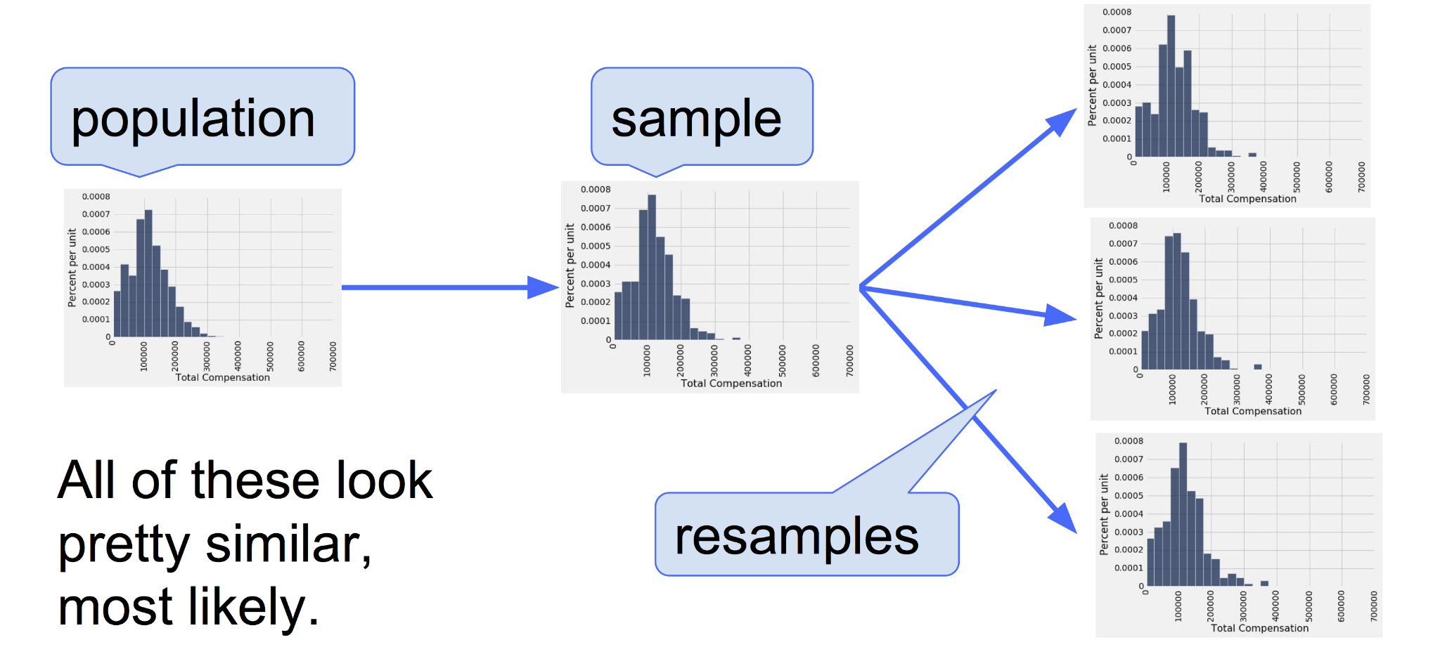
Confidence Intervals
Begins with the observation that empirical distribution of a large random sample typically resembles the distribution of the population from which the sample is drawn.

Slide 66
Linear Regression
The treatment of linear regression in Data 8 echoes the presentation of Statistics by Freedman, Pisani, and Purves.
Correlation as a descriptive statistic.
Properties of the regression line and the assumptions required to use it for prediction; the regression effect.
Equations: least-squares; non-linear regression.
Diagnostics and properties of residuals.

Slide 67
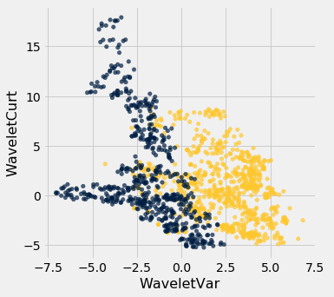
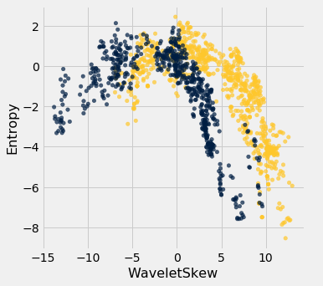
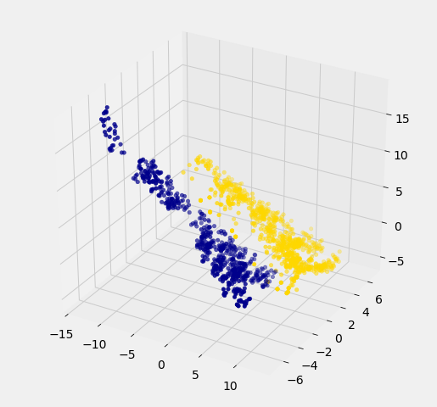
Classification
When (one day) our students learn about a vast array of machine learning techniques and how to implement them, we want them to correctly interpret the result of their work.

