Slide 1






Sustainability
Problems Monterey 2023
Sara Jones
Santa Rosa Junior College

Slide 2
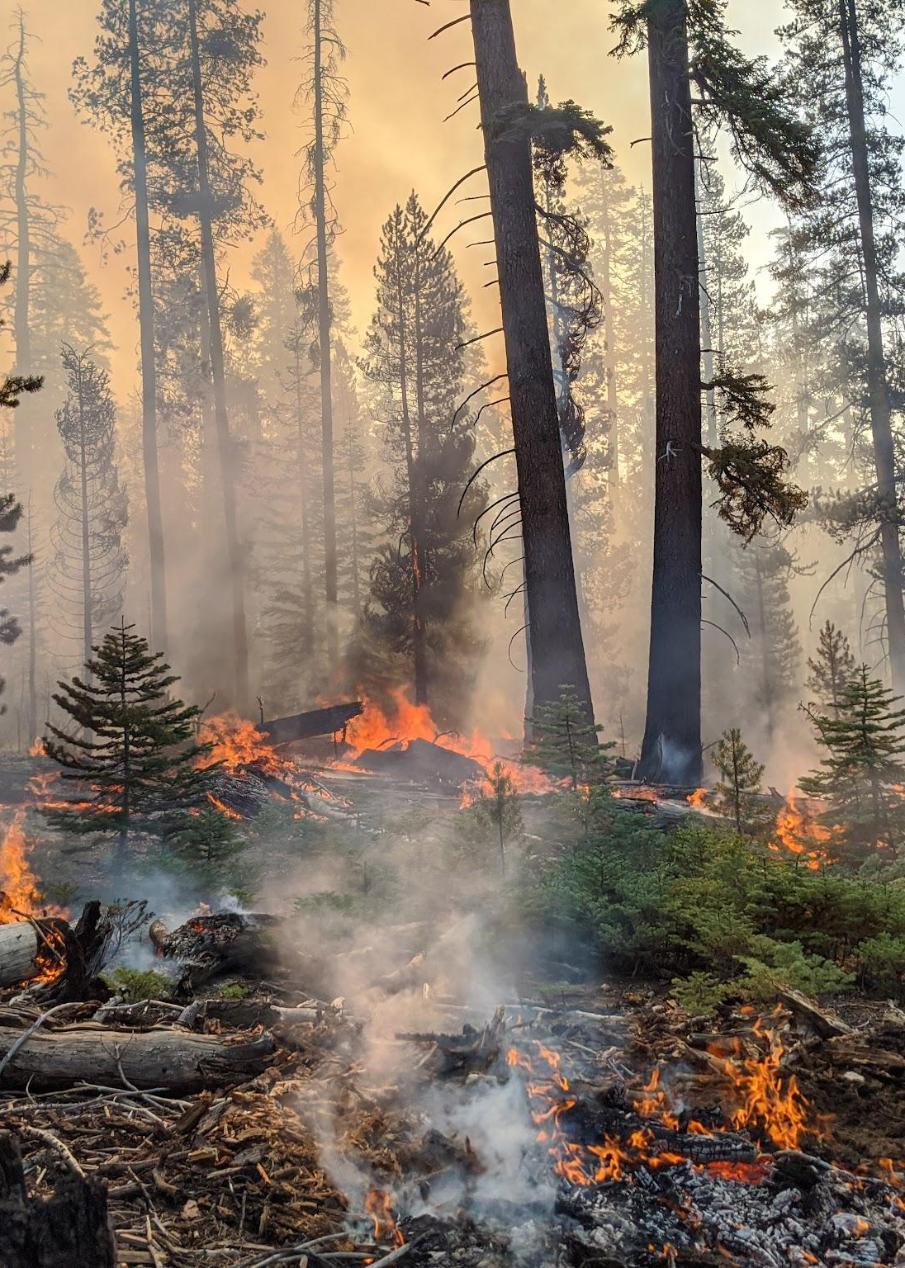
The Global Picture
The world is going to have between 1.5 and 2℃ of warming
Environmental degradation and drought is causing escalating conflicts in Asia, Africa, and the Middle East
Solar is the cheapest form of energy generation

Slide 3
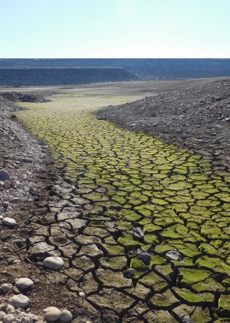


The State of California
California is the world’s breadbasket and agriculture is a significant driver of the state economy
California is a leader in addressing climate change
California has the most to lose
Senate Bill 32 requires California to reduce its emissions to 40% below 1990 levels by 2030
Senate Bill 350 requires 100% of the state’s electricity be from carbon-free sources by 20

Slide 4
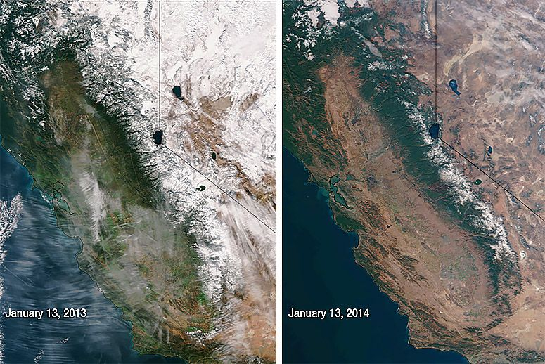

Slide 5
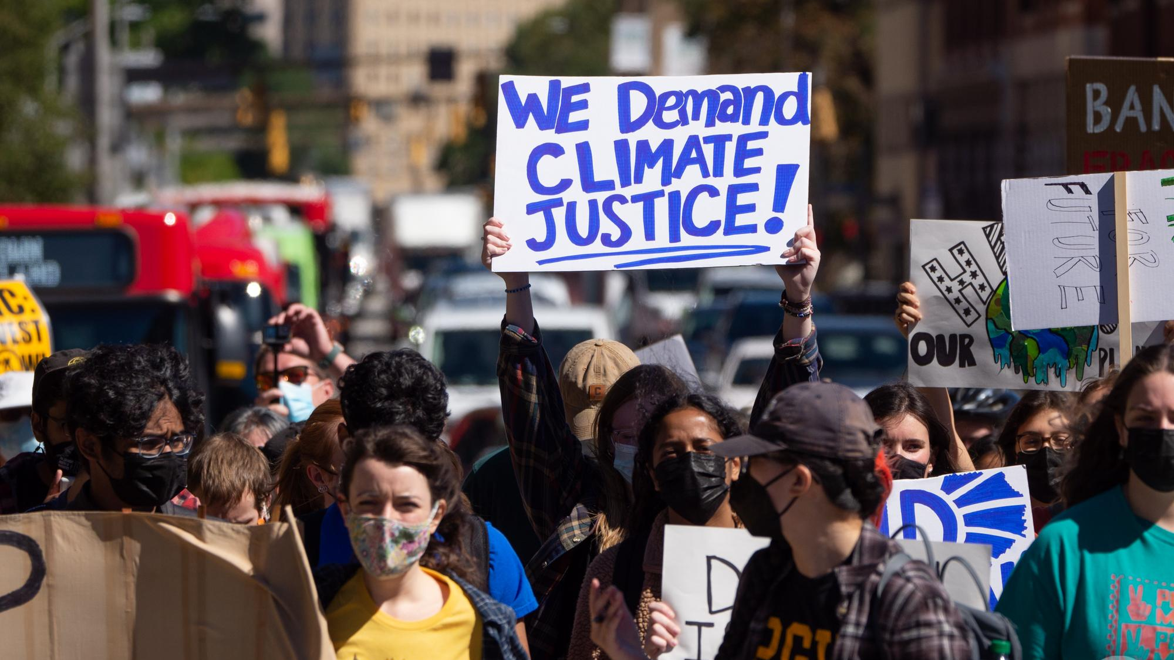
The Sonoma County Picture
Sonoma County is experiencing the adverse effects of climate change first hand.
2 major wildfires and 1 large flood in between is exactly the projected drought-flood cycle of a changing climate
SRJC has an active sustainability committee with extensive student engagement

Slide 6

Goals: Five Spheres
01
02
03
Education & Culture
Economics & Equity
Transportation & Access
10% of all courses offered at SRJC Sustainability Flagged by 2030
Update board policies with sustainability goals and sustainability purchasing
Ban on sale of single use plastics & a climate resolution
Create department of sustainability or office of sustainability
Divestment of SRJC Foundation Endowment from fossil fuel assets
Increase student bike ridership to 10% for majority of commutes by 2030 + Bike Bridge
Support and expand Any Lane Any Time, SMART EcoPass, SRJC Carpool Pass, and Clipper Baypass

Slide 7
Goals: Five Spheres
04
03
Carbon, Energy, Waste, Water, Facilities, & Grounds
(Built Environment)
Civic & Community Engagement
Continue to showcase SRJC leadership at sustainability events and conference across Sonoma County and California
Zero Net Energy District by 2030
Carbon Neutral Operations by 2030 (Scope 2)
Carbon Neutrality by 2040 (Scope 3)
Zero Net Non-Potable Water by 2030

Slide 8
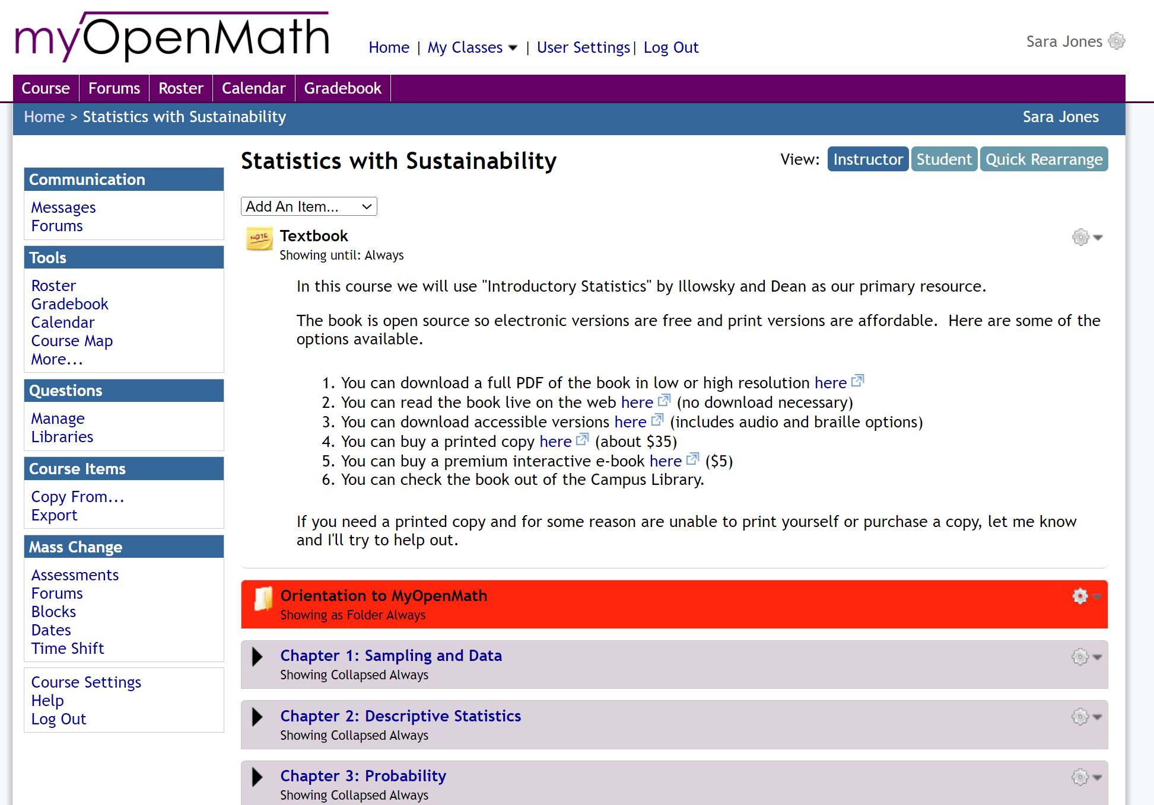
MyOpenMath Statistics with Sustainability
“I like the sustainability part of the course because it shows how the stats can be applicable and could help motivate more people
to be more eco friendly.”

Slide 9

Statistics with Sustainability
The Goal
Use sustainability issues and climate change to engage students in the standard statistics topics covered in Introductory Statistics
Features Include:
1. Early inference
2. Sustainability problems in every section
3. Video Lessons using TI-84 calculator and StatCrunch
4. Lecture notes to print and fill (Kimberley Polly)
5. Questions that test analysis and understanding of inference

Slide 10
MyOpenMath Templates
Videos and lecture notes from Kimberley Polly
Book: “Introductory Statistics” by Illowsky and Dean
Used problems by:
Cindy Moss | Adam Gilbert | Gregg Harbaugh
Larry Green | Jessica Kuang | David Lippman
Tophe Anderson | Kimberley Polly | Mitchell Barnett
Urszula Szpila | Alison Mastny | Darlene Diaz
Shadisadat Ghaderi | Lawrence Morales | Joshua Emmanuel
Maxine Francisco | Tuyetdong Phan-Yamada | Many more…
The course template was created by Larry Green (Lake Tahoe Community College), Cindy Moss (Skyline College), and Jessica Kuang (Oxnard College) and is licensed under a Creative Commons Attribution 4.0 International License

Slide 11
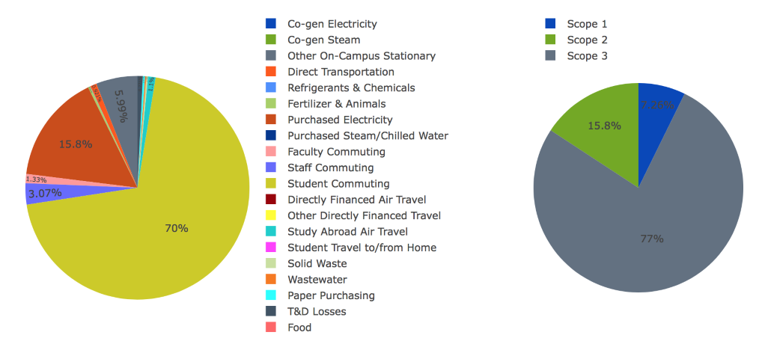
SRJC’s Carbon Footprint Baseline
Transportation and Buildings
Student commuting
Purchased electricity
Climate Action Plan being drafted → includes Adaptation & Carbon Sequestration and mitigation strategies
Carbon 2017

Slide 12

Transportation Project No. 1
Descriptive Statistics

Slide 13
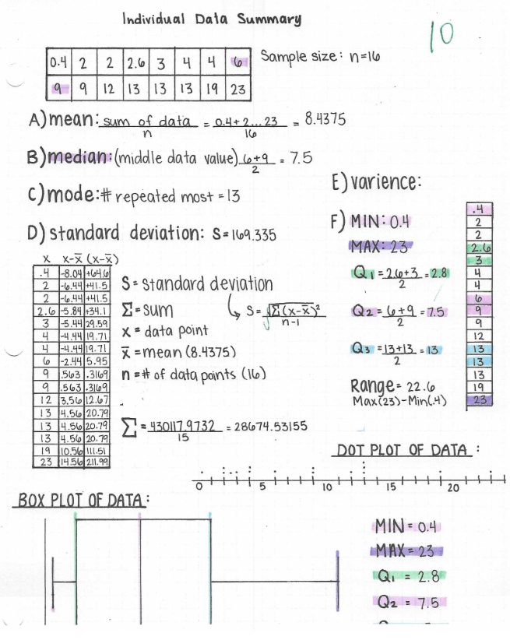
Data Collection
Collect 16 distance-to- school data values

Slide 14
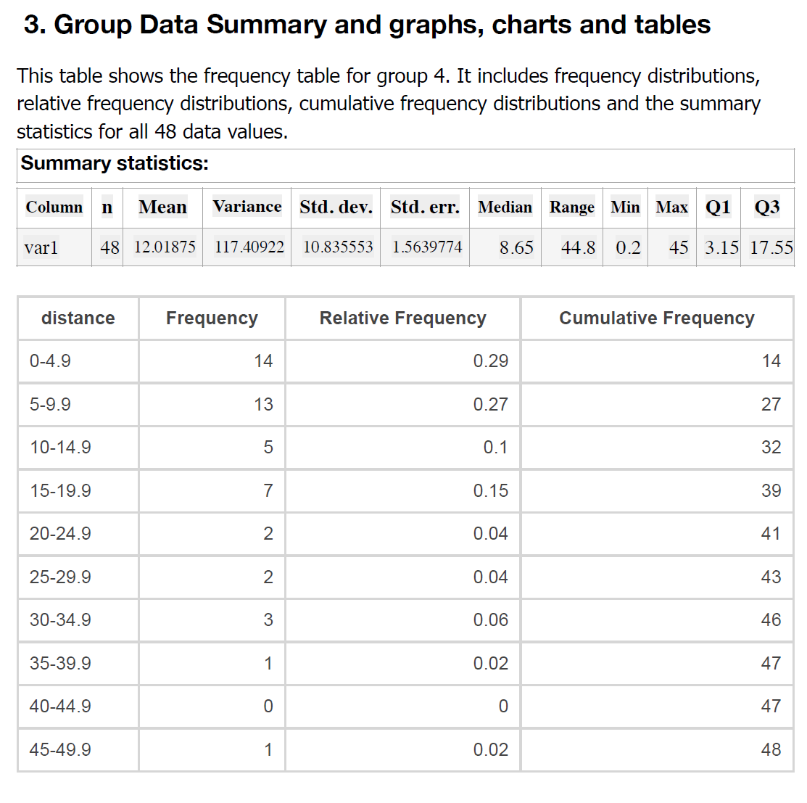
Data Summary
Group data summary

Slide 15
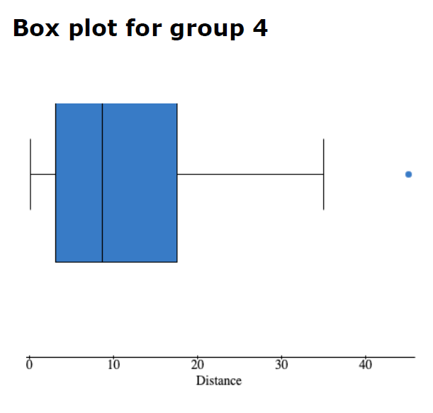
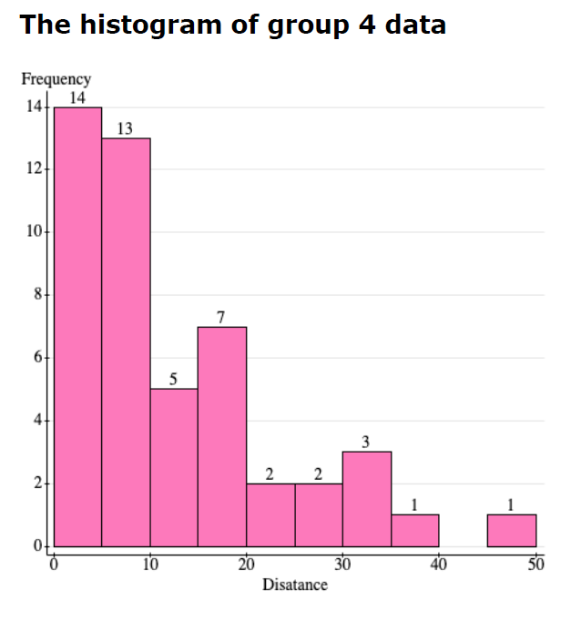
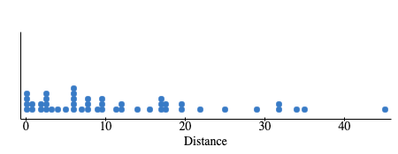
Graphs

Slide 16
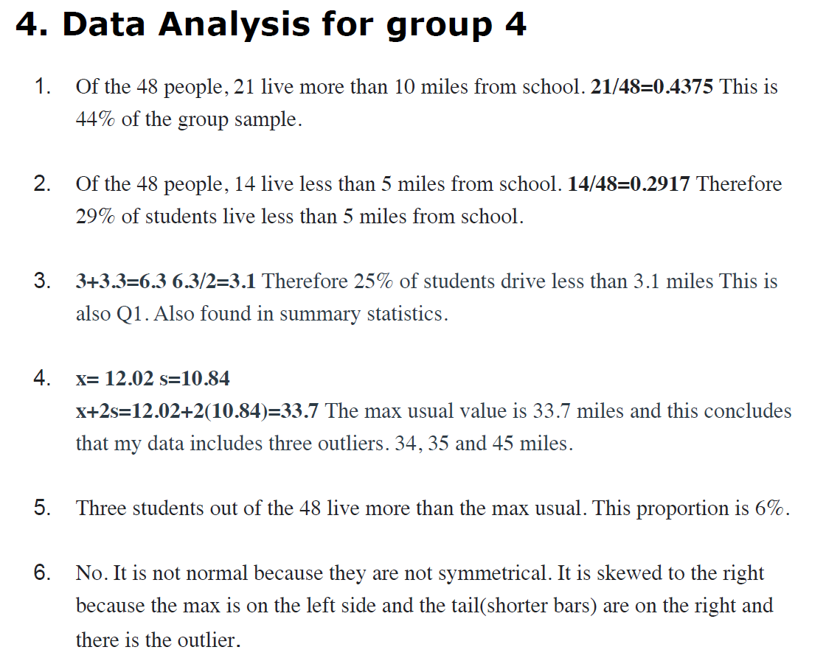
Analysis

Slide 17
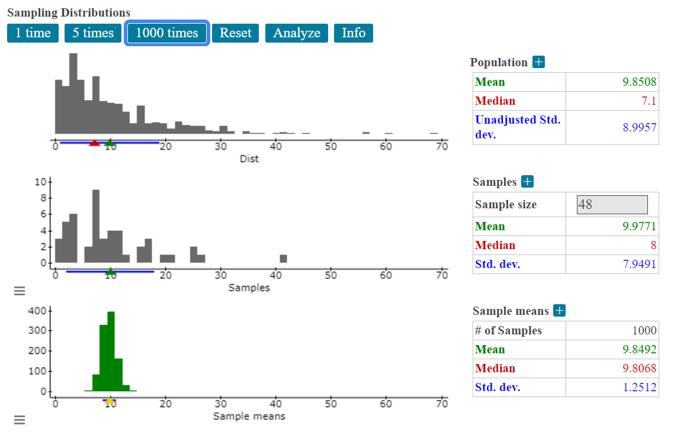
Central Limit Theorem
Sampling distributions for the mean

Slide 18
MyOpenMath Statistics
Air Quality Index (AQI) Scores
Purple Air

Slide 19
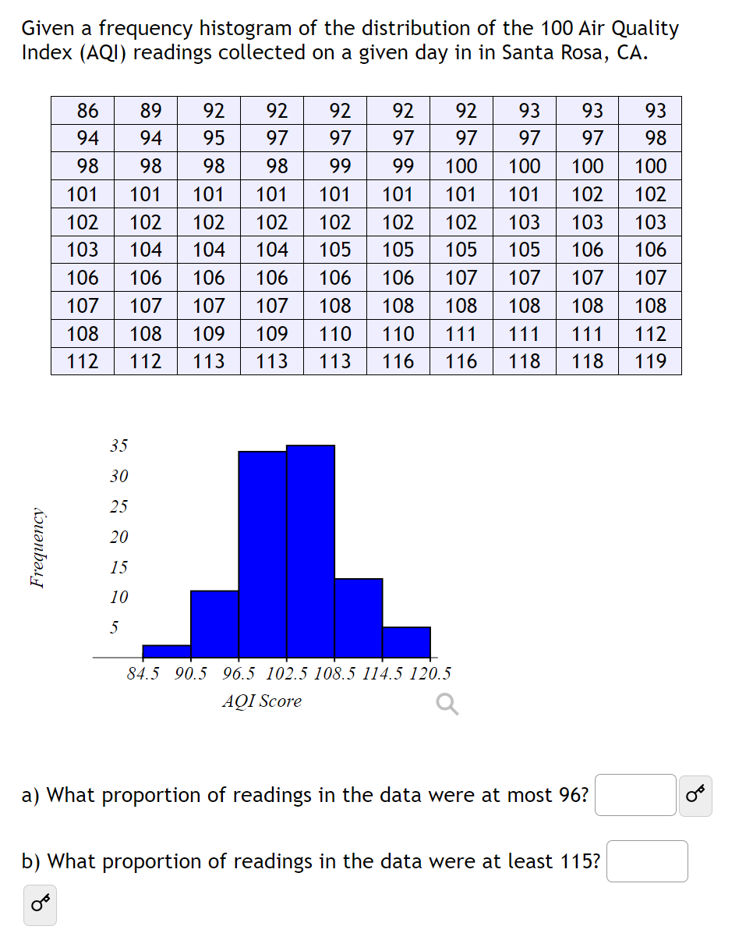
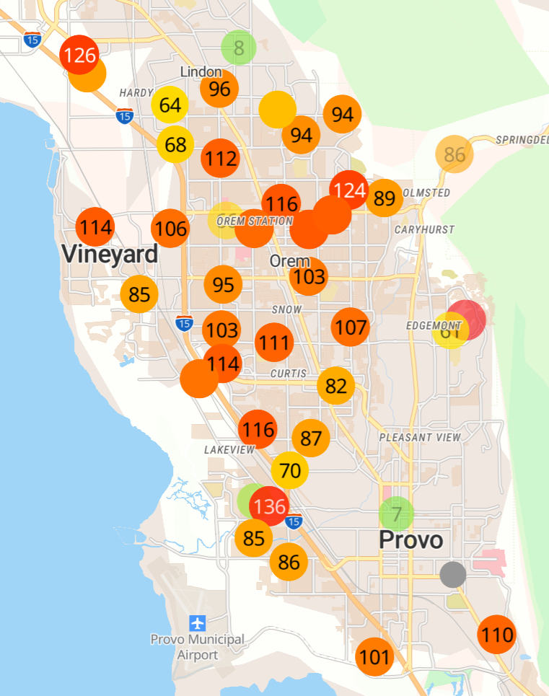

Slide 20
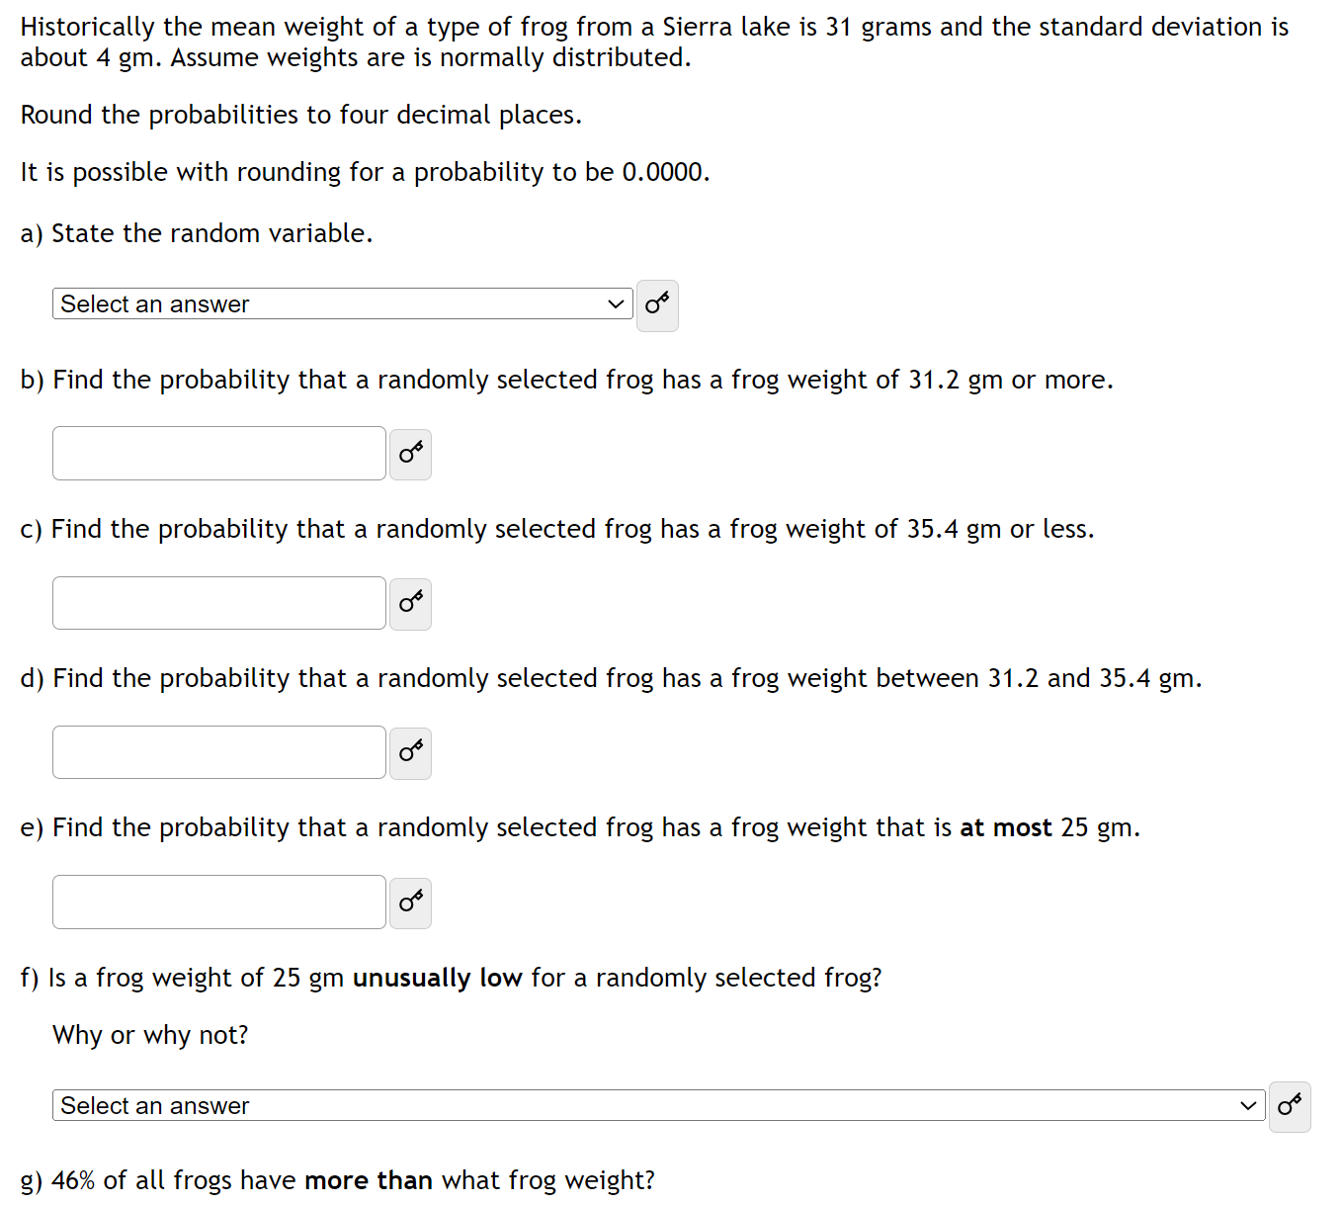
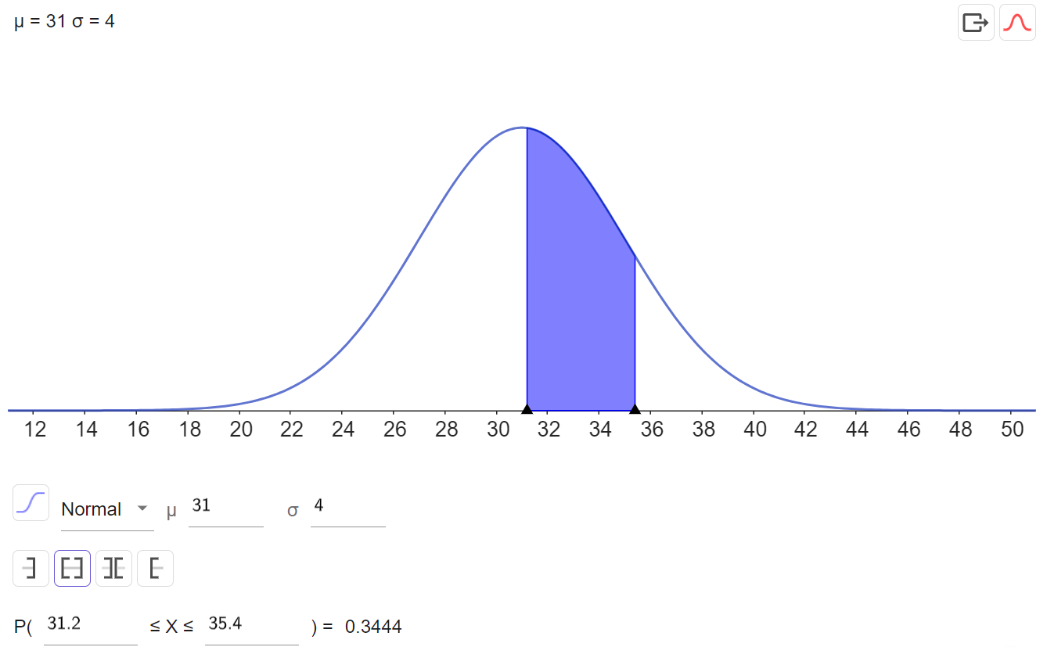
Normal Distributions

Slide 21
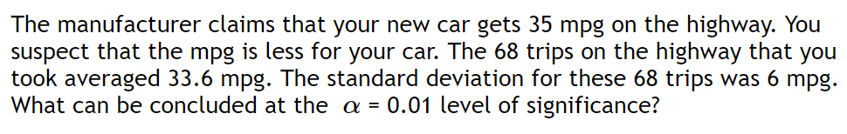
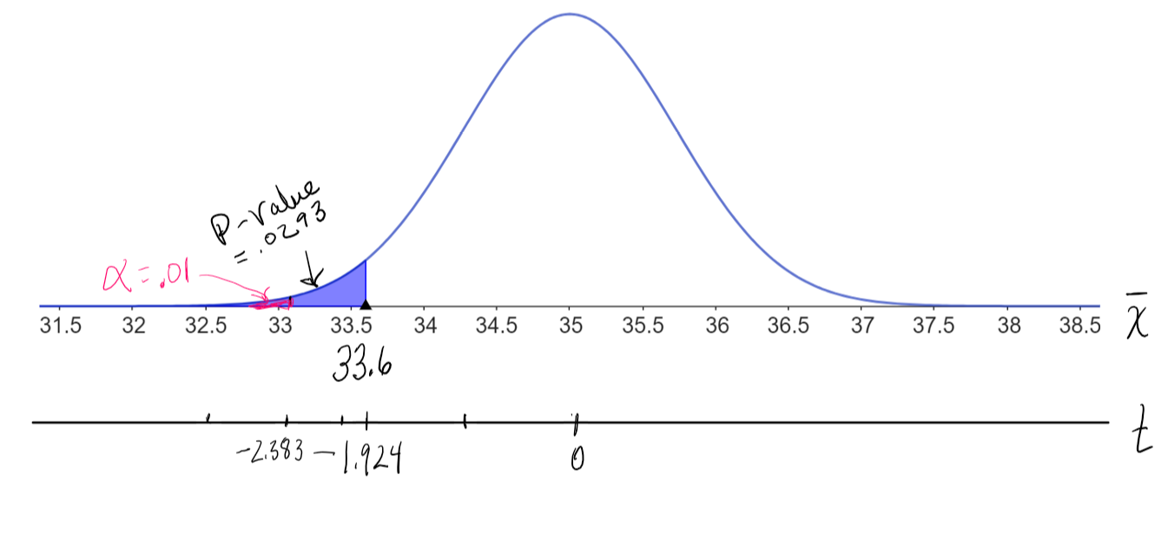
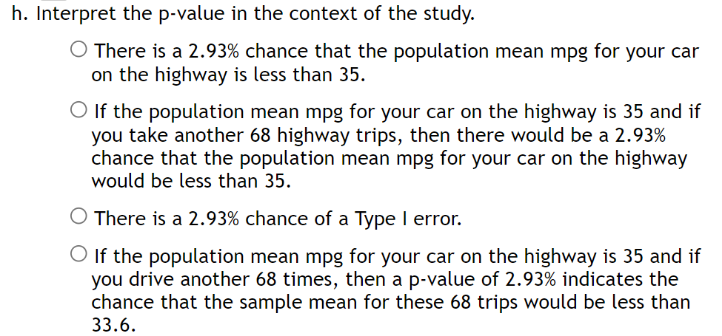
Hypothesis Testing
P-value interpretation

Slide 22
Project No. 2
Textbook Question

Slide 23
Textbook Question
1. Make up a textbook question for which the summary statistics will give two proportions. See examples below. In the end you may use one of these or you may use one of your own, but everyone should make up an example other than the ones listed.
Do you use a reusable coffee cup?
Do you print two sided?
How do you use sustainable transportation like walking, riding, or taking the bus to get to work or school?
Does the customer use reusable grocery bags?
Will your next car be electric?
2. Your Question
Determine which question you want to ask about and two populations to compare for your question. You will be collecting data. Pick something that will work for you. You will need at least 30 people/observations for each of your populations and 10 successes and 10 failures for each question.

Slide 24
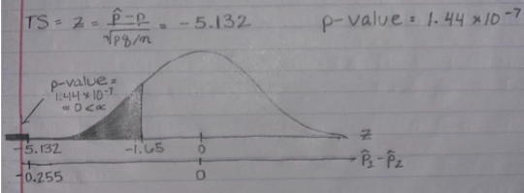
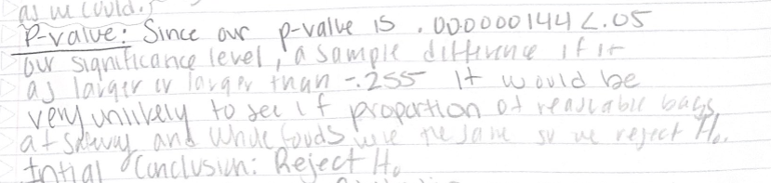
Reusable Bags
Safeway vs. Whole Foods
Student handwritten p-value meaning sentences
Handwritten model curves for hypothesis testing.

Slide 25
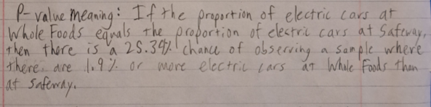
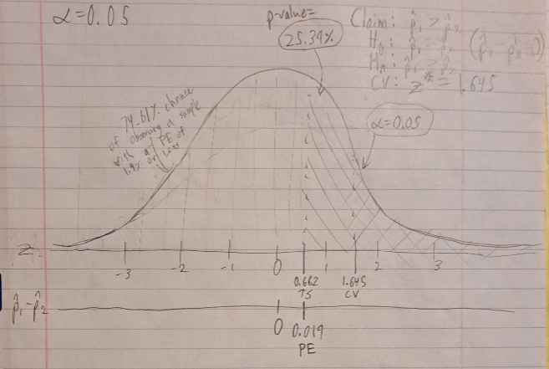
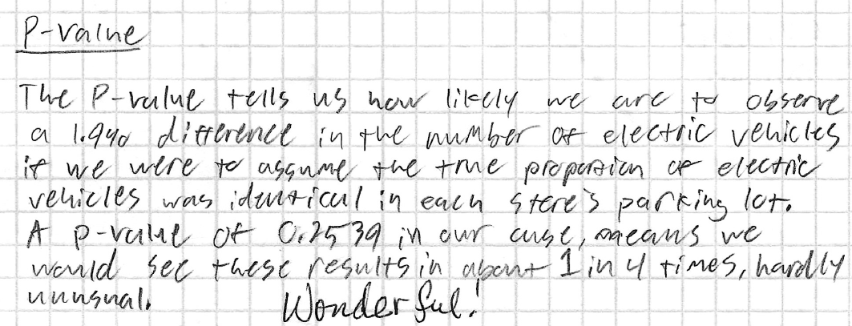
Understanding the Meaning of a P-Value

Slide 26
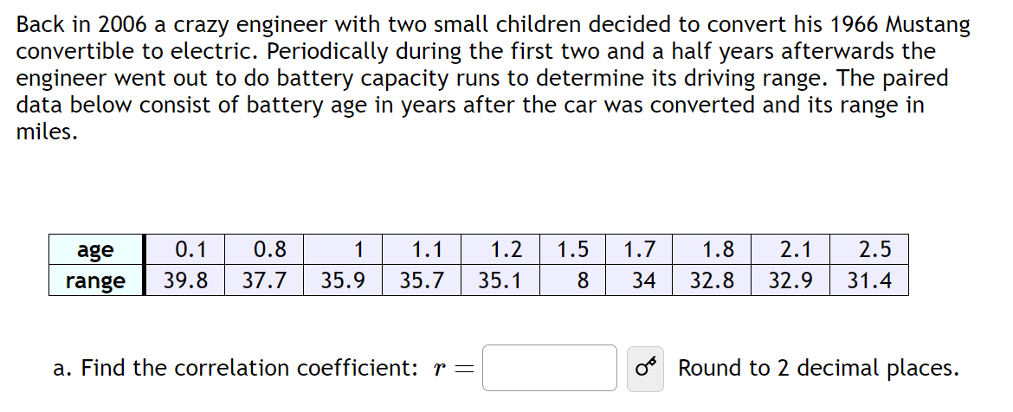
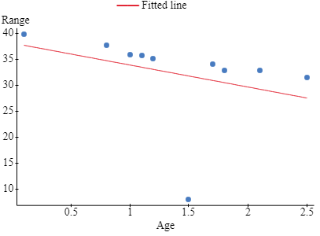
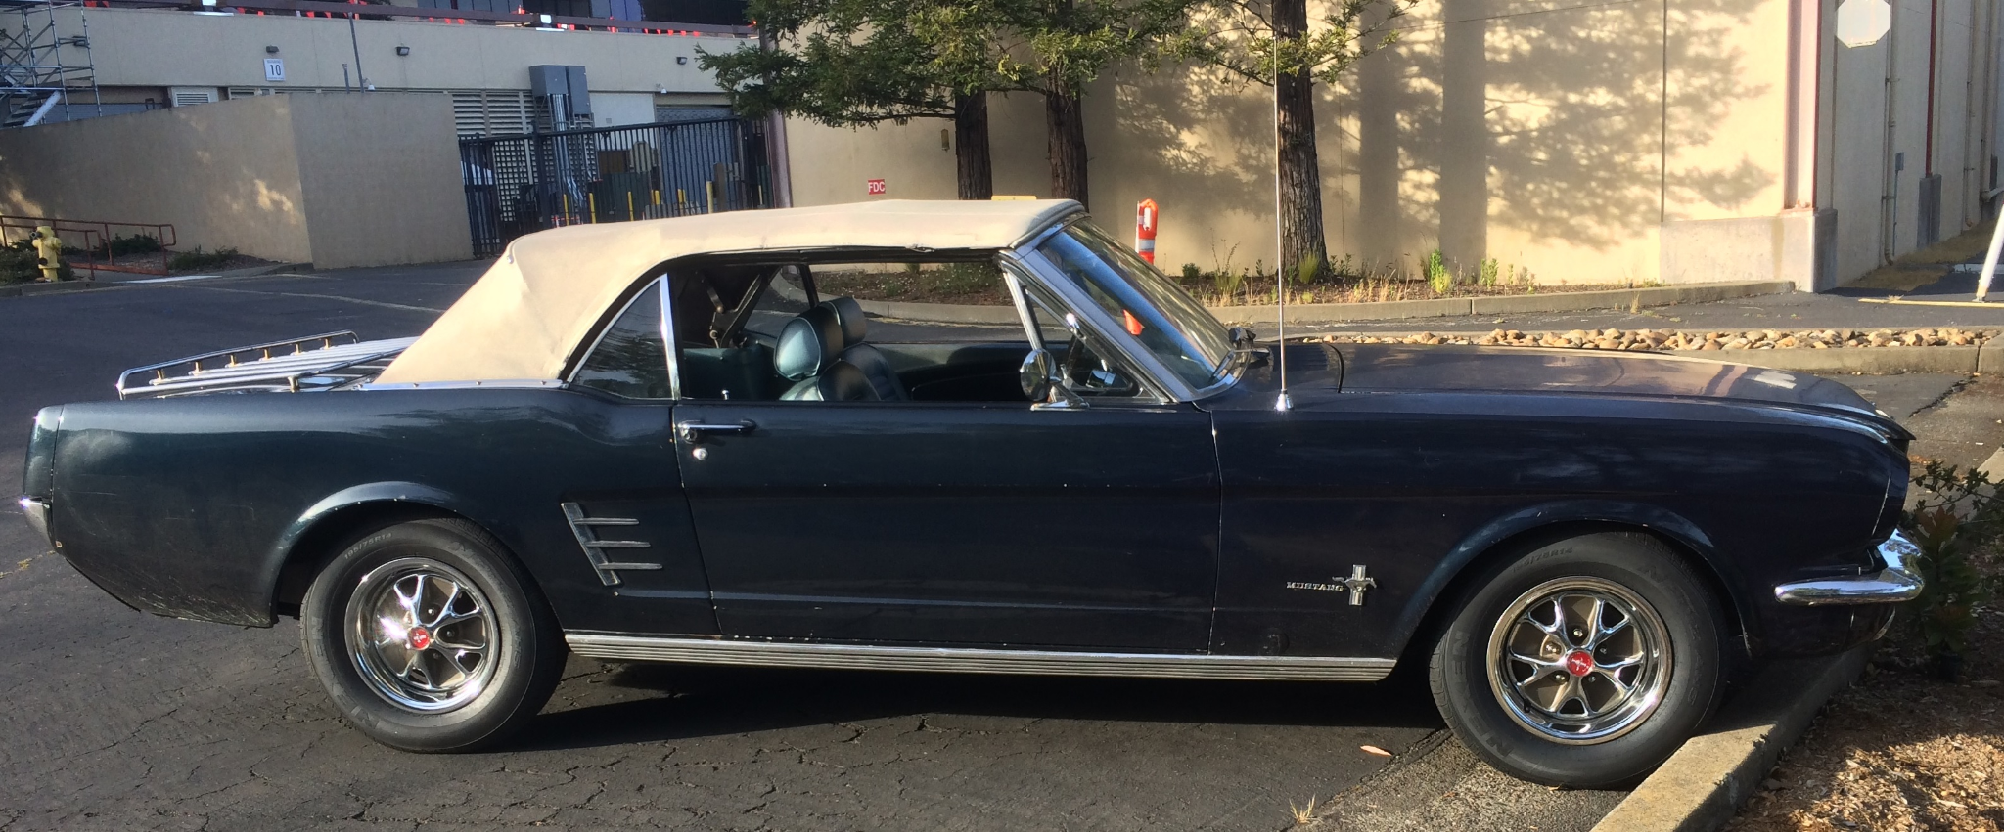
Correlation and Linear Regression

Slide 27
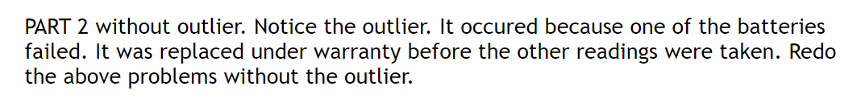
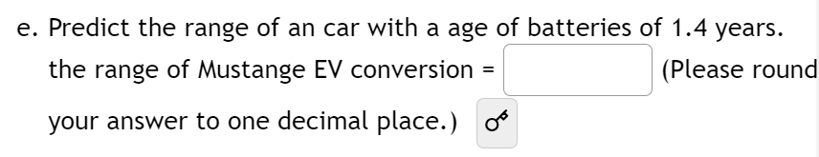
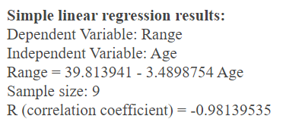
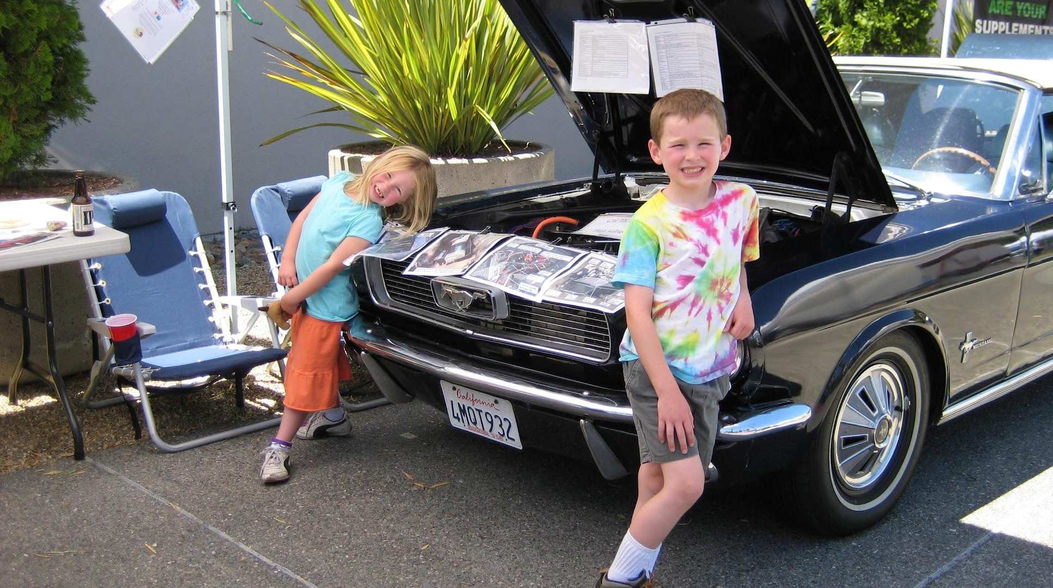

Slide 28
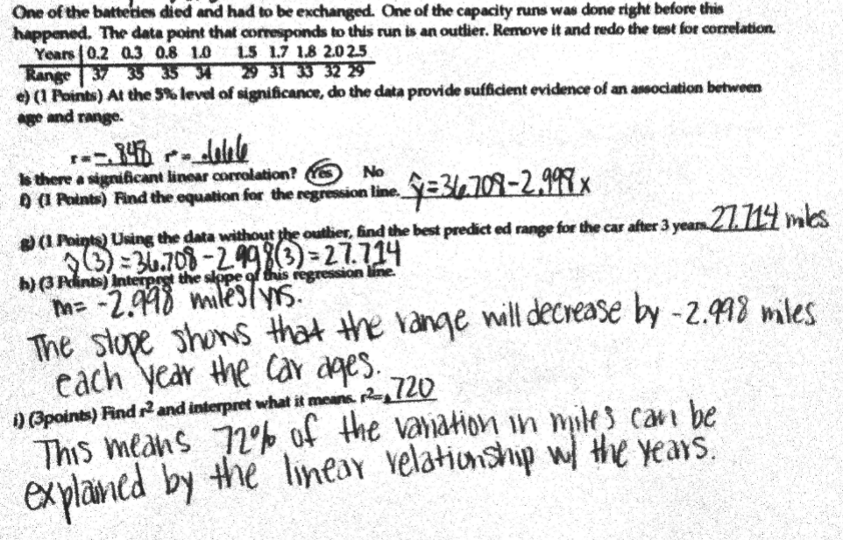

Slide 29
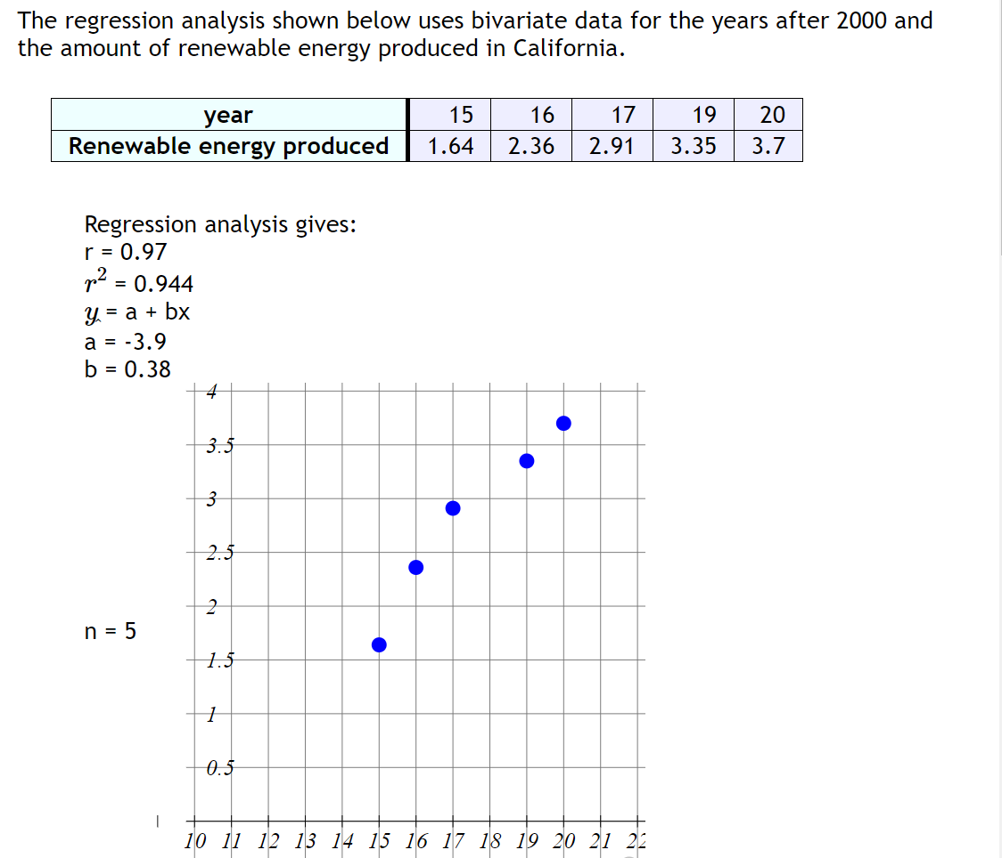
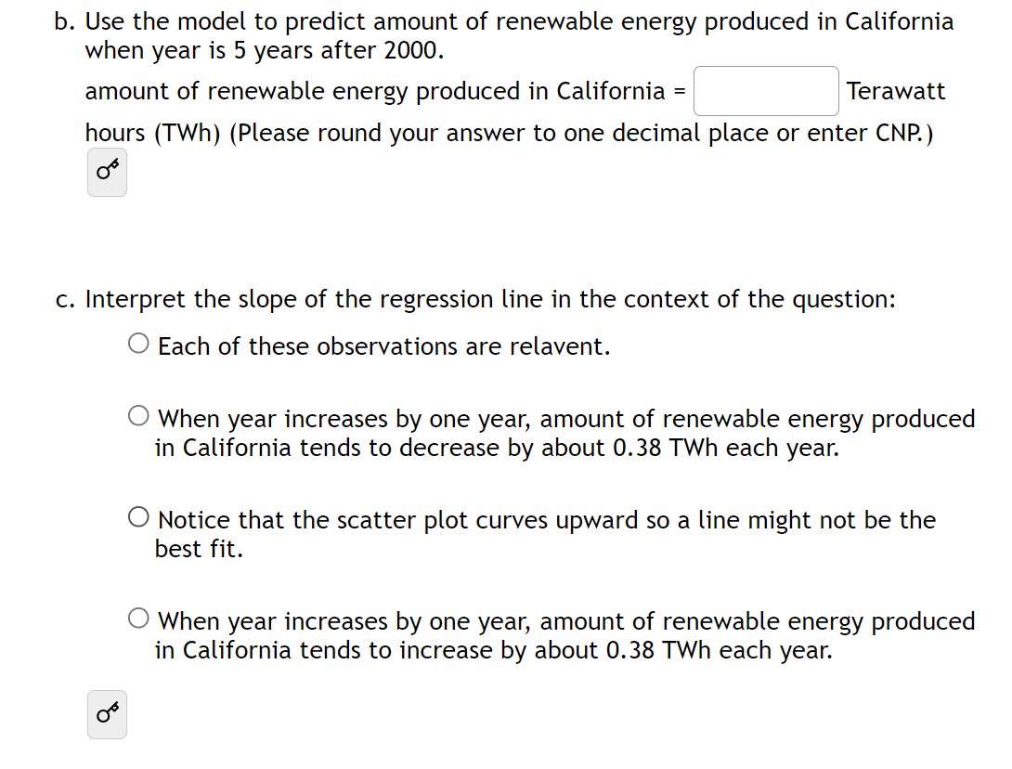
Correlation and Linear Regression

Slide 30
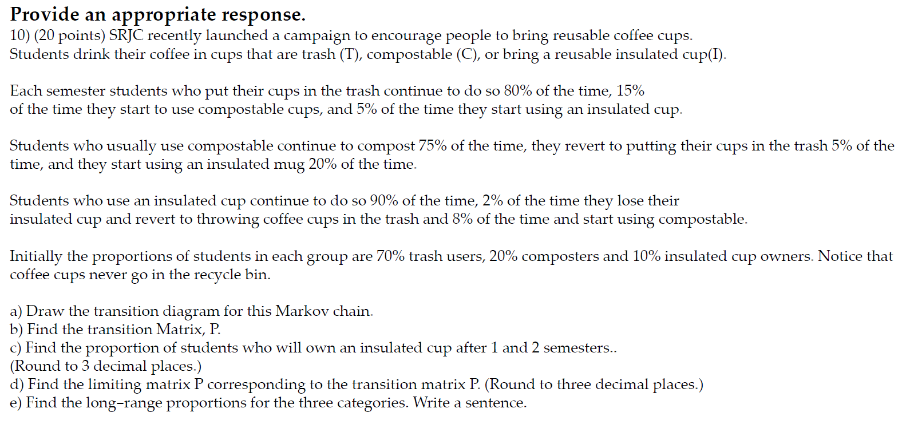
Finite Math and Linear Algebra
Markov Chains

Slide 31
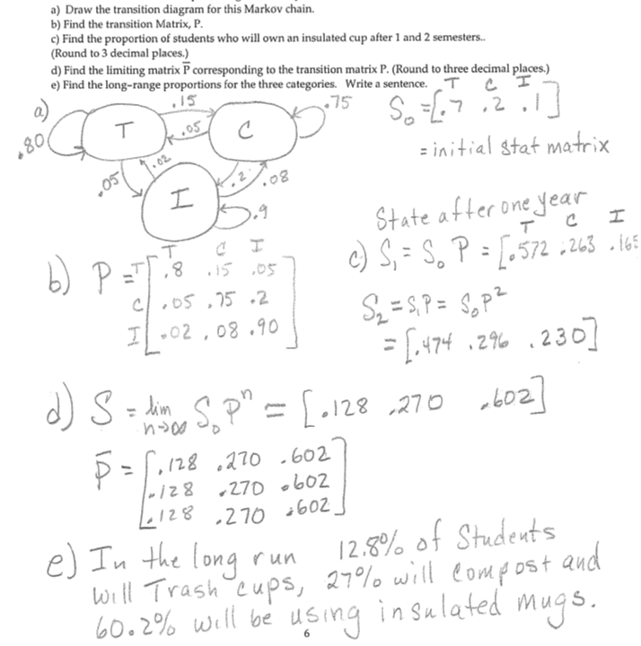
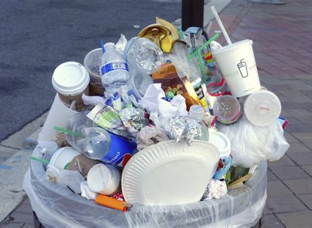
Coffee Cups

Slide 32
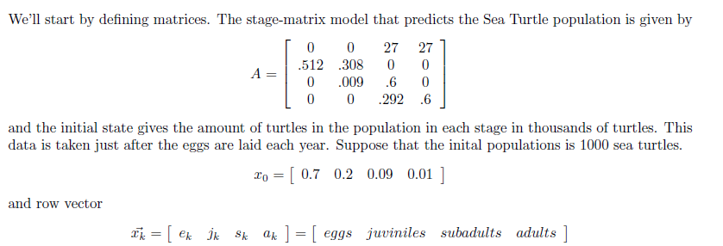
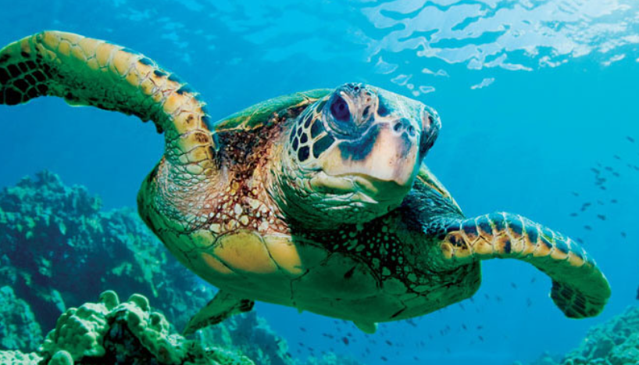
Sea Turtles

Slide 33

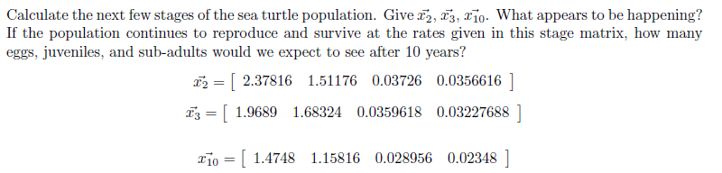
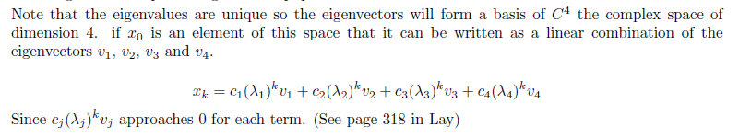
What happens if this reproduction cycle continues?

Slide 34
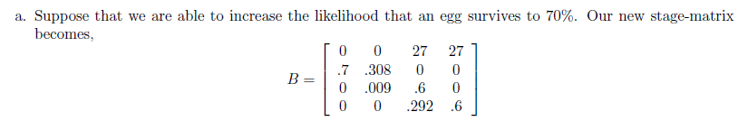
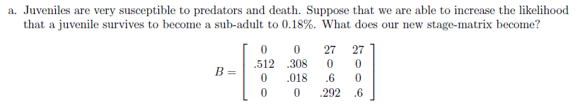
Use Sage to calculate eigenvalues

Slide 35
BREAKOUT
Breakout into groups based on courses
Statistics, Linear Algebra, Calculus

Slide 36
BREAKOUT QUESTIONS
Community
Inclusion
What should our larger community be doing?
Would you be willing to include sustainability in your class?
Ideas
Brainstorm
What ideas can you see yourself including in your course?
Do you have any ideas of your own for sustainability-related math questions?

Slide 37
Thank You
Do you have any questions?
Come talk to me after the talk!
Or shoot me an email at:
sjones@santarosa.edu
Please keep this slide for attribution

