Slide 1

Alliance of
Math Circles
Indigenous
Donna Fernandez, M.Ed
National Board Certified Teacher of Mathematics
Co-Director of AIMC/Piner High School
aimathcircles.org

Slide 2
PLAY A GAME.
ADDITION NIM
Start at 0.
First player adds 1, 2, 3 or 4 and passes the total to player 2
Player 2 adds 1, 2, 3, or 4 to the total then passes the total back to player 1.
Whoever reaches 20 wins.

Slide 3
DINÉ NUMBERS
0 - názbąs
1 – tʼááłáʼí
2 – naaki
3 – tááʼ
4 – dį́į́ʼ
5 – ashdlaʼ
6 – hastą́ą́
7 – tsostsʼid
8 – tseebíí
9 – náhástʼéí
10 – neeznáá
11 – łáʼtsʼáadah
12 – naakitsʼáadah
13 – tááʼtsʼáadah
14 – dį́į́ʼtsʼáadah
15 – ashdlaʼáadah
16 – hastą́ʼáadah
17 – tsostsʼidtsʼáadah
18 – tseebíítsʼáadah
19 – náhástʼéítsʼáadah
20 – naadiin
01
Don’t know how to speak Diné, this website has the recordings of the numbers.
Indigenius Games

Slide 4
Alliance of Indigenous
Mission
Math Circles
The mission of the Alliance of Indigenous Math Circles (AIMC) is to create mathematical opportunities for Indigenous students and to build community among math teachers of Indigenous students while respecting Indigenous culture.
Vision
Our vision is to increase by an order of magnitude the number of Indigenous students who choose to pursue post-secondary STEM degrees.

Slide 5
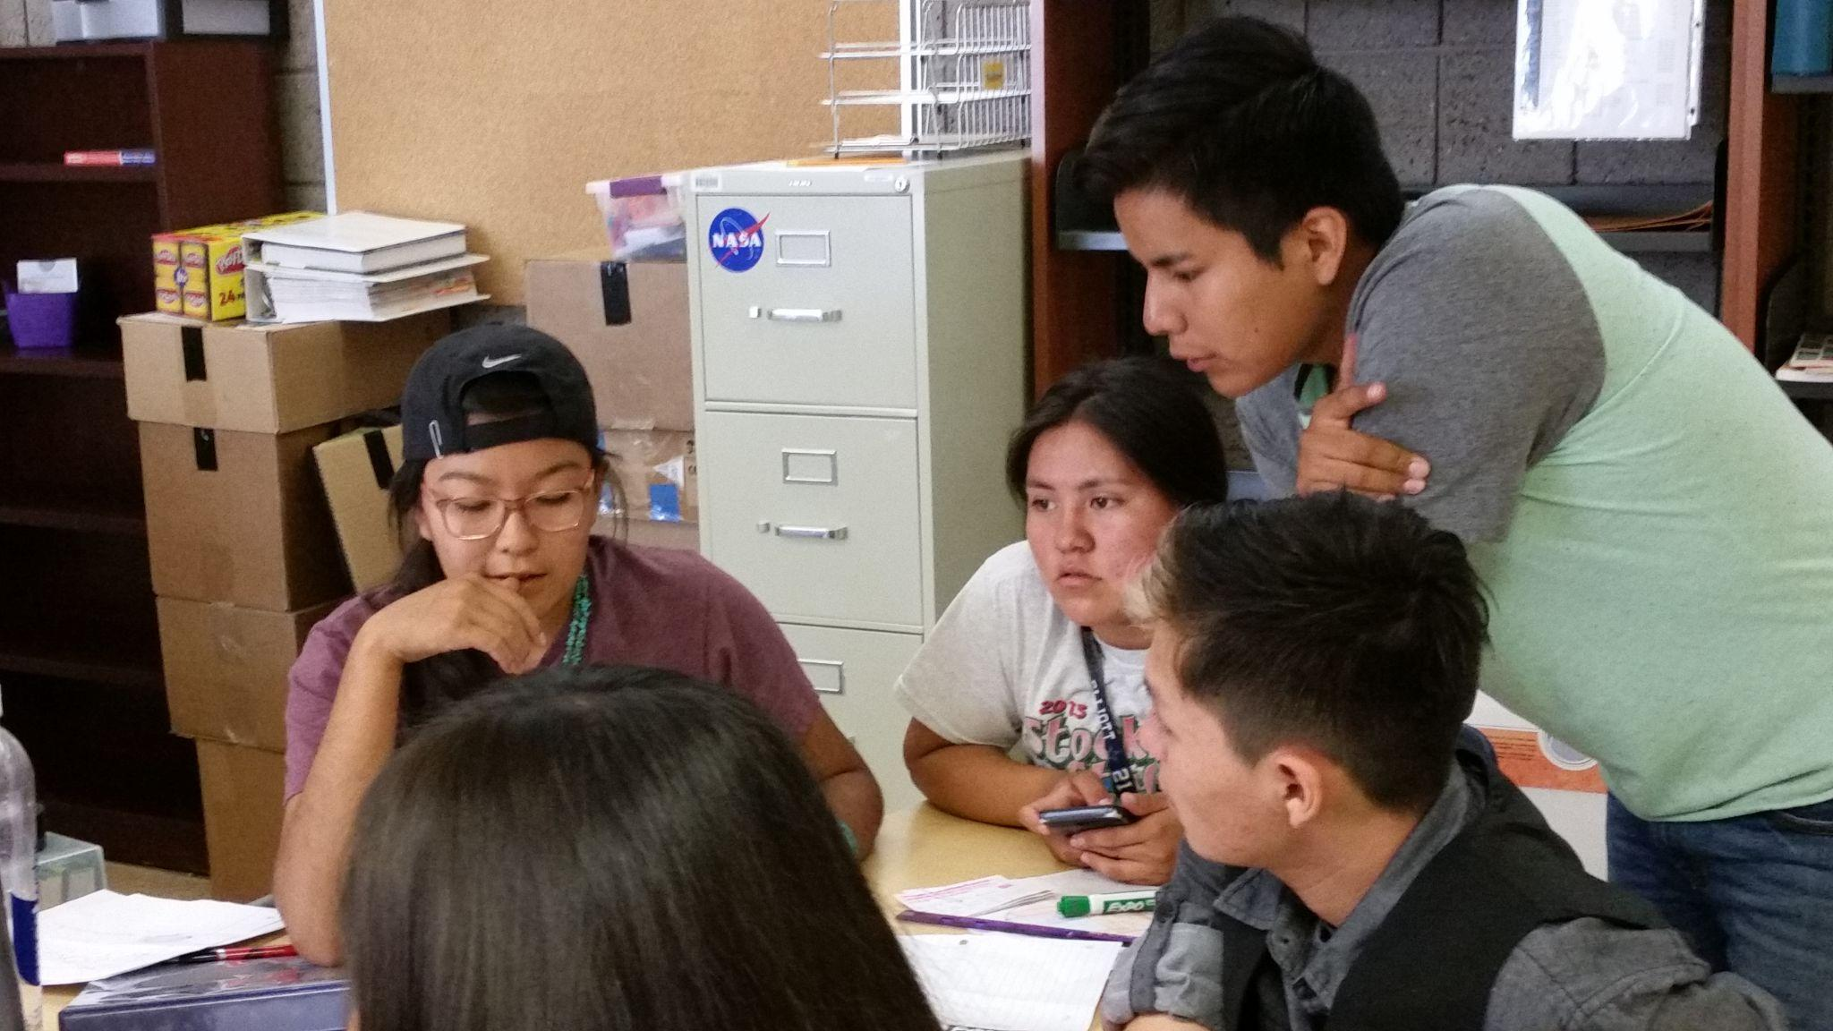
Systemic barriers to
indigenous students' success:
Indigenous people are underrepresented in STEM disciplines and especially in mathematics.
Notes:
Replace picture with students in AIMC

Slide 6
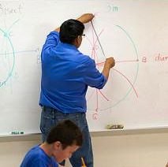
Mathematics, like music and poetry, is the birthright of every human, and mathematical talent is spread uniformly among all people. Thus, underrepresentation suggests that Indigenous students’ talents remain unrealized because of reasons beyond their control, and not because of a lack of capacity or interest. Moreover, indigenous people will bring their unique view point and thus will enhance and expand the professions.

Slide 7
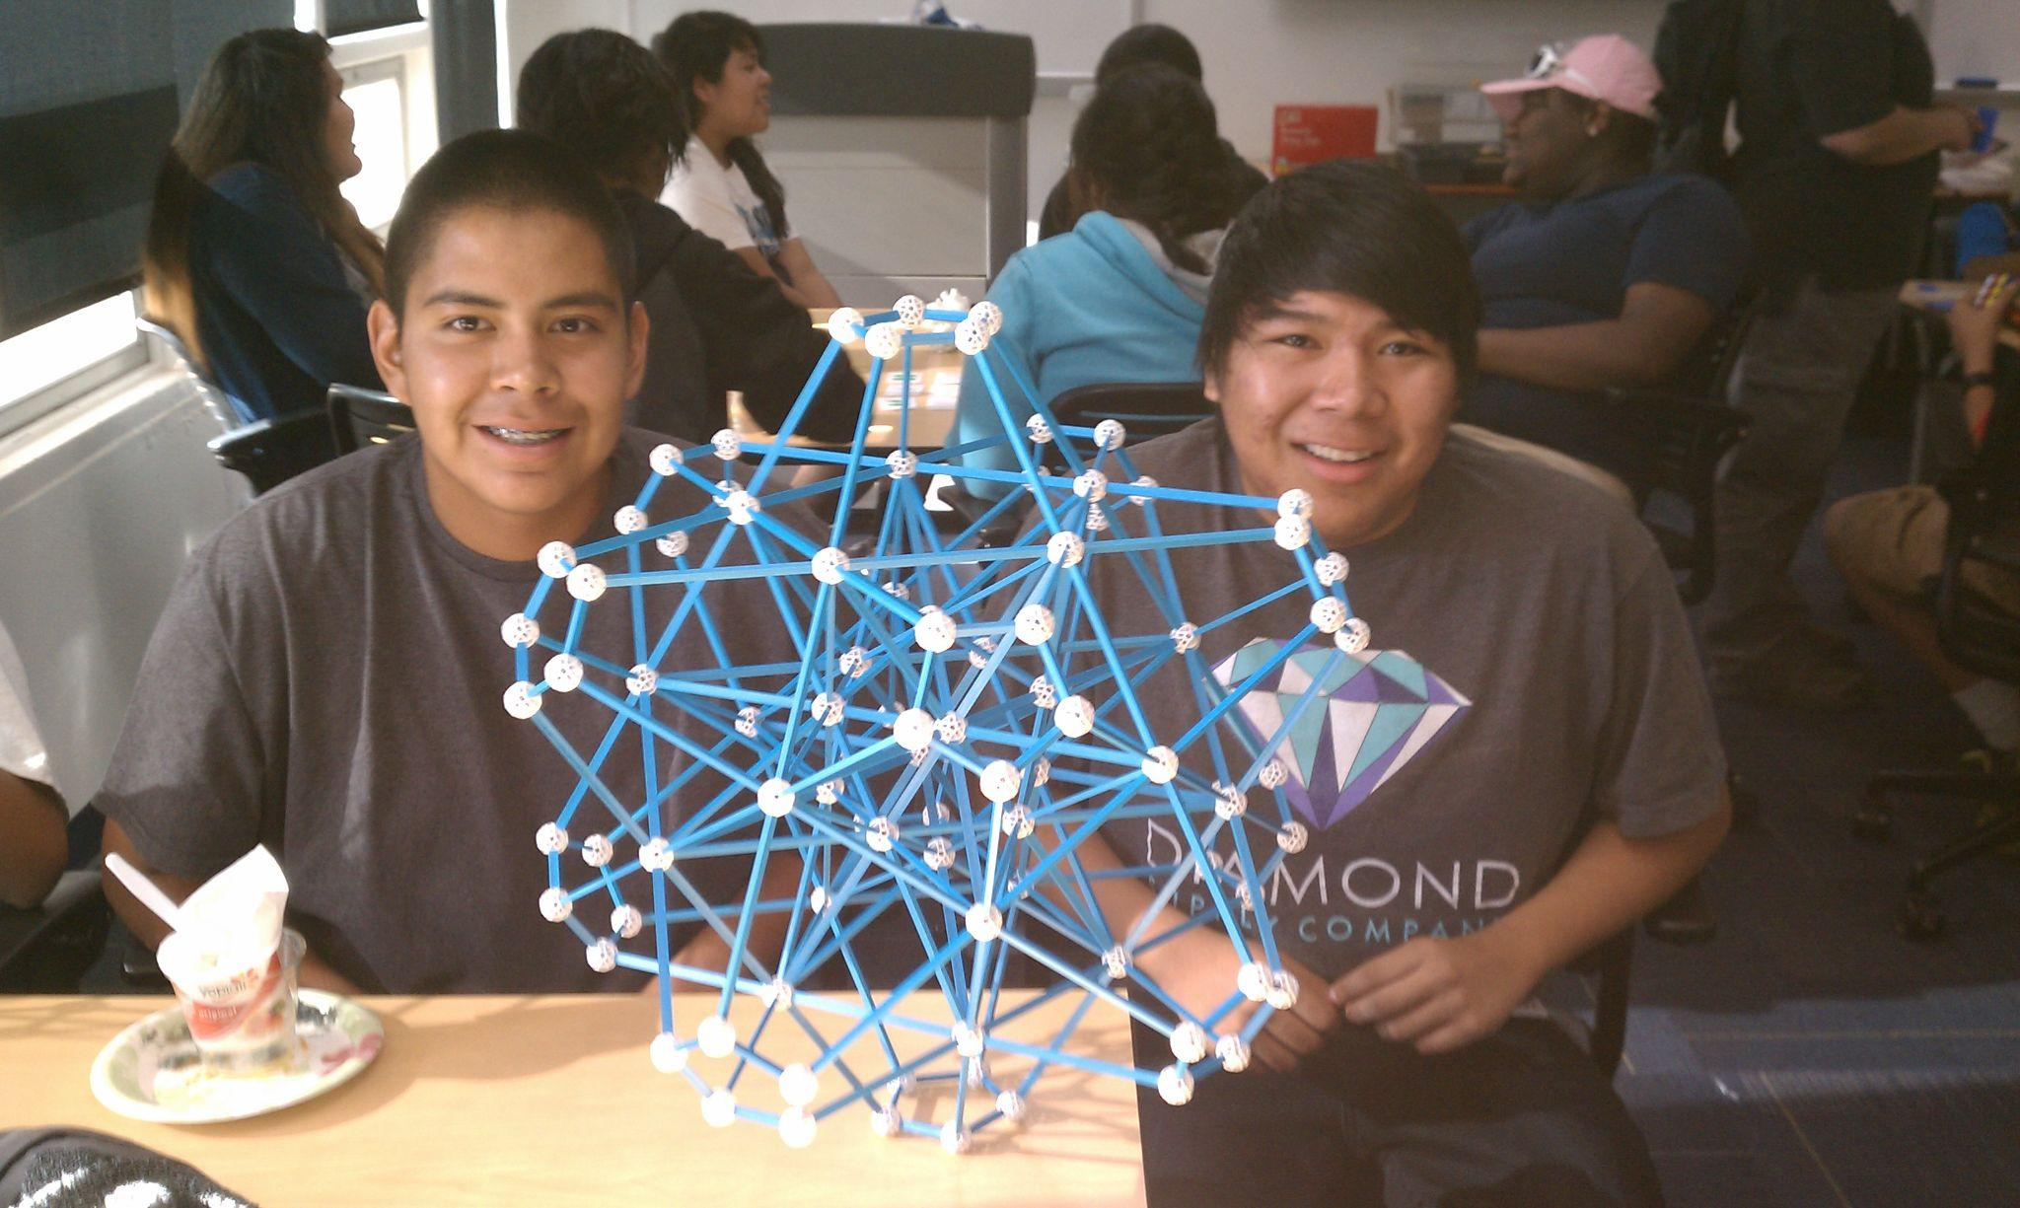
Systemic barriers to
indigenous students' success:
School mathematics hides mathematics’ role as a cornerstone of human civilization, leading to student disinterest in the subject.
Notes:
Tatiana will send a picture

Slide 8
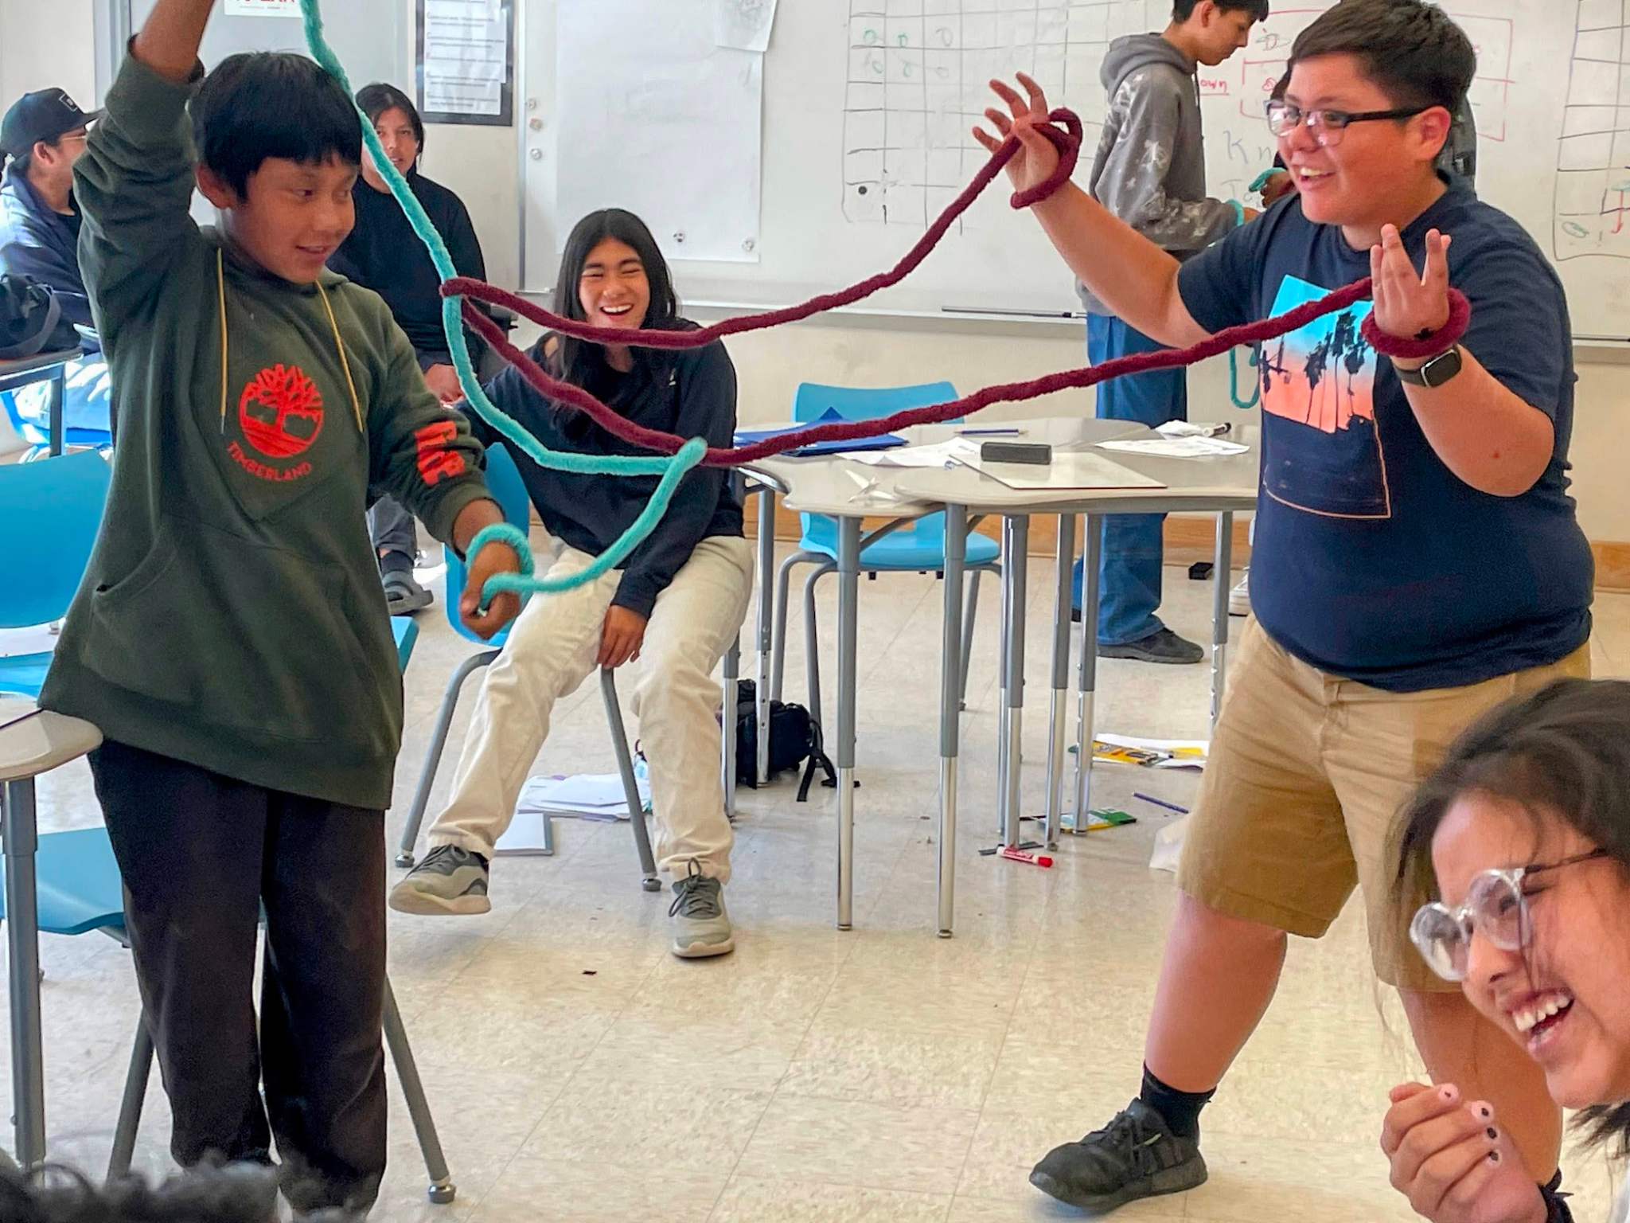
Besides opening many doors to STEM and other professions, mathematics is the best tool for developing logical thinking and training analytical abilities. Not studying math deprives students of an excellent opportunity to build their “mental muscles”.

Slide 9
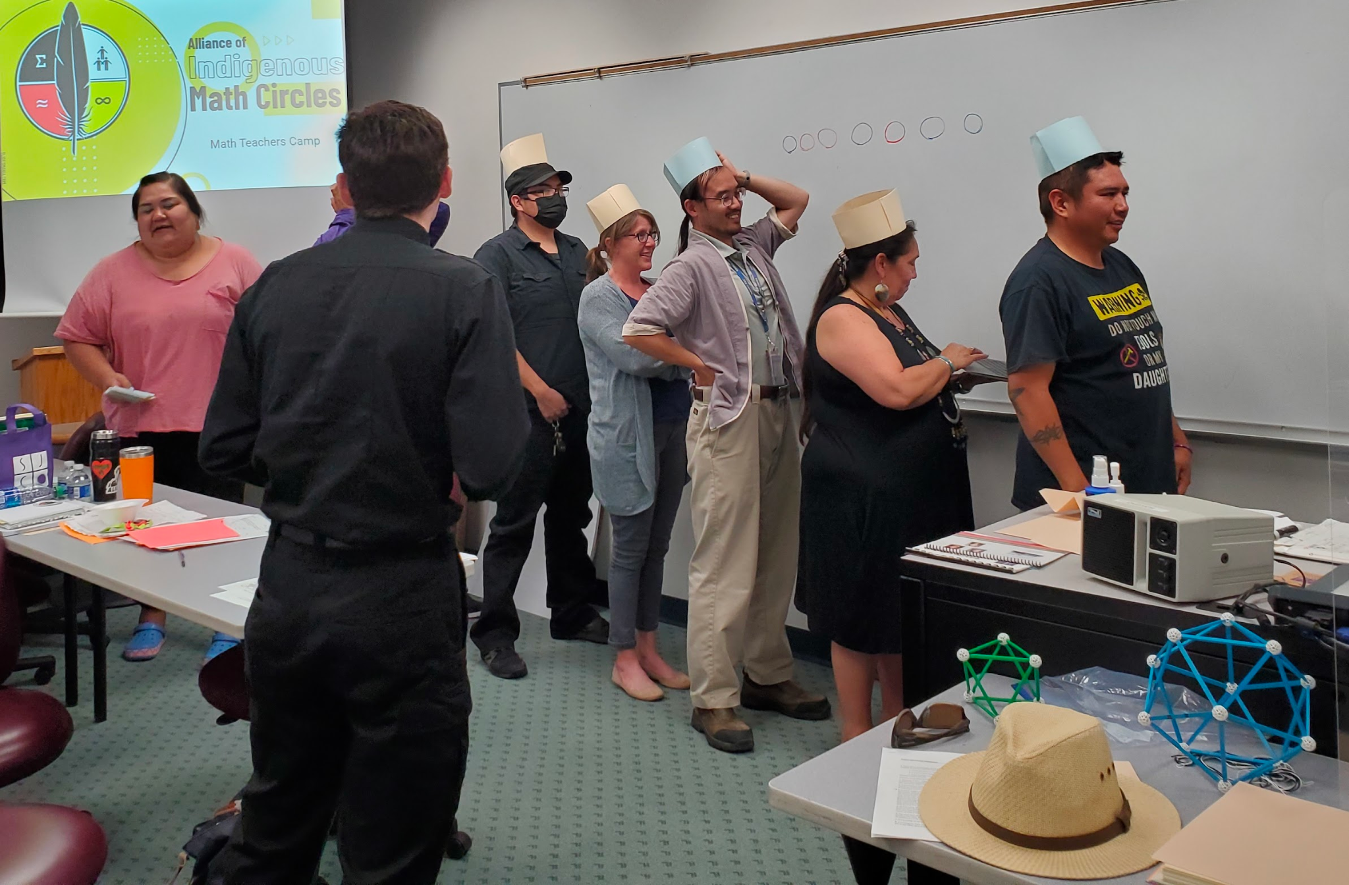
Systemic barriers to
indigenous students' success:
Schools serving large percentages of indigenous students face high turnover among math teachers, making it difficult for students to build the kinds of connections with role models that sustain students’ interests in pursuing mathematics.

Slide 10
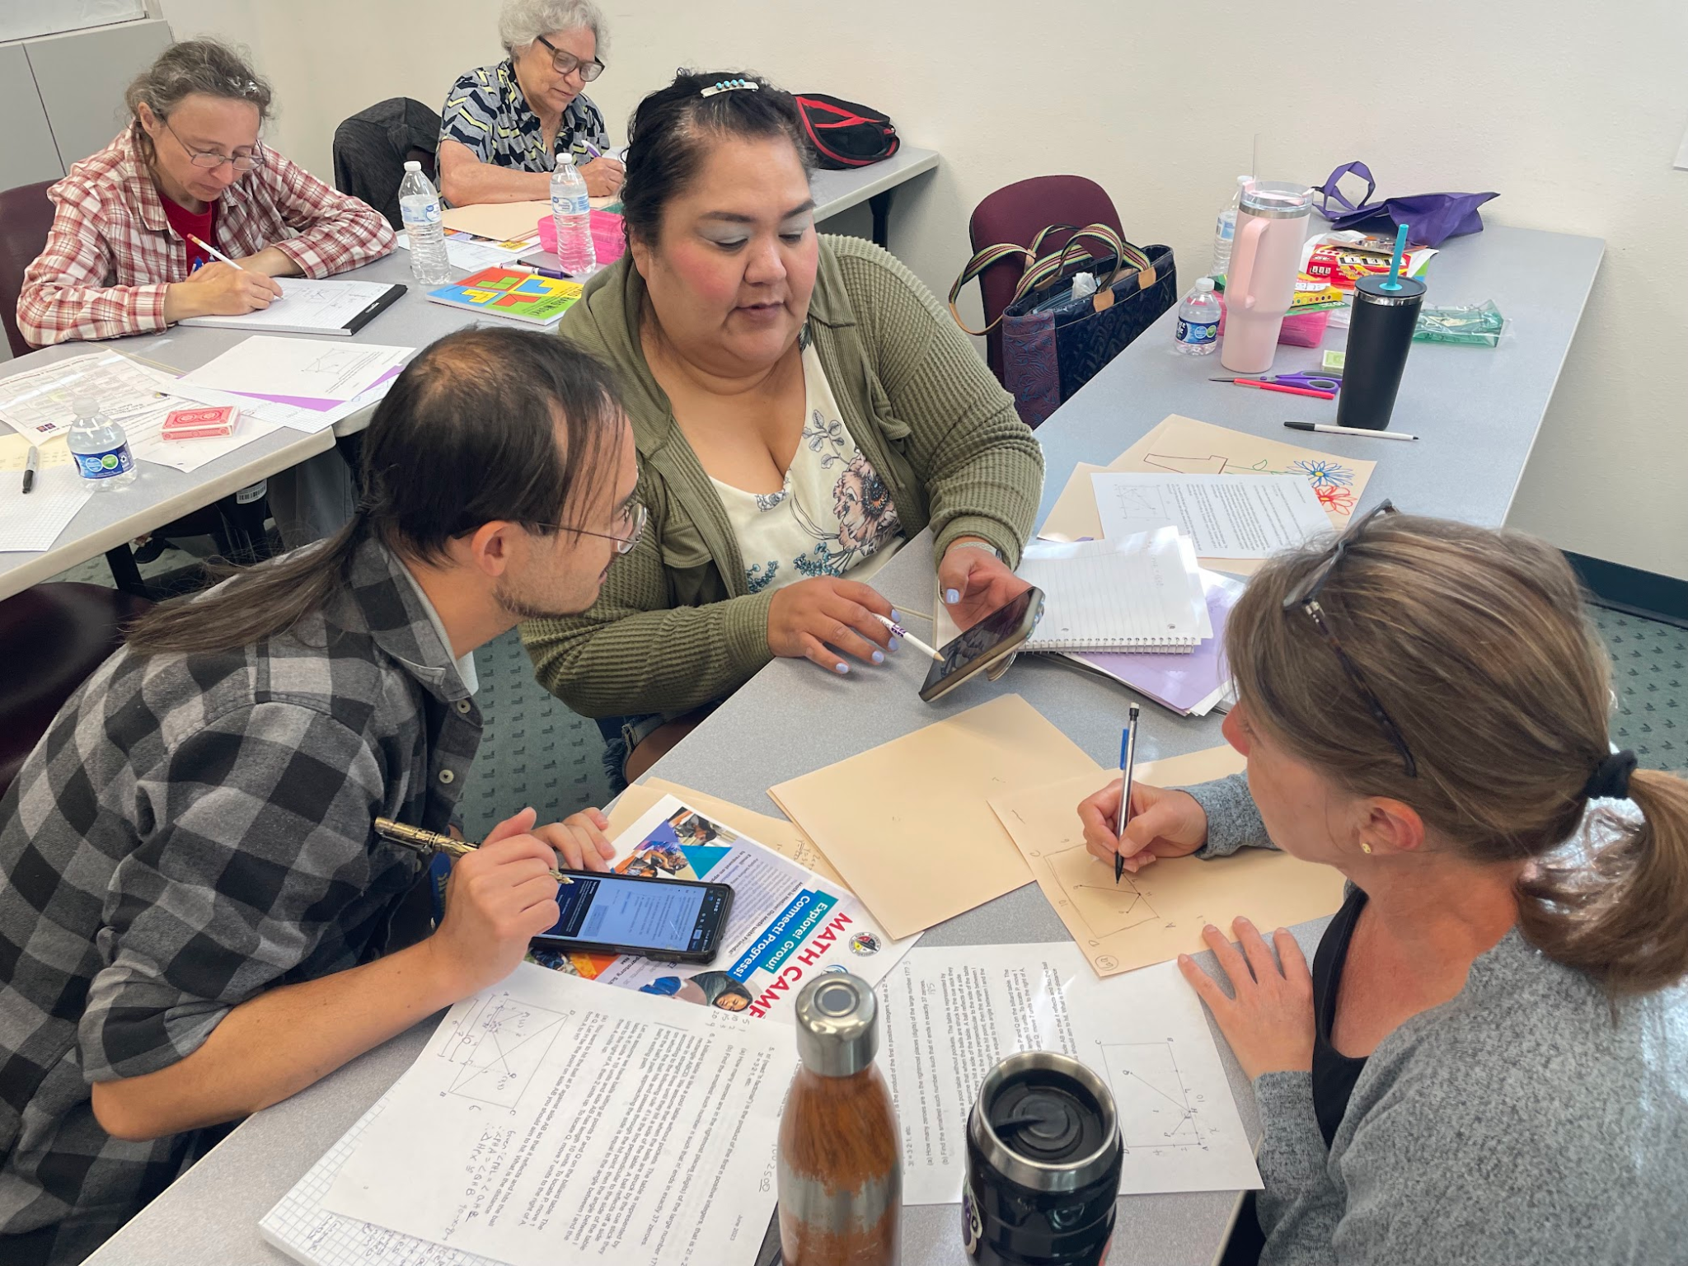
Building a community of math teachers’ who have a network of connections to peers and mathematicians around the country provides professional and emotional support. Decreasing teacher turnover has a high return on investment and supports student persistence.

Slide 11
AIMC addresses these problems
Network of
professional mathematicians facilitates math circle demonstrations, math camps, & teacher workshops
Math Circles partners with indigenous communities to uplift the beauty and power of mathematics
Respected teacher-leaders from indigenous-serving schools and organizations serve as regional coordinators

Slide 12
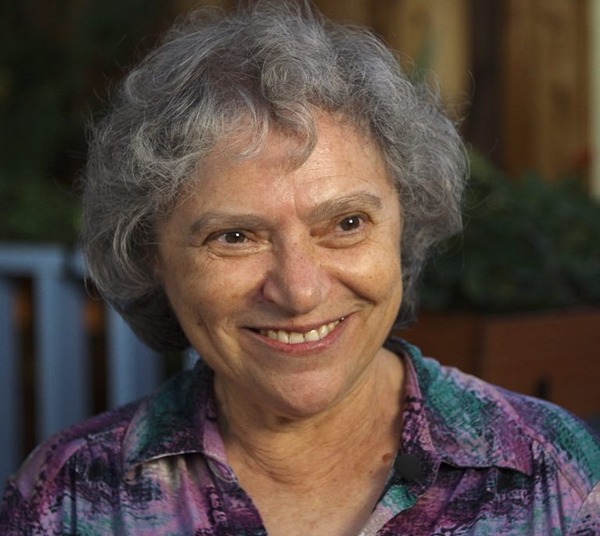
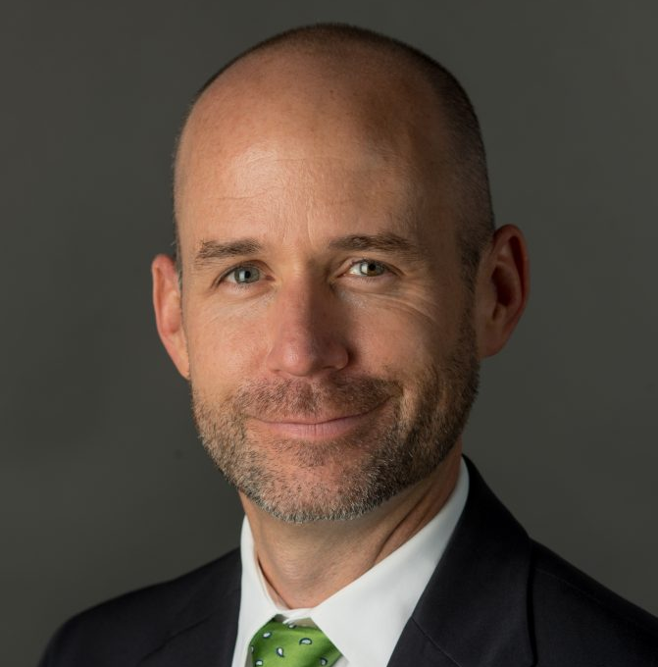
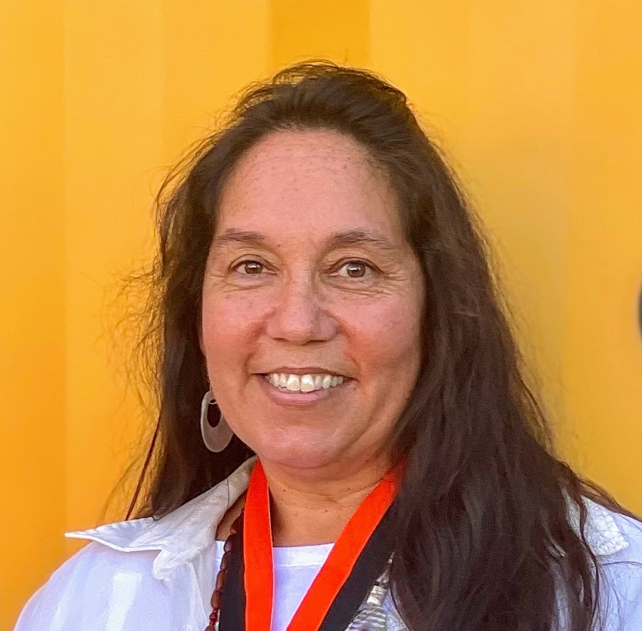
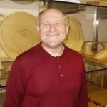
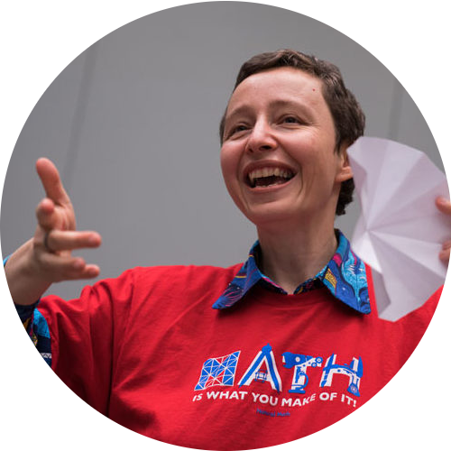
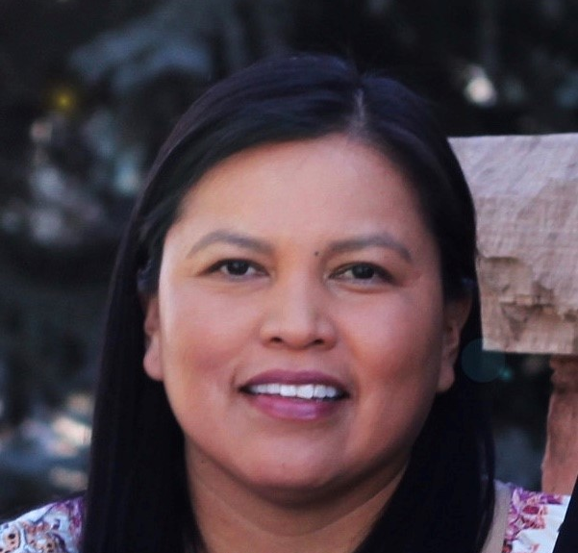
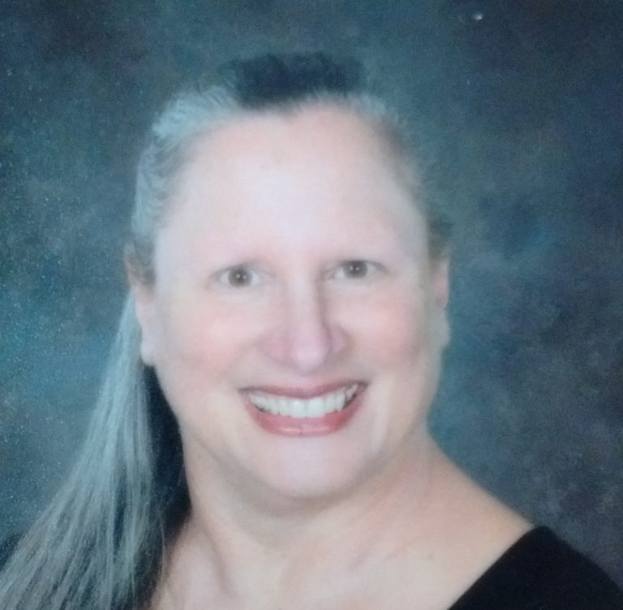
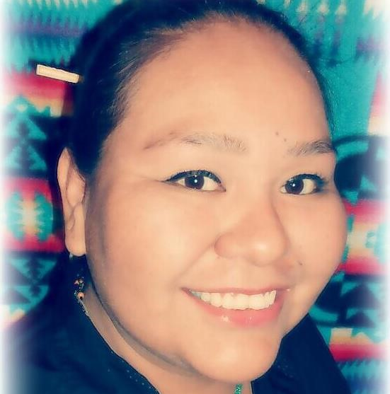
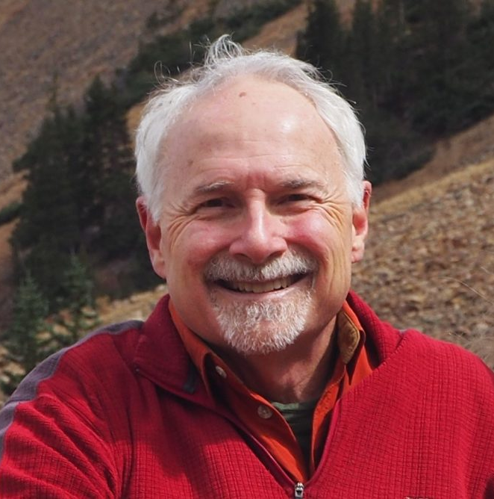
AIMC Directors
BMC Leaders & Regional Coordinators

Slide 13
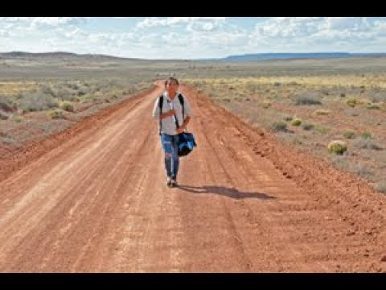
Navajo Math Circles
This movie highlights the importance of having Math Circles in an indigenous community. It shows the impact on lives of students and teachers.

Slide 14
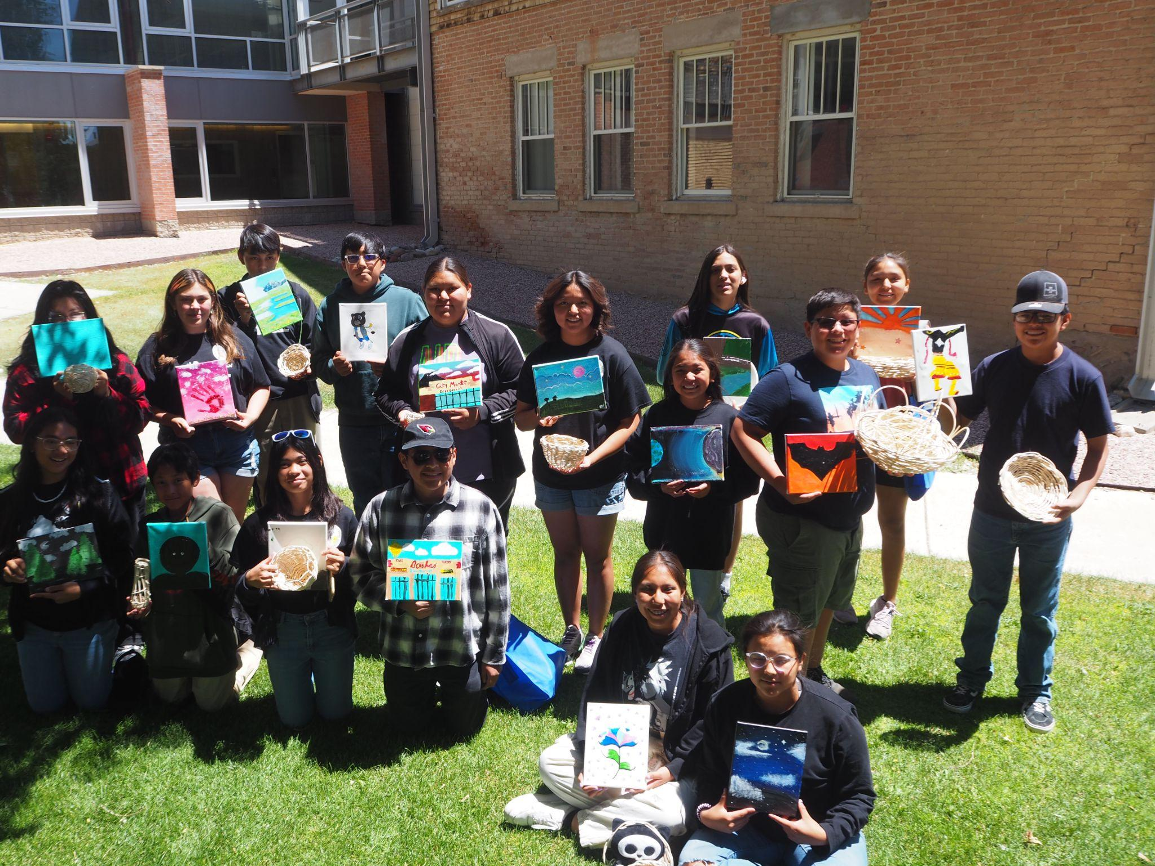
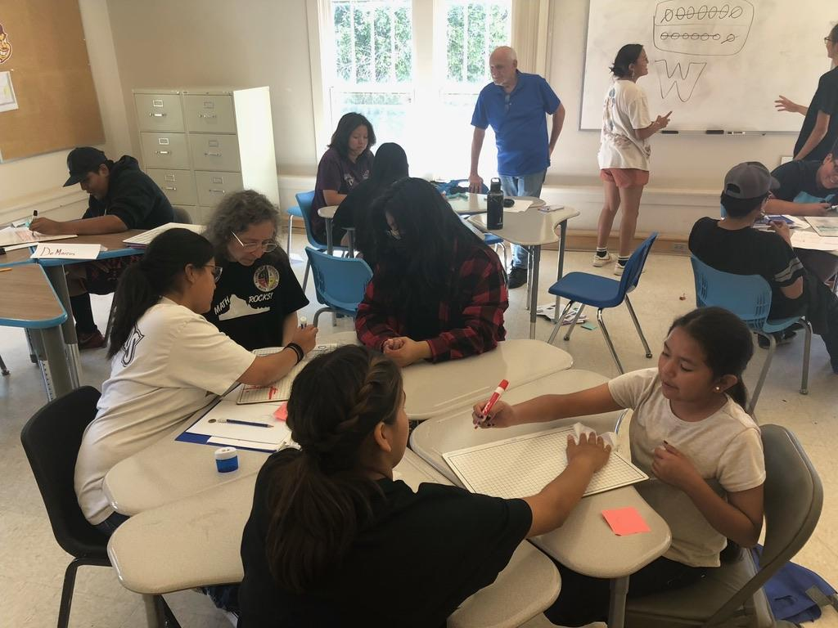
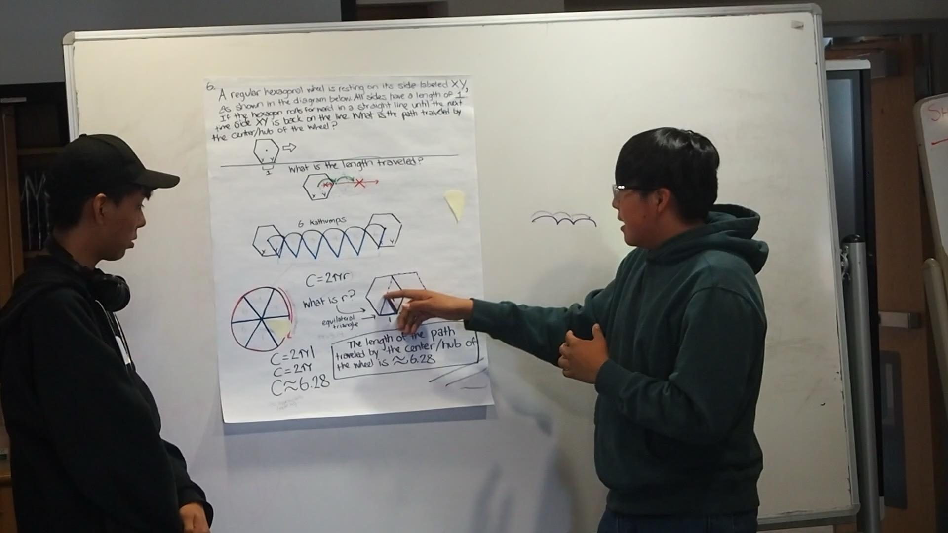
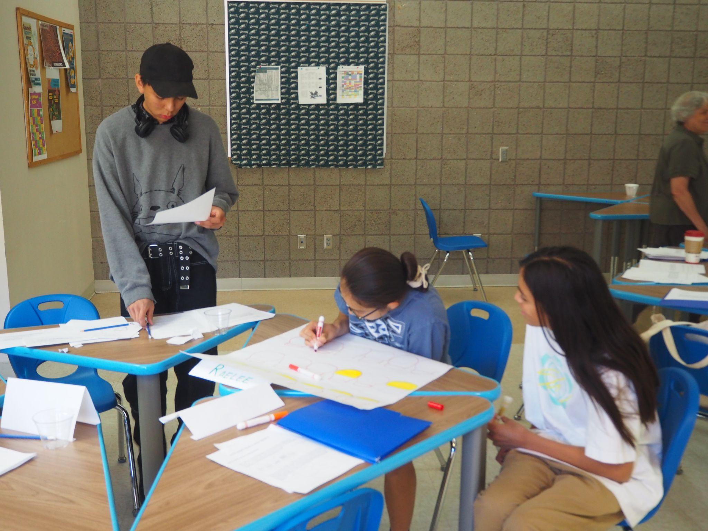
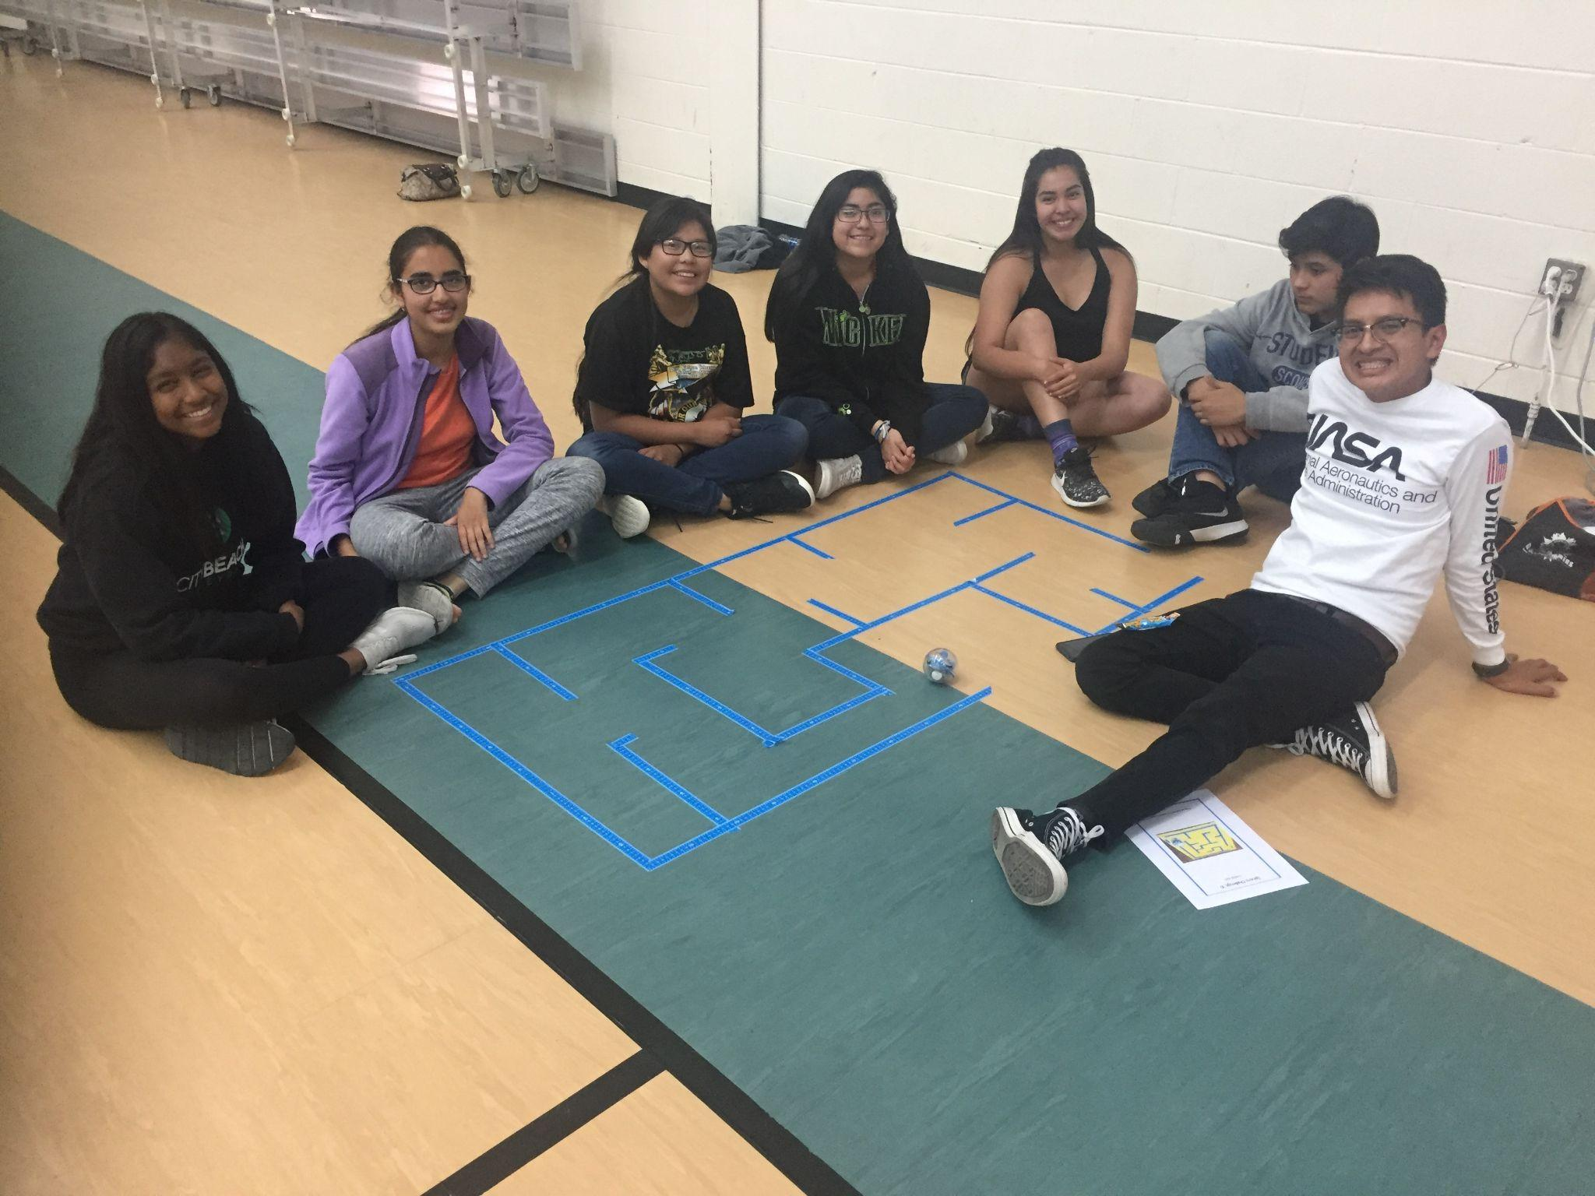
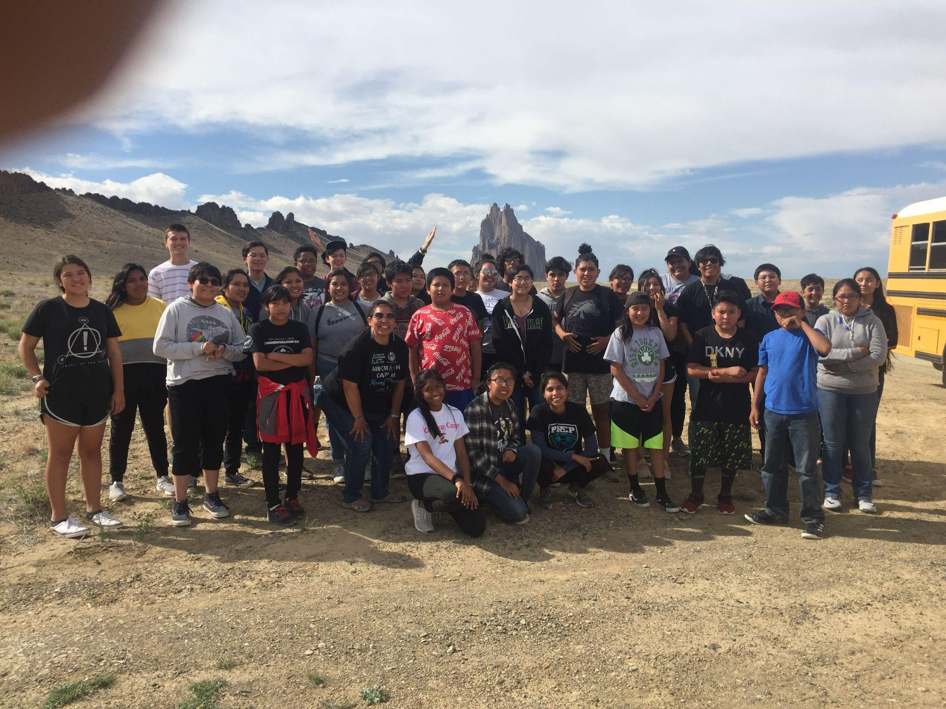
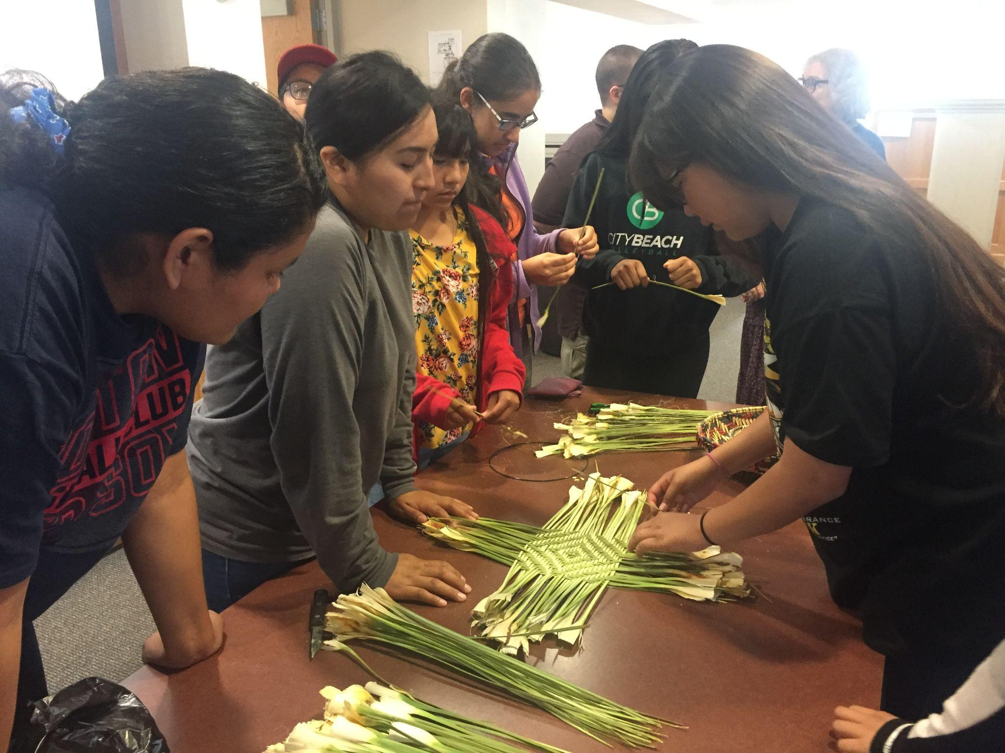
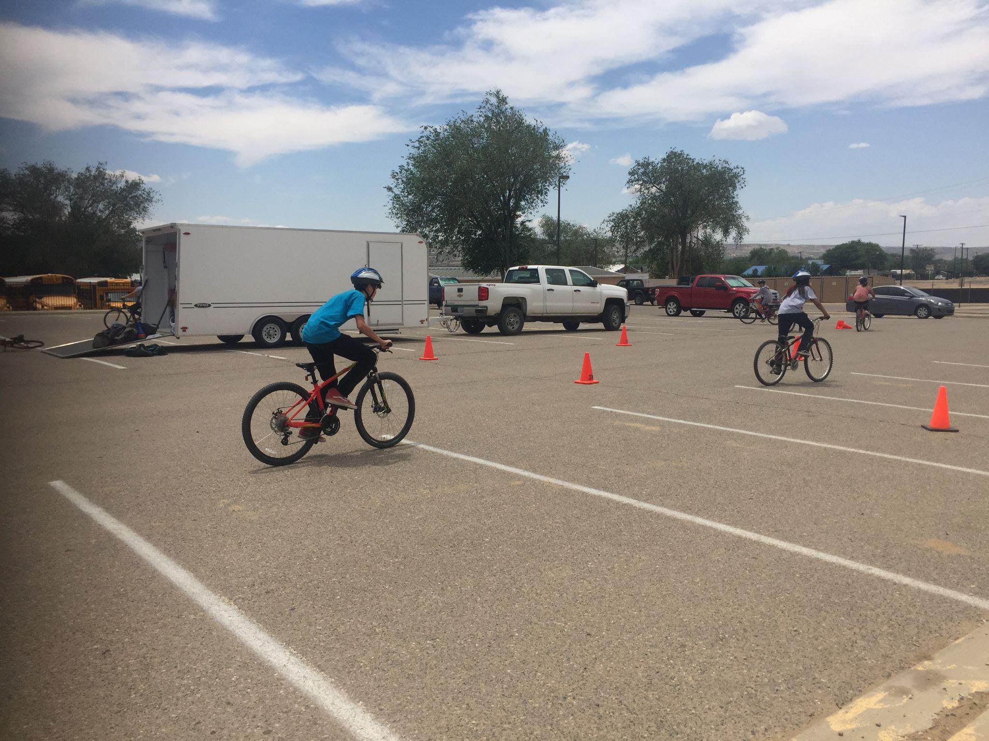
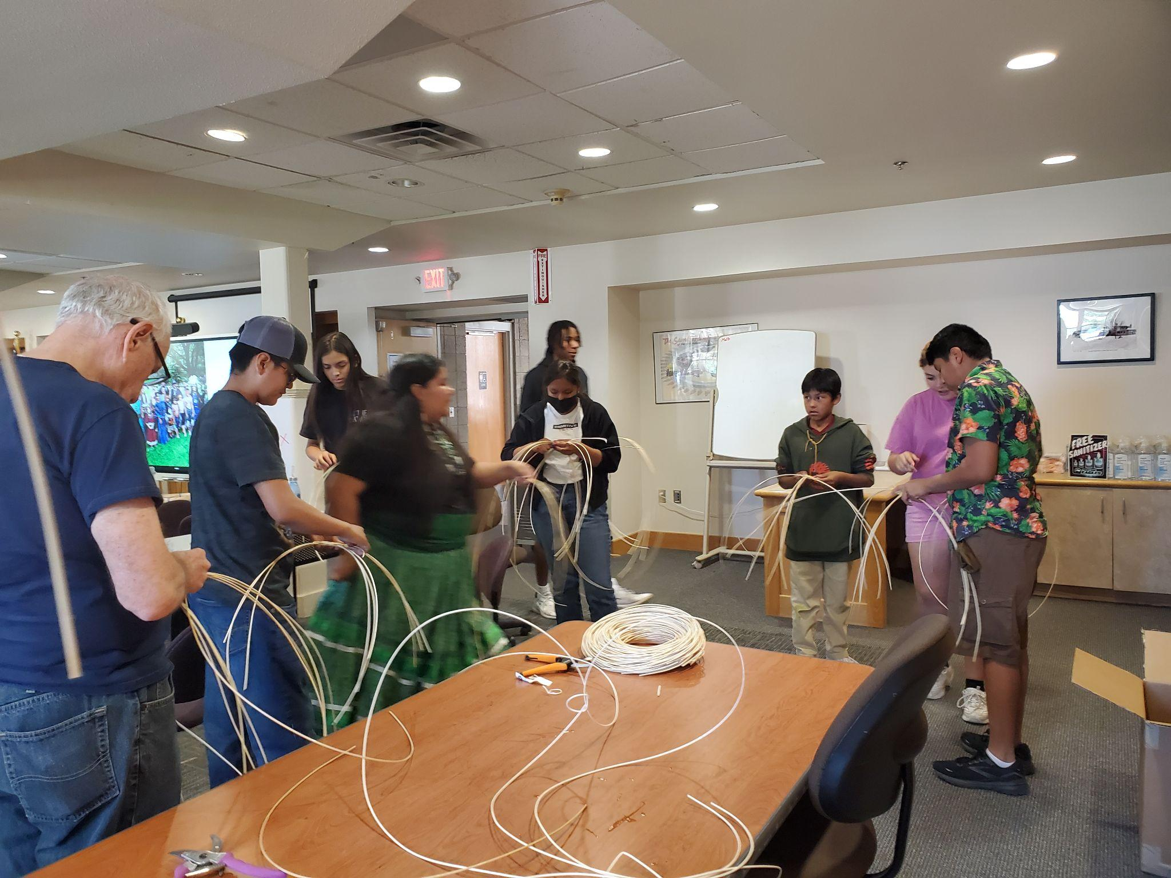
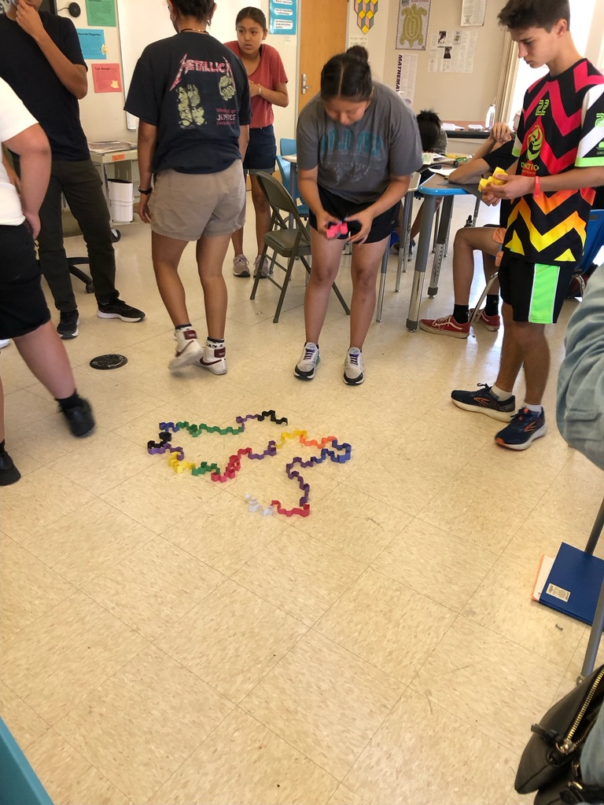
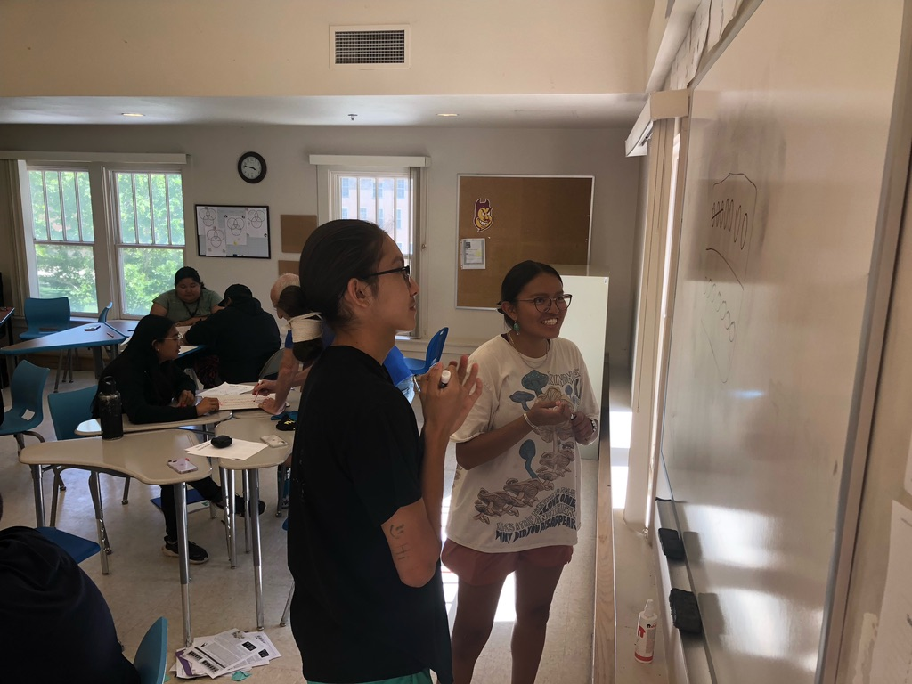
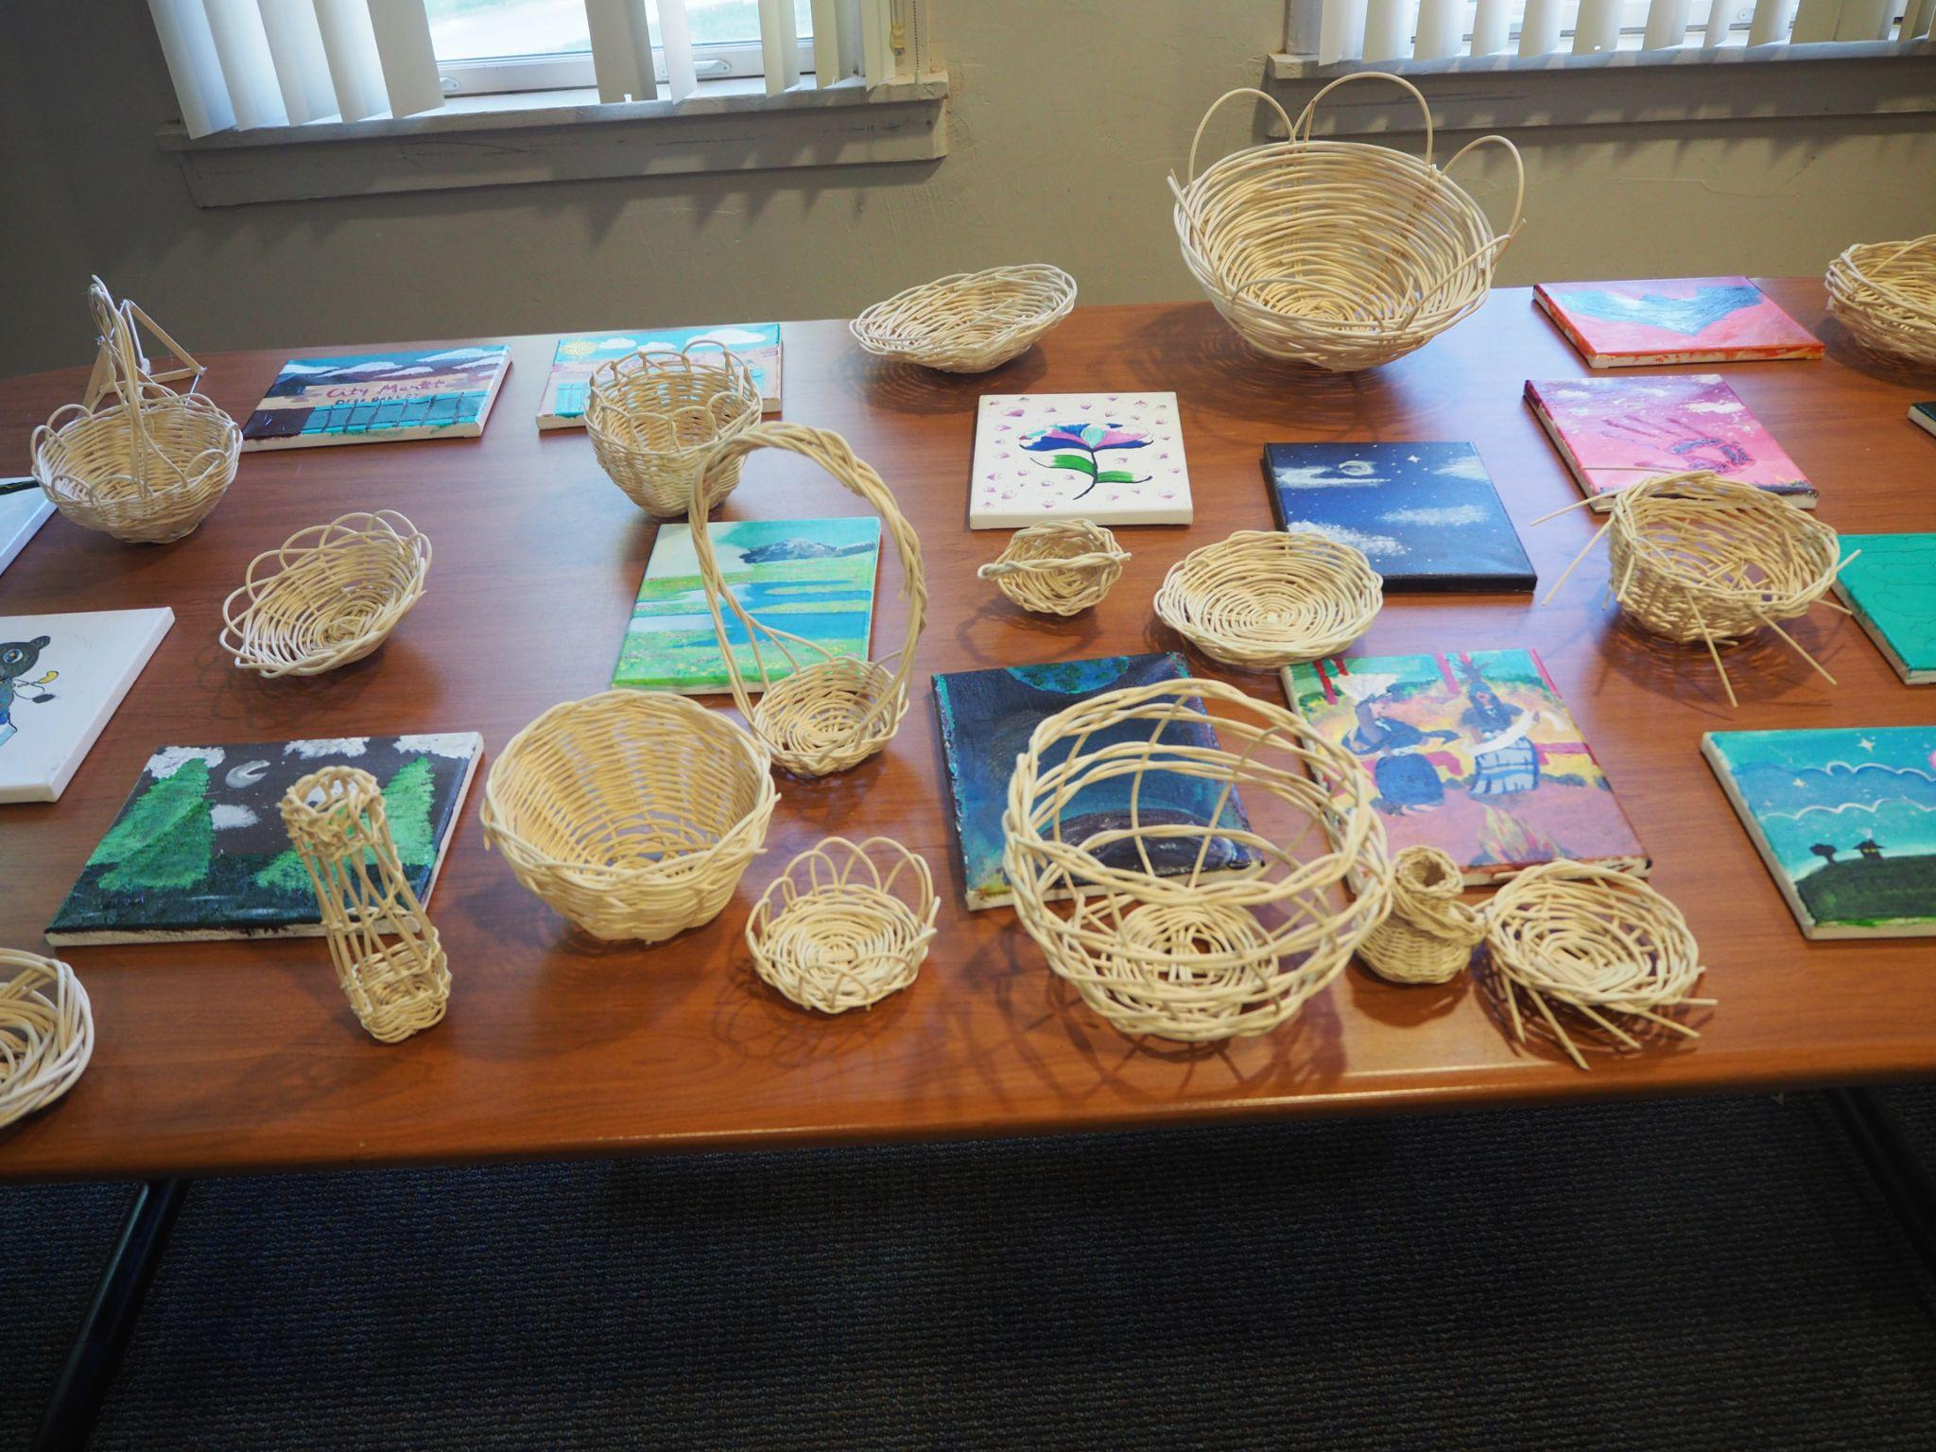

Slide 15
Math Camp Success

Slide 16
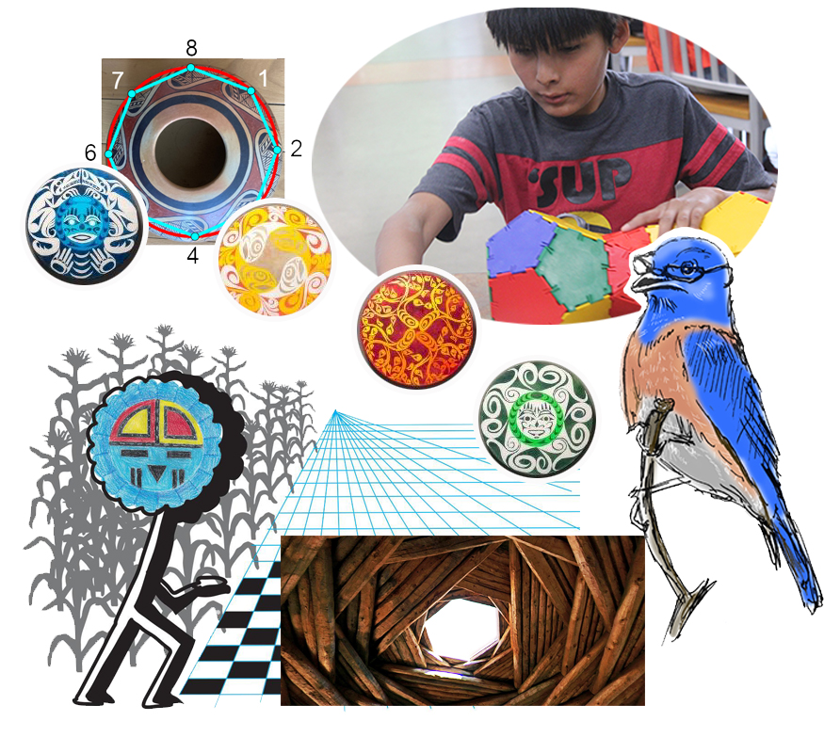
Bluebird Math Circle

Slide 17
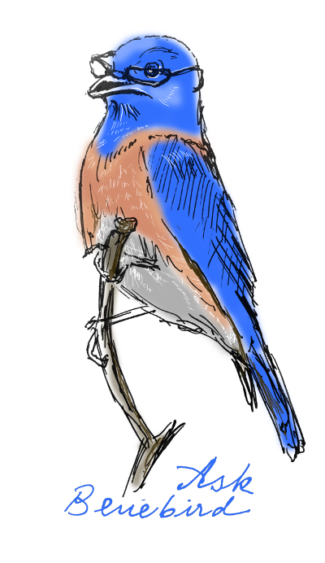
Bluebird Math Circle
Virtual Math Community
Launched in March 2021 it is a supportive community of teachers, students and their families – everyone who cares or is curious about mathematics, education and indigenous young people’s futures.

Slide 18
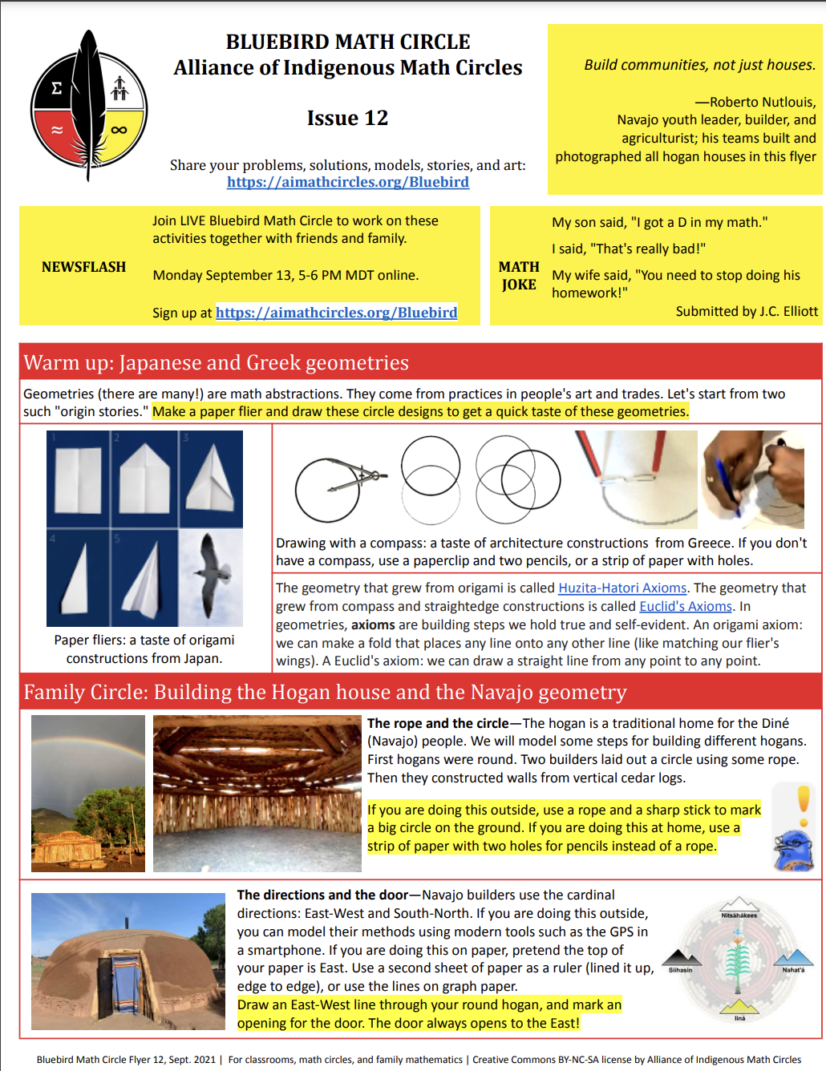
Bluebird Math Circle
Published every other week on Monday
Bluebird Math Circle newsletter released with fun and engaging math activities that are accessible to everyone.
https://aimathcircles.org/bluebird/
FREE & AVAILABLE ONLINE
People are encouraged to play with the activities in class and at home.

Slide 19
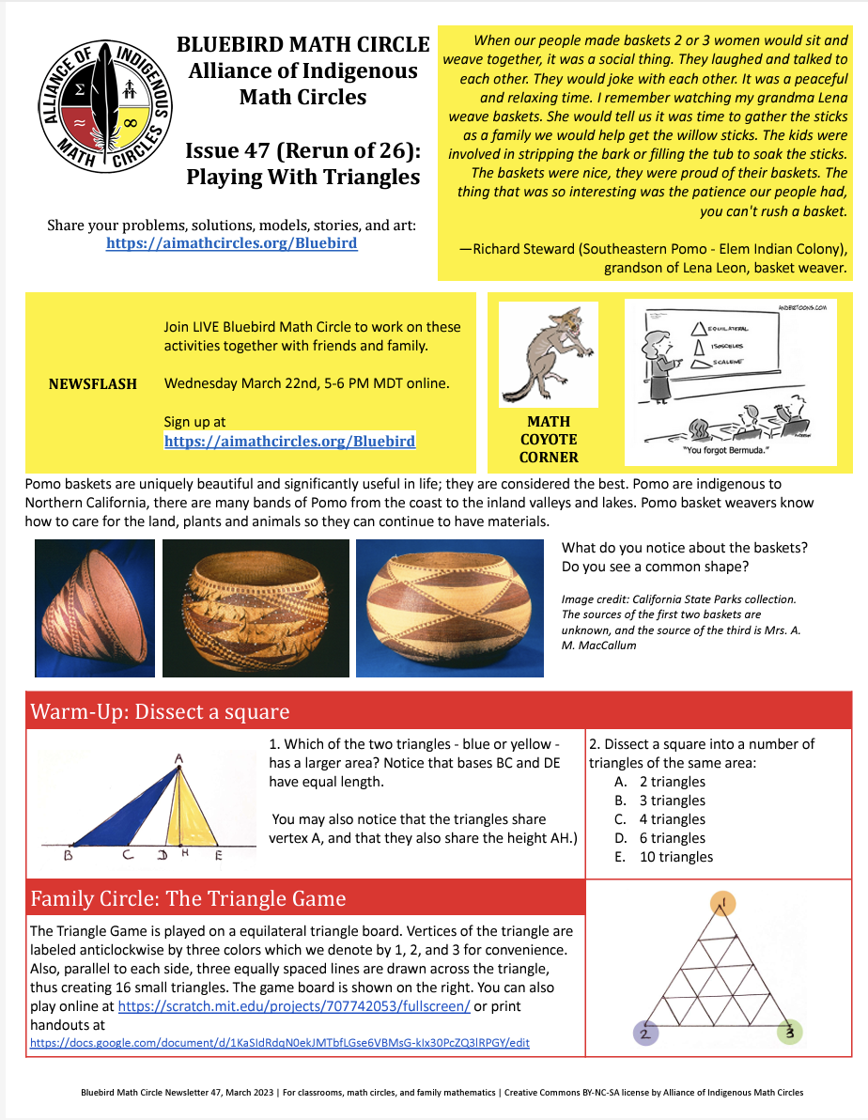
INDIGENOUS
MATHEMATICAL
KNOWLEDGE

Slide 20
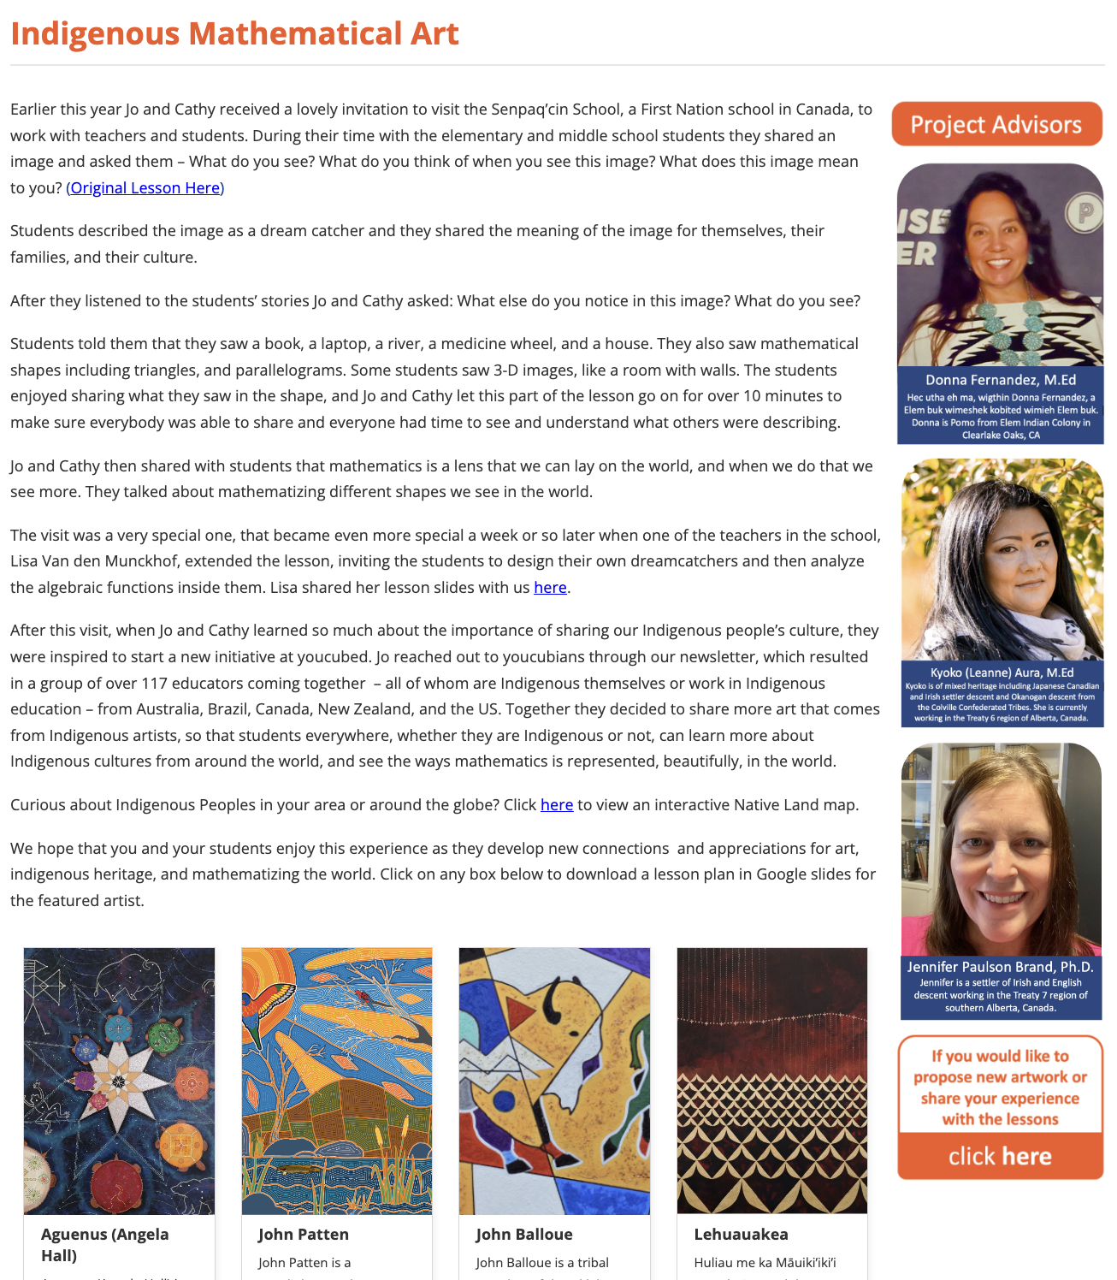
Youcubed.org
Partnering with Dr. Jo Boaler, Stanford University Nomellini and Olivier Professor in the Graduate School of Education (Mathematics)
Youcubed Indigenous Math Art Talk
Indigenous art infused with math….let’s talk about it.
Collaboration to lead the Indigenous Math Educators Network.

Slide 21
Questions
We would like you to spread the word about AIMC and Bluebird Math Circle. We encourage you to bring Native American students, teachers and families to join us for engaging math.
We welcome you to join our community as participants or leaders.
Notes:
Volunteers needed in BMC help develop future flyer and activities. Volunteer at the summer math camps, math during the morning, need help with STEM or cultural activities.

Slide 22
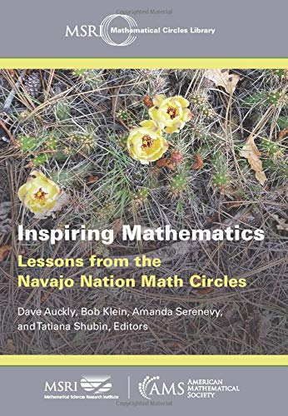
Book featuring activities used in Math Circles at Navajo Nation.

Slide 23
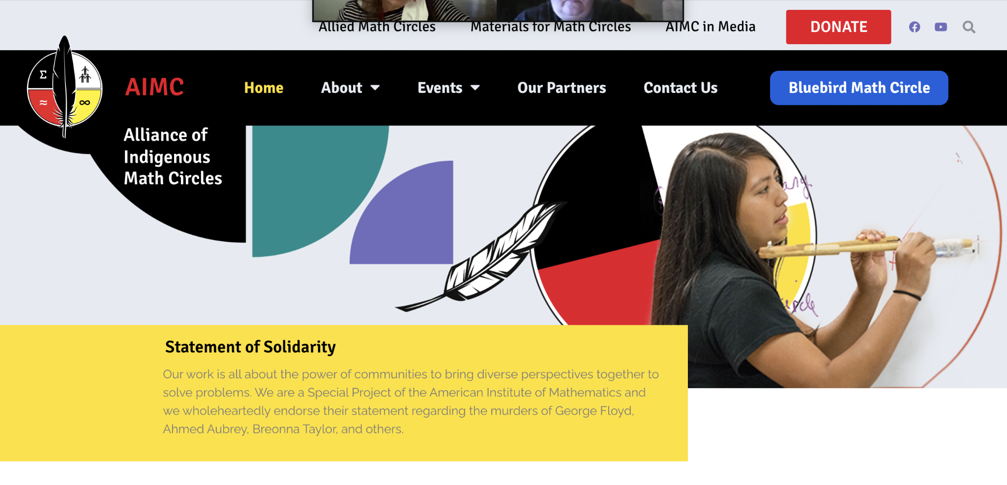
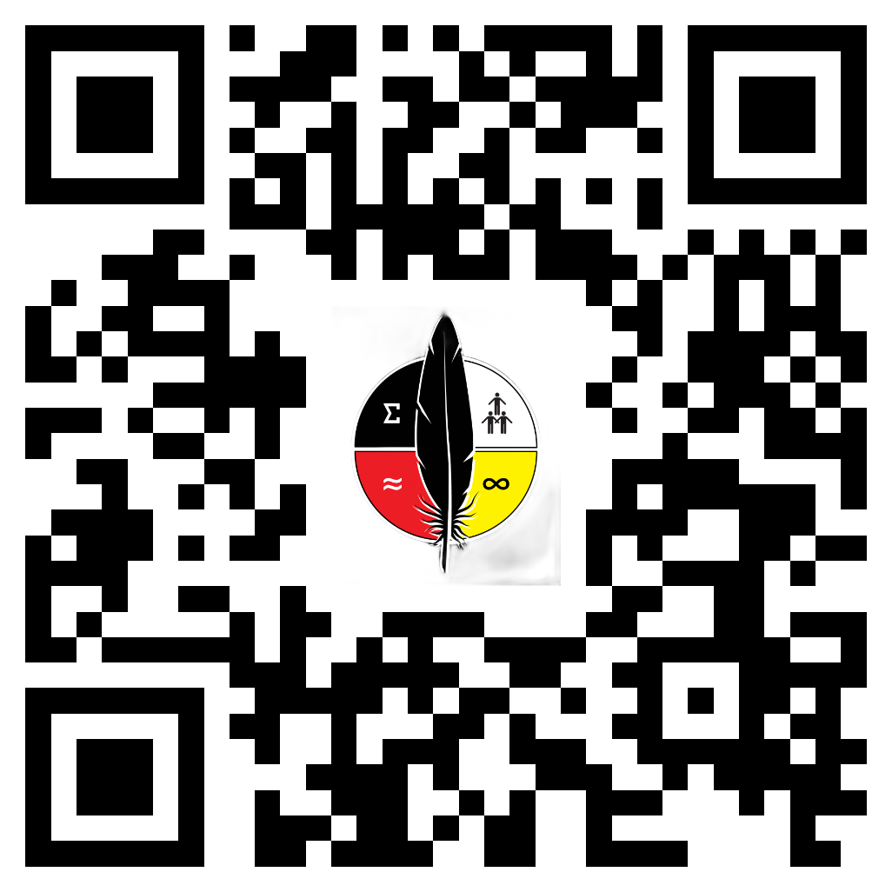
Join AIMC!
We want to partner with you. Please fill out our Contact Us online form at our website: www.aimathcircles.org

Slide 24
THANK
YOU!
Contact us at:
www.aimathcircles.org

