Slide 1



Teaching Data Science at Community College with UC Berkeley curriculum
Eric Van Dusen, Kseniya Usovich
Data Science Undergraduate Studies, UC Berkeley
ericvd@berkeley.edu
Notes:
Eric

Slide 2
Overview
Data 8 overview
Summer workshops
California Alliance
Transfers to Data Science Major
Data 8 in depth
More time to Demo / Q&A at 4-5PM - bring a laptop

Slide 3
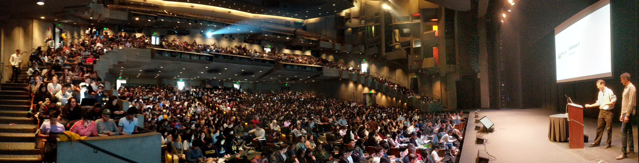
Data 8
1500 students per semester
Built to be scalable
Built as open source project

Slide 4



Data 8 as a common platform
The following are officially articulated courses equivalent to Data C8 at California community colleges:
CIS 107 at San Jose City College
CompSci 8 at El Camino College
Math 211 at Skyline College
Math 108 at City College of San Francisco
CS 118 at Santa Barbara City College
CSIT 128 at Palomar College
~200 students per semester in Community College Pilot
Articulated at several institutions
Common curriculum platform,
Computational Infrastructure

Slide 5
What are key Data 8 starting points
Coding is made accessible and not just for coders
Students learn within literate reproducible code documents
Consistent environments across learners has equity angle
  ( all machines are equal with cloud access )
No / Low prerequisites - data science as first class instead of upper division class
At Berkeley: 30-40 different majors in the class learning together - impacts how students see themselves, how they interact
Notes:
Balaji

Slide 6
Data 8 - as a platform
Open source curriculum project
  Composed of a set of Computational Notebooks
  Online Free Textbook
Lots of resources to share with instructors
Auto-graded assignments (slightly tricky to set up )
Notes:
Balaji

Slide 7
Data 8 at community colleges - pilot phase
San Jose CC - Sanjay Dorairaj - Run as flipped classroom
CC San Francisco - Shawn Wiggins (Math)
El Camino CC - Solomon Russell and Alice Martinez (CS)
Santa Barbara CC - Nathalie Guebbels - (CS co with Math)
Skyline CC - Kayvan Momeni (Math)
Palomar CC - Peter Chen (CS)
Forming a Community of Practice from Existing Adopters
Notes:
Balaji

Slide 8
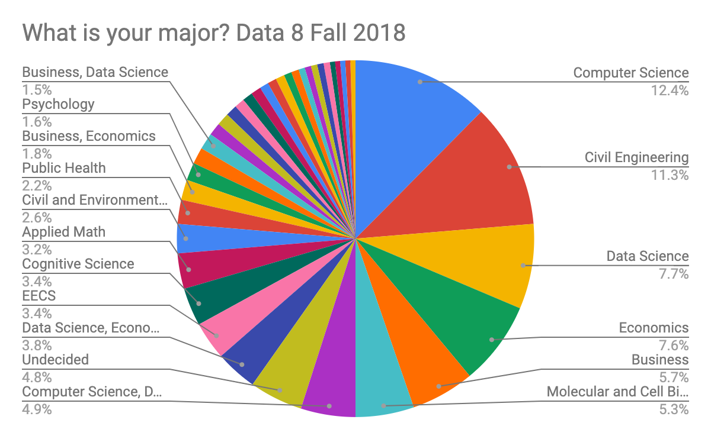
A New Path into Computing
Data 8, a first-year course with no programming or statistics prerequisites, fulfills the statistics requirement for 24 different majors on campus. (eg. like C-ID Math 110)

Slide 9
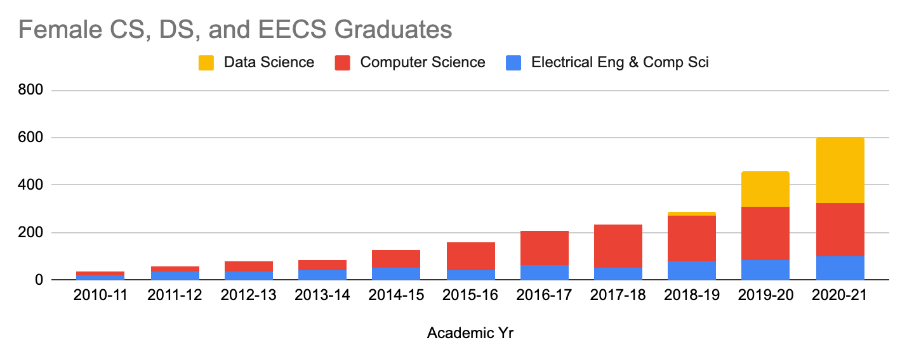
UC Berkeley Female Graduates in Computing

Slide 10
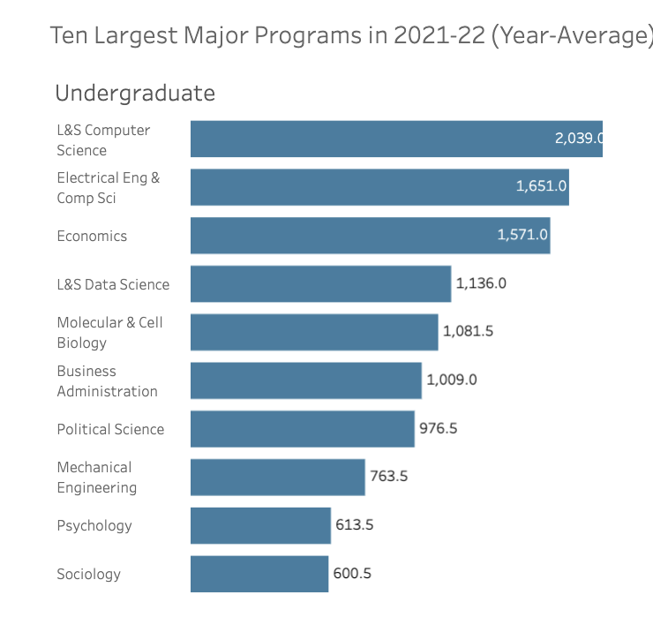
4th Biggest Major

Slide 11


Metacognition ~ Hypothesis ~ Praxis
Tools built for data science are powerful for pedagogy
  Meet student wherever they are in the University
Data Science teaching tools
  built on Open Source tools and reproducible practices
  Beginner students learn advanced toolkit ~ scaffold to more
  Teachers learning open source stack work collaboratively
Simultaneously teach Computational Thinking & Inferential Thinking
  Social Science students need Data Science skills / methods
  CS/ML students need inference / ethics
“Notebook based instruction” - is it an evolution in how we teach?
Notes:
Balaji

Slide 12
Inclusion Efforts around Data 8
Data Scholars - Foundation Seminar with extra support
Peer mentors, small group cohort, extra homework support
Data 6 - A class before Data 8 - work in progress
Not a major requirement, builds familiarity with computing
Offered as a summer bridge for SEED scholars program for 3 years
Community College
Support for community college instructors
Transfer student seminar for new transfers once at Berkeley

Slide 13
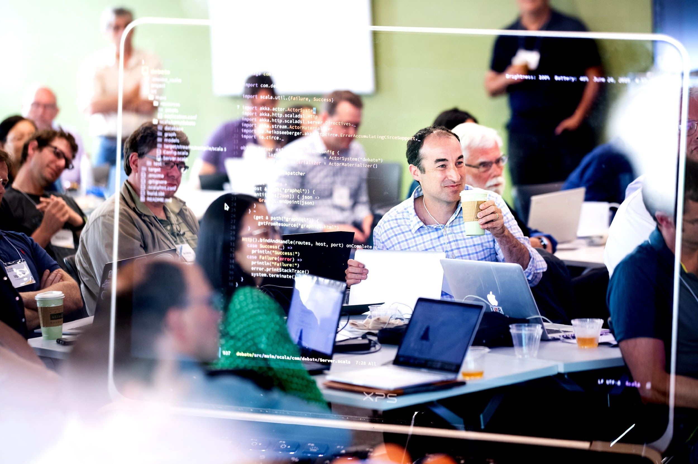
Teaching Other Teachers
Innovation in Pedagogy
Coding for Professors
Instructional Technology
Pedagogy workshop for UC Berkeley Professors → National Workshop for Data Science Education
Notes:
Balaji

Slide 14

Details on National Workshop for Data Science Education
National Workshop on Data Science Education aims to bring together Data Science educators from all over the world.
Training for Data 8
Overview of Berkeley Data Science
Human Context & Ethics
Panels
  Data Science across California
  Equity and Inclusion
  High School Data Science
  Math for Data Science
dates: June 20-23, UC Berkeley & Online
bit.ly/nwdse2023
Register Here:

Slide 15
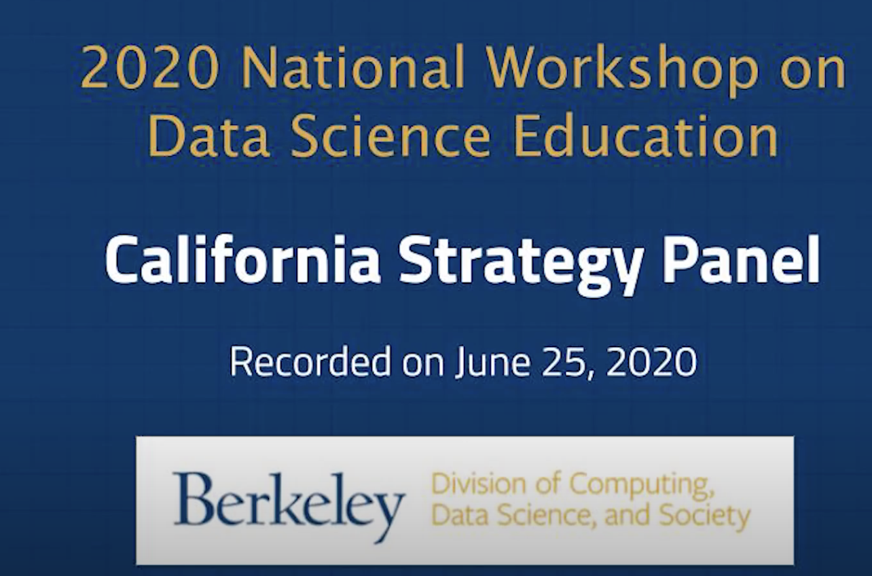
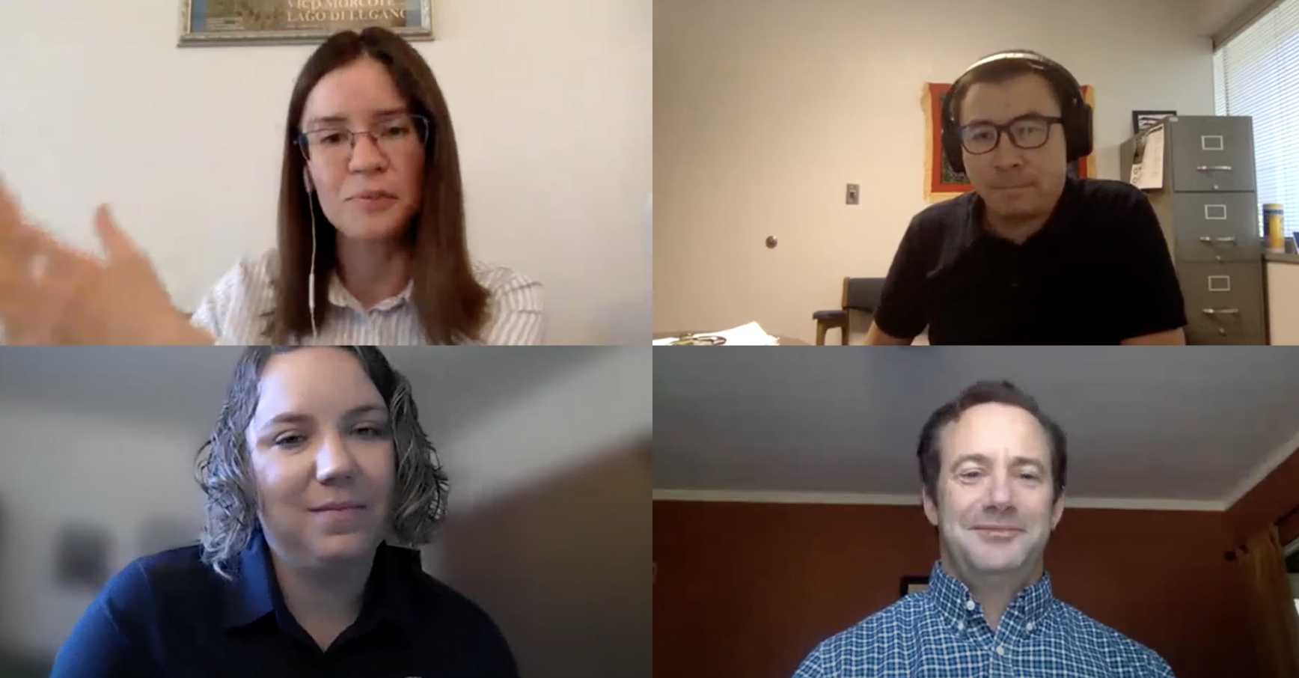



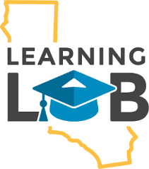

California Panel at National Workshop 2020-22
2020 - First Panel
2021 - Summary of efforts at UC CSU CCC
2022 - Learning Lab and CID Chair
Notes:
Balaji

Slide 16

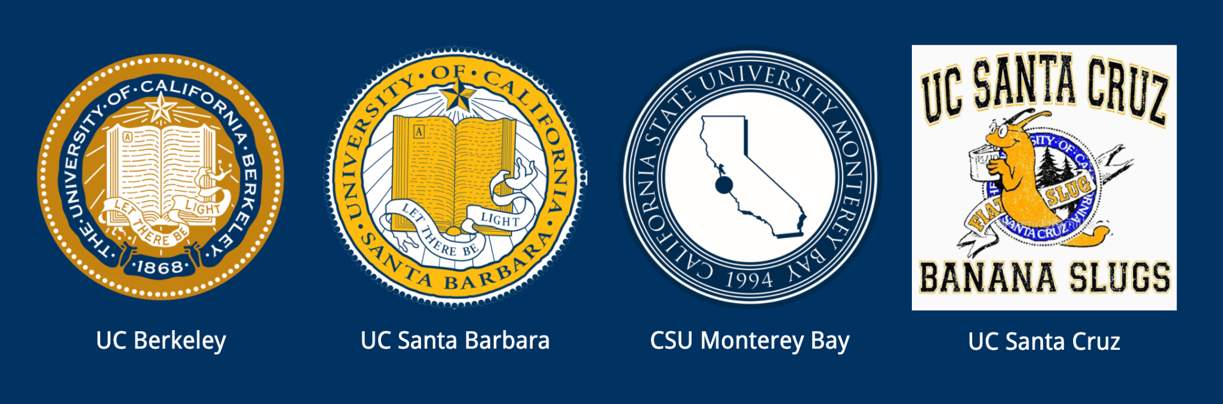



An advisory group from a diverse coalition of academic institutions.
16 California Institutions
  6 UCs, 5 CSUs, 4 CCCs, 1 Private Institution
Quarterly Board Meetings
Key Topics Discussed
  Articulation efforts
    ( eg Katia at CCSF )
  Key Classes for Transfers
  DS Major Requirements and Pathways
Notes:
Meets Quarterly

Slide 17
Collaborative Vision
Streamlining Data Science Education across California
Coordination - DS Efforts across institutions
  Creating the first California-wide public survey of UC, CSUs and CCCs DS Programs
  Gaining support from UCOP CSUCO and CCCO
  Linkages for NSF (HDR) proposals
Process - Aiding the Transfer and Articulation process for CCCs
  Organized a Community of Practice Workshop
  Facilitating articulation for pilot institutions
  Fundamentals of Data Science requirements
  Mathematics background requirements
  UC Office of the President - articulation coordination
Support - Infrastructure and Curriculum
  Creating resources/training for Intro to Data Science adoption
  Cloud pilot partnership with 2i2c.org and Cloudbank

Slide 18

2021-2022 Progress Summary:
CADSE Website
UC, CSU, CCC Summary of Data Science Programs
Mathematics background requirements for Intro. to Data Science
Fundamentals of Data Science requirements
Intro To Stats Project: Beginning Database of CSU Intro To Stats Courses
A few of our 2021 milestones:
February 2021 meeting 149 attendees from 65 institutions across California
Participated in the CMC^3 and ADSA Conferences (December)
Microsoft and CADSE’s Faculty Residency Program Completed
Held a CCC Instructors Community of Practice Workshop (October)
February 2022 meeting (February)
CSU-Wide Workshop (April)

Slide 19
Let’s work together
data.berkeley.edu/californiaalliance
data.berkeley.edu/2022workshop
ds-help@berkeley.edu
ericvd@berkeley.edu

Slide 20
Working towards a UC Transfer Pathway
UC Campus | Degree | Department | 1st Year Calculus | Multivar Calculus | CS1 - Intro to Computing | CS2 - Data Struct | Lin Algebra and/or Disc Math | Fndns of Data Science | Intro Stats class
UC San Diego | Data Science, B.S. | Halicioglu Data Science Institute | Math 20A 20B | Math 20C | DSC 20 | DSC 30 | Math 18 | DSC 10
UC Berkeley | Data Science, B.A. | Division of Computing, Data Science, and Society | Math 1A 1B |  | CS 61A | CS 61B | Math 54 | Data 8
UC Irvine | Data Science, B.S. | Bren School of Information & Computer Sciences | Math 2A 2B | Math 2D | ICS 31 32 33 | ICS 46 | Math 3A |  | Stat 7
UC Riverside | Data Science, B.S. | Bourns College of Engineering, College of Natural and Ag Sciences | Math 9A 9B 9C | Math 10A | CS 10A CS 10B | CS 10C | Math 31 - LA CS 11 - DS
UC Santa Barbara | Data Science and Statistics BS Data Science and Statistics BA | Department of Statistics and Applied Probability | Math 2A 2B |  | CS 8 CS 9 |  |  | DS1 | PSTAT 8 / PSTAT 10
Not all are required - many are recommended - or chose 3 of 5 etc

Slide 21
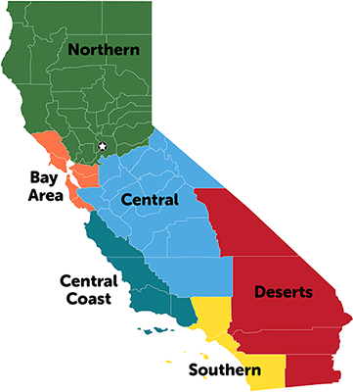
UC Berkeley Transfer Students
in DS Major
~200 Declared majors
~50-100 intending
75 incoming transfers
1
1
53 responses in a survey of 135 transfer students in the DS major
32
Which Community College did you transfer from?
LA
6
13

Slide 22
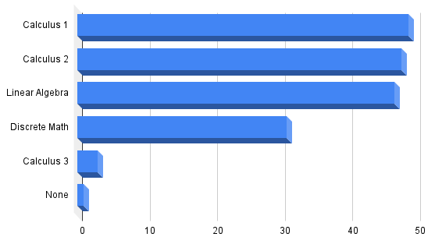
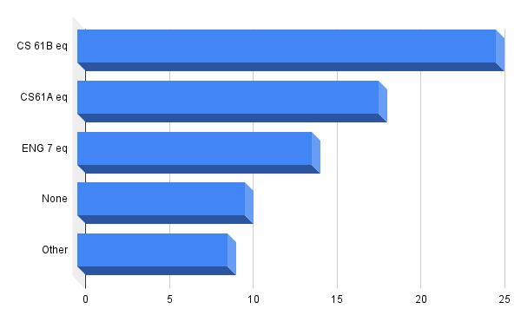
Math and CS/Engineering Classes Taken
Notes:
Some had 2 or more

Slide 23
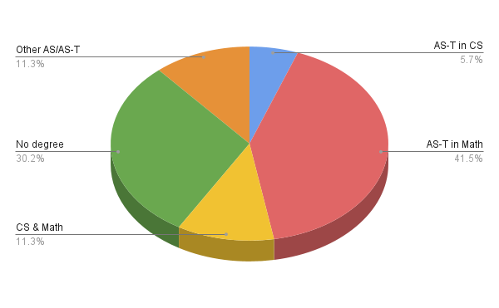
Did you transfer with a Transfer Degree?
More than 40% of respondents have transferred with a AS-T degree in Math
Some had 2+ degrees at the time of transfer

Slide 24
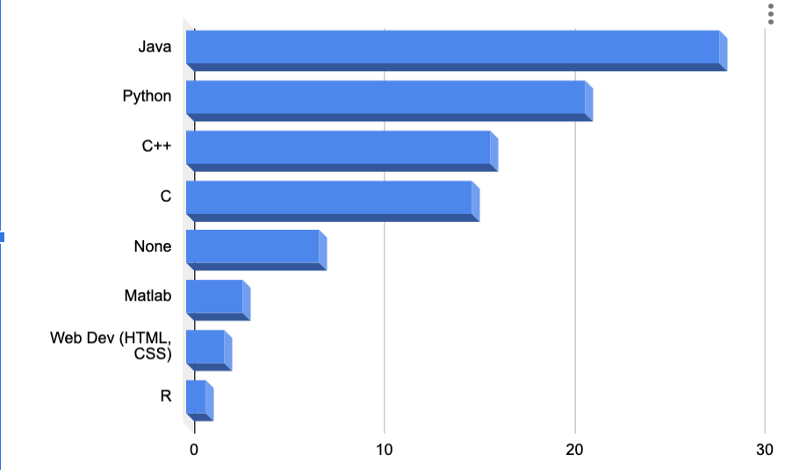
Familiarity with a programming language (if any)
Both Python & Java (studied in DS at UC Berkeley) were the most popular
Some had familiarity with 2 or more before transferring to UC Berkeley

Slide 25
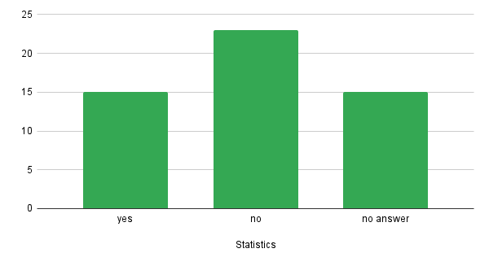
Have taken Statistics prior to the Transfer

Slide 26
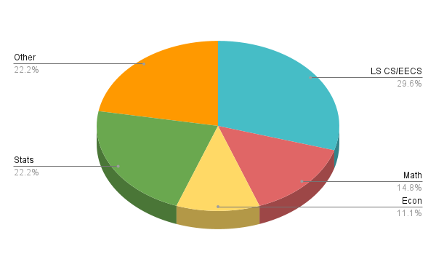
Intended major at the time of transfer (if not DS)

Slide 27
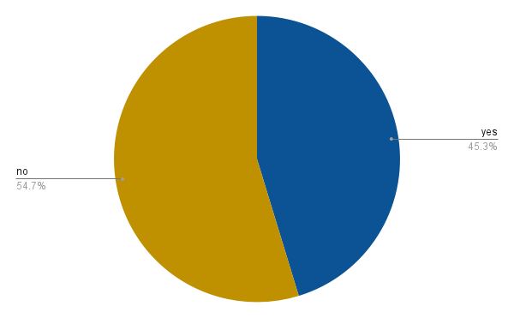
Did you know about Data Science before transferring to UC Berkeley?

Slide 28
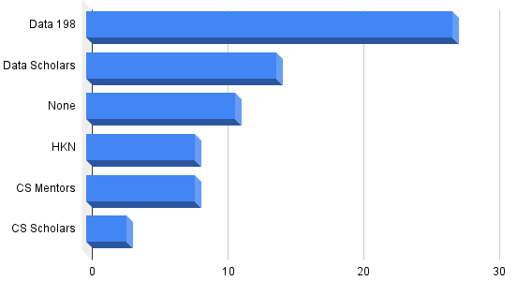
Support Programs at UC Berkeley
- transfer students have taken advantage of:
*Data 198 is a transfer success class
~30% get support from 2 or more of the organizations/classes listed here
Notes:
Thanks to Anara Myrzabekova, Vivrd Prasanna, and Kseniya Usovich as well as the DS advisors for helping us with the survey

Slide 29
Data 8 Course Overview

Slide 30
Data 8 Structure
Hybrid of an intro Stats with intro CS course
4 credit class
3 hours lecture / 1 hour lab / 1 hour discussion
Optional small group tutoring
Collaborative discussion board
Student powered office hours
Set of Jupyter notebooks with pedagogy and coding
Midterm and Final

Slide 31
Data 8 Jupyter notebooks
Pedagogy and assignment combined curriculum
Mirrors textbook as well
10 labs - usually complete in lab class (supports hw)
11 homeworks - weekly most weeks
3 projects - longer, 2-week-long homework assignment
  Applied to real world problems
Set of lecture notebooks as well
Autograding within notebooks
  Real time feedback for sanity checks, progress
  Can be used for assessment as well

Slide 32
Teaching through vignettes

Slide 33
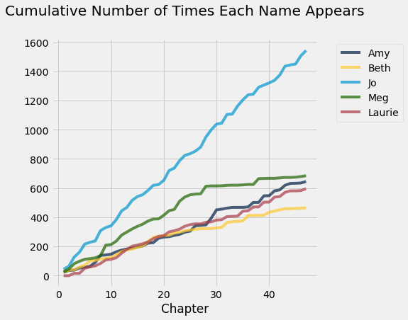

Slide 34
Course Design

Slide 35
Computational Thinking
Use computation to automate repeated tasks & learn how repetition is useful for reasoning and inference.
Applying a function to many values
Iteration for repeated sampling
The effective use of modules (libraries) and objects
np.mean(nba.where(“height”, are.above(80)).column(“salary”))
nba.where(“height”, are.above(80)).select(“salary”).hist()

Slide 36
Computational Thinking
Use computation to automate repeated tasks & learn how repetition is useful for reasoning and inference.
Applying a function to many values
Iteration for repeated sampling
The effective use of modules (libraries) and objects
Keep the programming simple, let the data motivate, and provide lots of opportunity for practice toward mastery.
Supported by Jupyter notebooks, the datascience module, and automated feedback in all assignments.

Slide 37
Inferential Thinking
Visualize, then quantify:
Description & Visualization: Many questions can be answered with a carefully crafted picture.
Chance, models, hypotheses, inference: The primary tool for inference is to draw new samples and see the difference. Sampling variability is expected and visible.
Correlation, prediction, classification: Simple techniques with a strong emphasis on interpretation.
Throughout, precise conclusions stated in plain English.

Slide 38
Teaching with Real Data
Arrays, tables, visualizations, inference, regression, and classification can all be introduced with real-world data sets.
The human context and ethics of data become a natural focus when examples use real-world datasets.
How were data collected and why?
What information is lost due to data collection decisions?
Associations between geography and race in the U.S.

Slide 39
Content Highlights

Slide 40
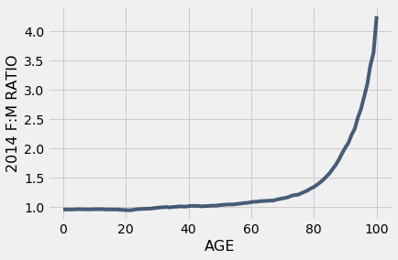
Table Manipulation
Relational operations: select columns, filter rows, sort, group, join, and perform arithmetic on columns of data

Slide 41
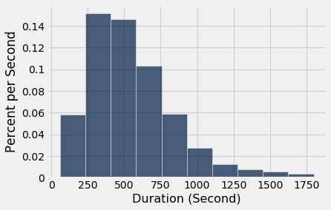
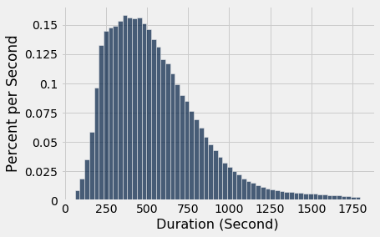
Histograms
Transition from measuring counts to density: allows for bins of different sizes and prepares for future probability courses.

Slide 42
Distributions
Probability content is intentionally limited:
Focus on uniform random sampling from finite populations.
Partitioning and addition, intersections and conditioning, & Bayes’ theorem including a discussion about base rates.
The normal curve, variability of sample means, & the Central Limit Theorem.
No formal treatment of random variables or distribution families other than the normal.

Slide 43
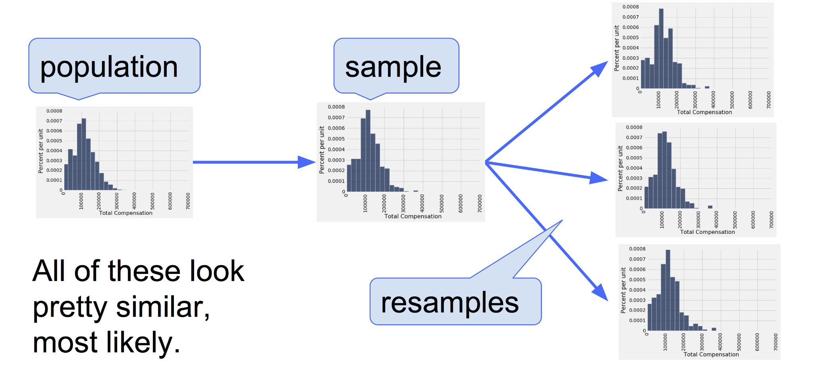
Confidence Intervals
Begins with the observation that empirical distribution of a large random sample typically resembles the distribution of the population from which the sample is drawn.

Slide 44
Linear Regression
The treatment of linear regression in Data 8 echoes the presentation of Statistics by Freedman, Pisani, and Purves.
Correlation as a descriptive statistic.
Properties of the regression line and the assumptions required to use it for prediction; the regression effect.
Equations: least-squares; non-linear regression.
Diagnostics and properties of residuals.

Slide 45
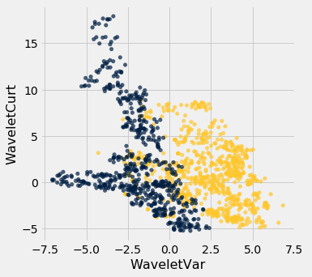
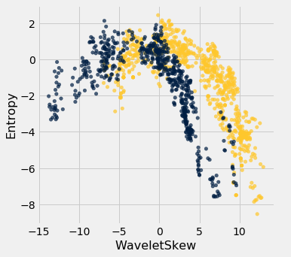
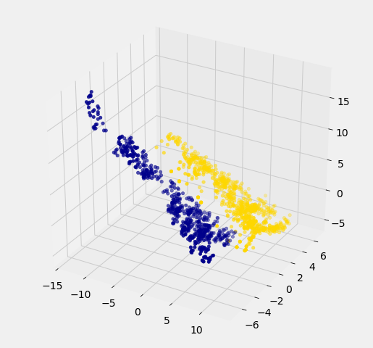
Classification
When (one day) our students learn about a vast array of machine learning techniques and how to implement them, we want them to correctly interpret the result of their work.

Slide 46
Let’s try it out!
More time to Demo / Q&A at 4-5PM - bring a laptop
Regency 4
data8.org/materials-sp22/demo.html
EVD Handy Comm - data8robot
Donna Pink Lady- zoamzng2

