Slide 1
AB 705: Is it working?
California Mathematics Council Community Colleges
Fall Conference 2021
Presenter: Myra Snell,
Professor of Mathematics, Los Medanos College
Co-Founder, California Acceleration Project

Slide 2
CMC³ committed to anti-racist practices
From the CMC³ homepage:
CMC³ as an organization is committed to engaging in anti-racist practices and engaging in discourse to address systemic issues of racism and exclusion in STEM education. We continue to dedicate ourselves to the empowerment of marginalized mathematics students from Northern California Community Colleges.

Slide 3
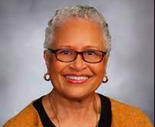
AB 705: most consequential for moving the dial on equity
Pamela Haynes, President, California Community College Board of Governors
“The most consequential thing that is happening on our campuses that will really help move the dial in terms of success for students of color, and in particular Black and Latino/a students is AB 705.”
https://www.cccco.edu/About-Us/News-and-Media/California-Community-Colleges-Outlook-Newsletter/celebrating-black-student-success

Slide 4
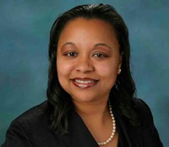
AB 705: historic equity reform
Dr. Aisha Lowe, California Community College Vice Chancellor of Educational Programs and Services
“AB 705 is one of the most significant equity reforms of our time, not just for our state, but nationally. California community colleges are leading the way on remedial education reform and this is the kind of reform that will be talked about in history books.”
From Nov. 29, 2021 CCCCO webinar on Equitable Placement and Completion Improvement Plans.

Slide 5
Core Standard of AB 705
“a community college district or college shall maximize the probability that a student will enter and complete transfer-level coursework in English and math within a one year timeframe”

Slide 6
What was problem?
What is the problem that AB 705 is designed to address?
Why is AB 705 viewed by our system leaders as a pivotal equity lever?

Slide 7
A structural problem: Inevitable attrition
Where students start the sequence | % of students who successfully complete transfer-level math in 3 years (pre-AB 705)
 | At LMC | In California | In AtD study of 5 states | Model 70% success and persistence
Intermediate Algebra | 37% | 35% | 27% | 34%
Elementary Algebra | 18% | 15% | 20% | 17%
Pre-algebra or Arithmetic | 10% | 6% | 10% | 8%
Fall 2016 72% of CCC students start below transfer-level (BTL)
Across CA, more than half of Black and Hispanic students in pre-transfer math
began here

Slide 8
The problem with placement testing
Placement tests were widely used to determine a student’s starting point in math.
Black and Latinx students disproportionately assigned to lower levels of BTL math
Placement tests did a poor job identifying who would and who would not do well in college, e.g. Accuplacer scores explained about 4% of variation in California community college course grades in math.

Slide 9
A form of systemic racism
Tests with very weak predictive validity were being used to place the vast majority of our Black and brown students into remedial pipelines where it is guaranteed (due to inevitable attrition in the pipeline) that they will not achieve early milestones to transfer.

Slide 10
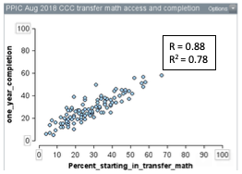
The larger the share of students starting in TL math, the better the TL completion
Fall 2016 first time math takers

Slide 11
AB 705: Is it working?
Did a larger share of students begin in transfer-level math?
Did completion improve?
What has been the impact on equity?

Slide 12
Enrollment in transfer-level math courses increased
% of first-time math students by starting course

Slide 13
TL course completion increased
Completion rate among first-time math students (%)

Slide 14
Completion much higher if students start in transfer-level course
RP Group

Slide 15
Greatest gain in completion for Black and Latinx, but gaps remain

Slide 16
Students of color still less likely to start in TL math

Slide 17
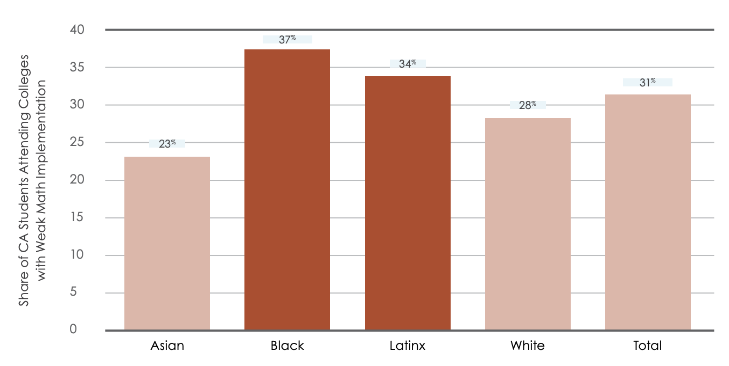
Black and Latinx students disproportionately attend colleges that offer a lot of BTL sections
Weak implementer = remedial courses constitute 30% or more of introductory math sections offered
Sources: Datamart 2018-19, Still Getting There

Slide 18
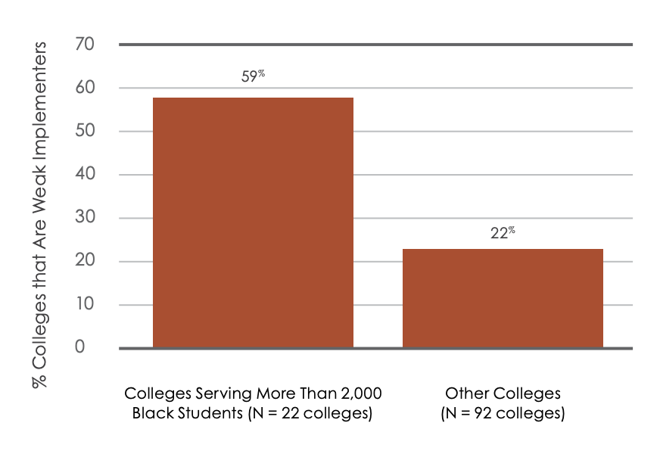
Colleges serving large black populations disproportionately maintain large BTL offerings
Weak implementer = remedial courses constitute 30% or more of introductory math sections offered
Sources: Datamart 2018-19, Still Getting There

Slide 19
Inequitable Implementation Drives Inequitable Completion
Inequitable Transfer-Level Offerings
Black and Latinx students disproportionately attend colleges with large remedial math offerings post AB 705
Inequitable Transfer-Level Enrollment
Black and Latinx students enrolled in remedial math at higher rates (28%, 23%) than Asian (15%) and white students (19%) in first year of AB 705
Inequitable Transfer-Level Completion
Black and Latinx students had lower one-term completion of transfer-level math post-AB 705 (28%, 34%) than Asian (59%) and white students (50%)
Sources: RP Group, Still Getting There

Slide 20
Why do colleges continue to offer BTL math?
We all want what is best for students.
Beliefs about …
Students with weak HS preparation, students with disabilities, older students
Were any groups harmed?
Unprecedented gains in college math completion for every student group examined, including
  low-income students, students with disabilities, students with low HS GPAs, foster youth, veterans.

Slide 21
What about student with weaker high school preparation?
  Belief: Are students with lower HSGPA harmed?
  What does the data say?
  Students with HSGPA < 2.3 twice as likely to complete TL math in one year (fall 2018 vs fall 2019)
  Corequisite support produced better and more equitable outcomes than remediation
  Students in corequisites were much more likely—by more than 30 percentage points—to complete a gateway college course in one term than students who started in remedial education when given one year.
  Corequisite support produced equitable completion for both Black and Latinx students in SLAM math and for Latinx in STEM math.

Slide 22
What about STEM?
  More Black and Latinx students enrolled in TL STEM math and more completed.
  STEM college math enrollments up
  College STEM math enrollments increased 53% for Latinx and 59% for Blacks, compared to 10% for Asians and 5% for Whites.
  STEM college math completion up
  The number successfully completing a gateway STEM math course in one-term increased 32% for Latinx and 29% for Blacks compared to 6% for Asians and 2% for Whites.

Slide 23
What about STEM students with weak preparation?
STEM students more likely to complete TL BSTEM math if they start in TL math, regardless of their level of math progression in high school.
Even those STEM-oriented students who had only completed Algebra 1 in high school had a much higher throughput rate (38%) when they started in TL math vs. Intermediate Algebra (12%).
Only 25% of BSTEM majors who start in BTL in fall 2019 enrolled in a transfer-level BSTEM math by fall 2020

Slide 24
What about students who fail?
Success rates dropped in fall 2019 relative to fall 2018
7% in TL BSTEM (68% to 61%) and 9% in TL SLAM (68% to 59%)
What does the data say?
For students with transfer-intent: TL math completion is 7% higher for those who start in TL and fail vs. those starting in BTL

Slide 25
What factor is the strongest predictor of TL math course success rates?
Is it …
Student characteristics? HSGPA, race, gender, age, disability status, low income, first generation
Instructor variables? Full-time/part-time, experience teaching course
Course-level variables? Time of day, modality (online/face-to-face), learning community, coreq
What factor is the strongest predictor?
Instructor. Who a student has as an instructor explains their odds of passing more than any other factor examined.

Slide 26
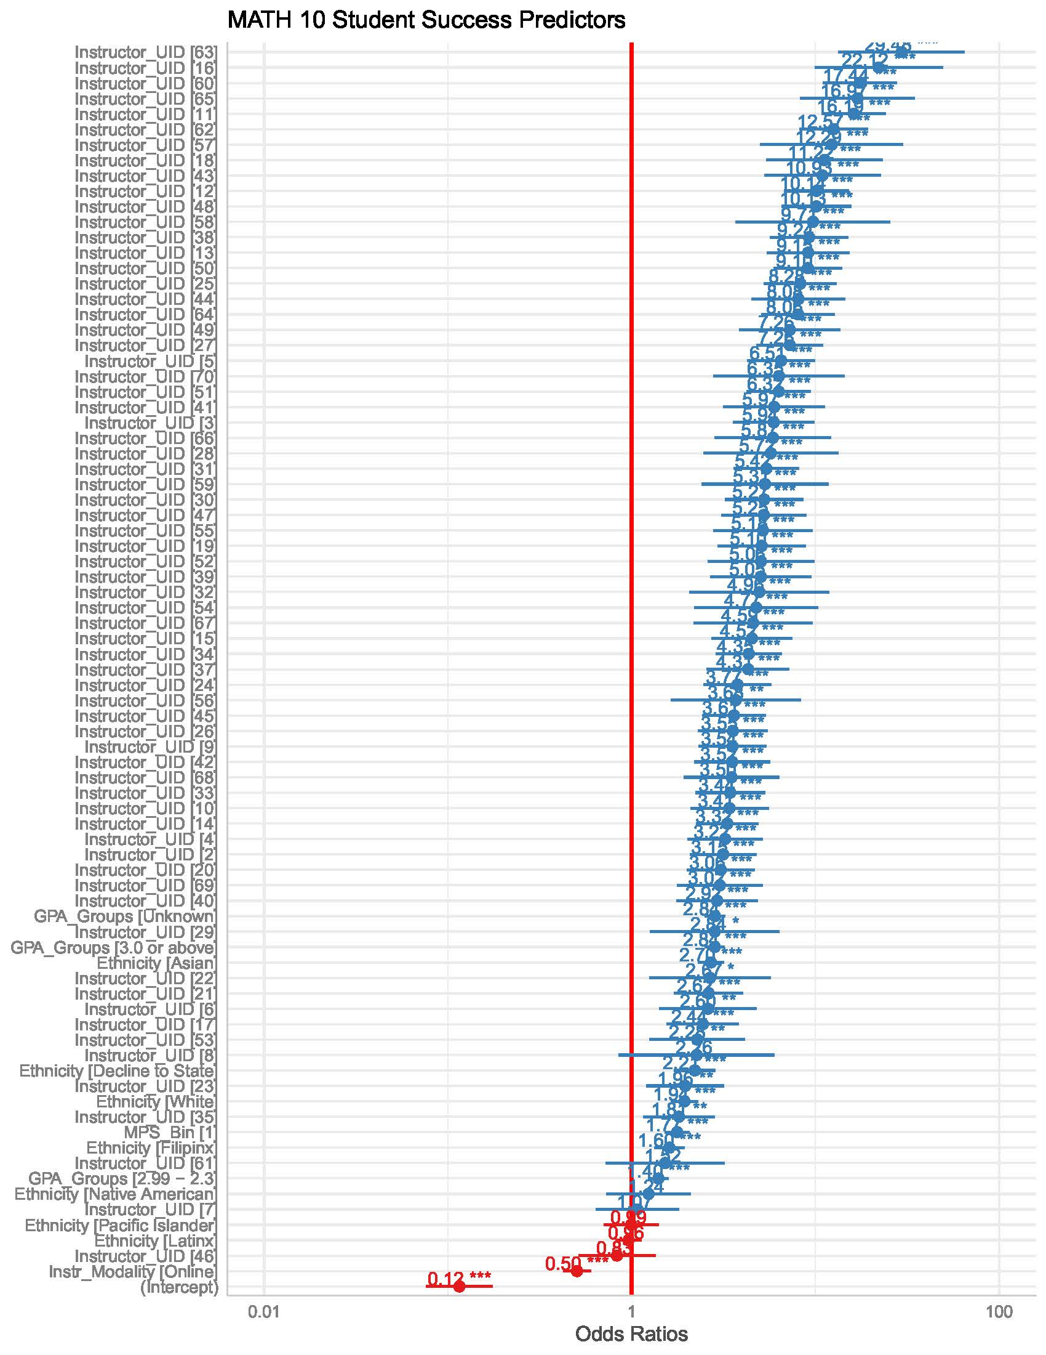
Students in Instructor 16’s course are 22.12 times more likely to pass the course.
Students in Instructor 42’s course are 3.50 times more likely to pass the course.
Asian students are 2.67 times more likely to pass than other ethnic groups.
If a student has a high school GPA of 3.0, they are 2.7 times more likely to pass Statistics
Students in Instructor 46’s course are 0.96 times less likely to pass the course.
Notes:
Walk them through a bit of the data as an example.
Ola

Slide 27

Expectations are powerful
Genius
Dummy
Rats randomly assigned an “intelligent” label
were almost 2x more likely to successfully complete the maze Rosenthal & Fode (1963)
Notes:
How do we explain this? Handling rats …

Slide 28

Teacher expectations are powerful
First grade teachers told by researchers that certain students were going to “spurt ahead” academically.
Students were randomly assigned to this group.
End of year: these students made larger IQ gains. IQ scores increased over 2x more than control group (27.4 points vs. 12 points)
Rosenthal & Jacobson (1963)
Notes:
How do we explain this? Small but consistent difference in teacher’s treatment of “spurters” … more attention, more praise and encouragemnet, more help

Slide 29
Do you agree or disagree with the following statements?
To be honest, students have a certain amount of intelligence and they really can’t do much to change it.
There is not much that the instructor can do to motivate students to do their best work. Students are either intrinsically motivated to do well or they are not.
The achievement gaps for underrepresented minority students (URM) in college math and science are largely due to factors beyond our control and cannot be significantly reduced by the actions of individual STEM faculty.

Slide 30
Teacher expectations are powerful
Study of 150 STEM faculty with growth vs. fixed mindsets about intelligence.
  “To be honest, students have a certain amount of intelligence and they really can’t do much to change it.”
When faculty who espoused a fixed-mindset view, students had lower course grades, and racial equity gaps were twice as large as in classes where faculty believe intelligence can be grown. Students also reported lower motivation in class.
Faculty mindset was a more powerful predictor of student performance than any other faculty characteristic (gender, race/ethnicity, age, teaching experience, tenure status).
Canning, Muenks, Green, Murphy (2019)
Notes:
What might growth mindset faculty be doing that fixed mindset faculty are not? Think-pair-share. This is the focus of our time together.

Slide 31
We can do it!
We can improve math outcomes.
PPIC completion gains largely explained by degree to which colleges started students in TL math
“…it is an important finding that a single variable, within the direct control of colleges, is associated so strongly with improvements in completion.”
We can learn from colleges with strong and equitable math outcomes (the three P’s: placement, pedagogy, professional development)
We are math super heros!

Slide 32
Resources
A New Era of Student Access at California’s Community Colleges
Marisol Cuellar Mejia, Olga Rodriguez, Hans Johnson
Public Policy Institute of California, November 2020
Community College Math in California’s New Era of Student Access
Marisol Cuellar Mejia, Olga Rodriguez, Hans Johnson, Cesar Alesi Perez
Public Policy Institute of California, December 2021
Enrollment and Success in Transfer-Level English and Math in the California Community Colleges System: Fall 2015 to Fall 2019 Statewide Analysis
Brohawn, Katie, Newell, Mallory, Fagioli, Loris
Research and Planning Group, January 2021
CCCCO Transfer-level Gateway Dashboard
Maximizing Math Throughput of Students Who Did Not Complete Algebra 2 in High School
Craig Hayward, Research and Planning Group, August 2021
Still Getting There: How California’s AB 705 is (and is not) Transforming Community College Remediation and What Needs to Come Next

