Slide 1
Incorporating "Social Justice" and Multivariable Thinking Topics in Introductory Statistics Courses
Beth Chance
Cal Poly – San Luis Obispo
bchance@calpoly.edu
www.rossmanchance.com/chance/

Slide 2
GAISE: Guidelines for Assessment and Instruction in Statistics Education (ASA, 2005, 2016)
1. Teach statistical thinking.
Teach statistics as an investigative process of problem-solving and decision making.
Give students experience with multivariable thinking.
2. Focus on conceptual understanding.
3. Integrate real data with a context and purpose.
4. Foster active learning.
5. Use technology to explore concepts and analyze data.
6. Use assessments to improve and evaluate student learning.
Notes:
www.amstat.org/education/gaise

Slide 3
Outline
What is the statistical investigative process?
What is multivariable thinking?
What are some newer technology options?
How can I incorporate more “real data with a context and a purpose” into my courses?
“Social Justice”: What role can “socially relevant” contexts play?
Examples
High school non-AP students
Math/Stat majors
References/Slides posted soon

Slide 4
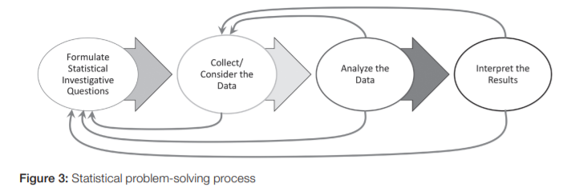
What is the “statistical investigative process”?
Are many variations, but key idea is helping students see the entire process from beginning to end to replication/revision
GAISEIIPreK-12
Notes:
https://www.amstat.org/asa/files/pdfs/GAISE/GAISEIIPreK-12_Full.pdf

Slide 5
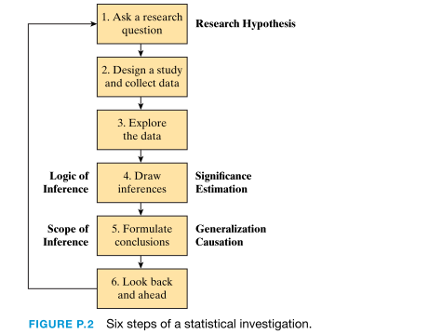
Focusing on the statistical investigative process
Teaching tip:
Effective use of technology so Step 3 and even Step 4 do not take the majority of the course

Slide 6
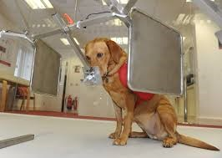
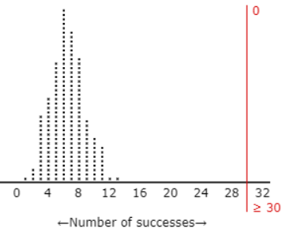
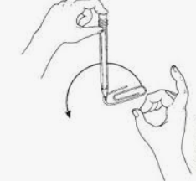
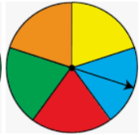
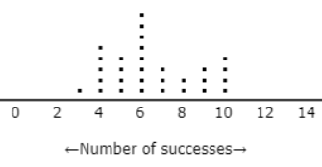
Example
Can dogs detect cancer from breath samples?
Marine was repeatedly given sets of 5 bags, one from a patient with colorectal cancer
Marine was correct in 30 out of 33 attempts
Could Marine have been simply guessing?
Notes:
Leaves time to think about other issues/other questions. Binomial but for a reason. Research question vs. practical use.

Slide 7
Focusing on the statistical investigative process
Teaching tip:
Effective use of technology so Step 3 and even Step 4 do not take the majority of the course
Simulation-based Inference
www.causeweb.org/sbi
Notes:
Students will probably have seen some of these ideas before they get to you. Context and purpose.

Slide 8
Focusing on the statistical investigative process
Teaching tip:
Involve students
Notes:
Students will probably have seen some of these ideas before they get to you. Context and purpose.

Slide 9
Example
Simulation-based inference (SBI) implementation questions
How important is the tactile simulation?
How important is being an individual dot in the distribution?
How well do they “map” to the context?
Last year: randomly assigned students in Canvas to different introductions to this topic, then assessed understanding of process
Appears helpful for students to “be one of the dots”
Asked students to reflect and critique on the process themselves
Ethics, fidelity, blindness, power

Slide 10
Focusing on the statistical investigative process
Teaching tip:
Involve students
Engage
Empower
Enrage?
Notes:
Students will probably have seen some of these ideas before they get to you. Context and purpose.

Slide 11
Examples
Castaneda v. Partida – underrepresentation of Mexican-Americans on grand juries in Hidalgo County
Hazelwood School District vs. United States – underrepresentation of African Americans among high school teachers
What is the comparison group?
Title IX lawsuit against Brown University
Why Binomial Distributions Do Not Work as Proof of Employment Discrimination
Flint, MI water crisis
Removal of “unusual observations”
Notes:
Small steps

Slide 12
What is multivariable thinking?
Recognize that variation in a response comes from many, many sources and be able to identify possible sources
Analyze data in the presence of confounding and bias
Studies can be designed to more effectively control for the many variables that may influence the response
Draw appropriate conclusions from a data analysis and convey the limitations of these conclusions

Slide 13
Why multivariable thinking?
Why?
The world is multivariable; data-centric decision making is on the rise
Making good decisions informed by data requires multivariable understanding
Should not wait for only the students taking advanced statistics courses

Slide 14
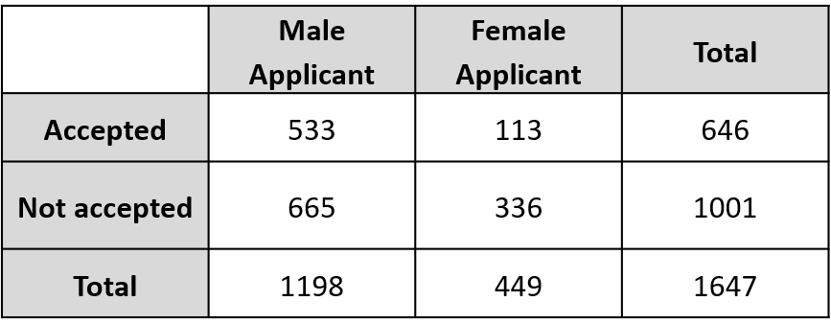
Example: Berkeley admissions
Two-way table
Proportion of females accepted 113/449 = 0.252
Proportion of males accepted 533/1198 = 0.445

Slide 15
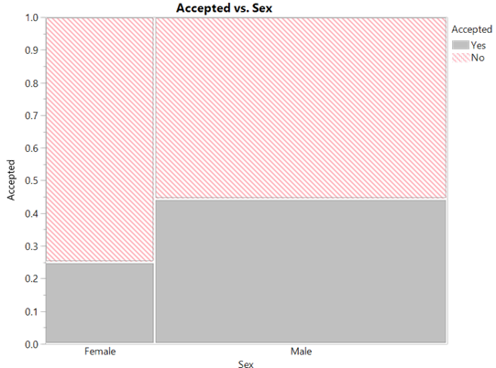
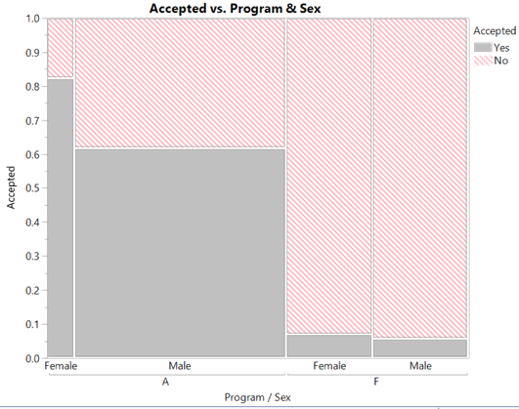

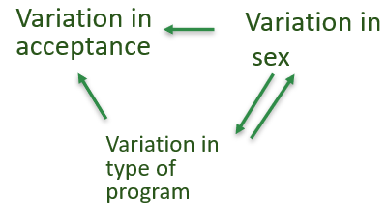
Example: Berkeley admissions

Slide 16
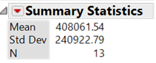
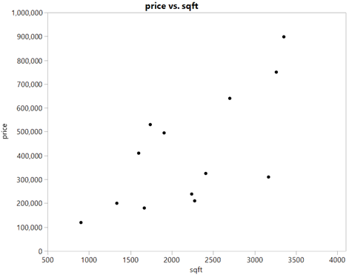
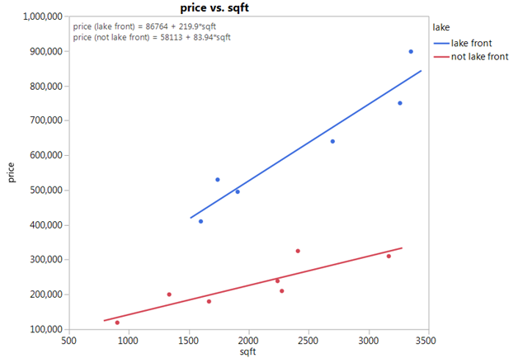
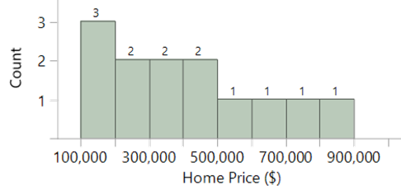
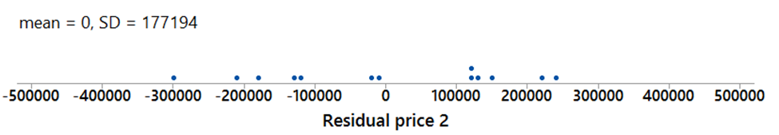
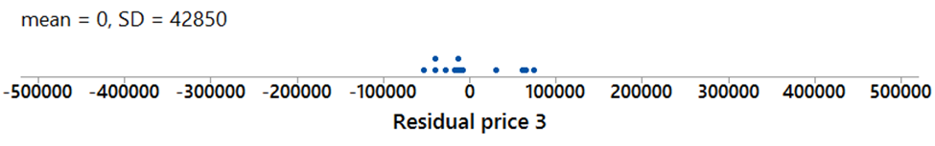
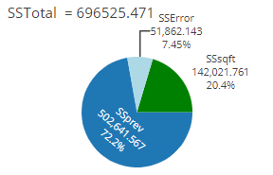
Example: Housing Prices in Michigan
data = “model” + unexplained variation

Slide 17
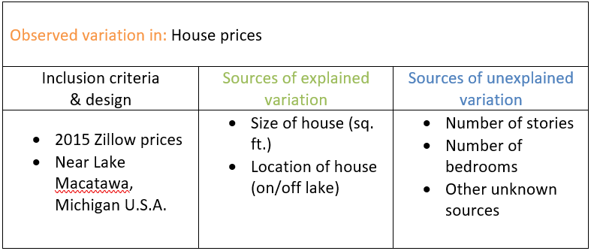
Sources of variation diagram
data = “model” + unexplained variation

Slide 18
Multivariable thinking
Teaching tip:
Effective use of technology so students can explore
Notes:
Students will probably have seen some of these ideas before they get to you. Context and purpose.

Slide 19
Examples
Multiple Variables applet
www.rossmanchance.com/applets/index2021.html
Breakfast and GPA (paste in data)
FEV
Car acceleration

Slide 20
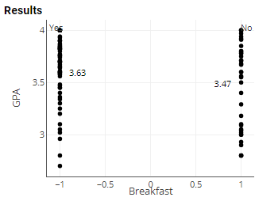
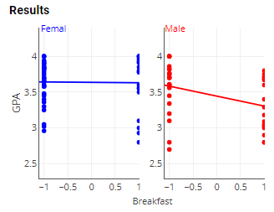
Example: Breakfast and GPA
Subset by males and females

Slide 21
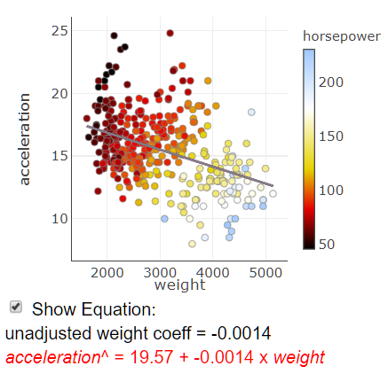
Multivariable thinking
Teaching tip:
Effective use of technology so students can
Explore
Ask questions
Notes:
Students will probably have seen some of these ideas before they get to you. Context and purpose.

Slide 22
Rouncefield (1995)
(p. 3) “Using this dataset, students can ask real questions about real-life situations. These in turn raise ethical and moral questions, which motivate students’ learning, making the subject matter more relevant and interesting. Just as the teacher of history or literature would not avoid moral issues in her lessons, the statistics teacher likewise should not avoid them.”
The statistics of poverty and inequality. Journal of Statistics Education, 3(2).

Slide 23
Example (High school)
Strengthening Data Literacy Across the Curriculum
Funded by NSF DRK-12 (Award no. 1813956)
In collaboration with researchers at Education Development Center (EDC) and The Concord Consortium
Develop modules for use in non-AP Statistics courses in racially and ethnically diverse urban high schools
Raw data from U.S. Census and American Community Survey (IPUMS)
Common Online Data Analysis Platform (CODAP)
Team investigation

Slide 24
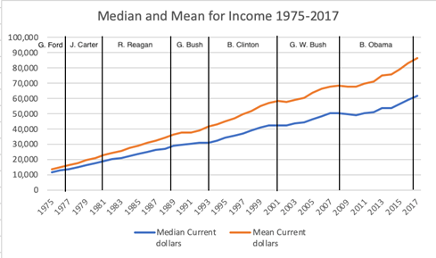
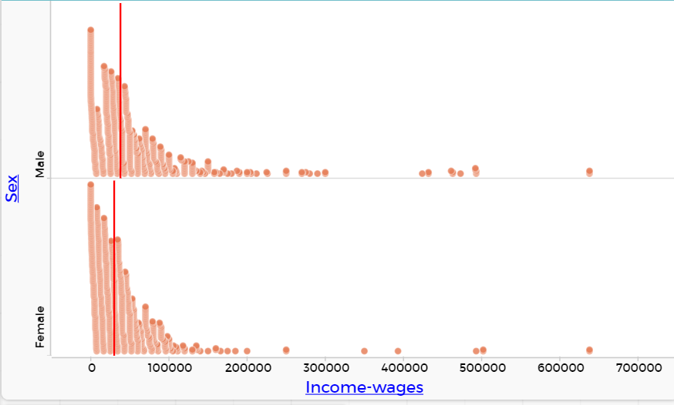
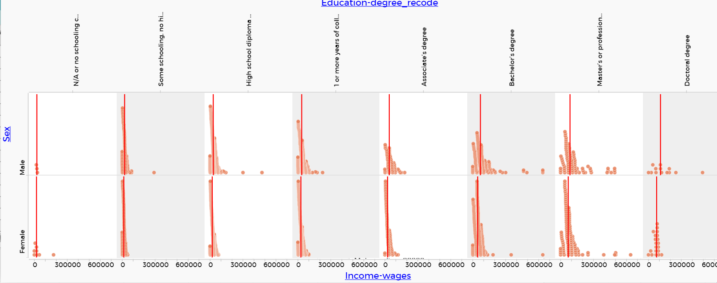
Module 1 - Income Inequality
How is income measured (e.g., vs. wages)
What do we mean by “income inequality”?
What does the income distribution look like in 2017?
Random sampling
Data cleaning
Mean vs. Median
Percentiles (e.g., top 25% vs. bottom 25%), Boxplots
How has the distribution changed over time?
Adjusting for inflation
Mean/Median ratio
Males vs. Females (79 cents to dollar)
Males vs. Females after adjusting for education
$38,000
$30,000
30/38 = .79

Slide 25
Module 2 - Immigration
Myths (TeachingTolerance.org)
Estimating proportion of population that are immigrants
Margin of error
Changes over time
Where have immigrants come from over time
Immigration Timeline
Where have immigrants settled
Conditional proportions
Are immigrants as likely to be employed as U.S. born
Employment rate vs. Labor force participation
Are immigrants as likely to be employed as U.S. born after adjusting for education

Slide 26
SDLC Student quote: Useful, fun, and interesting
“It helped me put the pieces together when people say you’ll never use this in the real world. This was very helpful to understanding and it made me have a new appreciation for math and especially statistics in general. It just helped me be way more engaged throughout the year, and this was probably the most fun I’ve had in math in a very long time and the most interesting thing I’ve done in years.”
Strengthening Data Literacy across the Curriculum

Slide 27
SDLC Student quote: Real-world relevance
“It was more akin to the real world and it had more to do with stuff that you see on the news or that you hear. Everyone needs to know about income and what you make and what you expect to make… I thought it was just really interesting compared to the regular put numbers on paper and see what comes out.”
Strengthening Data Literacy across the Curriculum
Notes:
Another student appreciated how the modules
Focus on real-word topics,
And are much more interesting
Than their usual book exercises and worksheet calculations

Slide 28
SDLC Student quote: Focus on current social issues
“I enjoyed the lessons that discussed current issues such as income inequality between men and women and people with different levels of education. It connected the lesson with the real world and helped me understand both statistics and society in more in-depth ways.”
Strengthening Data Literacy across the Curriculum
Notes:
Another student said the focus on current social issues
Helped them “understand both statistics and society
in more in-depth ways.”

Slide 29
Example (HW exercise)
The Current Population Survey (CPS) is “one of the oldest, largest, and most well-recognized surveys in the United States. It is immensely important, providing information on many of the things that define us as individuals and as a society – our work, our earnings, and our education.” (Optional: video overview)
CPS webpage https://www.census.gov/programs-surveys/cps.html. Follow the links for Technical Documentation and then Methodology.
Current Population Survey Datasets. Follow the link for Annual Social and Economic Supplements. Download a csv file.
Data Dictionary. Find the description of the A_HRSPAY variable. (How did you find it? What did you search on?) What does this variable measure? Who is measured for this variable?

Slide 30
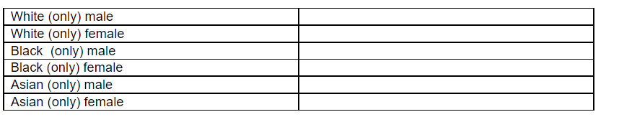
Example
Subset the data to only include the individuals with A_HRLYWK = 1 and A_HRSPAY > 0

Slide 31
Extensions
https://www.pewresearch.org/fact-tank/2016/07/01/racial-gender-wage-gaps-persist-in-u-s-despite-some-progress/
Check out the World Income Inequality database, produce a graph for the USA over time and comment on what it reveals.
Work through Introductions to Databases and/or Introduction to Querying at the Databases for Many Majors website.

Slide 32
Example student response
The article discusses other concrete factors (which we didn’t explore in the homework) that might potentially affect the difference in median hourly wages by gender and race, such as workforce experience, industry/occupation, and standardized tests scores. Even controlling for these factors, the article points out there are still gaps in median hourly wages by gender and race, which could be attributed in part to racial or gender discrimination. However, there are what are referred to as “unmeasured differences” that could be due to factors other than discrimination, for example women or minority groups may be discouraged from entering high-paying STEM fields. I though this reference to “unmeasured differences” was cool, since the researchers are essentially talking about potential confounding variables, but using a more accessible name for it!

Slide 33
Cal Poly end of (intermediate) course survey
Favorite part of course
looking at data with multiple variables and how the impacts differed when certain variables/interactions were included and not included
Best feature
loved how we had an interactive day where we got to work on our own and ask questions when needed. However, this lab part of class would not have been beneficial if we did not get the class time the next day to discuss everything.
the course allows us to get practice doing statistical analyses ourselves, and be able to discuss them later.
Notes:
I LOVE THE SET UP!!! What a brilliant learning mechanism. We are able to be presented something in class, learn it further during the exploration in lab and struggle through it on our own a bit, and then have it all tied back together by reviewing what we did. I think this is extremely successful and would strongly encourage it going forward.
The explorations helped me to understand how ideas were applied and used on real data

Slide 34
Lessons learned
Need careful consideration of how to have these conversations in class (e.g., “myths”)
Make sure students feel empowered for change
Need to balance data cleaning/messiness of real data with more productive struggle, open exploration
Importance of scaffolding experiences across the grades and across disciplines

Slide 35
Resources
Establishing Classroom Ground Rules Washington University in St. Louis, 2009
Facilitating Challenging Conversations in the Classroom.
Four Ways to Facilitate Teaching About Immigration ProQuest, 2017
Making the Most of “Hot Moments” in the Classroom University of Michigan
Speak Up At School: How to Respond to Everyday Prejudice, Bias and Stereotypes Teaching Tolerance, 2018
Race Talk: Engaging Young People in Conversations about Race and Racism Anti-Defamation League, n.d.
Teaching Race: Pedagogy and Practice Vanderbilt University, 2019

Slide 36
References
Gutstein, E. (2003). Teaching and learning mathematics for social justice in an urban, Latino school. Journal for Research in Mathematics Education, 37–73.
Lesser, L. M. (2007). Critical values and transforming data: Teaching statistics with social justice. Journal of Statistics Education, 15(1), 1–21.
Linnenbrink-Garcia et al. (2010). Measuring situational interest in academic domains. Educational and Psychological Measurement, 70, 647–6
Manyika, J., Chui, M., Brown, B., Bughin, J., Dobbs, R., Roxburgh, C., & Hung Byers, A. (2011). Big data: The next frontier for innovation, competition, and productivity (pp. 1–143). McKinsey Global Institute.
Priceonomics. (2017, September 28). The data science diversity gap. Forbes. Increasing demands for data fluency, including in K-12 curriculum (e.g., McKinsey Report, 2016)
Voss, R., & Rickards, T. (2016). Using Social Justice Pedagogies to Improve Student Numeracy in Secondary School Education. Journal of Education and Practice, 7(15), 40–47.
Sproesser, Engel, & Kuntze (2016). Fostering self-concept and interest for statistics through specific learning environments. Statistics Education Research Journal, 15(1), 28–54.

Slide 37
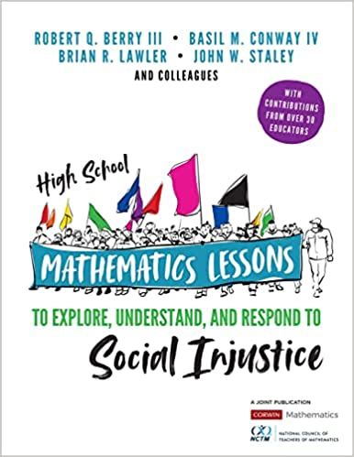

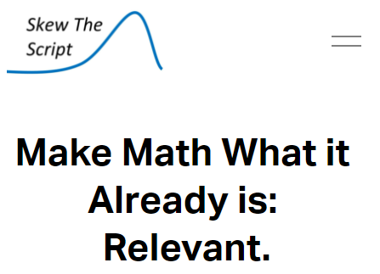
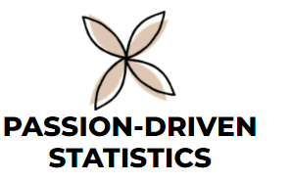

References

Slide 38
Technology for good
Focus on technology for learning
Ease of use, free, platform-independent
Able to handle large (new) datasets
Encourages student exploration and discovery
Data visualization
Multiple variables
Interactive and dynamic
Provides meaningful feedback to/back-and-forth with the student
Doesn’t behave like a “black box”
Can be used to teach as well as do statistics
Conceptual understanding
Communication tool

Slide 39
Thank you!
Questions or Comments?
bchance@calpoly.edu
Copy of slides will be available from the CMC³ conference webpage soon.

Slide 40
More references from discussion
Dana Center Statway (and other resources)
HollyLynne Lee MOOC: Teaching Statistics Through Data Investigations (and other resources)
Active-learning in an Online Environment, Wiley webinar (to receive access to the recording register for the workshop (https://register.gotowebinar.com/register/7958307348926986763 )
Collaborative keys/Engaging diverse learners online (talk)
Flipgrid

