Slide 1
THE DEPARTMENT OF LOWER MATHEMATICS
Rick Luttmann
CMC³ Spring ConFerence
LAKE TAHOE community college
26-27 April 2019

Slide 2
1) From the SSU Star, 10-16 November 2015, page 3, column by Ryan Green, “Quality Education Worth Striking For”:
“[President Obama] gave $561 billion to the Department of Defense. The $102 million needed to give [CSU] teachers their 5 percent increase [Chancellor’s Office figure] is two millionths of $561 billion.”
Uh – two ten-thousandths??? The cost of the raise for professors is a tiny fraction of the military budget, but not quite that tiny!

Slide 3
2) From the SSU Star, 10-16 November 2015, page 4, article by Anna Kehrlein, “The Economist‘s College Rankings Sheds Light on a Liberal Arts Education”:
A bar-graph accompanying the article shows the average annual earnings of university graduates for five universities, including Sonoma State ($45,600) and Chico State ($45,100).
“Sonoma State University was ranked dead last among other California State Universities.” – Uh, the figure for Chico State, another CSU campus, is $500 lower than Sonoma???

Slide 4
“For each institution, they [The Economist] looked at their freshmen class of 2001 and determined average SAT score, ratio of male to female, racial demographics, students’ majors, the size of the college, and the wealth of the state.” – Well, perhaps they did, but how does this relate to the story?
“According to the results from their formula, students who graduate with a degree from Sonoma State are estimated to earn an annual income of $48,462.” What formula? They have the data, why do they need a formula? And the formula apparently “predicts” a higher figure than the bar-graph shows!
I suspect that what The Economist did was a linear regression, and that’s the “formula” the student journalist is referencing. Apparently s/he has never taken a course in statistics!

Slide 5
3) From The Nation, 9 November 2015, page 13:
“[In the Arctic Ocean], minimum summer sea-ice area has decreased by more than half, as has estimated summer sea-ice thickness. Even more alarming, total summer sea-ice volume is less than a quarter of what it was a generation ago.” [Time interval of this decrease unspecified.]
Well, it wouldn’t be more alarming if you know that volume is area times thickness! (And one-half times one-half is one-quarter.)

Slide 6
4) From the Scientific American, March 2016, p 46, summary of an article entitled “Brain Drain”:
“Every day the brain eliminates a quarter of an ounce of used proteins. … The waste-disposal process traffics half a pound of detritus a month and three pounds a year.”
Let’s see: A quarter ounce a day is an ounce in four days and eight ounces (half a pound) in 32 days – close enough. But a half-pound per month times 12 months is six pounds a year, not three!

Slide 7
5) From the Scientific American, March 2016, “Skeptic” by Michael Shermer:
In defense of his claim that there is a lack of political diversity among university faculty in the USA, “the Skeptic” says, “a 2014 study … found that 59.8% of all undergraduate faculty nationwide identify as far left or liberal, compared with only 12.8% that is far right or conservative. The asymmetry is much worse in the social sciences. A 2015 study … found that 58% to 66% of social scientists are liberal and only 5% to 8% conservative.”
Well, maybe 5 to 8 is “much worse” than 12.8, but how can he seriously say that 58 to 66 is “much worse” than 59.8?
And by the way, how does this asymmetry even qualify for “worse”? Does “the Skeptic” find it puzzling that some of the most intelligent, well-educated, well-informed, and thoughtful individuals in our society are liberal? That is indeed a puzzle!

Slide 8
6) I actually saw a use of Denying the Antecedent stated in explicitly fallacious logical form on the Letters page of the East Bay Times. Here it is, quoted exactly word for word: "When I worked for the Navy in Alameda, it was said: ‘If you're not making anybody mad, you must not be doing your job.’ Our President … has so many people mad at him that he must really be doing his job."
Interestingly, the headline that the EBT wrote for the letter states the argument that the author of the letter intended to make:
"Trump doing good job, so many are angry."
Note that this reverses the order of the two propositions, and thus attempts to turn it into a modus ponens. In order to make this a modus ponens, however, the author would need to offer some evidence or argument supporting the claim that Trump is doing a good job other than the fact that people are angry.

Slide 9
7) Contrapositive in folk song
A German folk song has the following lyrics:
Mein Hut, der hat drei Ecken; My hat, it has three corners;
Drei Ecken hat mein Hut. Three corners has my hat.
Und hat er nicht drei Ecken, And has it not three corners,
Dann ist er nicht mein Hut! Then is it not my hat!

Slide 10
8) A guy posted to U-tube a 27-minute recording of a conversation with Verizon’s accounting department regarding a billing discrepancy. He had an unlimited data plan good throughout the US, but in preparation for a trip to Canada he called to find out their data charge in Canada. They said it was .002 CENTS per kilobyte (kb). That seemed awfully low to him so he queried them about whether they didn’t really mean .002 DOLLARS per kilobyte. Nope, they insisted, it’s .002 CENTS. He made them repeat it several times and had them write it explicitly in the record.
Then he got a bill for his usage that was, predictably, based on .002 DOLLARS per kb. It worked out to about $72 this way, but would have been 72¢ at the rate they quoted. They insisted that .002 CENTS is the same thing as .002 DOLLARS, and that he was billed for the correct amount.

Slide 11
They kept going over the multiplication, like he was some kind of dummy: .002 x 35,763 = 71.78. But 72 WHAT? That was the issue, not the arithmetic. He kept pointing out that the .002 was allegedly in CENTS and therefore the result had to be in CENTS, but they were interpreting it as DOLLARS without any attempt at conversion of units. He went through three levels of authority and got the same story from each one. The last was the overall manager, and all she could say was “I’m no mathematician, but …” – hardly something we didn’t already know. She claimed that she and the caller had a “difference of opinion” but he pointed out that arithmetic is not a matter of opinion. Whatever, she said, you owe us $72; your bill is correct. In the end, she told him to write to corporate headquarters.

Slide 12
He was not unwilling to pay the $72, which seemed like a more fair and reasonable price than 72¢. But they have no business charging in dollars when they’ve quoted in cents.
Analogy: If you drive at 50 mph for 3 hours, how far do you go? Well, 50 x 3 = 150 miles. But wait! What if this was in Canada? There they use metric. So 50 mph for 3 hours gets you 150 kilometers.

Slide 13
Here’s another instance of a similar confusion between dollars and cents. A North Bay non-profit I work with needs all its documents available in English and Spanish. Whichever language the document originates in, it must be translated to the other.
A translation service offered to do the translation for .1 (= 1/10) cents per word. That’s 10 words for a penny, 1000 words for a dollar, and $2.30 for a (typical) 2,300-word document. This is absurdly low, so the quote evidently should have been .1 dollars ($.1) or in plain English 10 cents per word.
Another translation service cited a rate of “$.18 cents” per word, which is even worse: mixing the units of dollars and cents together. How about either “$.18” or “18¢”?
At a supermarket I sometimes see signs such as: “cantaloupes, .99¢ per pound”. Really, less than a penny a pound! I’ll take a ton, and feed my pigs.
At one time in the distant past, gasoline sold for less than a dollar a gallon, and one would see signs at filling stations offering, say, “67.9”. No units were specified, but it was assumed to be cents per gallon. Then the price went over a dollar, and oh my the creative uses of the decimal point! I saw signs such as “$103.9” and even “$1.03.9”.

Slide 14
9) From the SSU Star, 29 Aug – 4 Sep 2017, page 5, “News in Brief”: “Hurricane Harvey hit Texas as a category 4 hurricane on Friday night, with winds of up to 130 mph. On Saturday afternoon, the National Weather Service downgraded the system to a tropical storm with exponential rainfall expected to cover the state as late as Thursday.”
Uh, “exponential rain”?!! What kind of rain is that? Rain that’s its own derivative?

Slide 15
10) A writer to Facebook was complaining about having to pay “exuberant taxes”. But aren’t exuberant taxes much more fun to pay than “exorbitant” taxes?

Slide 16
11) From the Community Voice, 10 Nov 17, in an article about putatively low voter turnout: “There are 21,144 registered voters in Sonoma County and only 6,120 ballots were received”, so the turnout was only 28.9%. Indeed that sounds pretty pathetic, but the fact is this was an off-off-year election and many precincts had nothing to vote on. Mine, for instance. So the percentage should have been determined by dividing the number of voters by the number of potential voters who had something to vote on.
Actually, this may be what they did, despite not explicitly saying so. Sonoma County has a population of about half-a-million, so the total number of registered voters in the County is surely a lot higher than 21,144. I suspect this number is in fact the denominator which I suggested is appropriate. But they should have realized that 20,000 is way too small.

Slide 17
12) From Mother Jones Magazine, Nov/Dec 2017, “You Will Lose Your Job to a Robot” by Kevin Drum. Having cited Gordon Moore’s Law that computer power appears to double about every 18 months, the author apparently got hung up on doubling as the benchmark for growth. On page 43 he states, “… even as computer power doubles from a trillionth of a human brain’s power to a billionth …” Whoa, stop right there! “Doubling” means multiplying by 2, whereas to go from a trillionth to a billionth means multiplying by 1000. It takes doubling ten consecutive times to bring about an increase of approximately 1000-fold. Same to go from a billionth to a millionth. However, in partial redemption for his arithmetic sins the author allows that “the final few doublings” will go from a thousandth of human brainpower to full human-level intelligence. As long as “a few” means 10, I’m OK with that.

Slide 18
Based on Moore's Law, 10 doublings will take about 15 years. That means from a trillionth of human brain power to full human brain power would take about 60 years. This is of the same order as Drum's prediction. It must be borne in mind, however, that Moore's Law is only an empirical observation; there is no theory that says it should be valid indefinitely.

Slide 19
13) From “The Humanist”, July/August 2017 issue. On page 42, in the article "Sexual Relativity and Gender Revolution", author of "First Person" Nick Catalano says "Copernicus put the final nail in the coffin of Ptolemy's heliocentric theory ..." He presumably meant GEOcentric rather than HELIOcentric, since precisely what was novel in Copernicus's approach was thinking of the Sun (Helio) as the center of the Solar System, rather than the Earth (Geo) as envisioned by Ptolemy.

Slide 20
14) From “The Humanist”, Sept/Oct 2017 issue. On page 16, the author claims that on a clear night, with the unaided eye, one can see stars "millions or billions of light years away". No, not so. The Universe is indeed enormous, but only our most powerful telescopes can see stars and galaxies that far away. Virtually everything we can see with the unaided eye (with the possible exception of the Andromeda Galaxy) is in our galaxy, the Milky Way, which is about 100,000 light years in diameter. The sun's nearest neighbor is over 4 light years away, and the rest of the stars we can see are at best no more than 30,000 light years away. A far cry from "millions or billions"!
And if the author meant “miles” instead of “light years”, he’s off even more, although in the other direction. It’s 25 trillion miles to the sun’s nearest neighbor.

Slide 21
15) From “The Humanist”, Sept/Oct 2017 issue. On page 26, we read that the Russian Far Eastern city of Vladivostok is "near the Bering Straits between Russia and Alaska". NEAR?! How "near"? It's about 3,000 miles from Vladivostok to the Bering Straits, which is 75% the radius of the Earth! San Francisco is closer to the Bering Straits than Vladivostok is. Take a look at a globe: the Pacific coast of Russia is enormous!

Slide 22
16) From “The Humanist”, Nov/Dec 2017 issue. On page 48 we read that “The [United Nations Environment Programme report Towards a Pollution-Free Planet] … suggests five priorities for the future:
1) strengthening environmental governance;
2) improving resource efficiency;
3) investing in cleaner production and balanced consumption;
4) establishing multi-stakeholder partnerships and collaborations.”
5) ???

Slide 23
17) An article in the Community Voice of 8 December 2017, page 4, purports to argue that elderly drivers are unsafe drivers (well, have a "challenged ability to drive safely"). But then the article goes on to tell us that, while “drivers age 65 and older made up approximately 15% of the licensed drivers in California in 2016”, statewide records show that “drivers age 65 and older were involved in 10.7% of the fatal collisions and 8.3% of the injury collisions in California in 2016.” Sounds to me that these figures make the opposite case: Older drivers are less likely to be threats to public safety. And why should we be surprised? Older drivers: More experienced and less impetuous!

Slide 24
18) “Bombay has more than 40,000 residents” – according to a sleepy shopkeeper at 4 am one morning at the Mumbai Airport. This statement is true, but much too modest. The population of Mumbai was over 18 million in 2018.

Slide 25
19) On page 71 of Scientific American for November 2017, it is stated that "our observable universe is a sphere 93 billion light-years wide". This means, I take it, that the sphere has a diameter of 93 billion light-years and hence a radius of 46.5 billion light-years. That in turn implies that we can see objects that are 46.5 billion light-years away. But, as of this time, our most powerful telescopes can see only ("only"!) about 13.8 billion light-years -- about 30% of the stated figure. And it’s not likely to go higher because we’re already seeing the Universe as it was “moments” after the Big Bang. In other words, nothing can even be more than about 14 billion light-years away, irrespective of what we can see.

Slide 26
20) There is a significant arithmetic error in the February 2018 issue of Scientific American, page 27, in the article "The First Monster Black Holes", first paragraph under the subheading "Feeding a Black Hole". This error undercuts the whole premise of the article, which is that under current theories a 10 SM black hole could not have grown to a billion SM black hole (a “super-massive” BH) in only 300,000,000 years after the Big Bang. But since there seem to be such young and massive black holes, some new theory is putatively required.
We are told that there is a most efficient "feeding" rate for a black hole, known as the Eddington rate, and it is such that the mass of a black hole feeding at that rate will double in 10⁷ years. Since 2¹⁰ is close to 1,000, we see that in ten doubling periods (10 x 10⁷ = 10⁸ years) a black hole will grow three orders of magnitude, that is, by a factor of 1,000.

Slide 27
So what will happen to a black hole initially at 10 SM after a billion = 10 x 10⁸ years? It will have grown by 10 factors of 1,000, i.e., 10³⁰, and have a mass of 10³¹ SM. This is way larger than the desired one billion SM. In fact, after only 300,000,000 years (three periods of growing by a factor of 1,000 each) a 10 SM black hole will have grown by a factor of 10⁹ = (10³)³ to 10 billion SM, i.e., past the one-billion SM mark.
Actually, in only 270,000,000 years it would already pass the 1 billion SM size. For that matter, even a 1 SM black hole (if there were such a thing) would grow to a billion SM in 300,000,000 years. So it appears that there could easily be black holes of a billion SM only 300,000,000 years after the Big Bang, and no fancy new theories are necessary.

Slide 28
S5 0014+81is a super-duper-massive black hole with a radius roughly 800 AU (the distance from the Earth to the Sun) and a mass of up to 40 billion Suns.
Apparently if this quasar, known as a blazer, were 18 million AU from us (280 light years from Earth), it would shine as bright in the sky as our sun.

Slide 29
21) In “The Progressive” for February/March 2018, page 46, we read that a certain company “averages two complaints a day for a seven-year total of nearly 2,500 gripes.” Yes, but in seven years there are 2,557 days, so if there are only 2,500 gripes in that period, that’s an average of less than one a day, a long way from 2, no?

Slide 30
22) The Gay/Lesbian Victory Fund raved that “[out] LGBTQ members make up just 0.015% of Congress. That’s not representation – That’s ridiculous!” Then came the inevitable pitch for funds.
They probably meant 1.5% of Congress, which would be 8 Senators and Representatives out of 100 + 435 = 535. Because .015% (or .00015) is .08 people! We don't send body parts to Washington.

Slide 31
23) From an undated issue of The Nation, “Letters to the Editor”: The writer is concerned about a deceptive graphic in an article “Women in War Industries” from a previous issue. Similar icons of women of various sizes were used to illustrate the numbers of women in war industries in various WW II combatant nations. The actual numbers were also given.
Either the height of the women (as in a bar chart) or the area of the women should have corresponded to the numbers – but neither did. Because of the visual impact of a graphic, area would have been fairer – unless the women were all depicted as the same width and differed only in height. The actual ratios for US:UK:Germany:USSR were 1:3:5:17, whereas the height ratios were 1:2:4:12 and the area ratios were 1:4:16:144

Slide 32
Actually, since the women depicted are in reality three dimensional objects, their volumes should have represented the numbers.
This kind of graphical deception is common, but the letter writer is aghast to find it in The Nation! Shades of “How to Lie with Statistics”, a well-known book by Darrell Huff.
Political suasion may be an issue here. Going by height, the contribution of Russian women is understated, while the other gives succor to the anti-Communist hysterics.

Slide 33
24) From Kaua’i’s newspaper The Garden Island, 12 Nov 2018, in an article on “too many cars”, the author proceeds as follows:
“Count the number of vehicles on Kaua’i. Count [sic] the number of miles of roads on Kaua’i. Divide the number of miles by the number of vehicles, giving us the number of vehicles per mile of road.”
No. To get “vehicles per mile” it is necessary to do the division in the other order. “Divide miles INTO vehicles” would do it. A lot of people confuse dividing BY with dividing INTO. The two operations are similar, but definitely not the same. They give reciprocals, in fact, so when one quotient is large the other is small.
Usually the larger is preferred, as it is easier to grasp intuitively. Hence we calculate fuel efficiency for our vehicles in “miles per gallon” rather than “gallons per mile”. The latter might be appropriate if we are talking about tanks or private jets, e.g., “4 gallons per mile”.

Slide 34
Speaking of reciprocals, there is a type of problem that is common on scholastic aptitude tests, of which a typical example is the following: “Adam can complete a job working alone in 3 hours. His less-proficient apprentice Bart can complete the same job working alone in 6 hours. How long will it take Adam and Bart to finish this job if they work together?”
The trick in doing this kind of problem is to use reciprocals: Convert “hours per job” into “jobs per hour” by reciprocating. “Jobs per hour” can be added for the two workers. So, Adam does 1/3 of the job in an hour, Bart does 1/6 of the job in an hour, so together than do 1/3 + 1/6 = ½ of the job in an hour. Thus it takes 2 hours (reciprocate ½) for both to do the job working together. The operation we are implying here might be called “harmonic addition”: Reciprocate the sum of the reciprocals.

Slide 35
25) I visited the NASA exhibit in the Astronomy Building at Arizona State University in Tempe in late October 2018. I discovered a major arithmetic error in one of their exhibits!
The exhibit involved a large model of the Earth, with several significant facts about its motion on a placard. It said, among other things, that the orbital speed of the Earth is about 66 mph.

Slide 36
Now let’s see: The Earth’s orbit is nearly circular, about 92.9 million miles in radius, so 584 million miles in circumference (2πr). The Earth has 365.2425 x 24 = 8,766 hours to make this journey, requiring an average speed of 584,000,000 ÷ 8,766 = 66,589 mph or 66,589 ÷ 3,600 = 18.6 miles per second. The NASA figure of 66 mph was off by a factor of 1,000!
No wonder NASA crashed a $200 million Mars explorer several years ago because some of the staff was working in metric and some in Imperial.

Slide 37
Addendum: In the fall of 2018, NASA deliberately crashed the space probe Cassini into Saturn. Some music was written to commemorate Cassini’s fate. It is entitled “Cassini: An Opera in Three Minutes”. Here’s an Aria from that Opera (sung to “La Donn’ e Mobile” from Verdi’s Rigoletto):
“Farewell, Cassini,
“Your mission’s fini.
“Bravo, Cassini!
”Have some linguini.”

Slide 38
26)
Be careful how you order off the menu!
At our local café, it’s $3.75 for a bowl of soup, $3.75 for a salad, and if you want both you’d better order them separately (total $7.50), because the combo is $8.00!
At a local Thai restaurant, you can order on the side
Jasmine rice for $2.00
Brown rice for $2.00
But if you want a main dish that comes with rice to have brown rice instead of Jasmine you have to pay $1.00 extra!

Slide 39
Pizza menus can be total chaos!
There is usually a matrix displaying prices as a function of size and toppings. There should be a formula. At least for a constant-topping row. The price should be a fixed cost (K) plus a constant multiple (C) of the diameter (d) squared: price = K + C d^2. I’ve yet to see one even this organized!
The situation gets even murkier going down the matrix when topping choice varies. Whatever non-rule was used for prices in one row is often replaced with a different non-rule in another row. Sometimes topping A will exceed topping B for one size but the reverse in a different size.
A new vocation: Mathematical Consultant on Pizza Pricing!

Slide 40
27) In a fabric store, I encountered a whole shelf of fabrics marked “1/3 off!”. I went to the counter with my selections, which totaled $27.54. The cashier computed a 30% discount and announced the sales price. I said, “The sign reads ‘1/3 off’”. She said, ”Yes, I gave you 30%, Sir.” I said again, “But the sign reads ‘1/3 off’”. Screwing up her face, she said, “But aren’t 1/3 and 30% the same?” My eyes surely showed my amazement.
No, they are not the same, I replied. “1/3 is 10/30, but 30% is only 9/30.” Now her eyes definitely showed her amazement. As if to say, “Who knew I’d ever need fractions again after I passed third grade?”
Now, the real problem: how to ask her cash register to determine 1/3. She thought there was no way for it to do that, because the register didn’t divide. I was about to write down the division of $27.54 by 3 on a piece of paper when she skittered away to discuss the matter with her supervisor. An animated discussion took place for several minutes. Then the supervisor came over to me and said, “Sir, you’re quibbling over round-off error. The closest our register can come to 1/3 is 30%.” I pointed out that nearly 92¢ is hardly round-off error. I showed her 3 divided into $27.54 is $9.18, my true discount, whereas her 30% of $27.54 is only $8.26. I also pointed out that she could ask the register to determine a 33.33% discount, and although that was not quite right I could accept that much round-off error.
They gave me the $9.18 discount, but they didn’t like it. They glared at me suspiciously as I left the store with my purchases.

Slide 41
28) BETTER LIVING THROUGH THE DISTRIBUTIVE LAW
Several months later I was back in this same fabric store. On the remnants table, offering any remnant for $2.98 a yard, I found nine pieces of fabric of various but overall short lengths that suited my purposes. When I got to the counter I announced the total price to the cashier, $28.69. She ignored me and proceeded to calculate laboriously $2.98 times each of the remnant lengths – which are stated in multiples of 1/8 of a yard. (Multiplying a decimal by a mixed number is a bit challenging.) Then I repeated the total I had calculated. She snorted that “such a smart-aleck” sort of snort, and began to add up her figures. Her demeanor changed entirely when she got the answer I had already given her.
“How did you do that?” she demanded to know, but appearing to fear I was some sort of shaman. “Well, I went to grade-school,” I replied snarkily.
“It’s a simple matter of making repeated use of the distributive law. First, you don’t have to calculate the price of each piece. Just add up the lengths and multiply once by $2.98. The lengths can all be converted to integer multiples of 1/8, which makes adding them up very easy. I got 77 eighths, which is 9 5/8.
“To multiply that figure by $2.98 in your head is easy, using the distributive law once again. Think of $2.98 as $3 less 2¢. Three (dollars) times 9 5/8 is 27 + 15/8 or $28.88. Two (cents) times 9 5/8 is 18 + 10/8 or about 19 cents. Total price is then $28.88 - .19 = $28.69.”
Her brow furrowed at the idea of having to borrow to do the subtraction. “Take away 20¢ and add back a penny,” I suggested.

Slide 42
29) The lead sentence in an article in The Nation magazine for 22 October 2018 reads: “The U S Supreme Court sits more than 12,000 miles from Tragadi Bandar, the patch of India’s west coast where Budha Ismail Jam has spent most of the past two decades fishing for a living.”
How can educated people (such as the writers and editors of The Nation must surely be) allow such an egregious geographical error to pass?
I was in grade school when I was taught that the circumference of the Earth is 25,000 miles. I believe it was in conjunction with a lesson on Columbus – most of which was historical nonsense, but the geographical fact is correct.
So, no point on Earth can be farther than 12,500 miles from the U S Supreme Court. And those points that are “more than 12,000 miles” from it lie within a relatively small circle (500-mile radius) around the antipodal point to DC. That point is in the southeast Indian Ocean, over a thousand miles southwest of Perth, Australia. Nowhere close to India.
It took me about 15 seconds to query SiRI about the distance from DC to Mumbai: just over 8,000 miles. The flight path goes right over Gujarat and the Gulf of Kutch, so it’s a couple hundred miles less between there and DC. Thus the figure cited in the article is exaggerated by over 50%!
Although this error is not material to the story, how can The Nation expect to have credibility on any of its stories if it can’t even get something this elementary correct?

Slide 43
30) The Democratic Party Council of a deep-red Congressional District in the Sierra Nevada had to choose which of three candidates to endorse. They decided to do a straw poll of registered Democrats. Voters were instructed to mark “1” by their first choice, “2” by their second, and “3” by their third. Observe that here, a lower score indicates stronger support. These votes were tallied and the one with the lowest score declared the most popular and thus the Party’s endorsed candidate.
The trouble is that some voters chose to express only their first choice, and left blanks for the other two candidates. So these candidates got counted as “0”, which is an even better score in this system than “1”! About 1/3 of the voters did this. Thus the most popular candidate lost.

Slide 44
UNTIL! -- a local mathematician came to the rescue! Having received the data for use in a statistics course, he discovered the problem. He explained the concern to the Council, and suggested that the fairest way to proceed when two candidates were not ranked would be to give each of the two candidates scores of 2.5 each – the average of 2 and 3, on the theory that they were evidently, in the voter’s mind, tied. This would significantly raise their tally, and make them appear appropriately less popular.
So in the end the most popular candidate did win the straw vote, and got the local Party Council’s support.
(And after all that, went on to lose to the Republican candidate in the general election!)

Slide 45
31) Sorority case: A predominantly Latina sorority says it was wrongly punished for hazing by the University of Virginia for requiring its members to study 25 hours a week. Sigma Lambda Upsilon sued in September, saying the University in Charlottesville agreed with a recruit who complained that being asked study so much violates the school hazing policy. The school suspended the sorority in March. The University claimed immunity in a motion to dismiss the suit, but a judge last week allowed the sorority to add University officials as defendants.
Can you imagine how terrible this must be, sorority members expected to study 25 hours a week in college? Everyone knows sororities and fraternities are for partying.

Slide 46
32)
An article in the Community Voice regarding the one-year anniversary of the beginning of SMART rail service in Sonoma and Marin Counties:
Paragraph 1: “After one year of carrying countless passengers …”
Paragraph 2: “The rail service has carried a whopping 660,000 passengers since opening …”
Clearly these journalists don’t know the mathematical definition of “uncountable”!

Slide 47
33) Australia passes Back-Door Encryption-Busting Law
“Encryption is simply math,” Apple wrote in a statement submitted to the Australian Parliament’s Joint Committee on Intelligence and Security on Oct. 12. “Any process that weakens the mathematical models that protect user data for anyone will by extension weaken the protections for everyone.”
But politicians said the risk of encryption technology’s being used by terrorists was too significant. Prime Minister Malcolm Turnbull of Australia said in July, “The laws of mathematics are very commendable, but the only law that applies in Australia is the law of Australia.”

Slide 48
34) From the 3-9 Sept 2013 issue of the Sonoma State STAR: "... An agreement ... calls for a salary increase of 1.34 percent. ... Assuming a teacher in the CSU system makes an average of $90,000 a year, their [sic] salary would increase to $120,600 per year." The mathematical illiteracy of this calculation is mind-boggling. I'd flunk a kid out of third grade who turned in something like this. They've actually given (the "average" teacher) a raise of 34%, not 1.34%. Multiply the salary by .0134 to get the amount of the raise, or by 1.0134 to get the new salary.

Slide 49
We have to wonder about the accuracy of some of the rest of their claims, as well. It is beyond belief that the "average" of CSU faculty member salaries is $90,000 a year. It's doubtful that was even the average of full professor salaries. Besides, the agreement that was reached does not speak of percentages at all, although it is perhaps the case that the amount available for raises is 1.34% of total current salaries. Each faculty member got the same raise of a bit under $1,000 per year. Also please note that "a teacher makes an average salary of ..." and "the average teacher makes a salary of ..." are both inferior to "the average of teachers' salaries is ... "

Slide 50
35) Tax or Discount First?
When a merchant offers a sale on a purchase, it’s sometimes stated as a fixed dollar amount or, more commonly, as a percentage. Does it make a difference whether the discount is applied before or after the tax?
Yes, if the discount is a fixed dollar amount, no if it’s a percentage.
Suppose 20% discount on a $200 microwave in a jurisdiction with 9% sales tax. The customer pays $200 x .80 x 1.09 if discount is first, $200 x 1.09 x .80 if tax is first. Multiplication is commutative, so no difference.
But suppose a $15 credit against a $35 meal in the same jurisdiction. The customer pays ($35 - $15) x 1.09 with the discount first, but $35 x 1.09 - $15 if the tax is first. The latter is higher (by 9% of $15), and is probably illegal – the merchant is charging tax on an amount the customer didn’t pay.

Slide 51
36) How to build a volcano Mauna Kea is of volcanic origin, so we shall model it as a cone. It is the highest mountain in Hawaii, and the highest mountain in the world measured from its base. The mountain’s peak is 13,000 feet above sea level, but the ocean is about 13,000 feet deep there. So the sea’s surface cuts its vertical reach in half. There is botanical evidence that the above-water part of the mountain has been exposed for a million years. So how old is the mountain?

Slide 52
Although volcanic activity is episodic, over long intervals of time the volcano can be considered to add mass at a constant rate. A geology book argued that since the whole cone is 8 times the above-water part (true) it should have taken 8 times as long to build. Therefore the volcanic activity began 8 million years ago. WRONG! A mason might begin building such a cone from the base up, and it would take him 8 times as long to build the whole thing as the final segment at the top. But that’s not how volcanos are built. The shape is always a cone, based on the ocean floor, and it gradually grows higher as mass is added. When the top of the cone broke the surface of the sea, the cone looked like the right-hand sketch. It would then take 8 times as long to create the whole cone as seen today. So 7/8 of the life of the volcano was spent with some part above water. Thus the volcanic activity began (8/7) million years ago.

Slide 53
37) “… up to more than …” ??
From The Progressive Magazine, Oct/Nov 2018, p 43, in an article about marijuana dispensaries: “… a deal to open up to more than [my emphasis] two dozen dispensaries across [Florida] …”
“Up to two dozen” means D ≤ 24
“More than two dozen” means D > 24.
No D could possibly be both ≤ 24 and > 24 at the same time!

Slide 54
38) This story involves someone doing something right, but leaving out some important details. A letter-writer to the Community Voice (23 Nov 2018) was concerned about utility bills from Rohnert Park not getting delivered. He figured there were five potential places where there could be a screw-up (the billing office, the printer, the post office, etc), and he apparently assumed that the probabilities of a screw-up at each of the fives places are equal – though he didn’t say that, nor what they are – and he also apparently assumed independence, though not explicitly.
According to his calculations there is a 1 in 120 chance of any given bill being mishandled somewhere along the five stages and not being delivered, so out of 10,000 bills for all the residences in the city about 83 are not delivered each billing cycle. What I wonder, then, is what would those five equal probabilities have to be in order to reach this conclusion.

Slide 55
Well, a probability of 1/120 that a bill will be mishandled somewhere and not delivered means a probability of 119/120 that it won’t be mishandled at any stage. Thus 119/120 is the fifth power of the probability of non-mishandling at any one particular stage, which must therefore (by extraction of a fifth root) be .99832775… . By complementation, we find the probability of mishandling to be about .00167225. By looking at the reciprocal of this number, we find it is about 1/598, and this is the closest number of the form 1/n for n an integer. So this is the missing probability.
But given our penchant for “round numbers”, I suspect the author actually began with 1/600. That is, there is 1 chance in 600 of a bill being mishandled at any single stage, or put another way, in the long run about 1 in 600 bills is mishandled.

Slide 56
Is it a coincidence that the two probabilities, 1/120 and 1/600, are related by a factor of 5, the number of possible screw-up stages? No! If we run through this entire argument again but generically (i.e., using algebra instead of arithmetic), we find ourselves using the binomial theorem. And when one of the terms of the binomial is significantly smaller than the other, a one-term approximation is very accurate.
Specifically, letting p denote the probability desired, we must solve
1 – (1 – p)⁵ = 1/120, which is easily done formally to get p = 1 - ⁵√(119/120). But how big is that? Hard to see.
Expansion of the LHS of the equation yields 5p - 10p² + 10p³ – 5p⁴ + p⁵ = 1/120. Since p is clearly going to be very small, we can with relative impunity discard all but the first term on the LHS, because the powers of p from 2 on up are small even compared to p. (Alternatively, factor the LHS into p(5 - 10p + 10p² – 5p³ + p⁴), and observe that the second factor is virtually 5.) Thus approximating, 5p = 1/120 and so p = 1/600.

Slide 57
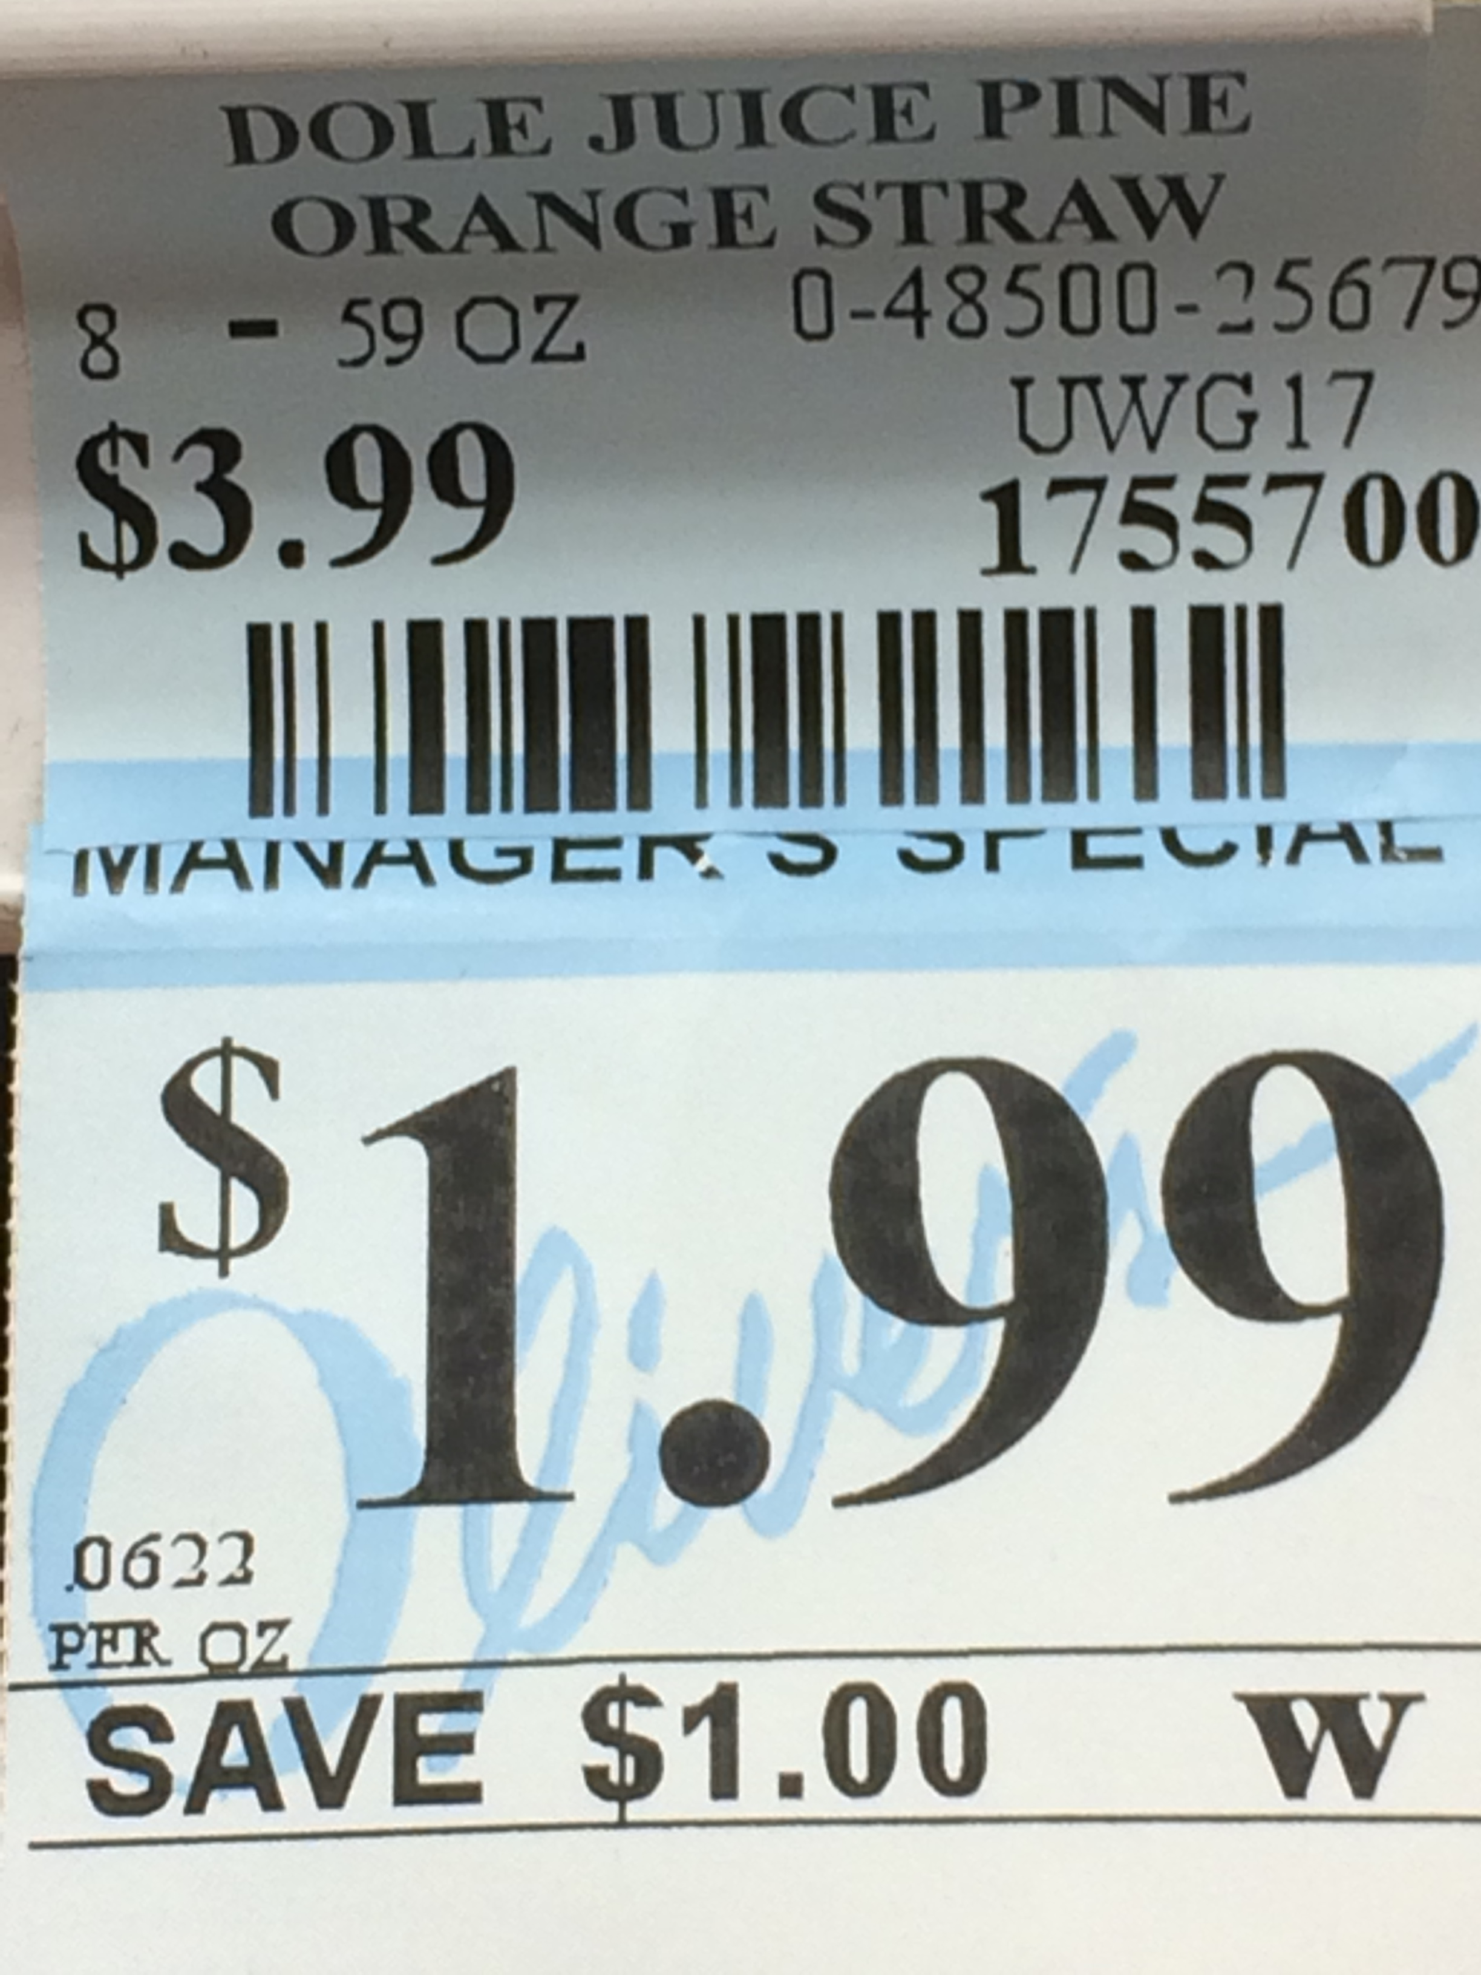
39)

Slide 58

40)

Slide 59
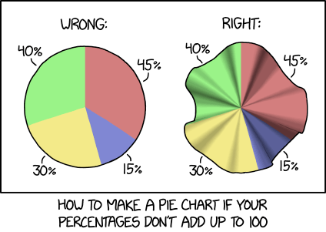
41) Creative uses of Hyperbolic Geometry!

Slide 60
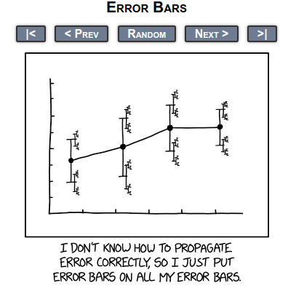
42)

Slide 61
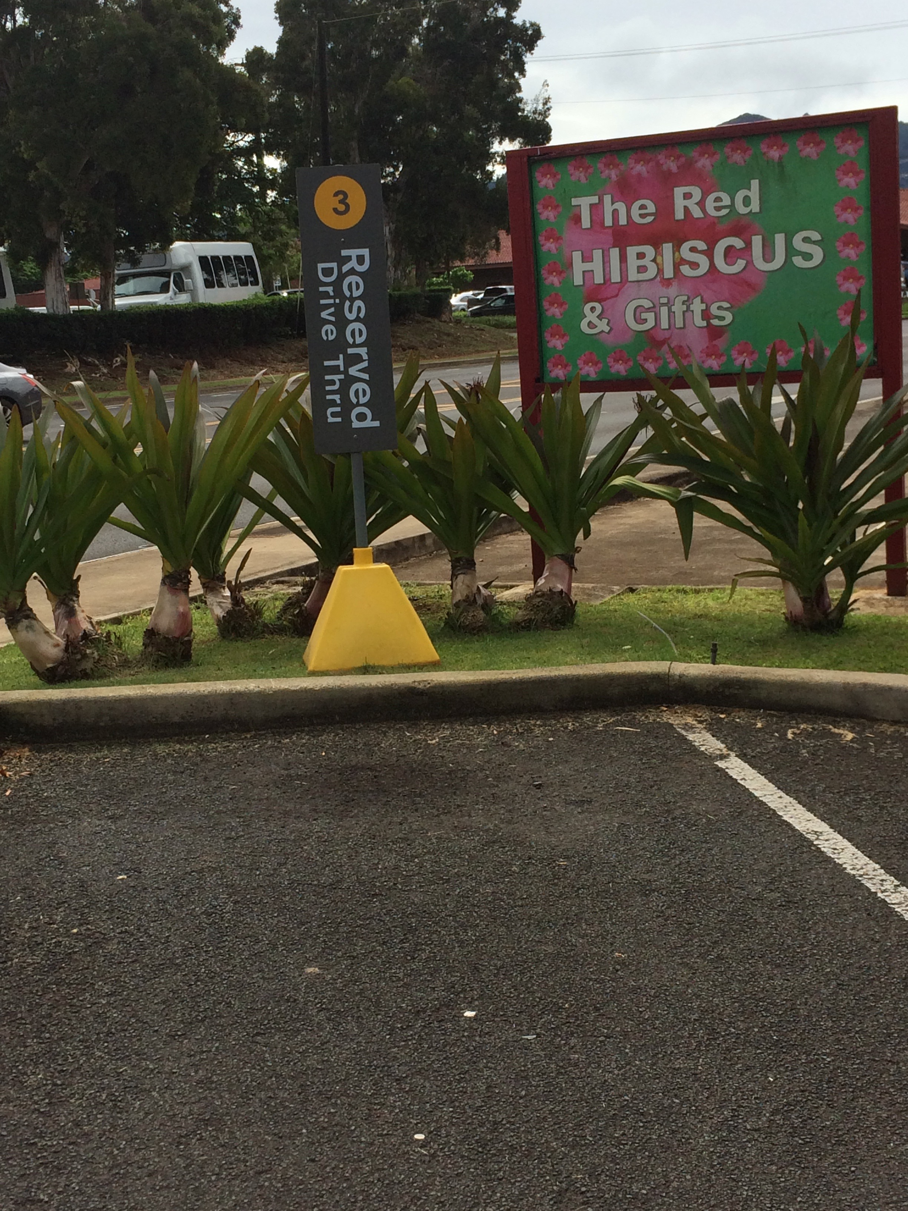
43)

Slide 62
44)

Slide 63

Bonus

