Slide 1
The Pancake and Ham Sandwich Theorems; Scottish Café; Polish Mathematics during WWII Occupation
Charles S. Barnett
Formerly Adjunct Instructor
Las Positas College
Presented at the 23rd Annual Spring Conference
California Mathematics Council, Community Colleges
Lake Tahoe Community College
April 26-April 27, 2019

Slide 2
Attribution
Hill, Theodore, Slicing Sandwiches, States, and Solar Systems, Volume 106, No. 1, American Scientist, January-February, 2018
Davis, P. J. and Hersh, R. The Mathematical Experience, Houghton Mifflin, 1981 (pages 274 to 284)
Various online sources

Slide 3
Overview
“Fair” division of an asset is an old and continuing problem. The Supreme Court gerrymandering cases in Wisconsin and Pennsylvania constitute recent examples. The mathematics of fair division, begun in Poland in the 1930s, has matured into a sophisticated branch of modern mathematics
“The general subject of fair division has been studied extensively using mathematical tools, and some of that study proved very useful in practice for problems such as dividing estates or fishing grounds.
For gerrymandering, however, there is still no widely accepted fair solution. On the contrary, this October Pablo Soberón of Northeastern University showed that a biased cartographer could apply mathematics to gerrymander on purpose, without even using strange shapes for the districts.” (Hill, 2018)
I restrict most of my presentation to the seminal work that was done in Poland in the 1930s. About half is mathematics and half is about the mathematicians; their story simultaneously charms, inspires and distresses.
And a marginally related personal anecdote.

Slide 4
Part I: the Mathematics

Slide 5
First up: the Borsuk-Ulam Theorem
This theorem is not the Pancake or Ham-Sandwich Theorem, but it is used to prove the general, n-dimensional version of the Ham-Sandwich Theorem (a proof that I will not present). Its main import for this presentation involves interesting implications of the theorem’s one and two dimensional cases.

Slide 7
Popular and surprising (at least to some of us) implications of the
Borsuk-Ulam theorem
At any given time, there exists at least one pair of antipodal points on the earth’s equator with equal surface air temperatures. A similar assertion applies to any great circle and any other single, continuously variable parameter.
At any given time, there exists a pair of antipodal points on the earth’s surface
at which the air temperatures and atmospheric pressures are equal.

Slide 9
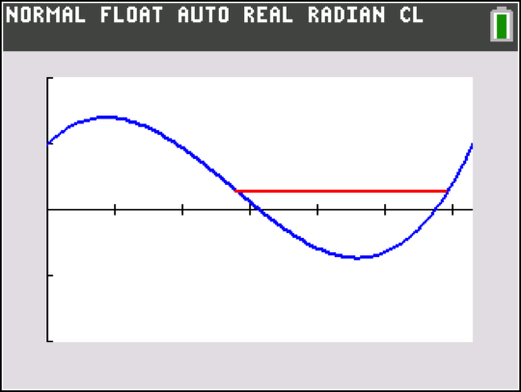
Simple example of equality of a function at antipodal points
Y₁ :[0,2π]➔ R ;Y₁(0)=Y₁(2π) Antipodal line

Slide 10
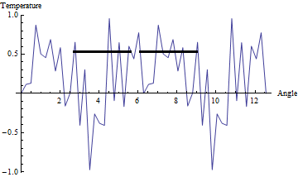
A not-so-simple example of equality of a function at antipodal points

Slide 11
A physical model of the n=1 case is easy to construct
A coffee can, a strip of paper, a pair of scissors and a wooden dowel suffice to illustrate the n=1 case of the Borsuk-Ulam theorem.
The crude model now circulating illustrates the assertion. Observe that continuity is required but differentiability is not.

Slide 12
The theorem takes its name from the n=3 case.

Slide 13
Ham Sandwich Theorem for n=2 is the Pancake Theorem
The area of two plane pancakes of arbitrary shape can be simultaneously bisected by a single straight-line cut of the knife.
Note the generality of the assertion. No particular shapes are required. The pancakes can even have holes in them.

Slide 14
Proof of the Pancake theorem
⬇
Next seven visuals

Slide 15
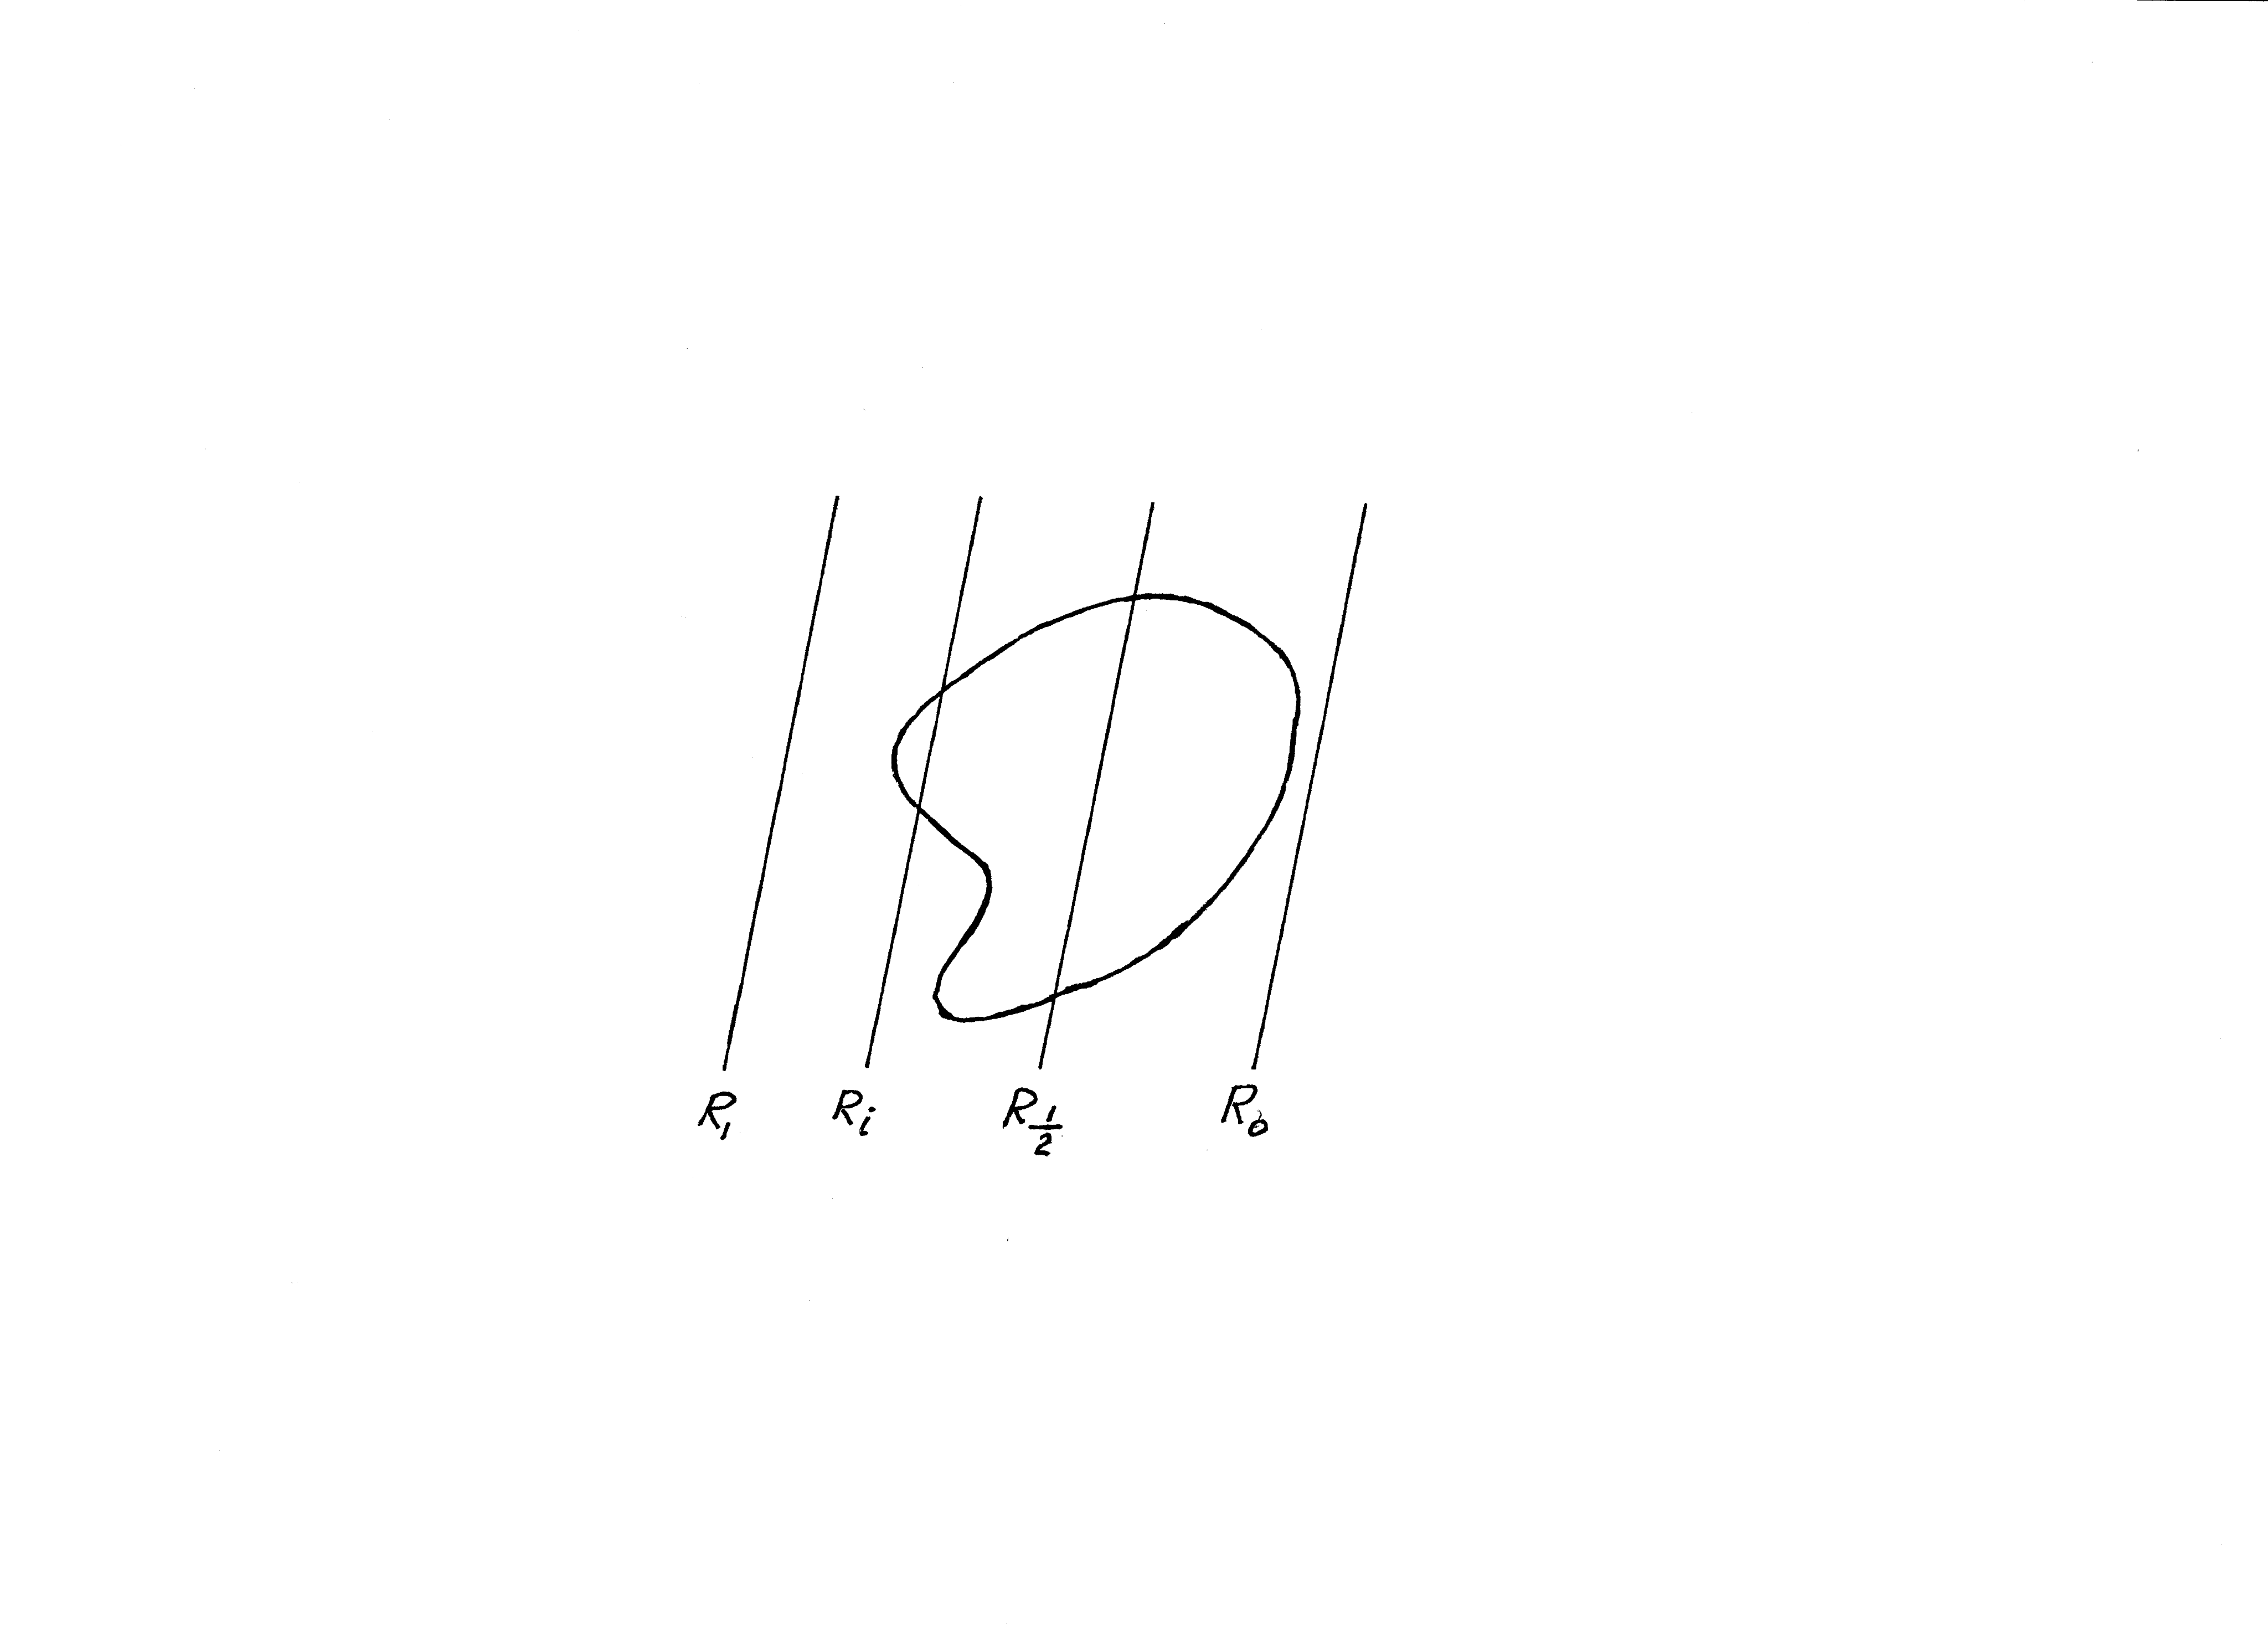
Lemma: Given any orientation in the plane, there exists a line in that direction that bisects a connected, planar set.
Argument: R_{i} in the figure indicates that fraction i of the set lies to the right of the line R_{i}.
As i runs from 1 to 0, i passes through 1/2 (Intermediate value theorem).
Corollary: Given any orientation in the plane, there exists a line perpendicular to that direction that bisects a connected, planar set.

Slide 16
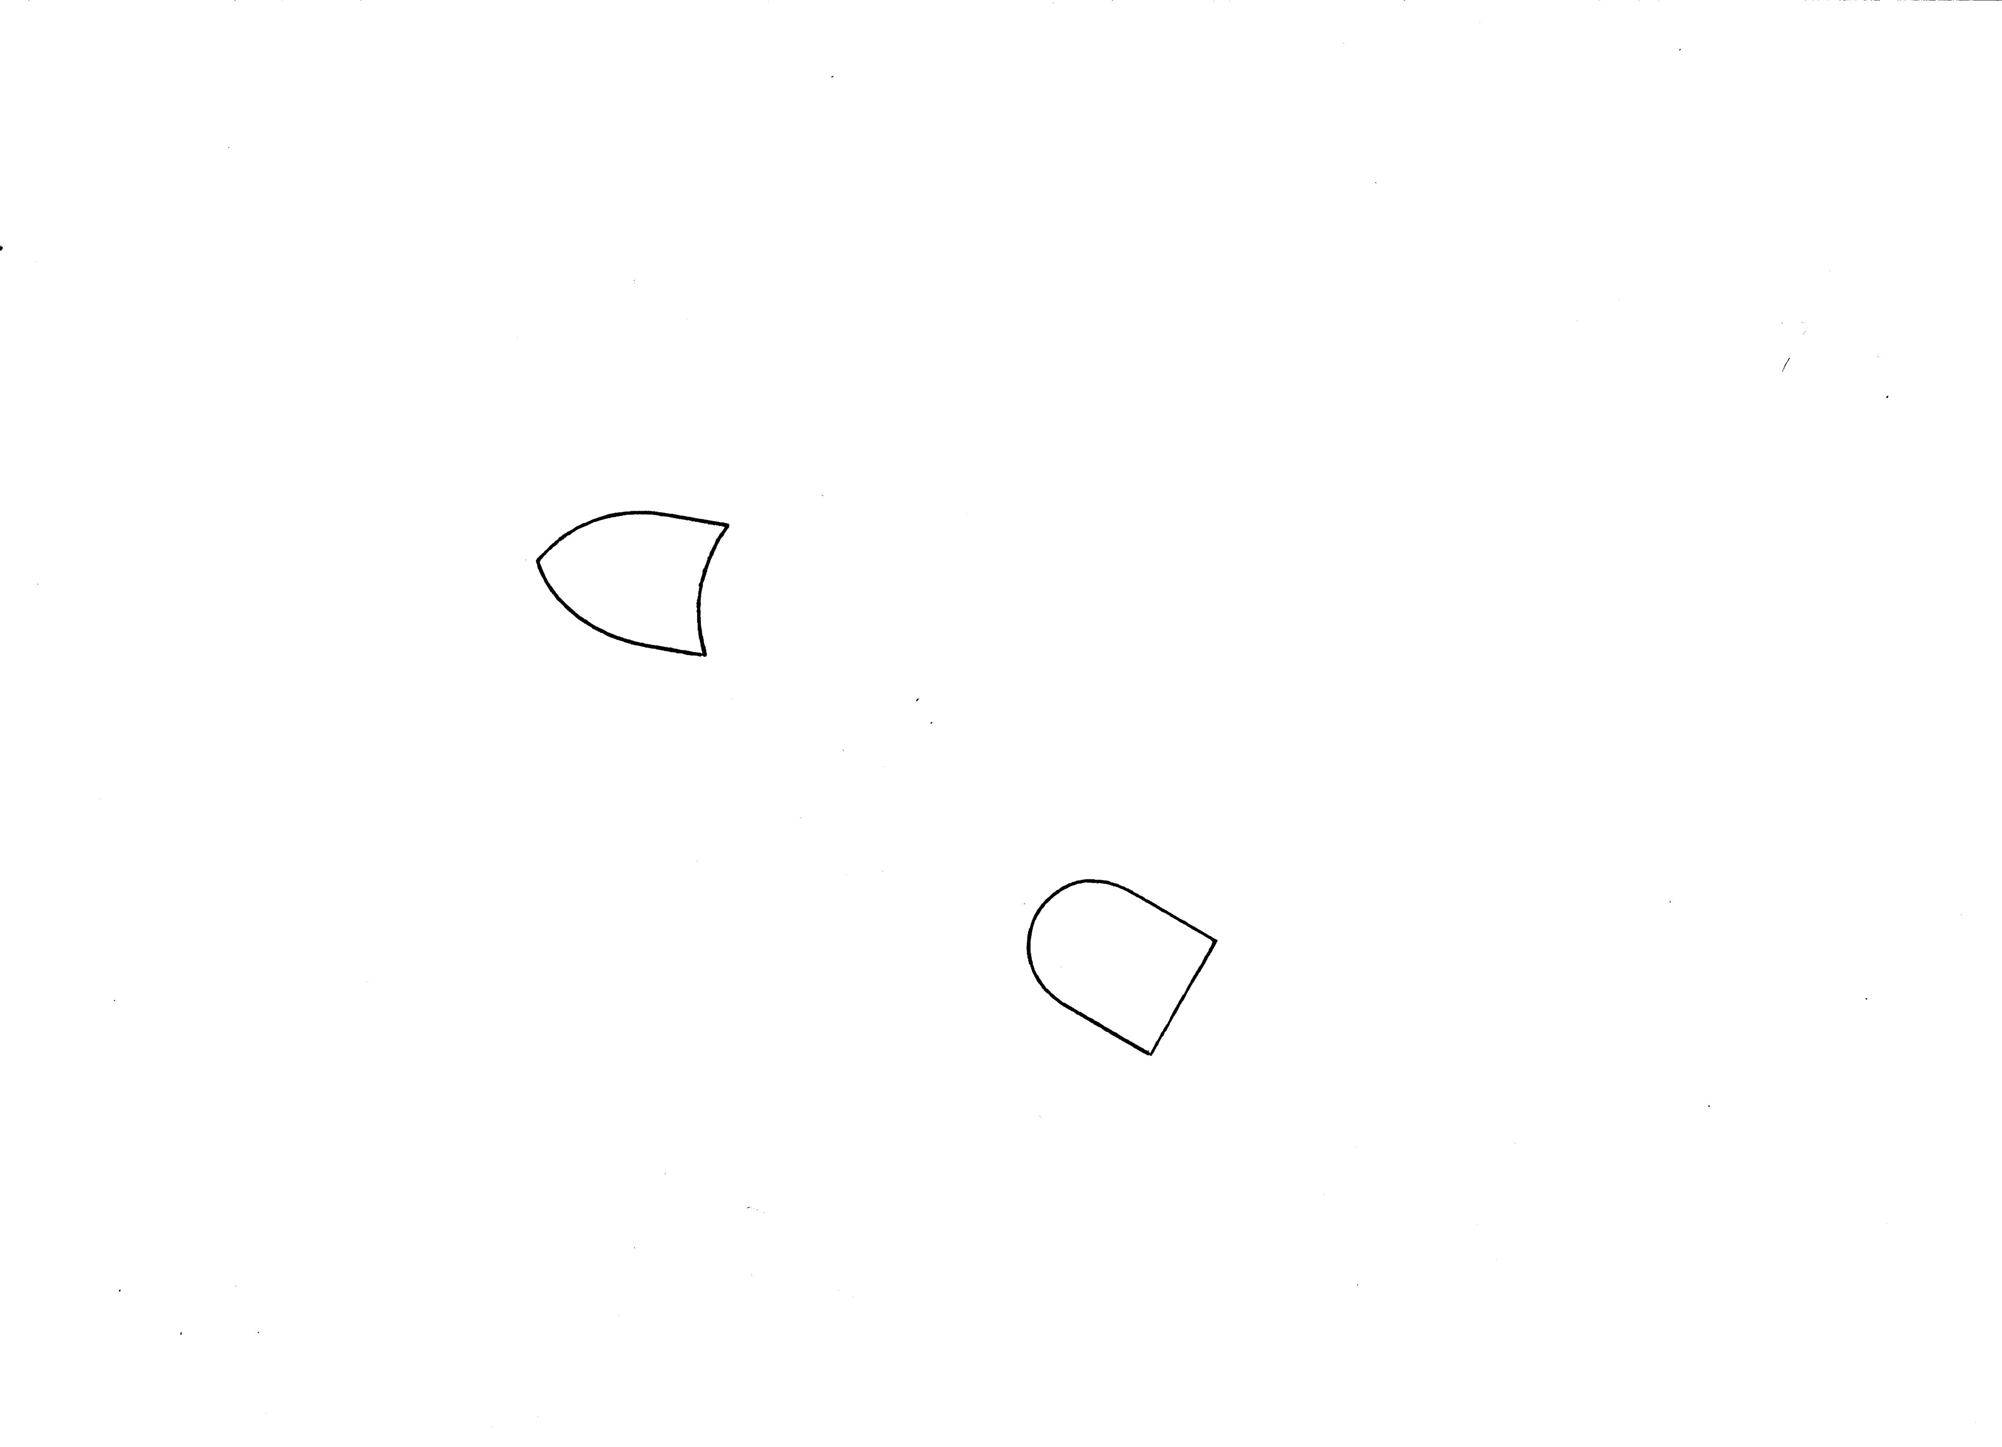
Given two planar sets, find a line that bisects both.

Slide 17
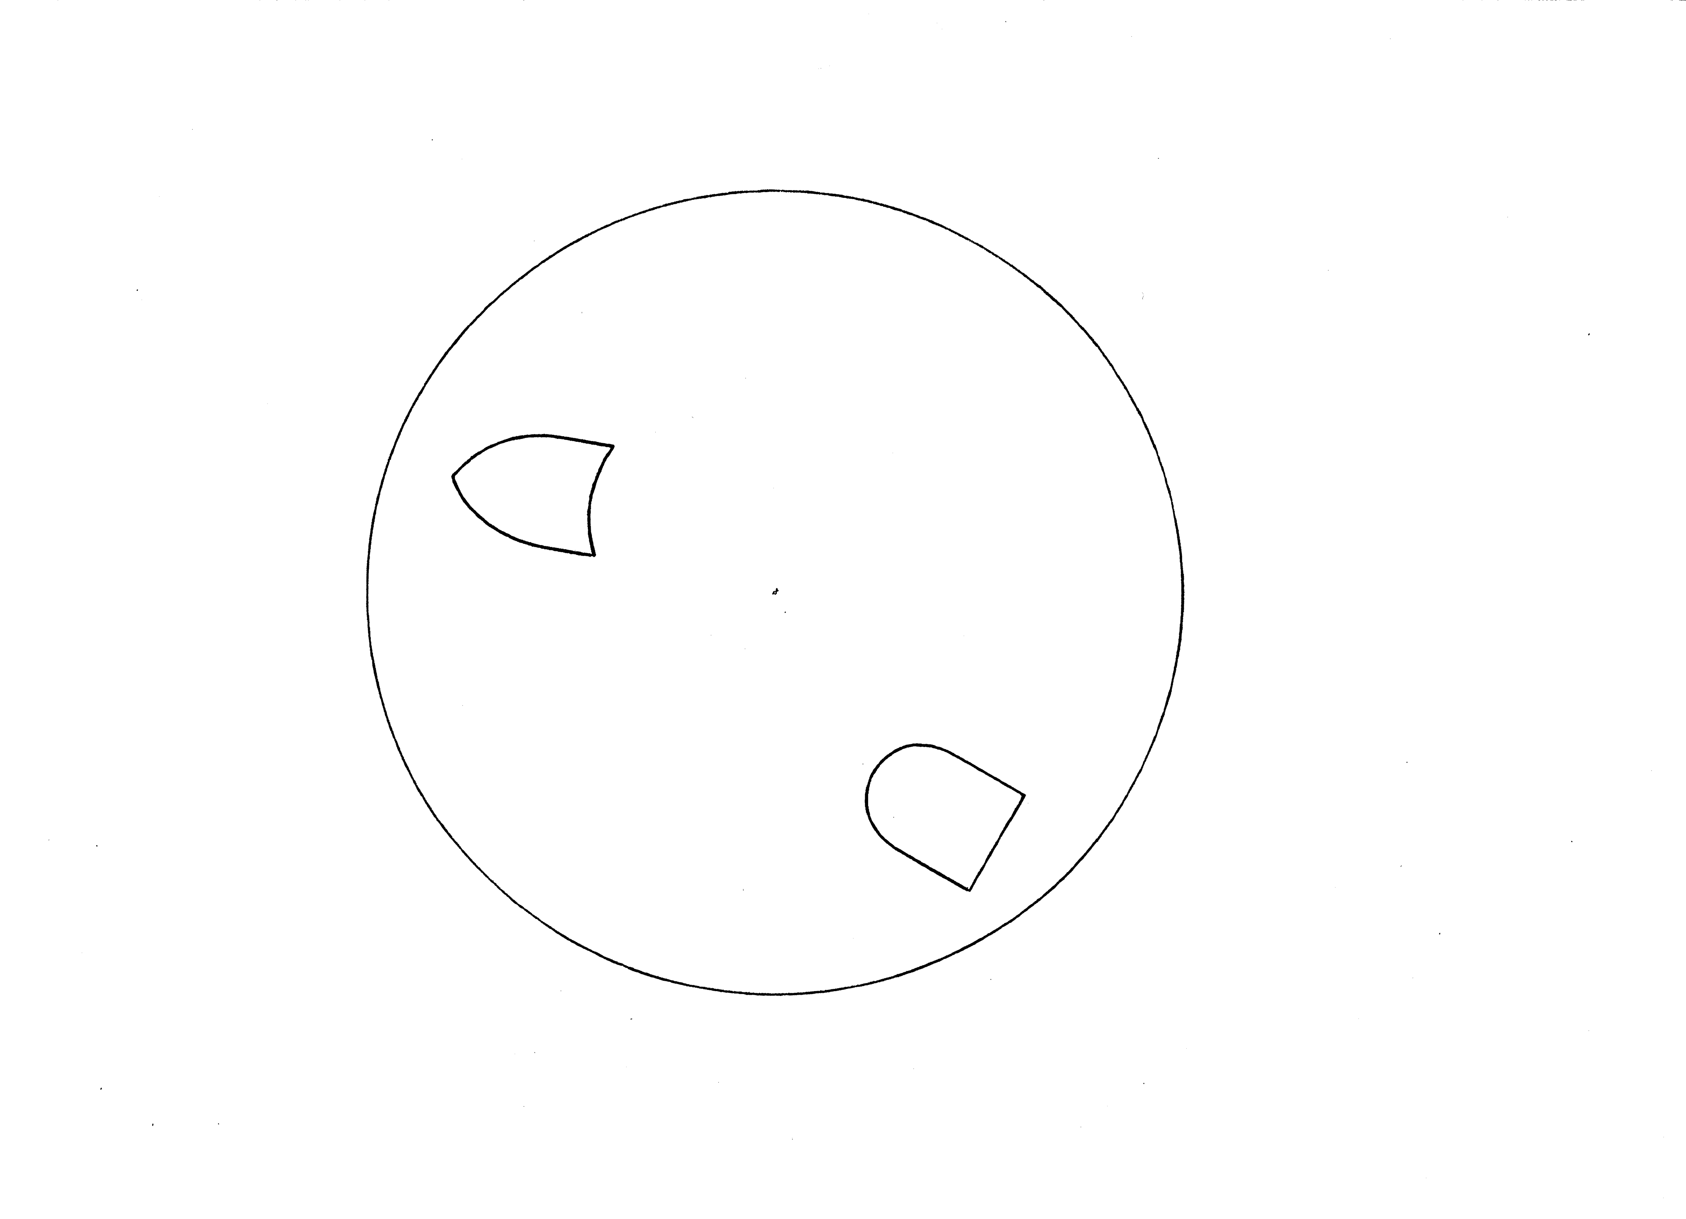
Construct a circle, any circle, that contains both sets.

Slide 18
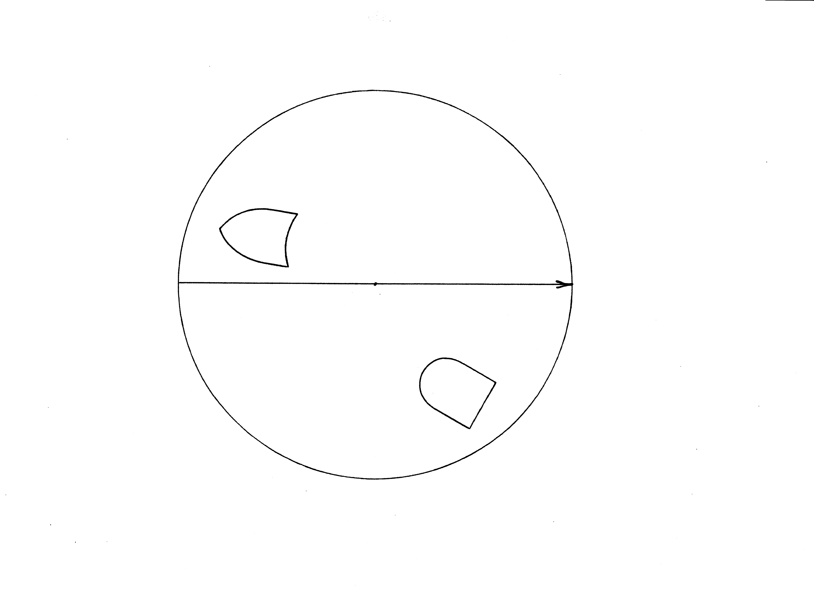
Construct a directed diameter of the circle. Assign direction θ=0 to that diameter.

Slide 19
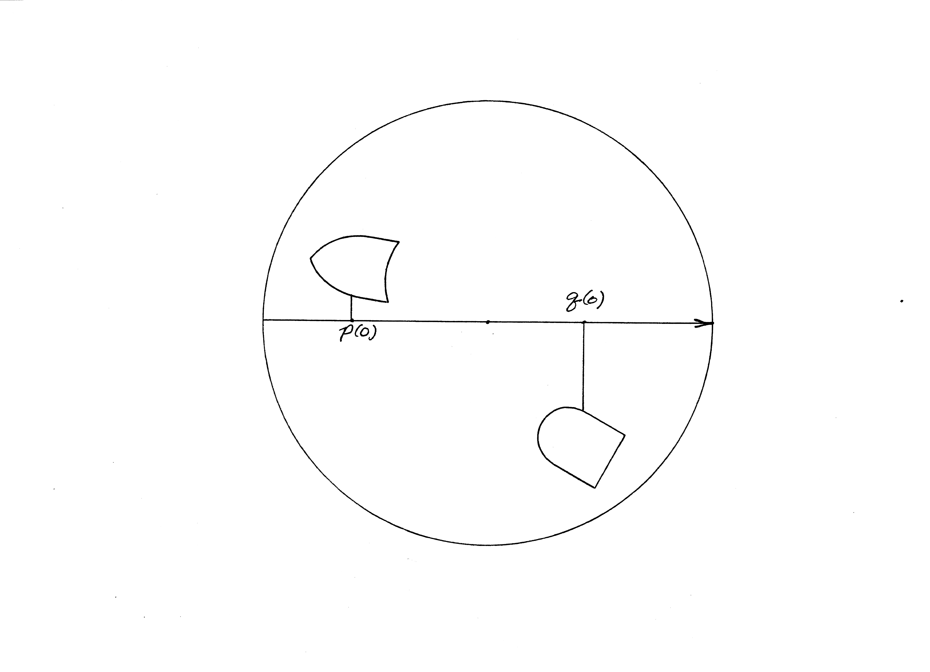
Construct area bisectors as shown; they exist as argued earlier. “p(θ)” and “q(θ)” are coordinates of the perpendicular bisectors relative to the directed diameter. As shown, p(0) is negative and q(0) is positive.
For subsequent use, let p(0)-q(0)=L

Slide 20
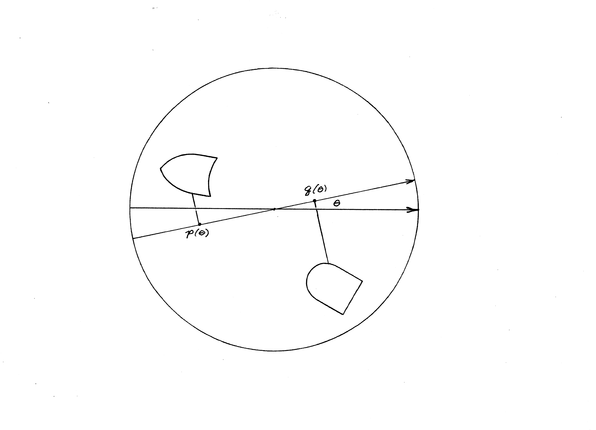
Rotate the coordinate system as shown and construct or “imagine” new bisectors at each θ. This is a “passive” or “alias” transformation.

Slide 21
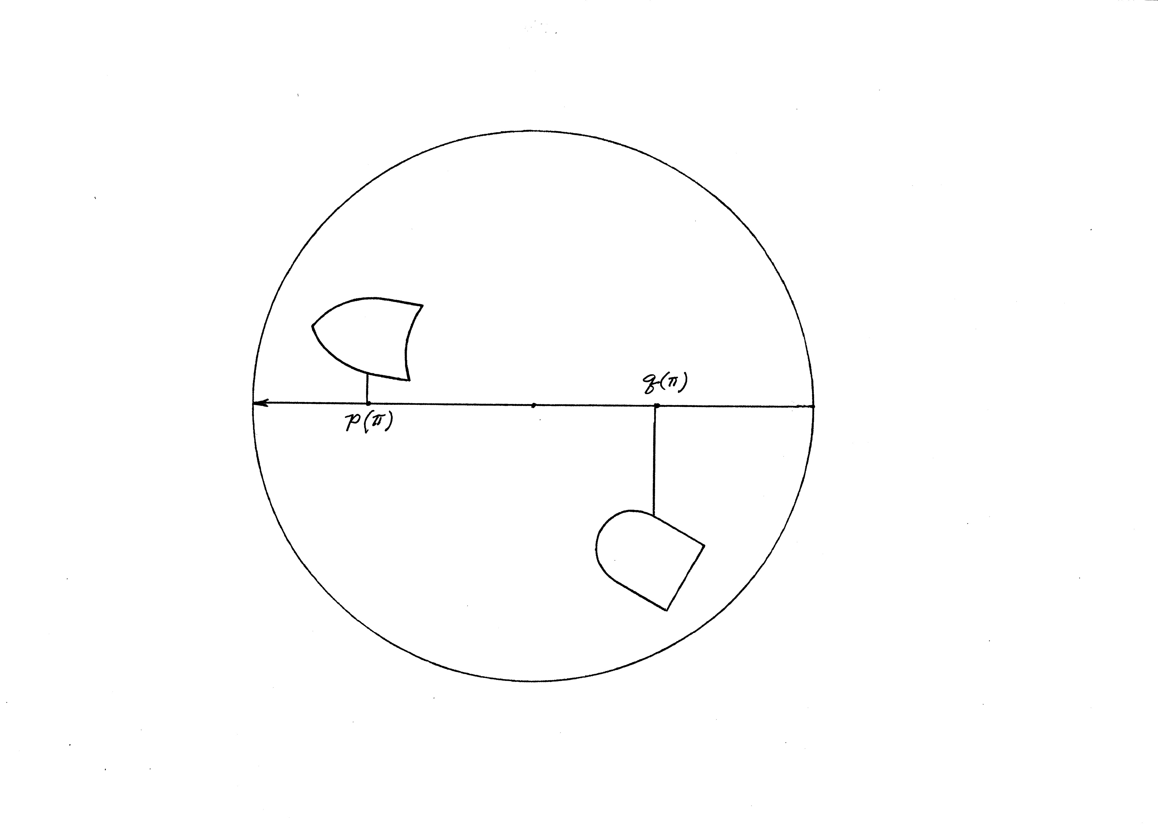
Rotate the coordinate system through angle π and pause.
Observe that p(π) - q(π)= - L. Therefore, as θ swings from 0 to π, p(θ) - q(θ) passes through a point θ₀ at which p(θ₀) - q(θ₀) = 0. At that point the two bisectors are collinear (Intermediate value theorem). We are done.
The prop being circulated might give an intuitive feel for the proof.

Slide 22
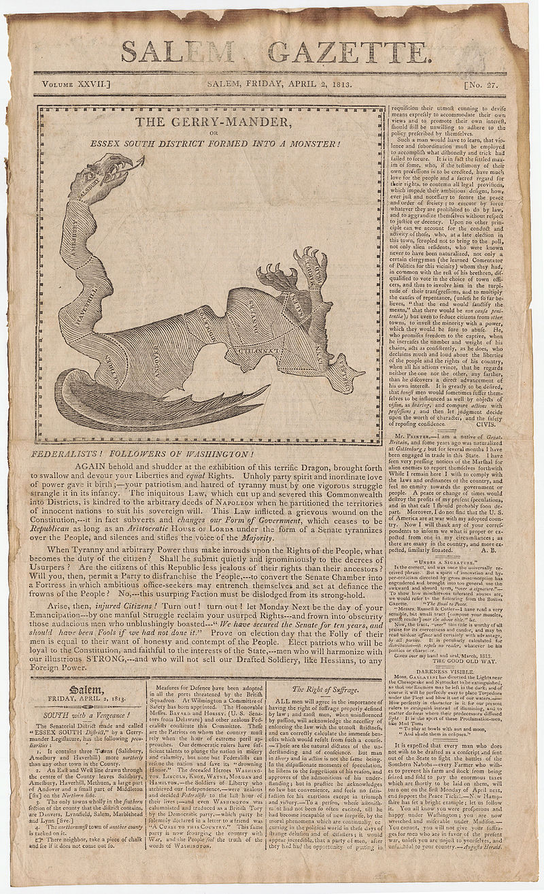
But still no satisfactory means for treating Gerrymandering
Salem Gazette, Friday, April 2, 1813

Slide 23
Part II: the Mathematicians
and
The Scottish Book
Caveat
I think that what follows is essentially correct, but I am aware of the observation that
“history repeats itself and historians repeat each other”.

Slide 24
The Scottish café in Lwów, Poland, circa 1930s
Much of the early work was done here.

Slide 25
The Scottish Café in the 1930s
The Scottish Café (Polish: Kawiarnia Szkocka) was the café in Lwów, Poland (now Lviv, Ukraine) where, in the 1930s and 1940s, mathematicians from the Lwów School collaboratively discussed research problems, particularly in functional analysis and topology.
Stanislaw Ulam recounts that the tables of the café had marble tops, so they could write in pencil, directly on the table, during their discussions. To keep the results from being lost, and after becoming annoyed with their writing directly on the table tops, Stefan Banach's wife provided the mathematicians with a large notebook, which was used for writing the problems and answers and eventually became known as the Scottish Book.
The book—a collection of solved, unsolved, and even probably unsolvable problems—could be borrowed by any of the guests of the café. Solving any of the problems was rewarded with prizes, with the most difficult and challenging problems having expensive prizes (during the Great Depression and on the eve of World War II), such as a bottle of fine brandy.
For problem 153, which was later recognized as being closely related to Stefan Banach's "basis problem", Stanisław Mazur offered the prize of a live goose. This problem was solved only in 1972 by Per Enflo, who was presented with the live goose in a ceremony that was broadcast throughout Poland.
The café building now houses the Szkotcka Restaurant & Bar (named for the original Scottish Café) and the Atlas Deluxe hotel at the street address of 27 Taras Shevchenko Prospekt.

Slide 26
Copy of the Scottish Book on display at the Library of the Mathematical Institute of the Polish Academy of Sciences in Warsaw
The original book remains in custody of the Banach family

Slide 27
The Scottish Book today
You can buy it on Amazon. Stan Ulam translated the early version into English after coming to the United States. Over the ensuing years, various mathematicians have added to it, solved some of the early-proposed problems and added new problems.

Slide 28
Current picture of the building that housed the Scottish Café
Lviv, Ukraine

Slide 29
The mathematicians
Steinhaus (1887, 1972)
Banach (1892, 1945)

Slide 30
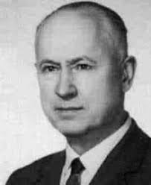
The mathematicians (2)
Borsuk (1905, 1982)
Ulam (1909, 1984)

Slide 31
Hugo Steinhaus
Steinhaus was the senior member of the Scottish café crowd. Apparently, he was the first to state the Ham Sandwich Theorem.
During the Soviet occupation of Lwów, he continued to teach at the reconstituted university.
He was of Jewish origin, and during the subsequent Nazi occupation he assumed the identity of a deceased forest ranger and taught clandestine classes.
According to Marc Kac, his biographer, the happiest day of his life was the 24 hours between the departure of the Germans and the second arrival of the Soviets.

Slide 32
Stefan Banach’s life during the 30s and 40s
After the outbreak of World War II, in September 1939, Lwów was taken over by the Soviet Union. Banach became a member of the Academy of Sciences of Ukraine and was dean of Lwów University's Department of Mathematics and Physics.
In 1941, when the Germans took over Lwów, all institutions of higher education were closed to Poles.
As a result, Banach was forced to earn a living as a feeder of lice at Rudolf Weigl's Institute for Study of Typhus and Virology. While the job carried the risk of infection with typhus, it protected him from being sent to slave labor in Germany and from other forms of repression.
When the Soviets recaptured Lwów in 1944, Banach reestablished the University. However, because the Soviets were removing Poles from Soviet-annexed formerly-Polish territories, Banach prepared to return to Kraków. Before he could do so, he died in August 1945, having been diagnosed seven months earlier with lung cancer.

Slide 33
Stanislaw Ulam
He was here visiting the United States in September 1939 when Germany invaded Poland. Von Neumann had invited him to spend some time at the Princeton Institute of Advanced Study. He remained in the USA and wound up at the Los Alamos National Laboratory located in New Mexico.
The hydrogen bomb design involves the Teller-Ulam idea for initiating a thermonuclear reaction.
Ulam made many contributions to mathematics, both pure and applied. While at Los Alamos he pioneered the Monte Carlo method for solving otherwise intractable problems in applied mathematics. That method is a workhorse in various fields today.

Slide 34
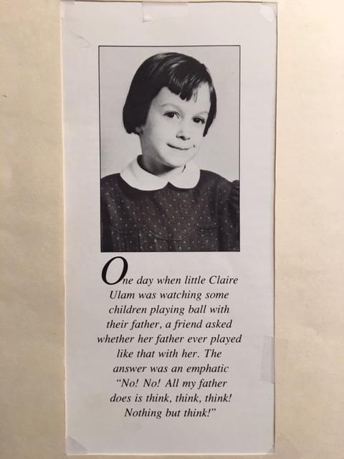
Stanislaus Ulam was a family man
Claire became a ballerina.
“From Cardinals to Chaos”, Cambridge University Press, 1989

Slide 35
A Personal Anecdote (1)
An error in an early-college-level math calculation that had significant consequences
Time span: January, February, March, 1954
Place: Nam Island, Bikini Atoll, Marshall Islands
Situation: Preparation for the test of the Bravo Thermonuclear Device (Teller-Ulam design)
I was a member of a group of physicists tasked with recording the first few milliseconds of the reaction history of the device.
An array of sixteen 10” diameter, 7500-feet-long evacuated pipes would transport neutrons and gamma rays from the explosion to a recording bunker that contained the electronic recording equipment.
The pipes had to be straight, not level, and thereby hangs the story.
A seasoned contract surveyor had the job of aligning a reference pipe located near the center of the
4 X 4 array. A group of technicians would align the remaining pipes relative to the reference pipe.

Slide 36
A Personal Anecdote (2)
So here is what happened: The surveyor aligned the reference pipe.
We, the physicists in the Diagnostic Group from Lawrence Livermore National Laboratory, checked to see if we could get a gamma ray signal through the pipe. We could not.
The surveyor assured us that he knew what he was doing and dismissed us
as a bunch of amateurs (our mean age was 27 years).
We went through this sequence three times. Same result.
Shot schedule is closing in on us; still no signal.
So, on a Sunday, our group aligned the reference pipe, got a signal through, and proceeded to complete preparing our detectors for the event.
It turned out that the surveyor’s home office in Los Angeles had made an error in correcting for the earth’s curvature. So he had a faulty set of instructions on how to compensate for the readings from his leveling instruments. Laser survey instruments were still in the future.

Slide 37
A Personal Anecdote (3)
The poor guy returned to LA immediately and in shame. I felt sorry for him.
We completed our detector prep on time and collected the necessary signals from the explosion.
The device was detonated on March 1,1954.
Incidentally, the Bravo event yield was 15 megatons, the largest ever detonated by the USA.
Its predicted yield was 6 megatons.

Slide 38
Closure
“A great many mathematicians today owe a huge debt to those intrepid Polish academics, and we raise our cups of java to those original Scottish Café mathematicians!”
A quote from Theodore Hill, Slicing Sandwiches, States, and Solar Systems, Volume 106, No. 1, American Scientist, January-February, 2018
Thank you for attending!

