Slide 1
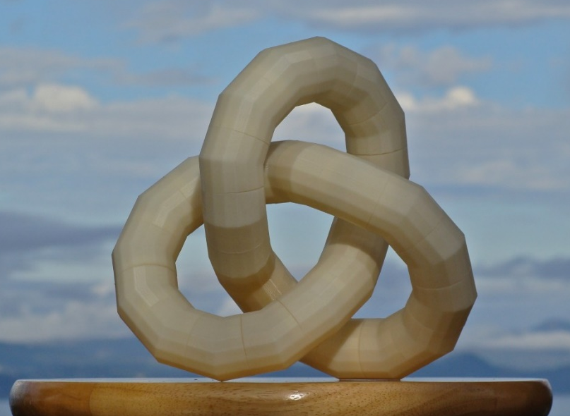
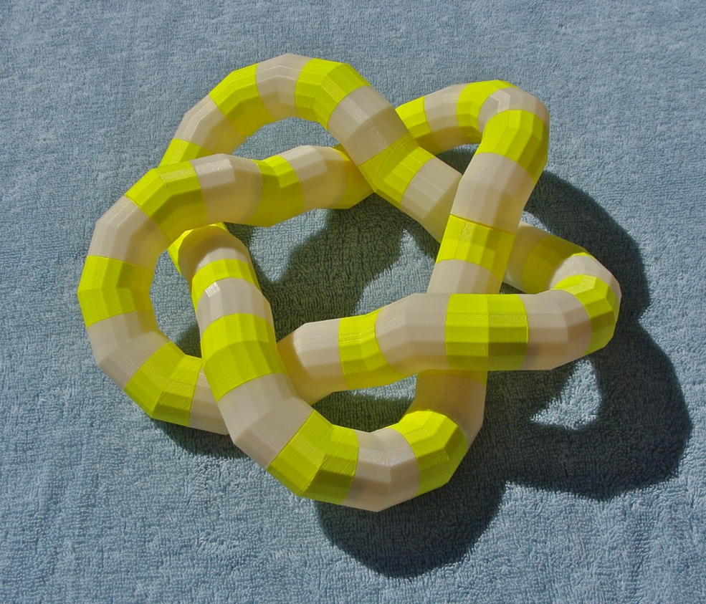
CMC3_Tahoe, April 27, 2019
Modular Knot Construction with Smooth and Discrete Optimization
Carlo H. Séquin
EECS Computer Science Division
University of California, Berkeley
Notes:
This is the title of my talk …
But first a little bit on my background:

Slide 2
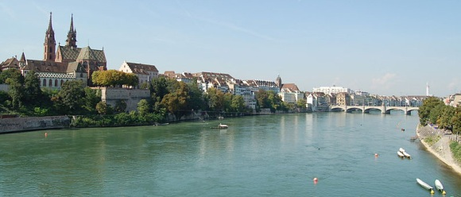
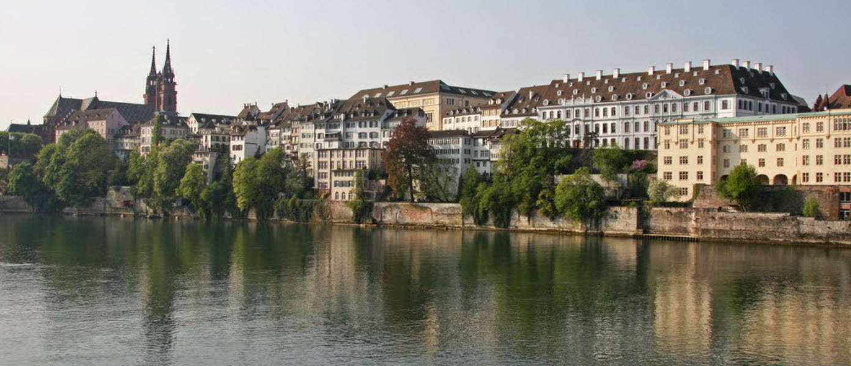
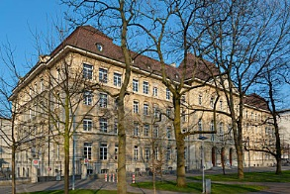
Basel, Switzerland
M N G
Notes:
I grew up in Basel, CH,
>>> where I attended the M N G (a high school with emphasis in math and science).
>>> During my university years I heard my math lectures in this 500 year old institute, where many famous mathematicians have lectured:

Slide 3
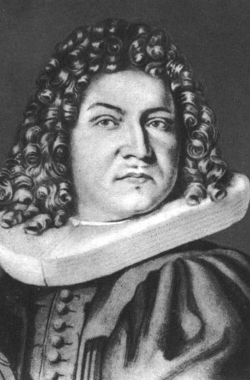
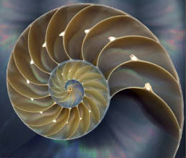
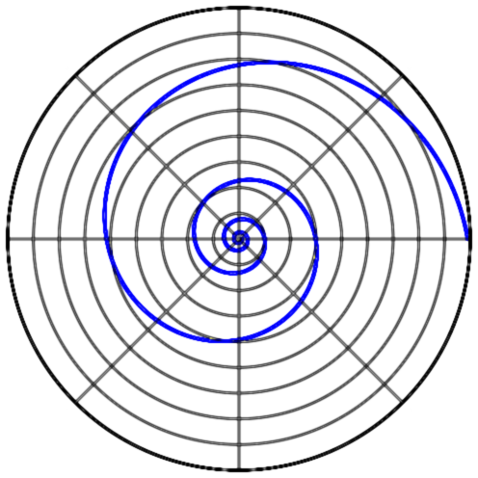
Jakob Bernoulli (1654‒1705)
Logarithmic Spiral
Notes:
such as Jakob Bernoulli, or . . .

Slide 4
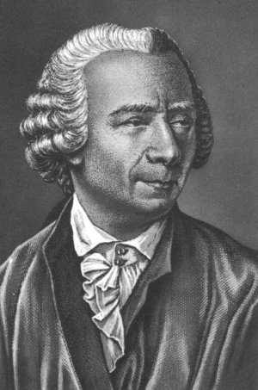
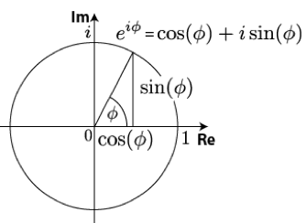
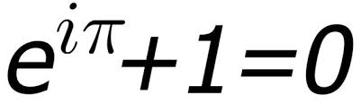
Leonhard Euler (1707‒1783)
Imaginary Numbers
Notes:
… or Leonhard Euler.
From an early age on, I was fascinated with numbers …

Slide 5
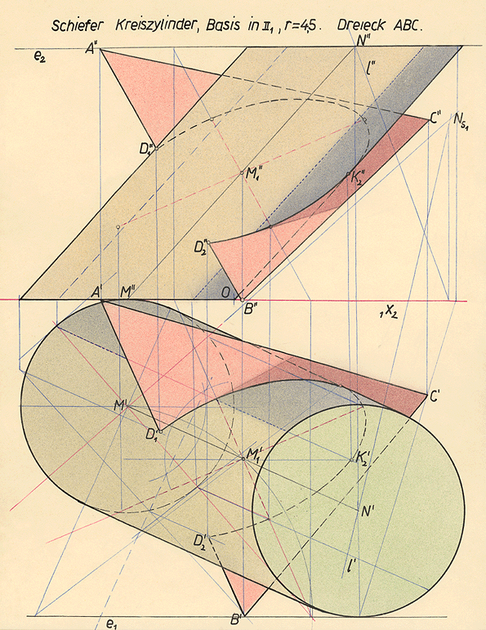
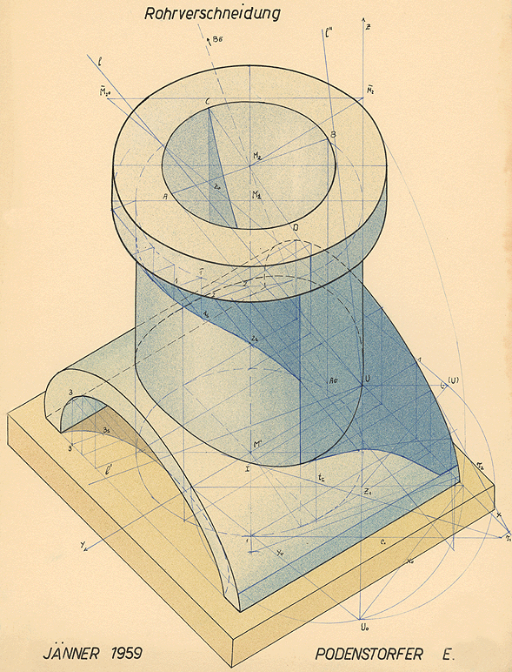
Descriptive Geometry
Notes:
and during high-school I fell in love with geometry.
In 11th grade we had a subject called Descriptive Geometry , where we constructed the intersection lines between two cylinders. -- I thought that this was very cool stuff!
– Ever since, geometry has been in my blood stream! And it has never left me.

Slide 6
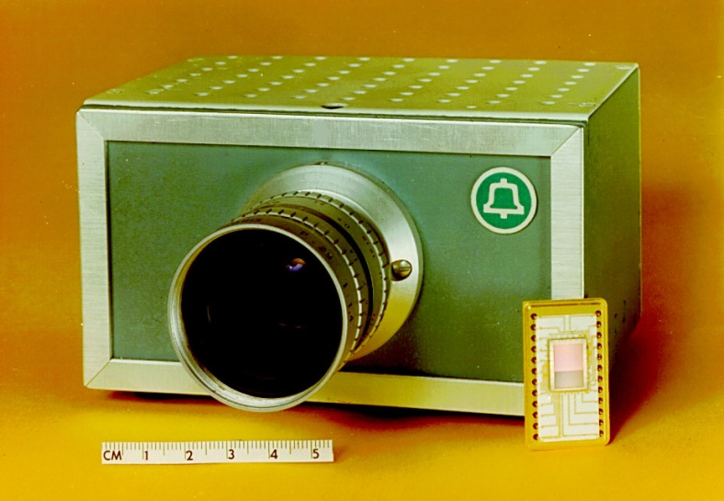
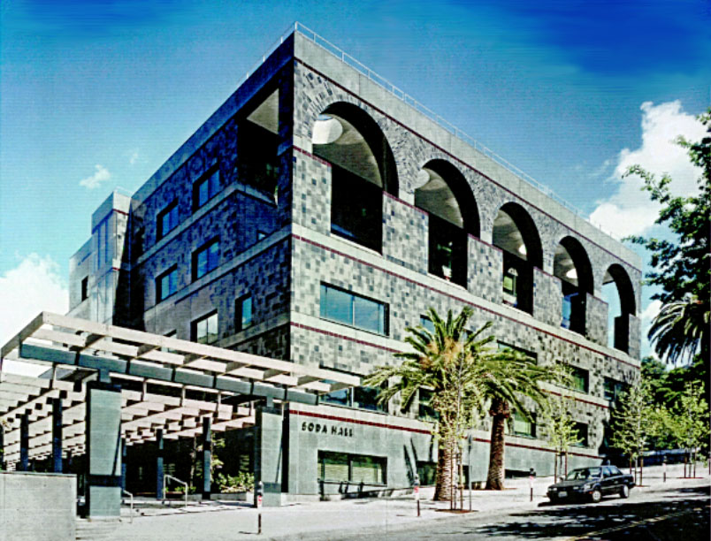
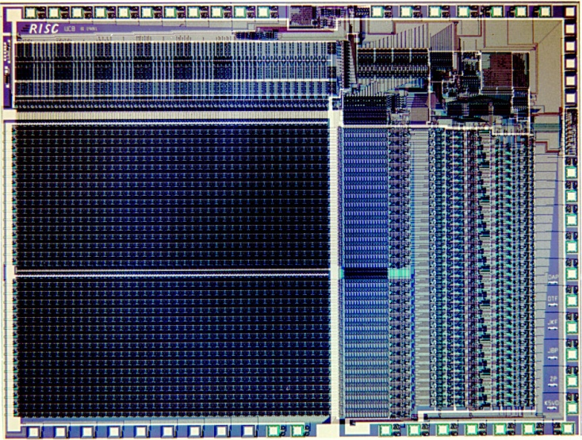
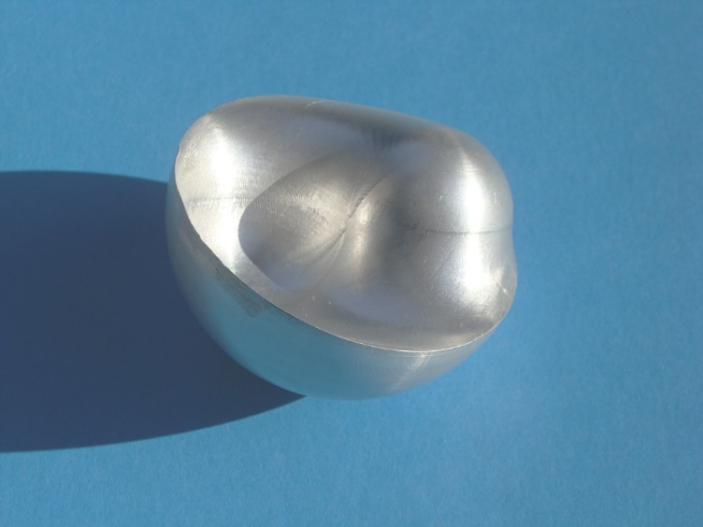
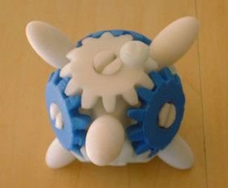
Geometry in every assignment . . .
CCD TV Camera (1973) Soda Hall (1992)
RISC 1 MicroChip (1982) 3D-Yin-Yang (2000)
Notes:
So, in many of my professional activities during the last 40 years, I always look for the geometry problems.
My first job was at Bell Labs in Murray Hill. I worked on the layout of the sensor chip for the first all-solid-state TV camera. (The success of this brought me to Berkeley). There I teamed up with D. A. Patterson, and we built the first Reduced Instruction Set Computer on a chip. At that time, my students and I worked mostly on IC-layout programs which offer a lot of 2D geometry problems.
Then we needed a new home for CS; and I transitioned from 2D geometry to 3D geometry. == Later I teamed up with Paul Wright in ME on a project called “CyberCut – CyberBuild”. This started with optimized tool paths for 3-axis milling machines to make free-form surfaces such as this 3D Yin-Yang. Then came along the 3D printers and additive layered manufacturing. . .

Slide 7
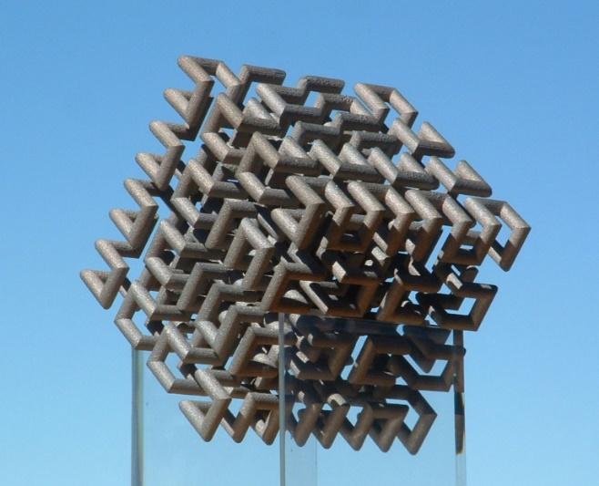
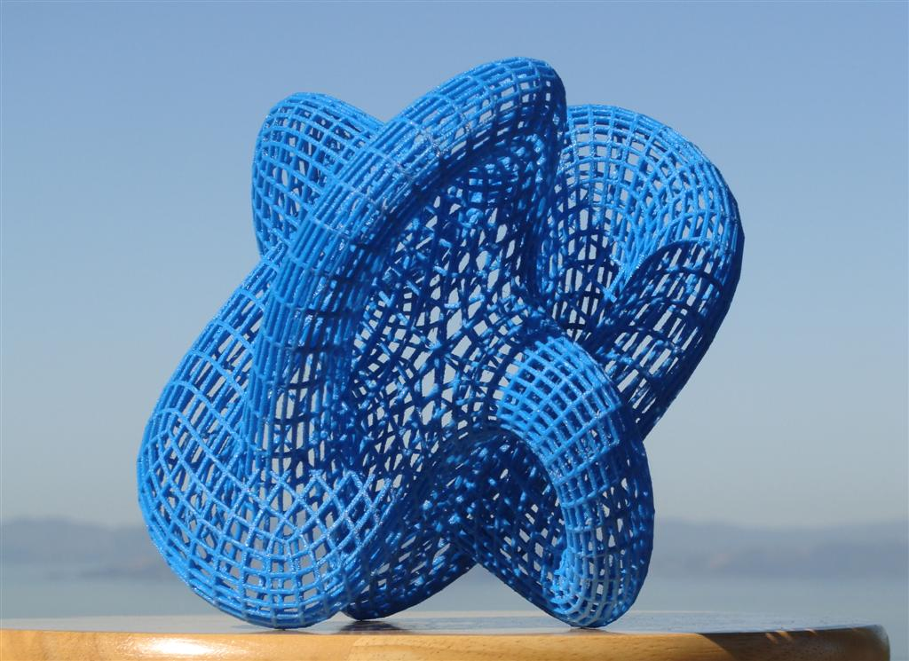

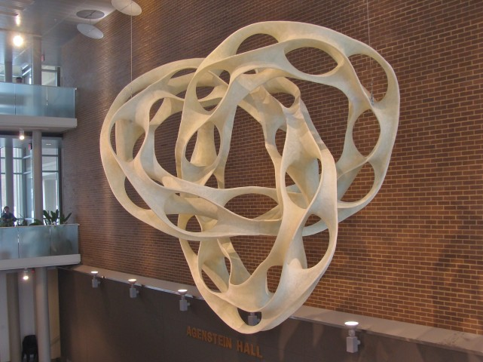
More Recent Designs and Models
“Hilbert Cube”
“Klein Bottle”
“Pax Mundi”
“Evolving Trefoil”
Notes:
During the last two decades, I have worked with artists and with mathematicians.
The top row shows some mathematical visualization models fabricated on 3D printers. Top-left is a 3D Hilbert cube with 512 “elbows”. Top right is a special, highly symmetrical Klein bottle. The bottom row shows two larger sculptures that emerged from my collaboration with Brent Collins. -- All of these involve some intricate geometry!

Slide 8
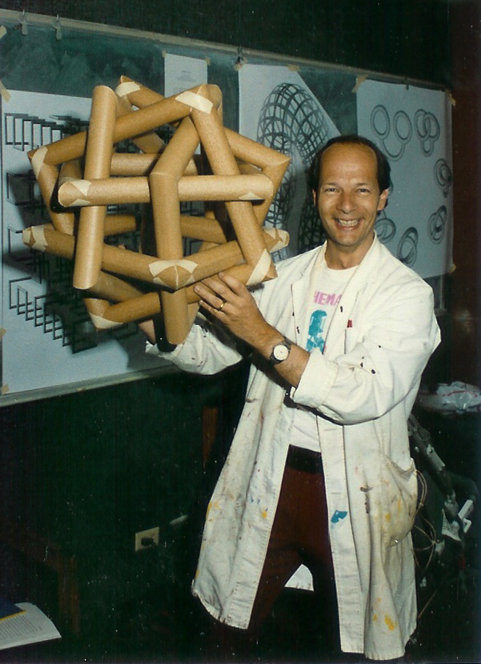
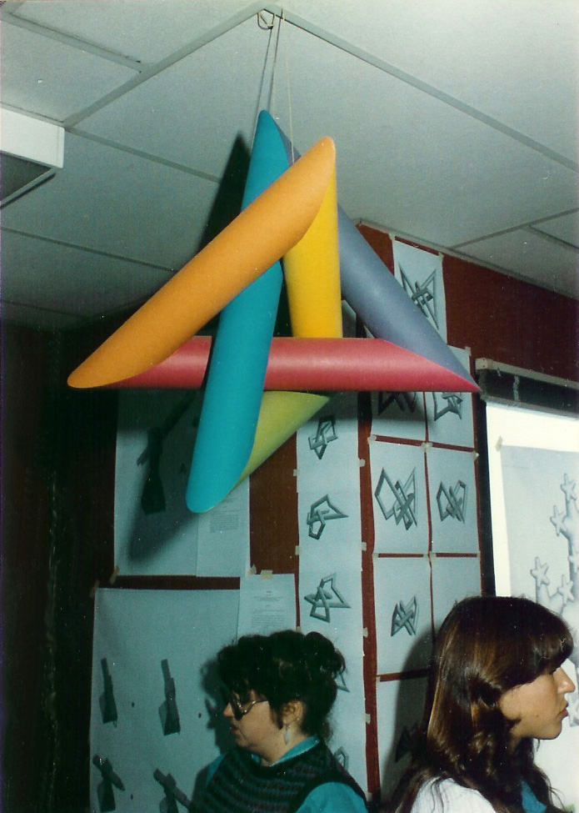
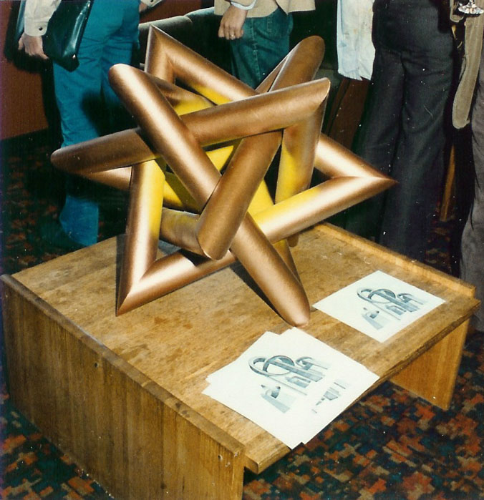
Graduate course, Fall 1983: Creative Geometric Modeling
Notes:
In 1983 I taught a graduate course on Creative Geometric Modeling, and I started to build some tubular structures as demonstration objects for this class. Here you see a minimal trefoil knot and a couple of regular link structures, one with 4 triangles and one with 6 squares, respectively.
At the end of the semester we had a vernissage where the students exhibited their modeling programs, samples are visible in the background of the left picture; this concerned a simulated annealing program to minimize the total ax-length of the trefoil knot shown hanging from the ceiling.

Slide 9
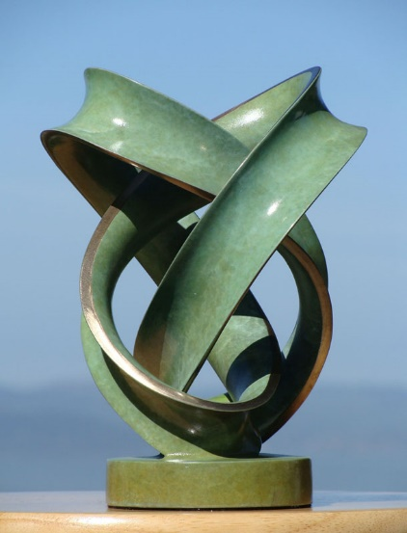

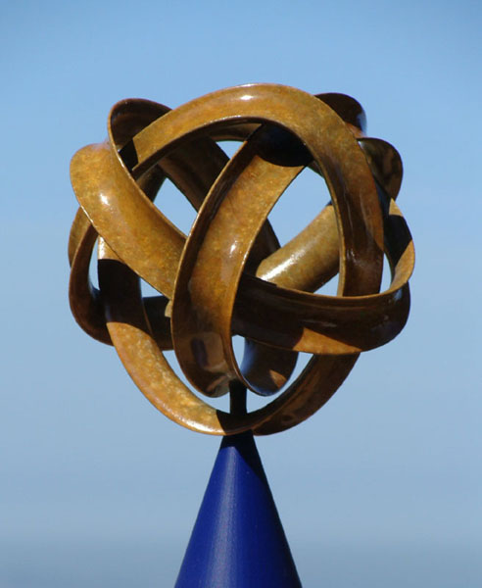
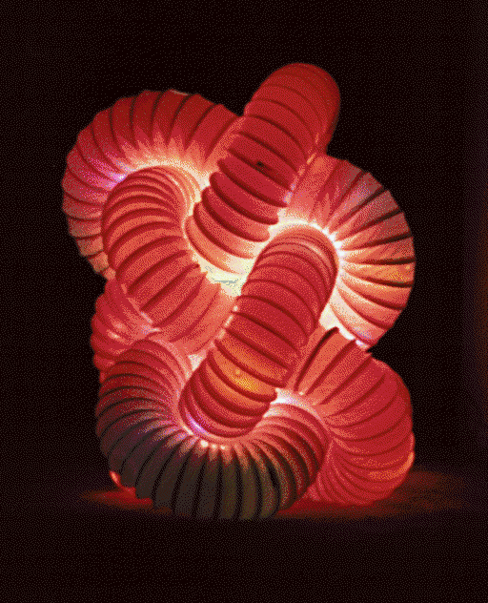
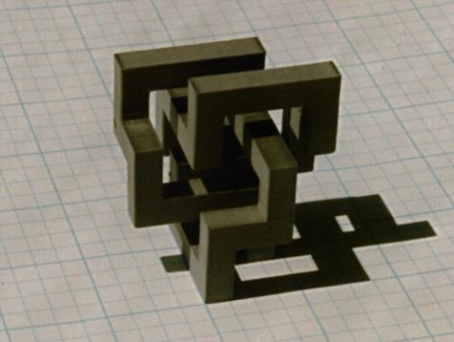
My Fascination with Knots
Figure-8 knot TorusKnot (3,5) Chinese Button Knots
Bronze sculptures cast by Steve Reinmuth, Eugene, OR
Modular, building-block knot models
Notes:
I was always fascinated by knots – not just the mathematics of them, but also their aesthetic appeal. On the top you see some knots realized as bronze sculptures with a nice patina by Steve Reinmuth, Eugene, OR.
I am also intrested in constructing knot models from simple geometrical building blocks.

Slide 10
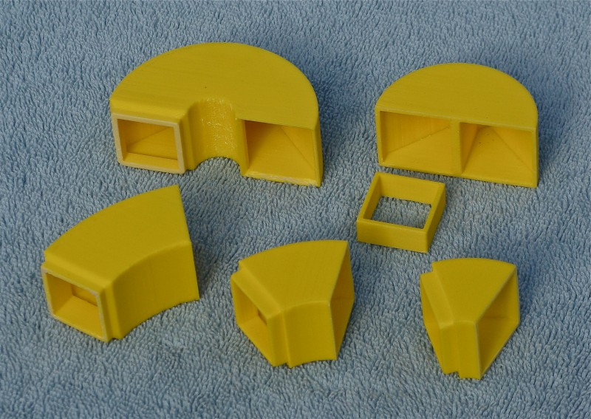
First “LEGO Knots” Parts
2 types of end-caps; 3 curved connectors
Notes:
In 2014 I started a project called LEGO-Knots. I created a set of snap-together parts that I wanted to use to make aesthetically interesting knot models.
This shows my initial starter set of parts.

Slide 11
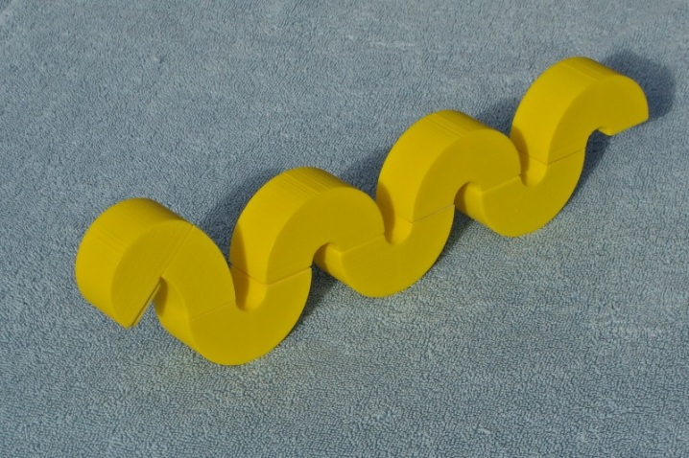
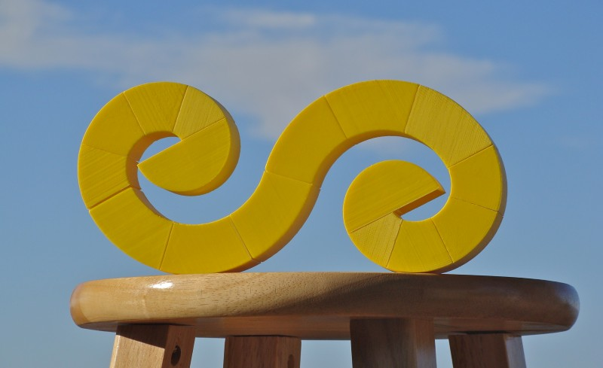
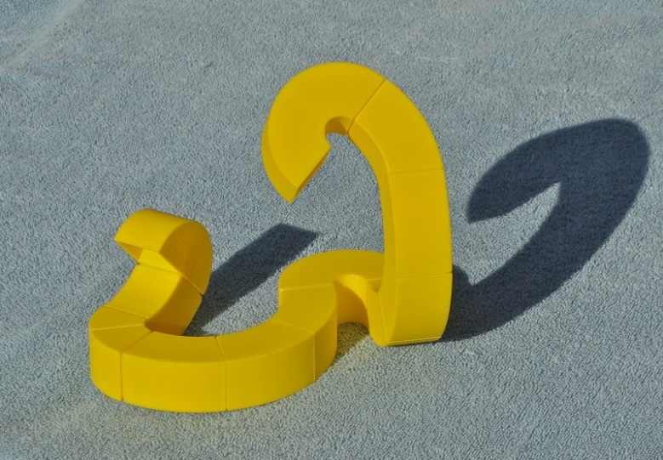
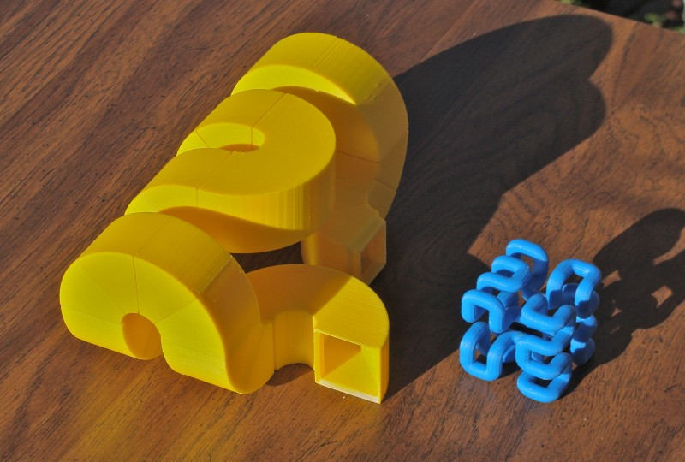
What can we do with those 5 Parts?
Wild and crazy “snakes”, or part of a Hilbert curve …
Notes:
Here are some examples what one can do with those 5 parts: We can make all kinds of wild and crazy snakes; or form recursive, space filling paths as one finds in the Hilbert curve. (see lower right).

Slide 12
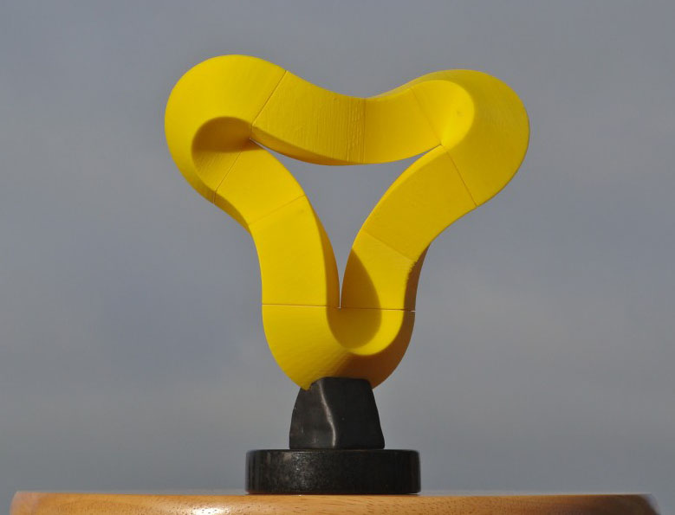
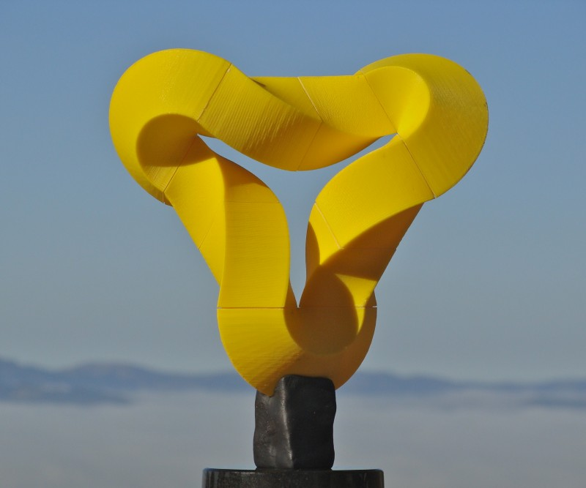
“Rhombic Borsalinos”
Original and with twisted legs
Notes:
We can also make aesthetically pleasing sculptural shapes.
This “rhombic” Borsalino was inspired by ..
I created some new twisted building blocks so I could make the modified version on the right.

Slide 13
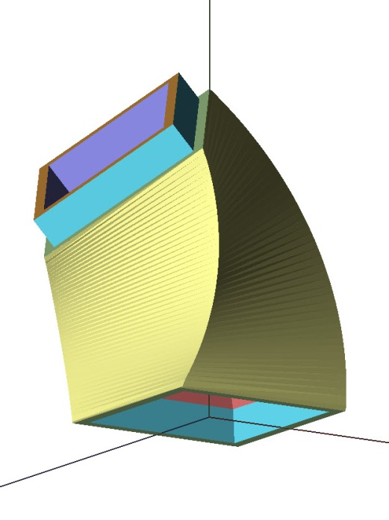
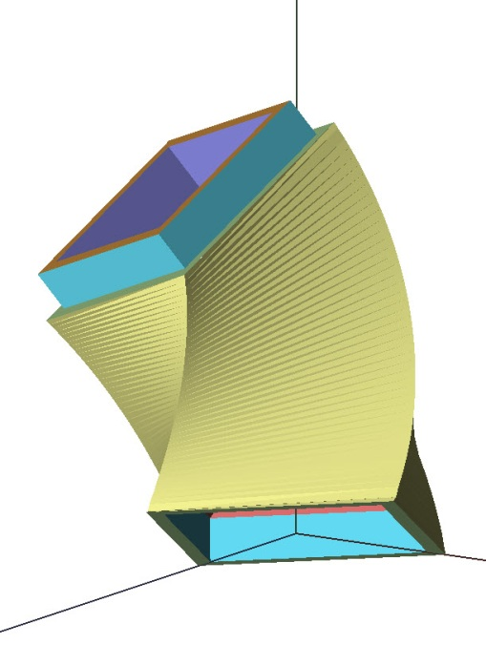
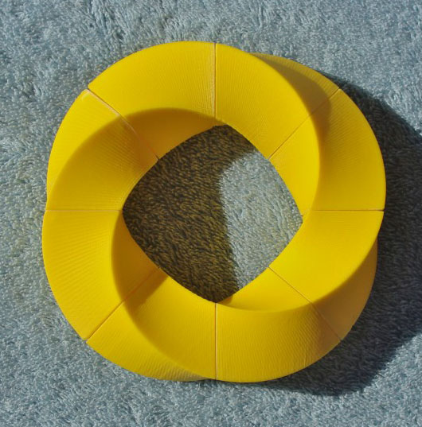
Twisted Connector Pieces
Enlarged connector pieces with 45º twist: add flanges: → two different pieces (azimuth!)
➔ 4 pairs make a nice twisted ring (360º)
Notes:
Here are the two twisted connector pieces shown up close.
Four of these pairs also make a nice twisted ring with 360 degrees of twist.

Slide 14
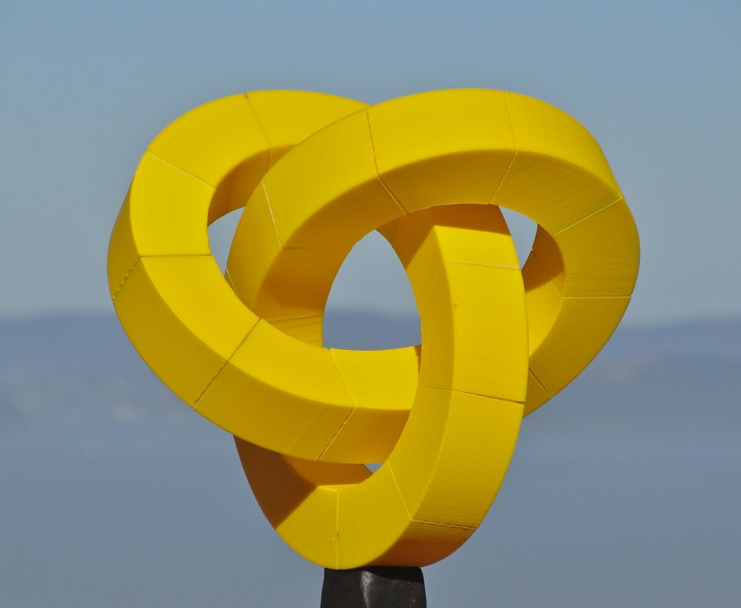
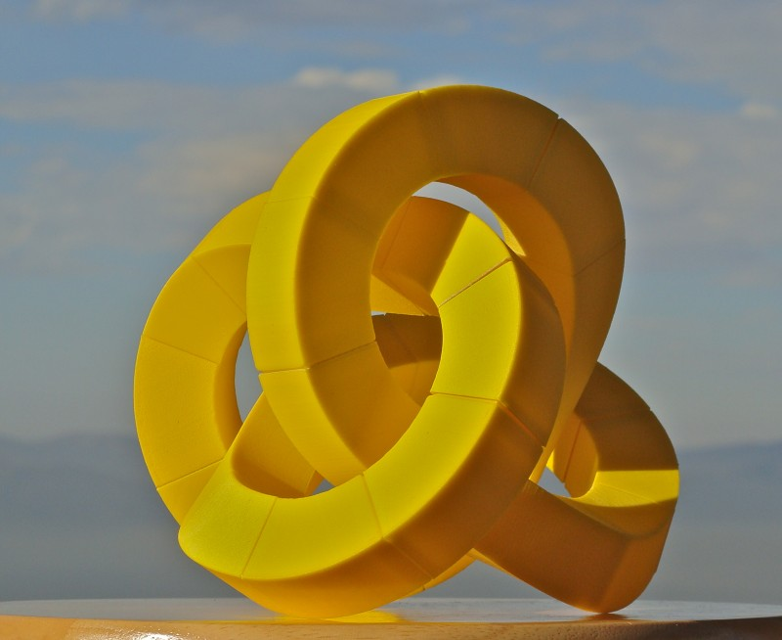
LEGO Knot Sculptures
Trefoil (knot 3₁) Figure-8 Knot (knot 4₁)
Notes:
And we can also build actual mathematical knots with these LEGO Knot parts.

Slide 15
Single-Module Knots
Suppose we are restraining ourselves to using just one single module!
Can we build elegant and symmetrical knots?
Some previous work and inspiration . . .
Notes:
The knots you have just seen use 3 or 4 different “LEGO” parts. During the last couple of years, I have focused on another challenge: Can we build reasonably good-looking knot sculptures from just ONE SINGLE MODULE ?
I am not the first one to ponder this question. Let me give you a little background on this and pay homage to some people who have influenced me.

Slide 16
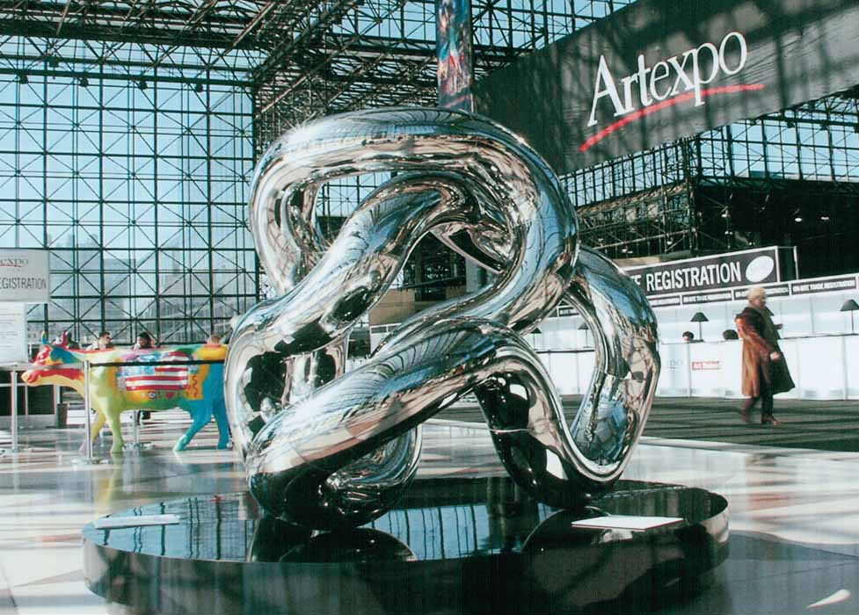
Richard Zawitz: Statue of Infinity (2003)
Notes:
Richard Zawitz has created large tubular sculptures with just a single module …

Slide 17
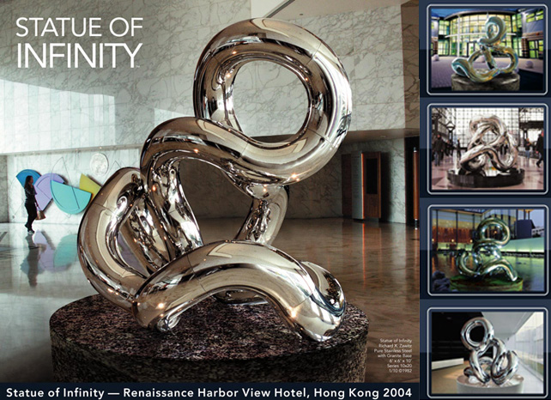
Notes:
Here is another example placed in the Harbor view hotel in Hong Kong.
A closer look shows that this is made of tubular pieces that bend through 90 degrees.
At right you can see various configurations of this piece that result when the pieces are joined with different torsion angles.

Slide 18
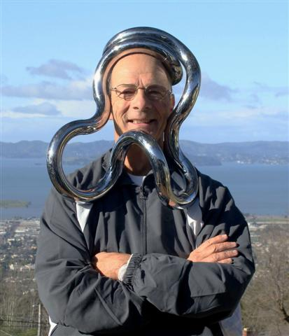
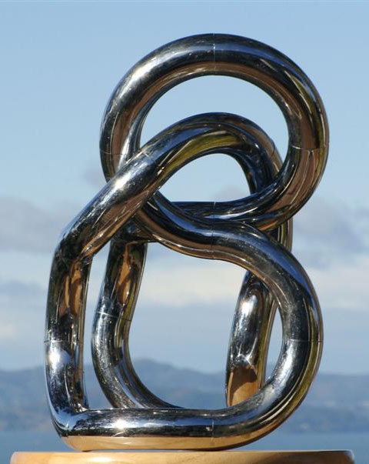
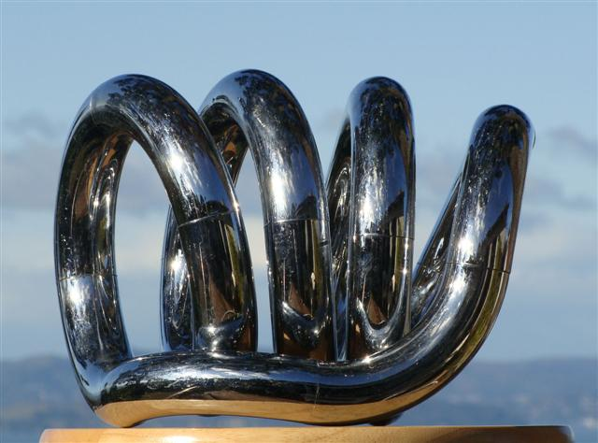
Richard Zawitz: Museum Tangle (1982)
A deformable unit with 18 quarter-circle segments
Notes:
Here is a smaller version: In 1982 Richard Zawitz created “Museum Tangle.”
This is a deformable unit composed of 18 quarter-circle tube elements.
>> I was given one of those in 1983 and was immediately fascinated by it …
>> and now everybody can be an instant tubular sculptor.
These tangles now come all kinds of sizes and materials. Here are a few examples ….

Slide 19
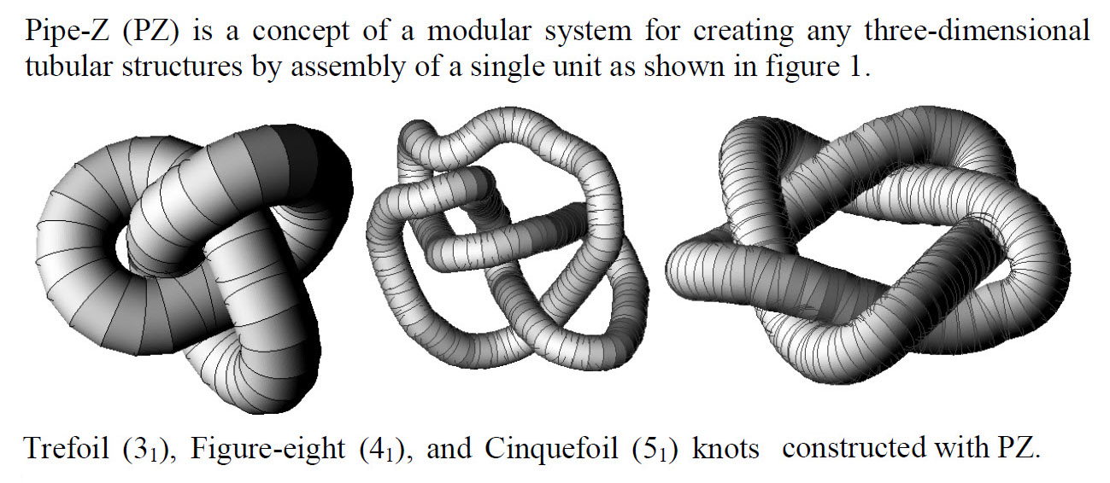
Knots Made from ONE Module
M. Zawidzki & K. Nishinari (2013):
Problems: too many elements, lack of symmetry, self-intersections, bad loop closure.
Notes:
In 2013 Zawidzki and Nishinari proposed a system they called “Pipe-Z) and showed some virtual designs of knots composed with it.
Their component is a wedge-shaped element with a circular cross section.
But the models displayed have many problems. The knots don’t look very nice, they use too many elements, and they lack symmetry, -- and even more problematic: they exhibit self-intersections and bad loop closure.

Slide 20
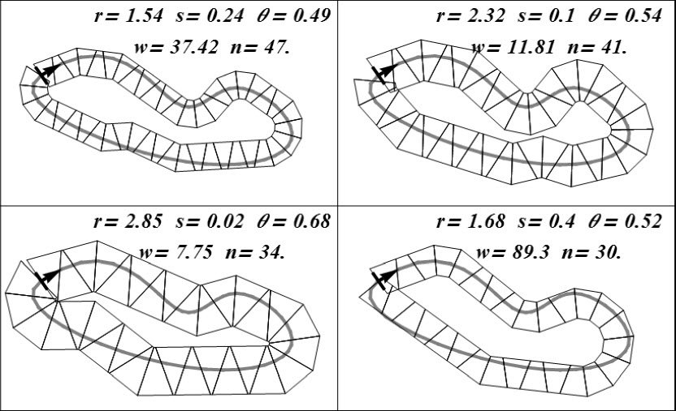
Forming Closed Loops Is Difficult !
M. Zawidzki & K. Nishinari:
Notes:
Here is a 2D version of their program that fits a chain of trapezoidal elements along a given, fixed path. The program varies the parameters for the single trapezoidal module and the placement and orientation of subsequent modules.
In the plane there are only 3 degrees of freedom (DoFs). But it is already difficult to match all three constraints! As you can see, the loops do not close nicely!
In 3D space there are 6 DoFs – this makes the problem even harder! Hopefully this gives you a feeling for the design challenge I want to address.

Slide 21
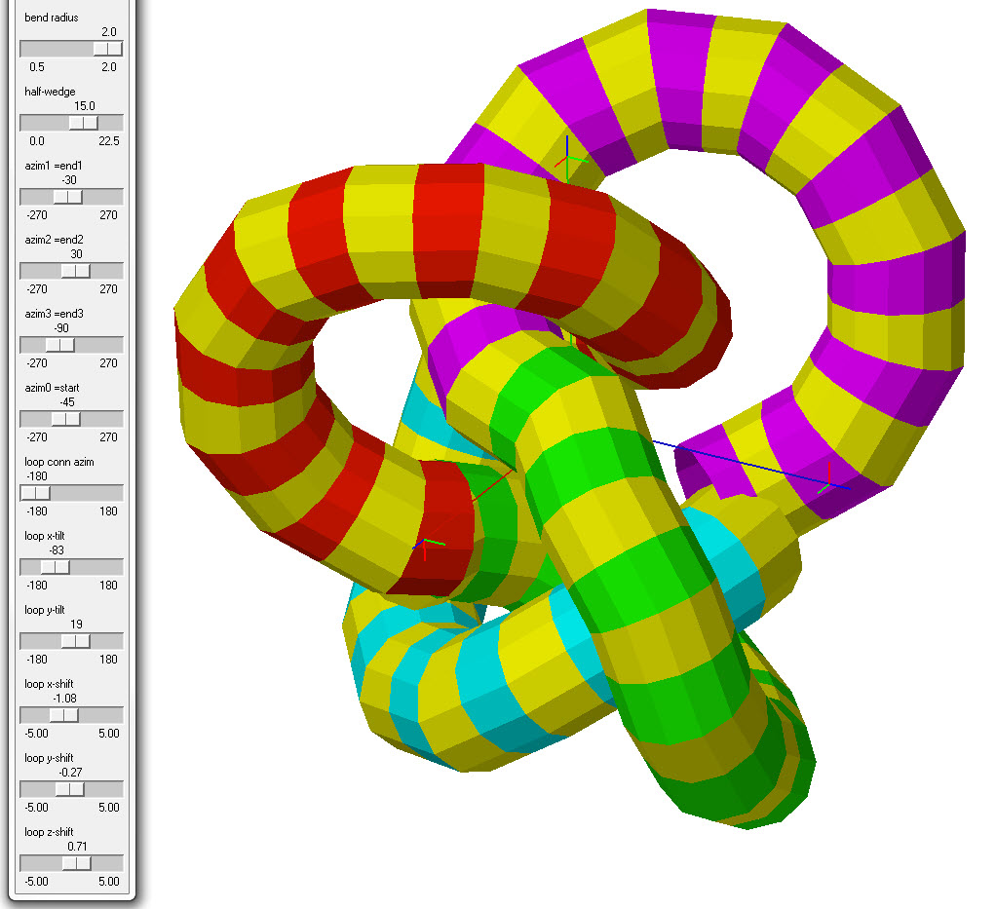
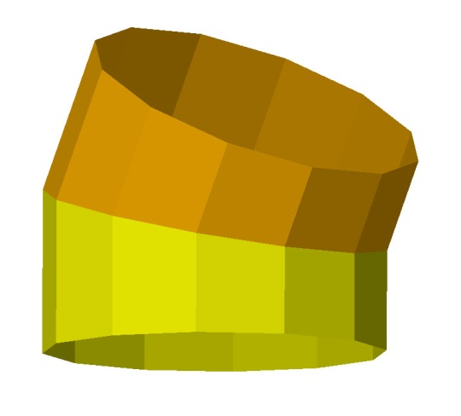
A First Try on a Figure-8 Knot
Λ-module
12-gon profile,
30° bending angle
Composed of 4×10 Λ-modules (S₄ symmetry)
Does not properly close! ( 6 DoF )
Notes:
Here is an early result from my first system in an attempt to model the Figure-8 knot with only 40 “LAMBDA” modules.
On the right you see the module I used: two short tubular elements joined with a 30 degree bending angle.
I used a cross section in the shape of a regular 12-gon, to have precise control of the torsion angles between neighboring modules during assembly
Because I wanted S4-symmetry, all 4 lobes are the same, and there are (only) 10 torsion angles to set independently, which is done with the sliders on the far left; -- but there are still 12^10 combinations to explore!
It is difficult to control the resulting shape, and even more difficult to obtain an exact closure of the loop based on all 6 degrees of freedom in 3D-space.

Slide 22
Polygonal Cross Section
Why NOT using round tubes:
If program specifies a torsion angle of 37.18 degrees, how would a user make sure to get the right angle ?
With a discrete n-gonal profile, there are a finite number of discrete clicks for the torsion angle.
16 clicks is a good compromise between finding the right angle and still having reasonable design freedom.
Notes:
Here is again the important reason, why we do not use a circular cross section, which would give us much more design freedom.
If in such a system the program were to specify a torsion angle of 37.18 degrees, how would a user make sure to get the right angle ?
With a discrete n-gonal profile, there are a finite number of discrete clicks for the torsion angle.
16 clicks is a good compromise between finding the right angle and still having reasonable design freedom.

Slide 23
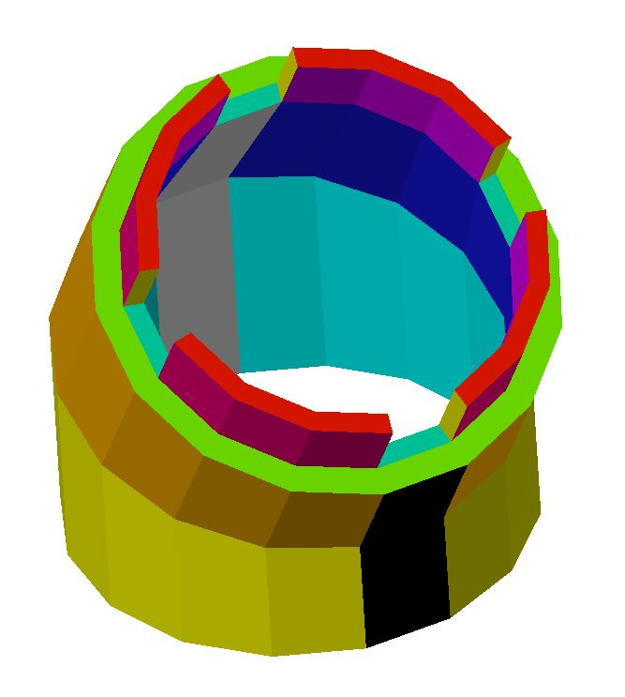

The Chosen Λ-Module Geometry
16-gon cross section (finer control of torsion angles)
30°bending angle in module (fewer overall modules)
2/3’’ pipe radius; 2’’ bending radius → (“wiggle space”)
Notes:
After much experimentation, we decided to make THIS our standard Λ-module.
We chose a 16-gonal cross section to have reasonably fine control over the torsion angle and no difficulties during assembly to pick the right one. To help with this, we notched the connecting flanges at torsion angles of 0, ±90, and 180 degrees.
We chose a bending angle of 30 degrees, so that I could keep the number of modules needed for a particular knot reasonably small, but not have to much undulating wiggles in curve segments that are fairly straight.
The diameter ratio was chosen based on aesthetic considerations and to leave me some room as branches pass through tightly curved loops.
The detailed geometry was chosen, so that the module could be built on an inexpensive machine with a minimal amount of material and with no support scaffolding at all.

Slide 24

Tightest Closed Toroidal Ring
Could just fit two more branches through the tunnel!
Notes:
With this geometry it takes 12 Λ-modules to form a perfect toroidal ring.
The inner tunnel is wide enough to fit just two more branches through it, -- so in principle we could form a chain of such rings.

Slide 25

A First Batch of 20 Modules
Out of the “Uprint” FDM machine from Stratasys
Notes:
Here is the first batch of 20 modules fabricated on a Fused-Deposition-Modeling machine from Stratasys.
Now let’s see what we can build with these modules …

Slide 26






Modular UnKnots
The UnKnot Undulating Loops Figure-8 Loop
(Torus) (24, 20 modules) “Infinity”
Notes:
12 modules make the UnKnot in the shape of a simple torus.
4 half-circles can readily be combined into an undulating loop;
Or with a different assembly they can form a Figure-8 Loop or “infinity” sign. – But this already needed 24 modules, so I cooked a second batch.

Slide 27


Exploiting Symmetry
Build the whole trefoil from three C₂-symmetrical branches.
Branch-ends can always be brought into coincidence, BUT . . . .
Notes:
Now I have enough components to try to build a trefoil knot
I start by defining one C2-symmetrical branch and then check whether three of them form a good trefoil knot
>> We can always align 3 such branches so that they form a 3-sided equilateral configuration with matching end-points.
BUT the direction of the end modules may not line up for joining;
And -- the overall configuration may not be a trefoil at all!

Slide 28


Simplest “ModKnot”: K 3₁
Trefoil Knot: K 3₁; D₃ symmetry; uses 33 modules.
Only 5 torsion angles need to be specified.
Notes:
But if each branch is forming the right kind of helical loop, I can indeed realize the simple trefoil knot – using 33 copies of this one modular component.
It’s geometry is defined completely by five (six) discrete azimuth angles: 0, 0, 0, -45, 0, (135). (The sixth one results automatically, at the joints between the branches. I have to find a solution the axes line up AND the torsion angle I close enough to a “legal” values.

Slide 29

Trefoil Knot Sculpture
33 modules, D₃ symmetry.
Notes:
After I fiddled with the 5 torsion angles for about 2 hours, I was able to obtain this sculpture.

Slide 30

Modular Figure-8 Knot, K 4₁
Figure-8 Knot: K 4₁; S₄ symmetry; uses 40 modules
Even with the computer plan, this is difficult to assemble!
Notes:
The next knot in the table, the Figure-8 knot, turned out to be surprisingly challenging: I had to adjust 9 separate torsion angles.
Because this knot – by design – had 4-fold symmetry, I first constructed four identical branches. Then I had to interweave them properly.
And when I finally had the design on the computer, it was still quite tricky to assemble. I had to be very careful to get all the azimuth angles right.

Slide 31

Figure-8 Knot Sculpture
40 modules, S₄ symmetry
Notes:
But eventually, I succeeded!

Slide 32

Cinquefoil Knot: K 5₁
D₅ symmetry
50 modules
Notes:
And after I cooked a third batch of modules, this time in yellow, I was also able to build the Cinquefoil knot with full D5 symmetry.
Finding the right angles to realize this knot was done again with the same interactive graphics program. This was not too bad, because here I had to adjust only 5 unique azimuth angles. This again took a couple of hours of trying different combinations.

Slide 33

Designing More Complicated Knots
What if one wants to build a more complicated knot, where there are a dozen or more unique torsion angles?
Couldn’t a computer program do the work?
Let’s tackle the simpler problem first: assume tubular module has circular cross sections.
This seems harder: Infinitely many possible angles !
But it is actually simpler, because we have a smooth, continuous optimization space, where we can use gradient descent optimization.
Notes:
But I would also like to build more complicated knots – like the Chinese Button Knot K 9_40. I would like to engage the help of a computer!
… Gradient descent: A first optimization scheme I want to discuss.

Slide 34

Knot Design for Circular Cross Section
Describe the knot to be realized with a smooth curve, e.g., defined by some spline curve.
Sample that curve with as many points as you think you need to use number of modules. Each sample point then is the center of a module; neighboring modules join their ends exactly half-way between two sample points.
Adjust the positions of all those points so that: neighbors are separated by exactly 2L (leg-length) and bending angles between subsequent segments are 30°.
Notes:
Start by describing the knot you would like to get with a smooth 3D space curve…

Slide 35

Computer Optimization
Point distances must all be the 60 mm.
Bending angles must all be 30 degrees.
Move all the points around (in x,y,z) until all requirements are met everywhere.
Symmetry: →15 Degrees of Freedom (DoF)
Notes:
The computer program makes small random movements on all the red vertices to move them closer to positions where all the geometric constraints are met. Then the program reports all the torsion angles. This can be done by gradient descent optimization. This could be an optimization space of rather high dimension. For 33 modules we would have 99 degrees of freedom! So we want to exploit its D3 symmetry to the fullest. If done right, it leaves us with a 15 dimensional space.

Slide 36
The Error (“Cost”, “Penalty”) Function
Try to minimize all the possible deviations listed in the previous slide:
Edge Length Differences (ELD):
ELD = ∑ (length_{i} – 60mm)²
Bending Angle Deviations (BAD):
BAD = ∑ (bending-angle_{i} – 30°)²
Combine local errors into one overall error function:
COST = α * ELD + β * BAD { 0.5mm ∼ 1° }
Notes:
Need to define an Error Function:
First there are the Edge-Length Differences. For each segment we square the differences from the desired 60 mm for our module.
Second there are the Bending Angle Deviations. Between two segments sharing a vertex.
We sum all the squared local errors and combine them into on overall error function.
Since there are two different kinds of errors, measured in mm and in degrees, we have to decide how to weigh them against one another.
Experimentally, we have determined a “visibility threshold”: 0.5mm in separation, 1 degree, in both types of angles; so we equate those two values. (We define these values as an error of “0.001”.

Slide 37

The Error (or “Cost”) Surface
Visible flaws = “Cost”
Param. #1
Param. #2
Cost function is a “hilly landscape” over our 5-dimensional parameter space. (In the example above we only show 2 dimensions)
In this “landscape” do gradient descent optimization (= follow a drop of water to the lowest point it can go to)
Notes:
Now we let the program run with this: This is a conceptual view of how gradient descent works:
The error (or “cost’) surface defines the total error for all possible combinations of parameter values. Graphically, this forms a “hilly landscape” in our 15-dimensional parameter space. -- But in the example here, I show you only a 2-dimensional parameter space. == The goal now is to find the lowest point in this landscape. This can be done by gradient descent. You can think of this as starting with a reasonable sampling point, corresponding to a combination of parameters that are not too far off from an acceptable solution.
>>> There we insert a drop of water and watch it run down-hill to the lowest point in that neighborhood.

Slide 38
The Math behind Gradient Descent
We could differentiate the total error function that I showed you earlier. Here it is not too bad; (sums of squared deviations from desired values).
For any position of our rain drop, we can calculate the direction of the steepest descent in our cost landscape.
Then we take a small step in that direction – and repeat the process.
Notes:
For simple error functions, like our sum of quadratic error terms, we might be able to calculate the gradient at arbitrary points based on the {x,y,z} coordinates of all the vertices in one half or our C2-symmetrical branch of 5 modules. Then we take a small step following the steepest gradient at the current location; find a new location, and repeat the process.

Slide 39
Finding the Gradient by Sampling
In mathematically more complex situations we may not have such a convenient closed-form expression to differentiate. Then we determine the gradient experimentally:
Take a small step in “x” (axis of the first parameter) and see how much the cost function changes. ∆_cost / ∆_ step gives the slope in that direction.
Do this for all parameters.
Notes:
In mathematically more complex situations
…combine this information to find the overall gradient at that point.

Slide 40
Gradient Descent in One Dimension
∆_ cost / ∆_ step = gradient.
If our test step shows a cost increase, move in the opposite direction.
error, cost, penalty
Notes:
Here is a graphical visualization of this:

Slide 41
The Overall Gradient
Overall, we would like to move in the direction that gives the largest cost reduction; i.e., move in the direction of the steepest gradient.
So, we test the gradient in all DoFs: “x”, “y”, “z”, “w” …
Form a vector that proportionally combines steps in all possible directions by weighted them with the amount of cost reduction they provide.
Notes:
This is how we combine the gradients of all the parameters:
We would like to move as steeply down hill as we possible can…

Slide 42
Tricky Issues
How large should the test step be to find the gradient reliably?
Small enough to be in “linear range”
Not so small that it is dominated by noise and rounding error.
BAD!
Notes:
But in the implementation of gradient descent, there are some tricky issues: …
Test of linear range: A step half the size should result in a cost change of half the size.
But don’t make the step too small!

Slide 43
Optimal Step Size?
Once we have figured out the direction of the gradient, how big a step should we take in that direction?
Again we would like to stay in the “linear” range: Half the step size should give roughly half the effect.
STEP TOO BIG!
Notes:
Next, once we know the direction of the gradient: How big a step should we take in this direction?
If our step is too big we may wildly oscillated back and forth in the current well; or we might even fly out of the local minimum into another valley.
On the other hand, if the steps are too small, the system might not move at all, and we might wait for a long time to get any results.
Again the goal is to stay in some kind of “linear range”, where a step twice as big would give almost twice the amount of error reduction.
We may want to test this and check what step sizes of 2.0 or 0.5 times the last step would do.
If the step size seems be too small, we may want to double it. If the effect also doubles, we may want to double it again, until we come to a step size where the gain no longer linearly increases with step size; then we back off to the last step previously tested for linearity.

Slide 44


Using Gradient Descent
There may be no perfect solution . . . E.g. if trying to make a ring with only 11 segments:
3°
30°
30x30 = 900 deg.² 11x(3x3)= 99 deg.²
Error Minimization: By distributing it over all joints
Notes:
Gradient descent, if done properly, will just end up in the closest local minimum. This may not be the best solution. There may not even exist a perfect solution, as in this example:
… This still leaves gaps of about 3 degrees. This is clearly visible!
But the error has been reduced from 30x30 = 900 deg.squared to only 11x(3x3)= 99 deg.squared.

Slide 45
Summary: Gradient Descent
Not too difficult to implement!
Normally works quite well.
We can readily find solutions for circular tubing.
But it would be difficult to actually use those results for a precise realization of a symmetrical knot.
This is why we use an n-gonal cross section.
But then gradient descent can no longer be used.
Notes:
…,
But then gradient descent can no longer be used.

Slide 46
Adding Discrete Torsion Angles
Allow only 16 legal torsion angles at any joint for robustness of symmetrical knot configurations.
Start as before with circular cross sections and reduce module separation and bending angle errors. These results will have arbitrary torsion angles; they could deviate from a “legal” value by 11.25°.
Thus we round all angles to their nearest legal values and set them as goals for a new optimization run.
In this new optimization, we try to reduce the deviation from the legal torsion angles at a cost of increasing the deviations in module separation and bending angles.
Notes:
But now we want to find a way of designing complex knots with our lambda-module with 16 discrete torsion angles.
…
Again this can be done with gradient descent, with just one more type of error terms, -- which we treat like the bending angle terms.
As in the example before, we distribute the errors as uniformly as possible, so each one does the least damage when they are being squared.

Slide 47
Is this the best solution for our Knot?
The rounding of the torsion angles was a rather dramatic change in knot geometry!
Had we chosen slightly different “legal” values, would we have found a solution with lower overall error?
To be sure, we should test neighboring combinations of legal torsion angles.
BUT, this means making discrete changes: Gradient Descent does NOT work for this problem!

Slide 48
A Discrete Optimization Problem
No smooth continuous moves; no gradient calculations possible.
There are only discrete “moves”! One “click” in one torsion angle: → cost function will take a jump!
Any single such move will probably make matters worse; we may need a combination of several discrete moves to get an improvement. -- but what combinations? -- there is a very large set of possible combinations !

Slide 49
Discrete Optimization Techniques
There are two techniques that you may want to know about:
Simulated Annealing
Genetic Algorithms
Both are extensively used in industrial applications.

Slide 50


Genetic Algorithms
Inspiration! 8 Variations from the central figure

Slide 51

“Biomorph” Shapes

Slide 52
Not Suitable for Knot Optimization
No separate features (organs) (eyes, ears, noses …) that can be optimized independently and then combined into superior “animals”!
All torsion angles are equally important.
They all work “in concert” with one another.
No good features that can be transferred from one knot to another one.
Notes:
---
So lets look at another discrete optimization technique…

Slide 53
(Metallurgical) Annealing
Annealing is a metallurgical process: heat a solid and then cool it slowly until it crystallizes.
At high temperatures the atoms have much freedom to rearrange themselves.
As the temperature is lowered gradually, atoms settle into good, low-energy positions, producing a nice crystalline structure.
Notes:
So I will focus now on “Simulated Annealing”…
But first: what is annealing ?

Slide 54


Simulated Annealing
This is a computed emulation of crystal annealing.
It has been introduced in the 1970s by Kirkpatrick (IBM) to optimize the layout of integrated circuits:
How can the circuit modules best be placed to result in the smallest chip layout with the shortest (fastest) connections between them?

Slide 55

Integrated Circuit Module Placement
wasteful wiring
A “greedy” optimization may end up in a local minimum.
Notes:
Problem: Exchange block positions to minimize total wiring length.
If we just move modules “greedily” by the pull of their attached wires … we may end up in a poor local minimum with some wasteful wiring.

Slide 56
Starting at a “High Temperature”
The goal is to make significant (non-local) changes and have the results accepted even if it is somewhat worse than the previous layout.
The higher the temperature, the larger an increase in the total error (or “cost”) value will be accepted.
But then we gradually lower the temperature.
Eventually, the temperature is zero, and then we accept only net improvements.

Slide 57
A Good Solution-Space Profile
A nicely behaved function, good for simulated annealing
Notes:
Yellow is high temperature; blue is cold. Diameter of fuzzy ball indicates the amount of added error we are willing to accept in any single move.
At high temperature, with the large fuzzy yellow ball we explore to overall course structure of the solution space and end up in the big yellow trough.
At a reduced temperature given by the red ball, we explore to profile more finely. Finally the blue probe will end up in one of the blue local minima near the bottom of the yellow trough.

Slide 58

What is a Good Move-Set?
For every problem we want to solve, we have to define a good “move set” i.e. a set of random changes with which we explore different locations in the solution space.
It is important to pick a good, “promising” set of moves!
E.g.: building block placement in integrated circuits: Moving one module at a time is NOT a good move!
Notes:
Swapping two modules of about the same size may have a better chance of keeping the total error within the range allowed at that temperature.

Slide 59
Simulated Annealing for Knot Design
Here, the (discrete) variables are the torsion angles.
Changing just ONE angle by 22.5° makes a large local change and typically results in a large increase in error.
Rotating a whole module by 22.5°, corresponding to a ±22.5° change on 2 neighbor joints is a “gentler” move.
Still, just changing local torsion angles does not give an adequate evaluation of the error of the new combination. We first need to distribute the errors over all the joints!
Run a greedy optimization phase (with gradient descent).
Can we find the “best” solution with this approach?

Slide 60
Exploring the Solution Space
Full exhaustive search through the trefoil options with 30 modules and 5 independent torsion angles: There are 16⁵ = 1,048,576 different combinations!
Use the 5 torsion angles to build a C₂ symm. branch; arrange three of them in a triangular circuit with coinciding ends; and do some sanity tests:
(3,2)-torus knot, must circumnavigate the z-axis exactly twice.
Check for sufficient clearance between its different branches.
Only 4,286 candidates survive these tests! Only those are subjected to error re-distribution and used in our study of the solution space.

Slide 61


Neighbor-Patterns among Good Knots
Which knots are connected by 2 or 3 “gentle” moves?
We could reach about 15 reasonably good knots
with combinations of 2 gentle moves from the best possible knot. But how can we find our way into this good cluster ??
Notes:
We have not yet found a simple strategy that guarantees success!
There is a disturbing thought that our solution space may look more like …

Slide 62
ID Solution-Space Profiles
Difficult golf-course function; bad good for simulated annealing
Notes:
So now I am worried that our solution space may look more like this “Devil’s Golf Course.”
How can we possibly find clusters of good solutions in this landscape?

Slide 63
What Next ?
Within the last two days, while preparing this talk, I thought of a new possibility of finding good torsion angle combinations more efficiently.
Rather than rounding strictly to the closest legal angle, let’s try rounding up or down in the opposite direction. Those combinations that add less error will be evaluated first.
Moreover, let’s calculate the legal floor and ceiling of the initial torsion angles directly from the polyline resulting from the sampled smooth knot curve. Then we need to do only one error re-distribution by gradient descent optimization.
Notes:
We will study how promising this approach is by looking at the exhaustive search results on the trefoil.

Slide 64
Acknowledgements
I am grateful to:
The Staff in the Jacobs Institute of Design Innovation for their help with the fabrication of varous 3D parts.
My undergraduate co-workers: Arman Babakhani William Brandon Jonathan Liu
Notes:
And I would like to acknowledge the help and contributions of 3 outstanding undergraduate researchers: …

