Slide 1
Teaching Introductory Statistics: Ask Good Questions
Allan J. Rossman
Department of Statistics
Cal Poly – San Luis Obispo
Email: arossman@calpoly.edu
Twitter: @allanjrossman
Blog: https://askgoodquestions.blog

Slide 2
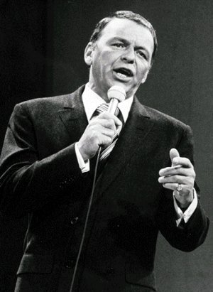
Frank Sinatra
What’s the secret to being a successful singer?
  “Sing Good Songs”
2

Slide 3
My similarly succinct suggestion
What’s the secret to being an effective teacher?
  “Ask Good Questions”
3

Slide 4
I’m tempted to stop right now
My take-home message
  Ask Good Questions
Quiz at end of presentation
  Q: What was my point?
  A: Ask Good Questions
I have started writing a weekly blog
  Name: Ask Good Questions
  https://askgoodquestions.blog

Slide 5
What kinds/purposes of questions?
Guide students to develop their understanding and skills
  Formative assessment
  Learning activities
Assess what students have learned
  Summative assessment
  Quiz/exam questions
5

Slide 6
Examples of questions for teaching …
Statistical thinking
Descriptive statistics
Sampling and experimentation
Probability
Simulation-based inference
Confidence intervals
Hypothesis tests

Slide 7
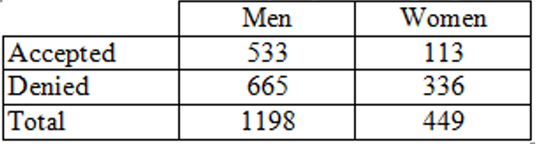
Statistical thinking
Example: Sex discrimination?
Men: 533/1198 ≈ .445 were accepted
Women: 113/449 ≈ .252 were accepted
Does this provide evidence of discrimination against women?

Slide 8
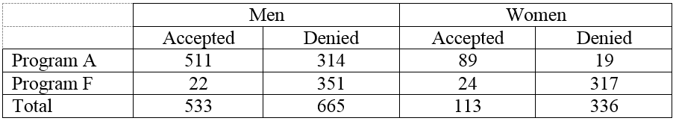
Statistical thinking
Program A
  Men: 511/825 ≈ .619
  Women: 89/108 ≈ .824
Program F:
  Men: 22/373 ≈ .059
  Women: 24/341 ≈ .070

Slide 9
Statistical thinking
Describe and explain the oddity, using the data given
Most men apply to the easy program to get in; most women apply to the hard program to get in
Multivariable thinking
  Simpson’s paradox

Slide 10
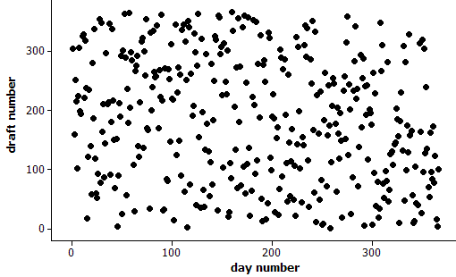
Statistical thinking
Example: 1970 Draft Lottery
Any reason to doubt randomness?

Slide 11
Statistical thinking
Calculate median draft number for each month

Slide 12
Statistical thinking
Calculate median draft number for each month
Jan 211 Jul 188
Feb 201 Aug 145
Mar 256 Sep 168
Apr 225 Oct 201
May 226 Nov 131.5
Jun 207.5 Dec 100
Do you see a pattern/trend?

Slide 13
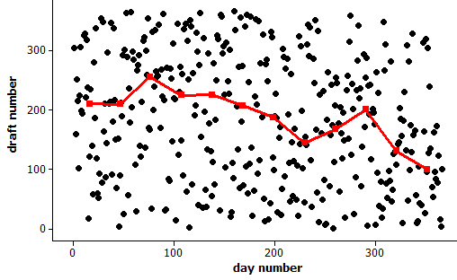
Statistical thinking
Example: 1970 Draft Lottery
Any reason to doubt randomness?

Slide 14
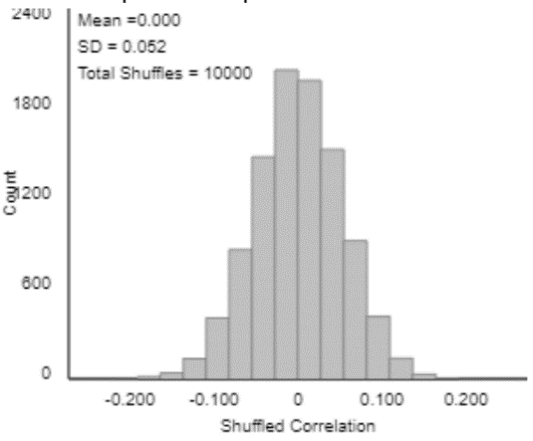
Statistical thinking
How often would such an extreme outcome occur with a truly random lottery?
What statistic might you use to determine “extreme”-ness?
  Correlation ≈ -0.226

Slide 15
Descriptive statistics
I suspect that when I moved from PA to CA, the average IQ dropped in both states!
  Is this possible?
  What would have to be true (in principle) for this to happen?
Yes, if (my IQ > average IQ in PA)
and (my IQ < average IQ in CA)

Slide 16
Descriptive statistics
Consider two new statistics:
  Midrange = (maximum + minimum) / 2
  Midhinge = (lower quartile + upper quartile) / 2
For each statistic:
  Is this a measure of center or variability?
  Is this resistant to outliers?

Slide 17
Descriptive statistics
Suppose that Abby records the ages of customers at The Avenue (on-campus snack bar) from 11am-2pm today, while Mary records ages of customers at McDonald’s (near freeway).
Who will have the larger standard deviation of customer ages: Abby or Mary? Explain.

Slide 18
Descriptive statistics
Example (adapted from Jay Lehmann):
Which would be larger – the mean weight of 10 randomly selected people or the mean weight of 1000 randomly selected cats? Explain briefly.
Which would be larger – the standard deviation of the weights of 1000 randomly selected people or the standard deviation of the weights of 10 randomly selected cats? Explain briefly.

Slide 19
Descriptive statistics
Many of my students think that larger sample size produces smaller SD
Do not realize that SD of the sample mean (or sample proportion) gets smaller as sample size increases
Advice: When you talk about SD, always emphasize SD of what

Slide 20
Descriptive statistics
Exam scores have mean 70, SD 8
  Arturo’s score is 75
  Bella’s score is 1.5 SDs above Arturo’s.
What is Bella’s score on the exam? Show your work.
  Concept: Measuring distance as number of SDs away from something
  Not necessarily away from mean

Slide 21
Descriptive statistics
Suppose that every student in our class scored 5 points lower on the second exam than on the first exam.
What would be the value of the correlation coefficient between (exam1 score) and (exam2 score)?
  Options: -5, -1, -0.5, 0, 0.5, 1, 5

Slide 22
Sampling and experimentation
Example: Gettysburg Address
Select a sample of 10 words from the population of 268 words in the Gettysburg Address. (Just circle 10 words.)
Record the length (# of letters) of each word.
Calculate the average length for your sample.
Produce graph of sample averages.

Slide 23
Sampling and experimentation
Is this a reasonable sampling method for estimating the average word length in the population?

Slide 24
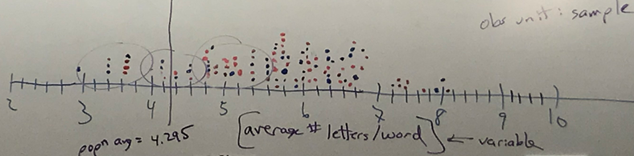
Sampling and experimentation

Slide 25
Sampling and experimentation
How does this graph indicate sampling bias?
Would closing eyes and pointing be unbiased?

Slide 26
Sampling and experimentation
Example: Mandela’s age
  Group 1: Nelson Mandela was the first president of South Africa following apartheid.
    Do you think he was older or younger than 16 years old when he died?
    Make a guess for how old he was when he died.
  Group 2: Nelson Mandela was the first president of South Africa following apartheid.
    Do you think he was older or younger than 160 years old when he died?
    Make a guess for how old he was when he died.

Slide 27
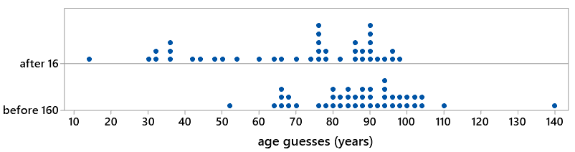
Sampling and experimentation
Example: Mandela’s age
t = -4.17; p-value ≈ .0000
Very strong evidence of anchoring effect

Slide 28
Sampling and experimentation
Random sampling and random assignment are different tools with different purposes
Random sampling
  Goal: Select representative sample
  Benefit: Generalize results
Random assignment
  Goal: Produce similar groups
  Benefit: Draw cause-effect conclusions

Slide 29
Repeated questions
Example: Anchoring (Mandela’s age)
What are the observational units in this study?
What are the variables in this study? Which type is each variable? Which variable plays which role?
Did this study make use of random sampling, random assignment, both, or neither?
Is this an observational study or an experiment?

Slide 30
Probability
2018 General Social Survey
  47% had a pet dog
  25% had a pet cat
Does it follow that 72% (which is 47% + 25%) had a pet dog or a pet cat?
  What would be required for this to happen?

Slide 31
Simulation-based inference
Example: Facial prototyping
Do people tend to associate names with faces?
Who is on the left: Bob or Tim?

Slide 32
Simulation-based inference
Example: Facial prototyping (cont)
36 of 46 students put Tim on the left
  What are two possible explanations for our observed sample result?
  Which explanation can we investigate/model? How?
  How often would such an extreme sample result occur by chance alone (if there were no facial prototyping)?
  Have students flip coins to investigate

Slide 33
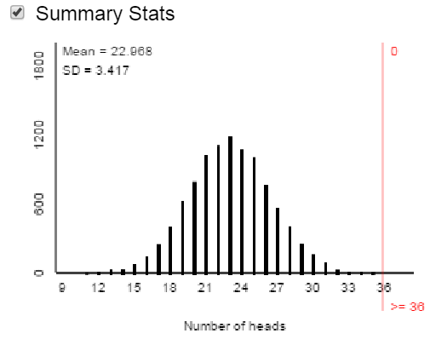
Simulation-based inference
Facial prototyping: 10,000 simulated samples of 46 students
Very strong evidence: people have a genuine tendency to put Tim on left

Slide 34
Confidence intervals
What does 95% confidence mean?
Simulation:

Slide 35
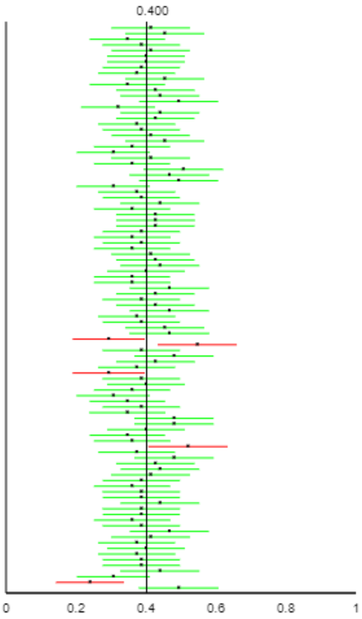
Confidence intervals
What does 95% confidence mean?
Simulation:

Slide 36
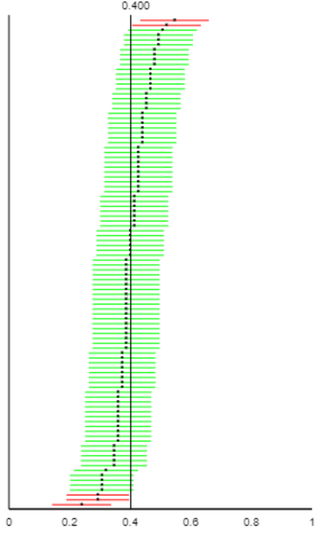
Confidence intervals
What does 95% confidence mean?
Simulation:

Slide 37
Confidence intervals
What would change (two things) if the confidence level was increased or decreased?

Slide 38
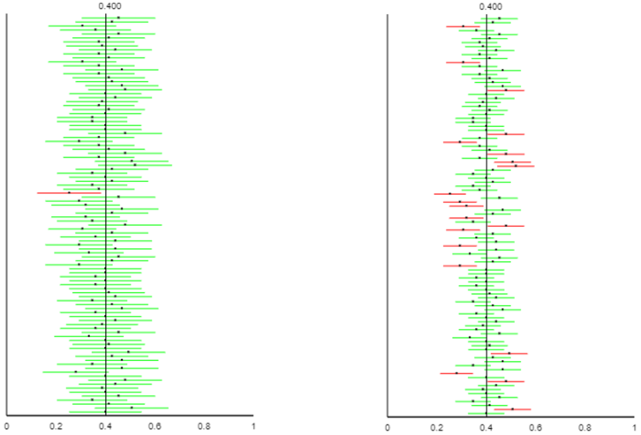
Confidence intervals
What would change (two things) if the confidence level was increased or decreased?

Slide 39
Confidence intervals
What would change if the sample size was increased?

Slide 40
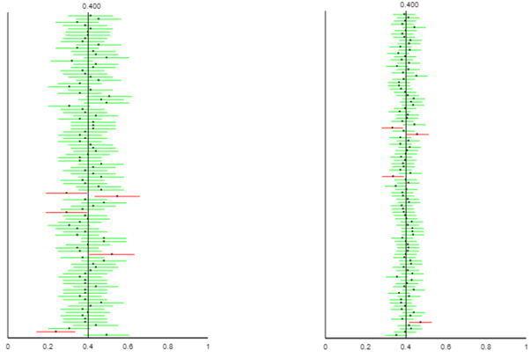
Confidence intervals
What would change if the sample size was increased?

Slide 41
Confidence intervals
Suppose that an alien lands on earth and sets out to estimate the proportion of human beings who are female
The alien took a good statistics course on its home planet and knows to take a sample, produce a confidence interval
Sample: the 2019 U.S. Senate, which has 25 women (the most ever!) and 75 men

Slide 42
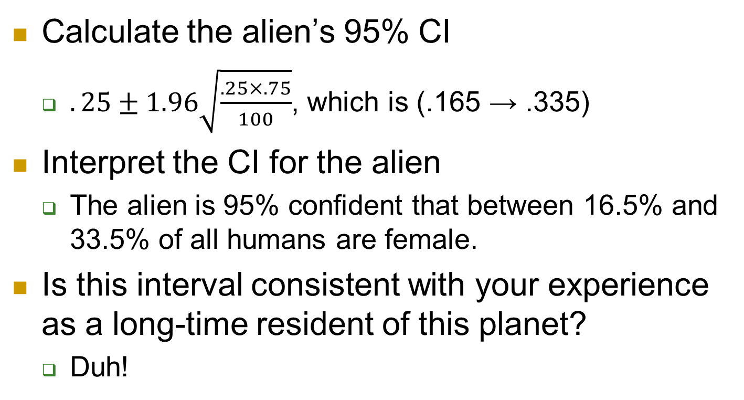
Confidence intervals
Calculate the alien’s 95% CI
  $.25±1.96\sqrt{\frac{.25×.75}{100}}$, which is (.165 → .335)
Interpret the CI for the alien
  The alien is 95% confident that between 16.5% and 33.5% of all humans are female.
Is this interval consistent with your experience as a long-time resident of this planet?
  Duh!

Slide 43
Confidence intervals
Is the problem that 5% of all 95% CIs fail to capture actual value of population parameter?
  No!
Then what went wrong???
  Biased sampling method!
If the alien was only interested in estimating the proportion of 2019 U.S. Senators who are female, would this 95% CI make sense?
  No, exactly 25% of current senators are female!

Slide 44
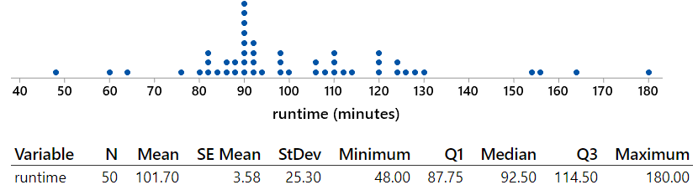
Confidence intervals
Random sample of 50 movies in “thriller” category from IMDb database

Slide 45
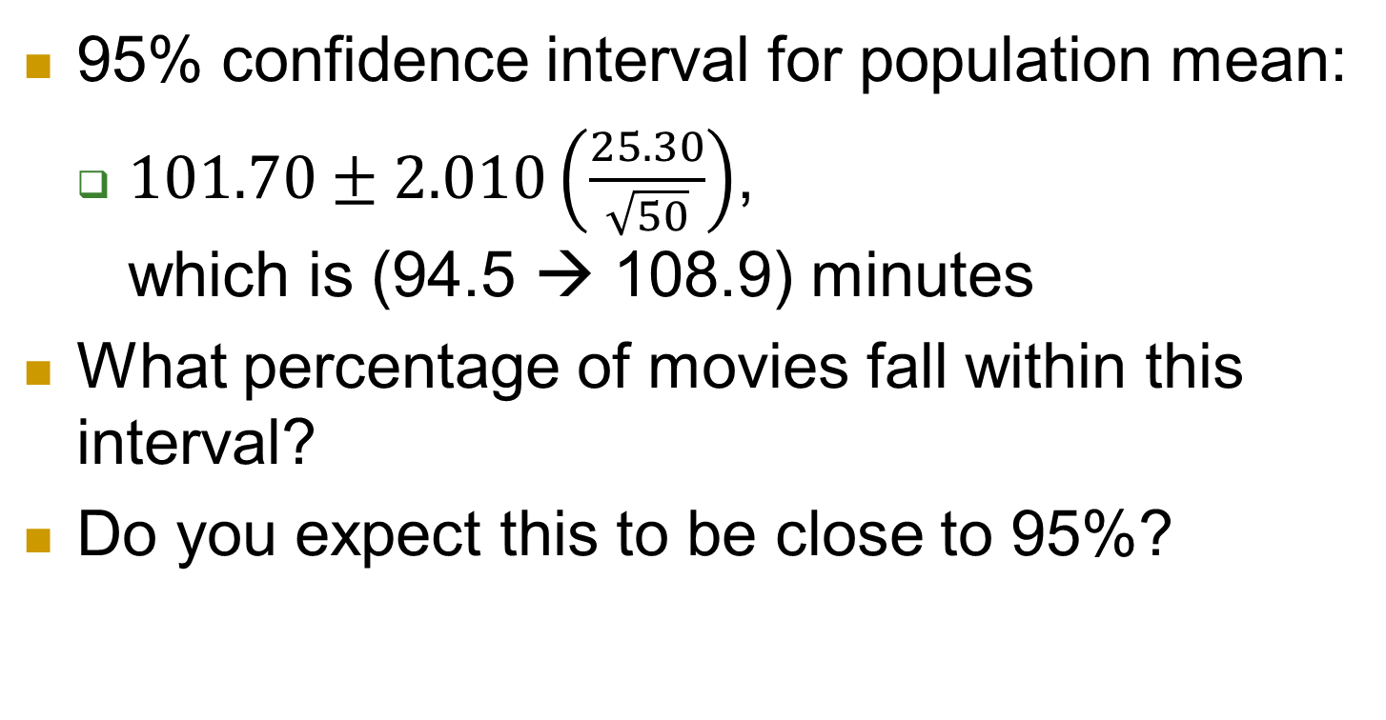
Confidence intervals
95% confidence interval for population mean:
  $101.70±2.010\left(\frac{25.30}{\sqrt{50}}\right)$, which is (94.5 → 108.9) minutes
What percentage of movies fall within this interval?
Do you expect this to be close to 95%?

Slide 46
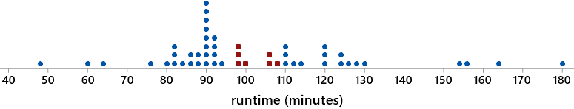
Confidence intervals
7 of 50 movies (14%) fall within this interval
CI estimates popn mean, not individual values
Many students misunderstand this
  Much more important than confidence level

Slide 47
Intervals and tests
Survey of 47,000 U.S. households in 2006 found that 32.4% had a pet cat
Does this provide very strong evidence that the population proportion with a cat is different from one-third?
Does this provide strong evidence that the population proportion with a cat is very different from one-third?

Slide 48
Intervals and tests
Does this provide very strong evidence that the population proportion with a cat is different from one-third?
  Yes! Test stat z ≈ -4.29, p-value ≈ .00002
Does this provide strong evidence that the population proportion with a cat is very different from one-third?
  No! 99.9% CI: (.317 → .331)

Slide 49
Intervals and tests
Hypothesis test and confidence interval give consistent results
  Value one-third is rejected, does not appear in CI
Statistical significance is different from practical importance
  Especially relevant with large sample sizes

Slide 50
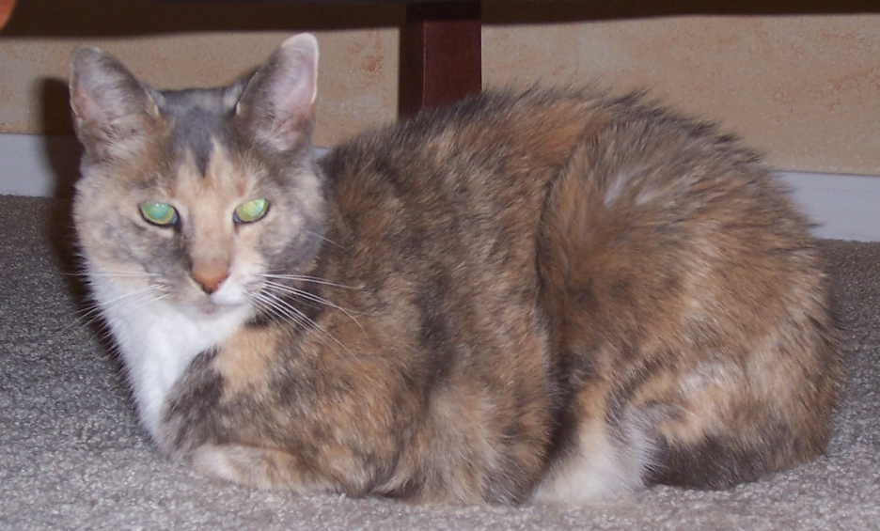
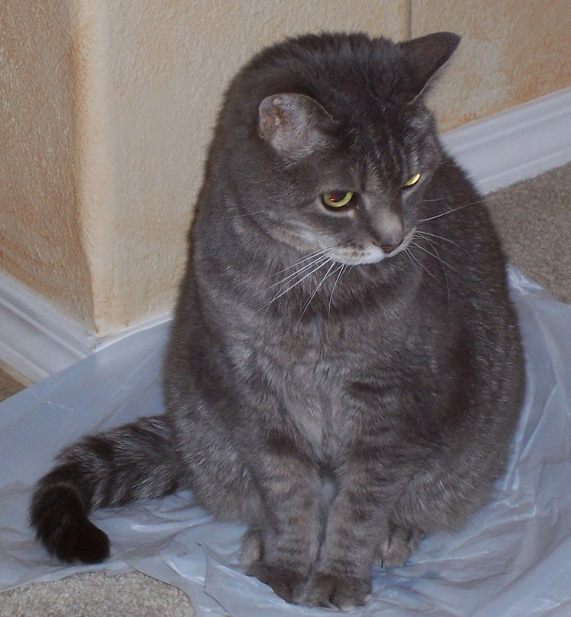
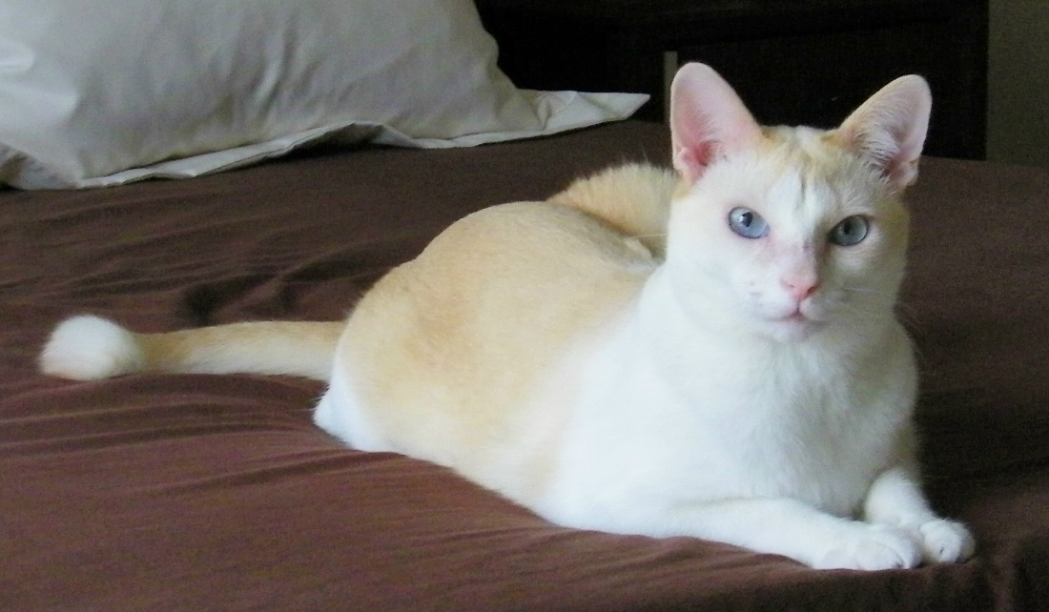
My cats

Slide 51
A question for you
In the last 20 years, the proportion of the world population living in extreme poverty has …?
  Almost doubled
  Remained more or less the same
  Almost halved

Slide 52
Human progress
“Over the past twenty years, the proportion of the global population living in extreme poverty has halved. This is absolutely revolutionary. I consider it to be the most important change that has happened in the world in my lifetime.” ‒ Hans Rosling

Slide 53
Human progress
“Here is a shocker: The world has made spectacular progress in every single measure of human well-being.
Here is a second shocker: Almost no one knows about it.”
‒ Steven Pinker

Slide 54
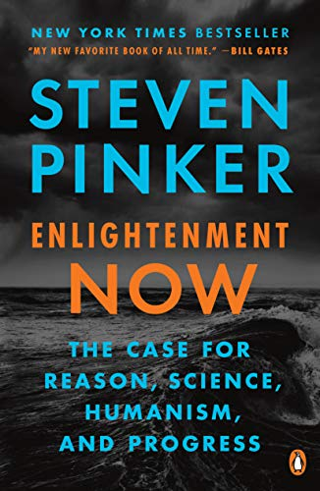
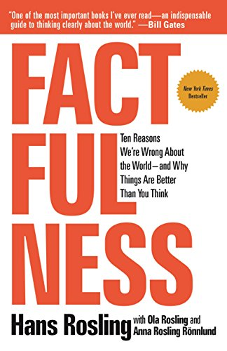
Human progress

Slide 55
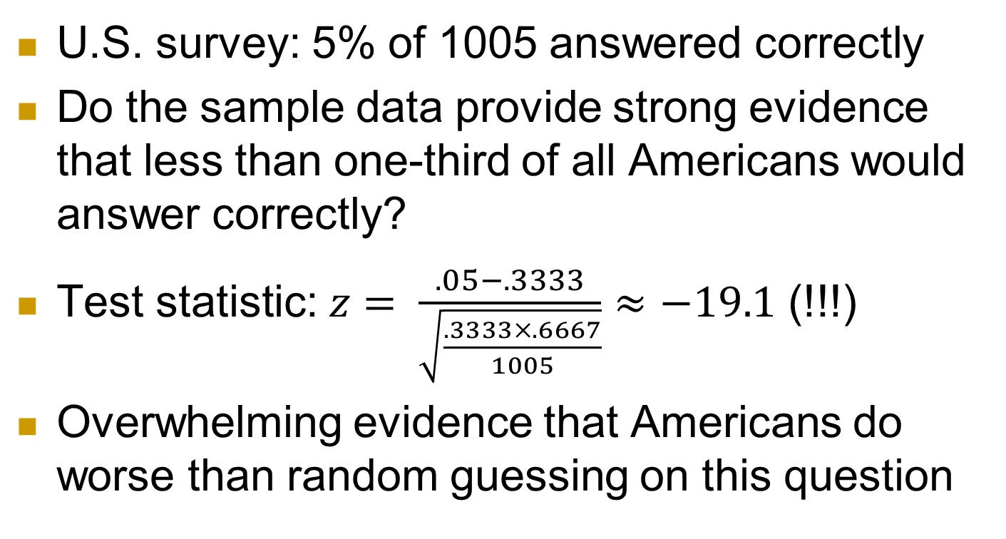
Human progress (more on inference)
U.S. survey: 5% of 1005 answered correctly
Do the sample data provide strong evidence that less than one-third of all Americans would answer correctly?
Test statistic: $z= \frac{.05−.3333}{\sqrt{\frac{.3333×.6667}{1005}}}$ $≈−19.1$ (!!!)
Overwhelming evidence that Americans do worse than random guessing on this question

Slide 56
Human progress (more on inference)
U.S. survey: 59% of 1005 answered “doubled”
Estimate the proportion of all U.S. adults who would answer “doubled” with 95% confidence
.59 ± .030: (.560, .620)
Interpret this interval.
  We are 95% confident that between 56% and 62% of all U.S. adults would give the most wrong answer to this question.

Slide 57
Some final questions for you
Have you ever attended a presentation titled
  Ask Bad Questions?
Have you ever attended a presentation titled
  Don’t Ask Questions?
Of course not! So, …
  Why am I wasting your time with such obvious advice as “Ask Good Questions”??
57

Slide 58
Yeah, why am I wasting your time?
I respectfully suggest that the next time you (or I) feel compelled to invest our valuable time, thought, energy, and creativity on …
  Preparing crystal-clear lectures
  Writing lucid paragraphs of exposition
  Crafting beautiful presentations
58

Slide 59
What should we do?
59

Slide 60

What should we do?
60
Resist this temptation!

Slide 61
So, what do I suggest instead?
Instead we should invest these precious commodities (time, thought, energy, creativity) on
  Developing engaging classroom activities
  Preparing thought-provoking assignments
  Crafting effective assessment items
In other words, we should be sure to …
61

Slide 62
What’s the take-home message?
Ask Good Questions!
62

Slide 63
Thanks very much!
Please follow my weekly blog with many more examples and advice:
https://askgoodquestions.blog
Please contact me with questions and comments: arossman@calpoly.edu
Applets: www.rossmanchance.com/applets

