Slide 1
Communities of Practice: Transitioning into an AB705 World
Vanson Nguyen, EdD, College of Alameda
https://goo.gl/AUL79m

Slide 2
New look math courses
Different student populations.
Increased access for disproportionately impacted students.
Extra time to work with students through co-requisites.
How to support faculty?

Slide 3
Professional Development
One-and-done speakers/trainings
Conferences
Webinars
FLEX days
Speakers
Ongoing dialogue
Continuous
Feedback
Hallway
conversations

Slide 4
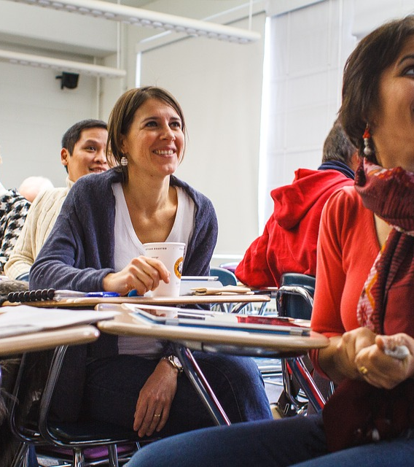
Communities of Practice
Spaces for collaborative thought

Slide 5
Content
Activities/Participation
Facilitation

Slide 6
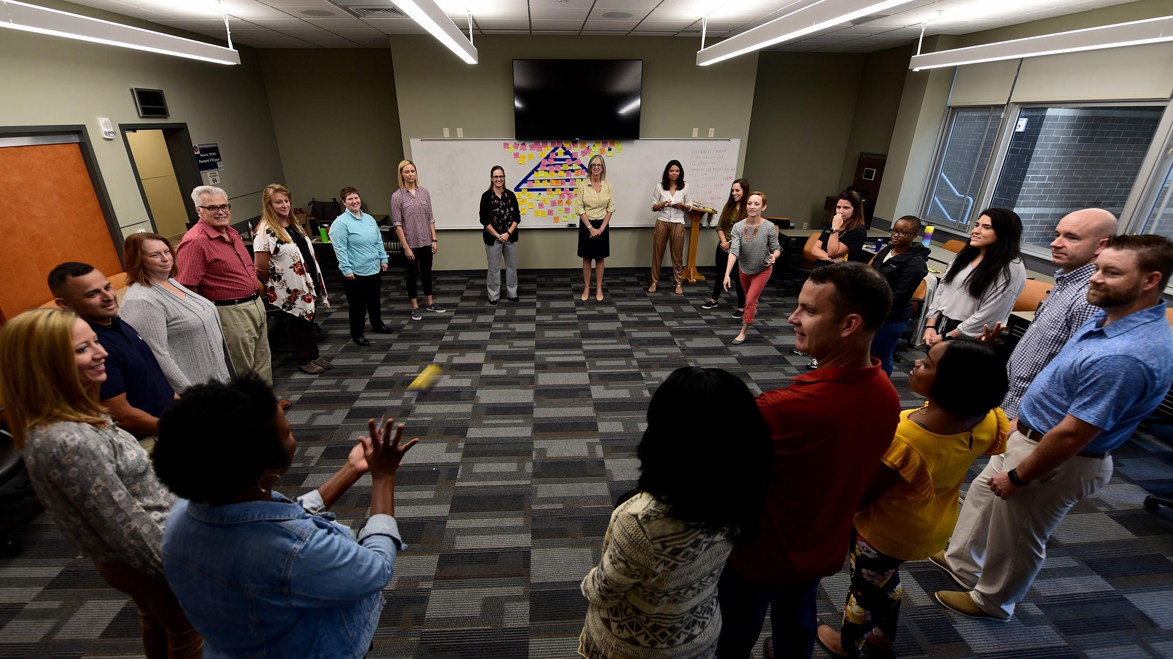
COntent Specific
Pedagogical
Resource development
ANYTHING YOU WANT!
Book club
Notes:
Can be several topics in one.

Slide 7
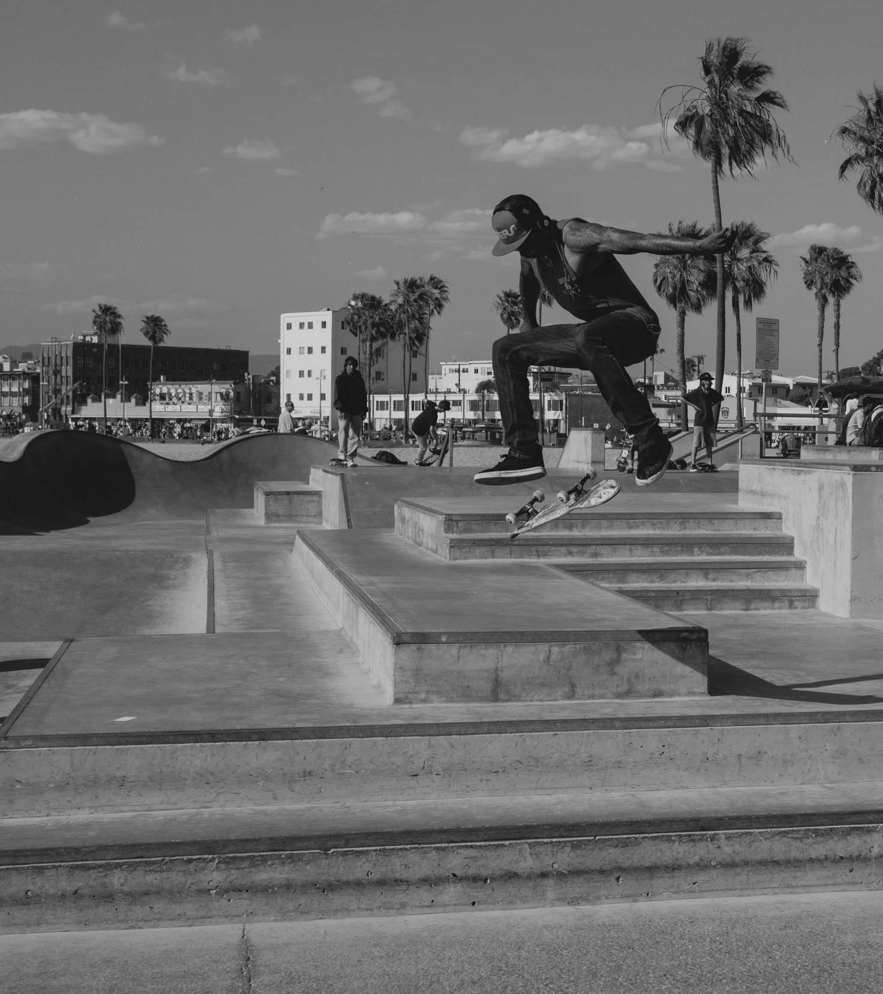
Activities
Discussion Boards
Using canvas, google groups, message applications
Shared drive/folders
For resources and easy sharing with new members/interested parties
Classroom visits
Similar to Japanese lesson study, low-stakes collaboration

Slide 8
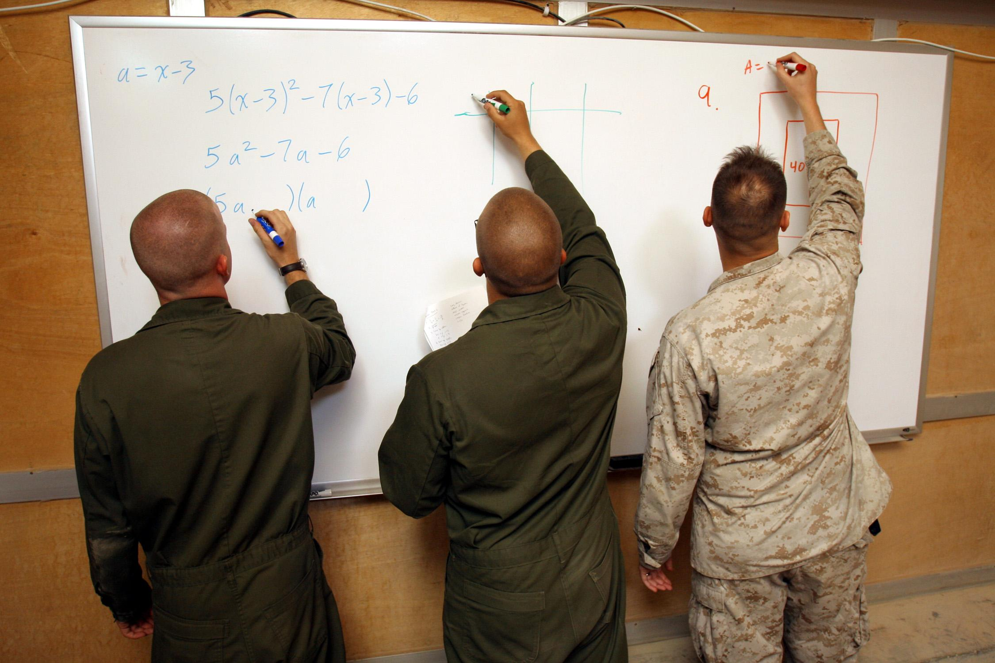
Facilitation
Increasing participation and voice of PT faculty
Step up/step back
Shared visioning
Participation without attendance
Small group strategies for class also works with faculty

Slide 9

What’s happening at
Stats + Co-req
Affective domain
Increasing student engagement
Trig/College Algebra + co-req
District-level CoP’s (developing conferences)
Notes:
BtG, GBABSC

Slide 10
What ideas do you have about starting a community of practice?
Thank you! vansonnguyen@peralta.edu
https://goo.gl/AUL79m

