Slide 1

Statway and AB 705
Developing Corequisite and Accelerated Statistics Courses for Developmental Math Students
Scott Guth, Mt. San Antonio College
Member of the Team of Statway Authors
Not a Policy Person!
CMC3 2018
December 8, 2018
Monterey, CA

Slide 2
Statway and AB 705
Outcomes:
Quick overview of consequences AB 705 that affect Statway
Overview of WestEd’s efforts to adapt Statway curriculum to the latest paradigm under AB 705.
Describe the design philosophy and structure of new curriculum.
Provide samples of newly developed preliminary lessons.
Most of all: ANSWER YOUR QUESTIONS!
Notes:
This is the original landscape of the Pathways.
Quickly go over the problem they were designed to solve and why they have this structure.
Really go into what each one is - slowly and clearly
-E.g. so everyone understands what QW2 is
-Ann and Jim tag team this slide

Slide 3

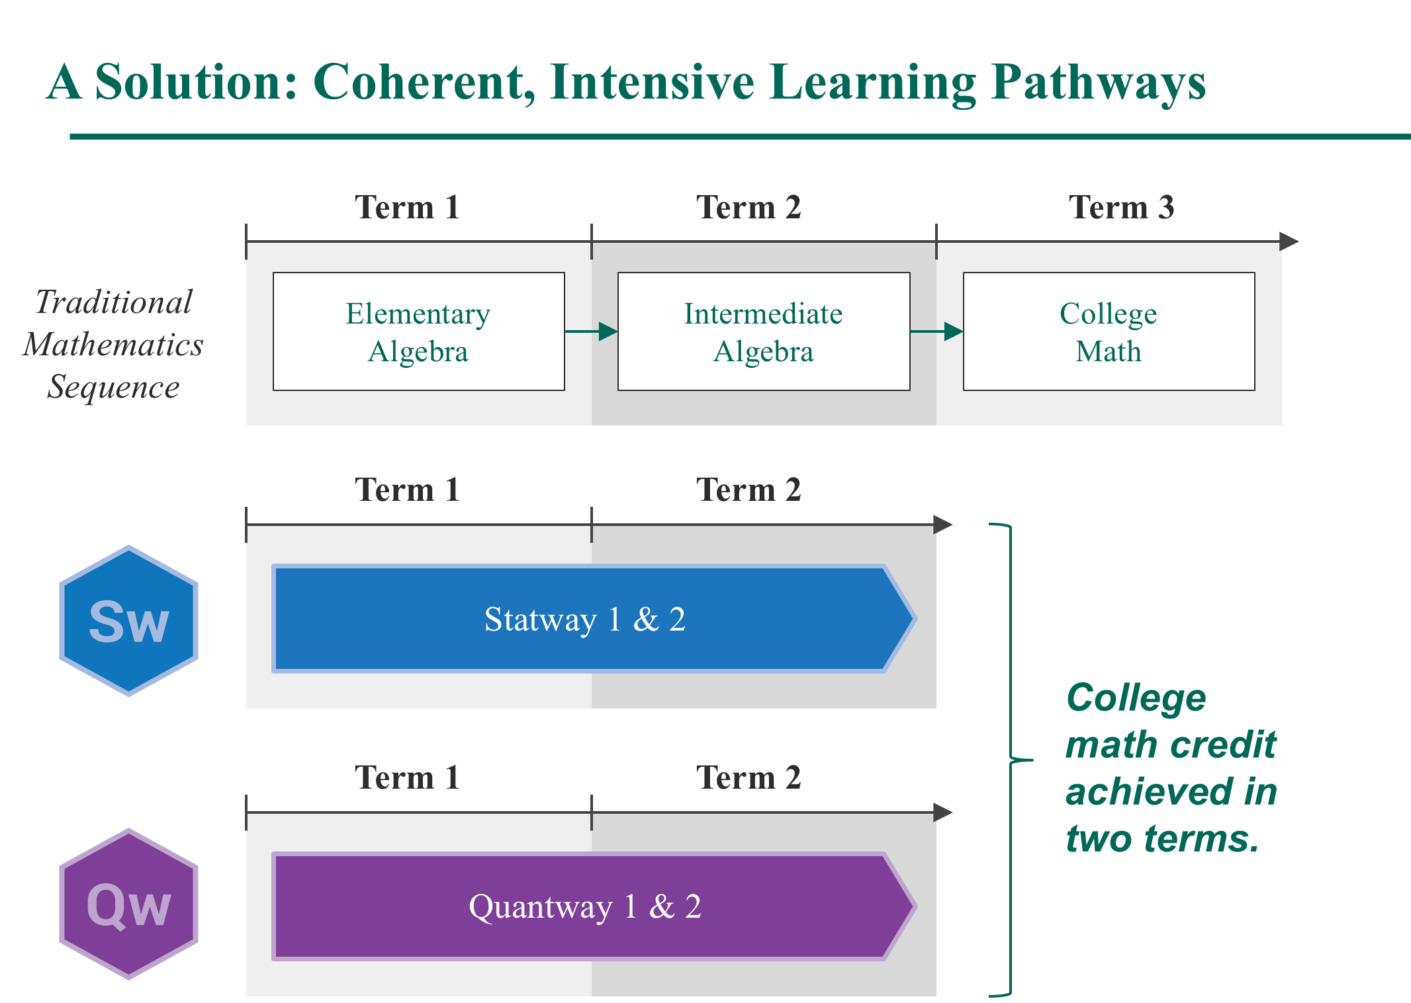
SW Pathway
QW Core
QW College
Notes:
This is the original landscape of the Pathways.
Quickly go over the problem they were designed to solve and why they have this structure.
Really go into what each one is - slowly and clearly
-E.g. so everyone understands what QW2 is
-Ann and Jim tag team this slide

Slide 4
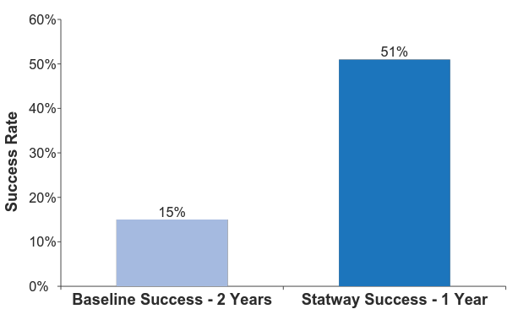
Statway: Triple the Success in Half the Time
Notes:
Similarly, SW students successfully completed Statway and achieved college level math at more than rates 3 times higher than baseline comparison students in half the time.

Slide 5
The Problem
AB 705 requires that community colleges maximize the probability that a student will enter and complete transfer-level coursework in math within a one year timeframe and use H.S. coursework, grades, and GPA for placement.
Notes:
Dive a bit into the landscape of the policies that are happening, e.g. entire states and school systems pushing for or even mandating co-req models.
Discuss the pressure we have felt from our participating schools to create Pathways models that fit with these policies so they can remain with the Pathways program.

Slide 6
The Problem
AB 705
How can Statway, a successful pathway for students to and through college-level statistics, adapt its program to meet the incoming wave of students who will be, in many cases, less prepared to take it?
Notes:
Dive a bit into the landscape of the policies that are happening, e.g. entire states and school systems pushing for or even mandating co-req models.
Discuss the pressure we have felt from our participating schools to create Pathways models that fit with these policies so they can remain with the Pathways program.

Slide 7


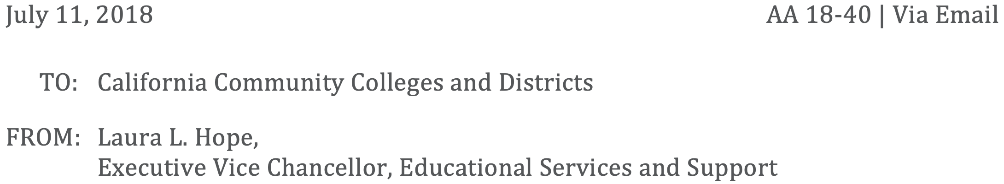
“… Similarly, special programs in which students start in non-transferable coursework (e.g. an accelerated two-semester sequence) are AB 705 compliant if the college is able to demonstrate that the program … maximizes those students’ likelihood of completion of the transfer-level English or math…”
Notes:
Dive a bit into the landscape of the policies that are happening, e.g. entire states and school systems pushing for or even mandating co-req models.
Discuss the pressure we have felt from our participating schools to create Pathways models that fit with these policies so they can remain with the Pathways program.

Slide 8
For Enrollment into College Level Statistics
The chancellor’s office recommends open enrollment… no college prerequisite to elementary statistics.

Slide 9
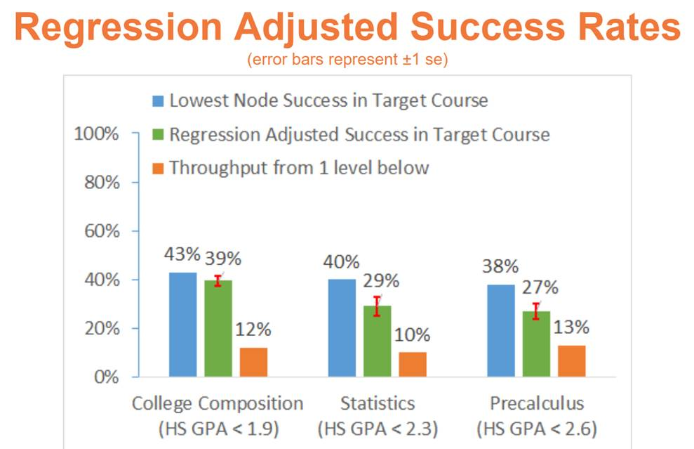
The Problem
Source: Multiple Measures Assessment Project (MMAP)

Slide 10
The Problem
AB 705
29%
Notes:
Dive a bit into the landscape of the policies that are happening, e.g. entire states and school systems pushing for or even mandating co-req models.
Discuss the pressure we have felt from our participating schools to create Pathways models that fit with these policies so they can remain with the Pathways program.

Slide 11
AB 705
Various AB 705 adaptations of Statway are possible:
Offer the traditional two-semester Statway course, with the extra burden of showing that students placed in the sequence would be highly unlikely to succeed otherwise.
The burden of proof is left to the college for this, but the 29% figure is a good start if we target students with HSGPA < 2.3.
Students with HSGPA < 2.3 will not be as prepared for concepts covered in traditional Statway.
Notes:
Dive a bit into the landscape of the policies that are happening, e.g. entire states and school systems pushing for or even mandating co-req models.
Discuss the pressure we have felt from our participating schools to create Pathways models that fit with these policies so they can remain with the Pathways program.

Slide 12
How Does Statway Adapt?
Can Statway help to solve the problem? It should be noted that the Statway success rates shown below are from the national network of participating colleges and that several California colleges achieve a success rate of approximately 80%.
Levels of Preparation High School | Expected Success in Transfer-Level Statistics/Liberal Arts Mathematics* | Success in Statway (one developmental course + transfer-level statistics)**
Most prepared (HSGPA ≥ 3.0) | 75% | N/A
Moderately prepared (2.3 ≤ HSGPA ≤ 2.9) | 50% | 57%
Least prepared (HSGPA < 2.3) | 29% | 55%
*MMAP. **Statway success rates from national network of participating colleges. Levels of preparation based on multiple indicators, including high school GPA. (Bryk, Anthony and Yamada, Hiro; Assessing the Effectiveness of Statway: A Multilevel Model with Propensity Score Matching; Community College Review, 1-26, 2016.)
Notes:
Dive a bit into the landscape of the policies that are happening, e.g. entire states and school systems pushing for or even mandating co-req models.
Discuss the pressure we have felt from our participating schools to create Pathways models that fit with these policies so they can remain with the Pathways program.

Slide 13
AB 705
Another possible response:
Offer an accelerated Statway course, covering Statway I and II in a single semester.
Clearly compliant with Chancellor’s guidelines.
BUT AGAIN, students with HSGPA < 2.3 may not be as prepared for concepts covered in Statway.
Notes:
Dive a bit into the landscape of the policies that are happening, e.g. entire states and school systems pushing for or even mandating co-req models.
Discuss the pressure we have felt from our participating schools to create Pathways models that fit with these policies so they can remain with the Pathways program.

Slide 14
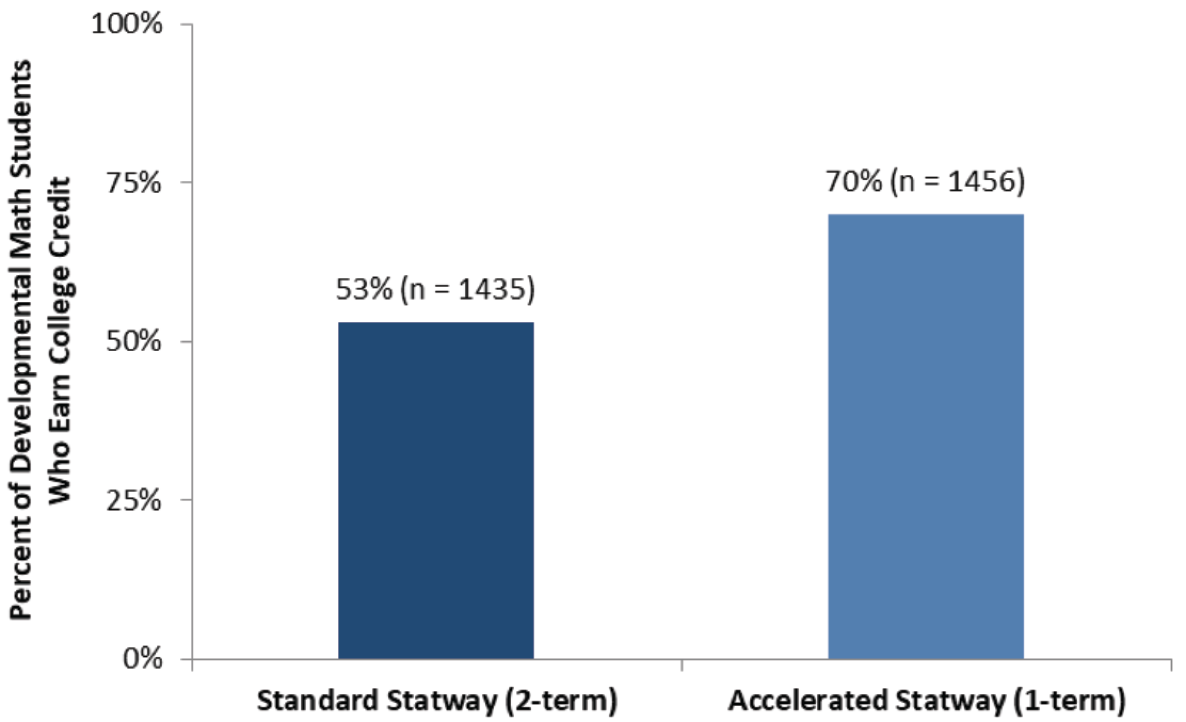
Single Semester vs. Accelerated Statway
Assumes basic mathematical skills (competence in prealgebra).
Source: Carnegie Math Pathways 2016-17 Impact Report (WestEd).
Notes:
It seems like the single semester approach has the best chance for getting as many of the weaker students through, only if they are appropriately prepared.

Slide 15
A Third Option
Another Statway Response to AB 705:
Create a single semester Statway course (referred to as Statway College), with an optional corequisite course for students who need extra math support to succeed in statistics.
Compliant with Chancellor’s AB 705 guidelines.
Statway + Corequisite course should raise the 29% figure for students with HSGPA < 2.3.
Similar approach for Quantway courses.
Notes:
Dive a bit into the landscape of the policies that are happening, e.g. entire states and school systems pushing for or even mandating co-req models.
Discuss the pressure we have felt from our participating schools to create Pathways models that fit with these policies so they can remain with the Pathways program.

Slide 16
Statway College + Optional Corequisite
First iteration written and simultaneously piloted during spring semester, 2018.
Small pilot group.
Materials polished and vetted for language and literacy.
Larger Fall 2018 pilot finishing now.
Pilot Instructors to be interviewed and suggestions integrated into course materials.
Primary problem: Shortening of lessons.

Slide 17
Design Principles for Restructuring Statway
Maintaining learning outcomes AND pedagogical design principles while moving from full Statway sequence to Statway College with Corequisite.
  In each component (e.g. in both co-requisite and college-level course components)
Flexibility of implementation
  Develop resources that can be used in a variety of models
  E.g. Variable credit model
Instructors’ Guides for recommended use of materials
  To support known or typical variations of implementation.
Notes:
1. Once we decided to create new offerings for the Pathways to address these needs, we knew it would be a challenge to keep all of our rigorous pedagogical approaches and learning outcomes while redesigning the courses into these models.
We knew we needed to create strong design principles to make sure none of the value to students was reduced when implementing the redesigned courses.
The next slide will go further into our curriculum approach, where you will see why this process is so complex.
2. We know that schools and faculty want flexibility in how they fit courses to their students needs, and this is particularly vital with redesigns since there are so much variance of definitions and administration with co-req and accelerated models.
3. We knew some schools would have less contact hours in their co-req portion that others, so we knew we’d need to design our materials to fit a variety of credits and contact hours. We’d need to think through advice for the different administrations, particularly with schools using only 1 credit and contact hour for the co-req (e.g. identifying key co-req materials that must be taught, and which materials are supporting a deeper dive into the support for the college-level lessons).

Slide 18
1. Maintaining learning outcomes
AND pedagogical design principles

Slide 19
Designing Statway College
Learning Outcomes
  College-level statistics
Pathways pedagogical design principles
TIME
Balancing content coverage with effective pedagogy (e.g. productive struggle, deliberate practice) with shorter course structures

Slide 20
Designing Statway College
Original Statway Pathway: 74 lessons across 11 modules
  Needed to extract all college level components first for Statway College
  Then we could create supporting lessons for Statway Corequisite
HOW IS THIS POSSIBLE?

Slide 21
Designing Statway College
Contact hours (~45 hours = 3 unit semester course)
Could have up to 45 lessons, but even that may be too many.
  Need wiggle room for review days, assessments, etc.
Started with module and lesson structure
  What is the ideal college-level “Intro to Statistics” structure?
Narrowed to 7 modules, 37 lessons (8 optional)
  Ensure needed Learning Outcomes are covered
  Ensuring transferability

Slide 22
Designing Statway College
What Statway lessons mapped onto the new structure? E.g. 1-to-1.
What Statway lessons could be combined to create the new lessons? E.g. 2-to-1 or 3-to-1
Which should be fully removed or recycled into the Corequisite?
What new content had to be created?

Slide 23
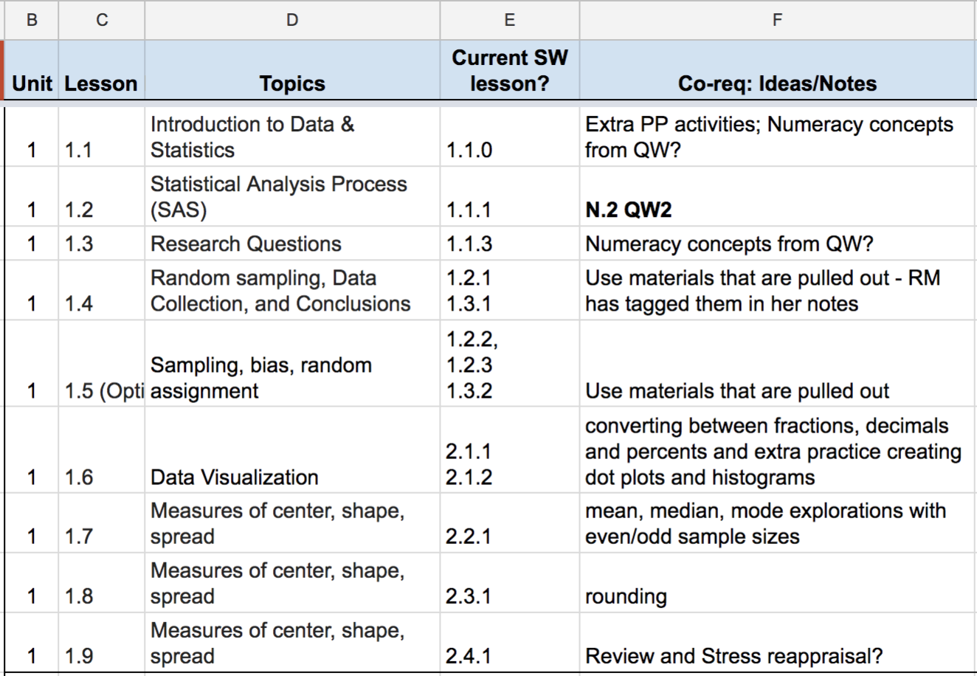

Slide 24
Maintaining pedagogical design principles
This was even harder than the content selection.

Slide 25
Pathways Instructional System
Learning Opportunities
Productive Struggle
Explicit Connections
Deliberate Practice
Ambitious learning goals & curricular materials designed with
authentic and
relevant
problem situations
Research-based collaborative and student-centered pedagogical practices that support deep and long lasting understanding
Statway
Curricula
Pathways Pedagogy
Productive Persistence
Language & Literacy Supports
Notes:
Review the instructional design here quickly - mostly to show the complexity of our approach and what we had to consider when doing our redesigns. The most critical components are keeping our learning opportunities, pedagogical approaches, and productive persistence*. (emphasize the real-world situations as well.)
*This is the first time they will see productive persistence, so go over it very carefully and explain why it is so critical and unique to the Pathways.

Slide 26
Maintaining pedagogical design principles
Statway College lessons
Need to keep the full spectrum of Learning Opportunities
Strategies
Prioritize hands-on, engaging activities
Limit repetitive practice problems
Make better use of homework and corequisite for this
Limit review of previous and basic materials/skills
Create more opportunities for making connections, through added, optional big picture review lessons

Slide 27
Designing Statway Corequisite
Learning Outcomes
AND
Pedagogical design principles

Slide 28
Designing Statway Corequisite
Learning Outcomes
Adapt the Statway material not used in Statway College
Algebra topics that support Statway College lessons (only)
Front load numeracy and developmental learning outcomes
Corequisite Features:
1-to-1 Corequisite to College lesson structure
Before or after lesson?
Homework
Assessments

Slide 29
Designing Statway Corequisite
Corequisite Features (Cont’d)
Pathways pedagogical design principles
Review time
Problem practice
numeracy skills, as well as more complex statistical tests
Balance of discovering concepts and connections with review time and practice problems

Slide 30
2. Flexibility of Implementation

Slide 31
Challenges
Meeting Everyone’s Needs
Many different implementation strategies across and even within institutions.
Instructors need to make decisions about what is best for them, their students, and their college, as well as meet policy demands.
Notes:
We knew there were several ways of implementing co-req and accelerated models, but were surprised by the variation is faculty’s needs and desires for this type of course. We knew creating a strict co-req model, for example, would severely limit who could implement it. For example, if we created a model for a 3-credit course with a 3-credit co-req, many schools could not support this since they only offer a 1 or 2 hour lab for co-requisite courses.
Also, even considering courses within the same school, faculty will have different desires for what they want to teach to their students (e.g. students in one course may need more support on a few topics than students in another course), so we needed materials to support this variation.

Slide 32
Strategies
Statway College
Having a stand alone course that does not depend on students taking the corequisite.
Adds flexibility e.g. cohorts vs non-cohorts.
Minimizing the required lessons
Minimizing interdependency of lessons

Slide 33
Strategies
Statway Corequisite
Independent lessons
Can be molded into the course structure available to each faculty.
No published workbook; print as needed
No lessons are mandatory
Faculty can adjust based on student needs (e.g. more numeracy/algebra content if those learning outcomes are required; more time for review/practice, etc.)
Faculty can adjust based on administration structure (1 - 3 hour corequisite, 50 or 75 minute lessons, etc.)

Slide 34
3. Guides for recommended use of materials

Slide 35
Instructors’ Guides Challenges
Faculty need to build a course that matches their contact hours (1, 2, or 3) , and the daily course structure (e.g. TH, or MWF)
Faculty may have to decide what material is essential and what lessons can be supplementary support if time allows.
  Especially with the Corequisite.
So we are helping identify the best material to support the various administration possibilities
Notes:
These are not yet in development, but we know we need them to support the design of the co-req materials, which we will discuss shortly.

Slide 36
Instructors’ Guides Strategies
Extremely clear Learning Outcomes in each lesson.
What are the implications for dropping a lesson
How to transition when lessons are skipped
How to prioritize
What do students struggle with the most.
Example course structures with recommendations
How/where to build in reviews and assessments
How to navigate cohorts and non-cohorts
How to structure in-class lesson
How to adjust if lessons are going too long
Notes:
These are not yet in development, but we know we need them to support the design of the co-req materials, which we will discuss shortly.

Slide 37
Design Process
Notes:
Now that the landscape of our design principles and challenges are laid out, we will discuss approaches we took / are taking to achieve the desired outcomes.

Slide 38
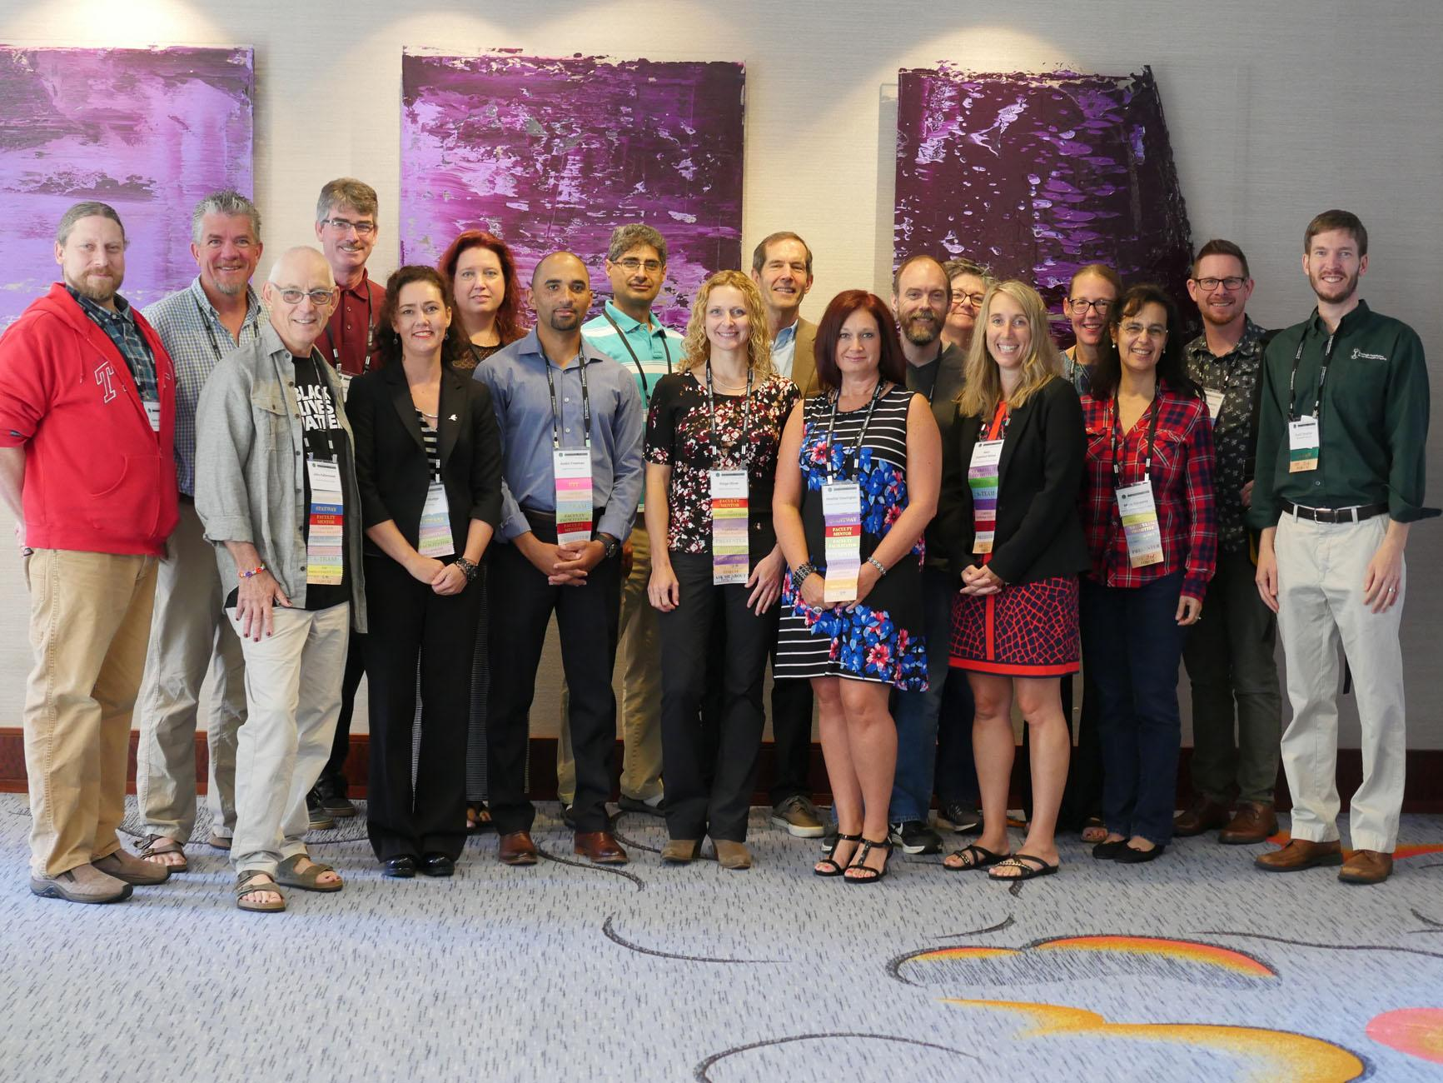
Networked Approach: Curriculum Committee
C^2 pic
Notes:
Just a shout out page to folks who do the heavy lifting for these project - and to recognize that these efforts and ideas come from the faculty who are teaching the Pathways.

Slide 39
Collaborative Creation
One primary author per module
One primary reviewer per module
Regular check-ins during creation (group brainstorm)
-comments aimed at individuals, groups, everyone, etc.
Piloting
Review and editing
Copyediting
Master editing

Slide 40
Statway Offerings
Notes:
Now that the landscape of our design principles and challenges are laid out, we will discuss approaches we took / are taking to achieve the desired outcomes.

Slide 41

Statway
Developmental Math
Transfer-level College Math
Statway Pathway
These all result in college-level credit for intro to statistics
Statway Accelerated
Statway College
Statway College
Statway Corequisite
Notes:
The original Statway Pathway is slightly different in that it is a yearlong course that integrates dev math learning outcomes into college level statistics. Students do college level statistics on day one and throughout the year.
We also support an accelerated Statway pathway, where the full Pathways is done in a single term.
We are currently developing a ‘college - level’ SW, which is a standalone college level only Statway, suitable as a replacement for any college level intro to stats course.
Finally, we are developing a SW Co-req, which takes the college level Statway as the primary course and offers dev math support for those students who need it.

Slide 42
SUMMARY TABLE STATWAY
Offering | # of Terms | Outcome | Contact Hours
SW Pathway | 2 | College-level credit | 3 or 4 contact hours each term
SW Accelerated Pathway | 1 | College-level credit | 6 or 7 contact hours
SW College | 1 | College-level credit | 3 or 4 contact hours
SW College + Corequisite | 1 | College-level credit | 3 or 4 contact hours (College) 1, 2, or 3 contact hours (Corequisite)
Notes:
Put up table of offerings, number of terms, outcome, and credit and contact hours
SW Pathway: 7 (typicaly) contact hours in total, 4 in first term, 3 in the second. Or 3 and 3.
As mentioned, SW Acc not an official offering, but we support its creation by institutions who want to run high contact hour Statway Pathway.
SW Coreq: The must have materials will be labelled accordingly to inform the implementation of 1- or 2-hour components.
Refer folks to learning outcomes in handout. 5 min to read the learning outcomes, ask questions.

Slide 43
Closing: Student Success
Pilot data
Students can succeed at high rates if the course is well-structured with effective content and pedagogy.
Pathways have shown high rates of success with both Statway Accelerated, and Quantway Corequisite.
Results will be evaluated as these options continue to expand.
Notes:
-SW accelerated courses have show as least as strong of success rates as the regular SW pathway
-Jim’s success rates in his co-req were comparable as well. He will discuss comparative success of QW2 only students and full Pathway students (which is the best comparison).
-More detailed results will be available as these offering become more prominent.

Slide 44
Contact Info
carnegiemathpathways.org
Scott Guth: sguth@mtsac.edu
Scott Strother: sstrother@carnegiemathpathways.org

