Slide 1
History of Math in Competitive Math Problems
by Steven Davis

Slide 2
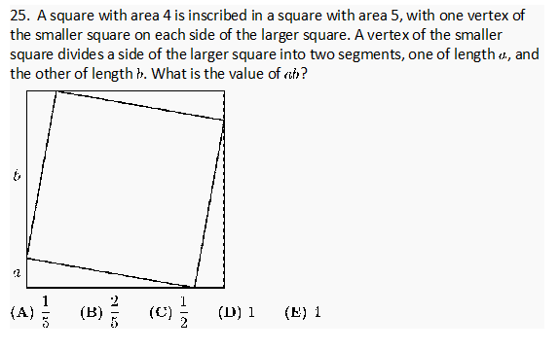
2012 AMC 8 Behold

Slide 3
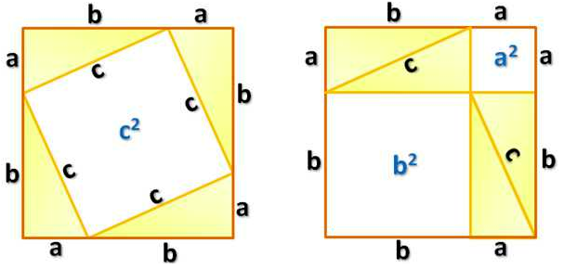
Solution

Slide 4

Calculations
5-4=1, so 4($\frac{1}{2}$ab)=1$⇒$ ab=$\frac{1}{2}$

Slide 5
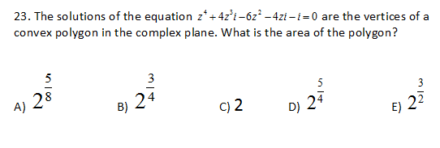
2008 AMC 12A Pascal's Triangle

Slide 6
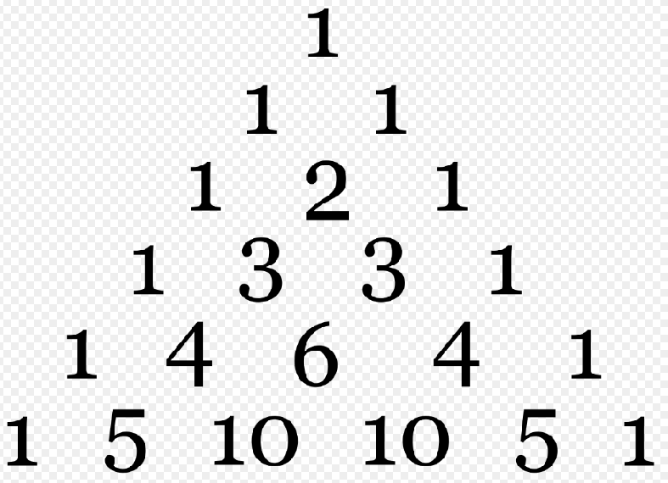

Strategy
$$z^{4}+4z^{3}i−6z^{2}−4zi−i=0$$
Looks like a binomial expansion. Recall

Slide 7
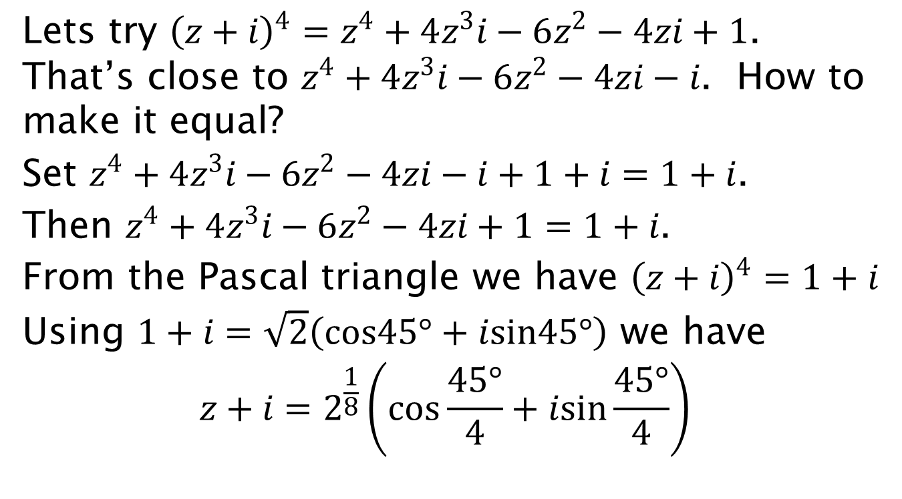
Lets try ${\left(z+i\right)}^{4}=z^{4}+4z^{3}i−6z^{2}−4zi+1$. That’s close to $z^{4}+4z^{3}i−6z^{2}−4zi−i$. How to make it equal?
Set $z^{4}+4z^{3}i−6z^{2}−4zi−i+1+i=1+i$.
Then $z^{4}+4z^{3}i−6z^{2}−4zi+1=1+i$.
From the Pascal triangle we have ${\left(z+i\right)}^{4}=1+i$
Using $1+i=\sqrt{2}\left(cos45°+isin45°\right)$ we have
$$z+i=2^{\frac{1}{8}}\left(cos\frac{45°}{4}+isin\frac{45°}{4}\right)$$

Slide 8
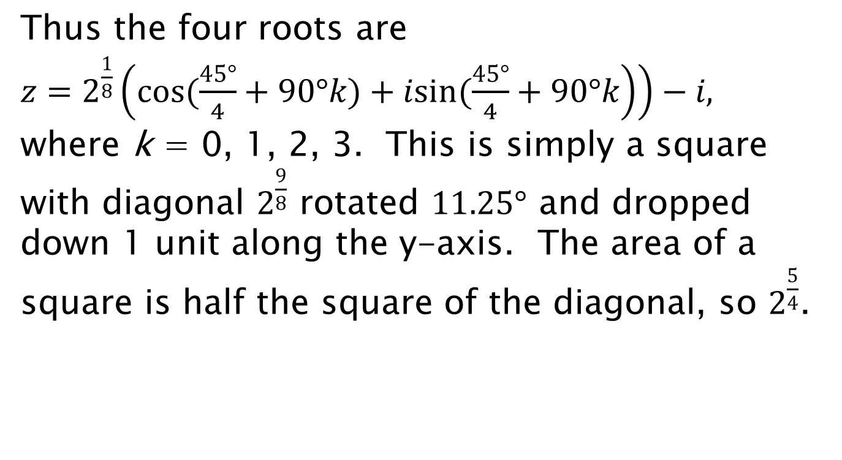
Thus the four roots are $z=2^{\frac{1}{8}}\left(\left.cos(\frac{45°}{4}+90°k)+isin(\frac{45°}{4}+90°k\right)\right)−i,$
$\text{where} \text{k}\text{ = 0, 1, 2, 3}$. This is simply a square with diagonal $2^{\frac{9}{8}}$ rotated $11.25°$ and dropped down 1 unit along the y-axis. The area of a square is half the square of the diagonal, so $2^{\frac{5}{4}}$.

Slide 9
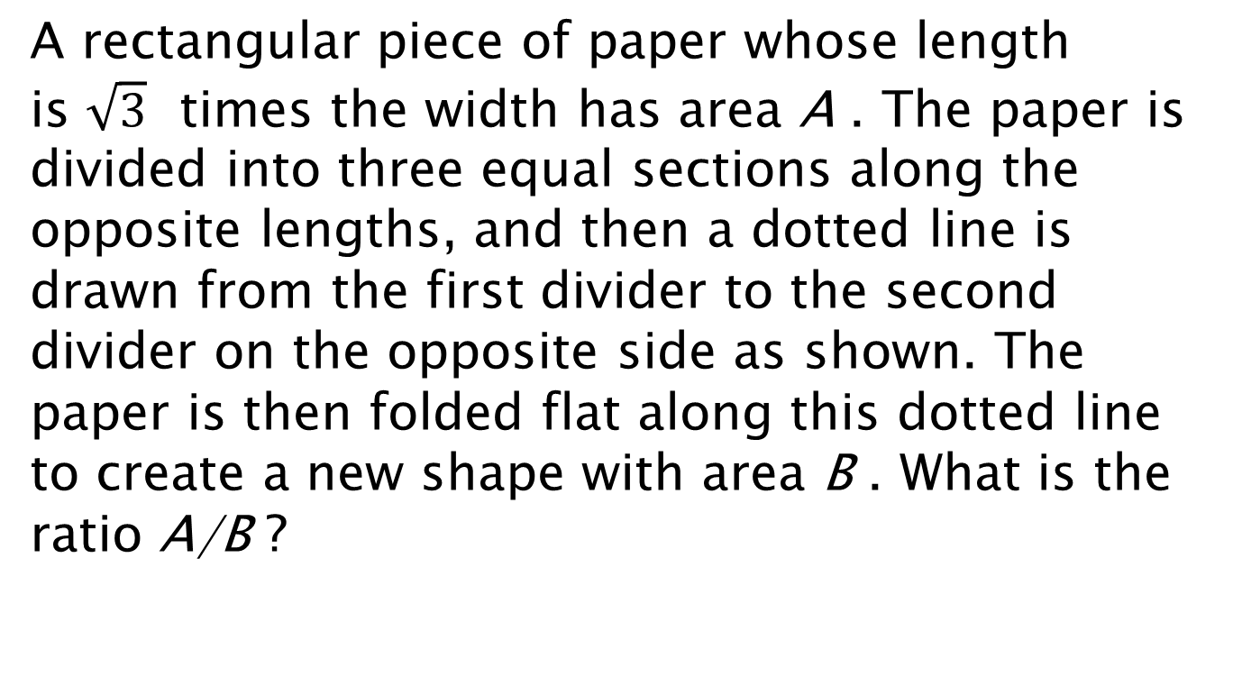
2014 AMC 10A Angle of Reflection
A rectangular piece of paper whose length is $\sqrt{3}$ times the width has area A . The paper is divided into three equal sections along the opposite lengths, and then a dotted line is drawn from the first divider to the second divider on the opposite side as shown. The paper is then folded flat along this dotted line to create a new shape with area B . What is the ratio A/B ?

Slide 10
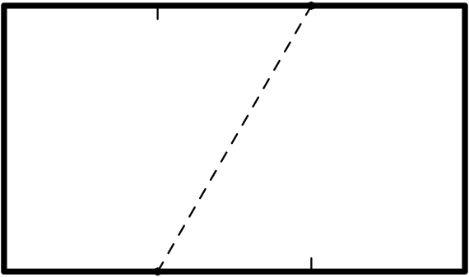
A) 1:2 B) 3:5 C) 2:3 D) 3:4 E) 4:5

Slide 11
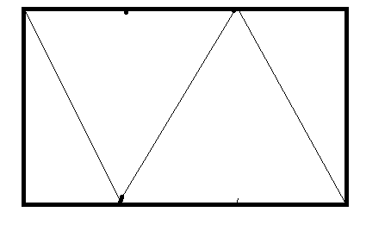
Solution

Slide 12
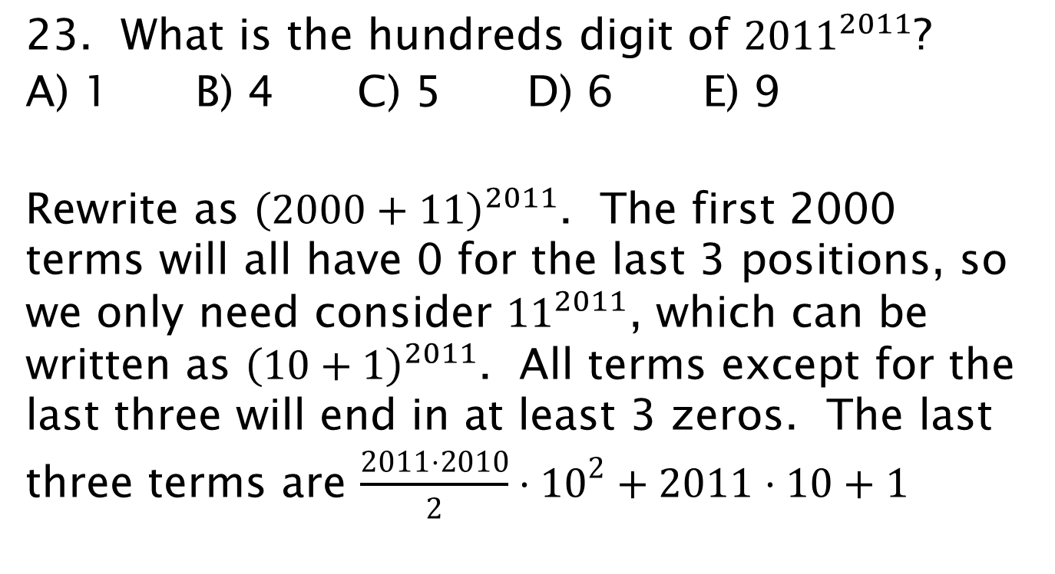
2011 AMC 10B Pascal’s triangle
23. What is the hundreds digit of ${2011}^{2011}$?
A) 1 B) 4 C) 5 D) 6 E) 9
Rewrite as ${\left(2000+11\right)}^{2011}$. The first 2000 terms will all have 0 for the last 3 positions, so we only need consider ${11}^{2011}$, which can be written as ${\left(10+1\right)}^{2011}$. All terms except for the last three will end in at least 3 zeros. The last three terms are $\frac{2011⋅2010}{2}⋅{10}^{2}+2011⋅10+1$

Slide 13
=2111550+20110+1=2131661, so 6, D.

Slide 14
2017 AIME II counting
4. Find the number of positive integers less than or equal to 2017 whose base-three representation contains no digit equal to 0.
AIME problems do not list the choices. The answer is any number from 000 to 999 and it must contain three digits, use 0 if needed at the front.

Slide 15
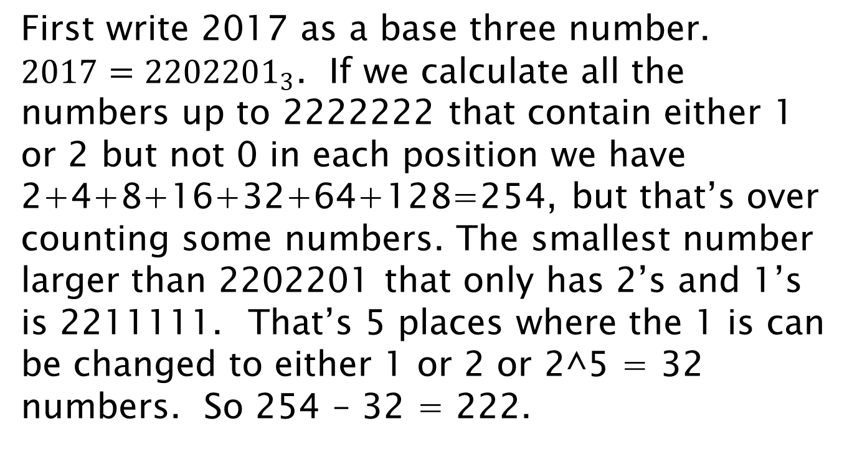
How to attack?
First write 2017 as a base three number. $2017={2202201}_{3}$. If we calculate all the numbers up to 2222222 that contain either 1 or 2 but not 0 in each position we have 2+4+8+16+32+64+128=254, but that’s over counting some numbers. The smallest number larger than 2202201 that only has 2’s and 1’s is 2211111. That’s 5 places where the 1 is can be changed to either 1 or 2 or 2^5 = 32 numbers. So 254 – 32 = 222.

Slide 16
2017 AIME I modular arithmetic
2. When each of 702, 787, and 855 is divided by the positive integer m, the remainder is always the positive integer r. When each of 412, 722, and 815 is divided by the positive integer n, the remainder is always the positive integer s ≠ r. Find m + n + r + s.

Slide 17
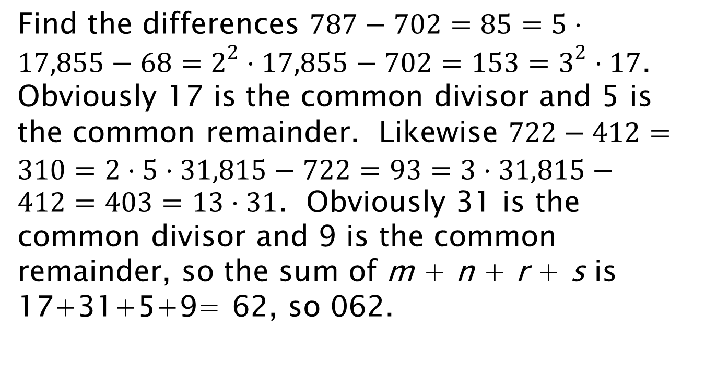
Solution
Find the differences $787−702=85=5⋅17,855−68=2^{2}⋅17,855−702=153=3^{2}⋅17$. Obviously 17 is the common divisor and 5 is the common remainder. Likewise $722−412=310=2⋅5⋅31,815−722=93=3⋅31,815−412=403=13⋅31$. Obviously 31 is the common divisor and 9 is the common remainder, so the sum of m + n + r + s is 17+31+5+9= 62, so 062.

Slide 18
2017 AIME I number bases
5. A rational number written as a b.c d, where all digits are nonzero. The same number in base twelve is b b.b a. Find the base-ten number a b c.

Slide 19
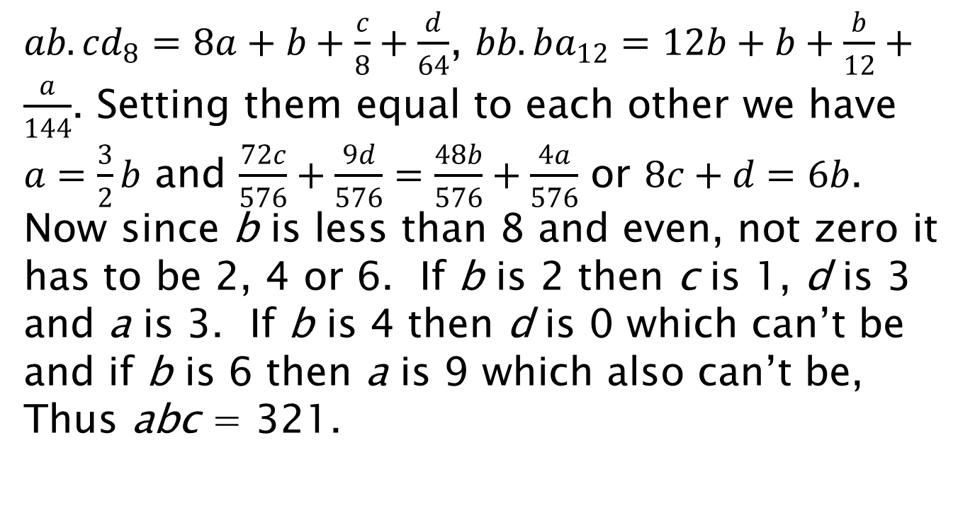
Solution
$ab.cd_{8}=8a+b+\frac{c}{8}+\frac{d}{64}$, $bb.ba_{12}=12b+b+\frac{b}{12}+\frac{a}{144}$. Setting them equal to each other we have $a=\frac{3}{2}b$ and $\frac{72c}{576}+\frac{9d}{576}=\frac{48b}{576}+\frac{4a}{576}$ or $8c+d=6b$. Now since b is less than 8 and even, not zero it has to be 2, 4 or 6. If b is 2 then c is 1, d is 3 and a is 3. If b is 4 then d is 0 which can’t be and if b is 6 then a is 9 which also can’t be, Thus abc = 321.

Slide 20
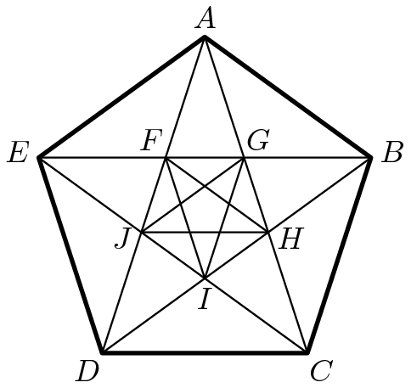
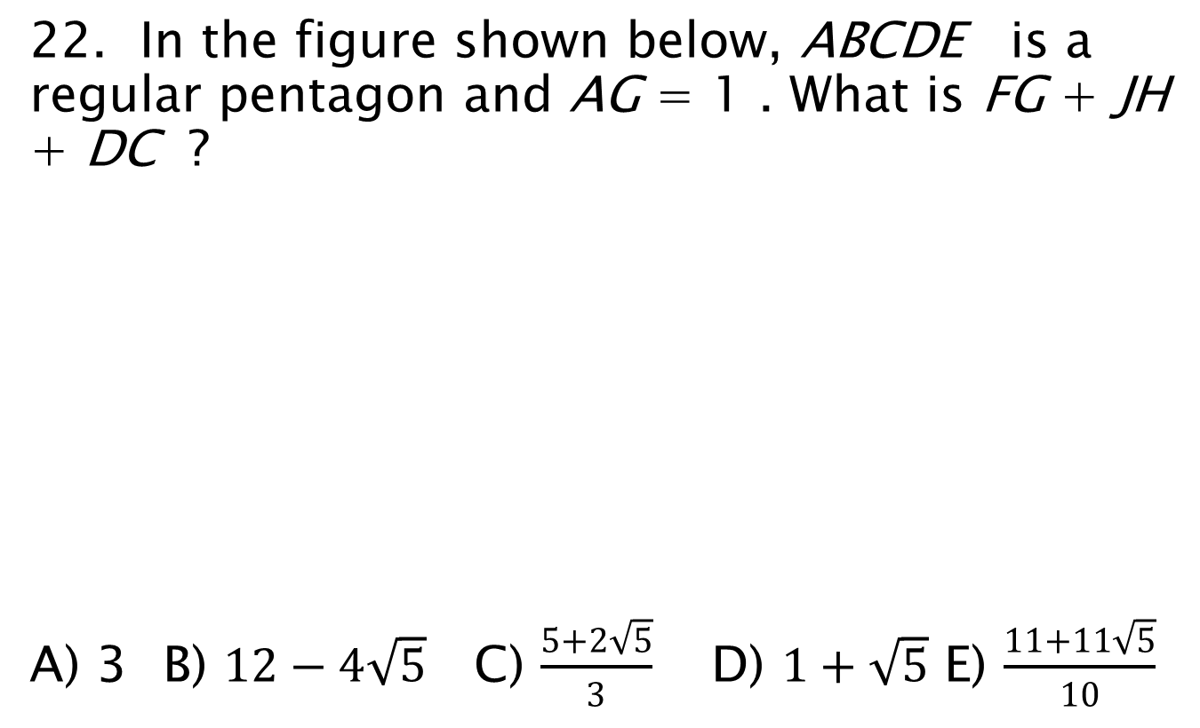
2015 AMC 10B Golden Ratio
22. In the figure shown below, ABCDE is a regular pentagon and AG = 1 . What is FG + JH + DC ?
A) 3 B) $12−4\sqrt{5}$ C) $\frac{5+2\sqrt{5}}{3}$ D) $1+\sqrt{5}$ E) $\frac{11+11\sqrt{5}}{10}$

Slide 21
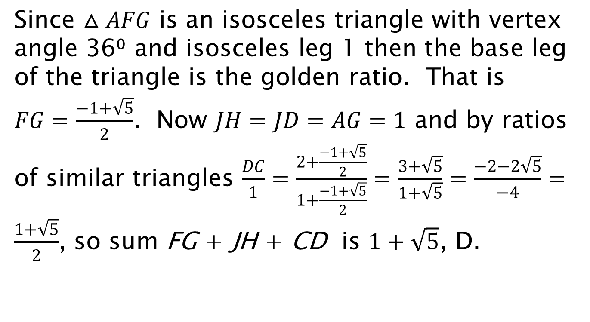
Solution
Since $△AFG$ is an isosceles triangle with vertex angle 36⁰ and isosceles leg 1 then the base leg of the triangle is the golden ratio. That is $FG=\frac{−1+\sqrt{5}}{2}$. Now $JH=JD=AG=1$ and by ratios of similar triangles $\frac{DC}{1}=\frac{2+\frac{−1+\sqrt{5}}{2}}{1+\frac{−1+\sqrt{5}}{2}}=\frac{3+\sqrt{5}}{1+\sqrt{5}}=\frac{−2−2\sqrt{5}}{−4}=\frac{1+\sqrt{5}}{2}$, so sum FG + JH + CD is $1+\sqrt{5}$, D.

Slide 22
2013 AMC 10B calculus
15. A wire is cut into two pieces, one of length a and the other of length b. The piece of length a is bent to form an equilateral triangle, and the piece of length b is bent to form a regular hexagon. The triangle and the hexagon have equal area. What is a/b ?
(A) 1 (B) √6/2 (C) √3 (D) 2 (E) 3√2/2

Slide 23
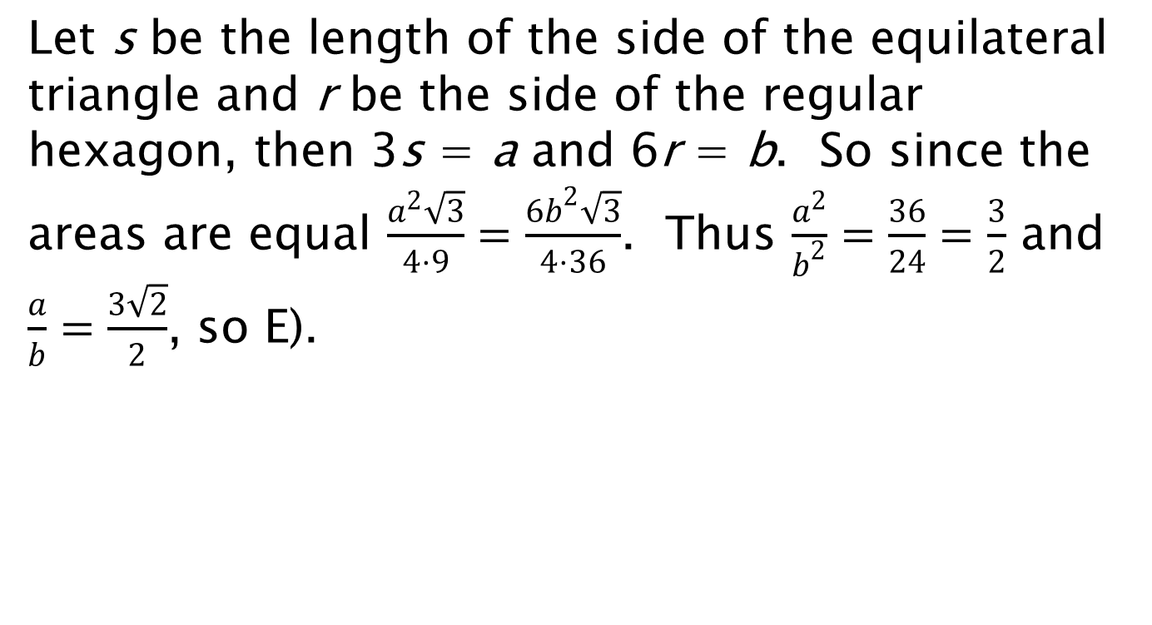
Solution
Let s be the length of the side of the equilateral triangle and r be the side of the regular hexagon, then 3s = a and 6r = b. So since the areas are equal $\frac{a^{2}\sqrt{3}}{4⋅9}=\frac{6b^{2}\sqrt{3}}{4⋅36}$. Thus $\frac{a^{2}}{b^{2}}=\frac{36}{24}=\frac{3}{2}$ and $\frac{a}{b}=\frac{3\sqrt{2}}{2}$, so E).

Slide 24
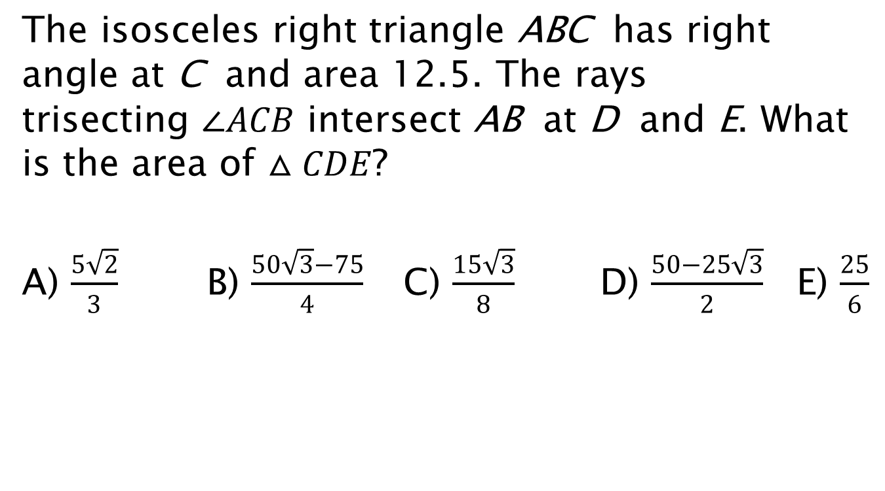
2015 AMC 10A Angle trisected
The isosceles right triangle ABC has right angle at C and area 12.5. The rays trisecting $∠ACB$ intersect AB at D and E. What is the area of $△CDE$?
A) $\frac{5\sqrt{2}}{3}$ B) $\frac{50\sqrt{3}−75}{4}$ C) $\frac{15\sqrt{3}}{8}$ D) $\frac{50−25\sqrt{3}}{2}$ E) $\frac{25}{6}$

Slide 25
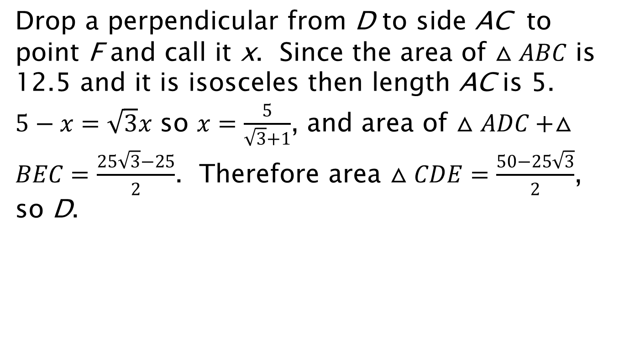
Solution.
Drop a perpendicular from D to side AC to point F and call it x. Since the area of $△ABC$ is 12.5 and it is isosceles then length AC is 5. $5−x=\sqrt{3}x$ so $x=\frac{5}{\sqrt{3}+1}$, and area of $△ADC+△BEC=\frac{25\sqrt{3}−25}{2}$. Therefore area $△CDE=\frac{50−25\sqrt{3}}{2}$, so D.

Slide 26
2016 AMC 8 Divisibility
24. The digits 1, 2, 3, 4, and 5 are each used once to write a five-digit number PQRST . The three-digit number PQR is divisible by 4, the three-digit number QRS is divisible by 5, and the three-digit number RST is divisible by 3. What is P?
A) 1 B) 2 C) 3 D) 4 E) 5

Slide 27
Solution
What does S have to be? What are the choices for QR? Given R, what must T be? Finally what is P?
Have a great conference and I hope to see everyone here again next year. Steven Davis sdcomet900@att.net To be a problem writer for AMC MAA contact Becky Vanarsdall
Program Assistant-Competitions
rvanarsdall@maa.org or fill out this form:
https://docs.google.com/forms/d/1FBlX6GmeNfyprZUqQM7JZjb1P1RWeh3Ui4cjiXGx90Y/viewform

