Slide 1

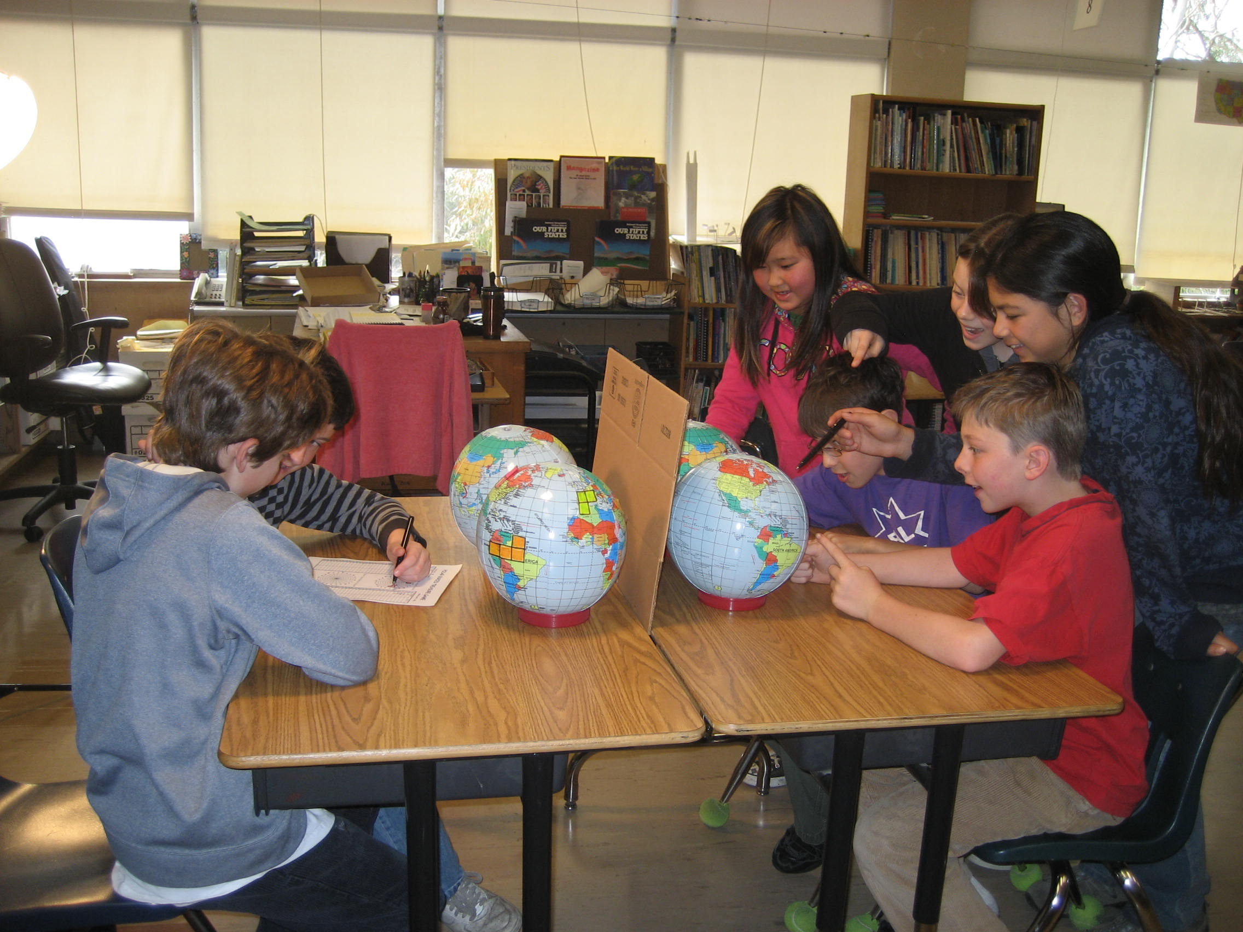
Spherical Buried Treasure

Slide 2
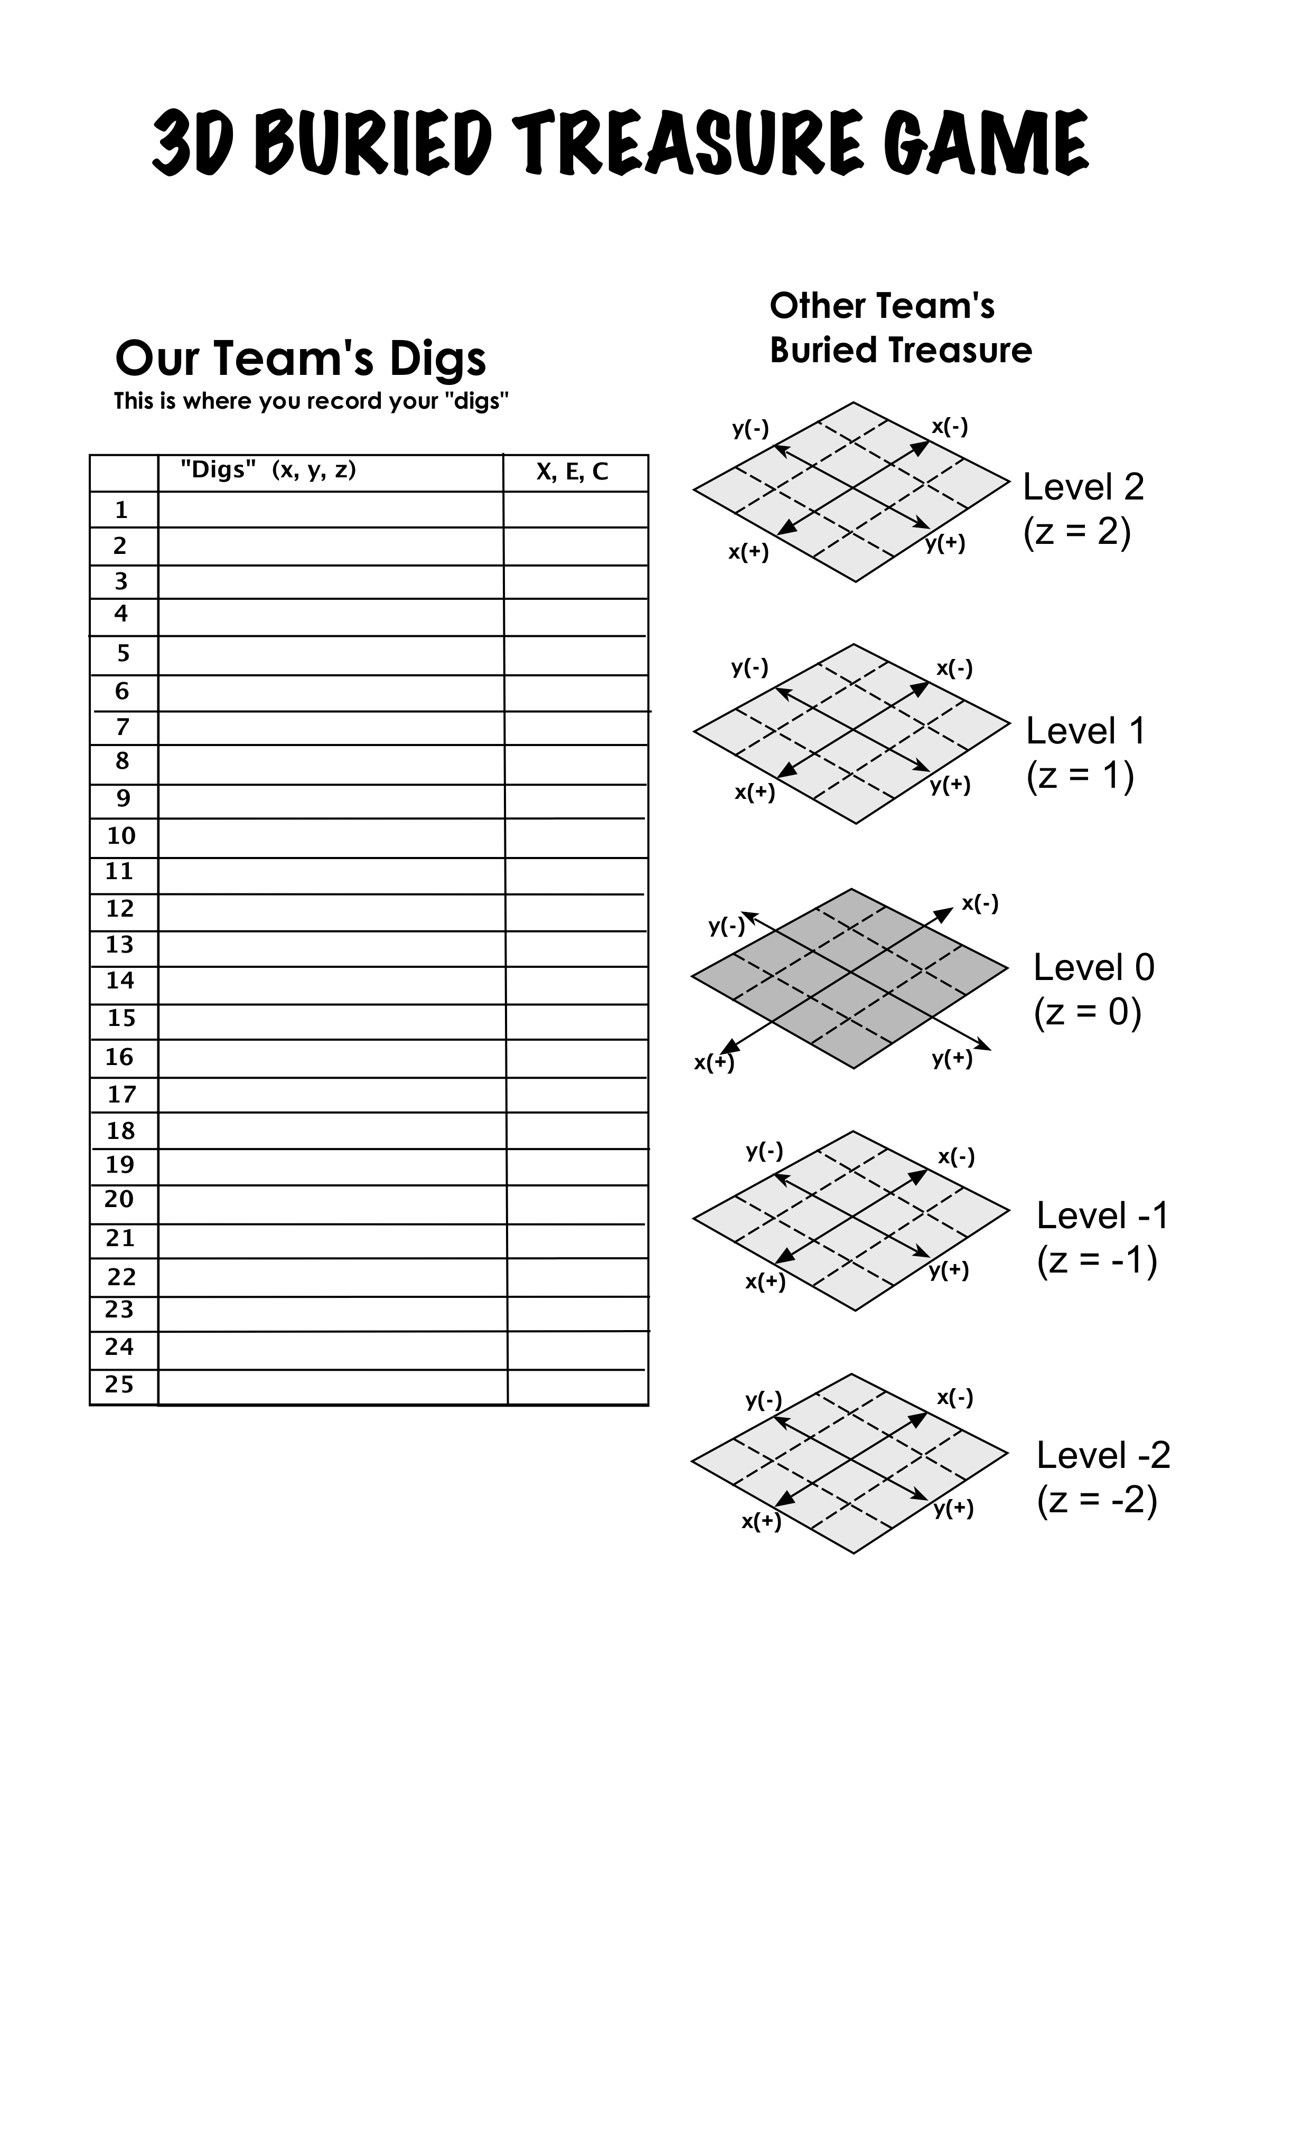
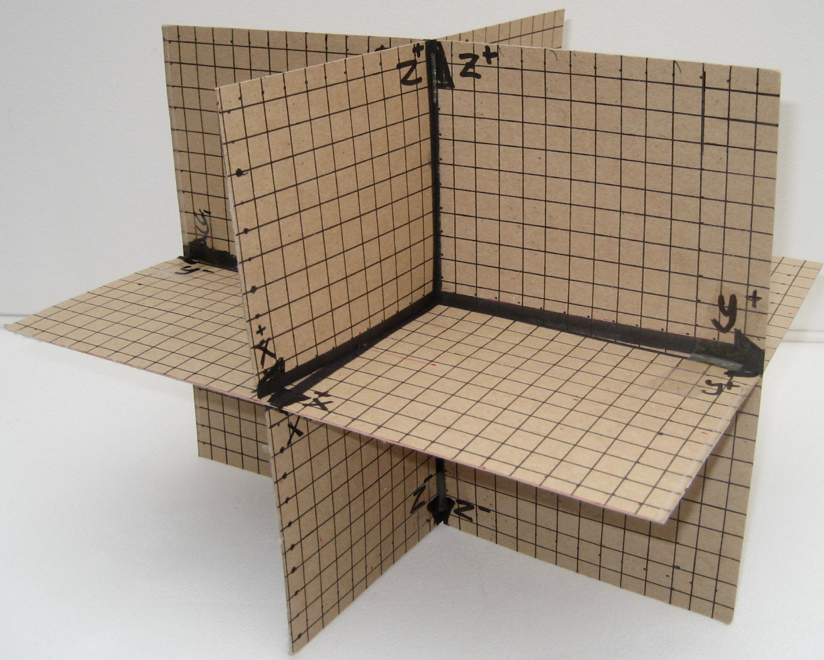
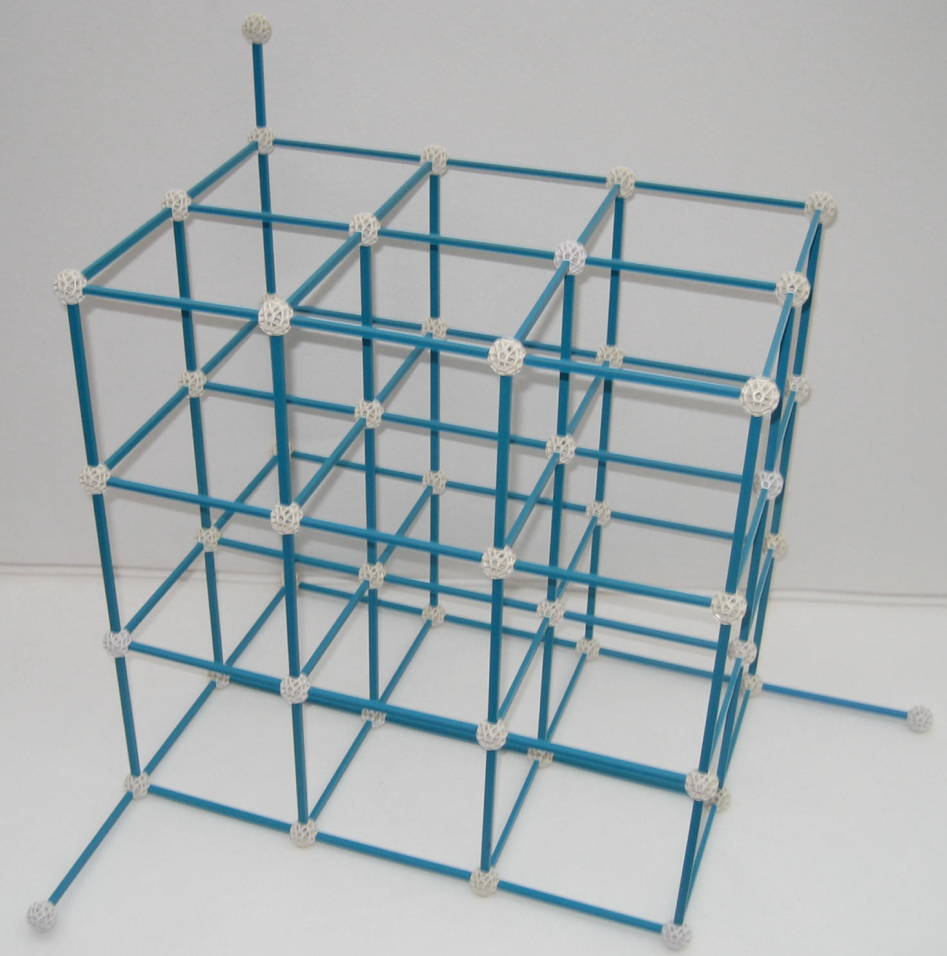
3D Buried Treasure

Slide 3
Pirate Geometry
Children learn as they play. Most importantly, in play children learn how to learn.
- O. Fred Donaldson

Slide 4
Thank you
Buried treasure puzzles and games can be found in my latest book Pirate Math at www.michaelserra.net.

