Slide 1

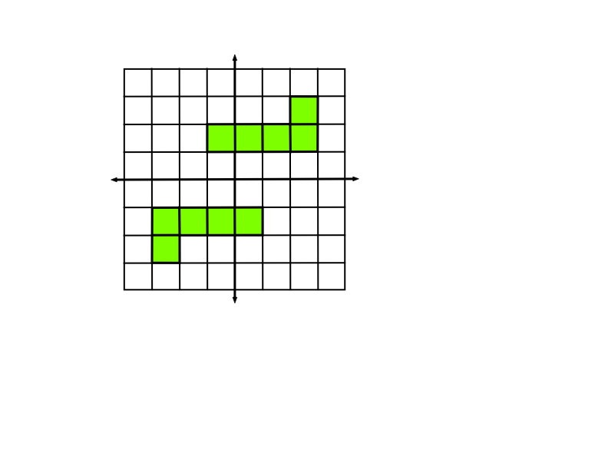
Rectangular Buried Treasure
Variation: The team hides a pair of identical pentominoes but one is a 180° rotation of the other about the origin. The two may not touch.

Slide 2
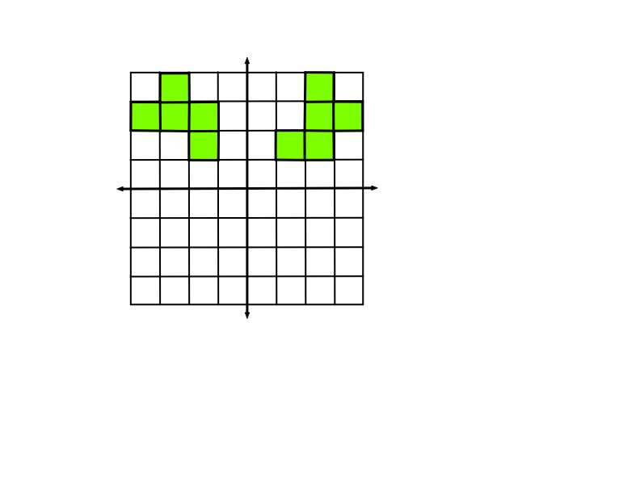
Rectangular Buried Treasure
Variation: The team hides a pair of identical pentominoes but one is a 90° rotation of the other about the origin. The two may not touch.

Slide 3
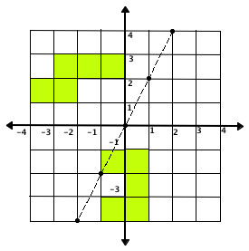
Rectangular Buried Treasure
Variation: A team calls out a linear equation (think of it as a metal-detecting ray). One line will locate a buried treasure if the line passes through any portion of the buried treasure. “You hit my U-pentomino”.

Slide 4
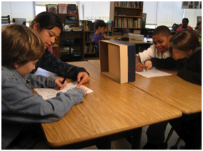
Pick a partner
and play Rectangular Buried Treasure with a pair of twin pentominoes where one is a transformation of the other.

Slide 5
Other Buried Treasure Games
• Polar coordinates
• Spherical coordinates
• 3-D coordinates

Slide 6
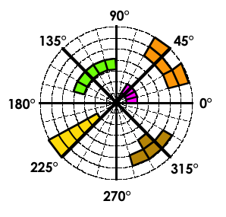
Polar Buried Treasure

