Slide 1
Pirate Geometry
CMC3 South Lake Tahoe April 22, 2017
A good math puzzle, paradox, or magic trick can stimulate a child’s imagination much faster than a practical application … and if the game is chosen carefully, it can lead almost effortlessly into significant mathematical ideas.
– Martin Gardner

Slide 2
Pirate Geometry

Slide 3
Polyomino Treasures
What are Polyominoes? Polyominoes are shapes made by connecting congruent squares complete side to complete side. The name came from the domino. Dominoes are examples of two squares connected side to side.
Tetromino Pentomino Octomino
Not polyominoes

Slide 4
Polyomino Treasures
Two polyominoes are considered different (distinct) if and only if they cannot be obtained from each other by translating, rotating, or flipping.
These are the same
These are different

Slide 5
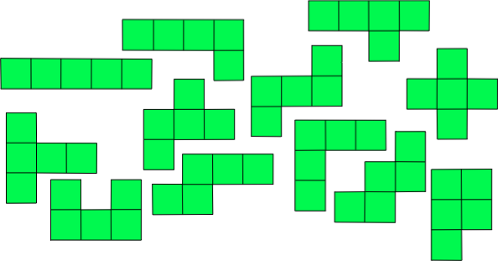
Pentomino Treasures
Y
L
I
Z
X
F
V
T
N
W
P
U

Slide 6
Transformations
Patty Paper Translations of Pentominoes

Slide 7
Transformations
Patty Paper Reflections of Pentominoes

Slide 8
Transformations
Patty Paper Rotations of Pentominoes

Slide 9
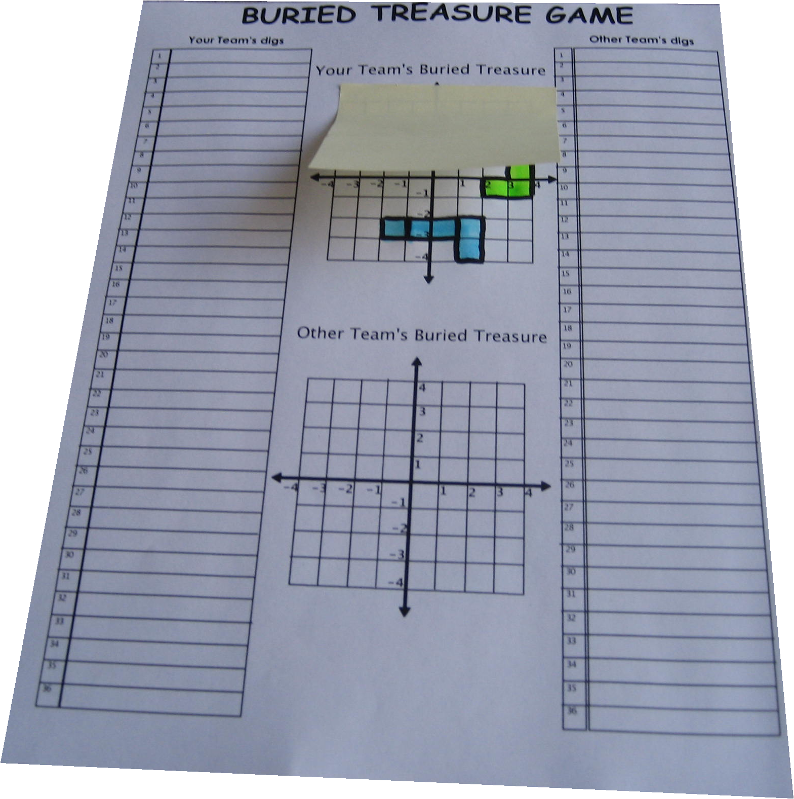
Rectangular Buried Treasure

Slide 10
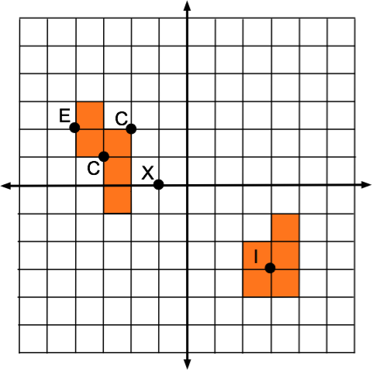
Rectangular Buried Treasure
X = “Miss”
C = “Corner”
E = “Edge”
I = “Interior”

Slide 11
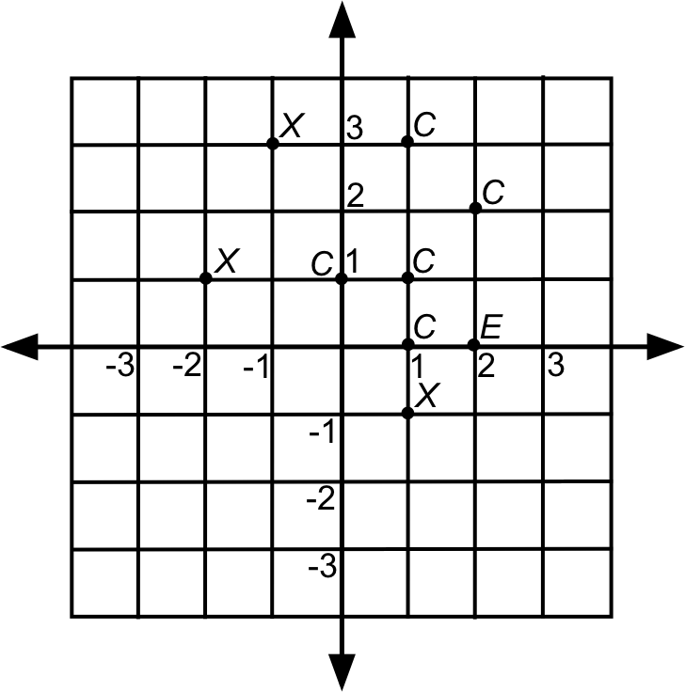
Rectangular Buried Treasure
Find the pentomino treasure from the given clues.
X = “Miss”
C = “Corner”
E = “Edge”
I = “Interior”

Slide 12
Rectangular Buried Treasure
• Hide 1 pentomino, 3 guesses, clues after each
• Hide 2 identical pentominoes…
• Hide 2 different pentominoes…
• Hide 2 different pentominoes, clues after set…

Slide 13
Rectangular Buried Treasure
Variation: The team hides a pair of identical pentominoes but one is a reflection of the other across one of the axes. The two may not touch.

Slide 14
Rectangular Buried Treasure
Variation: The team hides a pair of identical pentominoes but one is a reflection of the other across one of the axes. The two may not touch.

Slide 15
Rectangular Buried Treasure
Variation: The team hides a pair of identical pentominoes but one is a translation of the other. The two may not touch.

