Slide 1
Ancient Egypt, Archimedes, The Circle’s Triangle Subtitle: 2π beats π as a circle constant
Charles S. Barnett
Former Adjunct Instructor
Las Positas College
Presented at the 21st Annual Spring Conference
California Mathematics Council, Community Colleges
Lake Tahoe Community College
April 21-April 22, 2017

Slide 2
Abstract
Everybody knows that all circles, independent of “size”, possess a common circumference-to-radius ratio.
But “everybody” did not always know.
How was the ratio discovered, and why did later writers settle on the circumference-to-diameter ratio (PI) instead of (2PI)?
And how did the ancients conceive of and estimate the measure of the area of a circle?
A little fantasy mixed with some tentative history yields a plausible story.

Slide 3
Attribution (Limited)
Hartl, Michael (2015-06-28) "The Tau Manifesto”, Retrieved 2017-01-14.
Beckmann, Petr (1989). A History of Pi. Barnes & Noble Publishing.
Palais, Robert (2001). "Pi is Wrong”, The Mathematical Intelligencer. New York, USA: Springer-Verlag. 23 (3): 7–8. doi:10.1007/bf03026846
MSC (4 July 2011). "The Pi Manifesto". Retrieved 13 January 2017
"Why Tau Trumps Pi". Scientific American. 2014-06-25. Retrieved 2015-03-20.
➔
⬅
Online search of “TAU vs PI” yields a good start.

Slide 4
You are in Ancient Egypt circa 3100 BCE

Slide 5
You are interested in circles.
What properties of circles, if any, are invariant to change in circle “size”?
Important special question: What is the relation between the length of the radius of a circle and the length of its circumference? If curves have “length”?
Observe: you have no concept of real number; no algebra; you do have a limited notion of ratio.

Slide 6
The Rope Procedure
So you score a circular trench in the soil with an R-rope that has eyes at both ends.
Determine how many R-rope lengths fit into the C-trench.
You find six plus about one-fourth or six plus about one-third.
Repeat for many different “size” circles.
You get a list of results that seem to cluster about a common value.

Slide 7
On subsequent notation
I will, in what follows, frequently use modern-day algebraic notation for brevity and clarity. Keep in mind that the ancients did not have such a convenience.

Slide 8
Algebraic version of what you discovered in Ancient Egypt
So, in modern mathematical jargon, you surmise that there exists a number k, independent of circle size, such that
C = k×R
where C represents circumference and R represents radius.
And the value of k is between six and one fourth and six and one third.

Slide 9
A couple of facts, if historical accounts are reliable
The existence of k was known to many ancient civilizations.
Aristotle (ca 385-323 BCE): ”It is impossible to compare the lengths of curves and lengths of line segments”. Hence, one cannot discuss the ratio of the circumference to the radius. This belief was widespread until the seventeenth century.
Number 2 seems strange given the existence of threads and ropes and all sorts of flexible objects, but there is a subtle sense in which Aristotle was correct. The mathematics did not mature to current standards until the 19th century.

Slide 10
Your time machine takes you to circa 250 BCE, the time of Archimedes of Syracuse.
You are Archie’s assistant.

Slide 11
Task: Find a useful formula for the
“area” of a circular disc?
You have “formulas” for areas of rectangles and triangles at your disposal, and that is all. How to go about the task?

Slide 12
Again, a Rope Procedure
Coil a segment of rope about the center as tightly as possible and cut the ends to butt together with the butt planes perpendicular to a radial line.
Repeat with a coil of rope curled tightly around the first coil.
Continue the process until you reach the circumference of the parent circle.
Uncoil the outermost rope into a straight segment.
Uncoil the next-to-the outermost rope into a straight segment.
Position the two ropes alongside each other with centers aligned.
Continue the process until all ropes are aligned.

Slide 13
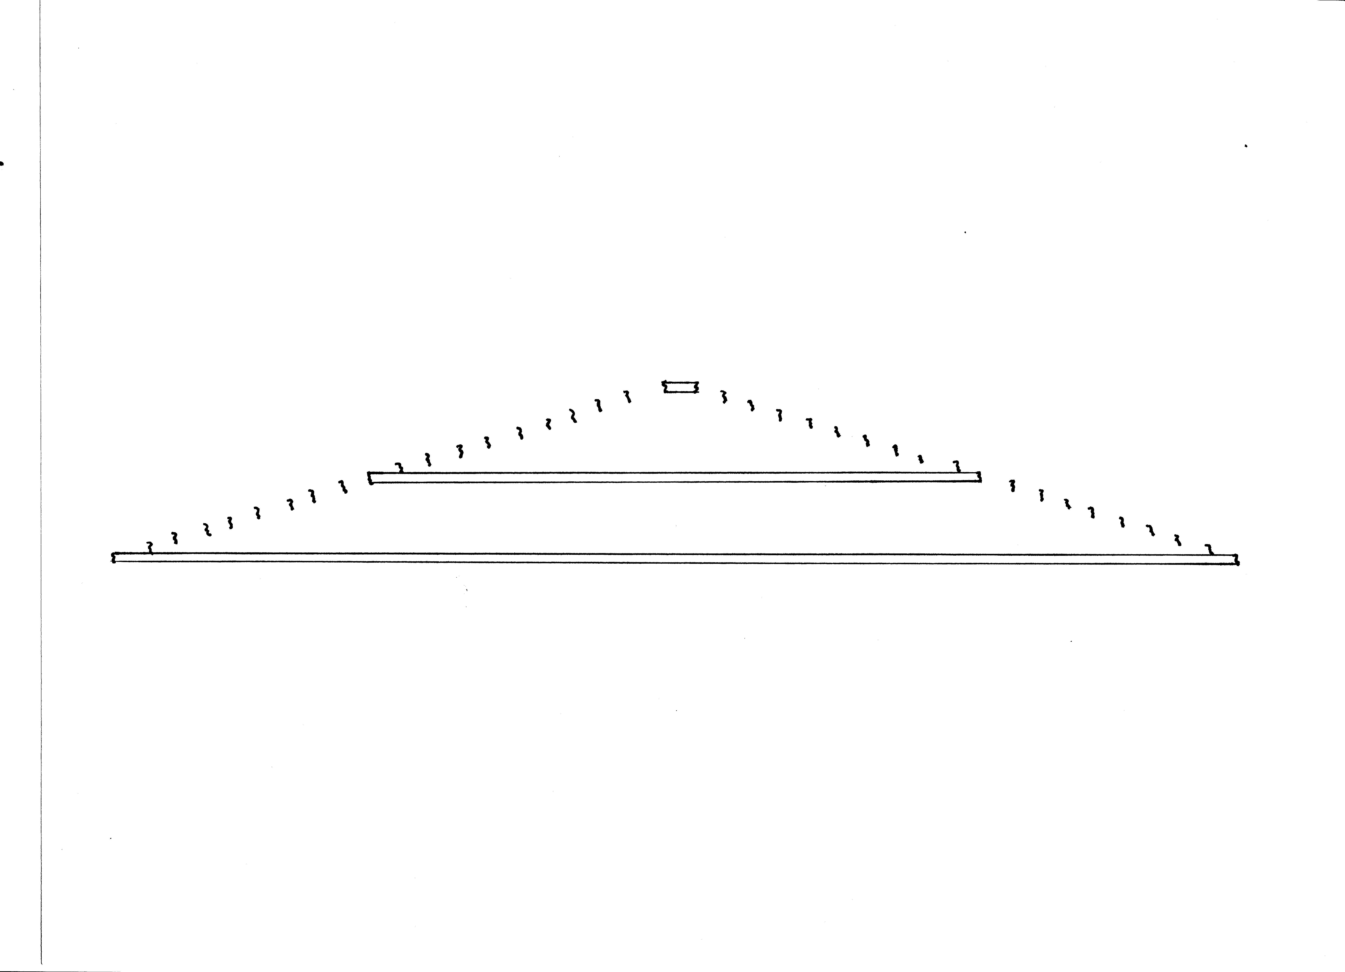
Uncoiled ropes display an isosceles-triangle-like figure
The result suggests, roughly, that the area of the circle might be equal to that of an isosceles triangle having
altitude = radius and base = circumference.

Slide 14
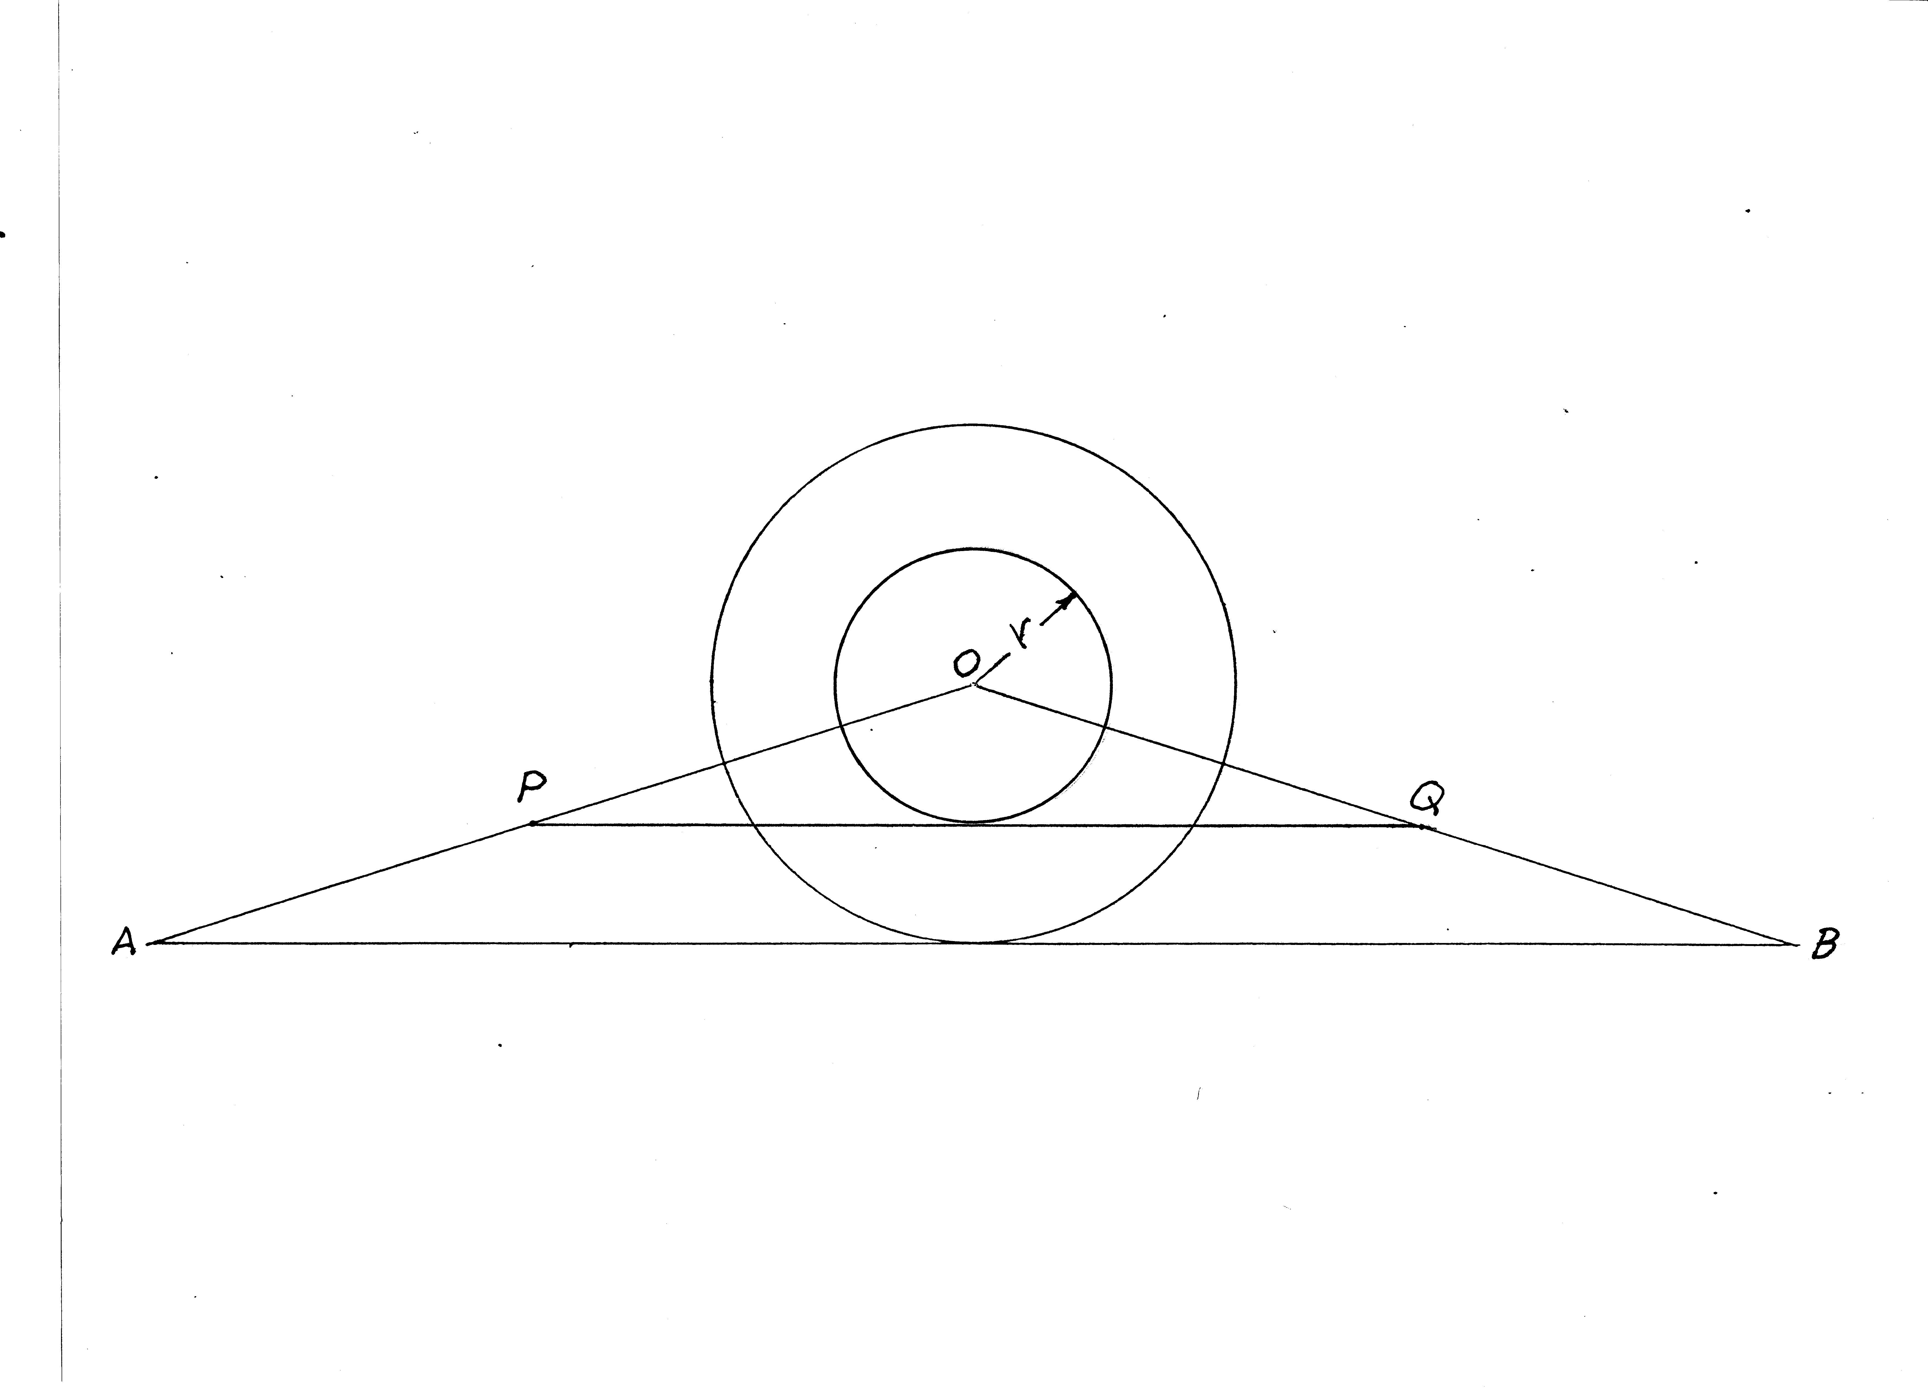
Do the sloping sides of the “rope triangle” really model straight lines?
Points P and Q represent endpoints of a generic, interior circle that is unwound. Some elementary (nowadays) calculation shows that they lie on the lines AO and OB (see Appendix I slide). Hence, the rope triangle models a mathematical isosceles triangle. Therefore, the disc has area of
(1/2)RC= (1/2)kR².

Slide 15
Archimedes cut the circle at the south pole and unwound it to get a right triangle.
Clearly, the area of a circular disc is equal to that of any triangle that has base C and height R. But your isosceles triangle is much prettier than Archie’s right triangle.
He should have known better.

Slide 16
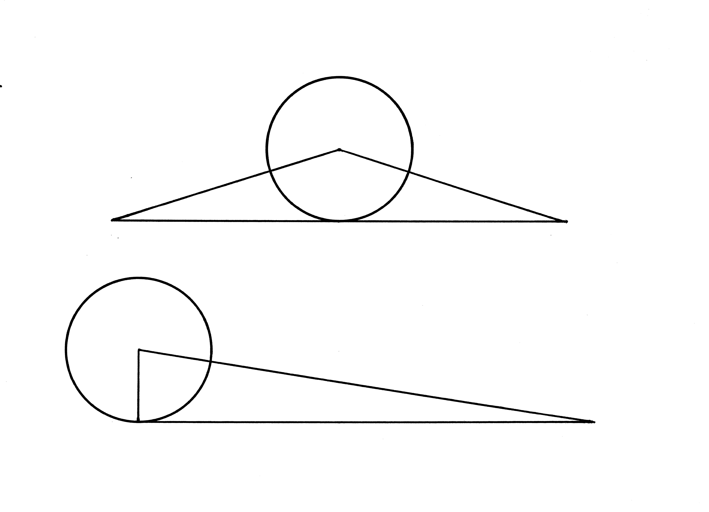
See ?
Your triangle ⬇
⬇ Archimedes’ triangle

Slide 17
Supporting argument
So, the above argument says that the area of a circular disc is equal to that of an isosceles triangle of height R and base C. Pretty convincing to you and Archie; pretty convincing to me.
But just in case: another, too pretty to omit, argument.
Next, a “mathematical rope” argument

Slide 18
Real rope vs “mathematical rope”
When you unwound the hemp rope, the ends were ragged, so the “triangle” was not sharp. It had rough, ill defined edges. Let’s see how mathematical rope behaves differently from real rope.

Slide 19
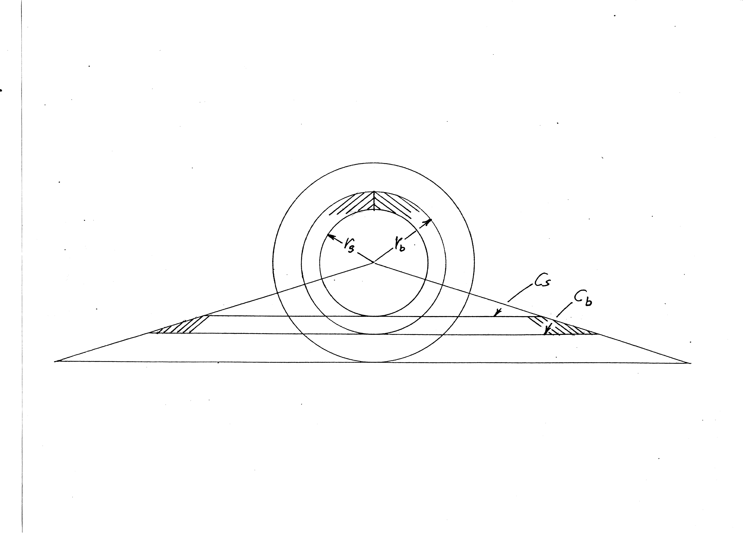
Mathematical rope unwound
The unwound rope is an isosceles trapezoid. Its area equals its height (r_{b}-r_{s}) times the average of its two sides (C_{b}+C_{s})/2. Fill the big disc with n adjacent ropes, sum their areas, and the area of the disc emerges. Same result as before.
Math details in Appendix II slide

Slide 20
Observe: We did not use “exhaustion” in the mathematical rope calculation of area.
Calculation of area via calculus invokes exhaustion. Indeed, calculus, at its roots, depends upon the concept of limit which is a form of exhaustion. We just summed the areas of n isosceles trapezoids, not an infinite sequence.
But is the argument based upon a hidden equivalence of exhaustion?
We select a sequence of radii. We are selecting real numbers, and the real number system consists of a subtle set of objects in today’s world. I do not know the answer. But practically speaking, the argument would be good enough to get on with the business of building things.

Slide 21
The area proof came before the circumference proof.
I discussed circumference before I discussed area above, but the proofs came in the reverse sequence, apparently.
Satisfactory proof, by modern standards, that A/D² is a constant came earlier than the proof that C/D is a constant.
Perhaps because the length of a plane curve is inherently more complicated than the area of a plane figure.
Ask any of your first-year calculus students.

Slide 22
You and Archie estimated the value of π
by inscribing and circumscribing
96-sided polygons
According to accounts you arrived at
223/71 < π < 220/70
To five digits that translates to
3.1408 < 3.1416 < 3.1429
Remarkable, given tools available.
Or, better, not available: no decimal or other positional notation, and no trigonometry.

Slide 23
Enter Newton and his fluxions
Calculus changed many things, including the ubiquity of π. Constant π surfaced in many situations not obviously related to circles.

Slide 24
The number that π represents fully characterized
Ferdinand von Lindemann proved that π is transcendental in 1882.
So circle squarers were finally defeated, but some are still at it.
And Aristotle had a point, but I can’t imagine that he anticipated anything like Lindemann’s result.

Slide 25
k today
k = 2π and π is known to a zillion digits.
Why did k/2 get all the publicity?
Isn’t k the real hero or heroine?

Slide 26
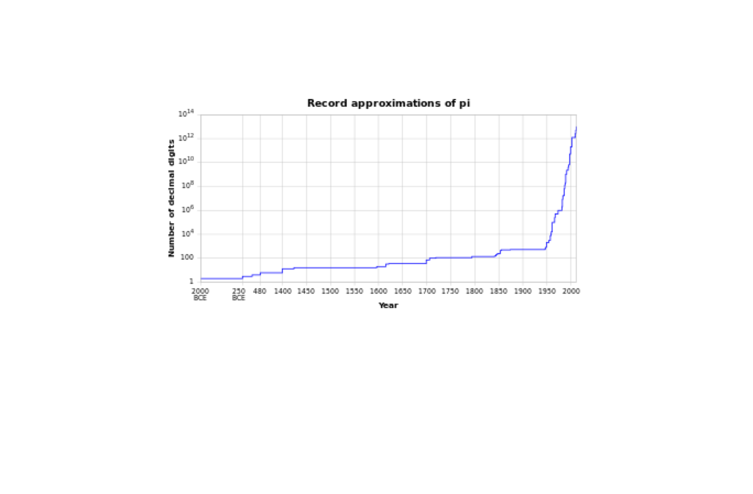
Known digits of π vs time
10¹⁴➔
10⁰ ➔
⬆
2000
BCE
⬆
1400
CE
⬆
2000
CE
Prior to 1400 CE
not to scale

Slide 27
Circle calculations could have been so much simpler.
February 5, 1897
The Indiana House of Representatives passed, 67 to 0, a measure to set PI to the value 3.2. The bill perished in the Senate. What a shame.
Damn!

Slide 28
The TAU vs PI controversy
Resolved:
The circle constant should be 2π, not π.

Slide 29
Origin of the symbol π as a placeholder for C/D
William Jones (1675-1734) used it; there exists some evidence that he may have had the word periphery in mind for a circle of unit diameter.
Euler, based on Jones’ work, picked it up; that did it.
Why did C/D come to dominate, rather than C/R? Common speculation: the diameter of a circular object is easier to measure than its radius.

Slide 30
Good for shop practice perhaps, maybe not so good for mathematics.
For the last ten or so years, there has been a movement, partly substantive, partly tongue-in-cheek, to replace the circle constant π by 2π and to use τ as the symbol for that constant.
Let’s take a look at some of the arguments. Of course it is unlikely that π will go away, but perhaps you will be entertained by the arguments.

Slide 31
But before we leave “practice”
Rotating machinery (your automobile engine, for example) almost always involves the measure RPM, not HRPM (half revolutions per minute).
So π = C/D has a practical side, but so does τ = C/R.

Slide 32
Why the symbol τ?
Symbol π represents a half turn; 2π represents a full turn. Hence the suggestion that τ be chosen for a full turn.

Slide 33
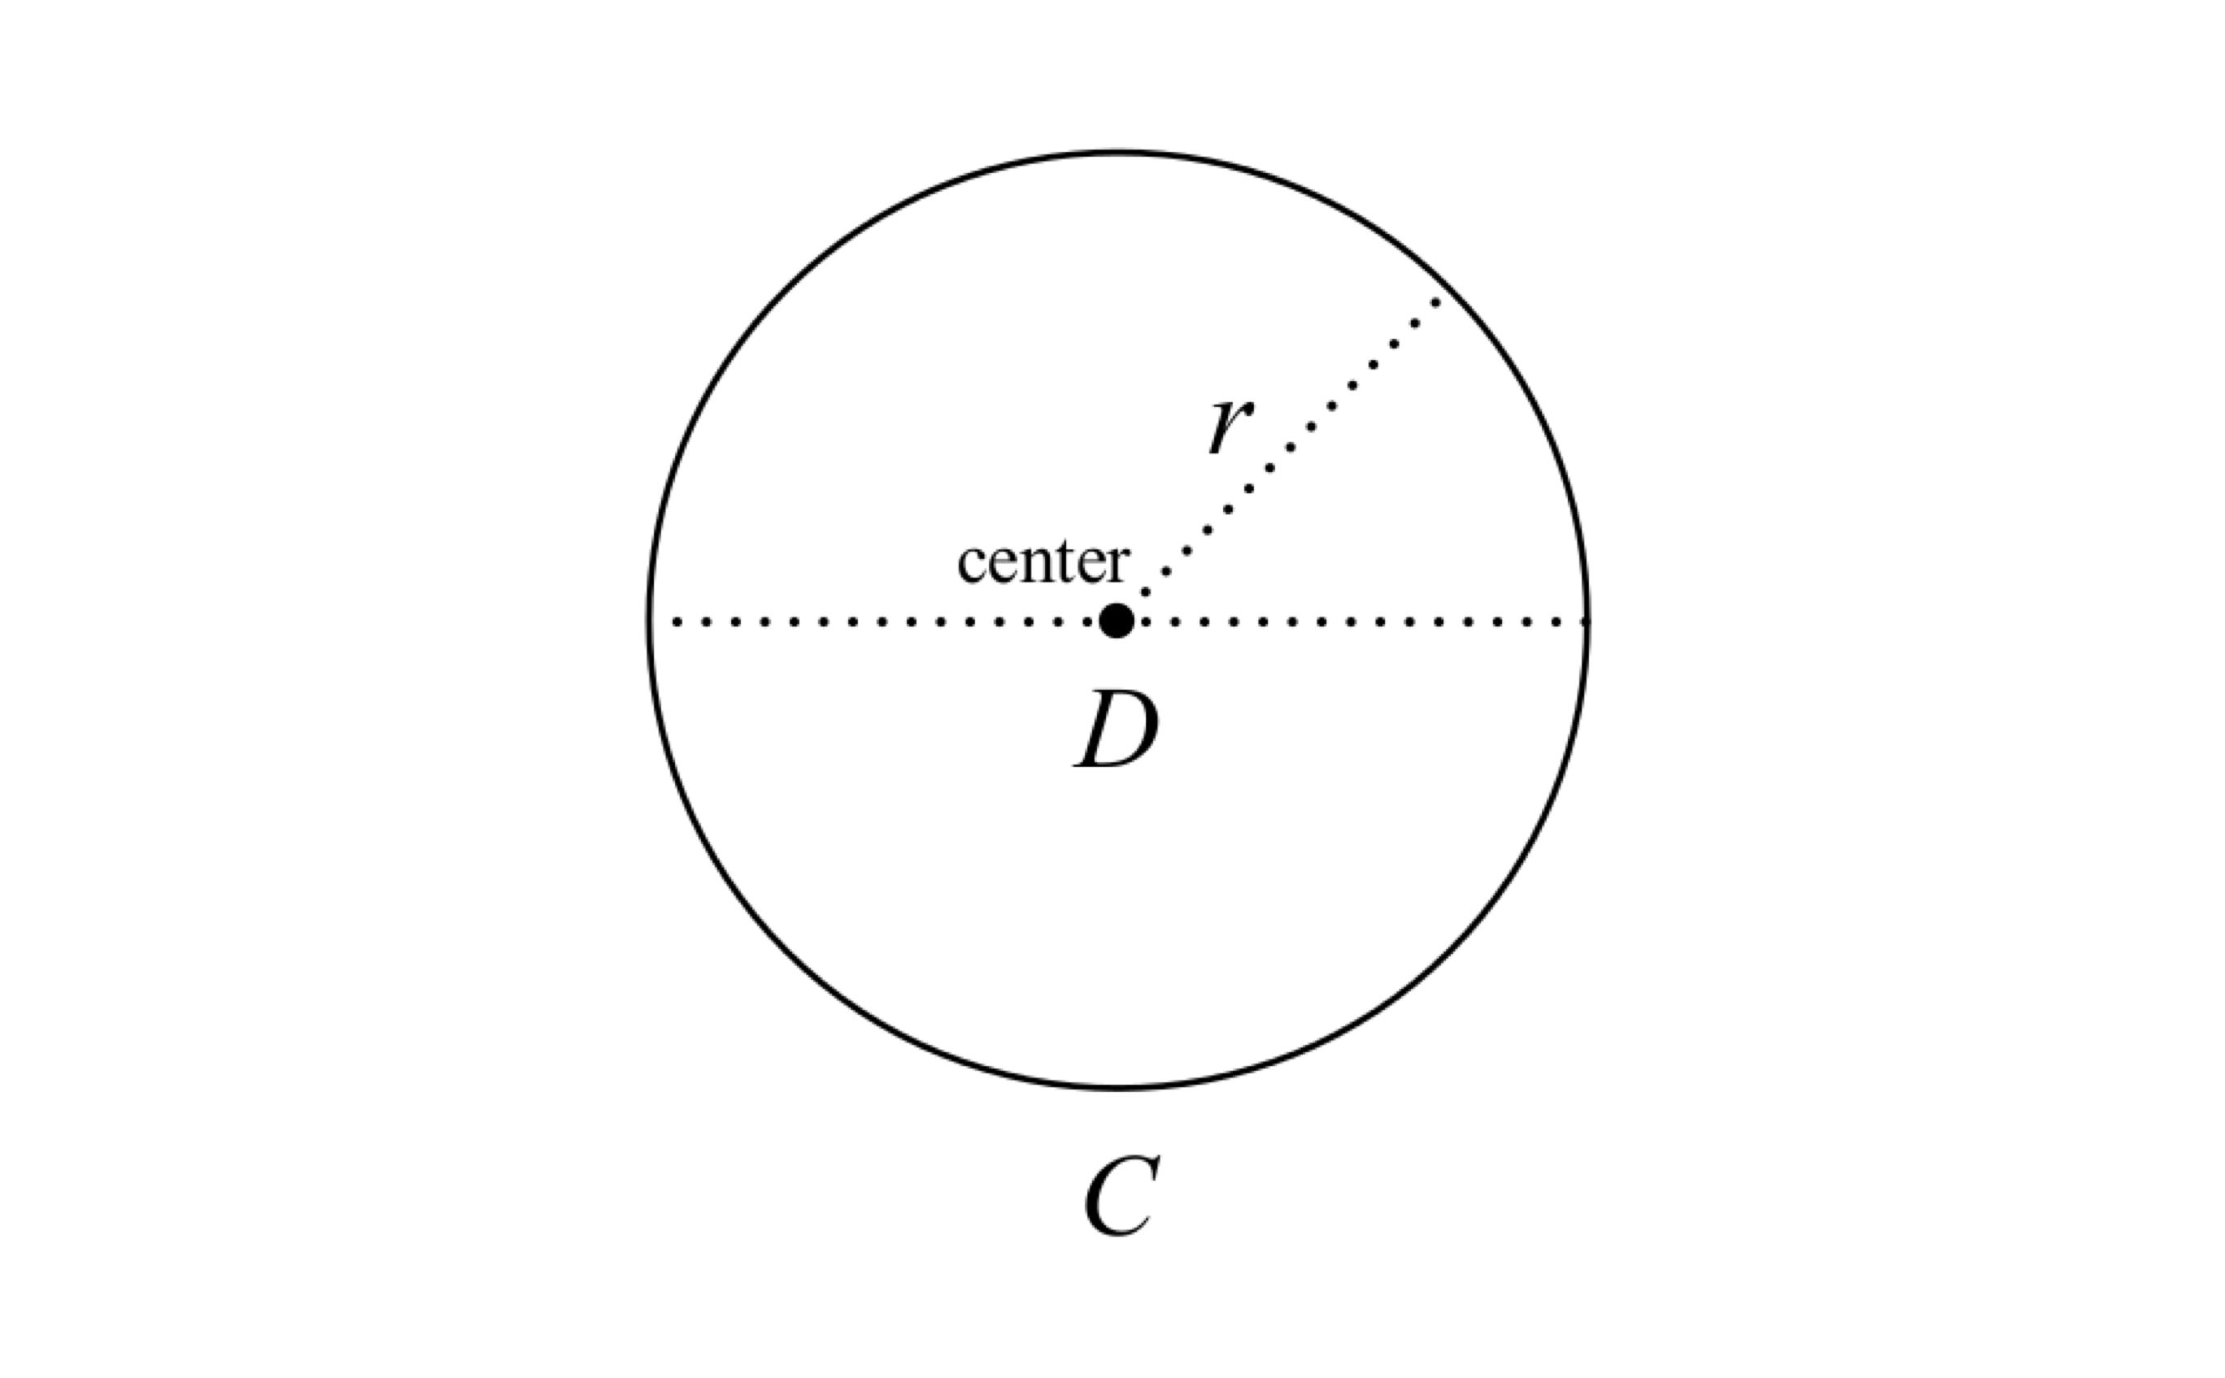
In case you have forgotten what a circle looks like
π = C/D
τ = C/r

Slide 34
A problem
Many shapes have constant diameter.
Only circles have constant radius.

Slide 35
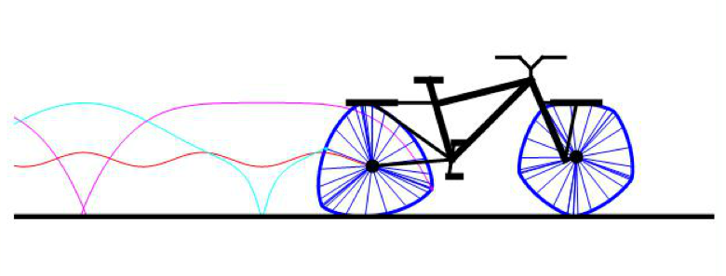
Meet your Reuleaux Bicycle
Rear wheel is a Reuleaux triangle; front wheel is a Reuleaux pentagon. Both wheels have constant width. Guan Baihua built one in 2009. Reinvention of the wheel?

Slide 36
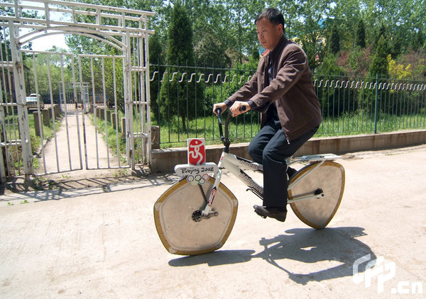
Baihu’s Bicycle

Slide 37
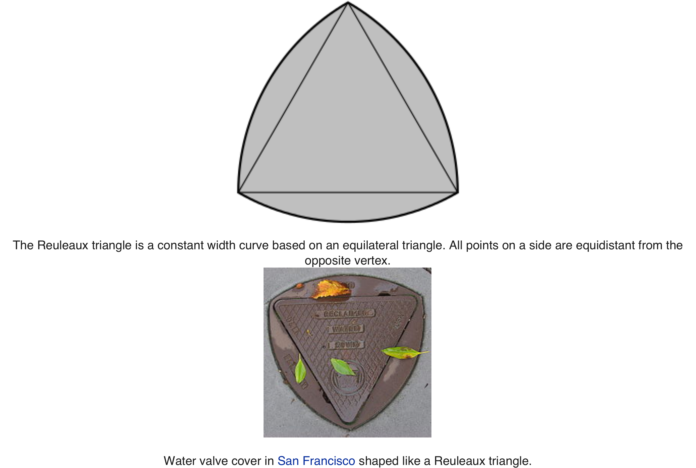
A practical example?
Constant-diameter objects do not “fall through”.
➔

Slide 38
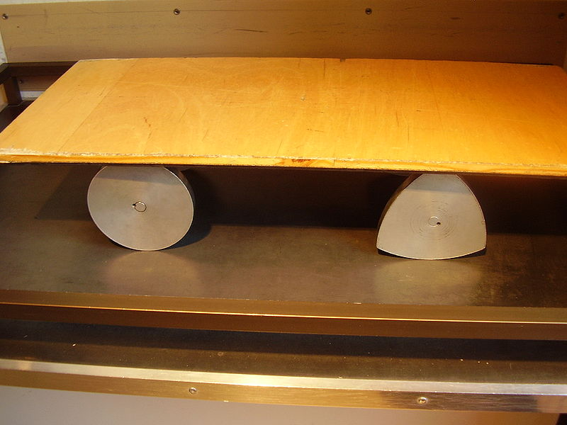
The board on top moves smoothly, but a Reuleaux wheel does not yield a smooth ride; the axle moves up and down three times per revolution.

Slide 39
Other applications exist
My kitchen blender
Cathedral window: Church of Our Lady Bruges in Brussels
Certain film projectors
Köintriangle high-rise in Cologne
Guitar picks
Watts Drill Bit

Slide 40
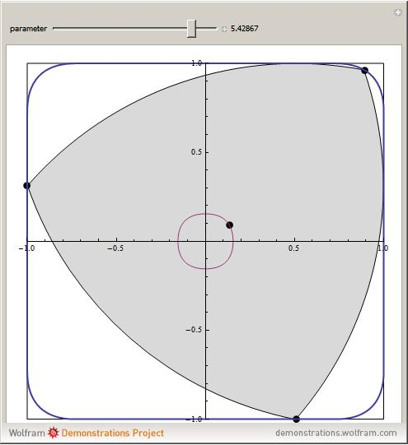
“Almost” Square Hole
The center appears to move in a circle, but each quadrant is the lobe of an ellipse.
⬅

Slide 41
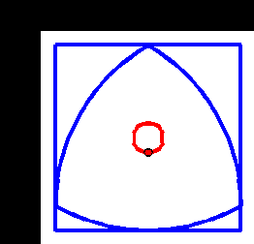

Slide 42
The Wheel and Axle
Evidence of the earliest: (5100-5350) years old; found in Slovenia in 2002.
Have you ever visited the Ancient Puebloan sites in the
Four Corners area of the United States?
Occupied until about 1200 CE.
No evidence of wheel and axle application.
No evidence of the arch.

Slide 43
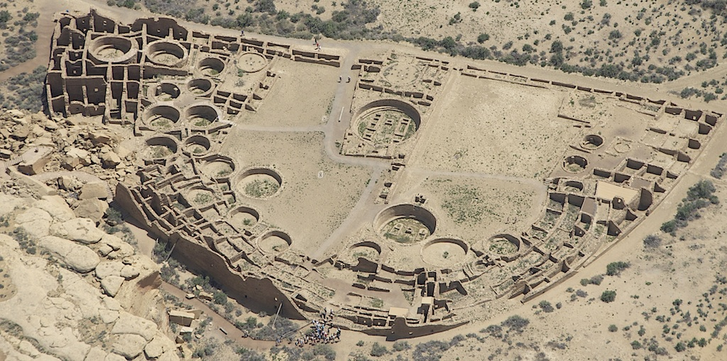
Pueblo Bonito; Chaco Canyon
Clear that the Anasazi could construct and use circles

Slide 44
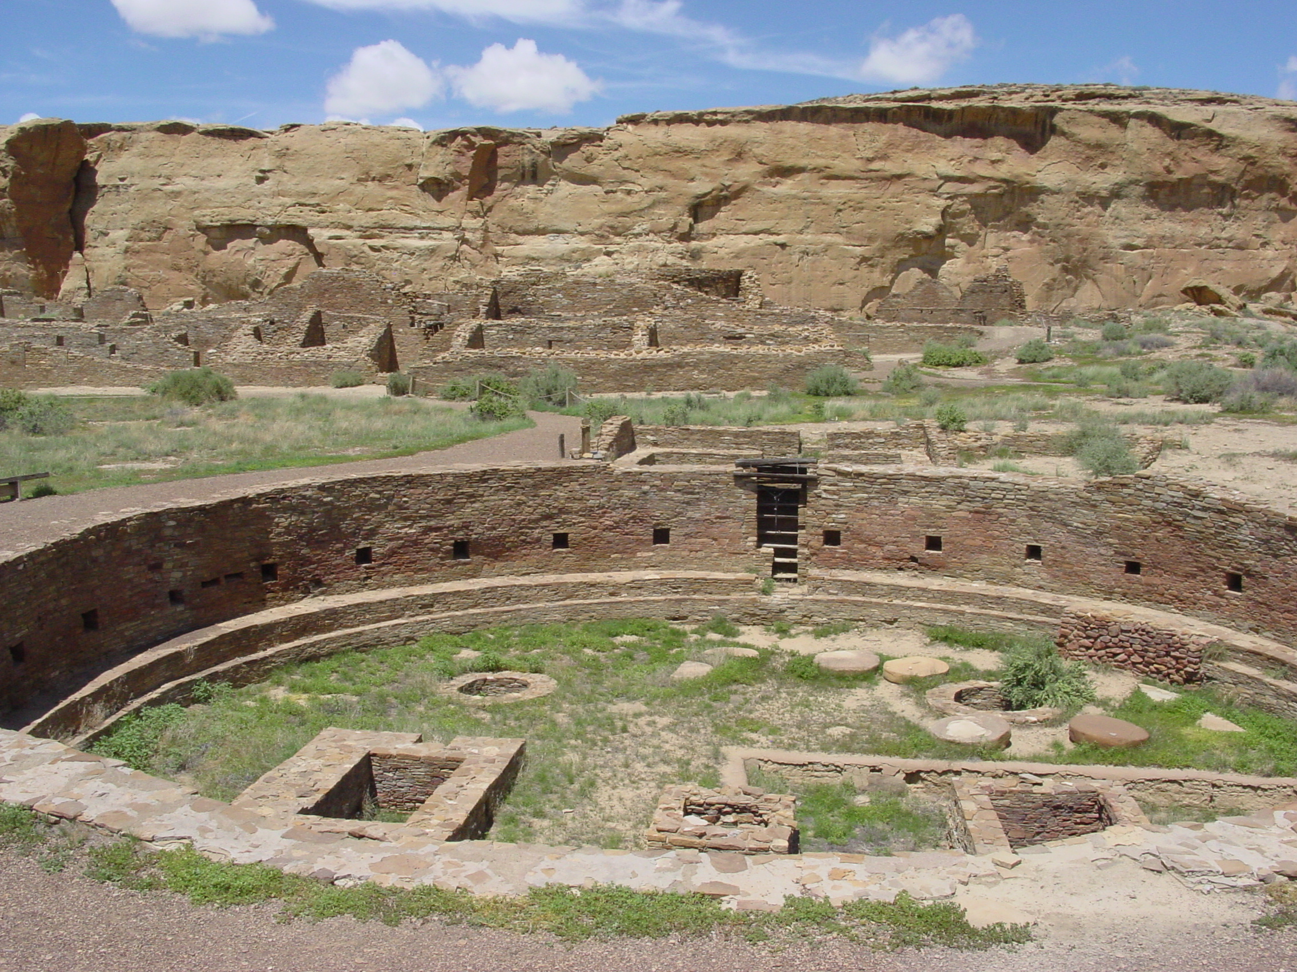
Great Kiva of Chetro Ketl; Chaco Canyon

Slide 45
Let’s leave applications and
return to the mathematics of TAU vs PI

Slide 46
Symbol 2π (one full turn) occurs frequently in mathematics.
Integrals over all space in polar coordinates:
upper limit of θ-integration is 2π
Normal(Gaussian) probability density function
Fourier Transform and its inverse
Cauchy Integral Formula
Riemann zeta function
nth roots of unity

Slide 47
But to be honest, I cherry picked.
You can find as many important formulas that contain π in isolation.
The Error function
The Gamma function at several important domain points
Euler’s Reflection Formula
Volume of the unit n-ball
Area of an ellipse
Integral of sin(x)/x over the real line

Slide 48
PI vs TAU and Area vs Angle in
Plane Geometry cases
Roughly, where convenience matters, π seems to have the edge when we are dealing with areas and τ seems to have the edge when we are dealing with angles and arc lengths.

Slide 49
That pesky “2”
Traditionalists: Dividing by “2” is a lot nastier than multiplying by “2”.
Reformers: Good point, but the half-circle aspect of π obscures the
fundamental nature of arc length, angle, and ultimately area.
Earlier we saw how (1/2)kR² emerged when we calculated the
area of a circle via unwinding the circular disc into a triangle.
The “1/2” also emerges when we calculate area via calculus.

Slide 50
The “(1/2)τ” cluster emerges naturally when we calculate the area of a circle via calculus. (I)
The ultimate Rope Procedure?

Slide 51
(II)

Slide 52
And the area of a sector?
A=(1/2)θr²
See how setting θ equal to 2π obscures the situation?

Slide 53
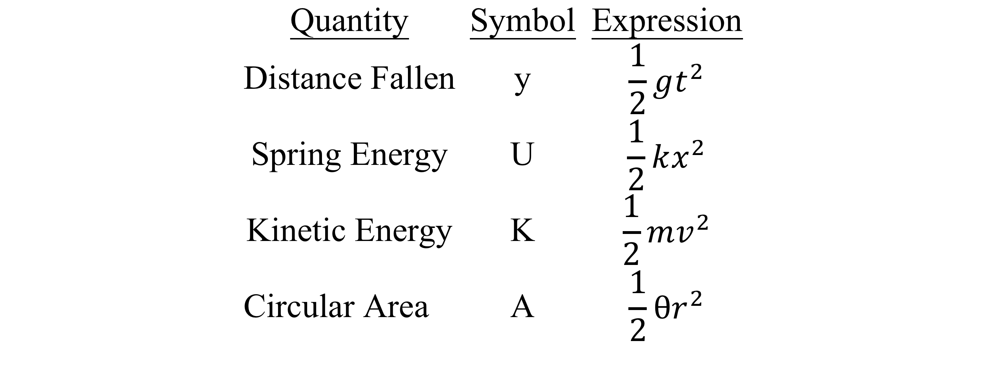
And the sector-area quadratic form has a lot of company in elementary physics.
➔
⬅

Slide 54
Plots of the basic trigonometric functions are particularly nice if we use TAU as
unit for the abscissa.

Slide 55
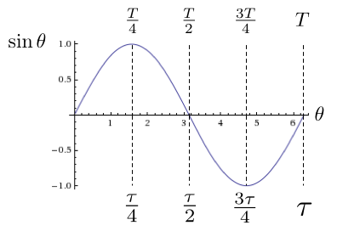
One of the two most important trig functions: the τ version

Slide 56
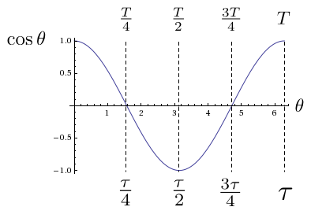
The other one
Aren’t they beautiful?

Slide 57
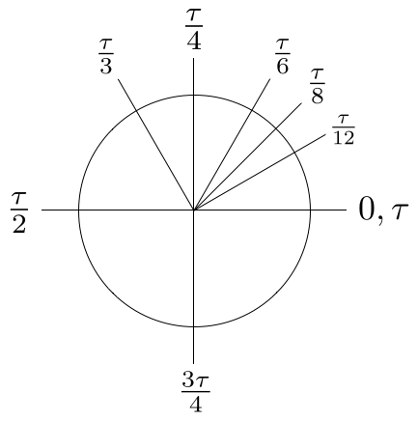
The TAU version of instructors’ favorite angles

Slide 58
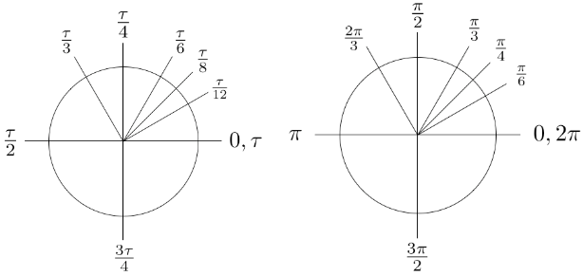
Instructors’ favorite angles: two versions
τ version
π version

Slide 59
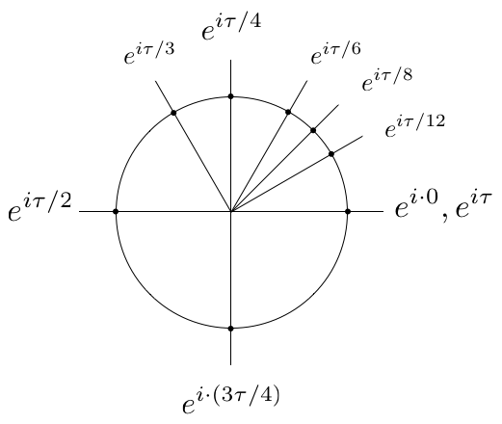
Multiplication by e^{iθ} for favorite values of θ: TAU version

Slide 60
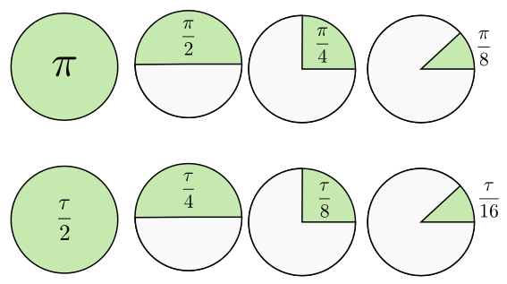
“We can draw pretty pictures too”, say the PI defenders.
Unit-circle areas
Now which do you prefer?

Slide 61
How about the “most beautiful” equation?
The π version
𝒆^{𝒊𝝅} = −𝟏 Not so pretty
𝒆^{𝒊𝝅} + 𝟏 = 𝟎 Classic
The τ version
𝒆^{𝒊𝝉} = 𝟏 Pretty, but no zero
𝒆^{𝒊𝝉} = 𝟏+𝟎 No problem

Slide 62
Puns, groaners, potpourri
PI in the sky (yeah, cute)
PI is a piece of TAU, not the other way around.
e^{iτ}=1 says “ Be one with the τ.”
“A rotation by one turn is 1” sounds like a τ-tology, but it reveals the true nature of τ.
TAU-ism is based on reason, not faith. TAU-ists are not PI-ous.
But perhaps they are TWO-pious.
On TAU-day you can eat two pieces of pie.
Clearly TAU is spiritually superior to PI. Why?
6.28 contains the first two perfect numbers {6, 28}.
3.14: boring.

Slide 63
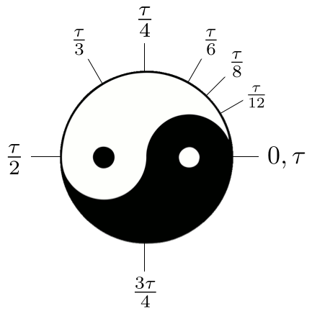
And the TAU-ists can appropriate a cool, ancient symbol.
Followers of TAU-ism seek the way of the τ.

Slide 64
As you struggle with the weighty problem of TAU vs PI, beware of a common trap.
Avoid circular reasoning.

Slide 65
And if you have trouble deciding between PI and TAU, consider the following:
Thank you for attending!

Slide 66
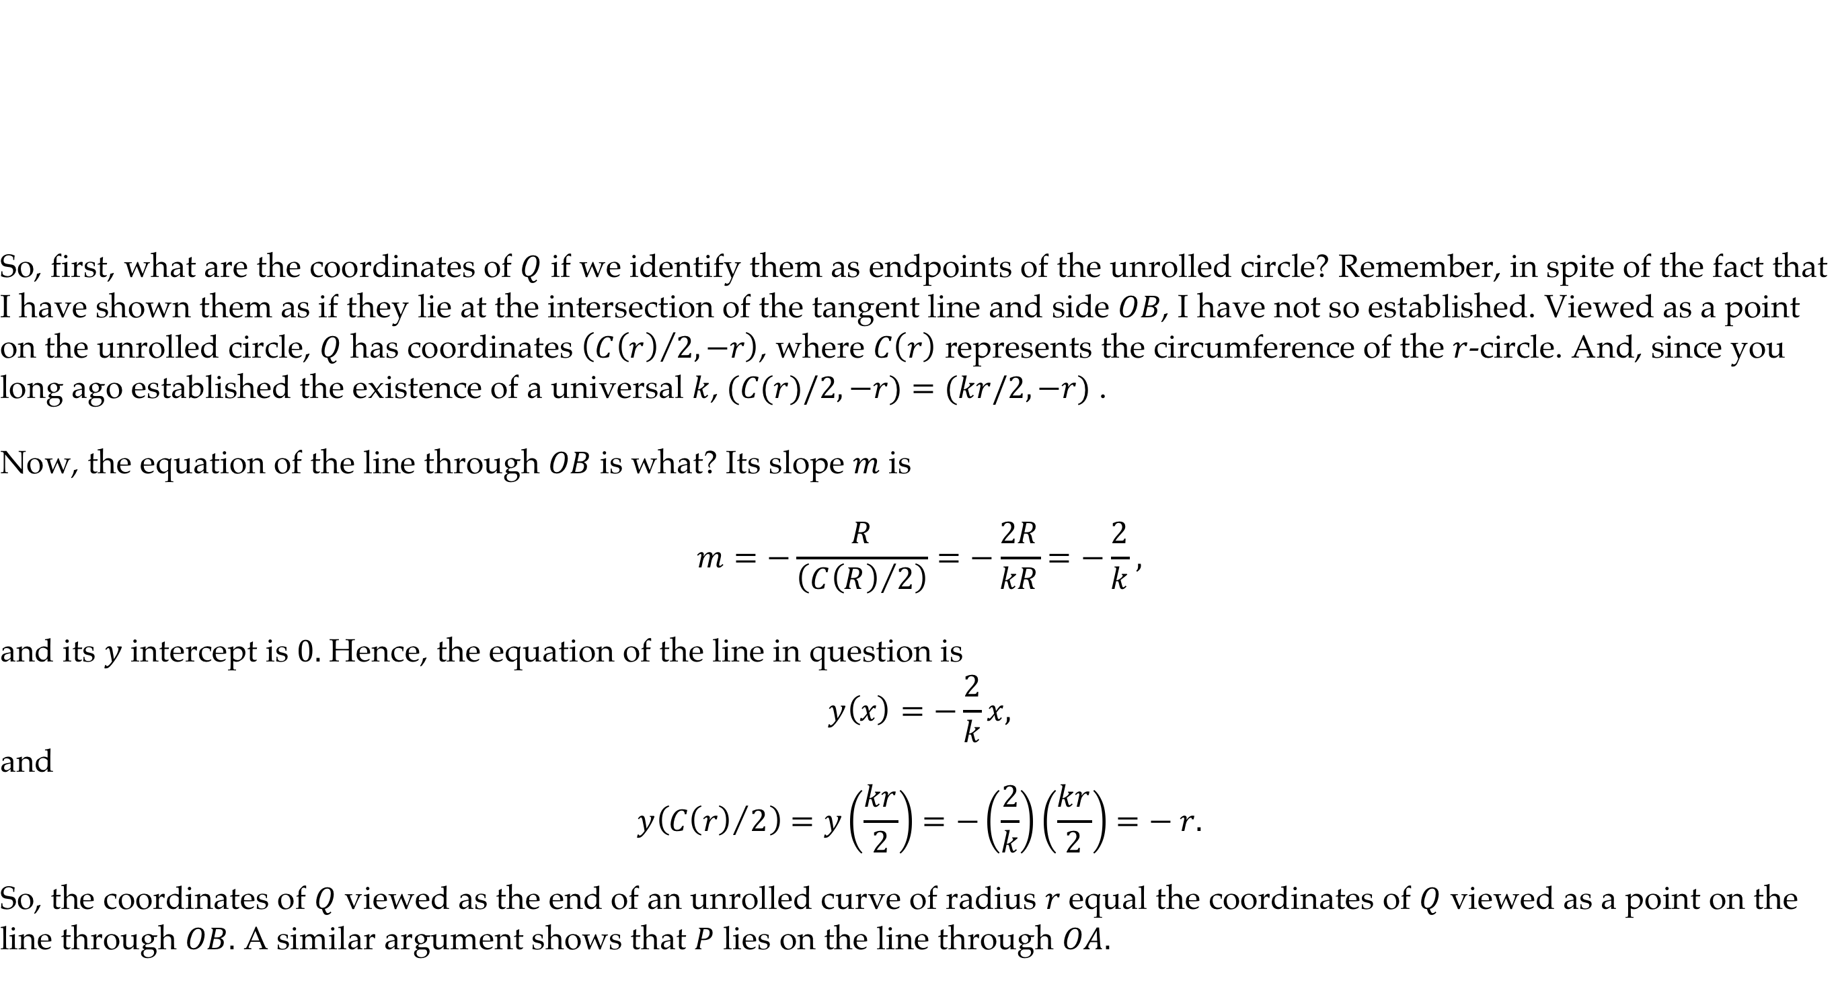
Appendix I
End points of the circumference of a generic uncoiled circle
lie on the triangle sides

Slide 67
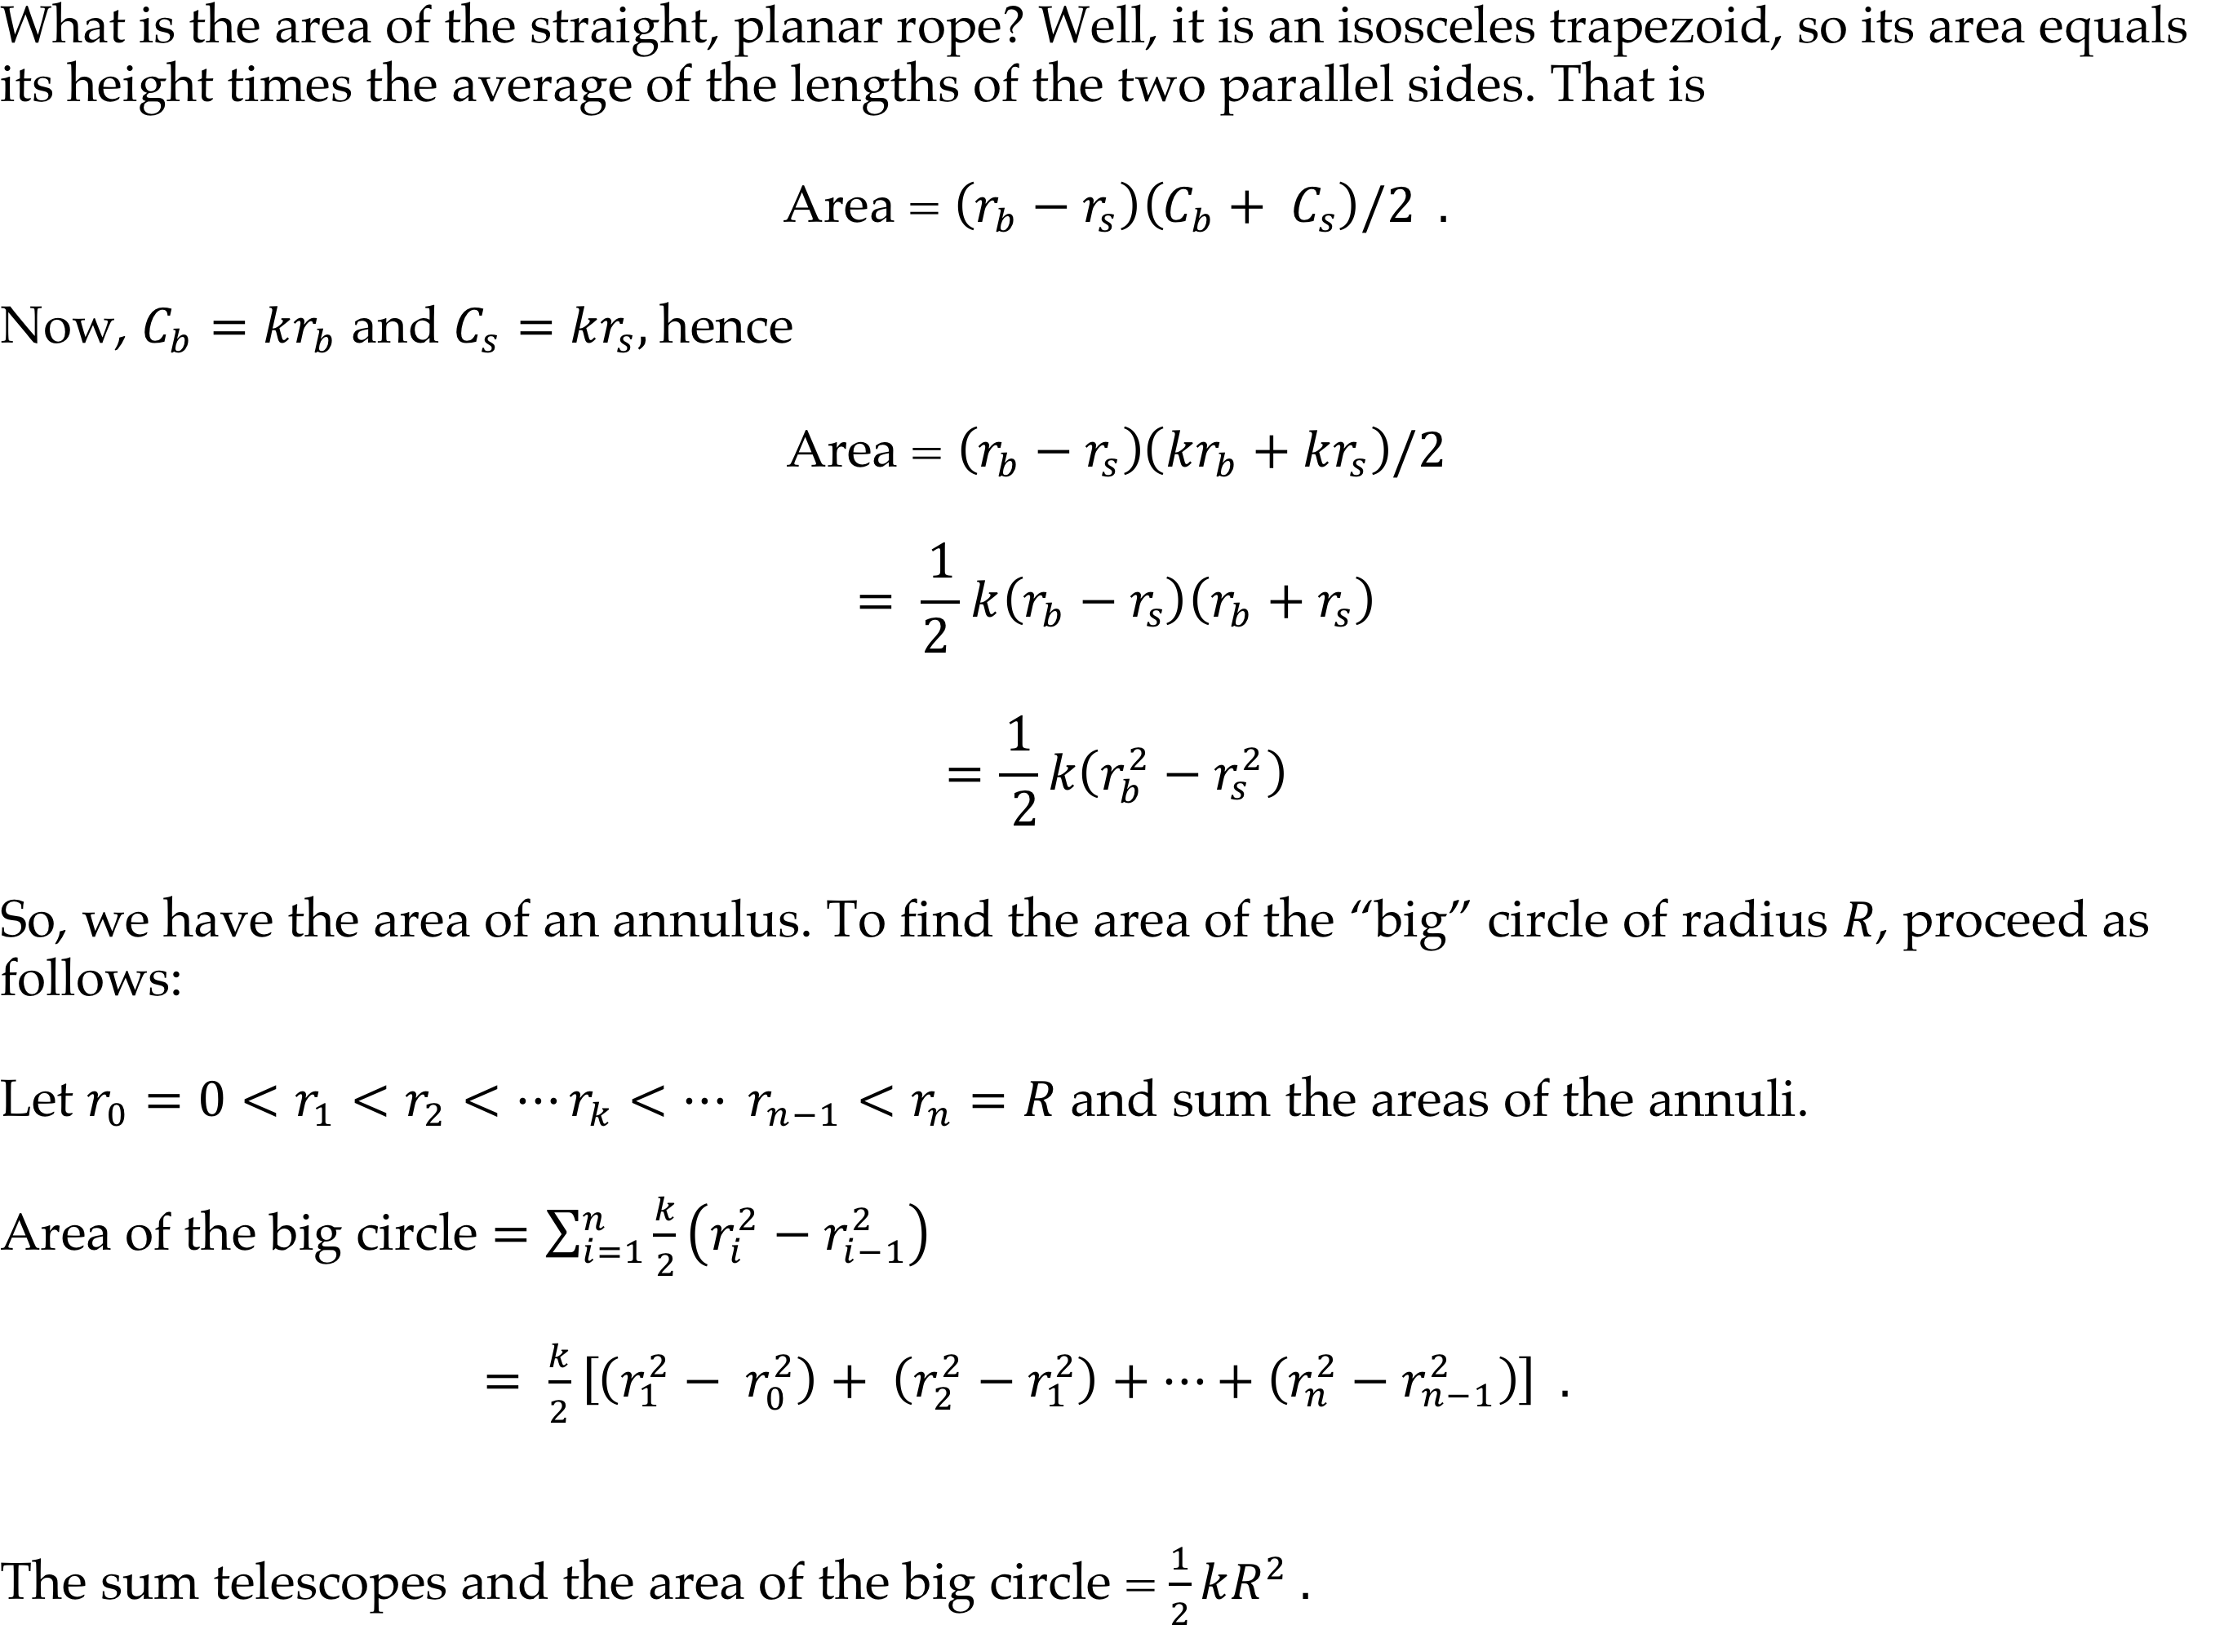
Area of a straight planar rope
AppendixII

