Slide 1
The Mathematics of Martial Arts
Tityik Wong & James Lee
College of Southern Nevada
41st AMATYC Conference
New Orleans, Louisiana
November 22, 2015

Slide 2
QUESTION
What do mathematics and the martial arts have in common?

Slide 3
ANSWER
They were both invented by the weak to overcome the strong ☺
But later employed by the strong to brutalize the weak ☹

Slide 4
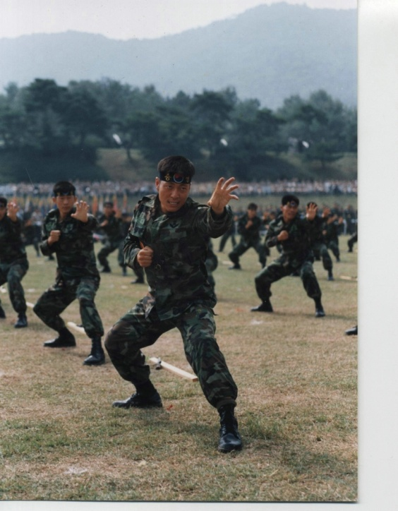
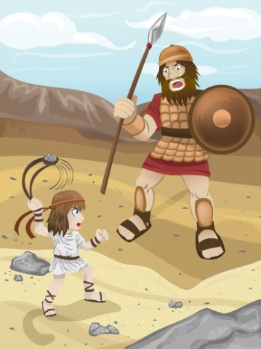
Exhibit A
Strong brutalizing weak
Weak overcoming strong

Slide 5

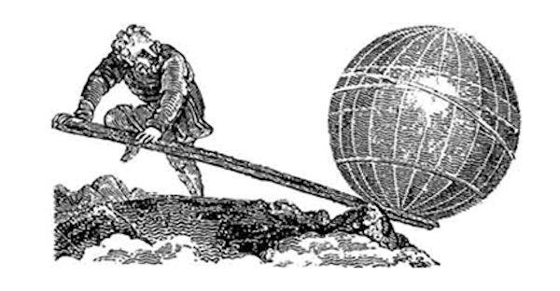
Exhibit B
Strong brutalizing weak
Weak overcoming strong
Archimedes’ Lever

Slide 6

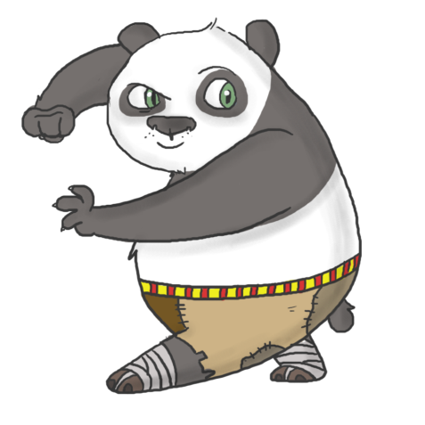
Actually, both math and martial arts are difficult; both require dedication, creativity and imagination!

Slide 7
The Chinese refer to “martial arts” as “martial skills” or “fist methods” – these terms carry some scientific/technical flavor.
The term “Kung Fu”, popularized by Bruce Lee, is not really a Chinese martial arts style. The term means “skills.” In China, if you hear that a chef has good kung fu, it doesn’t mean the chef is a good martial artist, it means she has very good cooking skills. So don’t run away, she is not going to beat you up. Stay and enjoy her cooking instead.

Slide 8
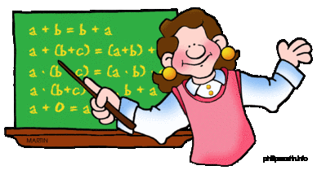
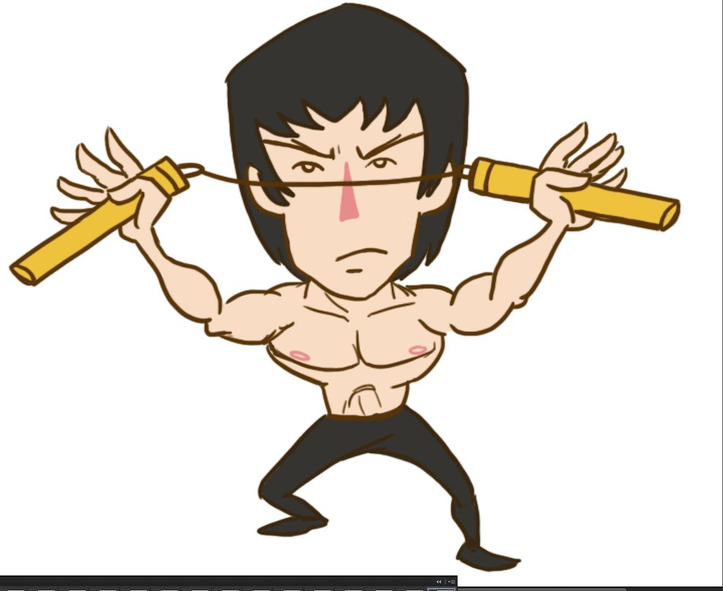
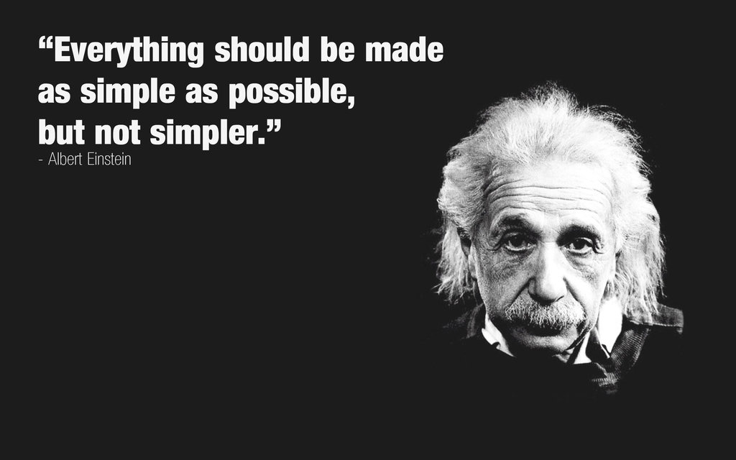
Amazing… Kung Fu
Excellent teaching kung fu
Unbelievable physics kung fu

Slide 9
Introduction
Science and math have been utilized to improve sports performance for a long time, from using biomechanics to fine tune athletes’ techniques to using statistics to determine the most suitable players for a team.

Slide 10
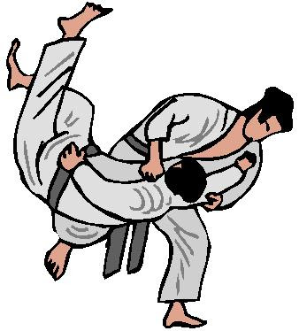
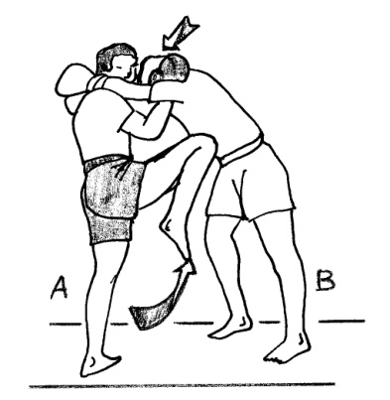
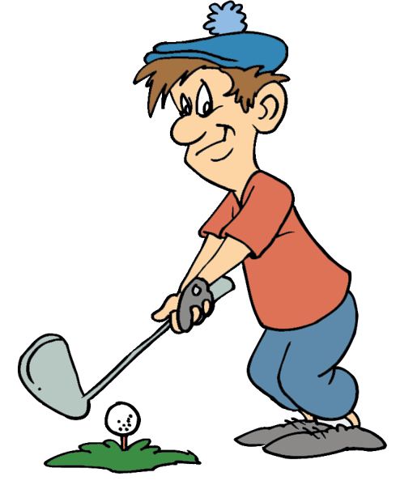
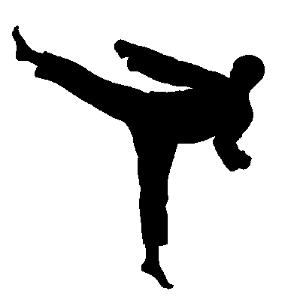

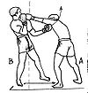
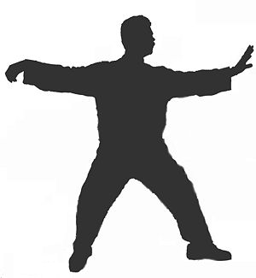
Martial arts post a unique challenge because there are so many disciplines and so many techniques.
I don’t need to punch people to feel good about myself.
Neither do I…

Slide 11
There has been some research done on the connection between mathematics and martial arts. Some deep, some shallow; some technical, some philosophical. We found the following two books to be quite serious and scientific:

Slide 12
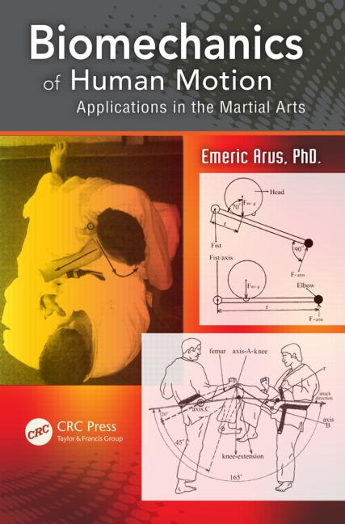
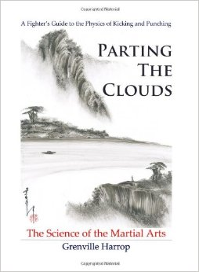

Slide 13
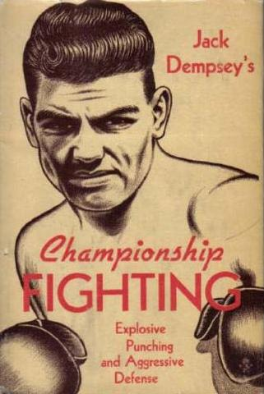
And a very well written boxing classic by heavyweight champion Jack Dempsey. Even though the book mentions no mathematics, it can be quite analytical and that makes it easy to see the science and math behind the techniques.

Slide 14

There is also a TV series produced by the National Geographic Channel called Fight Science that examines different martial arts techniques using some very fancy equipment.

Slide 15
Summary of Current Research
Philosophical similarities between mathematics and martial arts.
Computations based on laws of physics.
Measurement of martial artists’ punching / kicking powers.
Body relationships.

Slide 16
What We Will Do Today
Present some existing results.
Use vectors as our primary tool to analyze or explain some martial arts techniques and principles.

Slide 17
WARNING
This presentation may enhance or ruin your appreciation of martial arts performances in the future.

Slide 18

The Algebra of Martial Arts
Kinetic energy formula: E = ½ mv²
This is the amount of energy an object with mass m traveling at velocity v possesses.

Slide 19
Doubling m doubles E: ½ (2m)v² = 2E
Doubling v quadruples E: ½ m(2v)² = 4E
Where E = ½ mv²
Increasing the velocity by 20% can compensate a 30% reduction in the mass: ½ (0.7m)(1.2v)² ≈ ½ mv²

Slide 20
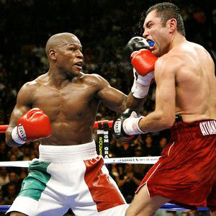
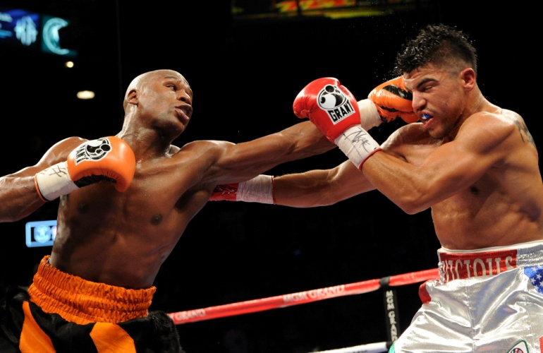
If you are punching, v is the speed at which your punching fist is traveling. The mass m, however, will vary depending on your body alignment.

Slide 21
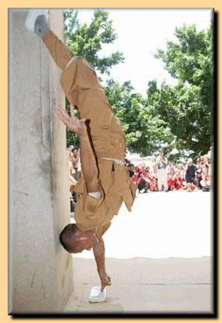
Handstand on fingers
And why do only smaller guys do it? (Shaq surely doesn’t have this in his Shaq-Fu curriculum.)

Slide 22
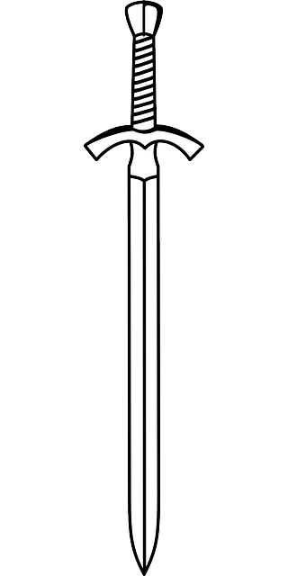
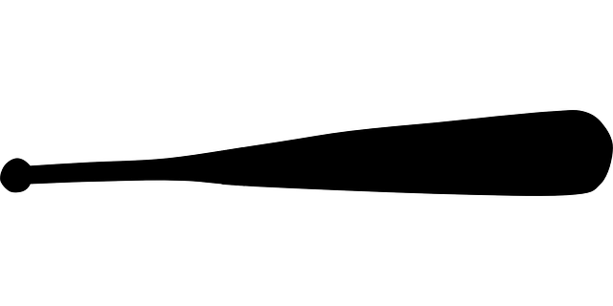
Pressure formula: P = F/A
Where P is the pressure, F is the force, and A is the contact area.
Smaller contact area, hurts
Larger contact area, doesn’t hurt as much

Slide 23
A large person generally punches harder. So what can a small person do to demand respect from the large person? Maybe a really fast finger jab to some soft body part will do?

Slide 24
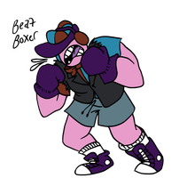



Fighter | Weapon | Force | Contact Area | Pressure
 |  | F | A | F/A = P
 |  | 0.3F | 0.1A | 0.3F/0.1A = 3P

Slide 25
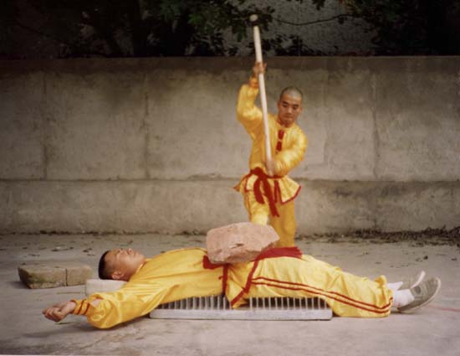
Trick or treat – bed of nails
The performer lies on a bed full of nails. A heavy object is placed on his body, and his friend breaks the heavy object with a sledgehammer.

Slide 26
Trick!
This is a matter of knowing how much pressure your skin can sustain. You divide your body weight by the number of nails, that’s how much weight each nail has to support – the nails can’t be super sharp by the way.

Slide 27
More nails on the bed may seem scarier, but that’s actually easier on your body. Can you imagine someone lying on a bed of just ONE nail? On the other hand, if the number of nails approaches ∞, the bed would become a solid iron bed ☺
Number
Of Nails

Slide 28

Bed of nails video

Slide 29
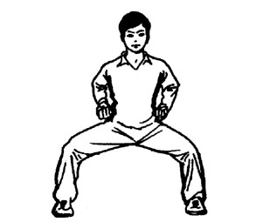
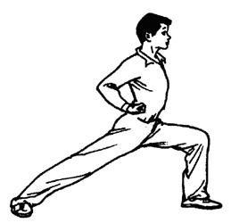
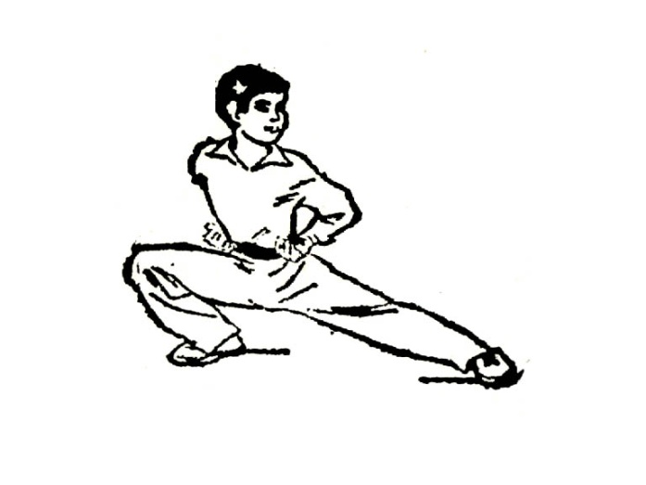
The Geometry of Martial Arts
Balance and stability are of ultimate importance in martial arts. A beginner has to first learn the basic stances.

Slide 30
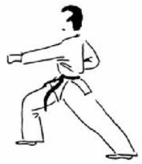
Example – the bow stance
Legs and hips form a triangular base for stability. The center of gravity should not be too close to either vertex of the base.
Stable
Gravity
Not too stable
Gravity

Slide 31
Jiu Jitsu
A Gracie Jiu Jitsu practitioner will always try to maintain the body in such a way that there are three points touching the ground for stability, and one point above the ground for maneuvering, like a four sided pyramid. A pyramid remains a pyramid when toppled.

Slide 32
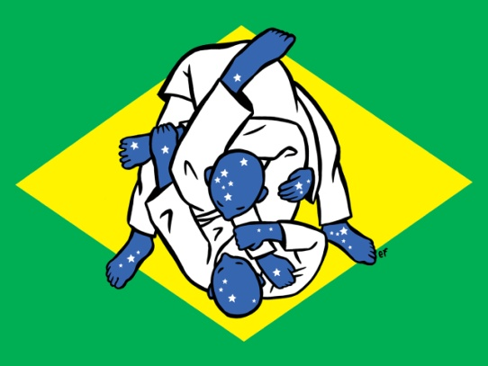

Slide 33
A strong stance is strong only in one direction
Because we have only two legs, all standing stances put our body in a “two dimensional plane.”
To upset your opponent’s stability, try to apply a force in a direction that’s more or less perpendicular to the plane.
Easier to move
Harder to move

Slide 34

Easier to move the man in this direction
Harder to move the man in this direction

Slide 35
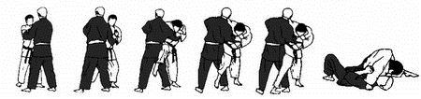
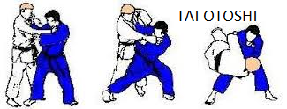
O Soto Otoshi

Slide 36
How to Move the Earth: The Lever
A very simple formula: L₁F₁ = L₂F₂
L₁ L₂
_{Fulcrum}
F₂
F₁

Slide 37
L₁F₁ = L₂F₂
F₂
L₂
L₁
F₁
When L₁F₁ is held constant, increasing L₂ decreases F₂

Slide 38
Blocking a punch
Longer lever Shorter lever
Takes less power to block Takes more power to block

Slide 39
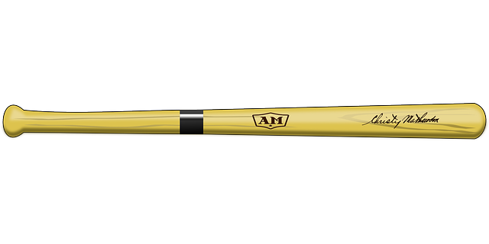

Fulcrum Force
If the hand is held in place, it is difficult for the hand to hold the bat if a force is applied to the tip of the bat.

Slide 40
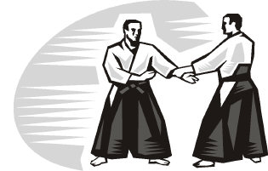
Getting out of a wrist grab

Slide 41
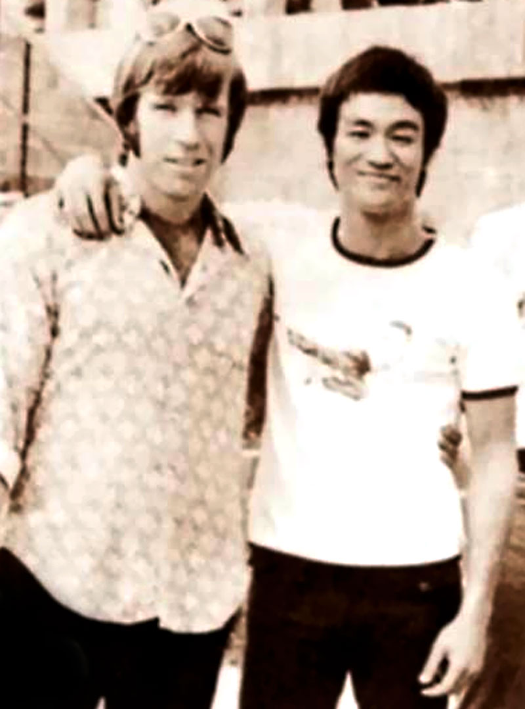
Invisible but Everywhere: Vectors
Balance is achieved only through correct body alignment. The feet, the legs, the trunk, the head are all important in creating and maintaining a balanced position. They are the vehicles of body force.
– Bruce Lee, The Tao of Jeet Kune Do

Slide 42
Why is correct alignment important
It increases speed by creating the smoothest movements
It reduces wear and tear on our body because we don’t need to rely too much on raw muscle power to generate functional power
It is eye pleasing. You may not be able to pinpoint exactly why and how, but when you see a bad dancer you know you see a bad dancer and most of the time it is because his body alignment is off – his body is not participating, only his arms and legs are swinging.

Slide 43
The sum of two vectors
θ F₂ = Force 2
F₁ = Force 1 F = Resultant Force
|F|² = |F₁|² + |F₂|² + 2|F₁|⋅|F₂| cos θ

Slide 44
The magnitude of the resultant vector is a decreasing function of θ from 0⁰ to 180⁰
The maximum magnitude when θ = 0⁰:
|F| = |F₁| + |F₂|
The minimum magnitude when θ = 180⁰:
|F| = ||F₁| – |F₂||

Slide 45


The lead hand punch
A tree log can “punch” you simply by falling down

Slide 46
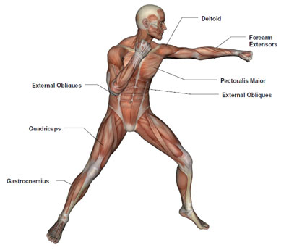
What does that have to do with a lead hand punch?

Slide 47
Your body is like a falling tree log

Slide 48
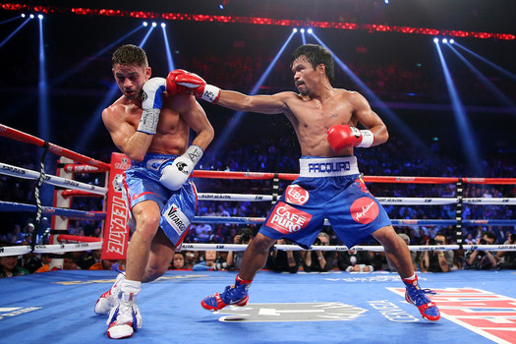
A master at work

Slide 49
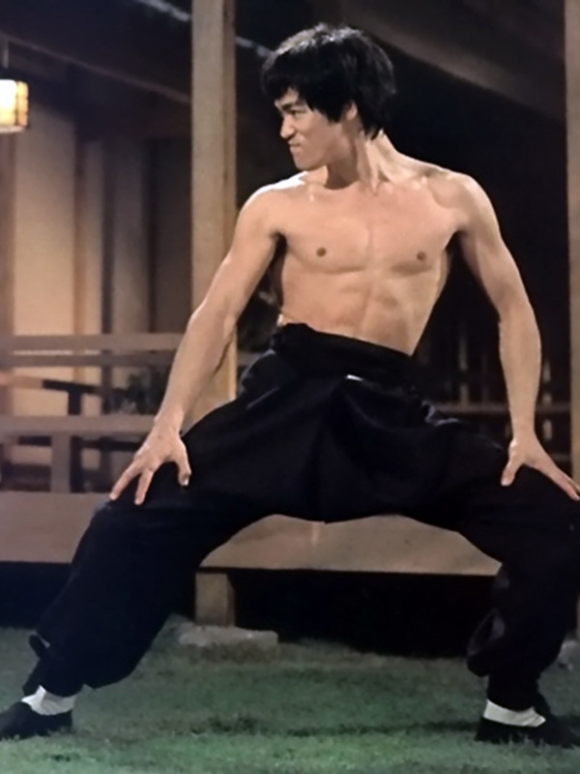
Bruce Lee’s body alignment

Slide 50
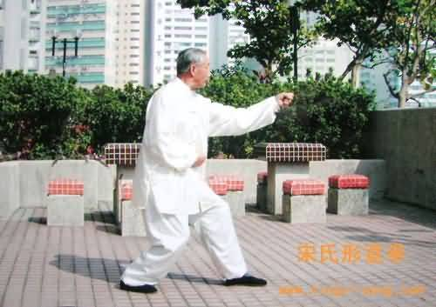
Chinese art Xing Yi
“Three Body Post” in the Chinese Art Xing Yi

Slide 51
Observations:
A straight line (pretty straight, anyway) goes through the back foot, the back hip, and the front shoulder.
The back leg’s pushing power is fully utilized this way. This force combined with the body’s downward / forward movement caused by gravity generates a forward force in the shoulder. This force can cause some damage to the opponent all by itself (the falling tree log effect).
Now add to this force the force of straightening your arm, and you have a lead hand punch that incorporates several parts of your body into one powerful strike.

Slide 52
Kicking with your arm
Bruce Lee’s Six Inch Punch video
Pay attention to his body alignment, the straight line that passes through foot, hip, and shoulder.

Slide 53
Math we can do
Given the angle between Line segment foot-hip and line segment hip-shoulder, find the component of the back leg’s pushing force in the direction of hip-shoulder.
Line segment foot-shoulder rotates as the body falls forward with foot as the fixed point. Find direction of tangent line at shoulder.

Slide 54
C
Suppose the angle between the line segments AB (foot-hip) and BC (hip-shoulder) is θ, and the force generated by the leg is F₁, then the force that is transferred to the shoulder is F₁ cosθ. The most efficient alignment is when θ = 0⁰.
F₁
θ
B
A

Slide 55
F₁
.87F₁
If θ = 30⁰, F₁ cosθ ≈ 87% F₁.
Suppose AB = x is the line segment from foot to hip and BC = y is the line segment from hip to shoulder. The line segment
AC = x² + y² + 2xycosθ .
C
.95F₂
y
F₂
θ
B
x
A
Notes:
|F|² = |F₁|² + |F₂|² + 2|F₁|⋅|F₂| cos θ

Slide 56
F₁
As a simplified example, assume x = y, and θ = 30⁰. Then AC = 1.9x = 95%(2x), where 2x is the max length when θ = 0⁰. This shortened “log” reduces the downward force due to gravity by roughly the same percentage, making it .95F₂ where F₂ is the downward / forward force when θ = 0⁰.
The resultant force is
(.87F₁)² + (.95F₂)², between 87% and 95% of the maximum.
.87F₁
C
.95F₂
y
F₂
θ
B
x
A

Slide 57
More investigations can be done. For example, we can add the angle between the back leg and the ground into consideration. This angle affects the pushing power generated by the back leg because the power is there only if the back foot doesn’t slip, that depends on the friction between the back foot and the ground, and this friction depends on both the component pointing towards the center of the earth and the component parallel to the ground.

Slide 58

The Superman punch

Slide 59
Superman punch

Slide 60
When you jump forward, your body’s trajectory follows a parabola.
You can generate the most power when you punch in the direction of the tangent line at the moment of contact.

Slide 61
Most powerful direction
Force from punch
Force from gravity
Resultant force
Less powerful direction

Slide 62


Slide 63
Math we can do
Equation of the trajectory – quadratic equation
Slope of tangent line – first order derivative
Angle of punch – trigonometry

Slide 64
Staggered attack - simple as one plus one
A staggered attack involves two (or more) attacks that are launched one after another. The first attack destroys the target’s balance by moving his center of gravity out of his base, and the second attack sends the target flying across the room. Both attacks come in roughly along the same straight line and that makes the whole movement look amazingly powerful.

Slide 65
Bruce Lee’s side kick

Slide 66
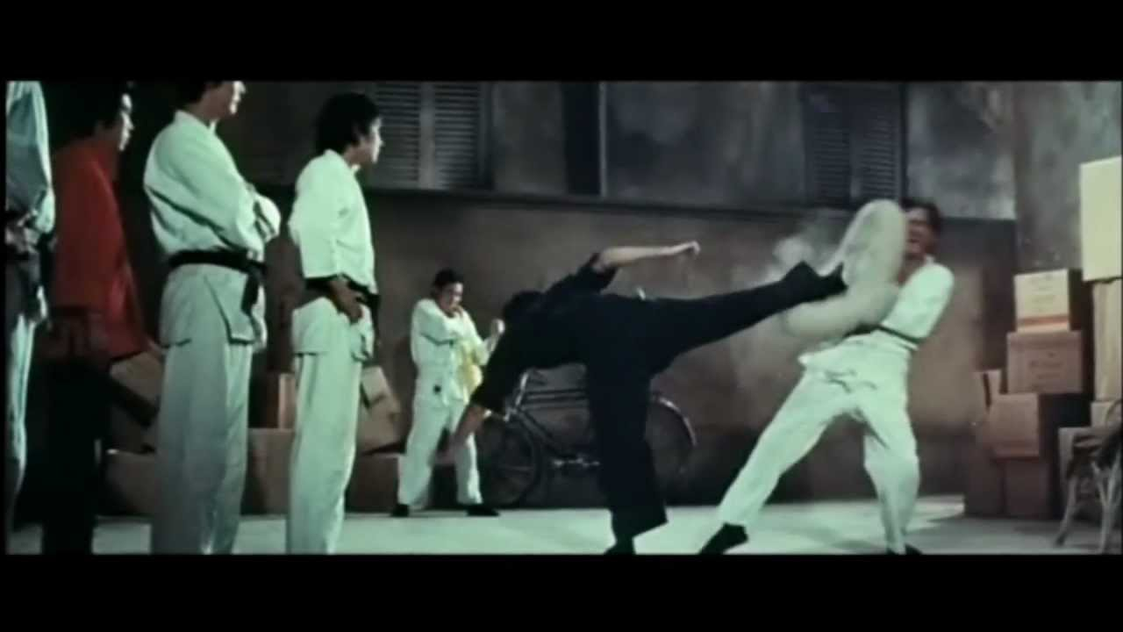

Slide 67
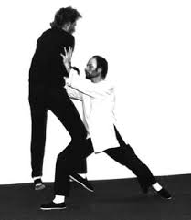
Tai Chi push

Slide 68
Math we can do
Momentum generated by the first attack
Momentum transferred to the target
New force from the second attack added to the already moving target

Slide 69
Conclusion
We have analyzed and explained some martial arts techniques using vectors as the primary tool.
The techniques we analyzed are “two dimensional” in that they pretty much occur in a “plane.”
Three dimensional techniques such as a hook or a roundhouse kick are harder to analyze.
There is a lot of math in the martial arts.

