Slide 1
What’s the BIG deal about BIG DATA?
The rising importance of training new Data Scientists

Slide 2
Outline
What is Big Data and Data Science?
Why should Mathematicians care about these fields?
What can Community College instructors do to train students to enter these fast growing fields?

Slide 3
What is big data?

Slide 4

Notes:
This is *a* Big Data, but not the type we’re concerned with.

Slide 5
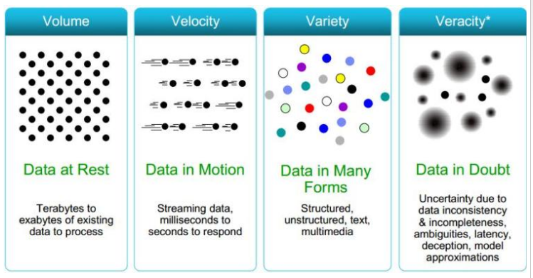
What is Big Data?
“a collection of data sets so large and complex that it becomes difficult to process using on-hand database management tools or traditional data processing applications”
Notes:
Basically if it can fit on your computer and you can analyze it using standard techniques, it’s not Big Data.

Slide 6
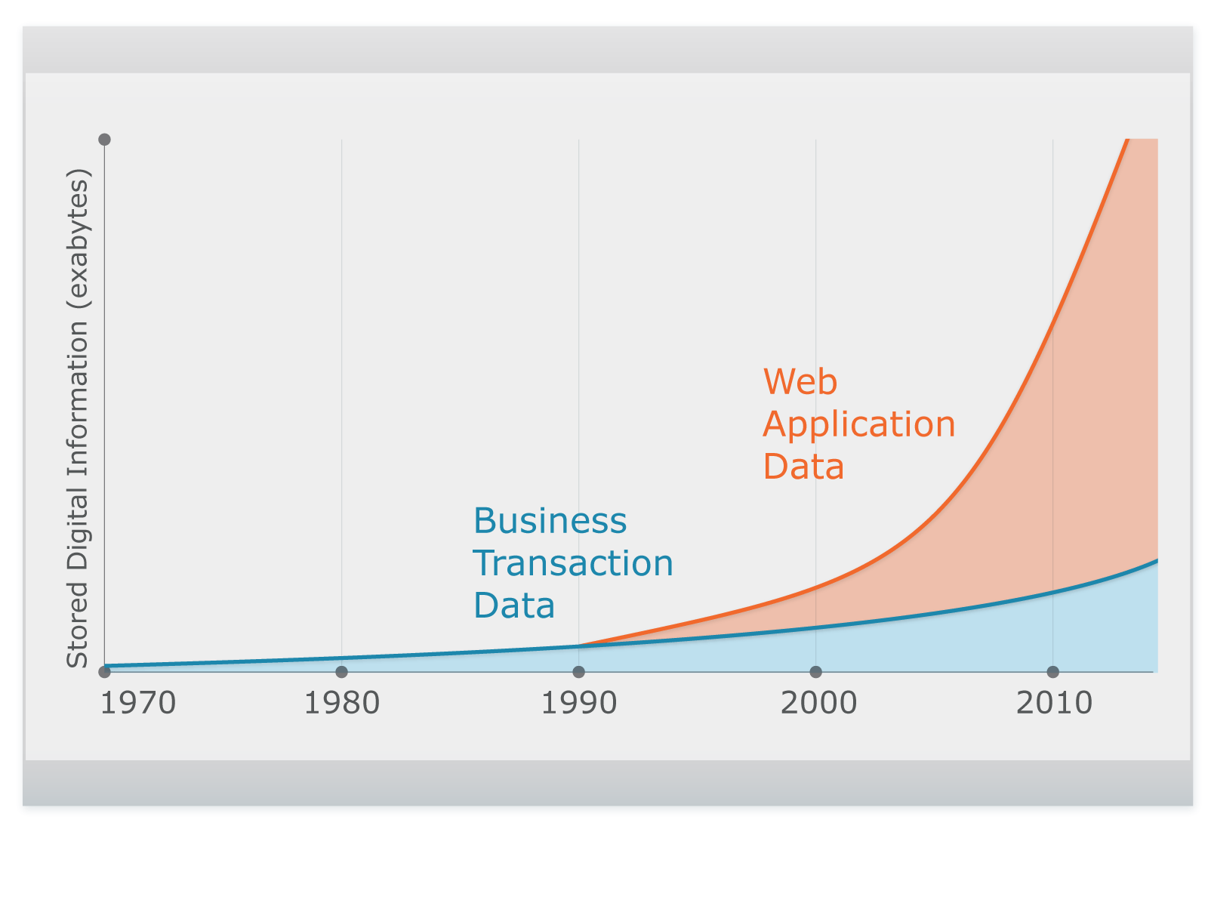
Big is relative to the time
1800- The US Census took 8 years to tabulate
1914 - punch card machines were cutting edge and touted as revolutionary for data processing
1944 – First warning signs of problems with data storage and retrieval (physical libraries)
1980 – “Data expands to fill the space available for storage”
1995 - The World Wide Web Explodes
1999 – Businesses start looking at predictive analyses
2014 – Google has indexed 200Tb worth of data, 0.04% of the total Internet
Notes:
http://www.computerworld.com/article/2942728/big-data/big-data-the-100-year-old-buzzword.html

Slide 7
Collecting data at the speed of the internet
Real time: http://pennystocks.la/internet-in-real-time/
Static: A 30 second snapshot
The amount of data we create is directly proportional the amount we can store, and storage is cheap. 1Tb external HD is ~$50
Notes:
This infographic shows you in real time just how fast data is being collected and transferred.

Slide 8
Who uses Big Data?
Healthcare: Medical conditions, procedures, drugs. Health profiles (individual & community), health care & insurance trends.
Retail: Combine enterprise data with relevant information (twitter, web browsing patterns, movie releases) to create predictive models to determine which games to stock this gift-giving seasons (and in what regions, for what price).
NASA – remote sensing of atmosphere from satellites, analyzing universe
Particle Physics – Large Hadron Collider stored on 83,000 physical disks, 150 million sensors delivering data 40 million times per second.
Bioinformatics – analyzing and correlating genomic and proteomic information.
Climate - Weather forecasting, storm surge forecasting,
Infectious disease - How does changes in climate impact the distribution of diseases like malaria?
Sustainability - Reducing carbon footprint for pharmaceutical companies, increase fuel economy and reduce emissions for Ford vehicles.
Notes:
Big data is so important to retail that in 2009 Netflix offered 1M in prize money to improve the accuracy of their movie preference predictions.
The gist is that Big Data can answer some Big important questions.

Slide 9
Other uses of Big Data
The Best Map Ever Made of America’s Racial Segregation
7Gb of visualization data
Fully interactive
Where do you store it so that it can be shared and used?
Social Analysis
Dogs of LA
Pop vs Soda
Notes:
But more importantly, it can be used for fun stuff.

Slide 10

Analysis Process
Collect data to answer a question about the world
STORAGE
People, Financial, Animals, Weather
Raw Data
Email, web link clicks, medical records, surveys, humidity, mineral content
Data from other sources
US Census, WHO
DISSEMINATION
Data Product
Tables, Traffic maps, Self-driving car, Health care access apps
Communicate Findings
Visualizations, Reports
Back to
Collection
RETRIEVAL
Data Processing
Cleaning, Error handling, merging external data
Impact of Big Data
Back to
Cleaning
ANALYSIS
Statistical Models
& Machine Learning
Classification, Clustering, Spatial, Regression, Bayes, Time Series, Prediction
Useable Data
Text, data matrix, images, video
Exploratory Data Analysis
Notes:
Where are you going to store it?
How are you going to get at it and clean it?
Algorithms that are optimized for a single machine may not be scalable with billions of rows
How are you going to analyze it if it won’t fit on your machine?
Even inverting a 1000x1000 matrix will bog down most computers.

Slide 11
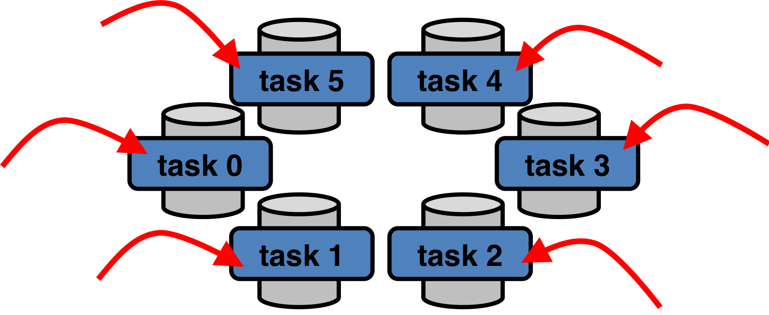
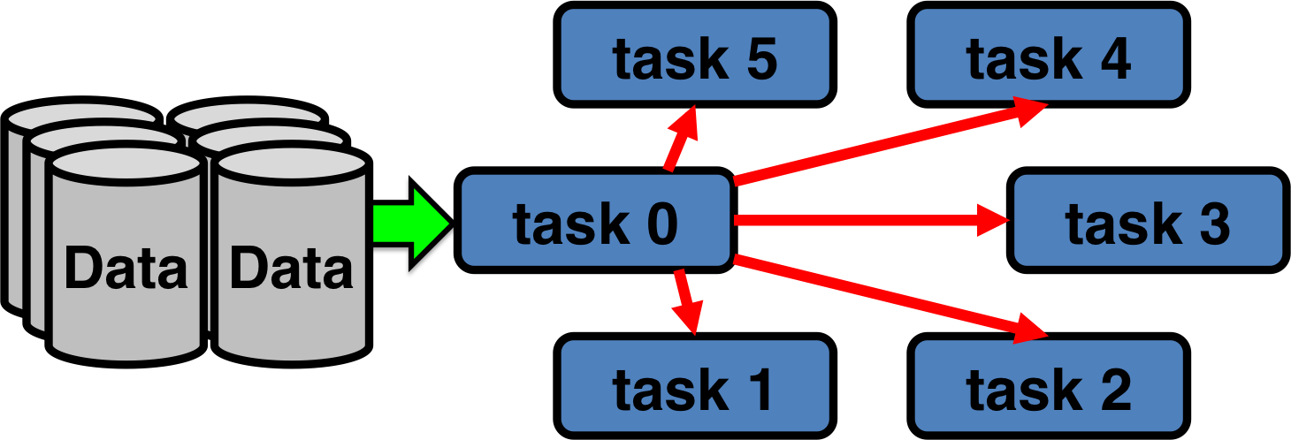
Problem of Volume – storage and retrieval
Traditional parallel computational methods take the data and farm the work out to multiple CPUs
New methods bring the computation to the data, bypassing the bottleneck of data transfer.
http://www.glennklockwood.com/data-intensive/hadoop/overview.html#2-comparing-map-reduce-to-traditional-parallelism
Notes:
Two main

Slide 12
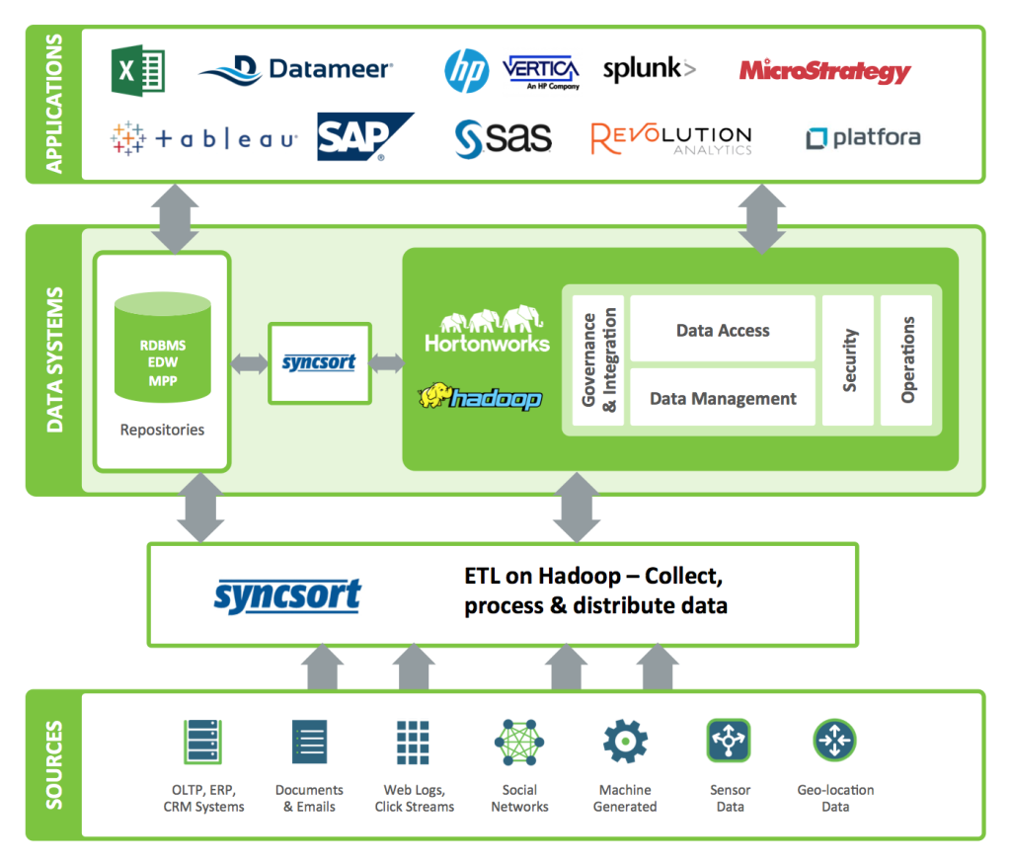
big money in managing big data “Eco systems”
Notes:
Remember, storing and accessing data is only part of the process. Companies, Syncsort being one of them that just had the best graphic (I am not promoting the company), have built ways of removing the end user from the really hard nitty gritty computing aspect of the data.

Slide 13
Some Big data buzzwords
Hadoop / Apache Spark / Map-Reduce: Powerful frameworks for storage, retrieval and analysis.
In memory computing: Dumping all your data into RAM because writing to the disk is slow
Business Intelligence, Business Analytics: Using data to make business decisions.
Data visualization: Because reading raw data is mind numbing and not informative. So draw pretty pictures.
Machine learning: A very large group of algorithms that study pattern recognition to learn from and make predictions on data.
Unstructured data: Text, images, video. Non-rectangular data.

Slide 14
What is Data Science?
Rule #1
about Data Science
Don’t Define Data Science

Slide 15
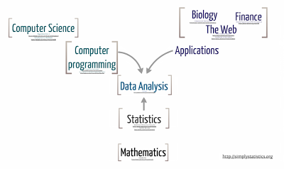
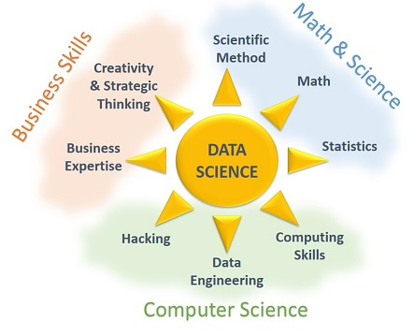
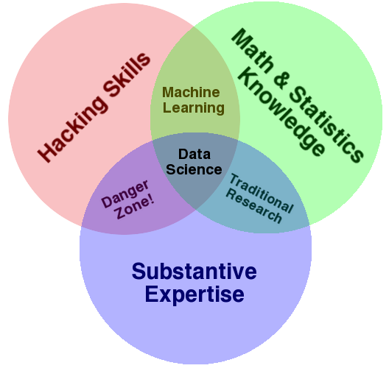
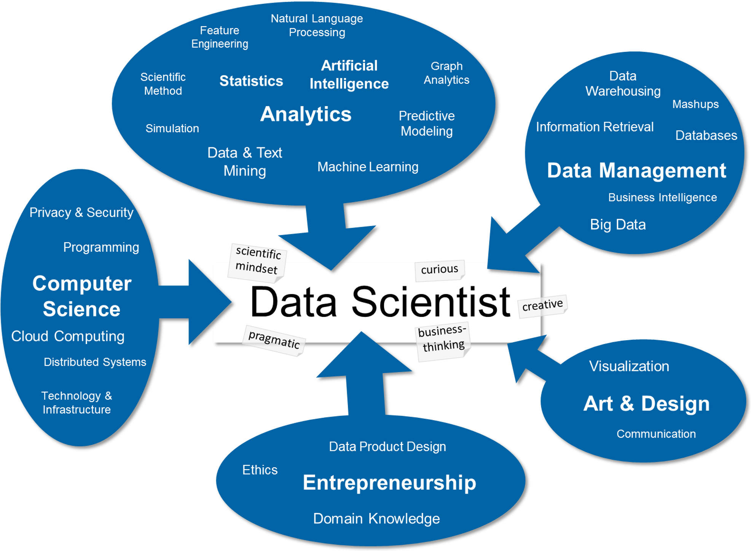
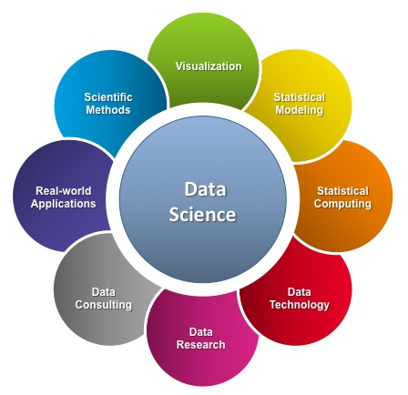
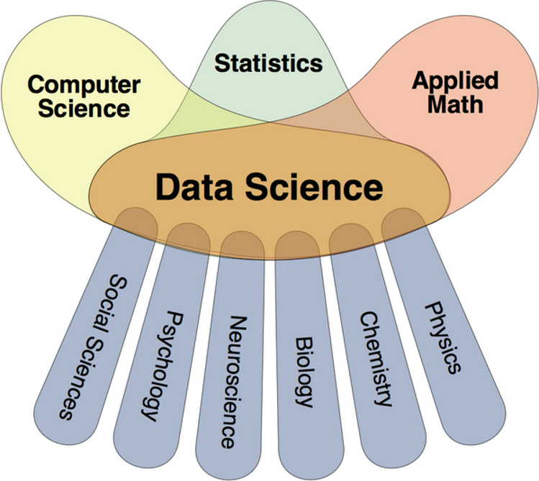
Notes:
A blend of disciplines and the same general feel with different hats.
Josh Willis – a Statistician turned Data Scientist for Cloudera tweeted in 2012 “A person who is better at statistics than any software engineer and better at software engineering than any statistician”.

Slide 16
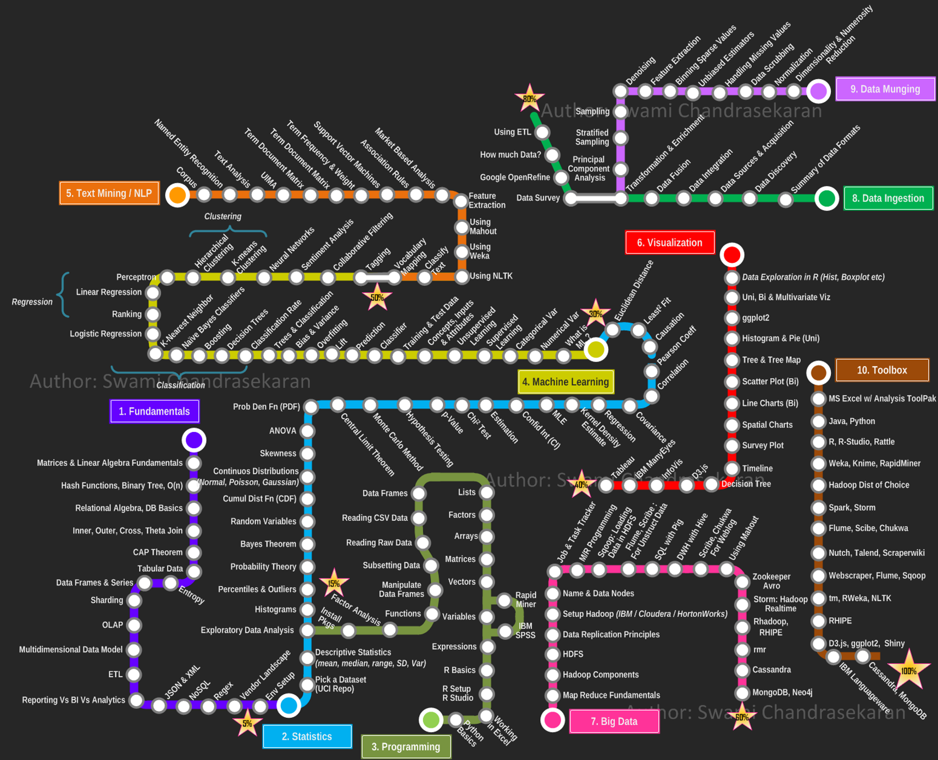
Huge skill profile
Big Data is one small part
Notes:
There are so many skills desired that it’s hard to comprehend.
The top 1 fundamental skill is matricies and linear algebra.
Then comes probability and statistics, then very basic programming.
Big data is only one small part in this whole mess, but it’s what everyone has been focusing on.

Slide 17
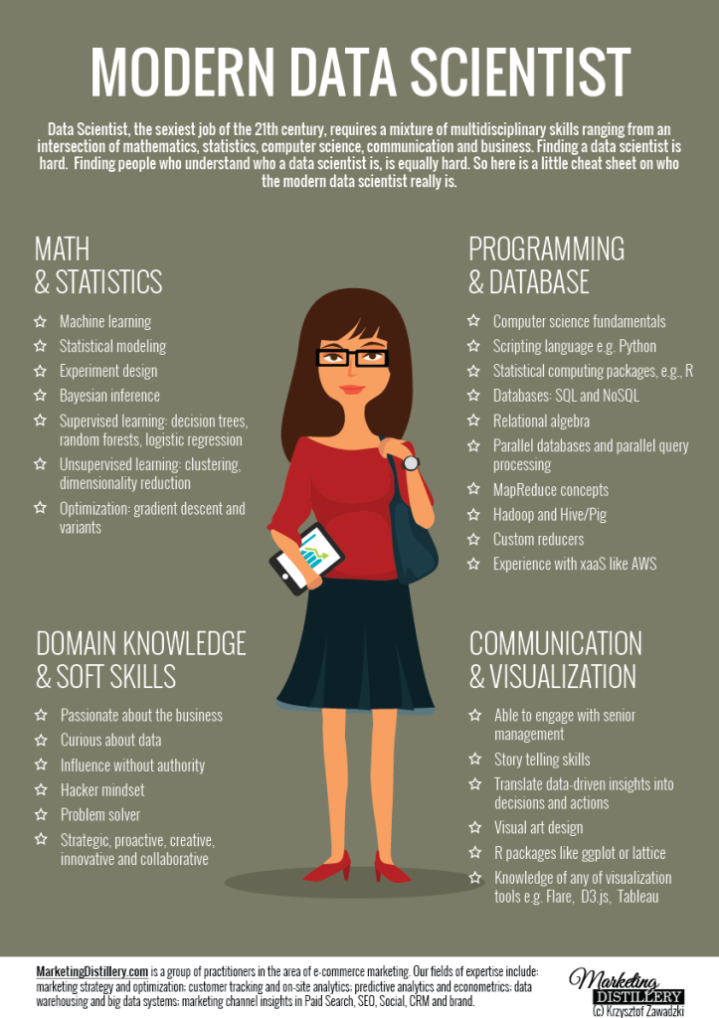
Realistic Skill Profile
People have started acknowledging the overwhelming nature of that skill list, and that it’s unreasonable to find all those skills in a single person.
Data scientist = “Unicorn”
Four foundations
Math & Statistics
Programming & Databases
Domain knowledge & Soft skills
Communication and Visualization

Slide 18
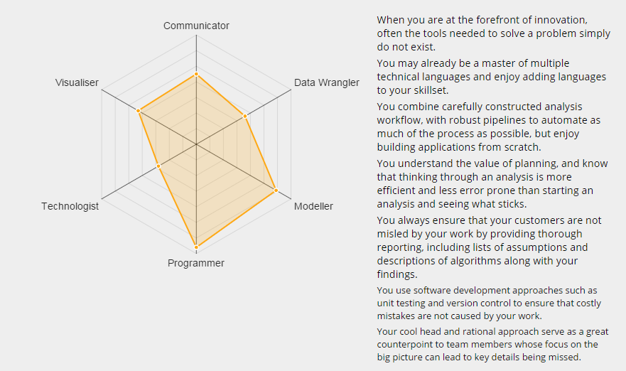
My data science profile
https://www.mango-solutions.com/radar/

Slide 19

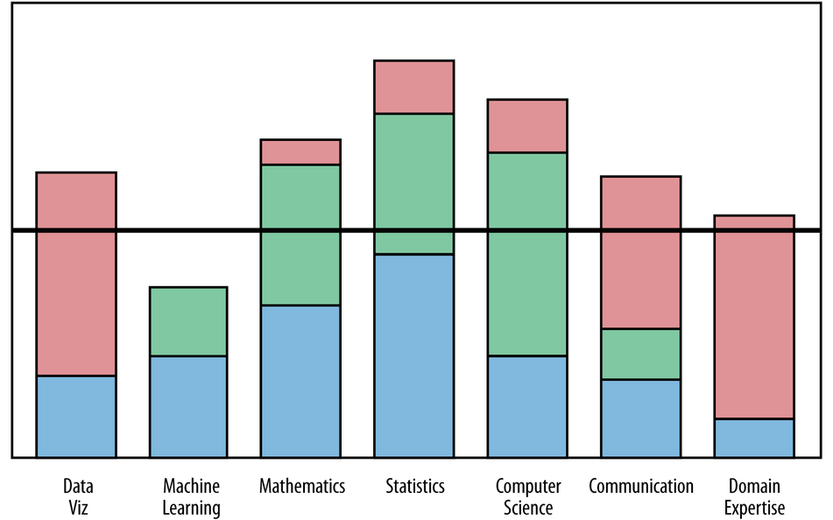
teamwork
Sample skill profile for a team of 3 people
Notes:
But more recently it’s becoming more clear to the general public, that data science requires a team effort. You can’t expect one person to master all those skills.
* Blue person has more math and stat skills, red person has the domain expertise and ability to create visualizations to communicate the results, and the green guy has a good amount of math but is better at computer science than the other two.

Slide 20
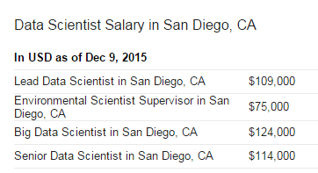
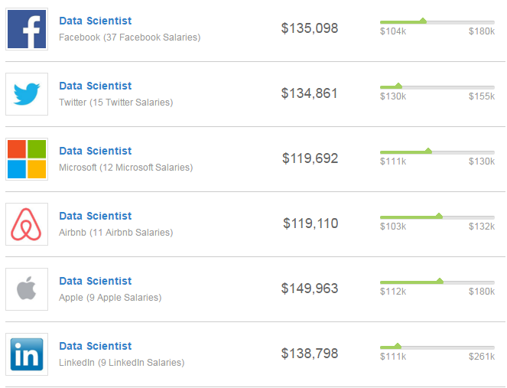
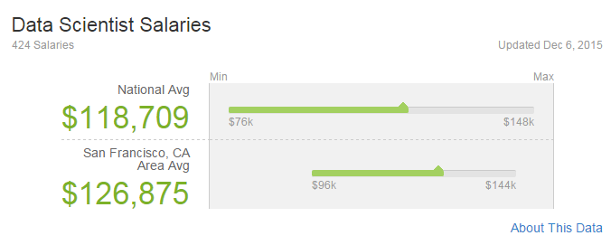
To much to learn! Why bother?

Slide 21
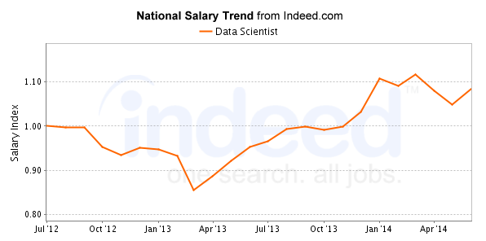
Potential for HUGE Payoff for a combination of Math, Stat, CS

Slide 22
Top 5 “Best” jobs in the past 7 years
Rank | 2009 | 2010 | 2011 | 2012 | 2013 | 2014 | 2015
1 | Mathematician | Actuary | Software Engineer | Software Engineer | Actuary | Mathematician | Actuary
2 | Actuary | Software Engineer | Mathematician | Actuary | Biomedical Engineer | Tenured University Professor | Audiologist
3 | Statistician | Computer Systems Analyst | Actuary | HR Manager | Software Engineer | Statistician | Mathematician
4 | Biologist | Biologist | Statistician | Dental Hygienist | Audiologist | Actuary | Statistician
5 | Software Engineer | Historian | Computer Systems Analyst | Financial Planner | Financial Planner | Audiologist | Biomedical Engineer
 |  | 6 - Mathematician |  | 10 – Mathematician | 18- Mathematician |  | 6- Data Scientist
 |  | 8- Statistician |  | 18- Statistician | 20- Statistician
Notes:
Rated on Environment (like toxic hazards and carpel tunnel), Income (including growth potential), Outlook (employment growth), Stress
http://www.careercast.com/jobs-rated/best-jobs-2015

Slide 23
Mathematics in Data Science aka “When will I ever use this?”
Cryptography & Cyber Security – Number theory, abstract algebra, probability
Mathematical modeling of biological systems - Differential Equations, Topology, Probability
DNA structure Modeling- Geometry, Topology, Linear Algebra, Differential Equations
Network analysis (Social, physical, logistical) - Topology
Spread of Infections Diseases - Network analysis, Probability
Artificial Intelligence – Probability, Logic
Some physical systems behave like random matrices (“Universality”) – Linear Algebra, Probability
Sentiment Analysis (“How do people feel about X?”) - Natural Language processing, machine learning, statistics
NLP –Probability, Statistics, Linear Algebra, Multivariate calculus
Machine Learning – Probability, Statistical Inference, Error estimation, Linear Algebra, Optimization theory
Predictive modeling, forecasting – Statistics, Probability
Calculus – Ability to integrate several smaller, simpler models into a larger picture
Critical Thinking – Finding order amongst the noise
Notes:
“Super coiling parameters [for DNA] can be computed from simultaneously solving algebraic equations”
Creating new encryption methods that don’t rely on prime humbers
Incorporate sea ice behavior into climate change models
Test for osteoporosis by examining pattern of bone density loss
Understanding and predicting the structure of the internet

Slide 24
Mathematics in Data science – sensemaking in High dimension
Supervised clustering methods were used on mRNA expression data have determined breast cancers have several distinct subtypes
Identifying the molecular differences between these subtypes allows for targeted therapies to be developed that could reduce the level of adverse effects that occur with generic therapies
How to comprehend and detect patterns of correlations between hundred of thousands of genes.
This is an easier example to demonstrate because genomic networks are typically matrix like data.
http://www.nature.com/nature/journal/v490/n7418/fig_tab/nature11412_F2.html

Slide 25

Mathematics in Data science– False Significance
Classical Statistics – p-value
As n increases, the p-value decreases
False Discovery rates
Accuracy, model verification and cross-validation
$$P \left(Z> \frac{|\overline{x} −μ_{0}|}{\frac{σ}{√n}} \right)$$

Slide 26
Bandwagon?
Big data technologies and applications are moving at such a rapid pace, what was the “hottest” tech last year is already being phased out for the new “hottest” trends.
Enough buzzword to make your head spin.
Newest version of an old concept.
Aren’t Statisticians Data Scientists? (Identity Crisis, Session at JSM 2015)

Slide 27
Everyone else is doing it…
Graduate programs (200+)
Undergraduate
CSU Chico, UC Davis, Cal Poly SLO (CS/Math minor), CSU Channel Islands (Math minor), USF, The Ohio State, Univ. of Montana (certificate), Winona State …
Community Colleges - certifications
Sinclair Community College (OH) - Data Analytics
Central Piedmont Community College (NC) – Data Management and Analytics
Online certifications
CSU San Jose – post graduate certificate in Business Analytics
CSU Fullerton – post-graduate certificate in Data Science
Johns Hopkins University through Coursera – Data Science Specialization
University of Washington – Online certification in Data Science
Notes:
This isn’t a bandwagon. This is a real

Slide 28
For good reasons!
Truly interdisciplinary science
Break down the “academic silos”. That’s not how the real world works!
Evidence based Interventions – application of do no harm!
Data informed decisions – no excuse for policies and business decisions being made on “gut” feelings or anecdotal data.

Slide 29
Chico State Data Science
4 year BS degree similar to the Statistics Option
Modernizing the Statistics courses to include more computing. (Requiring R)
American Statistical Association’s Revised Guidelines for Undergraduate Education in Statistics (2014)
Core courses in Statistics and Computer Science
Similar / same base set of topics covered as found in other programs
“Third field” emphasis such as Bioinformatics, Computational Mathematics and Business Analytics
Certificate program likely first.
Currently building capacity and demand
Different from the Applied Statistics minor option for non-majors
DRAFT
Notes:
Exploratory data analysis, missing data, web scraping, building an API, Collaborative coding with GitHub, Reproducible research with Markdown, R, python & shell scripting, SQL databases, basic statistics, regression modeling, predictive modeling, modeling diagnostics, machine learning, decision trees, Bayesian statistics, probability models, bootstrapping, k-means clustering, dimension reduction, parallel processing, data visualization by building interactive web-based graphics, and exposure to working with big data on a supercomputer.

Slide 30
Desirable skills for transfer students
Mathematics – with computation experience
Logic, Calculus, Linear Algebra
Statistics & Probability – with computation experience
Data literacy. Ability to think with and talk about data.
Computer Science
At least one programming languages: R, Python, C++, Java
Ability to work at the command line
Databases
Working knowledge of MS Excel – properties of tidy data
SQL, Relational Databases, remote servers

Slide 31
Mathematical Data Science at the Community College level
Getting students introduced to mathematical programming
MatLab/Mathmatica/Maple/Sage for Calculus and Linear Algebra
Increase digital literacy skills and comfort levels with using computers.
Anecdotal data: Apps are decreasing computer literacy.
Statistics
Practice with technical writing. I.e. describe a data distribution or relationship in plain language.
StatCrunch or R for Statistics. Anything but the TI83.

Slide 32
Outreach / Reaching out
Recruit interesting problems and/or data from other departments.
Regularly communicate and request the help of neighboring 4 year universities.
Graduate students as TA’s?
PD opportunities for non-Stat instructors to learn to teach Stat.

Slide 33
Funding opportunities
NSF announces the Community College Innovation Challenge (Sep 2014)
Challenging students enrolled in community colleges to propose innovative science, technology, engineering and mathematics (STEM)-based solutions to perplexing, real-world problems (for cash and prizes)
National Science Foundation (NSF) and the National Institutes of Health (NIH) - Core Techniques and Technologies for Advancing Big Data Science & Engineering
Encouraging research universities to develop interdisciplinary graduate programs to prepare the next generation of data scientists and engineers;
Issuing a $2 million award for a research training group to support training for undergraduates to use graphical and visualization techniques for complex data.
Notes:
You may not often apply for research grants but that doesn’t mean you can’t be a part of it. Work with your local CSU’s and UC’s to write the grants and get their help to provide funding and help to design classes, acquire software or modernize classrooms.

Slide 34
Final thoughts
Very exciting time to be in the STEM field
Computational data analysis and statistics are most interesting when applied to real problems.
Hands on exploratory data analysis in intro statistics fundamental for data literacy
Add computational components into current math and stat classes.
Ability to handle Big Data requires strong foundations in critical and algorithmic thinking
Early and often
Technical certifications are viable options for Community Colleges

Slide 35
Your turn!
What can you do today to increase awareness and interest in Data Science?
What is the current level of computing in mathematics?
If none - What would it take for you to do some?
This is HUGE and probably the best impact you can have.
Collaborative Campus champions?
What did I miss?

Slide 36
