Slide 1
A Cognitive Approach to Learning Order of Operations: Lessons from Language Processing
Richard Ries
College of Redwoods
Ying Lin
Santa Rosa Junior College

Slide 2
Reading and Math Placements in Community Colleges
English | Tot/FY | % placed
CSKLS 312 | 109 | 1.84%
CSKLS 313 | 388 | 6.55%
ENGL 305.1,305X,306X | 656 | 11.07%
ENGL 307,302X,100X | 1140 | 19.23%
ENGL 100 | 1531 | 25.83%
ENGL 1A | 2103 | 35.48%
Total English | 5927
Math Assessment
Math | Tot/Fy | % placed
CSKLS 371 | 1478 | 24.14%
CSKLS 372 | 883 | 14.42%
MATH 151 | 1373 | 22.42%
MATH 101/155 | 987 | 16.12%
MATH 9 | 828 | 13.52%
MATH 25 | 95 | 1.55%
MATH 58 | 199 | 3.25%
MATH 1A | 280 | 4.57%
Math Total | 6123
Reading Assessment
*Data from SRJC FY 2013-2014
Notes:
A large number of students are placed in the bottom left corner (low reading and math skills). On the other hand, we also have seen a fair number of students who are placed in the bottom right: the ones have reasonable reading skills, but have to start from developmental math. Very few students come in with high level of math skills, but poor readers.
I’ve seen similar patterns in previous colleges where I worked, and the same pattern has been observed in the K-12 education literature. Since there are so many different skills required to succeed in mathematics, I wasn’t thinking too much about this until I talked to Richard this summer. What we propose in this study is to focus on the more fundamental level of human cognition – the ability to process symbols and identify structure from them.

Slide 3
Dear John
I want a man who knows what love is all about you are generous kind thoughtful people who are not like you admit to being useless and inferior you have ruined me for other men I yearn for you I have no feelings whatsoever when we’re apart I can be forever happy will you let me be yours Amber

Slide 4
Dear John,
I want a man who knows what love is all about. You are generous, kind, thoughtful. People who are not like you admit to being useless and inferior. You have ruined me for other men. I yearn for you. I have no feelings whatsoever when we’re apart. I can be forever happy -- will you let me be yours?
--Amber

Slide 5
Dear John,
I want a man who knows what love is. All about you are generous, kind, thoughtful, people, who are not like you. Admit to being useless and inferior. You have ruined me. For other men I yearn. For you I have no feelings whatsoever. When we’re apart, I can be forever happy. Will you let me be?
Yours,
Amber

Slide 6
theredonateakettleoftenchips

Slide 7
The red on a teakettle often chips.
There, Don ate a kettle of ten chips.

Slide 8
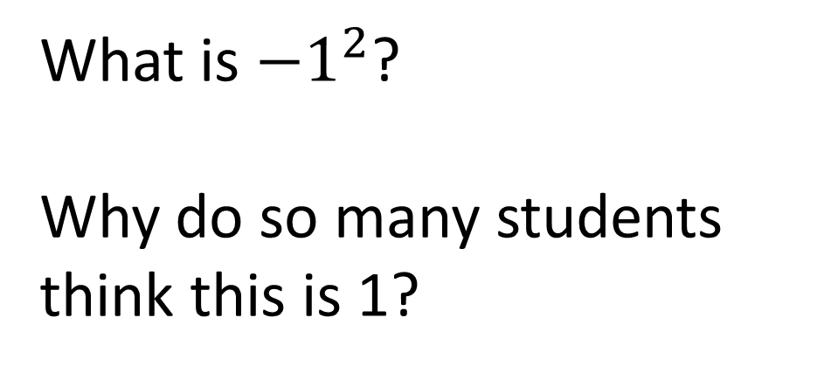
What is ${−1}^{2}$?
Why do so many students think this is 1?

Slide 9
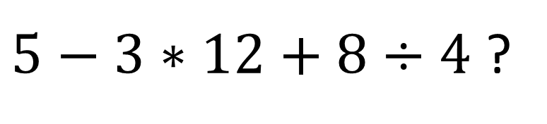
How would we evaluate something like
$5−3∗12+8÷4$ ?
PEMDAS

Slide 10
How would we evaluate something like
$5−3∗12+8÷4$ ?
PMASED
PDASME
SADMEP etc…

Slide 11
Answer the following
What is:
2-1=
4-1=
8-7=
15-12=

Slide 12
Now think of a number between 12 and 5.

Slide 13
Was it 7?

Slide 14
Subtraction mode?
(also known as “priming” in
cognitive psychology)

Slide 15
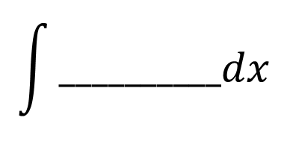
$$\int{__________dx}$$
¿ ________________ ?
ne ____________ pas
In my mind this stimulates two questions.

Slide 16
Q1. What are the psychological/cultural/linguistic factors creating these predispositions?
Q2. What are the frequencies at which various dispositions govern the interpretive order of operations?

Slide 17
Methodology and Subjects
Short quizzes containing the test items (6 each) were administered by instructors
8 Instructors from 3 colleges (Norco, Fullerton, SRJC) participated
Includes nearly 1000 students
Levels include Arithmetic, Pre-algebra, and Elementary Algebra

Slide 18



Test Items: Effect of Size
Facilitative Cues
Obstructive Cues
Experimental
Experimental
Control
Control

Slide 19
Effect of Size
Facilitative Cues
Obstructive Cues
 | Experi. | Control
# Correct | 256 | 169
Sample Size | 447 | 443
% Correct | 57.3% | 38.1%
 | Experi. | Control
# Correct | 133 | 253
Sample Size | 444 | 454
% Correct | 30.0% | 55.7%
P < 0.001
P < 0.001
Notes:
Breaking down the results by ethnicity does not produce any significantly different results.

Slide 20
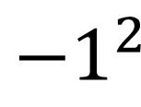
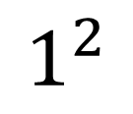
Effect of Length
Test Items
Facilitative Cues
Experimental
$${−1}^{2}$$
 | Experi. | Control
# Correct | 161 | 109
Sample Size | 233 | 227
% Correct | 69.1% | 48.0%
Control
–
$$1^{2}$$
P < 0.001
Notes:
Breaking down the results by ethnicity does not produce any significantly different results.

Slide 21
Effect of Prominence (size, boldness, length combined)
Facilitative Cues
Obstructive Cues
 | Experi. | Control
# Correct | 501 | 322
Sample Size | 784 | 776
% Correct | 63.9% | 41.5%
 | Experi. | Control
# Correct | 168 | 312
Sample Size | 548 | 560
% Correct | 30.7% | 55.7%
P < 0.001
P < 0.001
Notes:
The effect of providing additional cues (both facilitative and obstructive) seem to be consistently around 20-30%. This is striking since different manipulations were used. This means a quarter of our students have some difficulty processing the symbols according to the order of operations.
Breaking down the results by ethnicity does not produce any significantly different results.

Slide 22


Effect of Spacing
Facilitative Cues
Obstructive Cues
$− { 1}^{2}$ v.s. $−1^{2}$
$5+2 × 4$ v.s. $5+2×4$
 | Experi. | Control
# Correct | 294 | 236
Sample Size | 430 | 436
% Correct | 68.4 % | 54.1 %
 | Experi. | Control
# Correct | 129 | 135
Sample Size | 214 | 218
% Correct | 60.3 % | 61.9 %
P < 0.001
P = 0.36
Notes:
Breaking down the results by ethnicity does not produce any significantly different results.
The effect (10%) is smaller than the effect from manipulating prominence (about 20%).

Slide 23
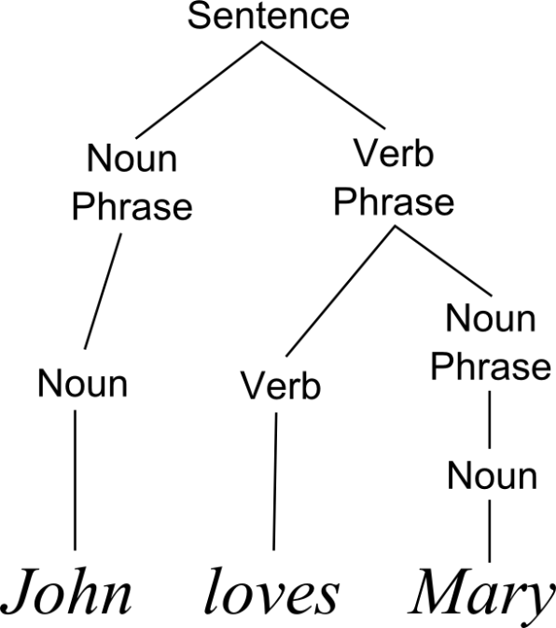
Reading as Sentence Processing
Each language has a grammar that specifies the syntactic structure of any sentence.
Production Rules:
[Sentence] → [Noun Phrase] [Verb Phrase]
[Noun Phrase] → [Noun]
[Noun Phrase] → [Determiner] [Noun]
[Verb Phrase] → [Verb] [Noun Phrase]
[Verb] → loves
[Noun] → John | Mary | dog
[Determiner] → the
Notes:
When we stay the students are making a mistake in the order of operation, what exactly do we mean? I think to understand Richard’s results, we need to dig a little deeper into what linguistics says about the process of reading a sentence.
Terminals are words in the language, non-terminals are what form grammatical categories in the grammar.
Production / rewrite rules are unordered. (there may be hundred of thousands in English) The vertical bars represent disjunction.
Show the production of this sentence as well as the bracketing showing the consitutuents.
Production versus reading/parsing. Sentences like “Mary loves the dog.” is grammatical while “John the dog” is not. Show how parse trees are constructed for “Mary loves the dog” (emphasize grouping)

Slide 24



Parsing Algebraic Expressions
A grammar that deals with the correct order of operations
[Expression] → [Expression] $+$ [Term]
[Expression] → [Expression] $−$ [Term]
[Expression] → [Term]
[Term] → [Term] $÷$ [Factor]
[Term] → [Term] $×$ [Factor]
[Term] → [Factor]
[Factor] → 1 | 2 | … | 9
[Factor] → ( [Expression] )
Expression
Expression
$$−$$
Term
Term
Term
$$÷$$
Factor
Factor
Factor
3
9
6
Notes:
Compared with English grammar, which can produce ambiguous sentences, the grammar for algebra is much more precise. There is no ambiguity if you use this set of rules.
We do teach students the difference between term and factors, but we’ve never shown them the grammar, or the structure specified by the grammar.
The rules are unordered. The use of non-terminal categories ensures the correct order of operation as specified by PEMDAS. Notice this set of rules has the correct associative order from the left to right.
Show it’s impossible to create the wrong order of operation based on this grammar by using 9*6/3
When students make a mistake in the order, the deeper issue is that they are not building the correct structure from the grammar.

Slide 25

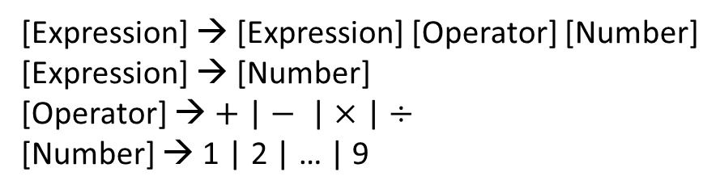
Parsing Algebraic Expressions
An “intuitive” grammar that produces ambiguous parses for $9−6÷3$
[Expression] → [Expression] [Operator] [Number]
[Expression] → [Number]
[Operator] → $+$ | $−$ | $×$ | $÷$
[Number] → 1 | 2 | … | 9
Notes:
Show it’s impossible to create the wrong order of operation based on this grammar.
When students make a mistake in the order, the deeper issue is that they are not building the correct structure from the grammar. Students generally know expressions, operators and numbers, but they are unclear about the role of terms and factors. So their intuitive grammar may look like the following.
Show that the incorrect use of PEMDAS corresponds to a parse tree that is not grammatical: 5 + 6 – 3

Slide 26
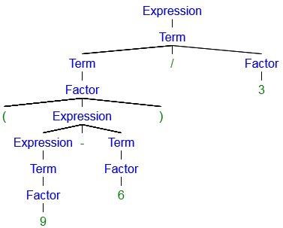
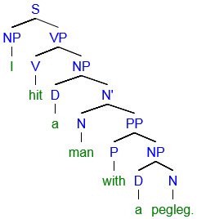
Are the trees real?
We don’t know. But there is plenty of evidence that people group the words first.

Slide 27
Psycholinguistic Research on Reading (Bever, 1992)
A strategy of chunking sentences into phrase units with these cues could be very effective, based purely on memorized features and not on meaning.
The same sentence will be easier to read if formatted as:
A strategy of chunking sentences
into phrase units with these cues
could be very effective
based purely on memorized features
and not on meaning.
Notes:
Psycholinguistics covers several domains related to language, but here we’re most interested in the early stages of comprehension: how sentences are first grouped into chunks

Slide 28
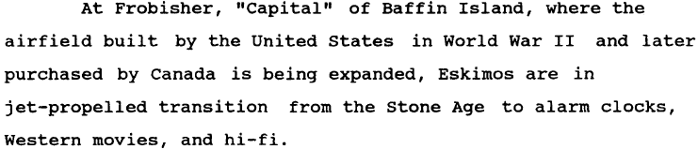
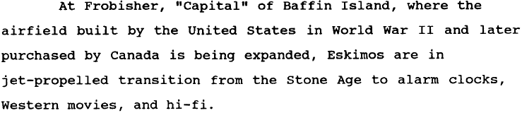
How spacing affects reading text
Phrase-spaced:
Even-spaced:
Notes:
Spend a few minutes contrasting the spacing between the two spacing strategies, focusing on the boundaries indicated by the function words.

Slide 29

Main findings regarding Effect of Spacing
Cromer (1970): people with good vocabulary and reading disabilities benefit from extra spacing that shows the correct grouping of words.
Bever (1991, 1992): Formatting the text with spacing cues improves the comprehension of average readers, but no effect on advanced readers.

Slide 30
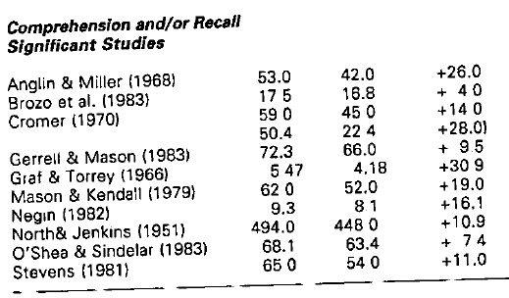
Summary of Effect of Phrase-based Spacing
Phrase-spaced Control Difference

Slide 31
Summary and Interpretation of Our Results
Dev Ed students’ grouping strategies for algebraic expressions is impacted by presence of cues in the stimuli
Such influence parallels the reading research in the past 40+ years
Reading and mathematics likely share a deep common mechanism for processing strings of symbols

Slide 32
Implications for the Classroom
Should formatting be used to facilitate the learning of order of operations?
Esp. for students who are good readers but have genuinely difficulty in reading algebraic expressions
Should we be teaching grouping strategies/trees in addition to PEMDAS?
Notes:
Say something about the parentheses

Slide 33
Future Explorations
New task / design
Measuring speed as well as accuracy.
Within-subject design to minimize the effect of test items
Automatic formatting of teaching materials
Using eye-tracking to identify the rapid eye movements during reading algebraic expressions
Notes:
Writing with facilitative spacing? Formatting your handouts? Special software for type-setting?

Slide 34
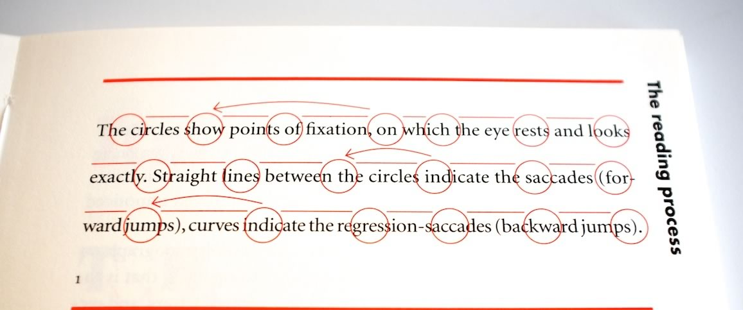
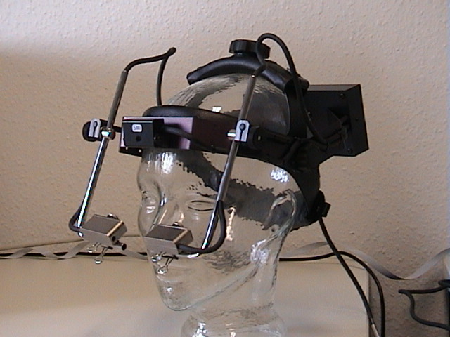
Eye Movement Patterns During Reading

Slide 35
References
Bever, T. G., Jandreau, S., Burwell, R. , Kaplan, R., & Zaenan, A. (1991). Spacing printed text to isolate major phrases improves readability. Visible Language, 25, 74–87.
Cromer, W. (1970). The Difference Model: A New Explanation of Some Reading Difficulties. Journal of Educational Psychology, 61
Jandreau, S., & Bever, T. G. (1992). Phrase-spaced formats improve comprehension in average readers. Journal of Applied Psychology, 77, 143–146.
MacGregor, M. & Price, E (1999). An Exploration of Aspects of Language Proficiency and Algebra Learning. Journal for Research in Mathematics Education, 30.4.
Shattuck-Hufnagel, S., & Turk, A. E. (1996). A prosody tutorial for investigators of auditory sentence processing. Journal of Psycholinguistic Research, 25(2),

Slide 36
Acknowledge
Assistance with data collection:
Norco College: Debbie Smith, Joseph DeGuzman, Steven Park, Andy Robles
Fullerton College: Mareike Claasen
SRJC: Carlos Valencia, Amy Flores

Slide 37
Richard.S.Ries@gmail.com
Or
ylin@santarosa.edu

Slide 38
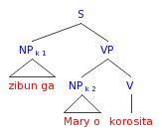
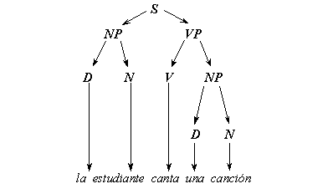
Arguments for Linguistic Structure
1) Colorless green ideas sleep furiously
2) Furiously sleep ideas green colorless.

Slide 39
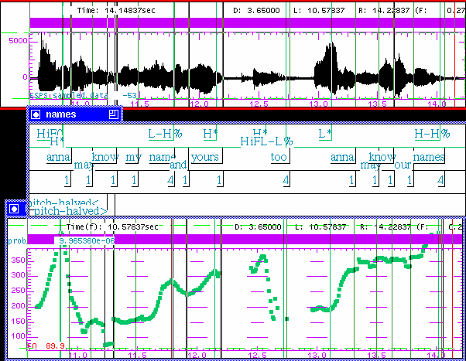
Acoustic Cues for Sentence Processing
Notes:
The use of pitch change (tone), amplitude and duration are analogous to the use of size, bolding, and length in Richard’s results and is well-documented in the spoken language processing literature.

