Slide 1
MATHEMATICS The Instrument of Science
Michael Greenwich

Slide 2
Confucius said, “Math is the language of science.”
I say, “Math is more than just the language of science.”
Mathematics useful and powerful
Fact: Math is a whole subject by itself. It is beautiful, useful & powerful.

Slide 3
This presentation has
Mathematics (Statistics)
Science (Biology) - Scorpions

Slide 4



Slide 5
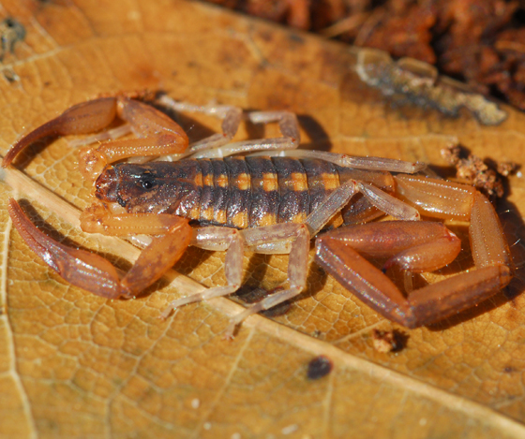
Striped bark scorpions (Centruroides Hentzi)
http://bugguide.net/node/view/246266

Slide 6
Biological (Scientific) facts
Scorpions are cold-blooded creatures.
No internal, biological temperature control.
Their body temperatures determined by the external temperature (surrounding medium - air temperature).

Slide 7
Biological (Scientific) Questions
Does a scorpion select preferable external temperature?
One thermal preference zone
Does scorpions randomly select external temperature?
No thermal preference zone – uniformly scattered

Slide 8
Biological (Scientific) Experiment
One scorpion put in a large tube from 5º to 65º.
After settled in, take the body temperature.
31 scorpions = 31 body temperatures.

Slide 9
Body Temperature Data

Slide 10
Biological (Scientific) Data
Biological property (body heat) is numerically measured and expressed with a number.
The interval scale.
Still, math is the language of science.

Slide 11
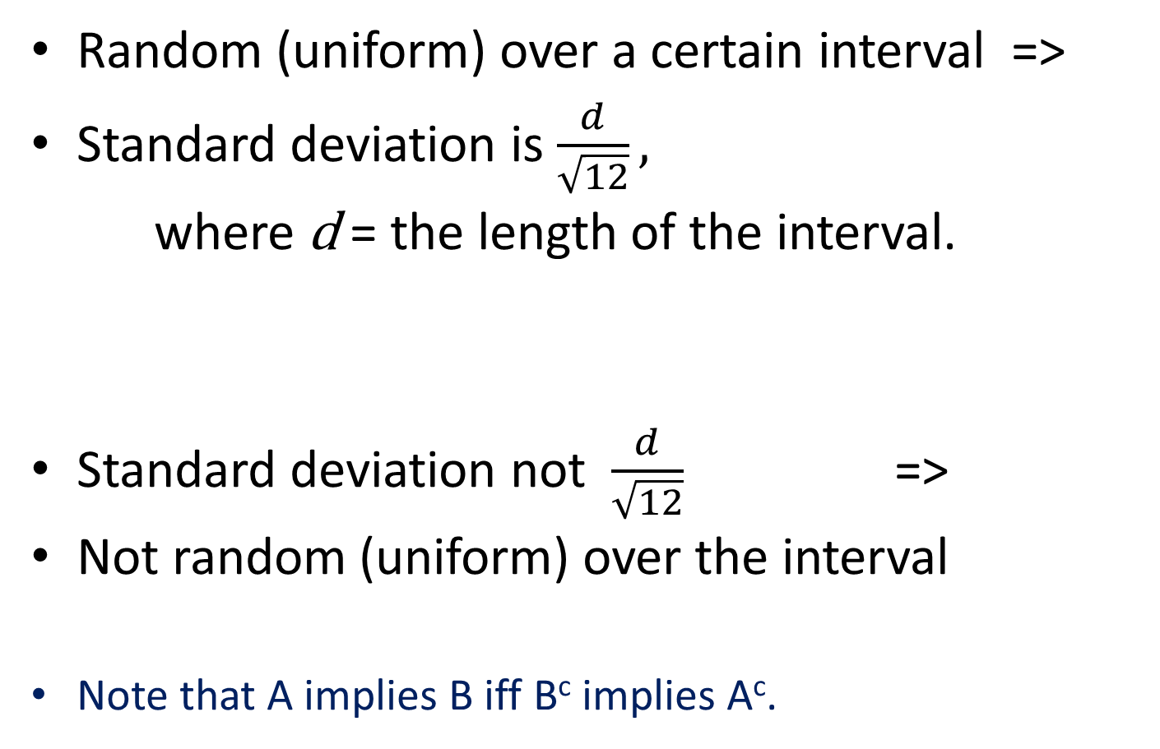
Logic (Mathematics)
Random (uniform) over a certain interval =>
Standard deviation is $\frac{d}{\sqrt{12}},$
where d = the length of the interval.
Standard deviation not $\frac{d}{\sqrt{12}}$ =>
Not random (uniform) over the interval
Note that A implies B iff B^{c} implies A^{c}.

Slide 12
Biology (Science) Questions
The interval is [5, 65]. So, d = 60 (by 65 - 5).
Do scorpions randomly select external temperature over [5, 65]?
Do scorpions select a preferable external temperature over [5, 65]? (a preference zone)

Slide 13
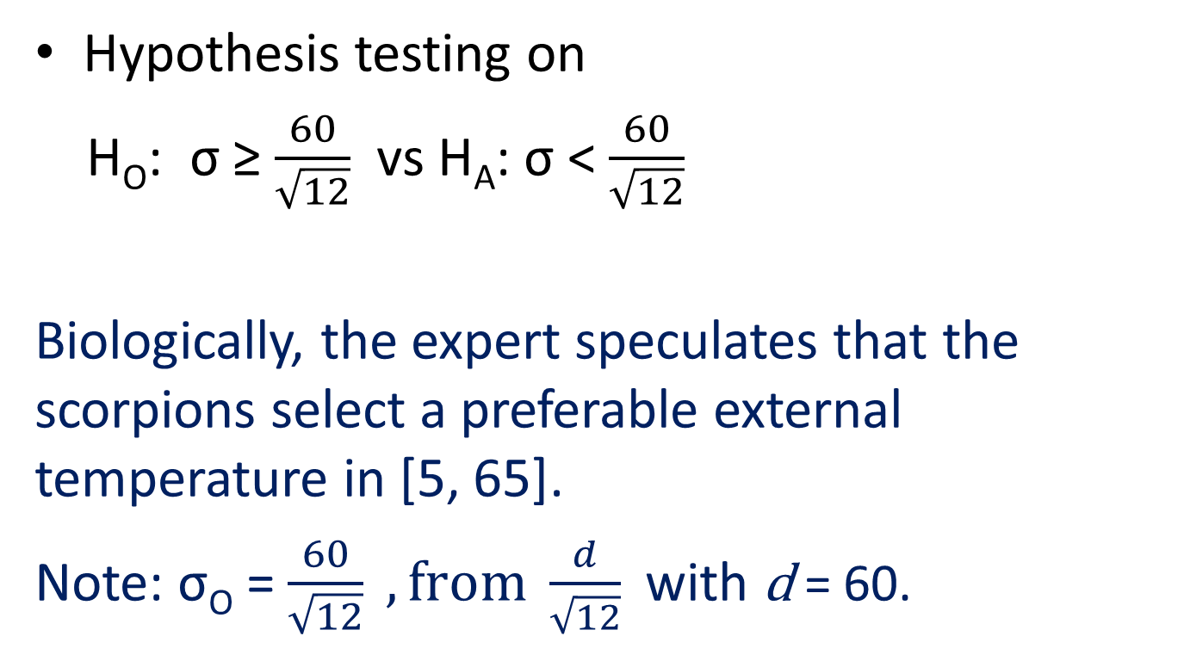
Statistics (Mathematics)
Hypothesis testing on
H_{O}: σ ≥ $\frac{60}{\sqrt{12}}$ vs H_{A}: σ < $\frac{60}{\sqrt{12}}$
Biologically, the expert speculates that the scorpions select a preferable external temperature in [5, 65].
Note: σ_{O} = $\frac{60}{\sqrt{12}} , from \frac{d}{\sqrt{12}}$ with d = 60.

Slide 14
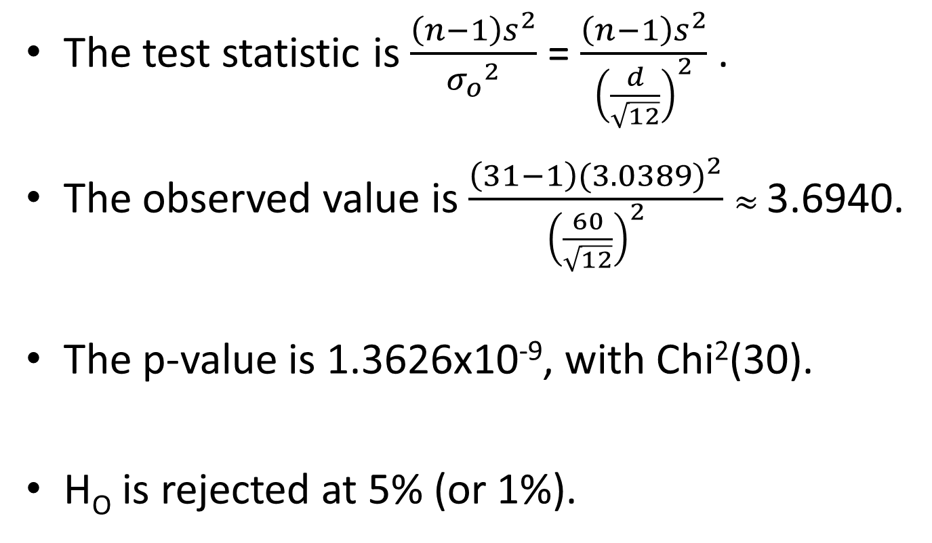
Statistics (Mathematics)
The test statistic is $\frac{\left(n−1\right)s^{2}}{{σ_{o}}^{2}}$ = $\frac{\left(n−1\right)s^{2}}{{\left(\frac{d}{\sqrt{12}}\right)}^{2}}$ .
The observed value is $\frac{\left(31−1\right){(3.0389)}^{2}}{{\left(\frac{60}{\sqrt{12}}\right)}^{2}}$ $≈$ 3.6940.
The p-value is 1.3626x10⁻⁹, with Chi²(30).
H_{O} is rejected at 5% (or 1%).

Slide 15
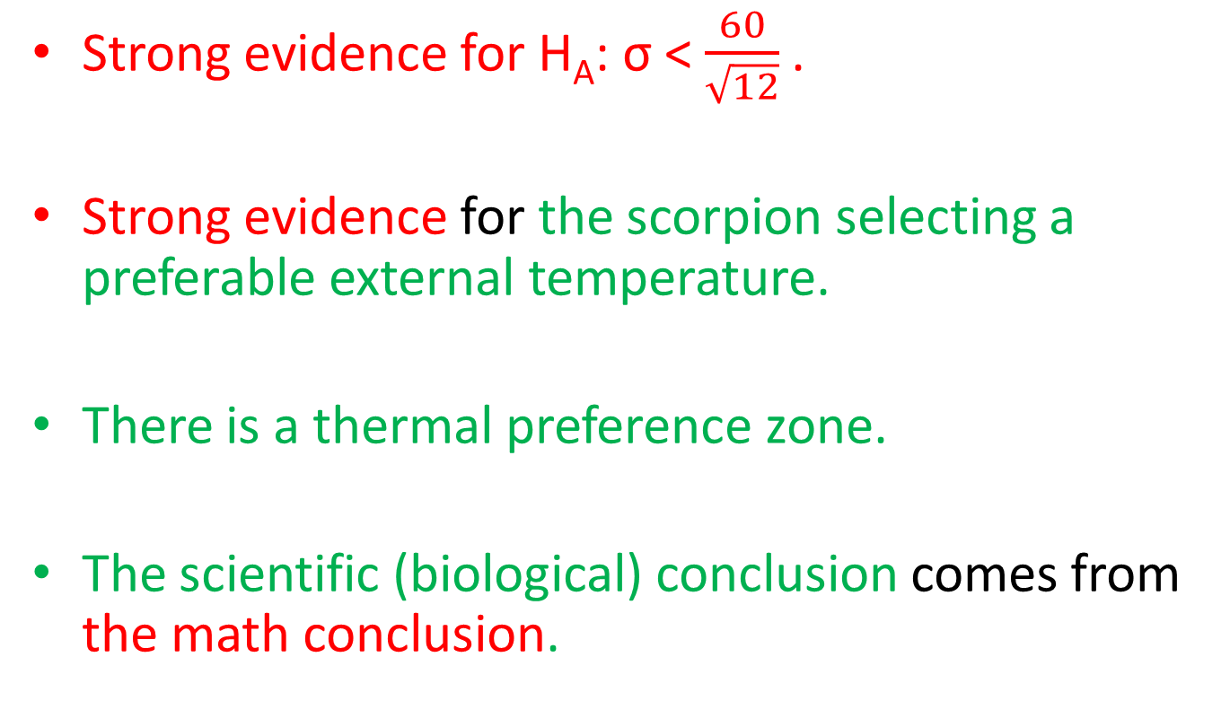
Math & Science Conclusions
Strong evidence for H_{A}: σ < $\frac{60}{\sqrt{12}}$.
Strong evidence for the scorpion selecting a preferable external temperature.
There is a thermal preference zone.
The scientific (biological) conclusion comes from the math conclusion.

Slide 16
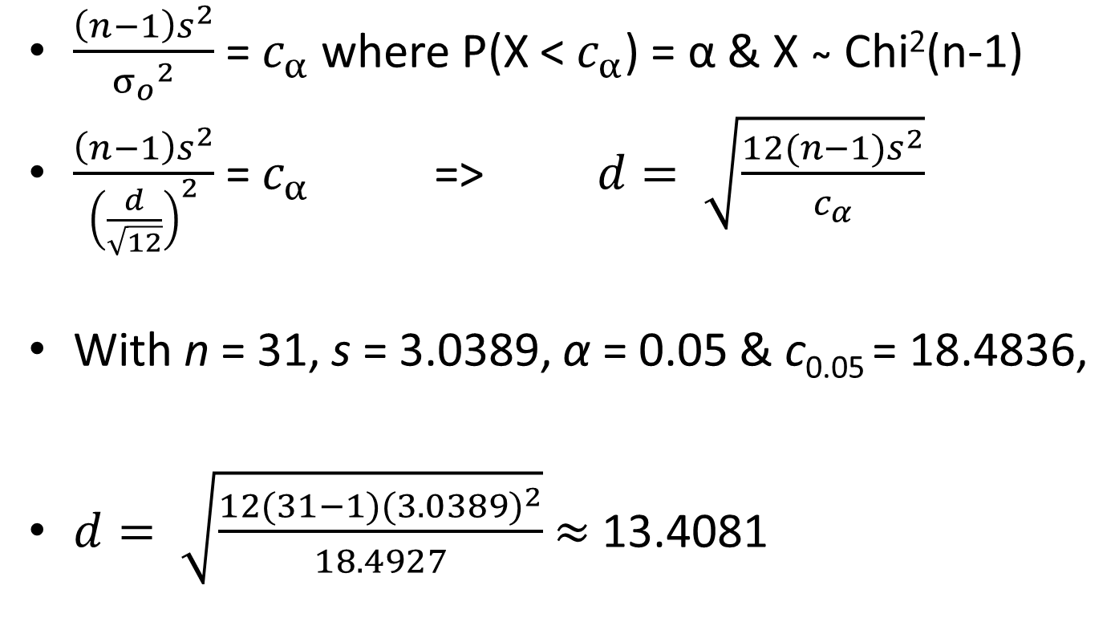
Estimation of Thermal Preference Zone
$\frac{\left(n−1\right)s^{2}}{{σ_{o}}^{2}}$ = $c_{α}$ where P(X < $c_{α}$) = α & X ̴ Chi²(n-1)
$\frac{\left(n−1\right)s^{2}}{{\left(\frac{d}{\sqrt{12}}\right)}^{2}}$ = $c_{α}$ => $d= \sqrt{\frac{12(n−1)s^{2}}{c_{α}}}$
With n = 31, s = 3.0389, α = 0.05 & c_{0.05} = 18.4836,
$d= \sqrt{\frac{12(31−1){(3.0389)}^{2}}{18.4927}}$ $≈$ 13.4081

Slide 17
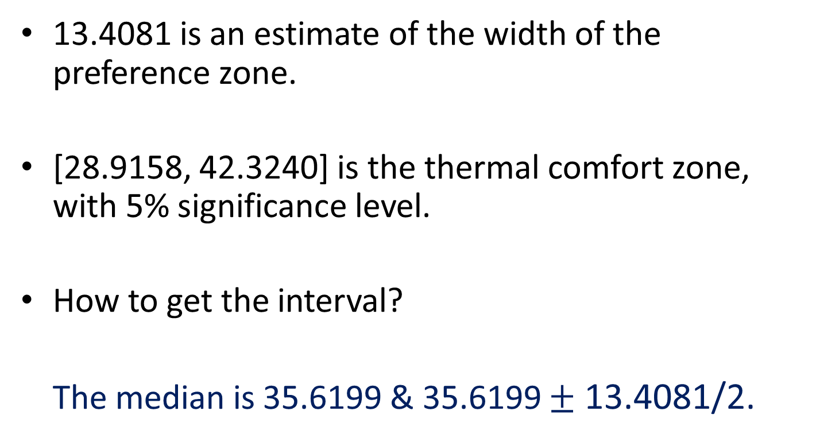
Thermal Comfort Zone
13.4081 is an estimate of the width of the preference zone.
[28.9158, 42.3240] is the thermal comfort zone, with 5% significance level.
How to get the interval?
The median is 35.6199 & 35.6199 $±$ 13.4081/2.

Slide 18
Notes & Comments
The comforter zone is different from other intervals (such as six-σ intervals or 95% intervals).
It is the only interval where scorpions tend to move to.
Scorpions tend to be found in a certain area does not imply they tend to move there.
The height of the density function, not the probability.

Slide 19
Math & Science
Math is the necessary instrument of science.
A lot more than just language of science.
Any subject without math is not a science.
Math can exist without science.
Science cannot exist without math. (at least, not in the current form)
Math is beautiful and powerful. (more than just useful)

Slide 20


