Slide 1
TIME to USE Software . . .
. . . meaning, what?

Slide 2
TIME…
the talk is about
Software for doing graphics, calculations, dynamic investigations and simulation
Includes a discussion of applets, statistical packages designed for teaching, and statistical packages designed primarily for doing statistics.
The argument is that the benefits are great for good stat teaching, and the barriers lower than one would think, or at least different than one would think. . .
So, go for it!
Also, briefly Excel and R
But not: On-line HW systems, or course management systems

Slide 3
TIME…
What does using software mean?
Students as well as instructors using technology
Primarily thinking of software other than graphing calculators – but will consider that too
Using software as an integrated part of the course
Next Steps
First: some background for using software,
Then some examples of various software options . . .not nearly all.
End with what may be some general questions about whether feasible: cost, resources needed, how software fits in with what else is done.

Slide 4
TIME…
Background: Negative side
Software packages not extensively used in community college teaching.
High cost of software one reason
Instructors not familiar with the software, but are familiar with graphing calculators
Argument here is that it is time to use some kind of software.
Need to consider the choices available, and the implications of the choices.
Not pushing for any one choice, and
Also, not a complete list, but perhaps can serve as a template.

Slide 5
TIME…
Background: Positive side
Students can do it
Dynamic and repetitive!
An example showing some of the issues involved. GeoGebra Distribution Calculator
Notes:
Also do Fathom and StatCrunch or JMP simulation

Slide 6
Distribution Calculator Example: Questions Raised
How does the use of the Distribution Calculator fit in with what we have been doing?
How do we exploit the connection between the “immediate calculation” and the graphics?
Is it important to see that probabilities are represented by areas?
But that is just one example; back off a bit before attacking the larger question of software choices.

Slide 7
TIME…
Background to using software
Students can do it
Dynamic and repetitive!
Students can do statistics
Students can do statistics?
The big stories of our course:
Helped by an idea of Chris Wild’s:

Slide 9
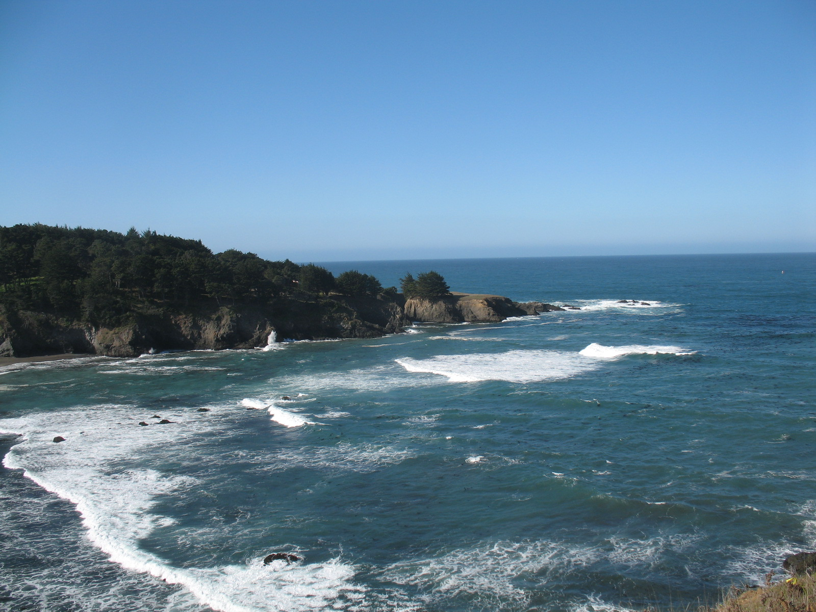
We really do want to see.
We want to answer questions using data
The two big stories are:
We want to understand using data
We see through a glass darkly
An Example of data, and an exercise
Census @ School data for New Zealand and Australia

Slide 10
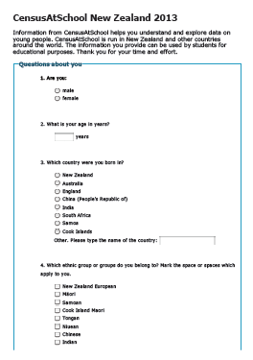
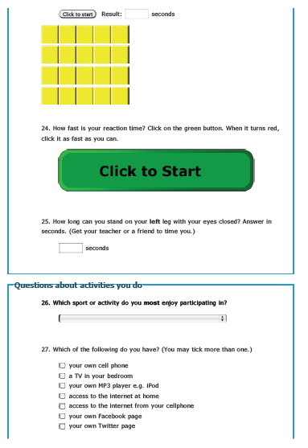

Slide 11
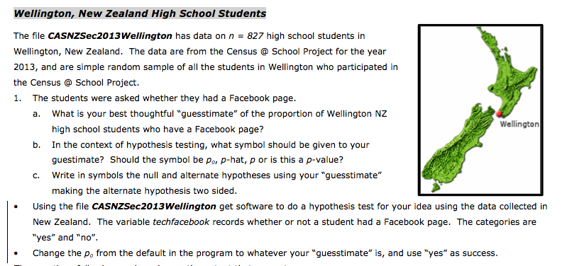
Answering questions example

Slide 12
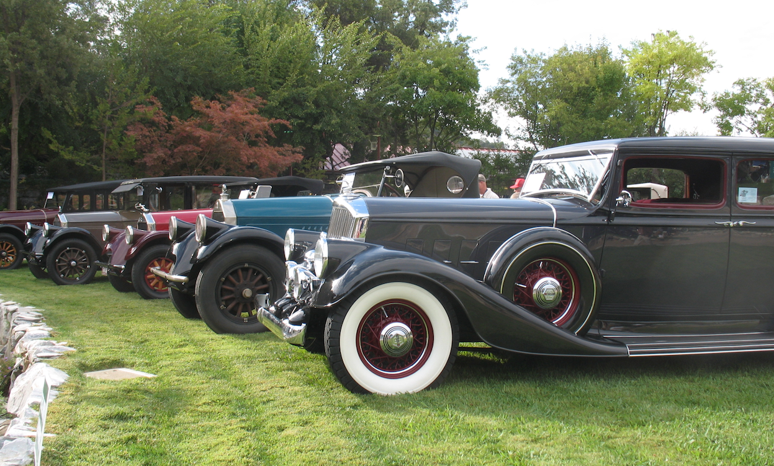
Choices (with examples)
• Applets
Rossman Chance
StatKey (Lock^5)
• Statistical packages for teaching
Fathom
StatCrunch
• Mainstream statistical packages
JMP
Minitab

Slide 13
Choices
Other options? . . . Only Pierce-Arrows? No, there are other options

Slide 14
Excel?
Story time.
Pros:
Widely used, familiar
Useful skills
Can be done: the resources may be there
Cons:
Clumsy compared with even mainstream packages
Not Mac friendly, and ~ 40% of students run Macs.
Conclusion: Not a good choice, in general, IMHO

Slide 15
R?
Pros:
Open Source
Useful coding skills
Works on all platforms
Used by statisticians
Cons:
Steep learning curve
Not designed for teaching, but
See:
Kaplan, Horton and Pruim: Start Teaching with R. Project Mosaic.
Verzani: Using R for Introductory Statistics, Second Edition. Chapman and Hall, 2014

Slide 16
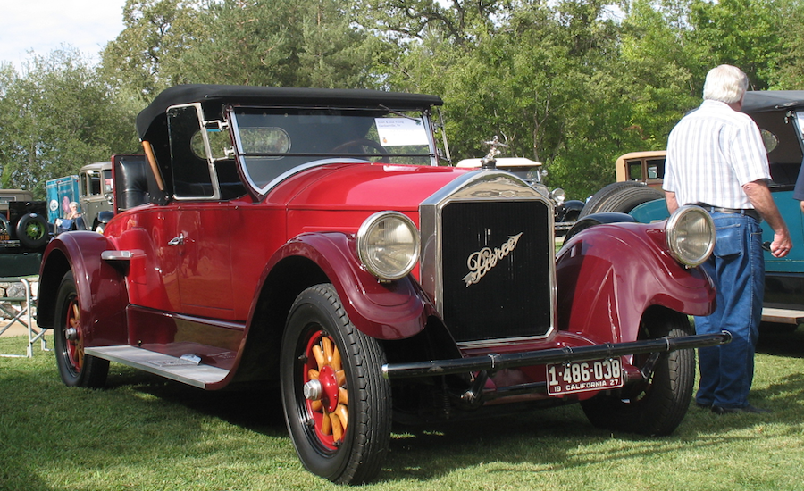
Choices: Internet or on Computer?
• Advantages of Internet based software:
• Internet everywhere? Always available? Many windows open?
• Some packages (e.g. StatCrunch) work on mobile devices.
• Internet based makes the maintenance of the application easier?
• Advantages of having the program on the computer:
• Always there.
• Usually means
that bigger data files
can be used.

Slide 17
Cost and Availability?
All of the examples listed are at a cost for the student for a semester of less than $30 – usually less than $20, often free.
LEARNING THE SOFTWARE?
Some take more time to learn, but some are very simple.
CHANGES IN HOW THE COURSE IS TAUGHT?
Yes, and should be.
Emphasizes discovery, and answering questions with data – therefore interpretation in context --- and not successfully getting the correct answer through calculation.
Use teaching materials that are coordinated with using software.

Slide 18
Need a Computer Lab/Classroom?
A dedicated computer lab/classroom is helpful, but perhaps not necessary.
Much depends on how the class time is run: is the class time devoted to lectures, or to hands-on work? Is the course run “partially flipped” or a traditional “lecture followed by HW”
But. . .
Can have some time in a shared computer lab.
Opinion: it is better not to have a computer for every student.
Perhaps we are getting close to the time when we can depend upon having enough students with laptops. Any experience?

Slide 19
Projects?
• Many different options for doing projects, and
• Labor intensive (Makes life harder for everyone)
• But, using a software package makes a project more feasible.
• And worth it: it is an alternative assessment tool to timed tests, brings things together.
• How to do projects is a another talk – but software helps.
TESTING?
• Software usage need not be tested directly; software is a tool to attain other goals, and not the goal of the course.
• Indirectly tested through projects.

Slide 20
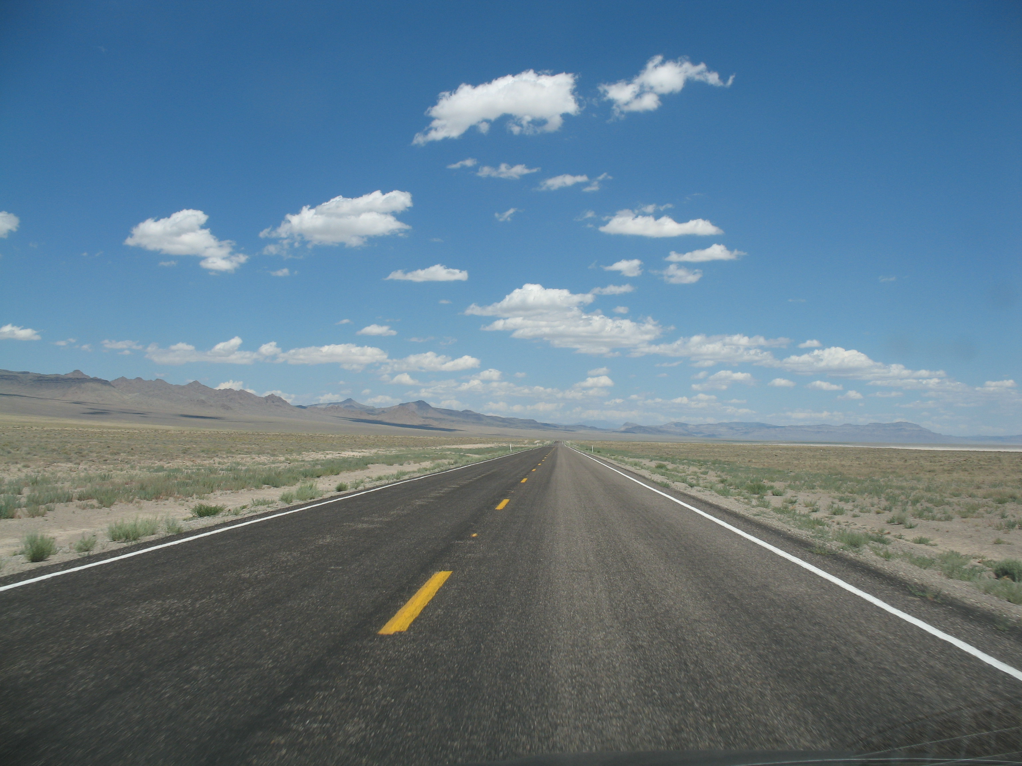
Conclusion
Argument has been:
• It is worthwhile having students use software beyond graphing calculators
• Involves doing statistics: answering statistical questions, while confronting looking through the glass with ripples.
• But, using software may imply changes in the overall way we do things.
• Hope that the specific of various packages has been helpful.

Slide 21
Questions?

