Slide 1
Randomness

Slide 2
Randomness
In Theory and Practice
Alon Amit
CMC3 Conference
Monterey, Dec 2014

Slide 3
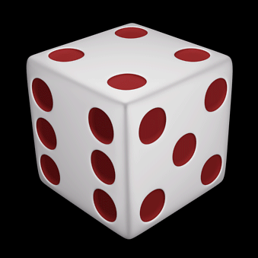
Randomness

Slide 4
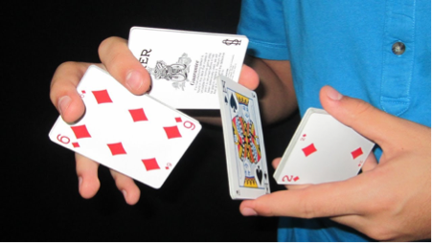
Randomness

Slide 5
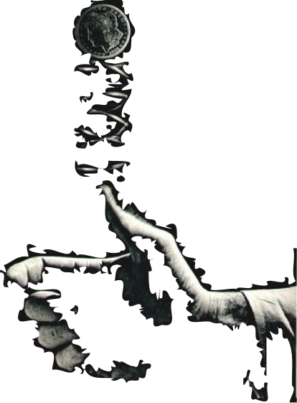
Randomness

Slide 6

Randomness
Mathematics

Slide 7
1. Tournaments

Slide 8
A

Slide 9
Rule: every 3 players simultaneously lose to someone.

Slide 10
Rule: every 3 players simultaneously lose to someone.

Slide 11
Rule: every 3 players simultaneously lose to someone.

Slide 12
Rule: every 3 players simultaneously lose to someone.

Slide 13
Rule: every 3 players simultaneously lose to someone.

Slide 14
Rule: every 3 players simultaneously lose to someone.

Slide 15
Rule: every 3 players simultaneously lose to someone.

Slide 16
Rule: every 3 players simultaneously lose to someone.

Slide 17
Can this be done?

Slide 18
YES.

Slide 19
Actually…

Slide 20
No.

Slide 21
We need 100 Players.

Slide 22
But How?

Slide 23
No Algebra.

Slide 24
No Geometry.

Slide 25
No Rules.

Slide 26
No Thought.

Slide 27
Just choose each arrow at random.

Slide 28
A

Slide 29
Fail probability: 7/8

Slide 30
All fail: (7/8)⁹⁷

Slide 31

Total Failed Tournaments:

Slide 32
At least 2/3 of those random assignments succeed.

Slide 33
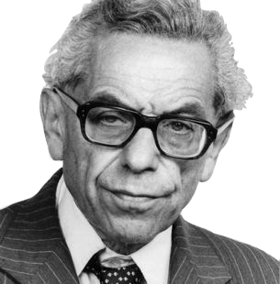
The Probabilistic Method

Slide 34
Sometimes it’s easier to randomly choose than to explicitly construct.

Slide 35
Often, 99.9% of the objects have what you need…
…but you can’t find them!
…

Slide 36
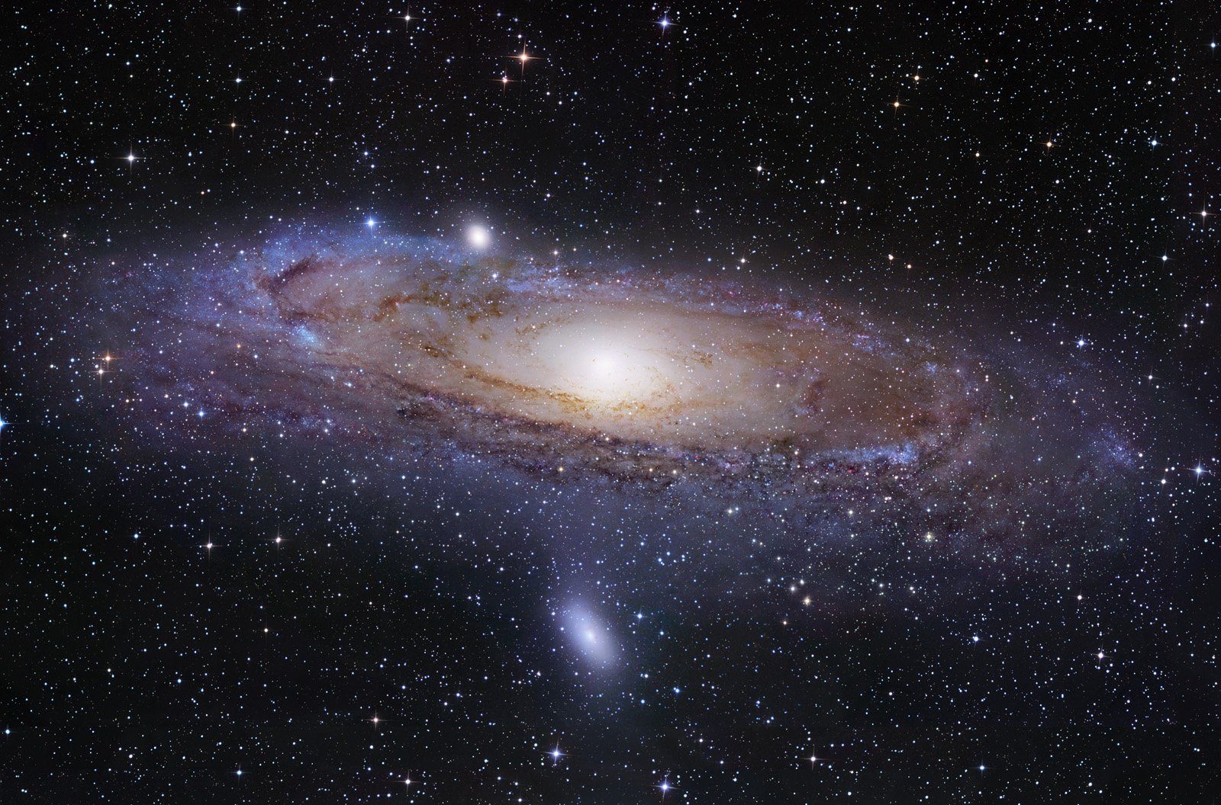

Slide 38
2. High Girth and Chromatic Number

Slide 39
Graphs

Slide 40
Graphs
A
B
C
F
E
D
Vertices

Slide 41
Graphs
A
B
C
F
E
D
Edges

Slide 42

Graphs
A
B
C
F
E
D
Vertices =
Edges =

Slide 43
Graphs
A
B
C
F
E
D
Cycles

Slide 44
Graphs
A
B
C
F
E
D
Cycles

Slide 45
Graphs
A
B
C
F
E
D
Shortest Cycle = Girth = 3

Slide 46
Graphs
A
B
C
F
E
D
Coloring

Slide 47
Graphs
A
B
C
F
E
D
Chromatic Number = 3

Slide 48
Can a graph have both high girth and large chromatic number?

Slide 49
High girth: 2-colorable locally everywhere.

Slide 50
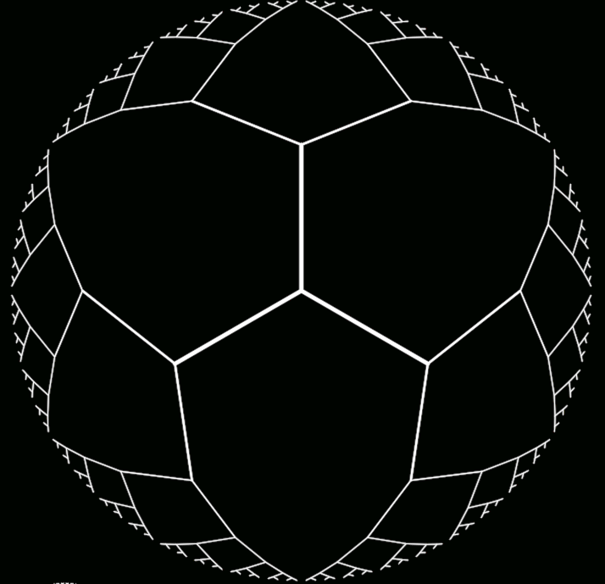

Slide 55
How can we force many colors if every region is 2-colorable?

Slide 56
That’s HARD.

Slide 57
Unless…

Slide 58
…you use the Probabilistic Method.

Slide 59
Take many vertices
Choose each edge with probability p
Carefully choose p
Make the graph have few short cycles and small independence number
Remove vertices to eliminate short cycles
Voila!

Slide 60
3. The Existence of Designs

Slide 61
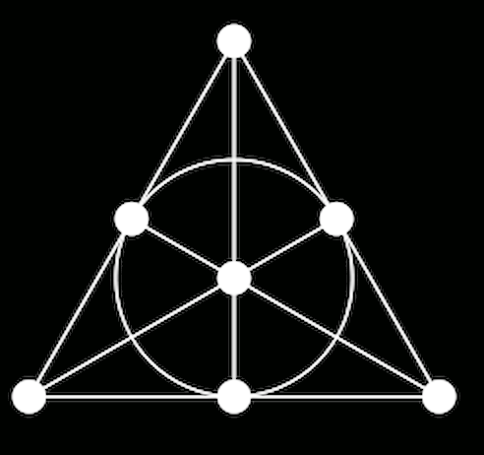

Slide 62
7 points
Sets of size 3
Every 2 points
are in exactly 1 set

Slide 63
7 points
Sets of size 3
Every 2 points
are in exactly 1 set

Slide 64
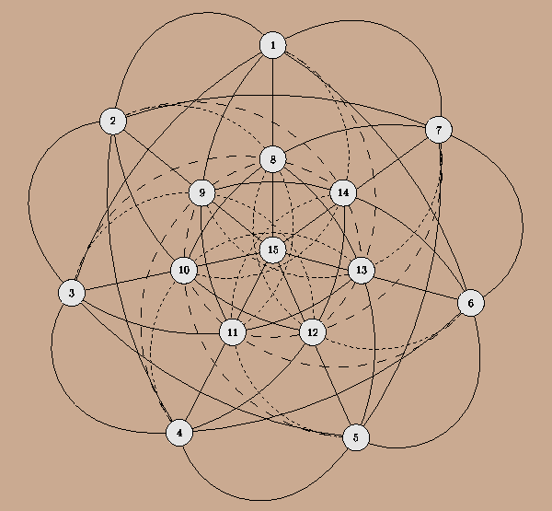
n points
Sets of size q
Every r points
are in exactly λ sets

Slide 65
n points
Sets of size q
Every r points
are in exactly λ sets

Slide 66
n q r λ
?

Slide 67
n q r λ
?
Divisibility conditions
Finitely many exceptions in n

Slide 68
Asked: 1853

Slide 69
Answered: Jan 15, 2014

Slide 70
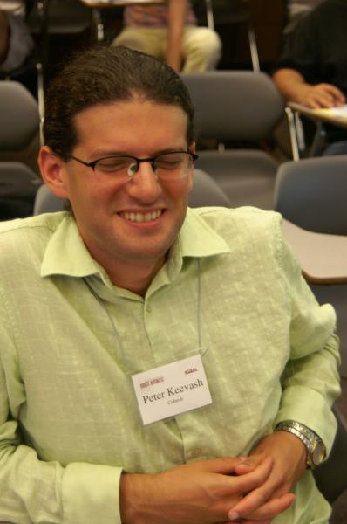
Solver: Peter Keevash

Slide 71
Method: Randomized Algebraic Construction

Slide 72
Rephrase the problem as hypergraph matching
Seek a matching by randomly picking edges and deleting their overlaps
The beginning is easy, but the end is out of control
Keevash: Cleverly pick stand-ins for the end game

Slide 73
4. The Crossing Lemma

Slide 74
Crossing Number: Minimum number of edge crossings in a plane drawing of a graph

Slide 75
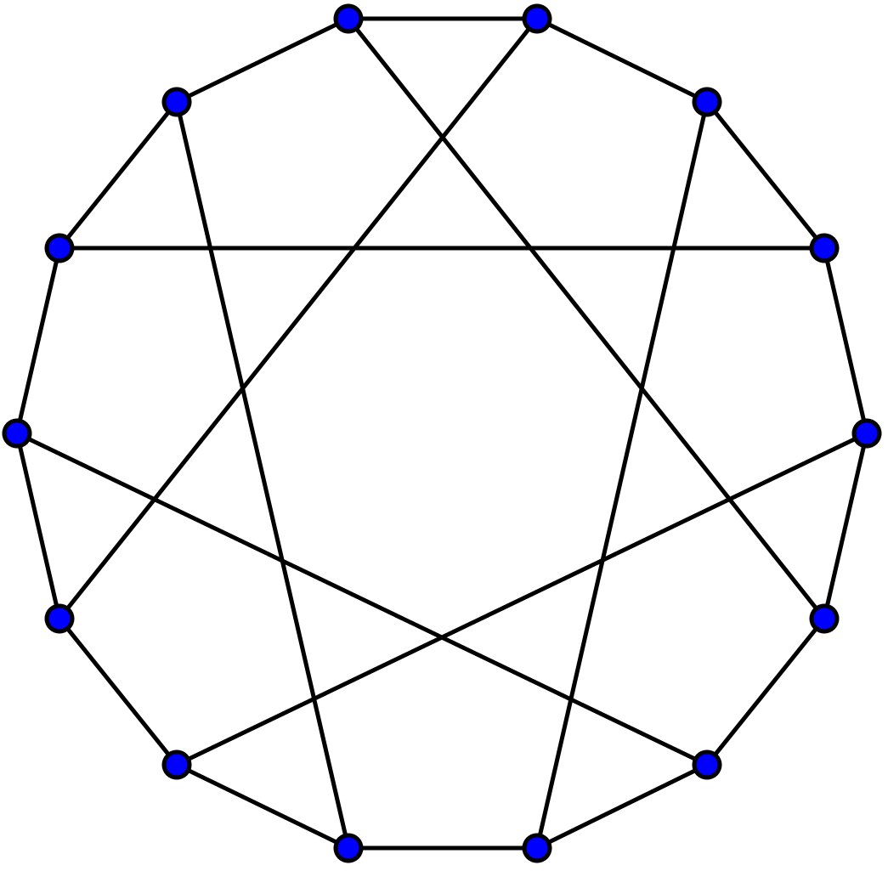

Slide 76
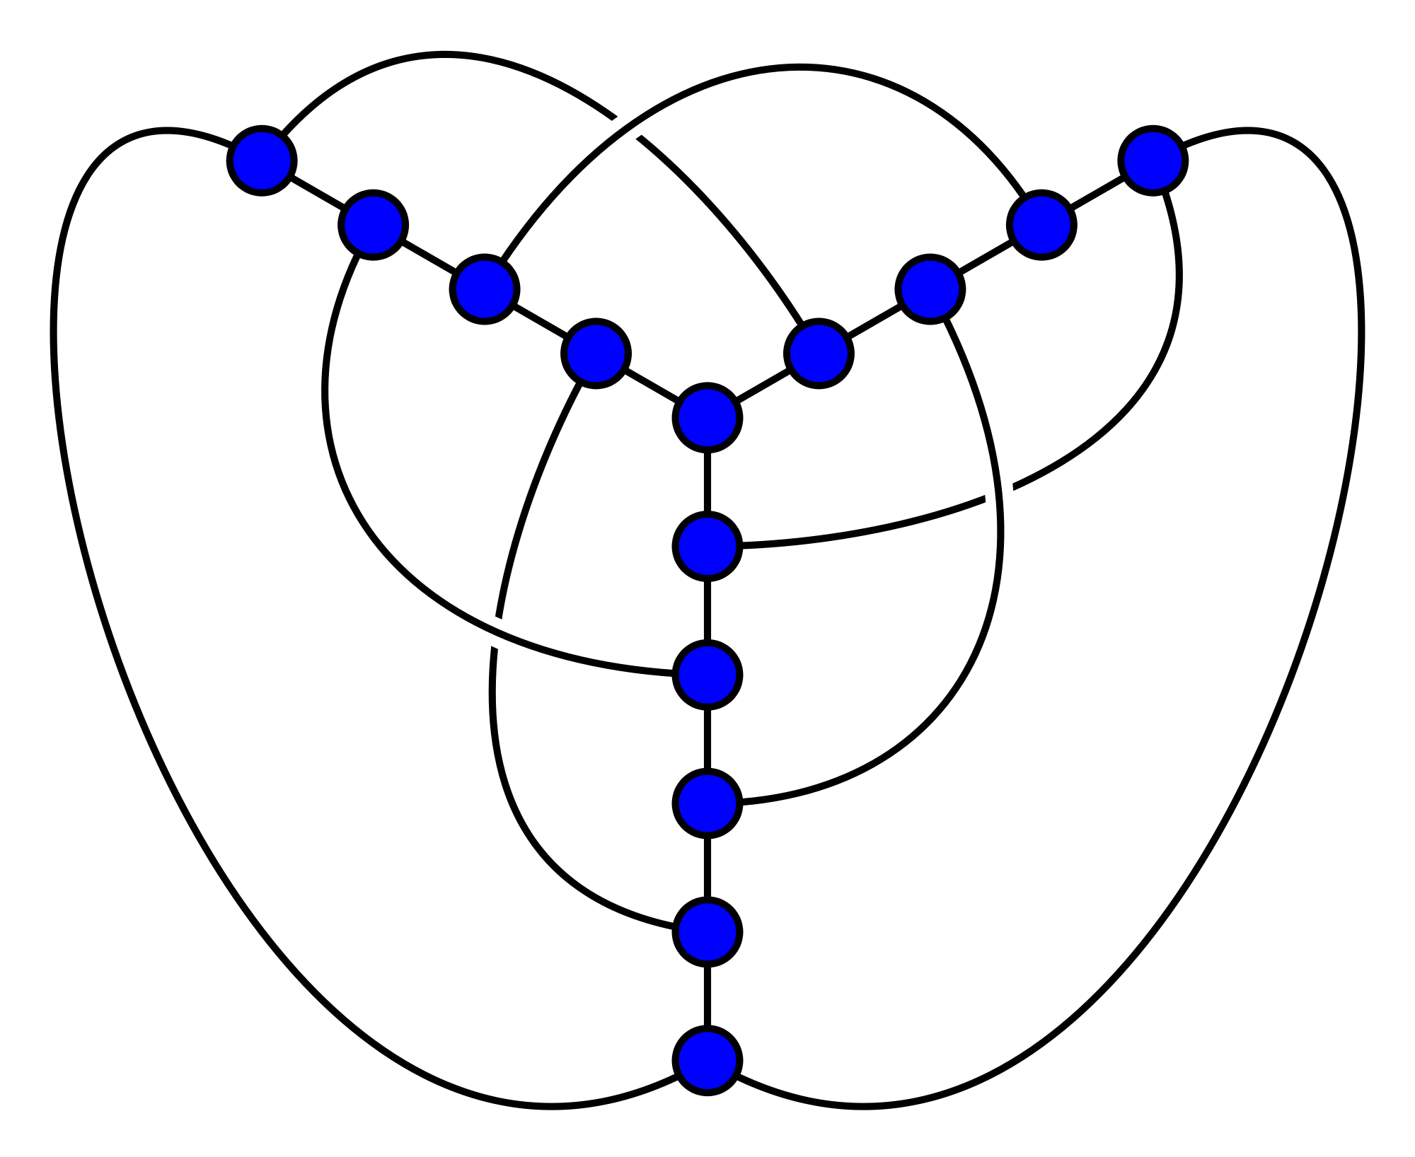

Slide 77

Crossing Lemma: if
then

Slide 78
Fact (easy):
Start with any graph
Pick a random subgraph H by choosing each vertex with probability p
Find the expected number of vertices, edges and crossings of H
Apply the easy fact. Pick the best p. Done!

Slide 79
5. Algorithms

Slide 80
Quicksort
Codes
Primality Testing
Min-Cut
Matrix Testing

Slide 81
Machine Learning

Slide 82







Machine Learning

Slide 83
Machine Learning
Learn from data: features and outcomes
Predict: Given features, what’s the outcome?

Slide 84
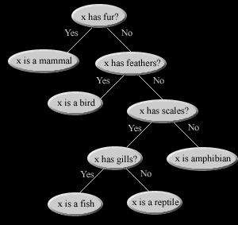
Decision Trees

Slide 85
Decision Trees are great…

Slide 86
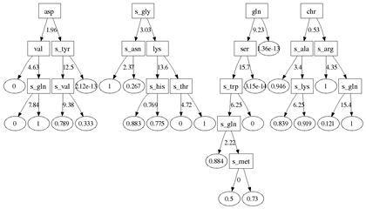
…Random Forests are Even Better.

Slide 87
…Random Forests are Even Better.
Train 100 decision trees with random data and random features
Merge into one predictor

Slide 88
Random Forests
Perhaps the single most successful
Machine Learning paradigm
Ever.

Slide 89
Summary

Slide 90
Randomness
Mathematics

Slide 91
Randomness
Mathematics
Artificial Intelligence

